Slide 1

Module: BMET4001-Hospitality & Guest services for Industry
Assessment: Individual Presentation
Title of presentation: An analysis of the importance of quality service, hospitality and guest service by the luxury brand in the hospitality Industry
Student ID: 2311256

Slide 2
Table of contents
Introduction
Overview of the RYANAIR
The importance of quality and guest service provided by the RYANAIR
RYANAIR service culture
Special service for passengers
Evaluation of the different types of customer service
Reputation management
Conclusion

Slide 3
Introduction
The purpose of the presentation is to analyse the nature, scope and role of the guest services offered provided to these guest.
Analyse the importance of hospitality and how RYANAIR meets their guest expectations to achieve service excellence.
Overview the transform of customer demands and how it effects on guest service management.
This presentation shall explore the strategies that RYANAIR uses to create value for its customers
Notes:
3

Slide 4
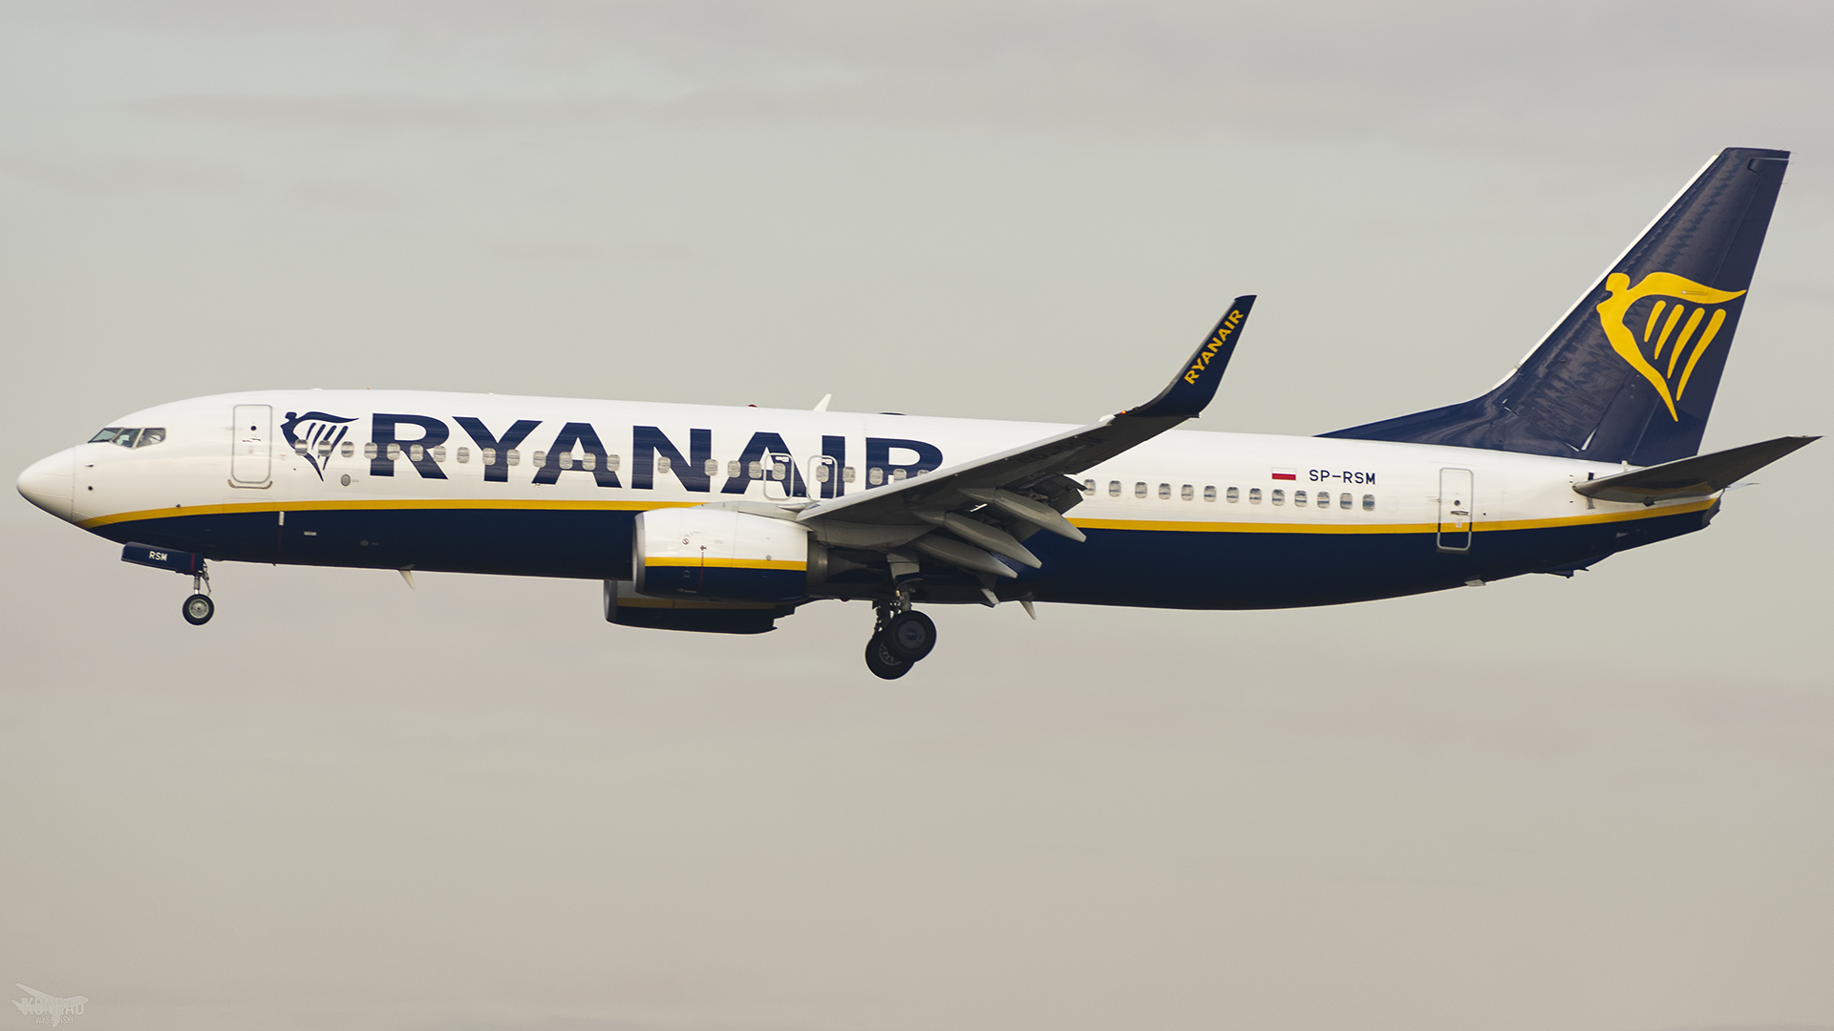
Overview of the Ryanair
Ryanair is one of the leading airline company in Europe which is known for its low-cost flights
The company carries 160 million passengers across Europe every year
Ryan is well known for is low-cost flight across European destination.
The Ryanair offer fights to over 200 destination across 34 counties.
One of the main strategy that the company is using for its business is cost leadership where it offer lowest flight compared to its competitors
The Ryanair is popular among European passengers for its cost and efficiency in flights
Notes:
Ryanair is one of the leading airline company in Europe which is known for its low-cost flights. The company carries 160 million passengers across Europe every year. Ryan is well known for is low-cost flight across European destination. The Ryanair offer fights to over 200 destination across 34 counties.
One of the main strategy that the company is using for its business is cost leadership where it offer lowest flight compared to its competitors . The Ryanair is popular among European passengers for its cost and efficiency in flights
4

Slide 5
The importance of quality and guest service provided by the RYANAIR
RYANAIR prioritized cost in the process of creating value.
The airline is well-known for offering extremely affordable plane tickets to prospective passengers.
RYANAIR coverage of many destination around Europe.
The airline is quite about innovating its services and amenities to meet the ever-increasing demands of its customers.
The airline with customer on social media and through a customer feedback site to find out about their needs.
Notes:
Marketing strategies of an organisation involves several process. These are Understanding of marketplace and the needs of customers, then Develop customer-based strategies, then there is Develop marketing program that can deliver value, then Build profitable customer relationship and finally Create value for customers of the organisation.
5

Slide 6
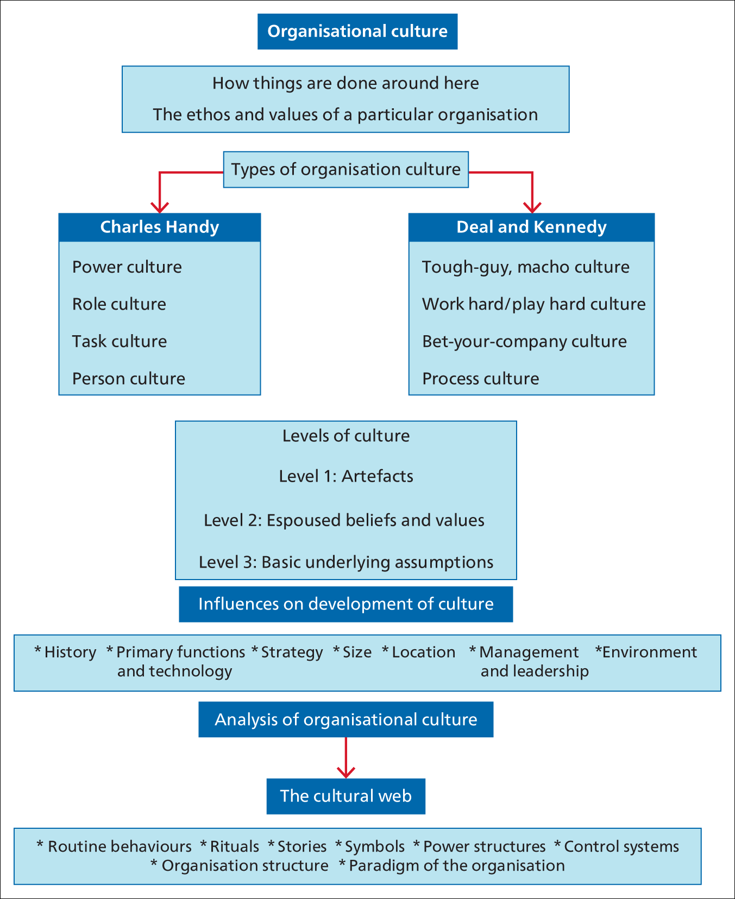
RYANAIR service culture
Looking at the organisational culture of Ryanair, it is found that the organisations has more resemblance to Charls hand’s cultural approach. For instance, the company follow strong power culture where decision comes from the top level. It’s CEO Michael O’Leary has created the culture based on four deeply held belief (White,2017).
RYANAIR has a role culture where employees follow their jobs description.
Individual role defined including air hostage, pilots, ground handling, checking in stuff and other stuff members.
The business also judge its employees based on their performance at the workplace and offer promotion and career advancement opportunities.
(Ryanair,2023)
Notes:
For the analysis of the Ryanair marketing strategies to investigate the ways the company create value for its customer, the first approach was to investigate the market situation where the business operates. For the analysis of market situation, the SWOT framework was used that identified the Strength, weakness, opportunity and threats from the market for the Ryanair.
As you can see the airline is strong in its brand value, it covers many destinations which is over 200 destinations, it is well known as low-cost airline and that is the main positioning of the company where customers see the airline as low-cost airline. Also, the company is financially sound compared to other airlines.
In term of weakness, there is issues with poor customer services, only one types of flights and the airline on time to time found in dispute with its staff with low pay and reduction of staff. There is also issue with high focus on cost and poor on customer facilities.
However, there are some opportunities that the airline can take from the European and global aviation market, These are as you can see on the slide that it can expand onto new global market with its low-cost flight's strategy, it can also focus on improving its customer services offering better facilities, it can also use more and more digitalised process for its services, and it can also target business customers.
There are some threats that the market can through on the airline and that can be there is constant competition in the aviation industry which can put pressure on the airline to continue to offer low-cost flights. Then there is economic downturn which makes it harder to keep offering low cost and the fuel price is fluctuation and that is problem for profit maximisation.
Overall, situational perspectives, the RYANAIR is having some difficulties which can be overcome with the opportunities that the airline have.
6

Slide 7
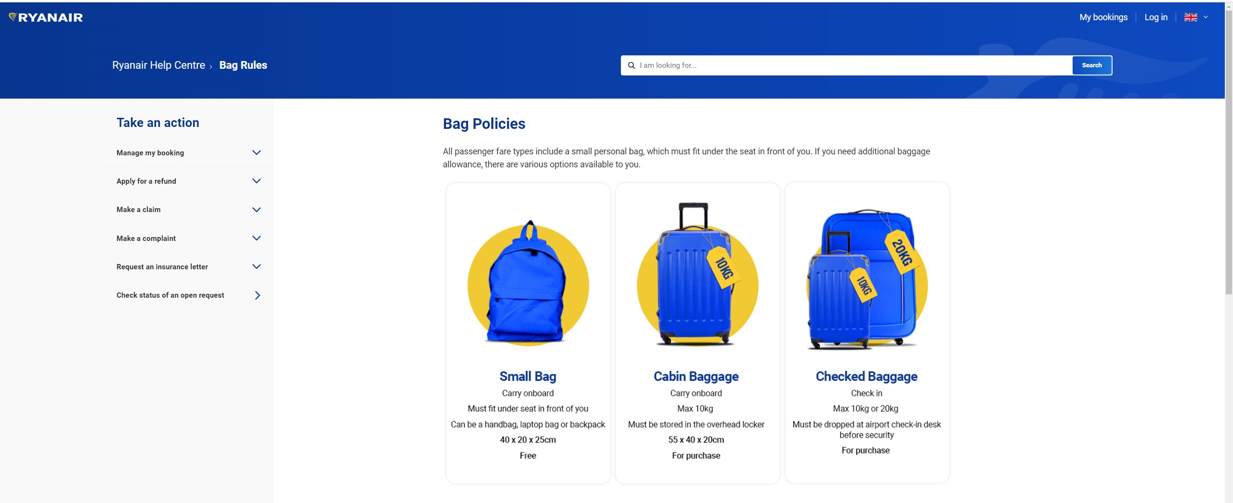
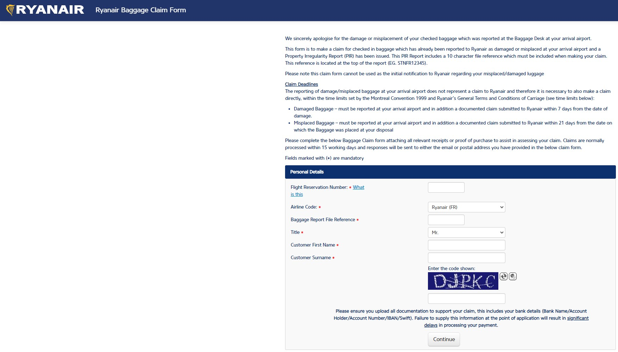
Special service for the passengers
The airline is very careful and concern about customer baggage handling and has good process and policies in place to ensure customer baggage is well managed.
The airline also offer baggage allowances for its pageanters and support in finding lost baggage. Serving customer with their free baggage allowances is also an important service that the airline provide at low cost.
The Ryanair understands the needs of all passengers and thus offer special services for its customers with reduced mobility and special needs. Customers with condition can request medical assistance as well as required equipment in aid of their movement while traveling with Ryanair
Notes:
7

Slide 8
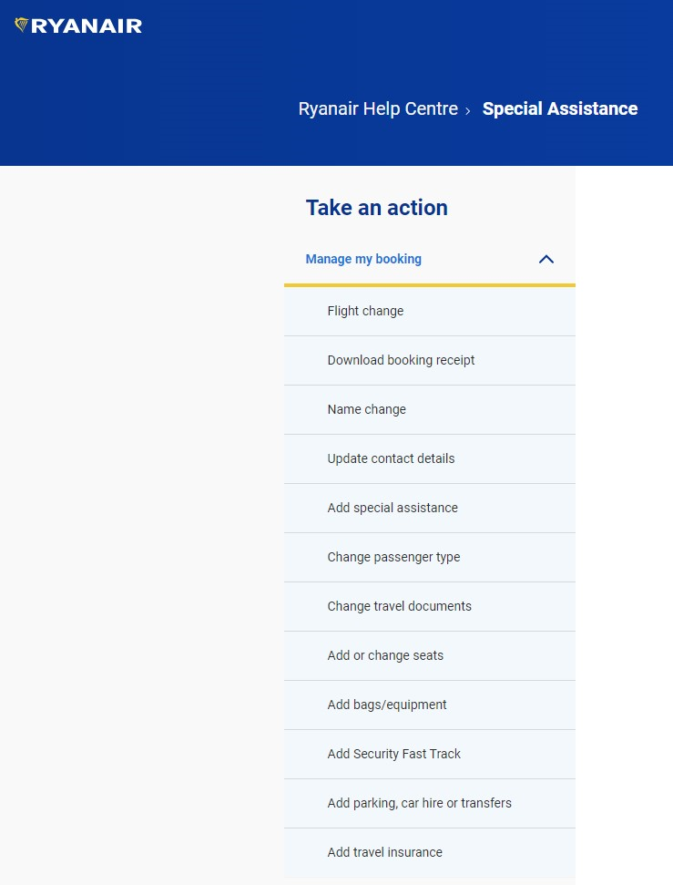
Evaluation of the different types of customer service
This is one of the fundamental services that the airline offers. For instance, customers can search, book and reserve seats and obtain information on the availability of flights and fairs using Ryanair website (www.ryanair.com).
It also allows check-in via online and get automated boarding passes. The image shows the types of services that airline offer for reservation and booking.
Using RYANAIR mobile apps, customer can change their flight, cancel journey on the existing bookings. This is very unique facility as customer can adjust their journey based on the change of circumstances.
Notes:
According to company annual reports and company website research, Ryanair is found to have segmented its market into three categories. As you can see on the slide that there is geographic segmentation where it market in 200 destinations of 38 European counties, then there is demographic segmentation where it target customers based on age, family size, and their incomes. There is also psychographic segmentation which the airlie use to target people based on their pattern of behaviour such as their ability to use technologies, use social medias, and consciousness to price of tickets and their travelling habits.
8

Slide 9
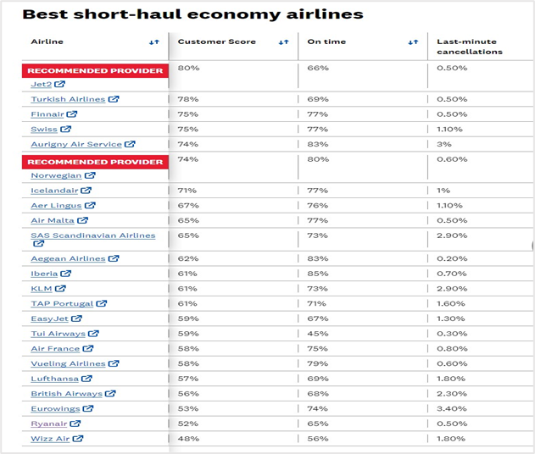
Reputation management
In terms of its reputation management, the RYANAIR has been rated as bottom in annual review of customer satisfaction conducted by which? (BBC,2017).
Out of 22 popular brands Ryanair only score 52% satisfaction rate in 2023 (Wilson,2023).
The airline came last for last six consultee years in term of customer satisfaction.
However, in term of safety rating of the airline, the aircraft was rated 7 out of 7 by the Airlineratings.com.
It was rated top 10 safest and low cost airline 2022. (Etzel,2023).
Notes:
The environmental analysis include number of factors such as political, economic, social, technological and environmental that has impact on the business and can influence business decision making.
The environmental analysis is also an important part to understand the market situation and how it impact on the business and ways these pressure and opportunities helps businesses to offer better value for customers. In term of environmental analysis as you can see from the slide the Ryanair is facing some challenges and opportunities from the European business environment where it mainly operates.
The political situation is not very conducive such as Brexit is making it harder for the airline to operate at low cost as many EU counties are charging airport Levy and there are new regulation coming up and that is increasing operational costs.
The economic condition is also not very good as there is high inflation as well as poor exchange rates and cost of living is raising that is affecting people frequency of travelling.
Social issues includes the change of lifestyles as well as people travelling patterns which has both positive and negative impact. For instance, more young people are travelling compared to family trips.
Technological changes is found to be good on the airline as it has helped the airline to take most of the services online and automated saving cost and made services efficient and that has added value to customer services while making it faster.
Environmental issues include pressure for green fuel use, cutting the carbon emission which the airline is not good at.
Therefore, overall environmental impact is mix but with innovation of new technologies there is evidence that the airline is creating value for its customer services.
9

Slide 10
Conclusion
The analysis shows that Ryanair provides its customers with a broad array of reasonably priced services in many different categories.
The company, which leads the market in cost leadership, is well-known for providing fair and affordable prices to its clients.
Additionally, it is discovered that the organisation employs a top-down, centralised cultural family. In term of reputation, its customers have given the airline low grades for satisfaction and service standards, but high marks for operational safety and efficiency.
Notes:
10

Slide 11
References
Akman, B. (2023). Ryanair’s Approach to Customer Interaction and Marketing. Segmentary: 13th April. Available: https://segmentify.com/blog/ryanair-social-media-strategy/ [Accessed: 17th of November 2023].
BBC (2019). Ryanair rated 'greedy and arrogant' by customers. Available: https://www.bbc.co.uk/news/business-49433807 [Accessed: 17th of November 2023].
Etzel, N. (2023). Is Ryanair Safe? Nerd Wallet: 15th Nov. Available: https://www.nerdwallet.com/article/travel/isryanairsafe#:~:text=Ryanair%20has%20a%20safety%20rating,Low%2DCost%20Airlines%20for%202022 [Accessed: 17th of November 2023].
Dowd, M. (2018). What are the duties of a guest service agent? Available at: https://work.chron.com/duties-guest-service-agent-19946.html (Accessed: 7th September 2023)
Fearis, B. (2021). Ryanair seeks passengers for new customer service panel. The Business Travel Magazine: 14th May. Available: https://thebusinesstravelmag.com/ryanair-seeks-passengers-for-new-customer-service-panel/ [Accessed: 17th of November 2023].
Notes:
11

Slide 12
Notes:
12

Slide 13
Notes:
13

