Slide 1


Training and Development needs for a HR officer
Name: MIHAITA GHEORGHE 2120440
Module Code: BMSW 5102 A1
Module Name: Developing Relationships and Workplace Achievements
Lecturer: Charles Nwaogwugwu

Slide 2
Table of Contents
Digital marketing includes different types of tools and techniques like search engine marketing or social media marketing or mobile marketing or e-mail marketing (Visser, 2019).
Digital marketing has had a magnificent impact on shaping the consumer behavior of different industries.
Tesco Plc uses different types of digital channels so that they can be able to engage with their potential and regular consumers or customers very quickly and smoothly.
By using digital marketing tools consumers can easily interact and make proper communicate with retail companies (Deiss & Henneberry, 2020).

Slide 3

Introduction
In this presentation there will be discussion on different perspectives on human resource management and training programs. First of all, there will be discussions on key expectations of human resource officers. Then there will be implication of personal skill audit as well as SWOT analysis. Then there will be discussions on different models and benefits of implementing training and development programs in Jacksons Fencing UK.
Notes:
Introduction
In this presentation there will be discussion on different perspectives on human resource management and training programs. First of all, there will be discussions on key expectations of human resource officers. Then there will be implication of personal skill audit as well as SWOT analysis. Then there will be discussions on different models and benefits of implementing training and development programs in Jacksons Fencing UK.

Slide 4

Key expectations of HR Officer Roles
Working closely with different types of functional departments within the business entity (Mondy & Martocchio, 2018)
Playing a consultancy role among the department of the companies (Rue et al., 2016)
Negotiating with employees as well as their representatives on different types of issues (Rue et al., 2016)
Administer payroll as well as maintain employee records (Mondy & Martocchio, 2018).
Notes:
Key expectations of HR Officer Roles
It is expected from the human resource officer that he or she will work closely with different types of functional departments within the business entity. That is why they will be playing a consultancy role among the department of the companies (Mondy & Martocchio, 2018). In addition, the human resource officer will assist line managers for understanding as well as implementing different types of policies and procedures (Rue et al., 2016). The human resource officer will negotiate with employees as well as their representatives on different types of issues which are related to pay structure and conditions. In addition, human resource officers will work on working conditions as well as performance management or disciplinary procedures (Mondy & Martocchio, 2018). The human resource officer will administer payroll as well as maintain employee records for developing proper human resource planning strategies (Rue et al., 2016).

Slide 5

Personal Skill Audit
I have very good grip in using Microsoft Office applications as well as e-mail mechanism and Internet activities
I have no experience regarding the drafting of employment contracts as well as delivering a training session
I am very good at making usage of verbal reasoning skills for handling complex data
Notes:
Personal Skill Audit
From the analysis of personal skill audit, I have very good grip in using Microsoft Office applications as well as e-mail mechanism and Internet activities. On the other hand, I have no experience regarding the drafting of employment contracts as well as delivering a training session. However, I am very good at making usage of verbal reasoning skills for handling complex data and deriving information.

Slide 6
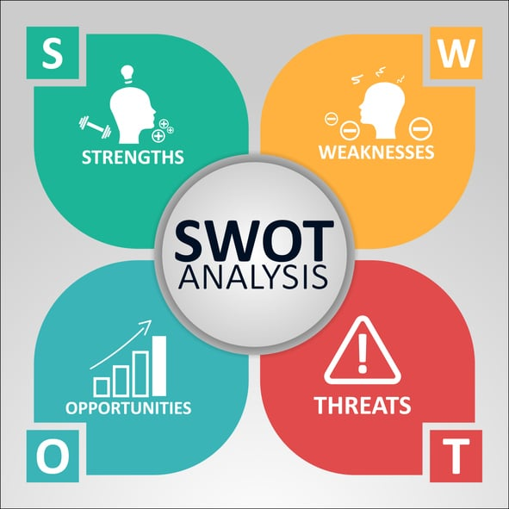
Personal SWOT Analysis
My strength factors are writing and doing analysis quantitatively
My weak points are proper communications and negotiations
My opportunity would be in research profession
But I have threats on time mismanagement and poor communications.
Notes:
Personal SWOT Analysis
I can do well in writing and analysis. I can focus on a big part and then distribute them into different parts so that I can grab the entire picture easily. In addition, I am good at quantitative analysis. I always try to focus on modelling so that I can identify the linkages.
I am very weak in proper communications. I have fewer resources on effective communications. I am not also good at negotiation with other people.
As I always focus on quantitative part, I have the opportunity to be in research. This will help me in my employment opportunities. I capitalize on my strengths to move forward by writing on different topics every day.
For having poor communications, I might not be able to present my research Infront of others. That is my ultimate threat. In addition, I have threat on time mismanagement as well.

Slide 7
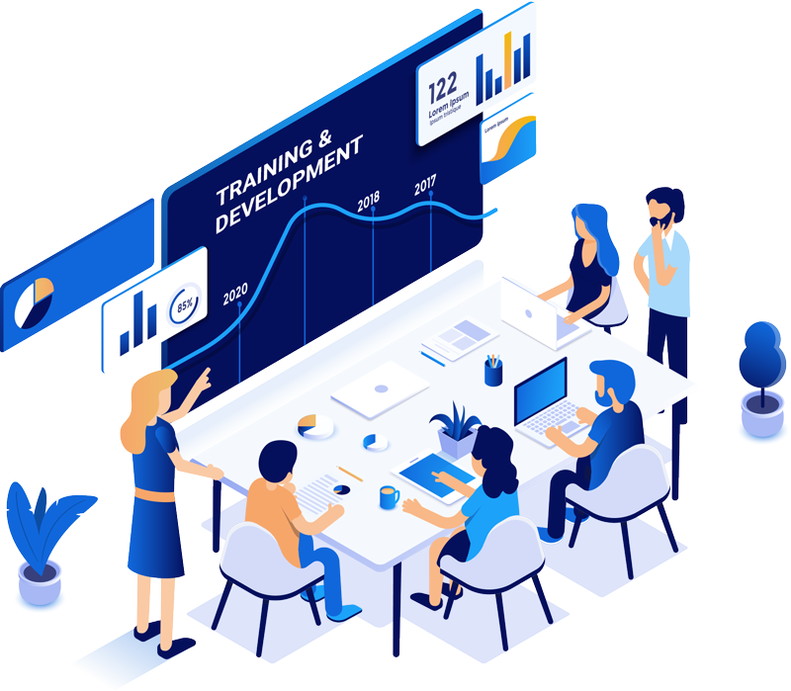
Training & Development
Training means acquiring the required knowledge or competencies as well as skill set for improving organizational as well as individual job performance (Valentine et al., 2020).
Systematic approaches designed to enhance the capabilities of employees (Ivancevich & Konopaske, 2019).
Training programs include workshops or professional seminars or on the job training or online courses (Valentine et al., 2020).
Development is to develop the abilities of employees beyond the requirements of their current job activities (Ivancevich & Konopaske, 2019).
Development programs include job rotations, mentoring or coaching.
Notes:
Training & Development
Training is the process of acquiring the required knowledge or competencies as well as skill set for improving organizational as well as individual job performance. Training module involves various systematic approaches which are designed to enhance the capabilities of employees as well as improve the effectiveness in their job roles (Valentine et al., 2020). Training focuses on providing specific knowledge and skills which are required to perform the job activities effectively and efficiently. Training programs include workshops or professional seminars or on the job training or online courses as well as simulations (Valentine et al., 2020). On the other hand, development focuses on broader perspective on professional as well as personal growth. Development is designed to develop the abilities of employees beyond the requirements of their current job activities (Ivancevich & Konopaske, 2019). In this case development is for future career advancement of employees. Different types of development programs include job rotations, mentoring or coaching or leadership development programs (Ivancevich & Konopaske, 2019).

Slide 8
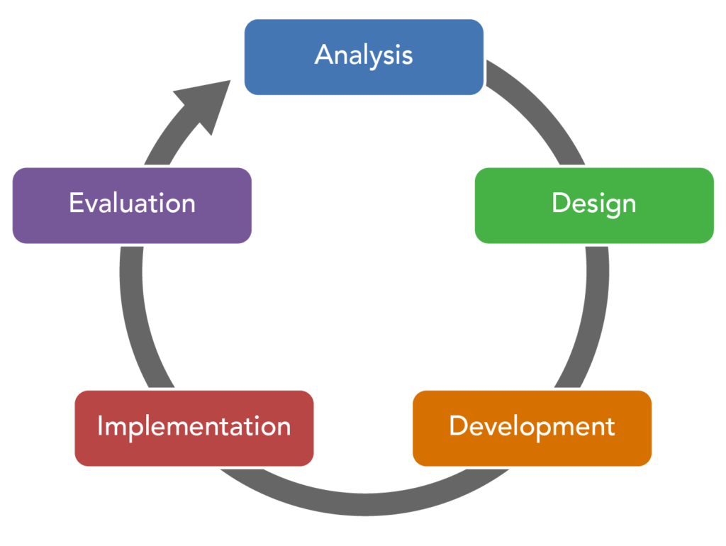
The ADDIE Model of Training & Developments
Organization will analyze the requirement of training modules (Nel et al., 2021)
Company will design the training program according to the requirement of employees
Organization will develop the materials which are required in training programs (Nel et al., 2021)
Provide training which is the implementation phase (Amos et al., 2019)
Company will evaluate the effectiveness of the training program (Trotter, 2017).
Notes:
The ADDIE Model of Training & Developments
One of the popular models for providing training and development programs to the employees in Jacksons Fencing UK is known as the ADDIE model (Nel et al., 2021). It incorporates 5 perspectives of analysis, then designing, developing, implementing and evaluating. In the first stage, Jacksons Fencing UK will analyze the requirement of training modules. Then the company will design the training program according to the requirements of employees (Nel et al., 2021). Then Jacksons Fencing UK will develop the materials which are required in training programs. Finally, the company will provide training which is the implementation phase of this model and finally the company will evaluate the effectiveness of the training program (Amos et al., 2019).

Slide 9
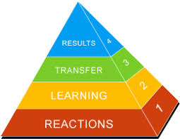
Kirkpatrick's Four-Level Training Evaluation Model of Training & Developments
Developed by Donald Kirkpatrick (Lim et al., 2020)
Reaction of employee is the satisfaction of learner
Provide learning modules to employees (Lim et al., 2020)
Carefully watch the behavior of employees which is the transformation of learning to the workplace (Trotter, 2017)
Monitor the results of the impact of the training program
Notes:
Kirkpatrick's Four-Level Training Evaluation Model of Training & Developments
In this model there are 4 focusing points which have been developed by Donald Kirkpatrick. First of all, for evaluating the effectiveness of training programs, Jacksons Fencing UK will focus on the reaction of employees which is the satisfaction of learner in a training program (Trotter, 2017). Secondly the company will provide learning modules which is the acquisition of skills and required knowledge to the employees (Lim et al., 2020). In the third stage, the company will carefully watch the behavior of employees which is the transformation of learning to the workplace. Finally, the company will monitor the results of the impact of the training program on the achievement of organizational goals (Lim et al., 2020).

Slide 10

Benefits of Effective Training & Developments
Providing training will equip employees with the updated and required knowledge (Celestin & Yunfei, 2018)
Employees will become more and more proficient in performing their job roles
Increase the brand reputation of Jacksons Fencing UK as a positive working environment (Celestin & Yunfei, 2018)
Increase employee engagement as well as employee’s satisfaction
Notes:
Benefits of Effective Training & Developments
There are different benefits to Jacksons Fencing UK for providing effective training and development to the employees (Celestin & Yunfei, 2018). First of all, providing training and development modules will equip employees with the updated and required knowledge as well as abilities necessary for performing the job activities effectively and efficiently (Celestin & Yunfei, 2018). In addition, by enhancing the competencies by providing job training modules, employees will become more and more proficient in performing their job roles, which will improve the job performance as well as job productivity of Jacksons Fencing UK. Providing training modules will demonstrate the commitment of the organization to their success as well. That is why this will increase the brand reputation of Jacksons Fencing UK as a positive working environment. This will increase employee engagement as well as employee’s satisfaction by providing proper training and career development programs.

Slide 11

Benefits of Effective Training & Developments (Cont’d)
It will increase employee retention as well (Ikeda, 2022)
Training programs will enable the employees to acquire new knowledge and new competencies (Scharff, 2018)
Employees will be updated on current industry dynamics as well as taking on responsibilities and challenges (Ikeda, 2022)
Adapt to technological advances and increase organizational performance
Notes:
Benefits of Effective Training & Developments (Cont’d)
If Jacksons Fencing UK provides required training and career development program, then it will increase employee retention as well (Ikeda, 2022). The reason is that the company will provide more and more opportunities for career advancement within the business entity. Providing development and training programs will enable the employees to acquire new knowledge and new competencies. It will help employees to keep updated on current industry dynamics as well as taking on responsibilities and challenges (Ikeda, 2022). In this way the company will be able to adapt to technological advances and increase organizational performance (Scharff, 2018).

Slide 12
Conclusion
A human resource officer is one of the key assets to the success of Jacksons Fencing UK as he or she will maintain the entire workforce of the business process. By implementing proper career development and training programs, Jacksons Fencing UK will be able to provide required knowledge to keep updated with the current industry dynamics. This will help the company to face uncertainty with greater competences. In this way the company will be able to improve their operational performance.
Notes:
Conclusion
A human resource officer is one of the key assets to the success of Jacksons Fencing UK as he or she will maintain the entire workforce of the business process. By implementing proper career development and training programs, Jacksons Fencing UK will be able to provide required knowledge to keep updated with the current industry dynamics. This will help the company to face uncertainty with greater competences. In this way the company will be able to improve their operational performance.

Slide 13
References
Amos, T. et al. (2019) Human Resource Management. Cape Town: Juta.
Celestin, B.N. and Yunfei, S. (2018) ‘The impact of learner characteristics on training transfer expectation: A survey of Thai teachers’ perception of cloud computing tools’, International Journal of Training and Development, 22(4), pp. 256–273. doi:10.1111/ijtd.12137.
Ivancevich, J.M. and Konopaske, R. (2019) Human Resource Management. New York, NY: McGraw-Hill Irwin.
Lim, G.S., Mathis, R.L. and Jackson, J.H. (2020) Human Resource Management. Singapore: Cengage Learning Asia Pte Ltd.
Mondy, R.W. and Martocchio, J.J. (2018) Human Resource Management. Boston: Pearson.
Nel, P.S. et al. (2021) Human Resource Management. Goodwood, Cape Town: Oxford University Press Southern Africa (Pty) Limited.
Rue, L.W., Ibrahim, N.A. and Byars, L.L. (2016) Human Resource Management. New York: McGraw-Hill.
Valentine, S. et al. (2020) Human Resource Management. Boston, MA: Cengage.
Notes:
References
Amos, T. et al. (2019) Human Resource Management. Cape Town: Juta.
Celestin, B.N. and Yunfei, S. (2018) ‘The impact of learner characteristics on training transfer expectation: A survey of Thai teachers’ perception of cloud computing tools’, International Journal of Training and Development, 22(4), pp. 256–273. doi:10.1111/ijtd.12137.
Ikeda, F. (2022) ‘Development of training programs and evaluation methods for question intelligence’, Impact, 2022(5), pp. 31–33. doi:10.21820/23987073.2022.5.31.
Ivancevich, J.M. and Konopaske, R. (2019) Human Resource Management. New York, NY: McGraw-Hill Irwin.
Lim, G.S., Mathis, R.L. and Jackson, J.H. (2020) Human Resource Management. Singapore: Cengage Learning Asia Pte Ltd.
Mondy, R.W. and Martocchio, J.J. (2018) Human Resource Management. Boston: Pearson.
Nel, P.S. et al. (2021) Human Resource Management. Goodwood, Cape Town: Oxford University Press Southern Africa (Pty) Limited.
Rue, L.W., Ibrahim, N.A. and Byars, L.L. (2016) Human Resource Management. New York: McGraw-Hill.
Scharff, J.S. (2018) ‘The impact of technology on development, community, and Teletherapy’, Psychoanalysis Online 2, pp. 3–14. doi:10.4324/9780429478840-1.
Trotter, C. (2017) ‘The impact of training and coaching on the development of practice skills in youth justice: Findings from Australia’, Evidence-Based Skills in Criminal Justice [Preprint]. doi:10.1332/policypress/9781447332961.003.0015.
Valentine, S. et al. (2020) Human Resource Management. Boston, MA: Cengage.

Slide 14
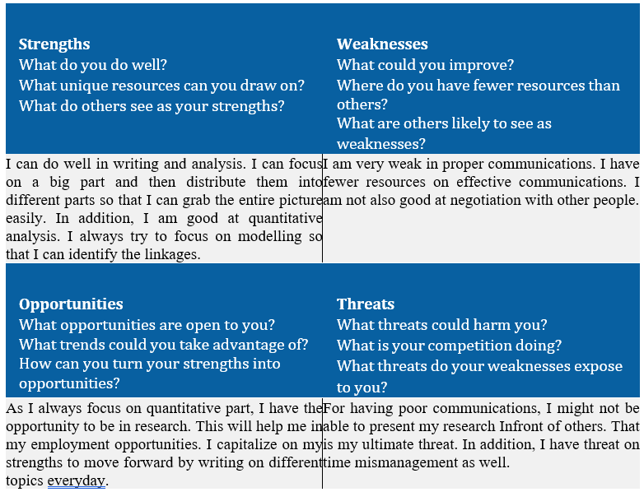
Appendix B

Slide 15
Appendix c
Skil audit
MIHAITA GHEORGHE
HR OFFICER
INFORMATION AND TECHNOLOGY | VERY GOOD | GOOD | ADEGUATE | NO EXPERIENCE
Microsoft office | ok
Hr software |  |  |  | no
internet | ok
email | ok

Slide 16
APPENDIX C
Communications skills | Very good | good | Adequate | No experience
Drafting employment contract |  |  |  | no
Write reports disciplinary mater | ok
Delivering a training sesion |  |  |  | no
Resolving disputes |  | ok
Interviewng | ok
Problem solving | ok

