Slide 1
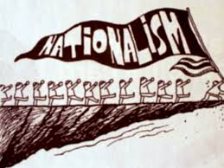
(Trans)Nationalism & Regionalism
The Nation, the State and the Nation-State

Slide 2
Key Topics
What is nationalism?
How are ideas of the nation – and the authority of the nation-state – reproduced?
  By the state
  By ‘popular’ culture and citizens
What is the relation between the local/regional, the national and the global?
How is ‘place’ still relevant
  Both real and imagined

Slide 3
Globalization and Nations
‘Nation’ as a fixed territory is challenged by global processes and the flows of people, ideas, capital, objects; national boundaries are permeable.
In some contexts – and at a particular scale – this appears to be leading to greater unification of economic systems and governance.
  EU and the Euro
  International Trading Agreements & Commercial Zones
  International Law, European Court of Human Rights, Universal Declaration etc
On the other hand, we see greater fragmentation and the break- up of previous nations
  Former Yugoslavia

Slide 4
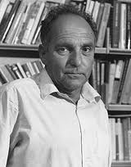
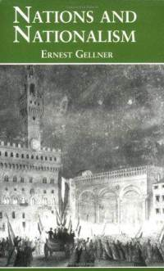
Gellner, (1983) Nations and Nationalism
Strongly influenced by modernization theories and functionalism
Asks what does culture do?
Nationalism is a political principle
And a theory of political legitimacy
  In which there is a correlation of ethnic and political boundaries.

Slide 5
Gellner’s Definitions
The state as an institution specifically concerned with (the enforcement of) order
The condition of nationalism is the existence of these politically centralized units, and a climate where they are seen as normative.
Sidesteps defining the nation in explicit terms
  Shared culture
  Individuals recognise each other as belonging to the same nation
  Occupants of a territory / or a group of people aren’t a nation until they recognise each other as such

Slide 6
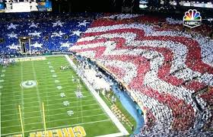
Mutual Recognition
This is where the state comes in
  it facilitates mutual recognition.
Nationalism is a product of industrial society, and is required to make industrial society function.

Slide 7
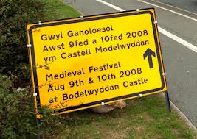
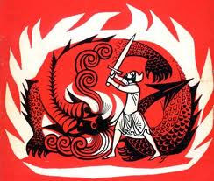

The Role of the State
The centralised state creates a;
  Common past
  Common language
  Common culture
It takes ‘low’ folk culture and establishes ‘high’ state culture
Education is a key mechanism

Slide 8
One state, One culture
It is through shared culture and commonalities that individuals are encouraged to work for the greater good (note the influence of Durkheim).
Each state presides over, and is identified with, one culture.
The state monopolises legitimate culture as much as, if not more so, than legitimate violence.
Nationalism engenders nations; they’re not there by default, but are rather created by the demands of industrialization.

Slide 9
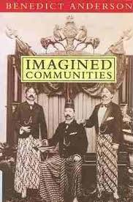
Anderson, Imagined Communities
Nationalism is a cultural artefact.
How it came into being, how it spread across the globe and how it acquired its emotional legitimacy from the end of the eighteenth century.
The nation is an imagined political community that is both limited and sovereign.

Slide 10
Imagined: Members don’t know their fellow-members, but still have a sense of mutual solidarity.
  imagined commonalities and culture are recreated, whereas Gellner implies ‘national’ cultures are falsities and inventions.
Limited: Each nation has finite (elastic) boundaries, beyond which lie other nations.
Sovereign: Post Enlightenment and French Revolution destroyed the age of the dynastic realm and divine rule, and the sovereign state became the emblem of freedom.
Community: Nation is conceived as a “deep, horizontal comradeship” (1991: 7)
  Affective bonds

Slide 11
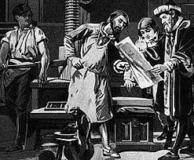
Print Capitalism & Colonial Expansion
Drew a wider variety of people into civil and military bureaucracies than previously
Created and established systems through which individuals would be drawn into the nation, while also being subject to discrimination

Slide 12
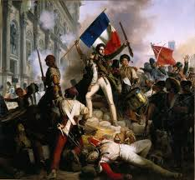
The French Revolution
Became a key symbol, and the model of modern republican society was diffused across national boundaries,
Although it was interpreted differently in different political contexts. (And not just in the colonies, e.g. Japan)

Slide 13

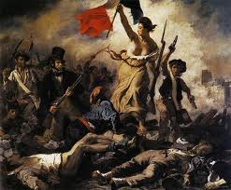
New Nations
European colonialism provided the cultural roots and the mechanisms for the forging of nationalisms within and outside Europe
Even if they had their own distinct political ideologies.

Slide 14
Radcliffe & Westwood (1996) Remaking the Nation
They explore ‘geographies of nationalism’
How the nation is produced, both by the state and by popular culture, in Latin America.
  Challenge Gellner
They also examine the relation between the local/regional and the national.
  The local/regional mediates the national

Slide 15
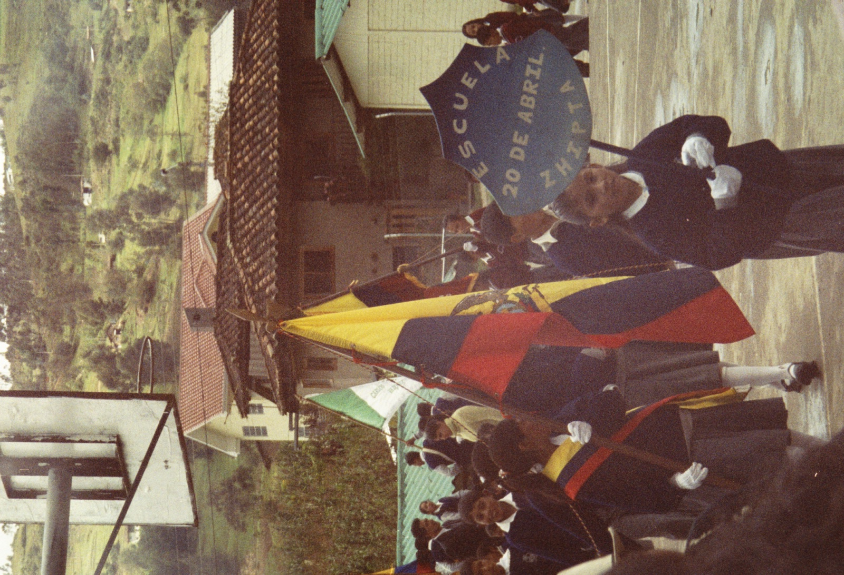
Ecuador: Education
A partisan nationalist – and often mythic - history is taught across all schools
Create distance from the Inca past as too close to ‘Peru’
Civic moments - raising of the flag and sing national anthem

Slide 16
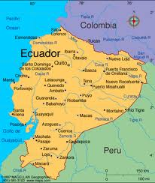
Ecuador: Geography & Cartography
Used as a nationalist tool by the state
A particular ‘geographic imagination’ is created by the state
The issue of lost territory

Slide 17
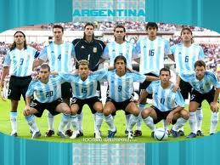

The Power of the Popular
Official nationalism interplays with the popular – and this contributes to its efficacy and power.
E.g. football and soap operas play on regional and national rivalries
They also produce deep emotional bonds and sentiments
They create a narrative of space and place that individuals can connect to.

Slide 18
Regional Affiliations: Mediating the National
Affiliations are not fixed – as people become more mobile they have multiple affiliations, at different scales (these also, at times, transcend national boundaries)
  Patria chica (hometown)
  Regional
  National
  Pan Andean / pan-Amazonian
  Latin America
These multiple geographies of identities shapes individuals’ views of the nation

Slide 19
Conclusions
“local senses of belonging fundamentally condition or qualify the national identities that are created and reproduced” (1996: 132)
National affiliations are expressed through local/regional aesthetics, practice and materials.

Slide 20
Van Beek (2001) in States of Imagination
Focuses on the political process of obtaining autonomy from Kashmir in Ladakh (India), and the reification of ‘imaginations of community’.
The tensions between the purity of legal forms and messiness of lived experience.
The quest for autonomy was based on a fuzzy, ambiguous, publically-recognised, unique cultural identity.
Ambiguity was not easily reconciled with;
  the identification of scheduled tribes
  Buddhist communalism

Slide 21
Scheduled Tribes
The identification of scheduled tribes, and the people within them, was a creative and bureaucratic act
‘Ladakhi’ was not regarded by the Indian state as an authentic tribe
Certifying individuals as tribe members was a creative and arbitrary practice that involved;
  Significant bending of the rules
The ambiguous is formally made unambiguous and reified

Slide 22
Buddhist Communalism
Strategies for autonomy were based on Buddhist homogeneity, and the argument that, as a group, they were consistently subject to discrimination.
This required further creativity, blurring and demarcation
Multiple rivalries and hierarchies among the Buddhist population
Intermarriage with Sunni Muslims and kinship relations
Butchers and bakers were all Muslims
Segregation on religious grounds was therefore difficult due to established socio-economic relations

Slide 23
The Ironies of Autonomy
It resulted in the dissolution of a Ladakhi ‘imagined community’
ST meant that no-one could be formally recognised as Ladakhi
Created divisions and increased tensions between Muslim and Buddhist populations
However, this doesn’t mean that a sense of ‘being Ladakhi’ does not exist, just that the process of formalising this identity is problematic, and often contradictory to the political purpose.

