Slide 1
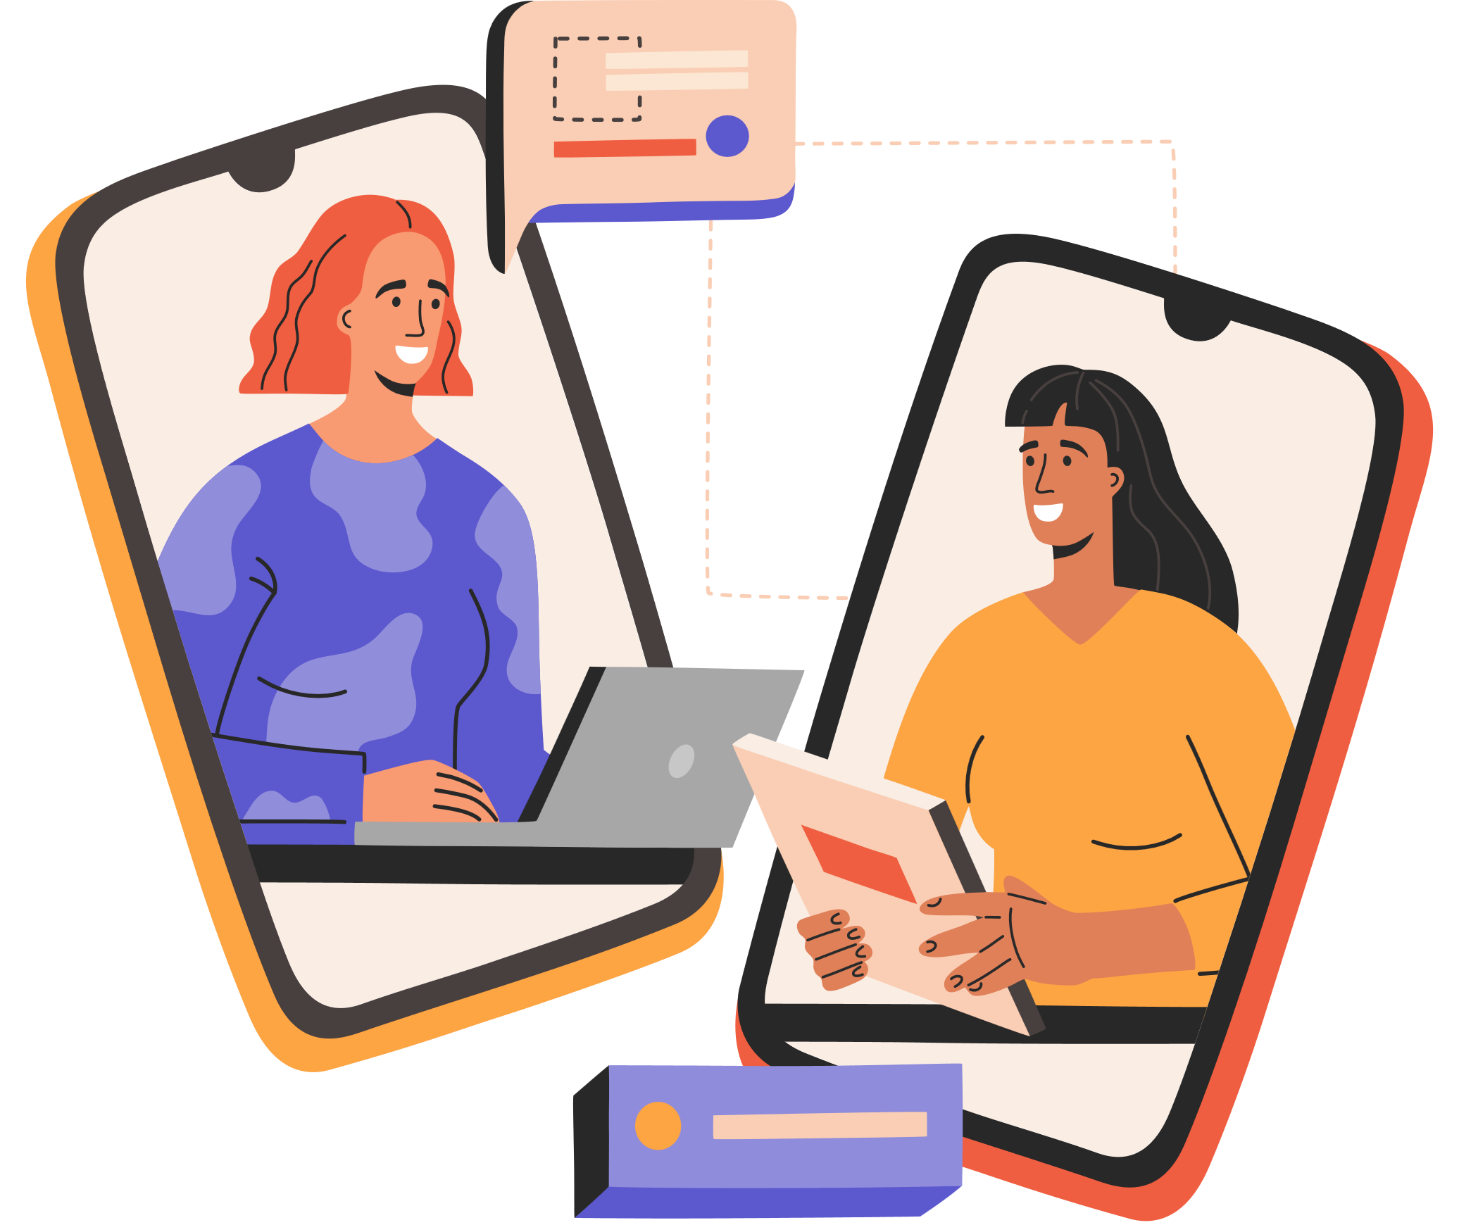



Basic Digital Safety: Protecting Yourself Online
Use Strong Passwords
People should make their passwords hard for someone else to guess. Therefore, when building one, include letters in uppercase and lowercase, some numbers, and special characters. One should also not select one's name, date of birth, or such related information easily guessable as the password (NCSC,2018).
Using Social Media Correctly
People should be careful with what they post on their social network accounts. To constantly update the number of people who can see posts and profile details, constant putters check privacy settings (Symanovich, 2021)
.
Let’s Turn on Two-Factor Authentication (2FA).
Hence, two-factor authentication serves as an extra measure in a security framework. The first is protected with a password, and the second requires input, such as a number from the text message received by phone (Microsoft,2022). The best practice is to enable 2FA where possible or where available.
Use Secure Wi-Fi Networks
People should refrain from performing tasks like carrying out a banking transaction through the Internet on a public Internet connection. If needed, a virtual private network (VPN) can assist in securing data through encryption (Sadiku et al., 2021).
Backup Important Data
It is important to save all work-related data to an external hard drive or cloud drive. A copy that acts as a backup ensures that valuable data is secure if a device is lost or hacked (Symanovich, 2021)
.
Be Wary of Phishing Scams
Phishing scams are intended to get a person to divulge key information. One should take great care when opening links or receiving attachments from unverified sources. One should never engage with any content without confirming who the message came from (Sadiku et al., 2021)..
Update Software Regularly
Old software can endanger an individual through factors such as cyber. Keeping devices, programs, and applications fresh minimizes the risk of running outdated and vulnerable operating systems. One should enable the update feature to update the system automatically to keep devices safe (Symanovich, 2021).
References
Microsoft (2022). The Importance of Two-Factor Authentication. [online] Microsoft 365. Available at: https://www.microsoft.com/en-us/microsoft-365-life-hacks/privacy-and-safety/importance-of-two-factor-authentication [Accessed 28 Nov. 2024].
NCSC (2018). Top tips for staying secure online. [online] www.ncsc.gov.uk. Available at: https://www.ncsc.gov.uk/collection/top-tips-for-staying-secure-online [Accessed 28 Nov. 2024].
Sadiku, M.N.O., Ashaolu, T.J., Ajayi-Majebi, A. and Musa, S.M. (2021). Digital Safety. International Journal Of Scientific Advances, 2(5). doi:https://doi.org/10.51542/ijscia.v2i5.21.
Symanovich, S. (2021). 5 reasons why general software updates and patches are important. [online] us.norton.com. Available at: https://us.norton.com/blog/how-to/the-importance-of-general-software-updates-and-patches [Accessed 28 Nov. 2024].

