Slide 1
Maintenance & Refurbishment:
Refitting & Retrofitting

Slide 2
Structure of the talk / Index
Maintenance & Refurbishment
Refitting & Retrofitting
Obsolescence versus Maintenance & Refurbishment
Task
Next lectures / topics
Students feedback

Slide 3
Recap
Recap!!
from the previous lecture(s)

Slide 4
FM’s main parts -
Maintenance & Refurbishment
What is maintenance??
‘Keeping a given facility in a state in which it can perform the required function’
What is refurbishment??
‘improvement, enhancement, or modernisation of a facility (to extend the life) but less than rebuilding or redevelopment’
Do both extend life?? How??
Maintenance is required to achieve the designed life of a facility .
Refurbishment helps to extend beyond the designed life of a facility.

Slide 5
Refit & Retrofit
What is refitting??
‘replace or repair machinery, equipment, and fittings in (a ship, building, etc.).’
General examples??
e.g. change a fused bulb
Changing worn out pistons in engines
Examples from the FM??
Where does the word ‘Retro’ come from??
What is retrofitting??
‘add (a component or accessory) to something that did not have it when manufactured’.
General examples??
e.g. retrofit catalysts to older cars;
buses retrofitted with features for persons with special needs; etc.
Examples from FM??

Slide 6
Refit & Retrofit
Refitting, Retrofitting, Maintenance and Refurbishment – which relates to which??
Examples??
Every refitting is maintenance??
Is the vice versa true??
Examples from FM??
Every retrofitting is refurbishment??
Is the vice versa true??
Examples from FM??

Slide 7
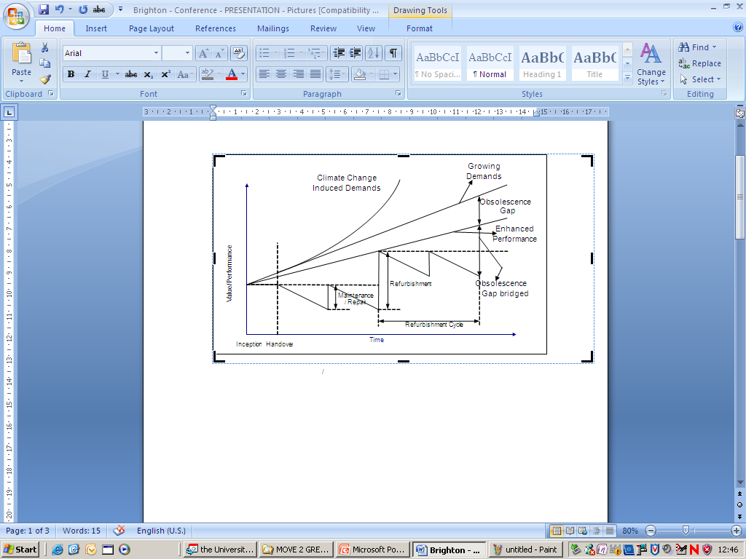
Conceptual Model of Obsolescence & Building Performance

Slide 8
Task
From your work place
Any scenario you worked for / managed
Put on these acetates
And present to the class
NOTE: Use the terms
Refitting
Retrofitting
Maintenance
Refurbishment
Obsolescence and its types
Climate change impacts, mitigation and adaptation
Define sustainability, performance and value in your chosen facility case
Identify physical and virtual boundaries of the facility
Screening & Scoping – Remits of your work e.g. time domain, etc.
Growing demands of end user, change-in-use, etc.

Slide 9
Climate Change
What is climate change in your view?
How would you like to describe climate change mitigation?
What is climate change adaptation in your eyes?
Climate Change Process
Inputs
Outputs

Slide 10
Next lectures / topics
FM and Obsolescence
Infrastructures and Buildings
FM, Energy and climate change impact of the Built Environment
Climate change and non-climate change factors / issues for FM
Sustainability and obsolescence – FM to enhance the former, and reduce the latter!
Communications
Report writing (professional and academic)

Slide 11
FEEDBACK from the Students
Postits:
One best thing you like about my lecture
AT LEAST ONE WORST thing you would like to change and how in my lecture
I seek ‘continuous improvement’!!

Slide 12


