Slide 1

Ethical Theory
Laura James

Slide 2
Re-Cap: Teleological
Teleological ethical theories, also known as consequentialist theories, focus on the consequences or outcomes of actions to determine their moral value. The central idea is that the rightness or wrongness of an action is judged by its results.
The most well-known teleological theory is utilitarianism, which suggests that an action is morally right if it maximizes overall happiness or pleasure and minimizes pain or suffering. Another example is ethical egoism, which holds that an action is right if it promotes the individual's own best interest.

Slide 3

Re-Cap: Deontological
Deontological ethical theories, also known as duty-based ethics, focus on the inherent morality of actions themselves rather than their consequences. The central idea is that certain actions are morally obligatory, permissible, or forbidden based on a set of rules or duties.
The most well-known deontological theory is Kantian ethics, developed by Immanuel Kant. According to Kant, an action is morally right if it is done out of duty and adheres to a universal moral law, which he calls the categorical imperative. This imperative requires that one should only act according to maxims that can be consistently universalized, meaning they could be applied as a universal law for everyone.

Slide 4

Teleological v. Deontological
Using the pre-lecture background research, think about the implications of using a teleological versus deontological approach to decision making in business. What are the advantages and disadvantages of using each approach.
See if you can provide a scenario where you think use of one is better than the other to make decisions. You can add context to this if you wish as part of your argument.

Slide 5
Activity- news stories
Starbucks Lawsuit:
Starbucks faced a lawsuit for allegedly using coffee from farms with human rights abuses while promoting its "ethical" sourcing. The lawsuit claims that Starbucks misled consumers by marketing its products as ethically sourced despite documented labour violations on some supplier farms.

Slide 6

Ethical Sourcing Claims:
  How does Starbucks' marketing of "100% ethical" sourcing align with the allegations of human rights abuses on supplier farms?
  What impact do these allegations have on consumer trust and brand reputation?

Slide 7

Impact on Farmers and Workers:
What are the real-world implications for farmers and workers on the ground if these allegations are accurate?
How can companies support fair labour practices and improve conditions for workers in their supply chains?

Slide 8
Milton friedman
Milton Friedman in his New York Times article - 'The Social Responsibility of Business is to Increase its profits' concludes with the following:
"there is one and only one social responsibility of business--to use its resources and engage in activities designed to increase its profits so long as it stays within the rules of the game, which is to say, engages in open and free competition without deception or fraud."
Do you agree with this?
What is your argument for or against?
He makes reference to perhaps an deontological position "so long as it stays within the rules of the game, which is to say, engages in open and free competition without deception or fraud"
Prepare an ethical argument for and against this position, stating your own ethical approach (teleological or deontological) to Friedman's position in relation to its practical application of sustainability in business.

Slide 9
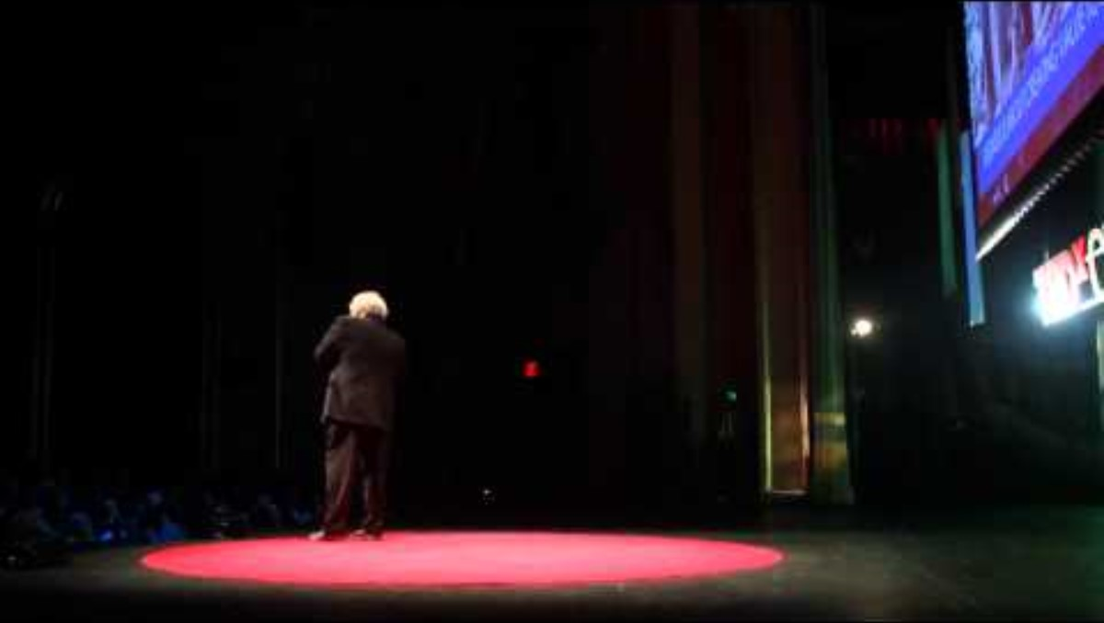
Business is About Purpose - R. Edward Freeman

Slide 10
discussion
In his talk, Freeman suggests that 'we need to tell a new story about business' - what could this new story look like? We will discuss this as a group in class.
Returning to Bob Willard's talk at the beginning of this week on the Business Case for Sustainability. What story can you tell about how Business can to reset its purpose today.

Slide 11

Ethical dilemmas
What ethical dilemmas do we face in a work environment on a day to day basis? With your group, make a list of all the business dilemmas that you have experienced, heard of or can think of.
For each decide what you would do and consider whether your action was Deontological or Teleological

