Slide 1
Module Code LCHS4007
Title Digital Skill and Research Method
Group member name
Muhammad Nabeel 2610243
Tayyaba Noreen 2604394
Lecturer,s Name: Bbianca Dodgen

Slide 2
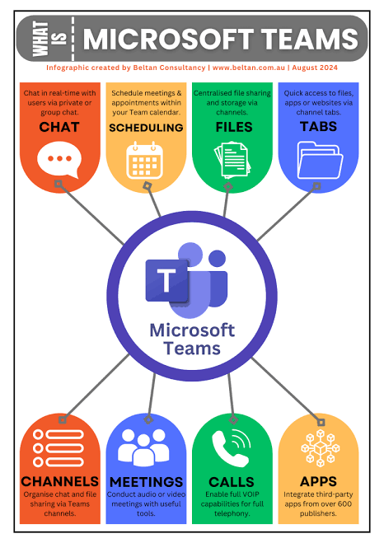
Improving Staff Communication Using Microsoft Teams at
Ashford Community Care Service
Module:
Digital Skills and Research Methods
LCHS4007
Student name: Tayyaba Noreen
Student number: 2604394

Slide 3
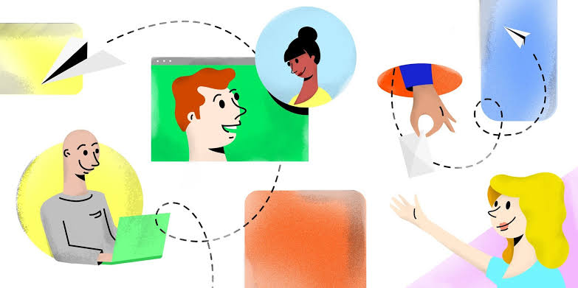
What the task involves: staff communication and daily updates
Who and where
Support workers, senior care workers, nurses, care coordinators, admin staff
Service users' homes, supported living settings, main office
What has to travel, in both directions
Out to staff in the field: visit changes, rota changes, medication reminders, appointment support
Back to the office: wellbeing check outcomes, concerns, what was done on a visit
What goes wrong today (Ashford case study)
Missed updates · duplicated work · unclear rotas · inconsistent records
Evidence: 84% of NHS staff used email constantly or hourly, and 27% used WhatsApp that often despite guidance against it (Bakhai et al., 2022)
A good solution needs four things: the right person · the right time · one place · confirmation it was seen
(Hubstaff, 2025)

Slide 4

The tool: Microsoft Teams, and how it works
What Teams is: the Microsoft 365 app that brings chat, channels, meetings and shared files into one place
How it works at Ashford
One team: Ashford Care Team, with all staff in it
Four channels (like noticeboards): Daily handover · Visit changes · Urgent alerts · Office updates
Posts and replies stay together under each update
@name notifies the right person · Announcement format for urgent changes · Files tab holds the handover template · Mobile app reaches staff in homes
Our four tests
Right person → @mentions
Right time → phone notifications
One place → channels
Confirmed → replies and reactions
Evidence: NHS trust handover moved to Teams: 100% of handovers used one template and 100% of tasks were acknowledged, compared with 35.7% of doctors feeling confident tasks would be completed beforehand (Gupta et al., 2023)
(DMS, 2020)

Slide 5
Improving Staff Communication Using Microsoft Teams at
Ashford Community Care Service
Module:
Digital Skills and Research Methods
LCHS4007
Student name: Muhammad Nabeel
Student number:
2610243

Slide 6
Improving Staff Communication Using Microsoft Teams at
Ashford Community Care Service
Module:
Digital Skills and Research Methods
LCHS4007
Student name:
Student number:

Slide 7
REFERENCES
Bakhai, A., McCauley, L., Stones, L., Khalil, S., Mehta, J., Price, N., Krishnamurthy, V., Parker, L.H.H. and Hughes, D. (2022) ‘Shining a light on an additional clinical burden: work-related digital communication survey study – COVID-19 impact on NHS staff wellbeing’, Humanities and Social Sciences Communications, 9, article 414. Available at: https://doi.org/10.1057/s41599-022-01427-7
Gupta, A., Narula, A., Patel, D., Arifin, M., Wheeldon, H., Ajayi, A., Sachdeva, G. and Aung, N. (2023) ‘A quality improvement project to increase junior doctors’ satisfaction with handover process using Microsoft Teams (MS Teams) as a platform’, BJPsych Open, 9(S1), p. S92. Available at: https://doi.org/10.1192/bjo.2023.280

