Slide 1
Bowlby’s Attachment Theory Presentation
Ann–Marie Naisbett
2313638
Psychology in Health and Social Care
LCHS4010
Alice Clayton
Individual Presentation

Slide 2
Introduction
Bowlby’s attachment theory
Key concepts and practical strategies
Nature versus nurture
Strengths, weaknesses and Vygotsky’s theory
Shona’s development needs
My role as an early-years practitioner

Slide 3
Bowlby’s Attachment theory
Emotional attachment to caregivers(Bowlby’s1969).
Security, protection and emotional support (Bowlby,1969).
Separation anxiety (Bowlby,1973).
Shona’s experience of starting nursery

Slide 4
Key Concepts of Attachment
Attachement (Bowlby,1969).
Secure base (Bowlby,1969).
Separation anxiety (Bowlby,1973).
Internal working model (Bowlby,1969).

Slide 5
Applying key Concepts of Attachment
Separation anxiety (Bowlby,1973).
Limited verbal communication (Bowlby,1969).
Impact on development and wellbeing (Boseman et al, 2020.)
Difficulty engaging in group play (Positive psychology n.d.).

Slide 6
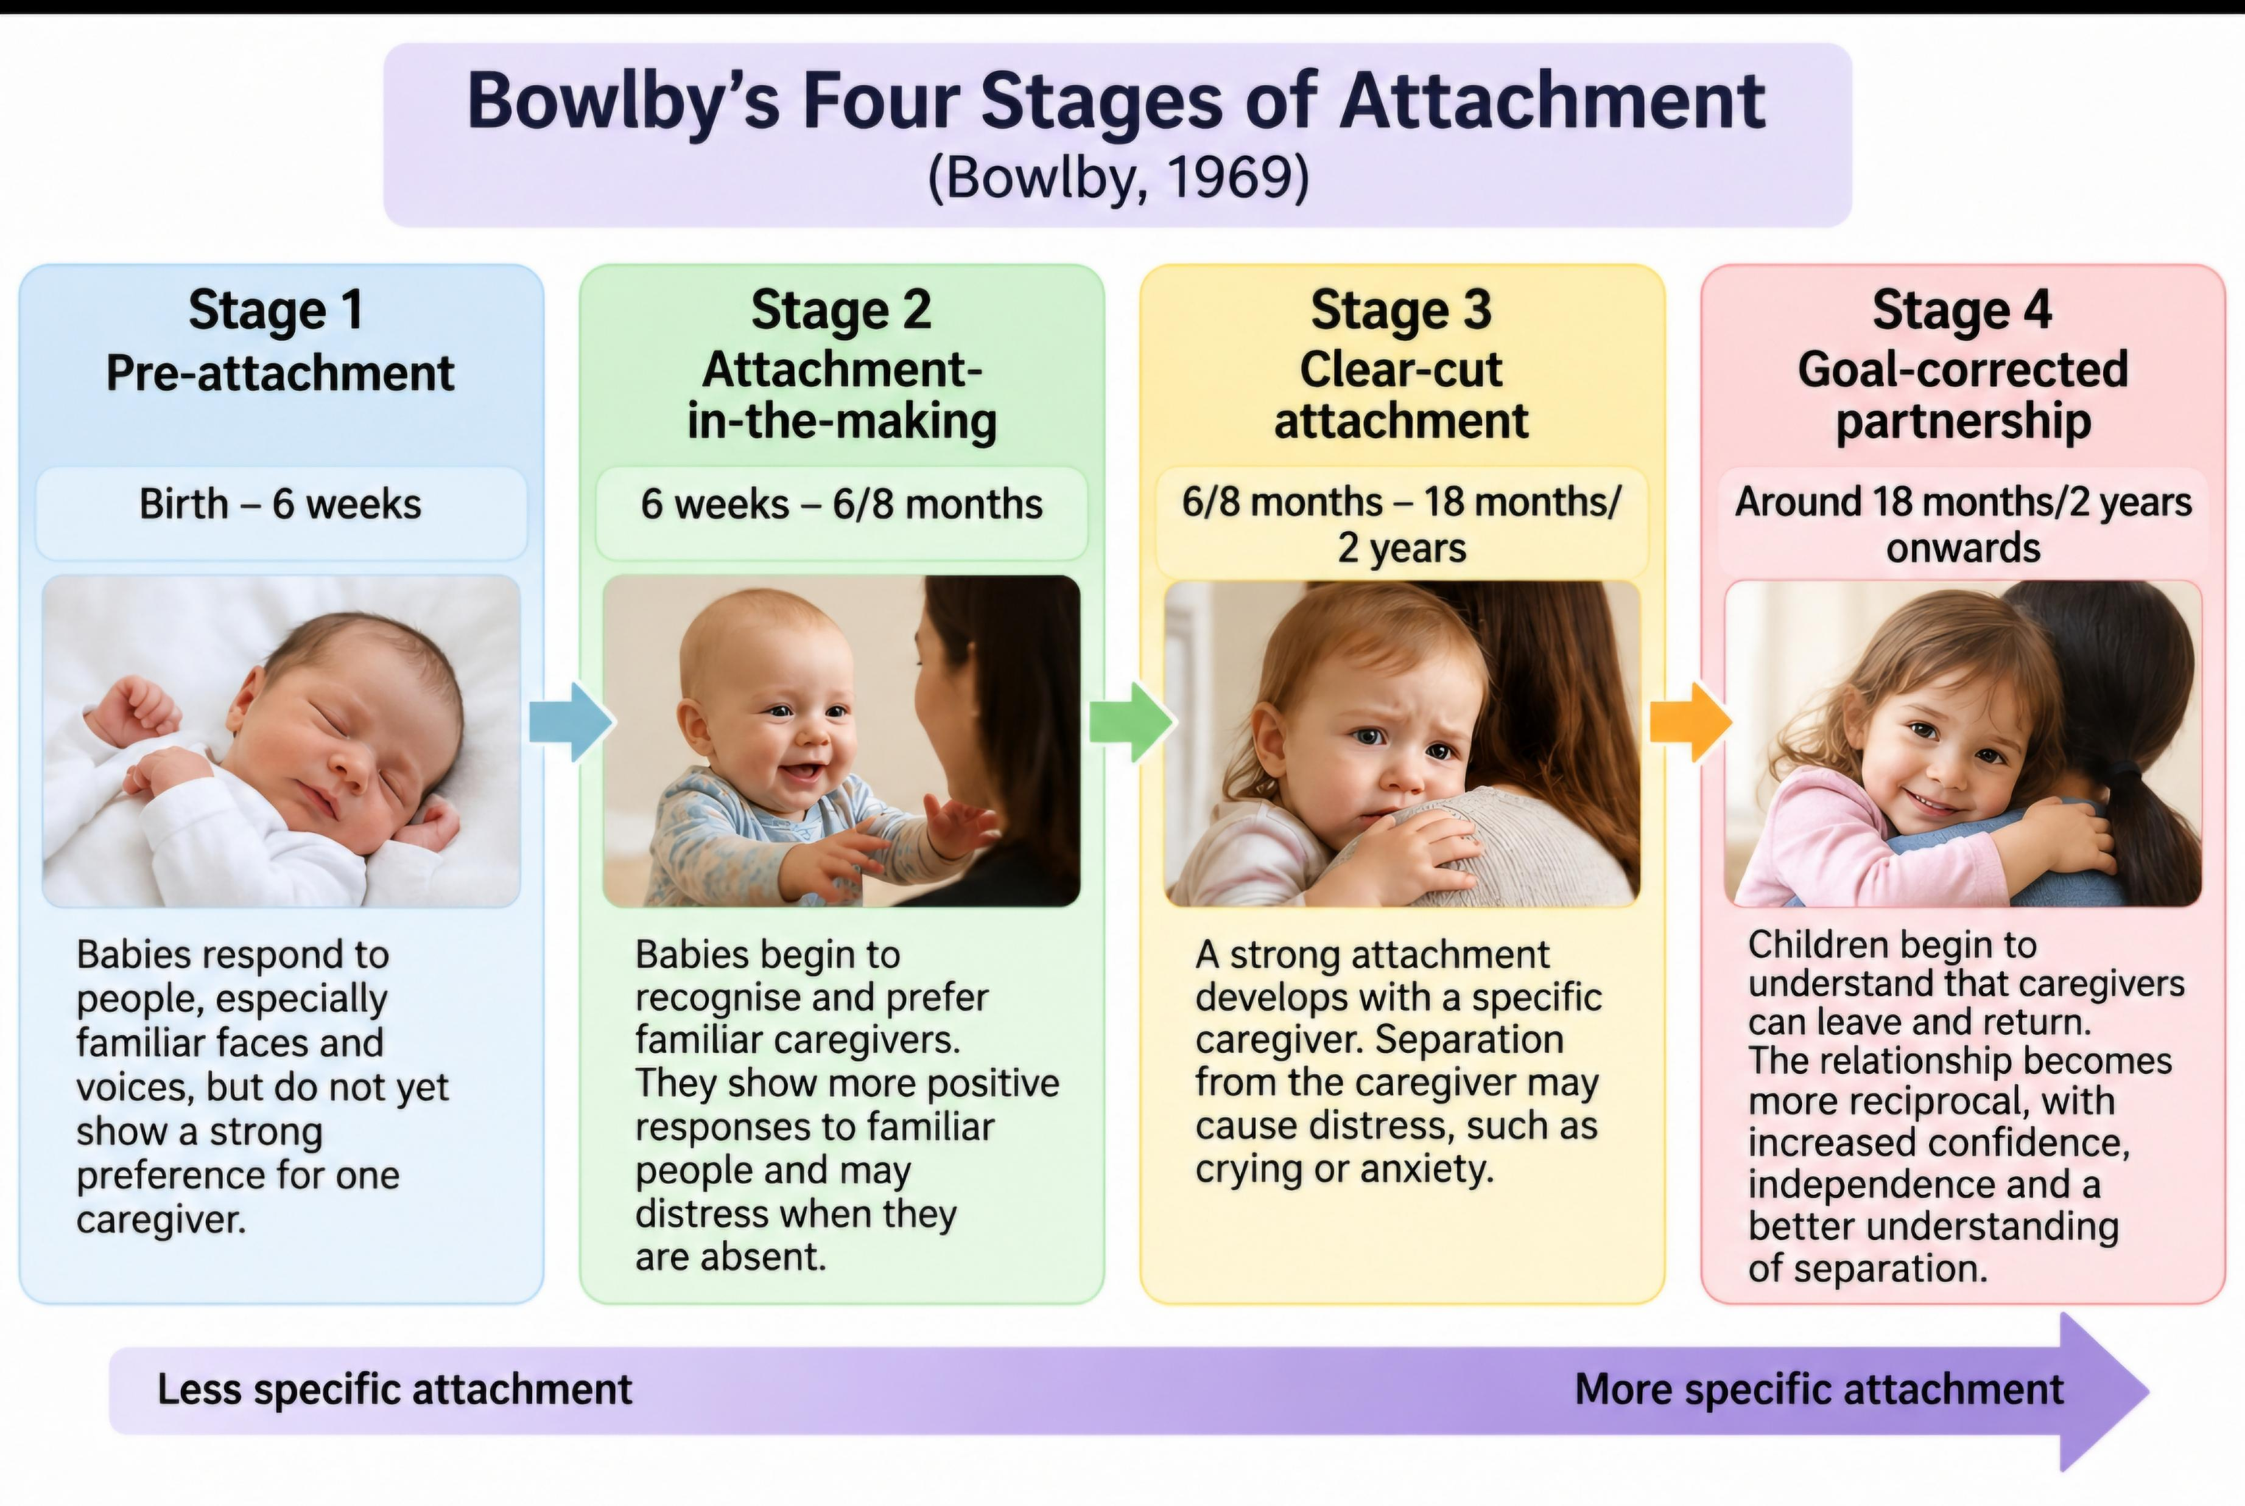
Bowlby’s 4 Stages of Attachment

Slide 7
Practical Strategies
Attachment-based support (NSPCC,2021).
Parent/care support and modelling (Department for Education, 2023).
Play-based learning Department of Education,2023).
Emotional regulation (Department of Education,2023).
Additional professional support where needed (Department of Education,2023).

Slide 8
Nature Versus Nurture
Nature:
Biological influences (Teachers institute,2025).
Inherited characteristics (Teachers institute,2025).
Temperament (Teachers institute, 2025).
Nurture:
Environmental experiences (Teachers institute,2025).
Separation and unfamiliar adults (Bowlby,1973).
Importance of early relationships (Bowlby,1969).

Slide 9
Evaluation of Bowlby’s Theory
Strength and Weaknesses:
Strengths:
Secure relationships (McLeod,2026).
Emotional support (McLeod,2026).
Understanding separation anxiety (McLeod,2026).
Weaknesses:
Emphasis on primary caregiver(McLeod,2026).
Other development influences(McLeod,2026).
Limited explanation of communication and play(McLeod,2026).

Slide 10
Vygotsky’s Theory as an Alternative
Alternative Theory- Vygotsky
Social interaction (McLeod,2026).
Language and communication (McLeod,2026).
Relevance to Shona’s group play(McLeod,2026).

Slide 11
Conclusion
Bowlby’s theory explains Shona’s emotional needs
Secure and supportive relationships
Practical strategies for development
Nature versus nurture
Vygotsky provides another perspective

Slide 12
References
Bosmans, G, Bakemans-Kranenburg, M.J, ,B, Verlet. Vorhees, M.W.F.T. and van Zinzendorf, M.H. (2020). A learning theory of attachment: Unravelling the black box of attachment development; Neuroscience & Biobehavioural Reviews, 113, pp. 287-298. Available at: A learning theory of attachment: Unravelling the black box of attachment development – ScienceDirect (Accessed 7 October 2026).
Bowlby, J. (1969) Attachment and loss: volume 1: attachment. New York: Basic Books. Available at: https://archive.org/details/attachmentloss0001bowl/page/n9/mode/2up (Accessed 10 October 2026).
Bowlby, J. (1973) Attachment and loss: volume 2: Separation: Anxiety and Anger. New York: Basic Books. Available at: https://archive.org/details/attachmentloss0001bowl/page/n9/mode/2up (Accessed:7 October 2026).
Department for Education (2023) ‘Mental health for early years children’. Help for Early Years Providers. Available at: https://help-for-early-years-providers.education.gov.uk/health-and-wellbeing/mental-health-for-early-years-children (Accessed 10 October 2026).

Slide 13
References
McLeod, S. (2026) ‘John Bowlby’s Attachment Theory; Simply Psychology. Available at: John Bowlby's Attachment Theory (Accessed: 7 October 2026).
McLeod, S. (2026) ‘Vygotsky’s Theory of Cognitive Development’. Simply Psychology. Available at: Vygotsky's Sociocultural Theory of Cognitive Development (Accessed: 7 October 2026).
NSPCC Learning. (2021) ‘Attachment and child development’. Available at: Attachment and child development | NSPCC Learning (Accessed: 7 October 2026).
Positive Psychology (n.d.) ‘Attachment Theory, Bowlby’s Stages & Attachment Styles’. Available at :Attachment Styles in Children (& How to Raise Secure Kids) (Accessed: 7 October 2026).
Teachers Institute (2026) ‘Nature vs Nurture: Understanding the Key Factors in Child Development’. Teachers Institute. Available at :Nature vs. Nurture: Understanding the Key Factors in Child Development • Teachers Institute (Accessed: 7 October 2026).

