Slide 1
Personality Types and Individual Differences
Dr Katie Sullivan

Slide 2
Learning Objectives:
Identify key personality traits linked to prejudice.
Explain classic and contemporary theories of prejudice-prone personalities
Evaluate how individual differences shape intergroup attitudes.
Apply theory to real-world contexts.
Apply theory to interventions.

Slide 3
What is personality?
Notes:
Personality refers to the enduring patterns of thoughts, feelings, and behaviours that distinguish individuals from one another. It encompasses the psychological traits and mechanisms within the individual that are relatively stable over time and across situations.
These traits influence how people perceive the world, interact with others, and respond to social situations—including those involving prejudice and discrimination.
Personality can be understood in terms of types or traits:
Personality Types: These are broad categories that group individuals based on shared characteristics. For example, the Authoritarian Personality is a type associated with rigidity, submission to authority, and hostility toward outgroups.
Personality Traits: These are more specific and measurable dimensions of personality. The Big Five model is a widely accepted framework that includes:
Openness to Experience – creativity, curiosity
Conscientiousness – organization, dependability
Extraversion – sociability, assertiveness
Agreeableness – compassion, cooperativeness
Neuroticism – emotional instability, anxiety

Slide 4
Why Personality Matters in Prejudice
Not everyone holds prejudiced attitudes to the same degree.
Personality traits can predispose individuals to be more or less prejudiced.
Understanding these traits is important for many reasons
Notes:
From previous lectures, you'll know that:
We all use stereotypes in order for us to be able to navigate our way around the world,
Stereotyping is potentially an automatic processes.
So from some of the research, it does suggest that these stereotypes can occur spontaneously, automatically, and they can be very difficult for us to control.
And we also know from Devine's work in particular:
cultural knowledge is very similar across groups,
in groups and out groups know the stereotypes that exist about them.
And quite often people know the stereotypes that exist about a group, even if they don't endorse those stereotypes and so are actually low on prejudice.
But with all of these things taken into account, we still have the fact that people differ on their levels of prejudice.
So, for instance, if we look at the two dimensional model, if we find that people fall into different categories.
This suggests that there are different levels of prejudice within people, even when they are presented with the same stereotypes, when they have the same cultural knowledge, when everything else about them could be equal.
Something is different between individuals.
So we have an individual difference element here. And one of the arguments that's been made for this is that this is down to individual differences in personality type in personality traits.
Today, we will explore whether personality traits can predispose individuals to be more or less prejudiced.
This is important as understanding these traits helps us:
Predict prejudice
Design interventions
Improve intergroup relations
Prompt for students:
"Think of someone you know who seems particularly open-minded or closed-minded. What personality traits might explain their attitudes?"

Slide 5
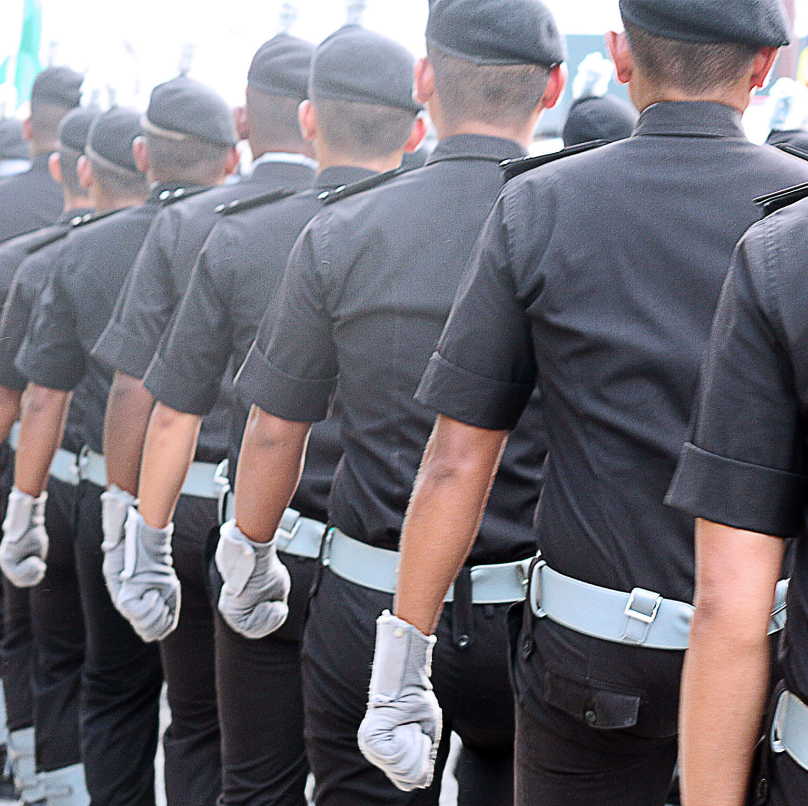
Historical Roots of the Authoritarian Personality
Early post-WWII psychologists sought to understand how ordinary people could support authoritarian regimes and commit atrocities.
Led to the development of the Authoritarian Personality theory.
Sparked decades of research into the psychological roots of prejudice.
Notes:
After the atrocities of World War II—particularly the Holocaust—there was a desire for Psychology to understand why German people had behaved in the way that they had during the war, particularly why individual citizens had been complicit in either helping or not standing up against the Nazis.
Both psychologists and sociologists were deeply concerned with understanding how ordinary individuals could support authoritarian regimes and commit acts of extreme prejudice and violence.
This led to a landmark study by Theodor Adorno, Else Frenkel-Brunswik, Daniel Levinson, and Nevitt Sanford, published in 1950 as The Authoritarian Personality. The research was part of the Studies in Prejudice series sponsored by the American Jewish Committee.
Their goal was to uncover the psychological roots of fascism and antisemitism, focusing on personality traits that predispose individuals to authoritarianism and prejudice.
Adorno's work was on personality. And Adorno, from his measures, came up with what was called the fascism scale, the F scale. And this was focused around these core elements, which he suggested were largely developed through childhood, but which you would see displayed in somebody who was high in what he called the F scale or this authoritarian fascism scale.
So the first of these things that he expected to see was people who were high in conventionalism that they had certain values and they were very rigid about and they they maintained those values and they didn't stray from those values. And they also, of course, didn't like people who didn't hold those values. Secondly, this idea of authoritarian submission. So it's recognizing an idealized moral authority and being completely uncritical about it. So not daring to criticize this authority whatsoever. Then we have anti-intraception. So a dislike of imagination, creativity, subjectivity. You can see that in the first one with conventional wisdom where we talk about rigid adherence and in a later one when we talk about dogma. Then you can understand that basically these are people who like certainty. They like things to be in a certain specific concrete way, if you like. And so the idea of something being abstract, of not being clearly defined. They don't particularly like it. The next item on Adorno's scale was superstition and stereotypy, so people who have rigid, categorical thinking, they like to put people into very fixed and rigid boxes. Again, they don't particularly like vagueness. And power, their belief in power and particularly in strength and toughness. Almost a might is right sort of attitudes towards power. Destructiveness is the next one. And so believing that hostility is a way to be able to achieve aims, and so this generalized hostility in particular thinking that's linked very much to the previous one. That by having power, by using strength and toughness and if needs be, by using this in a hostile fashion, in order to get things done, that there was nothing wrong with this. So people who are high on the F scale will tend to believe in that. And when we consider where this theory came out of, then we'll see why. That is in a moment. And finally, sex. So people who are high on the F scale tended to have a real concern with the sexual behavior of others. And what it was that they would do

Slide 6
Authoritarian Personality
Obey authority figures blindly
Conform rigidly to societal norms
Harbor prejudice against outgroups
Adorno, Frenkel-Brunswik, Levinson & Sanford (1950)
Notes:
Adorno and his colleagues proposed that certain individuals possess a personality syndrome that predisposes them to:
Obey authority figures blindly
Conform rigidly to societal norms
Harbor prejudice against outgroups
These tendencies were believed to be Influenced by Freudian psychoanalysis, particularly the idea that repressed instincts and strict parenting lead to suppressed emotional expression and encouraged obedience.

Slide 7
The Fascism Scale
(F-Scale; Adorno, Frenkel-Brunswik, Levinson & Sanford, 1947)
Conventionalism | Rigid adherence to traditional values
Authoritarian Submission | Obedience to established authority
Authoritarian Aggression | Hostility toward those who defy norms
Anti-intraception | Rejection of introspection and emotional expression
Superstition and Stereotypy | Belief in mystical forces and rigid thinking
Power and Toughness | Preoccupation with dominance and strength
Destructiveness and Cynicism | Generalised hostility and mistrust
Projectivity | Projection of unconscious impulses onto others
Sex | Exaggerated concern with sexual “deviance”
Notes:
The F-scale (short for Fascism Scale) was developed in 1947 by Theodor Adorno, Else Frenkel-Brunswik, Daniel Levinson, and Nevitt Sanford as part of their work on The Authoritarian Personality (1950).
It was designed to measure personality traits associated with authoritarianism, particularly those believed to predispose individuals to prejudice, conformity, and submission to authority
The F-scale assesses nine dimensions of authoritarianism, which he suggested were largely developed through childhood, but which you would see displayed in somebody who was high in what he called authoritarian fascism
1. Conventionalism
Example: “The established ways of doing things are always the best.”
Reflects rigid adherence to traditional social norms and values.
2. Authoritarian Submission
Example: “What this country needs most is discipline, with everyone following our leaders.”
Indicates unquestioning obedience to authority figures.
3. Authoritarian Aggression
Example: “People who challenge authority should be punished.”
Shows hostility toward those who deviate from conventional norms.
4. Anti-intraception
Example: “Too much thinking and analyzing just leads to confusion.”
Reflects a rejection of introspection, imagination, and emotional sensitivity.
5. Superstition and Stereotypy
Example: “Certain groups of people are just naturally inferior.”
Involves belief in mystical forces (such as fate) and rigid, oversimplified thinking about others.
6. Power and Toughness
Example: “The world is a dangerous place, and we need strong leaders to protect us.”
Emphasizes strength, dominance, and toughness as virtues.
7. Destructiveness and Cynicism
Example: “Most people are selfish and dishonest.”
Reflects a generally hostile and mistrustful view of humanity.
8. Projectivity
Example: “There are evil forces at work trying to undermine our society.”
Involves projecting one’s own unconscious impulses onto others, often in paranoid or conspiratorial ways.
9. Sexual Obsession
Example: “Sexual permissiveness is a sign of moral decay.”
Shows exaggerated concern with sexual “deviance” and moral purity.

Slide 8


The F-scale
Groundbreaking
.
Response Bias
Historical relevance
Influential
Correlations
Social Desirability
Ideological Bias
Overemphasis on Personality
Questionable Validity
Intellectual Bias
.
Notes:
Now, one of the big issues with the F scale is that is very much a child of its time. And so this was carried out in the 1950s and within psychology, psychodynamic theories so Freudian theory did hold sway. And so this was very much explained through issues like the self trying to protect the ego by derogating the outgroup, for instance.
And when you look at two or three of those items on Adorno's scale of what he thought would create people high in fascism. And we can see very much psycho dynamic concepts coming through in some of the terminologies.
But this created a few problems. The first of them being that, of course, we know that psychodynamism is extremely difficult to test empirically. And so the idea of it actually being a scientific study of individuals was always going to be a very difficult thing to do. Many of the claims aren't particularly robust in terms of the empirical evidence.
Response Bias: The scale is unidirectional—all items are phrased in one direction, making it vulnerable to acquiescence bias (tendency to agree with statements).
Social Desirability: Participants may give socially acceptable answers, skewing results.
Ideological Bias: Focuses on right-wing authoritarianism, ignoring left-wing variants.
Overemphasis on Personality: Neglects situational and cultural factors in prejudice.
Questionable Validity: Some argue it measures conservatism or traditionalism more than authoritarianism per se.
Intellectual Bias: Studies found negative correlations between F-scale scores and IQ/vocabulary, suggesting brighter individuals may “see through” the test and manipulate responses.
However,
Groundbreaking: First attempt to empirically measure authoritarian traits.
Historical relevance: Helped explain support for fascism and prejudice post-WWII.
Influential: Inspired decades of research into personality and political attitudes.
Correlations: Found links between high F-scale scores and prejudice, obedience (e.g., Milgram’s studies).
While the F-scale is rarely used in modern research due to its limitations, it remains a historically significant tool that laid the groundwork for more refined measures like:
Right-Wing Authoritarianism (RWA) – Altemeyer (1981)
Social Dominance Orientation (SDO) – Sidanius & Pratto (1999)

Slide 9
Task!
Complete the F-scale questionnaire and discuss:
Which items did they find most uncomfortable or controversial?
Which traits do they think are most relevant to modern prejudice?
How might upbringing or social context influence these traits?
What are the criticisms of the scale?

Slide 10
Right-Wing Authoritarianism
(RWA; Altemeyer, 1981, 1996)
Conventionalism
Authoritarian Aggression
Authoritarian Submission
Notes:
Purpose: To address methodological and conceptual issues in Adorno’s F-scale and provide a more reliable measure of authoritarian tendencies.
Unlike Adorno’s theory, RWA is not a fixed personality type, but rather a set of attitudinal dispositions that can vary across individuals and contexts.
RWA is a personality construct that reflects a cluster of attitudes centered around:
Submission to established authorities
Aggression toward outgroups or norm violators
Adherence to societal conventions

Slide 11

Authoritarian Submission
Obedience to political, religious, or institutional leaders.
Belief that authority figures are morally superior and should not be questioned.
Acceptance of hierarchical structures as necessary for social order.
Notes:
This cluster reflects a high degree of submission to authorities perceived as legitimate and established within society.
Characteristics:
Obedience to political, religious, or institutional leaders.
Belief that authority figures are morally superior and should not be questioned.
Acceptance of hierarchical structures as necessary for social order.
Psychological Basis:
Often rooted in early socialization that emphasizes respect for authority.
Linked to a need for security and stability, especially in uncertain or threatening environments.
Example Beliefs:
“Our leaders know what’s best for the country.”
“Children should always obey their parents and teachers without question.”
Relevance to Prejudice:
Encourages acceptance of discriminatory policies if endorsed by authority figures.
Reduces critical thinking about moral implications of prejudice.

Slide 12
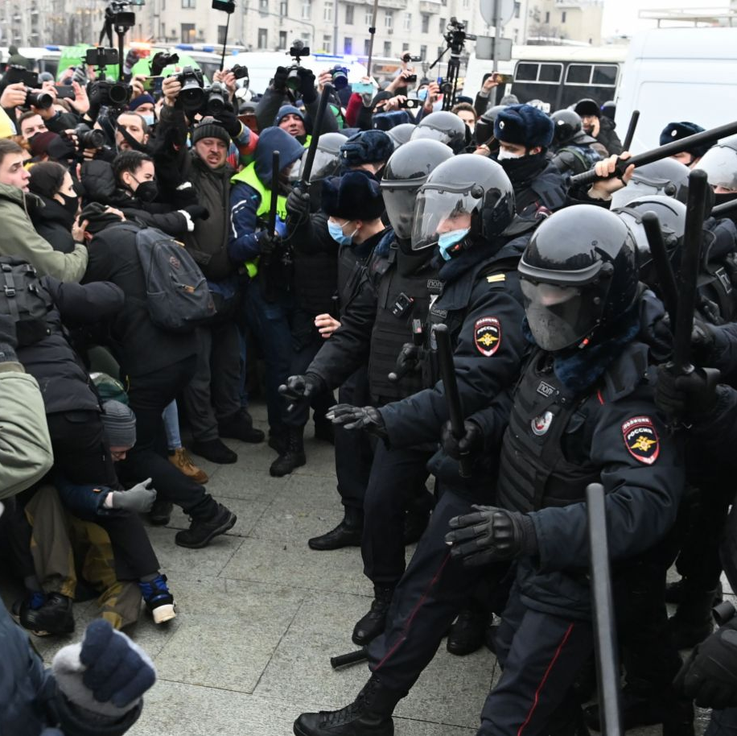
Authoritarian Aggression
Support for punitive measures against norm violators.
Intolerance of dissent or diversity.
Aggression is often justified as protecting societal values.
Notes:
This cluster involves hostility toward individuals or groups perceived as deviant, threatening, or non-conforming to societal norms.
Characteristics:
Support for punitive measures against norm violators.
Intolerance of dissent or diversity.
Aggression is often justified as protecting societal values.
Psychological Basis:
Often driven by perceived threat—social, moral, or economic.
Aggression is displaced onto outgroups as a way to restore perceived order.
Example Beliefs:
“People who break the law should be punished harshly.”
“Immigrants who don’t assimilate are a danger to our way of life.”
Relevance to Prejudice:
Strong predictor of racism, homophobia, and xenophobia.
Fuels support for authoritarian leaders who promise to “crack down” on deviance.

Slide 13
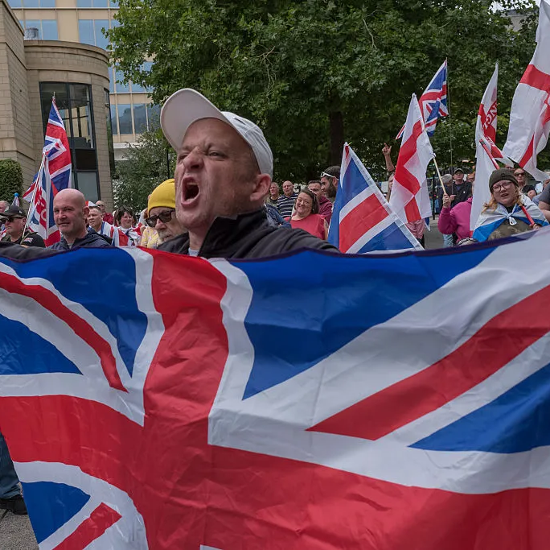
Conventionalism
Preference for familiar, time-honored ways of life.
Resistance to social change or progressive movements.
Belief that deviation from norms is morally wrong.
Notes:
This cluster involves hostility toward individuals or groups perceived as deviant, threatening, or non-conforming to societal norms.
Characteristics:
Support for punitive measures against norm violators.
Intolerance of dissent or diversity.
Aggression is often justified as protecting societal values.
Psychological Basis:
Often driven by perceived threat—social, moral, or economic.
Aggression is displaced onto outgroups as a way to restore perceived order.
Example Beliefs:
“People who break the law should be punished harshly.”
“Immigrants who don’t assimilate are a danger to our way of life.”
Relevance to Prejudice:
Strong predictor of racism, homophobia, and xenophobia.
Fuels support for authoritarian leaders who promise to “crack down” on deviance.

Slide 14
Authoritarian Submission
Authoritarian Aggression
Conventionalism
Notes:
These clusters are mutually reinforcing:
Submission to authority legitimizes aggression.
Aggression defends conventional norms.
Conventionalism justifies submission and aggression as moral imperatives.
Together, they form a psychological profile that is highly predictive of prejudiced attitudes, support for authoritarian leaders, and resistance to diversity and social change.
So as you can see is not that Altemeyer has particularly deviated a great deal from Adorno's initial work. But what he has done is explained it now in attitudes, something that social psychology prefers to focus on now rather than the ill defined psychodynamic theory. And it's also limited it down to these three clusters rather than the seven or eight which was contained within the Adorno work. It's important to recognize here that right wing authoritarianism isn't just about having right wing views.

Slide 15
RWA Scales
Duckitt et al., (2010)
Zakrisson’s (2005)
Altemeyer (1981)
Notes:
Developed by Bob Altemeyer in the 1980s, the original RWA scale includes items like:
“Our country needs a powerful leader, in order to destroy the radical and immoral currents prevailing in society today.”
“The ‘old-fashioned ways’ and ‘old-fashioned values’ still show the best way to live.”
Participants rate their agreement on a Likert scale (typically 1 = strongly disagree to 7 = strongly agree). Higher scores indicate stronger authoritarian attitudes.
Shortened and Revised Versions
Because the original scale was quite long and sometimes politically charged, researchers have developed shorter and more balanced versions, such as:
Zakrisson’s (2005) 15-item RWA scale – designed to be more neutral and suitable for broader populations.
Duckitt et al.’s (2010) dual-process model scales – which measure RWA alongside Social Dominance Orientation (SDO) and link them to personality traits.
These versions maintain the core dimensions but reduce ideological bias and improve psychometric properties.

Slide 16
The RWA Scale
Robust Predictive Power
.
Ideological Bias
Theoretical Clarity
Empirical Reliability
Cultural Specificity
.
Social Desirability Bias
Static Measurement of Dynamic Attitudes
Overlap with Other Constructs
Notes:
Strengths
Robust Predictive Power
RWA is consistently linked to prejudice, ethnocentrism, and support for punitive policies.
It helps explain how personality traits (e.g. low openness) translate into ideological attitudes.
Theoretical Clarity
The tripartite structure—submission, aggression, and conventionalism—offers a clear framework for understanding authoritarian attitudes.
Empirical Reliability
High internal consistency across studies (Cronbach’s alpha often > .80).
Validated in multiple cultural contexts, though with some caveats (see below).
Limitations and Criticisms
Ideological Bias
The original scale developed by Altemeyer has been criticized for being politically loaded, often framing right-wing views negatively.
Items may alienate conservative participants or confound authoritarianism with political orientation.
Cultural Specificity
The scale was developed in North America and reflects Western sociopolitical norms.
In non-Western contexts, the meaning of “authority” and “conventionalism” may differ, affecting validity.
Social Desirability Bias
Participants may underreport authoritarian attitudes due to fear of judgment, especially in academic or liberal environments.
This can lead to response distortion and reduced accuracy.
Static Measurement of Dynamic Attitudes
RWA is treated as a stable trait, but authoritarian attitudes can fluctuate with perceived threat, economic instability, or social change.
This raises questions about whether RWA is a personality trait or a situational response.
Overlap with Other Constructs
RWA shares variance with Social Dominance Orientation (SDO) and conservatism, which can complicate interpretation.
Some argue for a more integrated model of ideological attitudes.

Slide 17
Traditionalist Community Members
Strict Authoritarian Parents or Educators
Law-and-Order Advocates
Religious Fundamentalists
Populist Political Supporters
High-RWA
Personality
Profiles
Notes:
PREFACE: These profiles are not stereotypes but patterns observed in psychological research.
High RWA is not inherently linked to any one demographic—it can be found across age, gender, education, and cultural groups.
RWA is often activated by perceived threat, meaning even low-RWA individuals can show authoritarian attitudes under stress or fear.
1. Traditionalist Community Members
Often found in tight-knit, conservative communities.
Strong belief in traditional family values, religious norms, and patriotic ideals.
May view social change (e.g., gender roles, immigration) as threatening.
2. Strict Authoritarian Parents or Educators
Emphasize obedience, discipline, and respect for authority.
May discourage questioning rules or norms.
Often support punitive measures for deviance.
3. Law-and-Order Advocates
Strong support for policing, military, and harsh criminal justice policies.
Believe that social stability depends on strict rule enforcement.
May express hostility toward protest movements or civil disobedience.
4. Religious Fundamentalists
Adhere rigidly to religious doctrine and moral codes.
May view secularism, LGBTQ+ rights, or other progressive movements as morally corrupt.
Often support leaders who promise to uphold religious values.
5. Populist Political Supporters
Support leaders who promise to restore order, tradition, and national pride.
May be drawn to authoritarian rhetoric, especially during times of social or economic uncertainty.
Often distrustful of outsiders or minority groups.

Slide 18
RWA and Prejudice
Childs (2011)
RWA is a strong predictor of prejudice across diverse groups
Bilewicz et al. (2017)
Both RWA and SDO correlate with outgroup prejudice.
Bouguettaya et al. (2023)
High-RWA individuals showed consistently high prejudice against Muslims
RWA-driven prejudice is context-sensitive, especially to authority norms.
RWA is linked to support for hate speech prohibition.
RWA leads to resistance to anti-prejudice messaging
Duckitt & Sibley (2010)
RWA predicted prejudice when immigrants were described as socially deviant
Wedell & Bravo (2022)
RWA predicted: Modern racism, Modern sexism and Traditional gender role beliefs
RWA and SDO predict prejudice through distinct motivational pathways
Notes:
Childs (2011) – Meta-Analysis of RWA and Prejudice
Study Type: Meta-analysis of 76 publications
Key Findings:
RWA is a strong predictor of prejudice across diverse groups: feminists, LGBTQ+ individuals, Native Americans, Arabs, immigrants, and the obese.
Racial/ethnic prejudice showed a decline over time, likely due to changing social norms and reduced authority figure endorsement.
Anti-gay prejudice, however, increased, suggesting that prejudice persists where authority figures still condemn the group.
SDO remained a stable predictor of prejudice, unaffected by time-based societal changes.
Implication: RWA-driven prejudice is context-sensitive, especially to authority norms.
Bilewicz et al. (2017) – Hate Speech Regulation
Study Type: Two nationwide surveys (N = 653 adolescents, N = 1007 adults)
Key Findings:
Both RWA and SDO correlate with outgroup prejudice.
SDO is linked to acceptance of hate speech.
RWA is linked to support for hate speech prohibition.
This counterintuitive result suggests that high-RWA individuals may be punitive toward norm violations, even if they themselves hold prejudiced views.
Implication: RWA may lead to support for controlling prejudice expression, not necessarily reducing prejudice itself.
Bouguettaya et al. (2023) – RWA and Anti-Muslim Prejudice
Study Type: Experimental study (N = 388 Americans)
Key Findings:
Participants were exposed to anti-prejudice messages from either an in-group (American) or out-group (Iraqi refugee) source.
High-RWA individuals showed consistently high prejudice against Muslims, regardless of message source.
Low-RWA individuals responded positively to in-group anti-prejudice messages.
Implication: RWA leads to resistance to anti-prejudice messaging, highlighting the challenge of changing attitudes in high-RWA populations.
Duckitt & Sibley (2010) – RWA vs. SDO in Prejudice
Study Type: Experimental manipulation of immigrant group descriptions
Key Findings:
RWA predicted prejudice when immigrants were described as socially deviant (threatening norms).
SDO predicted prejudice when immigrants were described as economically competitive or low-status.
Supports the Dual Process Motivational Model: RWA is driven by security concerns, SDO by hierarchy and dominance.
Implication: RWA and SDO predict prejudice through distinct motivational pathways, depending on perceived threat or competition.
Wedell & Bravo (2022) – RWA, SDO, and Stigmatized Groups
Study Type: Cross-sectional survey of 1,244 U.S. college students
Key Findings:
RWA and SDO independently predicted:
Modern racism
Modern sexism
Traditional gender role beliefs
Found a synergistic interaction between RWA and SDO in predicting attitudes toward women.
Other interactions were not significant, suggesting mostly independent pathways.
Implication: RWA and SDO contribute to prejudice in distinct but sometimes overlapping ways, especially regarding gender.

Slide 19

RWA & Politics
Association with Right-Wing Ideologies
Support for Conservative Parties
Threat Sensitivity and Political Messaging
Notes:
Association with Right-Wing Ideologies
RWA is strongly correlated with right-wing political beliefs, especially those emphasizing:
Law and order
Traditional family values
Nationalism
Religious conservatism
High-RWA individuals often support authoritarian leaders, military strength, and strict immigration policies.
Support for Conservative Parties
In many Western democracies, RWA is a predictor of support for:
Conservative or right-wing populist parties
Politicians who use fear-based rhetoric, emphasize moral decline, or promise to restore order
Examples include support for parties like the Republican Party (US), UKIP or the Conservative Party (UK), AfD (Germany), or National Rally (France).
3. Threat Sensitivity and Political Messaging
RWA is activated by perceived threats—e.g., terrorism, immigration, moral decline.
Politicians who frame issues as existential threats to national identity or values often appeal to high-RWA voters.
HOWEVER:
RWA is not synonymous with being politically conservative. Some conservatives may score low on RWA if they value individual liberty over social conformity.
RWA can also appear in left-wing authoritarianism, though this is less studied and often context-specific (e.g., support for authoritarian socialist regimes).

Slide 20
Task!
Complete the RWA questionnaire(s) and discuss:
Which items did they find most uncomfortable or controversial?
Which traits do they think are most relevant to modern prejudice?
How might upbringing or social context influence these traits?
What are the criticisms of the scale?

Slide 21
Social Dominance Orientation
(SDO; Sidanius et al., 1994)
maintain or increase social inequality
Social Hierarchies
Natural superiority
Notes:
Social Dominance Orientation (SDO) is a personality trait that reflects the extent to which individuals prefer and support group-based hierarchies and inequality between social groups. It was developed by Jim Sidanius and Felicia Pratto in the 1990s as part of Social Dominance Theory.
People high in SDO believe that some groups are naturally superior to others and that society should be structured in a way that maintains these hierarchies.
Core Characteristics of High-SDO Individuals
Prefer hierarchical group relations over equality.
Support policies that maintain or increase social inequality.
Are more likely to:
Oppose affirmative action
Endorse harsh immigration policies
Justify systemic discrimination
Show prejudice toward low-status or disadvantaged groups

Slide 22
Pratto, Sidanius, Stallworth & Malle (1994)
Men scored higher in SDO than women.
Support military action and punitive justice
Oppose affirmative action, interracial marriage, and environmental protections
Endorse meritocracy, just world beliefs, and Protestant work ethic
SDO was negatively correlated with empathy, altruism, and egalitarian values.
SDO was not reducible to authoritarianism or interpersonal dominance
Notes:
1. Pratto, Sidanius, Stallworth & Malle (1994)
Title: Social Dominance Orientation: A Personality Variable Predicting Social and Political Attitudes
Published in: Journal of Personality and Social Psychology
Purpose
To introduce and validate SDO as a measurable individual difference variable that predicts support for group-based hierarchy and prejudice.
Key Hypotheses
SDO would correlate positively with hierarchy-enhancing ideologies (e.g., racism, sexism, nationalism).
SDO would correlate negatively with hierarchy-attenuating ideologies (e.g., egalitarianism, social welfare).
SDO would be distinct from related constructs like authoritarianism, interpersonal dominance, and conservatism.
Methodology
Developed a reliable SDO scale.
Conducted multiple studies with U.S. university students.
Measured correlations between SDO and:
Prejudice (e.g., anti-Black racism, anti-Arab racism)
Sexism
Nationalism and patriotism
Support for punitive policies (e.g., death penalty)
Opposition to civil rights and welfare policies
Key Findings
Men scored higher in SDO than women.
High-SDO individuals were more likely to:
Support military action and punitive justice
Oppose affirmative action, interracial marriage, and environmental protections
Endorse meritocracy, just world beliefs, and Protestant work ethic
SDO was negatively correlated with empathy, altruism, and egalitarian values.
SDO was not reducible to authoritarianism or interpersonal dominance.
Theoretical Contribution
Introduced the concept of “legitimizing myths”:
Hierarchy-enhancing myths (e.g., racism, sexism, nationalism)
Hierarchy-attenuating myths (e.g., human rights, egalitarianism)
Proposed that individuals high in SDO are more likely to endorse myths that justify inequality.

Slide 23
Legitimizing Myths
Hierarchy-Attenuating Myths
Hierarchy-Enhancing Myths
Notes:
Legitimizing myths are culturally shared beliefs, values, ideologies, and stereotypes that serve to justify and maintain social hierarchies. They make inequality seem natural, fair, or inevitable, even when it disadvantages certain groups.
These myths are often subtle, widely accepted, and rarely questioned, which makes them powerful tools for sustaining systems of dominance.
Two Types of Legitimizing Myths
1. Hierarchy-Enhancing Myths
These justify inequality and support the dominance of high-status groups over low-status groups.
Examples:
Meritocracy: “People succeed because they work hard.”
Just World Belief: “People get what they deserve.”
Biological essentialism: “Some races or genders are naturally better at certain things.”
Stereotypes: “Immigrants are lazy,” “Women are too emotional to lead.”
These myths are often endorsed by individuals high in SDO and are used to rationalize discrimination, resist social change, and oppose equality-promoting policies.
Hierarchy-Attenuating Myths
These challenge inequality and promote egalitarianism and social justice.
Examples:
Human rights discourse: “All people are equal in dignity and rights.”
Feminist ideology: “Gender roles are socially constructed and oppressive.”
Anti-racism frameworks: “Systemic racism creates unequal opportunities.”
Social justice education: “We must address historical and structural inequalities.”
These myths are more likely to be endorsed by individuals low in SDO and are often promoted by hierarchy-attenuating institutions like education, social work, and civil rights organizations.
Why Are Legitimizing Myths Important?
They help explain why people accept or resist inequality.
They influence policy support, voting behavior, and intergroup attitudes.
They show how ideology and culture interact with personality traits like SDO to shape social systems.

Slide 24
Sidanius & Pratto (1999)
Choose hierarchy-enhancing careers (e.g., law enforcement, business)
Oppose redistributive policies
Show prejudice toward low-status groups
Work in social services, education, or activism
Support equality-promoting policies
Notes:
Sidanius & Pratto (1999)
Book: Social Dominance: An Intergroup Theory of Social Hierarchy and Oppression
Publisher: Cambridge University Press
Core Thesis
All societies tend to organize themselves into group-based hierarchies, and SDO is a key psychological mechanism that helps maintain these hierarchies.
Key Concepts
Trimorphic structure of hierarchy:
Age-based
Gender-based
Arbitrary-set (e.g., race, class, religion)
Hierarchy-enhancing institutions (e.g., military, police, business)
Hierarchy-attenuating institutions (e.g., welfare, education, civil rights groups)
Empirical Evidence
High-SDO individuals are more likely to:
Choose hierarchy-enhancing careers (e.g., law enforcement, business)
Oppose redistributive policies
Show prejudice toward low-status groups
Low-SDO individuals are more likely to:
Work in social services, education, or activism
Support equality-promoting policies
Theoretical Innovations
Introduced the Dual Process Model (with Duckitt): SDO and RWA as distinct but complementary predictors of prejudice.
Emphasized the institutional and ideological reinforcement of inequality.

Slide 25
SDO Measures
Original SDO Scale (SDO-16)
SDO6
SDO7
Notes:
Original SDO Scale (SDO-16)
Developed by Pratto, Sidanius, Stallworth, & Malle (1994), the original SDO scale consisted of 16 items designed to assess an individual's preference for group-based hierarchy and inequality.
Sample Items:
“Some groups of people are simply not the equals of others.”
“We should do what we can to equalize conditions for different groups.” (reverse-scored)
Participants rate their agreement on a 7-point Likert scale (1 = strongly disagree, 7 = strongly agree).
Structure of the Original Scale
The original SDO scale was unidimensional, meaning it measured a single underlying construct: general support for group-based dominance.
However, later research found that SDO is multifaceted, leading to the development of refined versions.
SDO6 (2004)
A revised version with 16 items, improved for cross-cultural use.
Included balanced positive and negative items to reduce response bias.
SDO7 (Ho et al., 2015)
The most widely used modern version.
Introduced a two-factor model:
SDO-D (Dominance) – Preference for active oppression of outgroups.
e.g., “Some groups must be kept in their place.”
SDO-E (Egalitarianism Rejection) – Opposition to policies that promote equality.
e.g., “Group equality should not be our primary goal.”
Each subscale typically includes 4–8 items, and the full scale can be adapted for shorter versions (e.g., SDO7s with 8 items total).
Psychometric Properties
High internal consistency (Cronbach’s alpha typically > .80).
Strong predictive validity for:
Prejudice
Policy attitudes
Political ideology
Cross-cultural reliability: Validated in multiple countries and languages.
Administration and Scoring
Administered via self-report questionnaire.
Responses are averaged to produce an overall SDO score or separate SDO-D and SDO-E scores.
Higher scores indicate greater support for group-based hierarchy and inequality.
Why It Matters
SDO is a powerful predictor of attitudes toward:
Immigration
Welfare
Affirmative action
Policing and punishment
It helps explain why some individuals consistently oppose social equality, even across different domains.

Slide 26
Corporate Ladder Climber
Nationalist Politician
Traditional Gender Role Advocate
Authoritarian Manager
Militaristic Ideologue
High-SDO
Personality
Profiles
Notes:
PREFACE: High-SDO individuals are not necessarily “bad” or “prejudiced” in a moral sense—they are motivated by hierarchy and competition, which can manifest in various domains (e.g., politics, business, education). SDO is not tied to any one political party or ideology, though it often aligns with economic conservatism and anti-egalitarianism.
Corporate Ladder Climber
Traits: Ambitious, competitive, status-driven.
Beliefs: Success is earned, and those at the top deserve their position.
Attitudes: May oppose welfare programs or affirmative action, viewing them as unfair advantages.
Example: A business executive who believes that economic inequality is natural and necessary for motivation.
Nationalist Politician
Traits: Patriotic, assertive, focused on national superiority.
Beliefs: Some nations or ethnic groups are inherently superior.
Attitudes: Supports strict immigration policies and national dominance in global affairs.
Example: A political leader who promotes “us vs. them” rhetoric and resists multiculturalism.
Traditional Gender Role Advocate
Traits: Conservative, hierarchical, resistant to social change.
Beliefs: Men and women have “natural” roles in society.
Attitudes: Opposes gender equality initiatives and LGBTQ+ rights.
Example: A public figure who argues that feminism undermines traditional family values.
Authoritarian Manager
Traits: Controlling, hierarchical, power-oriented.
Beliefs: Some people are born to lead, others to follow.
Attitudes: Supports rigid workplace hierarchies and resists employee empowerment.
Example: A manager who believes that questioning authority disrupts productivity and order.
Militaristic Ideologue
Traits: Disciplined, order-focused, dominance-oriented.
Beliefs: Military strength and dominance are essential for national survival.
Attitudes: Supports aggressive foreign policy and suppression of dissent.
Example: A military official who views diplomacy as weakness and prioritizes national superiority.

Slide 27
SDO and Prejudice
Michinov et al. (2005)
Participants high in SDO were more likely to assign North African targets to lower-status roles and later in the selection order, reflecting subtle discrimination.
Prejudice mediated the relationship between SDO and discriminatory behavior.
SDO in 1996 predicted prejudice and ingroup friendship preferences in 2000.
Smith & Stathi (2022)
SDO was positively correlated with stigmatization of homeless people.
Supports the idea that SDO is a causal factor in the development of prejudice.
High-SDO individuals were resistant to the effects of positive contact.
Pratto & Shin (2000)
Under salient intergroup conditions, high-SDO participants showed stronger implicit prejudice.
Suggests that SDO influences not only explicit attitudes, but also automatic, unconscious biases.
Wollast et al. (2022)
SDO-D predicted blatant anti-immigrant prejudice via support for assimilation (a hierarchy-enhancing ideology).
SDO-E predicted subtle prejudice, mediated by opposition to interculturalism.
Kteily, Sidanius & Levin (2011)
Notes:
Michinov et al. (2005) – SDO and Discrimination in a Lab Setting
Study: Developed a computer-based method to measure discriminatory behavior in a simulated workplace hierarchy.
Key Findings:
Participants high in SDO were more likely to assign North African targets to lower-status roles and later in the selection order, reflecting subtle discrimination.
Prejudice mediated the relationship between SDO and discriminatory behavior.
Demonstrated that SDO predicts actual discriminatory behavior, not just attitudes.
Implication: SDO influences how people allocate power and status, reinforcing group-based hierarchies.
Kteily, Sidanius & Levin (2011) – Is SDO a Cause or Effect?
Study: Longitudinal panel study of UCLA students over four years.
Key Findings:
SDO in 1996 predicted prejudice and ingroup friendship preferences in 2000.
The reverse was not true: prior prejudice did not predict later SDO.
Supports the idea that SDO is a causal factor in the development of prejudice.
Implication: SDO is a stable, top-down driver of discriminatory attitudes, not just a reflection of them.
Smith & Stathi (2022) – SDO and Homeless Stigmatization
Study: Surveyed 187 participants on SDO, belief in a just world, and contact with homeless individuals.
Key Findings:
SDO was positively correlated with stigmatization of homeless people.
Contact reduced stigma, but only for individuals with low or moderate SDO.
High-SDO individuals were resistant to the effects of positive contact.
Implication: SDO moderates the effectiveness of prejudice-reduction strategies, such as intergroup contact.
Pratto & Shin (2000) – SDO and Implicit Prejudice
Study: Two experiments testing implicit group bias using priming tasks.
Key Findings:
Under salient intergroup conditions, high-SDO participants showed stronger implicit prejudice.
Suggests that SDO influences not only explicit attitudes, but also automatic, unconscious biases.
Implication: SDO shapes both conscious and unconscious forms of prejudice, especially in competitive or threatening contexts.
Wollast et al. (2022) – SDO and Anti-Immigrant Prejudice
Study: Cross-national and longitudinal study in France and Québec (N = 1,852).
Key Findings:
SDO-D (Dominance) predicted blatant anti-immigrant prejudice via support for assimilation (a hierarchy-enhancing ideology).
SDO-E (Egalitarianism rejection) predicted subtle prejudice, mediated by opposition to interculturalism.
Multiculturalism and colorblindness were less predictive once interculturalism was considered.
Implication: Different dimensions of SDO predict different forms of prejudice, and intergroup ideologies mediate these effects.

Slide 28
Task!
Complete the SDO questionnaire(s) and discuss:
Which items did they find most uncomfortable or controversial?
Which traits do they think are most relevant to modern prejudice?
How might upbringing or social context influence these traits?
What are the criticisms of the scale?

Slide 29
Dual Process Model
 | Worldview | Motivation | Personality Basis | Ideological Attitudes | Prejudice
RWA | Dangerous world (threat-focused) | Desire for security, order, and social cohesion. | High conscientiousness, low openness to experience. | RWA: characterised by submission to authority, aggression toward deviants, and conventionalism | Prejudice against norm violators (e.g., immigrants, LGBTQ+, criminals)
SDO | Competitive jungle (hierarchy-focused) | Desire for power, status, and group-based superiority. | Low agreeableness, low empathy, high tough-mindedness | SDO: support for group-based hierarchy and inequality. | Prejudice against low-status groups (e.g., poor people, ethnic minorities)
Duckitt (2001)
Duckitt & Sibley (2007, 2009, 2010)
Notes:
The Dual Process Model of Ideology and Prejudice, developed by John Duckitt and colleagues, explains how two distinct personality-attitude pathways—Right-Wing Authoritarianism (RWA) and Social Dominance Orientation (SDO)—independently predict different types of prejudice.
How Each Pathway Works
Right-Wing Authoritarianism (RWA) Pathway
Worldview: The world is a dangerous, chaotic place.
Motivation: Desire for security, order, and social cohesion.
Personality traits: High conscientiousness, low openness to experience.
Ideological outcome: RWA—characterized by submission to authority, aggression toward deviants, and conventionalism.
Prejudice target: Groups seen as threatening social norms or values, such as immigrants, feminists, or LGBTQ+ individuals.
Social Dominance Orientation (SDO) Pathway
Worldview: The world is a competitive jungle where groups fight for dominance.
Motivation: Desire for power, status, and group-based superiority.
Personality traits: Low agreeableness, low empathy, high tough-mindedness.
Ideological outcome: SDO—support for group-based hierarchy and inequality.
Prejudice target: Groups seen as inferior or subordinate, such as ethnic minorities, the poor, or refugees.
Why This Model Matters
It helps explain why people with different motivations (e.g., fear vs. dominance) can both hold prejudiced views—but for different reasons.
It informs tailored interventions:
For high-RWA individuals: Emphasize security and shared values.
For high-SDO individuals: Emphasize empathy and fairness.
Dual Process Model of Ideology and Prejudice was developed by John Duckitt, a social psychologist from New Zealand, and later expanded in collaboration with Chris Sibley.
John Duckitt first proposed the model in the early 2000s.
Chris Sibley joined in refining and empirically testing the model, especially through longitudinal and cross-cultural studies.
Key Publications
Duckitt (2001): Introduced the idea that different personality traits and worldviews lead to different ideological attitudes.
Duckitt & Sibley (2007, 2009, 2010): Provided empirical support and formalized the model, showing how Right-Wing Authoritarianism (RWA) and Social Dominance Orientation (SDO) predict distinct types of prejudice.

Slide 30
Dual Process Model
Duckitt & Sibley (2007)
RWA and SDO predict different types of prejudice and are rooted in distinct personality traits and social worldviews.
RWA and SDO are only moderately correlated, supporting the idea that they are independent pathways.
Altemeyer (1998)
RWA and SDO interact to predict support for punitive policies, militarism, and prejudice
Duckitt & Sibley (2010)
RWA and SDO originate from distinct personality traits and social worldviews
Osborne et al. (2021)
Longitudinal data showed that both RWA and SDO predict increases in generalized prejudice over time
Kugler et al. (2010)
Notes:
Duckitt & Sibley (2007, 2010): Found that RWA and SDO predict different types of prejudice and are rooted in distinct personality traits and social worldviews.
Kugler et al. (2010): Showed that RWA and SDO are only moderately correlated, supporting the idea that they are independent pathways.
Altemeyer (1998): Demonstrated that RWA and SDO interact to predict support for punitive policies, militarism, and prejudice.
Duckitt & Sibley (2010): Confirmed that RWA and SDO originate from distinct personality traits and social worldviews:
RWA: Low openness, high conscientiousness, belief in a dangerous world.
SDO: Low agreeableness, belief in a competitive world.
Osborne et al. (2021): Longitudinal data showed that both RWA and SDO predict increases in generalized prejudice over time
Conclusion
The Dual Process Model is empirically robust and helps explain:
Why different people are prejudiced for different reasons.
Why some interventions (e.g., promoting empathy vs. promoting order) work better for different individuals.
How personality, worldview, and ideology interact to shape prejudice.

Slide 31
THE BIG 5
Openness to Experience
Conscientiousness
Extraversion
Agreeableness
Neuroticism

Slide 32
Openness to Experience
Sibley & Duckitt (2008)
low openness predicts Right-Wing Authoritarianism (RWA), which in turn predicts prejudice.
high openness predicted less racial prejudice and more favourable impressions of Black individuals in impression formation tasks.
Brandt et al. (2015)
openness predicts tolerance only toward unconventional groups
Flynn (2005)
individuals high in openness may still show intolerance toward groups with conflicting worldviews.
Notes:
Openness to Experience
Consistent negative correlation with prejudice.
Meta-analytic evidence: Sibley & Duckitt (2008) found that low openness predicts Right-Wing Authoritarianism (RWA), which in turn predicts prejudice. [psycnet.apa.org]
Flynn (Columbia University) found that high openness predicted less racial prejudice and more favorable impressions of Black individuals in impression formation tasks. [business.c...lumbia.edu]
Brandt et al. (2015) found that openness predicts tolerance only toward unconventional groups; individuals high in openness may still show intolerance toward groups with conflicting worldviews. [psycnet.apa.org]

Slide 33
Agreeableness
Crawford & Brandt (2019)
low agreeableness was robustly associated with generalized prejudice
Agreeableness predicts low Social Dominance Orientation (SDO), which mediates its relationship with prejudice
Wilmot & Ones (2022)
agreeableness consistently linked to prosocial behaviours, empathy, and reduced hostility, all of which buffer against prejudice
Sibley & Duckitt (2008)
Notes:
Agreeableness
Strong and consistent negative association with prejudice.
Crawford & Brandt (2019): Across four large samples (N = 7,543), low agreeableness was robustly associated with generalized prejudice (r = –.23). [repository...ersity.edu]
Agreeableness predicts low Social Dominance Orientation (SDO), which mediates its relationship with prejudice (Sibley & Duckitt, 2008). [psycnet.apa.org]
Broader implications:
Wilmot & Ones (2022) reviewed over 3,900 studies and found agreeableness consistently linked to prosocial behavior, empathy, and reduced hostility, all of which buffer against prejudice. [gwern.net]

Slide 34
Conscientiousness
Sibley & Duckitt (2008)
Conscientiousness was positively associated with RWA, which predicts prejudice
found that conscientiousness was directly associated with anti-Black prejudice, even when controlling for ideological attitudes.
Lin & Alvarez (2020)
Notes:
Mixed findings.
Meta-analysis (Sibley & Duckitt, 2008): Conscientiousness was positively associated with RWA, which predicts prejudice. [psycnet.apa.org]
Recent evidence: Lin & Alvarez (2020) found that conscientiousness was directly associated with anti-Black prejudice, even when controlling for ideological attitudes. [journals.plos.org]
Interpretation: High conscientiousness may reflect a preference for order, tradition, and rule-following, which can align with authoritarian values under certain conditions.

Slide 35
Extraversion
found no robust link between extraversion and prejudice
Sibley & Duckitt (2008)
Notes:
4. Extraversion
Inconsistent and weak associations.
Meta-analytic reviews (e.g., Sibley & Duckitt, 2008) found no robust link between extraversion and prejudice. [psycnet.apa.org]
Hypothesized mechanisms:
Extraverts may engage in more intergroup contact, potentially reducing prejudice.
However, extraversion is not consistently predictive of ideological attitudes like RWA or SDO.
Leadership studies:
Extraversion predicts social engagement and leadership emergence, but not necessarily tolerance or prejudice reduction. [psycnet.apa.org]

Slide 36
Neuroticism
Jonáš et al. (2021)
high in neuroticism showed higher racism scores and greater social distance toward migrants and ethnic minorities.
Pearson et al. (2014)
Neuroticism influenced emotional reactions to racist incidents, including intrusive thoughts and negative affect, suggesting a role in internalizing prejudice-related distress
Notes:
Neuroticism
Weak and context-dependent associations.
Jonáš et al. (2021): Individuals high in neuroticism showed higher racism scores and greater social distance toward migrants and ethnic minorities. [cambridge.org]
Pearson et al. (2014): Neuroticism influenced emotional reactions to racist incidents, including intrusive thoughts and negative affect, suggesting a role in internalizing prejudice-related distress. [psycnet.apa.org]
Interpretation:
Neuroticism may not directly cause prejudice but may amplify emotional responses to intergroup conflict or perceived threat.
OVERALL:
The Big Five personality traits, particularly openness to experience and agreeableness, consistently emerge as protective factors against prejudice. These traits foster empathy, curiosity, and tolerance—qualities that counteract the rigid thinking and hostility often associated with prejudiced attitudes.
However, the picture is nuanced. Traits like conscientiousness and neuroticism show more complex or context-dependent associations. For example, conscientious individuals may be more prone to prejudice when their preference for order and tradition aligns with authoritarian ideologies.
Similarly, neuroticism may heighten anxiety in intergroup contexts, potentially leading to avoidance or defensive reactions.

Slide 37

In conclusion…
Compelling lens through which to understand individual differences in intergroup attitudes
Personality does not operate in isolation, it interacts with ideological attitudes
Practical implications
Personality traits are relatively stable, they are not deterministic
Notes:
The relationship between personality and prejudice offers a compelling lens through which to understand individual differences in intergroup attitudes.
Importantly, personality does not operate in isolation. It interacts with ideological attitudes such as Right-Wing Authoritarianism (RWA) and Social Dominance Orientation (SDO), which serve as mediators between personality and prejudice. These ideological constructs help explain how personality traits translate into broader worldviews that either promote or inhibit prejudice.
These insights have practical implications. Understanding personality profiles can inform interventions aimed at reducing prejudice, such as promoting openness through education, fostering empathy through perspective-taking exercises, or challenging authoritarian and dominance-based ideologies.
Finally, while personality traits are relatively stable, they are not deterministic. Social environments, education, and intergroup contact can moderate their influence. This underscores the importance of creating inclusive contexts that encourage openness and empathy, regardless of individual personality differences.

Slide 38
Thank you for listening!

