Slide 1

LCHS4009 PROFESSIONAL DEVELOPMENT WITHIN HEALTH AND SOCIAL CARE COMPONENT 1
SELF-AWARENESS PRESENTATION
Student Name: Jenelyn Bacero
Student ID: 2514341
Lecturer: Dilhara Mampitiya
J

Slide 2
AI Declaration
I did not use Artificial Intelligence tools to generate, paraphrase or structure any part of this assignment.

Slide 3
Table of contents
Slide 1: Introduction: Working in Teams
Slide 2: Importance of teamwork in Health and Social Care
Slide 3: Tuckman's Team Development Model
Slide 4: Practical Example of Teamwork
Slide 5: Conclusion
References
Questions

Slide 4
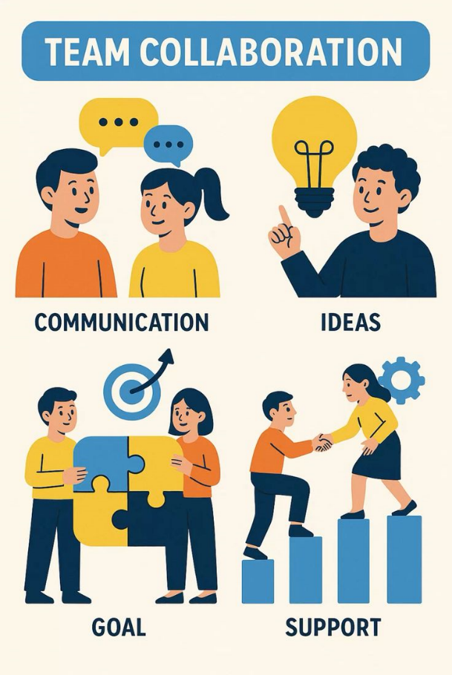
Slide 1: Introduction: Working in Teams
Togetherness is a way of operation in teamwork
People have their own set of skills and responsibilities
Having a team can help to deliver quality patient care
Teamwork enhances communication and trust
An effective skill in health and social care.
This presentation explains why teamwork matters
(Meneses-La-Riva et al. 2025)
Notes:
In teams, different professionals in the healthcare field use their skills collectively to reach the same objective. All team members play an important role. Increased patient safety and quality care due to improved communication, trust, and teamwork. According to Meneses-La-Riva et al. (2025), teamwork includes supporting a working environment where groups manage strong performance in the services. It is one of the most crucial skills for all health and social care professionals.
Teamwork skills will also help to enhance my professional growth as they will assist me to communicate and be confident in my work, as well as create an effective work team with the various disciplines in my future career path in health.

Slide 5
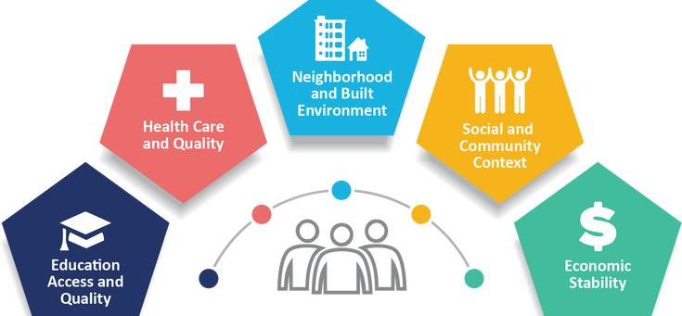
Slide 2: Importance of teamwork in Health and Social Care
Improves patient safety
Enables employees to express themselves clearly
Reduces mistakes in care
Supports faster decision-making
Creates a positive workplace
Increases patient satisfaction
(Efthymiou 2024)
Notes:
Teamwork is important due to the need for collaborative effort between staff members and the sharing of information. Effective communication is an effective way of preventing errors and ensuring patient safety. According to Efthymiou (2024), in some ways, doctor-nurse teamwork can affect the overall quality of care received by patients. Caring for patients is improved by collaborative working. Collaboration also develops a friendly environment in the workplace, as employees respect each other and are able to work through their problems better. Through effective working with others, I will keep to be a better professional in my career, develop positive working relationships and be able to provide safer, person centred care which continues throughout my career.

Slide 6
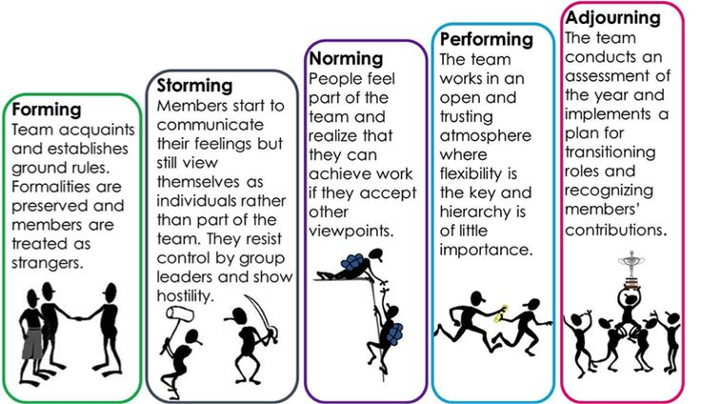
Slide 3: Tuckman's Team Development Model
Forming: Team members get together.
Storming: Different ideas are discussed.
Norming: Team establishes roles
Performing: The team works well together.
Adjourning – Work is completed.
Supports teams to improve the way that they function.
(Tuckman and Jensen, 1977)
Notes:
Tuckman's Model illustrates the development and growth of teams. People meet one another initially. There may be differences in opinions if they do that. According to Vaida and Șerban (2021), with the help of this model, it can be addressed as a requirement for a team vision. They then assign roles and get along because they work better together. Lastly, they achieve success in completing their work. This model can assist others in the healthcare team to grasp how they function.
Tuckman's Model of team development is helpful but assumes the teams will always go through each of the stages. In actual practice the teams can transition within the stages and sometimes more flexible models of the team dynamics can be more appropriate.

Slide 7
Slide 4: Practical Example of Teamwork
(Collin et al., 2025).
An older man was admitted to the hospital.
The doctor examines the patient's condition.
The nurse provides and administers daily care and medication.
Physiotherapist helps with movement.
A social worker makes arrangement for discharge.
Team communicates information for improved care.
Notes:
Think of an older person visiting a hospital. The doctor does the treatment, the nurse gives medicines, the physiotherapist helps with the exercises, and the social worker works on the care planning after discharge. They exchange information and communicate on a regular basis. Established protocols enable them to work in harmony and deliver safe, effective, and patient-centred care. This, I would do by giving my best in communication, give some attention to others, and accept other professionals wisdom. I also acknowledge that I will need to keep becoming more at ease in the process of making connections in a thematic approach.

Slide 8
Slide 5: Conclusion
Work is more effective when done in teams.
Lots of communication is crucial.
All team members are important.
Tuckman's Model is a model to understand teamwork.
Notes:
It is concluded that the ability to work in teams is critical in health and social care. It boosts communication, lowers the risk of errors and offers enhanced care for patients. By understanding Tuckman's Model, we are able to demonstrate an understanding of teamwork. I will further build my healthcare collaborative abilities and will be an accomplished healthcare professional.
I will continue to develop my team working skills in line with professional standards to ensure that I can deliver safe, respectful care throughout my career that is person centred, in line with NHS values and HCPC/NMC codes.

Slide 9
References
Efthymiou, I.P., 2024. The importance of soft skills in healthcare: The impact of communication, empathy, and teamwork on doctor-nurse interactions. International Case Studies Journal, 13(11), pp.6-11.https://www.casestudiesjournal.com/Volume%2013%20Issue%2011%20Paper%202.pdf
Meneses-La-Riva, M.E., Fernández-Bedoya, V.H., Suyo-Vega, J.A., Ocupa-Cabrera, H.G., Grijalva-Salazar, R.V. and Ocupa-Meneses, G.D.D., 2025. Enhancing healthcare efficiency: the relationship between effective communication and teamwork among nurses in Peru. Nursing Reports, 15(2), p.59.https://www.mdpi.com/2039-4403/15/2/59
Vaida, S.E.B.A.S.T.I.A.N. and Șerban, D., 2021. Group development stages. A brief comparative analysis of various models. Studia Universitatis Babeș-Bolyai Psychologia-Paedagogia, 66(1), pp.91-110.https://www.researchgate.net/profile/Sebastian-Vaida/publication/352815932_Group_Development_Stages_A_Brief_Comparative_Analysis_of_Various_Models/links/60dacf91458515d6fbe7adf8/Group-Development-Stages-A-Brief-Comparative-Analysis-of-Various-Models.pdf

Slide 10

ANY QUESTIONS?

