Slide 1
For king, country and community
Memorial Construction and Civic Pride (and Rivalry) in west Wales following the Great War

Slide 2
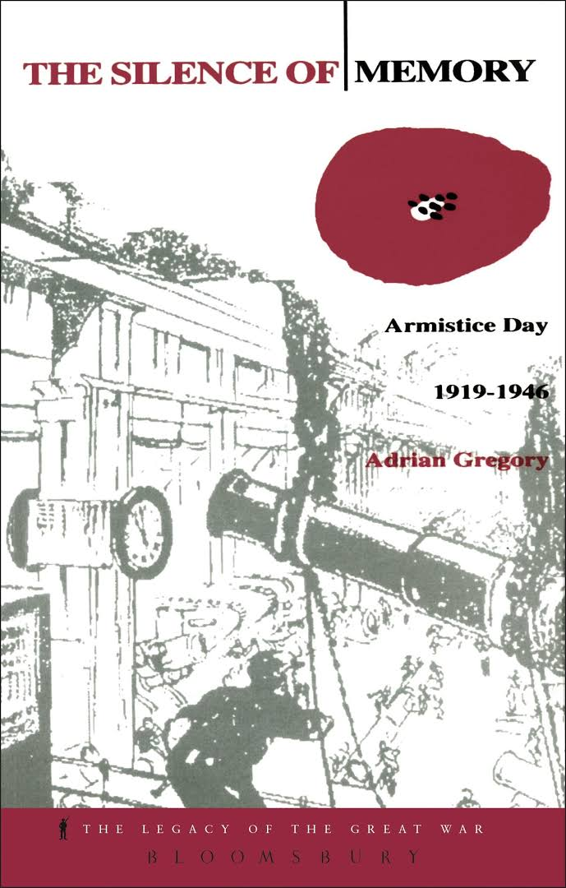
‘Memory of War’
‘memory of war was determined by existing predilections in cultural, political, religious, communitarian rather than the other way around’ Adrian Gregory, ‘The Silence of Memory’, p.5.

Slide 3
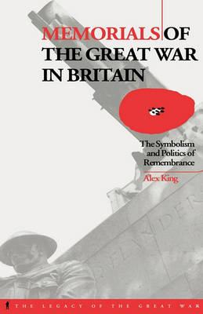
COMMEMORATION
Monument construction ‘relied for its organisation on the institutions of local politics…’
  Alex King, (PhD, University of London, 1993), p.11.
Veterans and bereaved secondary within decision making

Slide 4
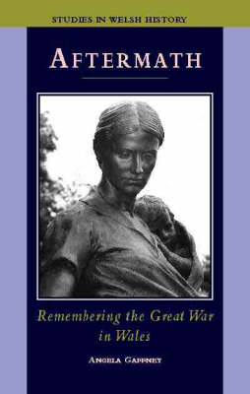
‘Communitas’
‘everyday social hierarchies are, temporarily, put aside and individuals relate to each other as human beings’
Angela Gaffney, ‘Aftermath’ p.114.

Slide 5

LOCAL NEWSPAPERS
RICH SOURCE FOR STUDY OF WAR MEMORIAL PROJECTS from 1919; examples:
CARMARTHEN JOURNAL ;
AMMAN VALLEY CHRONICLE;
PEMBROKESHIRE TELEGRAPH;
LLANELLI MERCURY

Slide 6
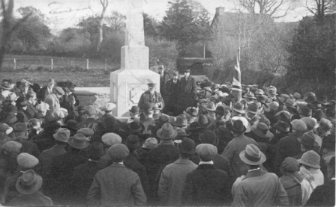
UNVEILINGS
Newspapers hold verbatim accounts of unveiling speeches
Addresses by local dignitaries deemed ‘a safe pair of hands’
Editors willing to include more critical addresses about the war
Pictured: Cellan memorial unveiling

Slide 7
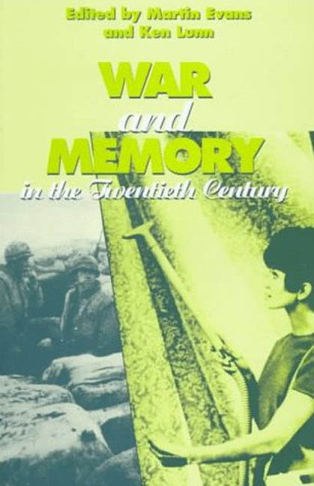
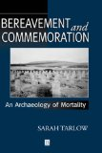
CONTROLLING COMMEMORATION

Slide 8
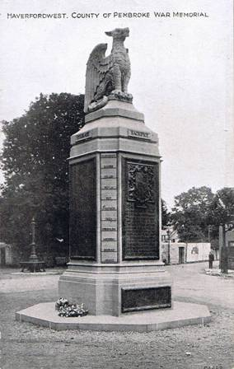
PEMBROKESHIRE COUNTY

Slide 9
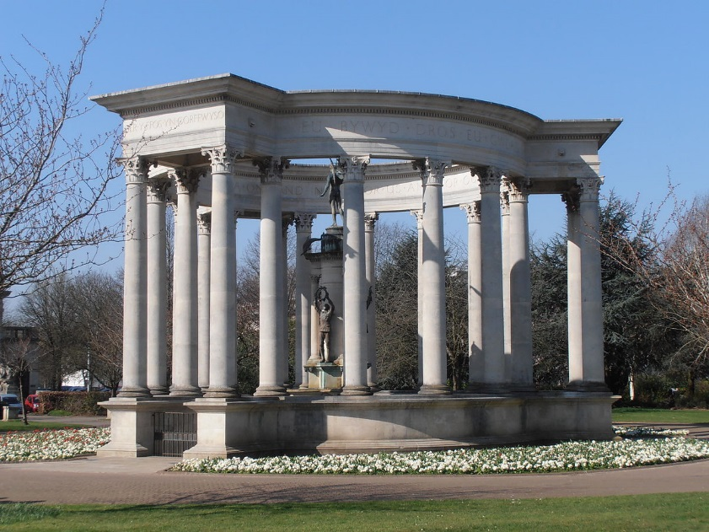
National Memorial

Slide 10
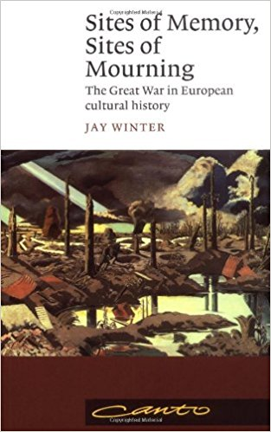
‘a new lease of life…’
The war:
‘gave a new lease of life to a number of traditional languages…’
Jay Winter, Sites of memory, sites of mourning, p.18.

Slide 11
Memorial Hospital funding
Rural Parishes £6481
(at an average of £45 each)
Outside Pembrokeshire £588
Haverfordwest £2933
Fetes held in Haverfordwest £2350
Tenby £273
Newport £191
Pembroke Dock £8. 2. 0d
Pembroke £43
Neyland £250
Fishguard £585
St David’s £171
Narberth £230
Milford £695
Dividends and Interest £2126
Red Cross Grant £12,000
(source: PCG March 1923)

Slide 12
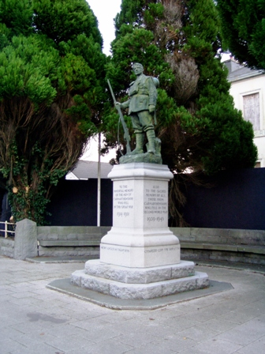
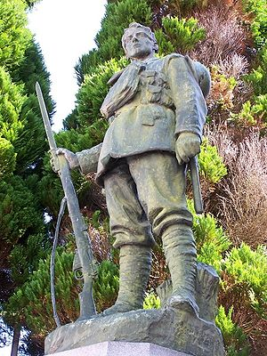
Carmarthenshire County

Slide 13
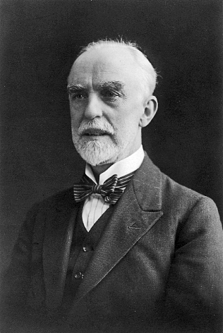
WILLIAM GOSCOMBE JOHN
1860-1952 (CARDIFF-BORN)
STUDIED AT CARDIFF CASTLE UNDER WILLIAM BURGES
ATTENDED THE LAMBETH SCHOOL OF ART AND THE ROYAL ACADEMY
WORKED UNDER RODIN IN PARIS (1890-91)

Slide 14
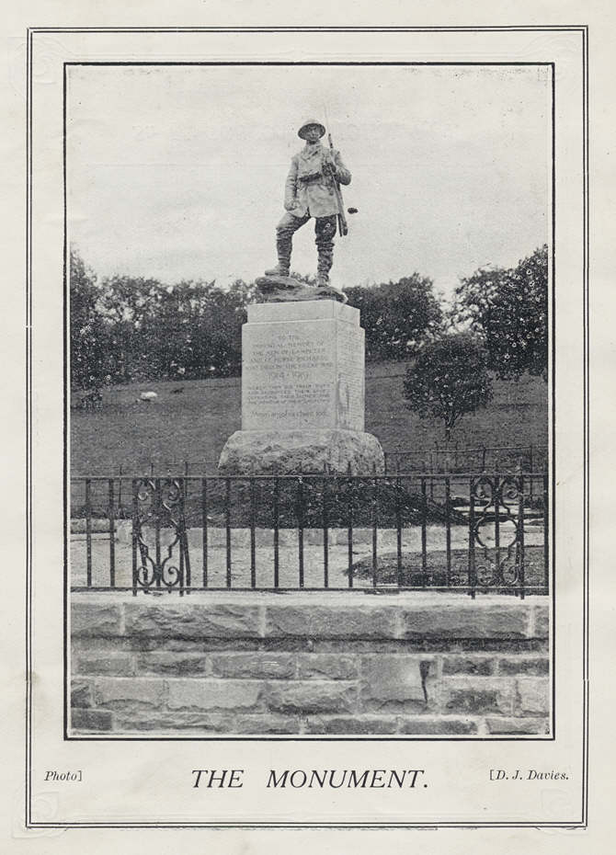

Slide 15
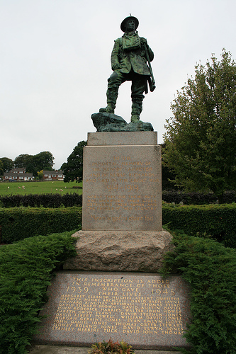
GOSCOMBE JOHN AT LAMPETER

Slide 16
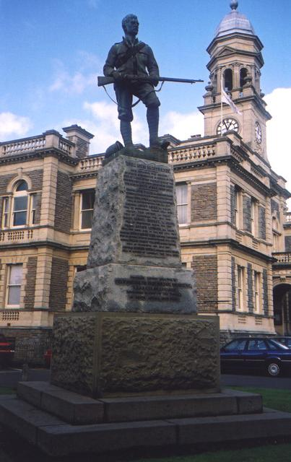
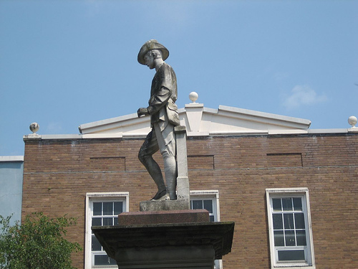
PRECEDENTS
BOER WAR MEMORIAL - LLANELLI
BOER WAR MEMORIAL - CARMARTHEN

Slide 17
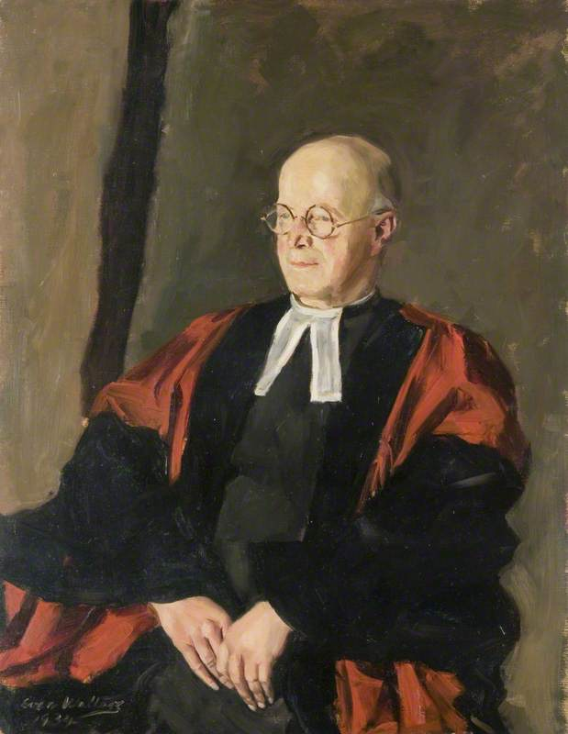
APATHY
REVEREND CANON MAURICE JONES (Principal of St David College):
‘they forget the many sacrifices made for them…’and are ‘beginning to lose sense of its (the war’s) great realities’
(Carmarthen, September 1924)

Slide 18
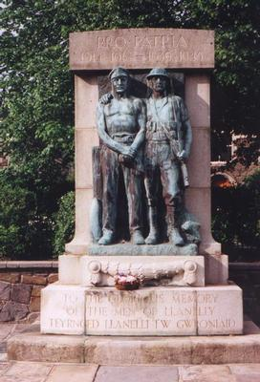
LLANELLI BOROUGH

Slide 19
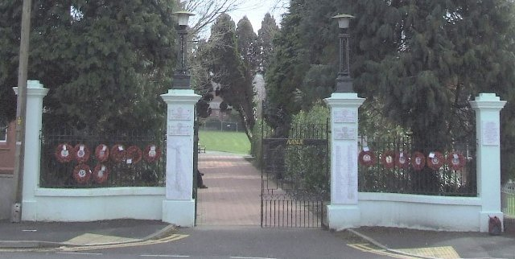
AMMANFORD MEMORIAL GATES

Slide 20
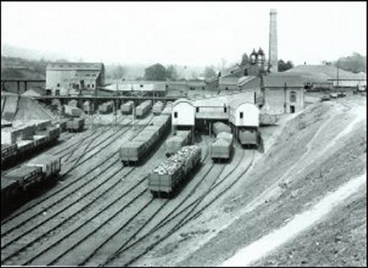
Ammanford No 1 Pit

Slide 21
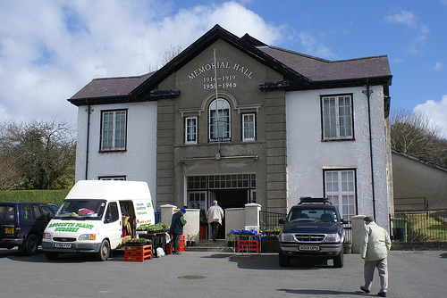
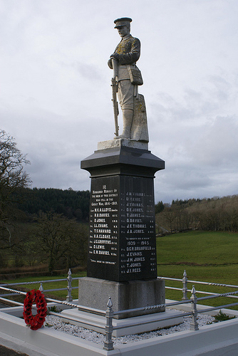
‘ACTIVE’ OR ‘SILENT’?

Slide 22
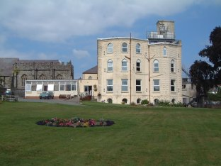
THE ‘ACTIVE’ – CARDIGAN MEMORIAL HOSPITAL
EXISTING BUILDING COST UNDER £5K (WITH RED CROSS HELP)
OFFICIALLY OPENED AUGUST 1922
HAVERFORDWEST COUNTY HOSPITAL IMPROVEMENT COST £20K (£12K FROM THE RED CROSS) AND OPENED IN MAY 1923

Slide 23
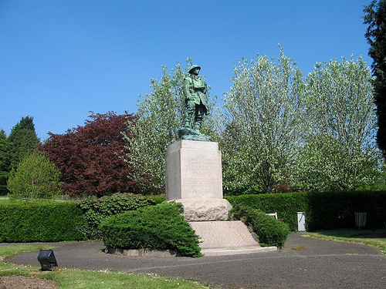


Slide 24
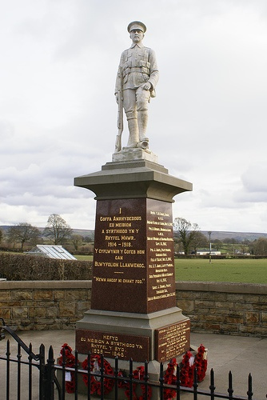
DREFACH – SOLDIER ON GUARD

Slide 25
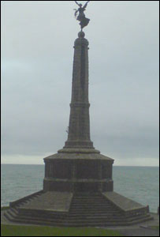
ABERYSTWYTH

Slide 26
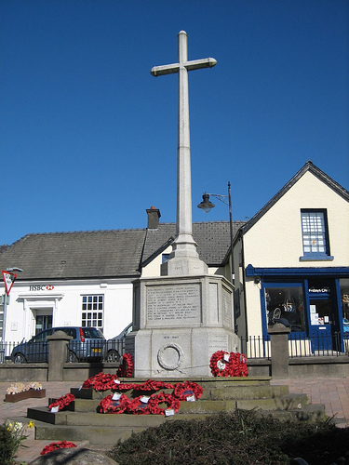
NARBERTH

Slide 27
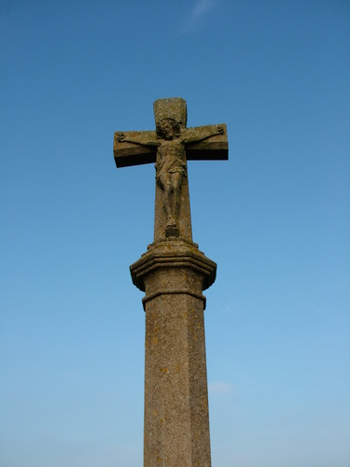
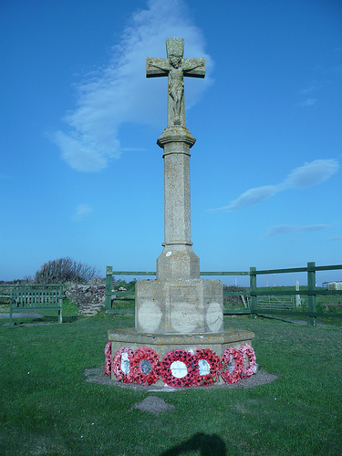
FRESHWATER WEST WAR MEMORIAL

Slide 28
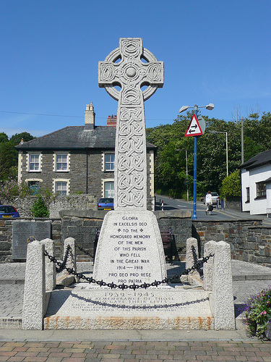
LLANBADARN FAWR CELTIC CROSS

Slide 29
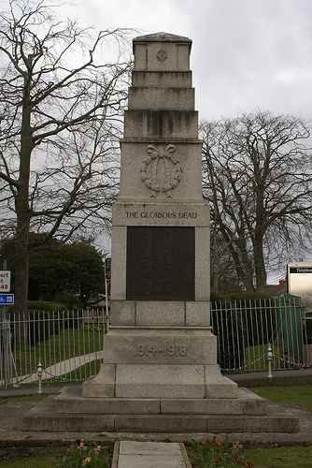
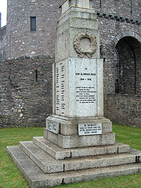
CARDIGAN (LEFT) AND PEMBROKE

Slide 30
Bibliography
Hywel Francis, ‘The Anthracite Strike and Disturbances of 1925’, Llafur, Vol 1, No 2, (1973), pp.15-28.
Adrian Gregory , The Silence of Memory: Armistice Day 1919-1946 (Oxford: Berg, 1994).
Angela Gaffney, Aftermath: Remembering the Great War in Wales (Cardiff: University of Wales Press, 1998).
Alex King, Memorials of the Great War in Britain: The Symbolism and Politics of Remembrance (Oxford: Berg, 1998).
Alex King, ‘The Politics of Meaning in the commemoration of the First World War in Britain 1914-1939’ (PhD, University of London, 1993).
L.J. Mason, ‘Is it nothing to you, all ye who pass by?’ – Commemorating the Great War in Ammanford, 1920-1937, Llafur – Journal of Welsh People’s History, Volume 11, No 1, (December 2012), pp.49-62.
Catherine Moriaty, ‘Private Grief and Public Remembrance’, in M. Evans and K. Lunn, (eds), War Memory in the 20th Century (Oxford: Oxford University Press, 1997), pp.125-39.
Sarah Tarlow, Bereavement and Commemoration: An Archaeology of Mortality (Oxford: Blackwell, 1999).

