Slide 1
DANCE IN CONTEXT
Lecture : German Expressionism, Laban, Wigman
Lecture Content: During this session, you will begin to understand the birth of modern dance in Europe and the context in which it was developing.
You will be encouraged to research aspects of their work, identifying key artistic and aesthetic choices made.
You will further develop your research skills.

Slide 2
Delsarte and Jaques-Dalcroze TEST
Please complete before next week. Typed and referenced.
1. Who were Delsarte and Jaques-Dalcroze? Consider their academic, social and cultural backgrounds.
2. Compare the differences in approaches to movement and how they developed them.
3. How did Delsarte and Jaques-Dalcroze both influenced the development of modern dance?
4. What aspects of their practice did the early modern dance pioneers develop and take further?

Slide 3
GERMAN EXPRESSIONIST DANCE LATE 1910’S TO EARLY 1930’S
Predominant form of dance in the Germany of the Twenties.
Ausdrückstanz” (in German).
Philosophy of life, that explained dance as a metaphysical experience.
Expression of the individual, the individual body and natural movement.
Works would expressed raw feelings, as well as lyrical-mood piece, satire, social and political commentary.
German expressionist dance ended in the 1930’s with Nazi Germany: It was forbidden under the National Socialist regime, and the non-classical direction of dance was designated German dance.
Numerous exponents such as Laban pupil Kurt Jooss, who had founded the department of dance at the Folkwang Academy were driven into exile. Many others fell victim to persecution.

Slide 4
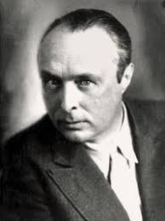
RUDOLF LABAN (1879 - 1958)
Rudolph Laban and his system for analysing and recording movement: Kynetography (Labanotation)
Among the figures that produce the ideological and conceptual basis of modern dance, Rudolf Laban is considered by modern dance history as one of the most important and productive.
Although a choreographer, dancer, teacher and researcher, his name, philosophies and ideas reached beyond his choreographed work, throughout Europe, the United States and the rest of the world.
Laban published several articles and renowned books that are still
important references for dance theory and history:
Choreutics
The Mastery of Movement
Educational Modern Dance

Slide 5
RUDOLF LABAN (1879 - 1958)
Born into noble family, Hungarian/French.
Founded a dance school in Ascona in 1912.
Began making dances during the Weimar Republic years, including movement choirs.
Had two groups in 1928 Tanzbühne Laban and smaller group Kammertanzbühne Laban.
Set up three Dance Congresses in 1927, 1928 and 1930 to further the role of dance and the status of the dancer in Germany.
From 1930 to 1934, he was director of the Allied State Theatres in Berlin,
Germany.
In 1934, he was promoted to director of the Deutsche Tanzbühne,
in Nazi Germany.
Had his work banned in 1936 by the Nazi regime.

Slide 6
RUDOLF LABAN (1879 - 1958)
1937 was permitted to travel to Paris and then went to England where he stayed.
Joined Joosse-Leeder dance school in Dartington Hall.
Taught dance and movement with Lisa Ullmann, his life long partner.
Set up Laban Art of Movement Guild, (which became what is now Trinity Laban) in 1945 and the Art of Movement Studio in Manchester.
His impact on British and world dance is immeasurable.

Slide 7
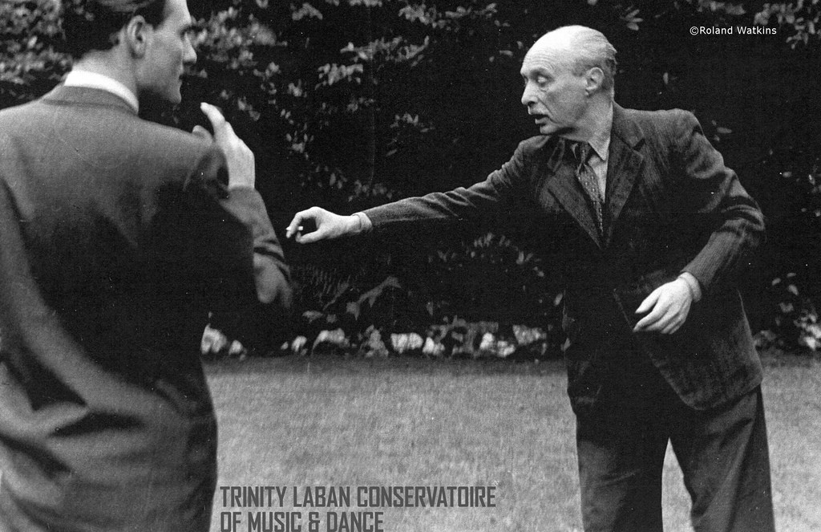
LABAN’S PHILOSOPHIES
Believed that human movement is the “seat of life” and that it expresses the social state of being.
Therefore, dance would be a need of communitarian (relationship between individual and community) experience.
Believed that educating individuals and groups by the means
of movement can correct society.
Expresses the individual sensibilities of single persons;
to create the inner movement as outer movement.
This was the central point of expressionist dance.
Believed that movement involved effort and shape;
patterns of both can indicate physical and mental
harmony/disharmony.

Slide 8
RUDOLF LABAN (1879 - 1958)
His passion was to establish dance as an art of equal standing to other art forms.
It had to establish a medium through its own literacy, hence in his burning desire to find a notation for dance. Without literacy dance would never be taken seriously by the cultural elite.
Influenced by the youth movement and the gymnastics and health movements, he developed a system of natural and harmonious body movement which became the foundation of expressionist dance body-movement.
He spent twenty years understanding movement sufficiently to create signs on paper that could represent body parts moving in space and time dynamically.

Slide 9
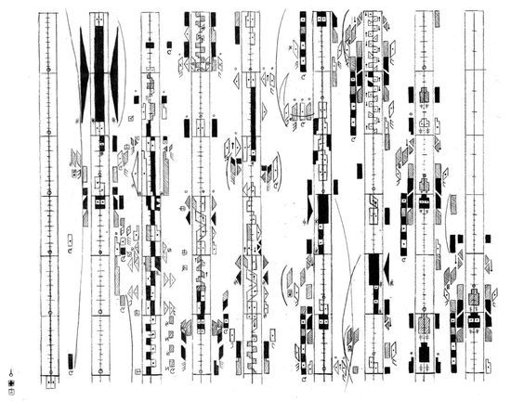
LABANOTATION
His codified system of body parts, in space, in effort and in time.
Classified parts of the body and basic movements.
In order to record his system of movement, Laban invented a symbolic alphabet which was used as kinetography or, in later international developments up until today, known as Labanotation.
Labanotation is the most complete and effective system for analysing and writing movement and a new theoretical
frame for movement shape and quality analysis.

Slide 10
LIFETIME IMPACT OF LABAN
Labanotation is still used today, recognised for being comprehensive, thorough and accurate.
His belief that dance can be an activity for all bodies, not just the favoured few.
Theories and philosophies which most likely led to the development dance science today.
Schools and academics still working with method – research Trinity Laban in London.

Slide 11
MARY WIGMAN (1886 – 1973)
Laban’s pupil, Mary Wigman, was the most famous dancer in Germany from 1919.
Started formal training at 24, three years studying the rhythmic gymnastic system of Jacques-Dalcroze.
Major contributor to the popularity of dance in the Weimar Republic (German state between 1918 and 1933).
She is, after Laban, the first relevant, European, modern dance figure.
As much as Laban, Dalcroze and Delsarte (who are of importance because of their ideological contributions), Wigman developed her own understanding of dance making a significant amount of choreographic works.
Performed predominantly as a solo dancer.
Between 1921 and 1928 had a dance group. She led the largest school of its time for artistic dance.

Slide 12
MARY WIGMAN – DANCE STYLE
She opposed classical dance values and methods, in search for a dance that would accomplish an expressive function of the dancer’s soul.
Interest in the close relationship between spirituality and movement.
Believed that dance was part of life and give life. From this point of view, she recreates the cathartic function attributed to dance in ancient societies.
Her work explored existential human experiences and metaphysical subjects.
Focus was on the body rather than costumes and scenery.
Developed improvisational practice.
Used her own and the body’s rhythms rather than musical accompaniment.

Slide 13
HER WORKS
Wigman’s dance pieces are remembered for their tragic, dark character and are described as introspective dances that reveal vibrant, vital, excited and passionate inner states of being.
For example:
Hexentanz (Witches Dance)
https://www.moma.org/interactives/exhibitions/2012/inventingabstraction/?work=238
Sommersdans (Summer dance)
https://www.youtube.com/watch?v=nV1Q9buVe04

Slide 14
THE INFLUENCE OF MARY WIGMAN
According to modern dance history, she influences the whole German dance trend during the 1920s and 1930s and what follows after the war.
Her ideas are brought to the United States of America by Hanya Holm, who passes the heritage to figures like A. Nikolaïs.
Still, in other countries like France, for example, Wigman heirs are responsible for the respective modern dance trends at the time.
She engages herself into the social and educational mission of the choreographer, by creating several schools and transmitting her artistic legacy. Among her renowned students are Hanya Holm, Harald Kreutzberg, Gret Paluca and Kurt Jooss.
Influences on Martha Graham – compare the Sommerdans of Wigman and Lamentations by Graham.
Traces of influence in the work of Pina Bausch.
Judith Mackrell writes about her influence - https://www.theguardian.com/stage/2013/may/22/mary-wigman-german-modern-dance-pioneer
Wigman interview - https://www.youtube.com/watch?v=y5cXtIE3JB0

Slide 15
FOR NEXT WEEK
Research Wigman’s and Laban’s relationship with the Nazis during the 30’s - for discussion next week
Try: Hitler's dancers: German modern dance and the Third Reich by Lillian Karina and Marion Kent (https://hdl-handle-net.ezproxy.uwtsd.ac.uk/2027/fulcrum.zp38wc98w)

