Slide 1
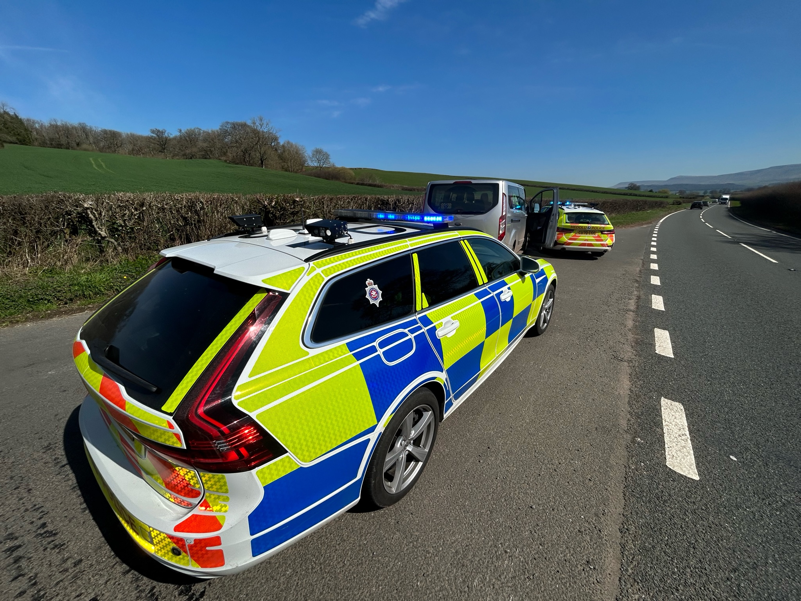
Roads Policing.
15.10.24
9
Careless driving and causing Death by Careless driving (drink or drugs).

Slide 2
By the end of the session, students will be able to:
Identify the offences of:
Careless driving
Death by careless driving whilst under the influence of drink or drugs.

Slide 3
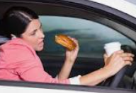
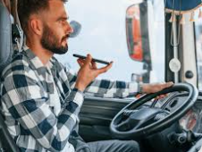
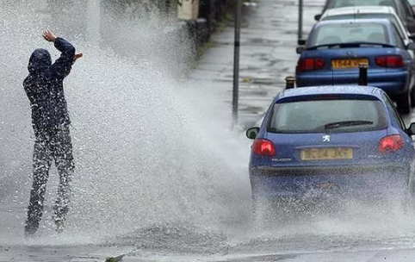
Sec 3. Road Traffic Act 1988
Careless, and inconsiderate, driving.
If a person drives a mechanically propelled vehicle on a road or other public place without due care and attention, or without reasonable consideration for other persons using the road or place, he is guilty of an offence

Slide 4


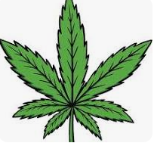

Sec 3(a). Road Traffic Act 1988
Causing death by careless driving when under influence of drink or drugs.
(1)If a person causes the death of another person by driving a mechanically propelled vehicle on a road or other public place without due care and attention, or without reasonable consideration for other persons using the road or place, and—
(a)he is, at the time when he is driving, unfit to drive through drink or drugs, or
(b)he has consumed so much alcohol that the proportion of it in his breath, blood or urine at that time exceeds the prescribed limit, or
(c)he is, within 18 hours after that time, required to provide a specimen in pursuance of section 7 of this Act, but without reasonable excuse fails to provide it,
he is guilty of an offence.
(2)For the purposes of this section a person shall be taken to be unfit to drive at any time when his ability to drive properly is impaired.
(3)Subsection (1)(b) and (c) above shall not apply in relation to a person driving a mechanically propelled vehicle other than a motor vehicle.”

Slide 5
Case exercise 1
John goes for a night out with college and consumes six pints, returns home at midnight.
The following morning, he is running later for his class. It is eight am and he decides to jump into the car and drive, rather than walk the two miles as he usually does to keep fit. On his way in he runs into a pedestrian who later dies from her injuries.
Discuss.

Slide 6
Case exercise 2
Adil, whilst driving to work, suffers from a seizure. He has no previous medical history. During the seizure, he loses consciousness, collides with another vehicle and the occupant of the vehicle dies as a result of their injuries.
Does he commit an offence?
What if he had known about his medical condition prior to this?

Slide 7
Case exercise 3
Candy, suffers from depression and is on medication. They know that the medication makes them feel a little sleepy in the evening after taking it and usually avoid driving, but tonight, they feel fine and have chosen to undertake a long drive during which they have become very sleepy. Their standard of driving drops and they unfortunately drive into a parked car on the side of the motorway, killing the occupant. Do they commit an offence under Sec 3(a). The medication is prescribed to them.

Slide 8
Case exercise 4
Hannah, is eighteen years old, has been driving for one year and is very careful not to drink and drive. Today as it is her eighteenth birthday, she has succumbed to having one glass of wine with her lunch at work. Her boss told her that she could finish early, and she is now driving home when she is stopped by a police officer and asked to provide a sample of breath for analysis. The specimen provided shows that she has 40 microgrammes of alcohol in 100 millilitres of breath. Has she committed any offences and if so, does she have any defence to that offence?

Slide 9
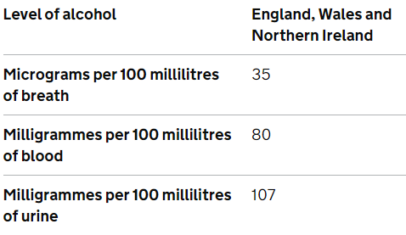
Limits
Table of drugs and limits
‘Illegal’ drugs (‘accidental exposure’ – zero tolerance approach) | Threshold limit in microgrammes per litre of blood (µg/L)
benzoylecgonine | 50µg/L
cocaine | 10µg/L
delta-9-tetrahydrocannabinol (cannabis) | 2µg/L
ketamine | 20µg/L
lysergic acid diethylamide | 1µg/L
methylamphetamine | 10µg/L
Methylenedioxymethamphetamine (MDMA) | 10µg/L
6-monoacetylmorphine (heroin) | 5µg/L
‘Medicinal’ drugs (risk based approach) | Threshold limit in blood
clonazepam | 50µg/L
diazepam | 550µg/L
flunitrazepam | 300µg/L
lorazepam | 100µg/L
methadone | 500µg/L
morphine | 80µg/L
oxazepam | 300µg/L
temazepam | 1,000µg/L

