Slide 1
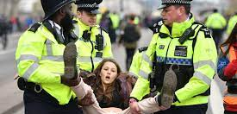
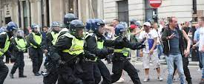

Operational Policing
Public Order Act 1986

Slide 2
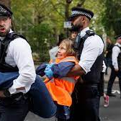
Learning Outcomes : Public Order Act 1986
S1 - Riot
S2 - Violent Disorder
S3 - Affray
S4 - Intentional fear of provocation of violence
S4a - Intentional Harassment, Alarm or Distress
S5 - Disorderly Conduct
Common Law Offence - Breach of the Peace

Slide 3

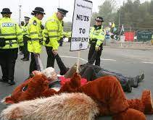
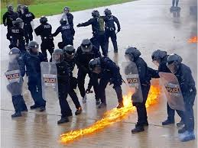

Discuss
What constitutes public order?

Slide 4
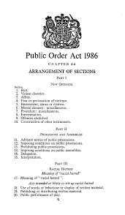
Public Order Act 1986
Deals with a wide range of behaviours and offences in descending order of seriousness.
A public-order crime is a crime which involves acts that interfere with the operations of society and the ability of people to function efficiently…
It is behaviour that has been labelled criminal because it is contrary to shared social values, and customs of people.

Slide 5
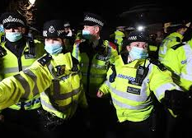
“…Maintaining Public Order…”
Balancing people’s rights and freedoms under the European Convention on Human Rights (ECHR) with public safety.
Consider Human Rights:
Freedom of expression – Article 10 of the European Convention on Human Rights (ECHR) – set out in Schedule 1 of the Human Rights Act 1998
Freedom of assembly and association – Article 11 ECHR – set out in Schedule 1 of the Human Rights Act 1998

Slide 6


“I was drunk!”
Intoxication is not a defence unless it can be proved that:
It was not self induced (spiked drinks)
Caused by taking prescribed medicines

Slide 7
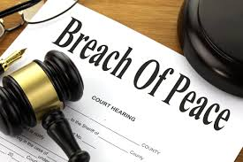
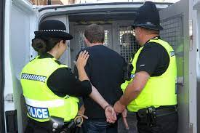

Breach of the Peace
(Common Law)
“BOP!”

Slide 8

Breach of the Peace
An old common law offence
It is "the common sense of the community, crystallised and formulated by our forefathers”…
Everyone is expected to keep the Queen’s Peace
A breach of the peace is not in itself a criminal offence, but the police and any other person have a power of entry and arrest where there are reasonable grounds for believing a breach of the peace is taking place or is imminent.

Slide 9
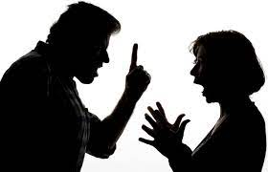
Breach of the Peace
‘A breach of the peace is committed whenever harm is done, or is likely to be done to a person, or
in his presence to his property, or
whenever a person is in fear of being harmed through an assault, affray, riot or other disturbance’
R v Howell 1981
‘…an act done or threatened to be done which either actually harms a person, or in his presence, his property, or is likely to cause such harm being done…’

Slide 10
To be a breach of the peace, the conduct in question does not have to be disorderly.
There can be a breach of the peace whenever and wherever (public/private place)
Harm is actually done, or is threatened to be done to a person, whether by the conduct of the person against whom the BOP is alleged or by someone it provokes.
Harm is actually done, or is threatened to be done to a person’s property in their presence provided that the natural consequences of such harm is likely to be a violent retaliation.

Slide 11
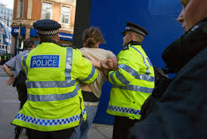
‘Binding Over’ after an arrest for B.O.P
A person may be released by the police without further action when it is deemed that a risk of a breach no longer exists.
The CPS may decide that further action is needed to reduce the risk of further breach of the peace.
The person arrested for BOP will appear before a Magistrate's court which can issue a binding over order.
This can refer to general terms of protection, or it can be more specific by naming people.
The order can require the recipient to keep the peace at a specified time or they will have to pay a financial penalty to the court if brought back before them after subsequent breaches

Slide 12
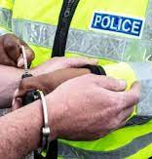
Breach of the Peace
A constable or any other person may arrest without warrant any person when:
  a. BOP is committed in their presence or,
  b. Person making arrest believes BOP will be committed in immediate future
  c. BOP has been committed & it is reasonably believed that a renewal of it is threatened

Slide 13

Case Law - BOP
Criteria for Arrest
-Bibby v Chief Constable of Essex 2000
Domestic Incidents
-McConnell v C.C. 1990
-Mcquade v the Chief Constable of Humberside Police 2001

Slide 14
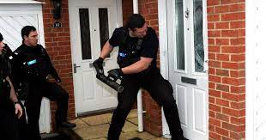
Power to Enter Premises
A police officer may enter & remain on any premises, public or private, to deal with or prevent a BOP
The right of entry is not absolute but it must be weighed against the degree of disturbance which is threatened
An officer must not remain on private premises once the breach has finished (assuming it is not likely to re-occur)

Slide 15
Section 5 Public Order Act 1986
– Disorderly Conduct
A person is guilty of this offence if he or she uses threatening or abusive words or behaviour or disorderly behaviour, or displays any writing sign or visible representation which is threatening or abusive, and this is done in the sight or hearing of a person likely to be caused harassment, alarm or distress.

Slide 16
Section 5 Public Order Act 1986
Uses threatening or abusive words or behaviour
or disorderly behavior within the hearing or sight of a person
likely to be caused harassment, alarm or distress

Slide 17
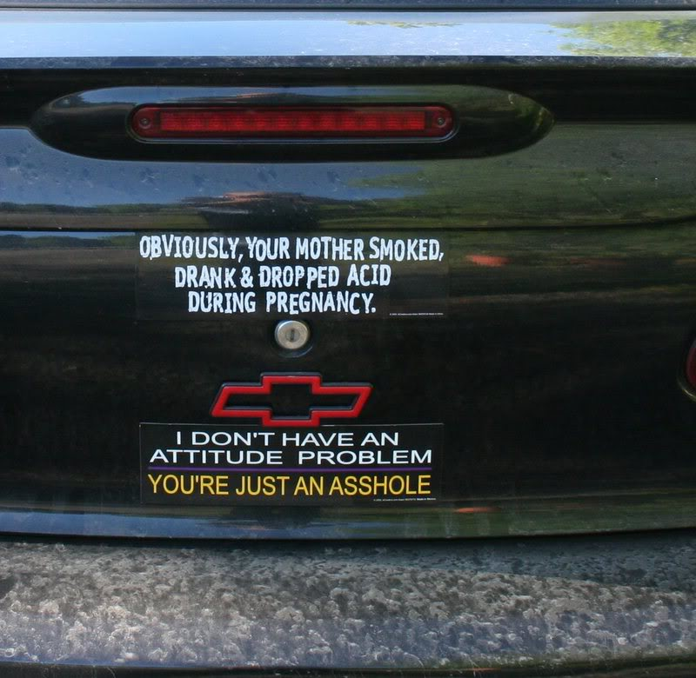
Section 5 POA 1986
Or ..
Displays any writing, sign or other visible representation which is threatening or abusive in the sight of a person likely to be caused harassment, alarm or distress

Slide 18
Key Words
S.5
Threatening includes verbal and physical threats
Abusive means using degrading or reviling language
Harass means to annoy or trouble constantly
Alarm is a sudden fear caused by awareness of danger
Distress means to cause mental pain or to upset badly.

Slide 19
The key features of
Section 5 are:
The conduct does not have to be aimed towards a specific person
The conduct must take place within the presence of a person who can see or hear the conduct , but the person does not need to be identifiable
The type of conduct is likely to cause HAD
Any material used (such as a poster) does not have to be distributed
The suspect must intend or be aware his conduct is threatening or abusive in general terms
There is no need to prove he actually intended to cause any person to be HAD

Slide 20
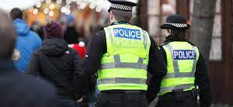
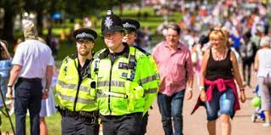
Who cannot be HAD under Section 5?
A Police officer cannot be alarmed or distressed because it was deemed that this sort of low-level behaviour because:-
‘very frequently, words and behaviour with which police officers will be wearily familiar will have little emotional impact on them save that of boredom’.
In other words, the police have heard it all before.
However, if there are members of the public present when the word/behaviour is used against them, that would be enough evidence.

Slide 21

Section 5 POA 1986
This can be committed in public or private
except
Where the words or behavior are used, or the writing, sign or other visible representation is displayed by a person inside a dwelling & the other person is also inside that or another dwelling

Slide 22
Why is it not an offence inside one dwelling?
Have you ever behaved in a disorderly manner at home or had a questionable poster displayed on your bedroom wall?
We would all be liable for arrest for just having a private argument.
Private in this instance means places such as factory premises, clubs or college premises, anywhere where a specific class or group of people only have access.
Public means anywhere the general public have access whether on payment or not, e.g. football grounds, car parks and shopping precincts.

Slide 23
Defences to Section 5
Could not be heard
Inside a dwelling
Reasonable conduct

Slide 24
Section 4A POA 1986
- Causing Intentional Harassment, Alarm or Distress.
A person is guilty of an offence, if with intent to cause a person harassment, alarm or distress, he:
uses threatening, abusive or insulting words or behaviour or disorderly behaviour OR
displays any writing, sign or other visible representation which is threatening, abusive or insulting
thereby causing that or another person harassment, alarm or distress
It is aimed at supporting the most vulnerable members of the community who may be specifically targeted because of their inability to respond appropriately to intentionally directed acts which cause them H.A.D.

Slide 25
Section 4A POA 1986
‘Intent’ has been brought into the definition…
Key features:
The suspect intends the conduct to be threatening, abusive or insulting and to cause a person harassment alarm or distress
The conduct does not have to be aimed towards a specific person
At least one identifiable person must be harassed, alarmed or distressed and

Slide 26
Section 4A POA 1986
This offence can be committed in public or private
except
Where the words or behavior are used, or the writing, sign or other visible representation is displayed by a person inside a dwelling & the other person is also inside that or another dwelling

Slide 27

Section 4A POA 1986
In order to prove this offence, you must be able to show that….…
The defendant intended to cause harassment, alarm or distress or was aware that they might,
AND
must cause someone to be HAD

Slide 28
Defences to Section 4A
Inside a dwelling
They had no reason to believe his words, behaviour or conduct inside a dwelling could be seen or heard by a person anywhere outside…
Reasonable Conduct
Their conduct was reasonable…
Although the offence can be committed on private premises, there is no specific Power of Entry & officers should consider Breach of the Peace powers.
Notes:
.

Slide 29
Points to Prove
S5 POA 1986
Public place (or private but not between 2 dwellings)
Display/use threatening or abusive words
Behaviour: disorderly behavior
Within sight/hearing of person likely to be caused H.A.D
S4A POA 1986
Public place (or private but not between 2 dwellings)
Display/use threatening or abusive words or insulting words
Behaviour: disorderly behaviour
Intention to cause that or another person H.A.D
Causes someone H.A.D (must have a complainant)

Slide 30
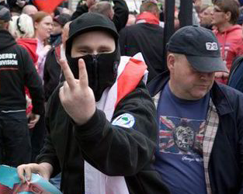
Section 4 Public Order Act 1986
- Fear of Provocation of Violence
Uses towards another person threatening, abusive or insulting words or behavior OR
Distributes or displays to another person any writing, sign or other visible representation which is threatening, abusive or insulting
with intent to cause……..
Notes:
Examples of the type of conduct that might provide evidence for this offence are:
threats made or abuse directed towards individuals carrying out public service duties or jobs, such as ambulance workers, fire fighters or bus or train drivers;
the throwing of missiles by a person taking part in a demonstration or other public gathering where no injury is caused;
scuffles or incidents of minor violence or threats of violence committed in the context of a brawl (such as in or in the vicinity of a public house);
incidents between neighbours or within domestic relationships which do not justify a charge of assault;
incidents which do not justify a charge of assault where an individual is picked on by a gang
Triable summarily offence penalty 6 months imprisonment and/or fine.
This offence can be racially aggravated

Slide 31
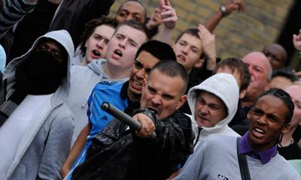
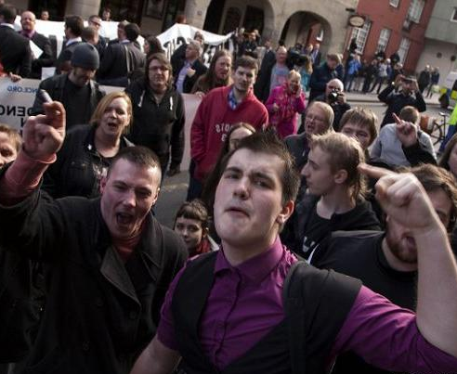
Section 4 POA 1986 – Fear of Provocation of Violence
…that person to believe that immediate unlawful violence will be used against him or another by any person OR
to provoke the immediate use of unlawful violence by that person or another OR
whereby that person is likely to believe that such violence will be used or it is likely that such violence will be provoked

Slide 32
Section 4 POA 1986 – Fear of Provocation of Violence
This offence can be committed in public or private except
where the words or behaviour are used or the writing, sign or other visible representation is displayed by a person inside a dwelling & the other person is also inside that or another dwelling
There is a power of entry to premises under S17 of PACE in order to arrest

Slide 33
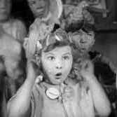


The difference between
S. 5, 4a, and 4 explained….

Slide 34
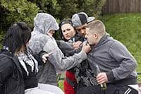
Section 3 POA 1986 ‘Affray’
A person is guilty of affray if he uses or threatens unlawful violence towards another &
His conduct is such as would cause a person of reasonable firmness present at the scene to fear for his personal safety
The threat of violence needs to be capable of upsetting others. The primary objective of the law is to protect the general public around the affray and therefore the court will consider a hypothetical person of reasonable firmness who witnessed the incident would feel.

Slide 35
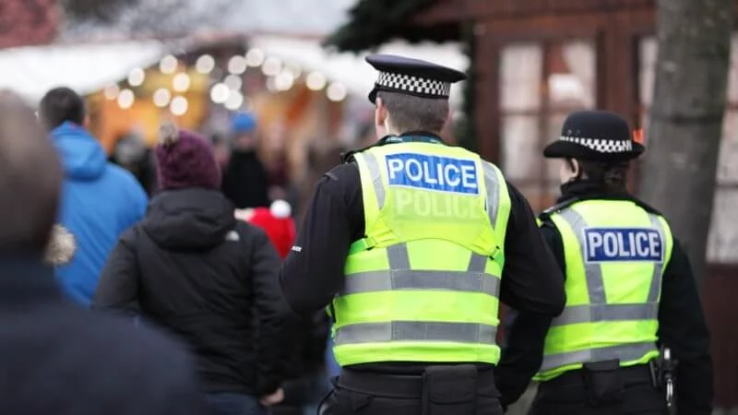
There are 3 parties involved in an Affray
1. The individual making the threats
(A threat cannot be made by words alone, he must intend to use or to threaten violence , or be aware that his conduct may be violent or threaten violence. E.g. shouting ‘I’m coming to get you!’ whilst brandishing a weapon or even shaking a fist)
2. The person subject of the threats who must be present,
(A person has to be physically present. The threat must be directed towards a person and this does not include property)
3.At least one bystander (person of reasonable firmness)
The bystander does not need to fear for their own personal safety e.g. police officers in riot gear with shields who are being bombarded with missiles may not be frightened , but a court can consider if a hypothetical person of reasonable firmness may fear for their safety
Notes:
This offence can be committed in private and public - therefore it can be committed in a dwelling.

Slide 36
There are 3 parties involved in an Affray…
This offence can be committed in private and public - therefore it can be committed in a dwelling.
The purpose of the offence of affray is to prevent incidents of public disorder. If an individual is simply threatening another and no-one else is involved or likely to be worried by the incident, then other offences such as common assault etc. exist to deal with the situation. For an affray, the threat of violence needs to be capable of affecting others.

Slide 37
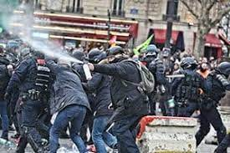
Section 2 POA 1986 ‘Violent Disorder’
Where 3 or more persons who are present together use or threatens unlawful violence
And the conduct of them (taken together)
is such as would cause a person of reasonable firmness present at the scene to fear for their personal safety

Slide 38
Section 2 POA 1986 ‘Violent Disorder’
It is immaterial whether or not the 3 or more use or threaten unlawful violence simultaneously. Three or more persons" means that as long as 3 or more persons can be proved to have been present together and using violence, even if intent can only be proved against 1 person, then that person can be convicted.

Slide 39
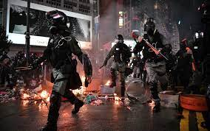
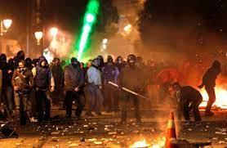
Section 1 POA 1986 ‘Riot’
Where 12 or more persons who are present together use or threatens unlawful violence for a common purpose
And the conduct of them (taken together)
is such as would cause a person of reasonable firmness present at the scene to fear for their personal safety

Slide 40
Section 1 POA 1986 ‘Riot’
It is immaterial whether or not the 12 or more use or threaten unlawful violence simultaneously.
The common purpose may be inferred from conduct.
No person of reasonable firmness need actually be, or likely to be, present at the scene.
Riot may be committed in private as well as in public places.
Indictment: maximum 10 years imprisonment and/or fine

Slide 41
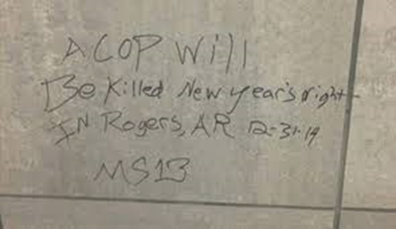
S16 Offences Against the Persons Act 1861….
Threats to Kill!
A person who without lawful excuse makes to another a threat, intending that the other would fear it would be carried out, to kill that other or a third person shall be guilty of an offence.

Slide 42

In which of the following cases will a Police Officer have a power to arrest for breach of the peace?
He has reasonable suspicion that a breach of the peace has been committed.
(ii) A breach of the peace has been committed in the Officer's presence.
(iii) He believes that a breach of the peace will be committed in the immediate future.
(a) All
(b) (i) and (ii) only
(c) (ii) and (iii)
(d) (ii) only
Notes:
(c) (ii) and (iii)

Slide 43
A person is guilty of an offence of Section 5 POA 1986, if they:
(a) use threatening or abusive words or behaviour, or disorderly behaviour, or
display any writing, sign or other visible representation which is threatening, or
abusive within the sight or hearing of a person likely to be caused
harassment, alarm or distress thereby.
(b) use abusive words or behaviour, or disorderly behaviour, or display any writing,
sign or other visible representation which is threatening, or abusive within the
sight or hearing of a person likely to be caused harassment, alarm or distress thereby.
(c) use threatening or abusive words or behaviour, or display any writing,
sign or other visible representation Within the sight or hearing of a person likely
to be caused harassment, alarm or distress thereby.
(d) use disorderly behaviour, or which is threatening, or abusive within the sight or hearing of a person likely to be caused alarm or distress thereby.
Notes:
(a) use threatening or abusive words or behaviour, or disorderly behaviour, or display any writing, sign or other visible representation which is threatening,
abusive or insulting within the sight or hearing of a person likely to be caused harassment, alarm or distress thereby.

Slide 44
REARDON places posters of a racist nature in the front window of his house, which is situated in a private road. The house is not overlooked and is in a secluded area of the road. In relation to Section 4a of the Public Order Act 1986, what statements (on this information alone) would be true?
(a) At least one person would have to be caused alarm, harassment or distress as a result of the threatening, abusive or insulting nature of the posters
(b) It doesn’t matter whether anyone is caused alarm, harassment or distress, only that REARDON intends this
(c) A constable could arrest REARDON if he was found committing this offence but only after he failed to remove the posters after being first warned
(d) No offence has been committed, a private road is not a public place
Notes:
(a) At least one person would have to be caused alarm, harassment or distress as a result of the threatening, abusive or insulting nature of the posters

Slide 45
Under Common Law, who may make an arrest for a breach of the peace and where may they make it?
A. Only a Police Officer may arrest for a breach of the peace and only in a public place
B. Only a Police Officer may arrest for a breach of the peace, either in a public or private place
C. Any person may arrest for a breach of the peace but only in a public place
D. Any person may arrest for a breach of the peace, either in a public or private place
Notes:
D. Any person may arrest for a breach of the peace, either in a public or private place

Slide 46
You are called to a neighbour dispute and on arrival in the street see QUENTIN walking up and down the pavement carrying a poster stating that his neighbour DAWSON is a child molester.
What has to be proved for QUENTIN to commit the offence of causing intentional harassment, alarm or distress under Sec 4A Public Order Act 1986?
A. That he intended to cause DAWSON harassment, alarm or distress
B. That DAWSON was actually caused harassment, alarm or distress whether QUENTIN intended it or not
C. That he intended to cause harassment, alarm or distress and DAWSON was actually caused it
D. That DAWSON was not actually caused harassment, alarm or distress although QUENTIN intended this or was reckless as to whether harassment, alarm or distress was caused.
Notes:
C. That he intended to cause alarm, harassment & distress & DAWSON was actually caused it.

Slide 47
SPARROW uses threatening language towards DIXON with the intention of causing him to fear unlawful violence. DIXON is not threatened by this behaviour. DIXON is in a dwelling and SPARROW wishes to enter.
In relation to Section 4 of the Public Order Act 1986, which of the following is correct?
A.SPARROW has committed the offence regardless of whether DIXON feels threatened.
B.SPARROW has committed the offence, but only if someone else witnesses the behaviour.
C.SPARROW has not committed the offence, because DIXON was not actually threatened.
D.SPARROW has not committed the offence, because DIXON was inside the dwelling.
Notes:
A. SPARROW has committed the offence regardless of whether DIXON feels threatened.

