Slide 1
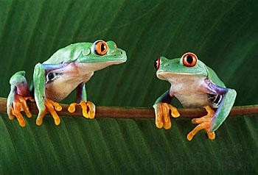
BSc (Hon) Environment, Sustainability and Climate Change
ACNA6005: Sustainable Urban Communities
Do you think it will
affect us?

Slide 2
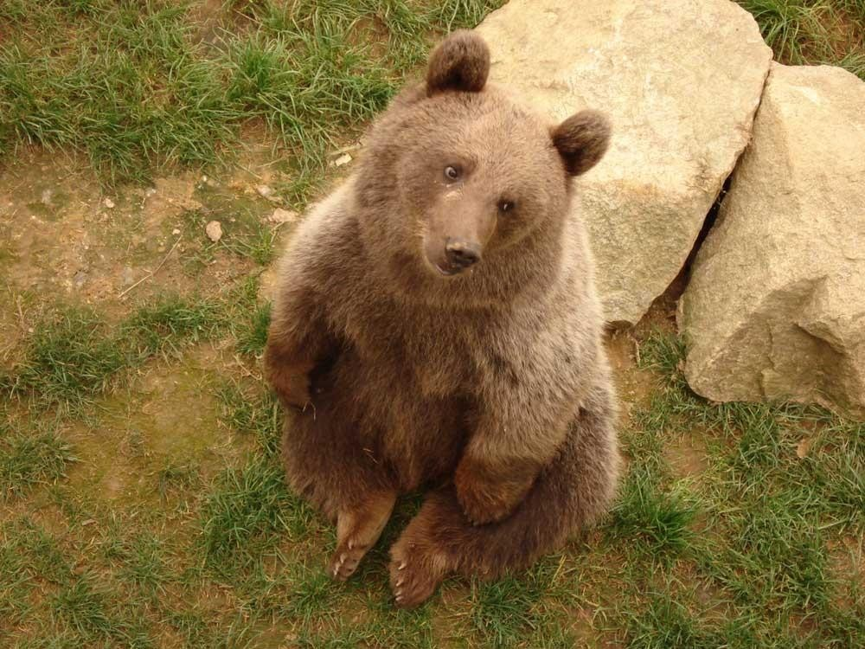
Sustainable Urban Communities
Module Aim:
To foster earlier work incorporating sustainable development and strengthen the case for mainstreaming resilience, building cities that are inclusive, low carbon, productive and more equal.

Slide 3
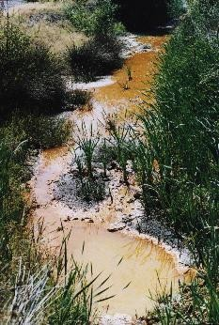
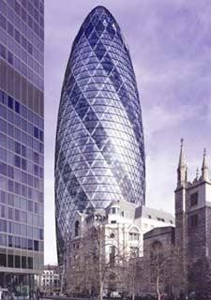
Learning Outcomes
Critically evaluate key factors influencing urban development strategies and compliance with the Sustainable Development Goal (SDG) 11 and Wellbeing of Future Generations Act 2015.
.
Compare and contrast principal issues and needs applicable to both rural and urban sustainable development locally, regionally and globally.
Synthesise strategies applicable to sustainable development, which apply urban planning, risk management and geospatial infrastructure.

Slide 4
Assessment methods
Assignment – 50%
Written assignment plus seminar presentation
2000 words + 15 min defence
Brief
Exam – 50%
2-hour exam
Answer all of section A
Select 1 question in section B
Staged during exam period in May 2027
Date TBC

Slide 5
Module delivery – term 1
Date | Topic area
28 September 2026 | Intro / principles & concepts
05 October 2026 | SD Strategy
12 October 2026 | UWTSD travel survey details (with DP)
19 October 2026 | FIELDWORK WEEK – NO LECTURES
26 October 2026 | SD Strategy continued
02 November 2026 | SD Indicators
09 November 2026 | SD Indicators continued
16 November 2026 | GROUP ACTIVITY WEEK
23 November 2026 | SDGs (including self-led work)
30 November 2026 | SDG11
09 December 2026 | Sustainable Cities
Please note, the above is subject to change – you will be advised each week

Slide 6
What does Sustainable Development mean to you?
What are its key elements?
Can you name any examples of Sustainable Development?

Slide 7
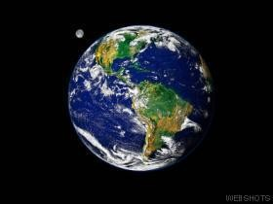
Sustainable Development
Concepts and Principles
5

Slide 8
General definitions
Some definitions of sustainability
…the capacity of system to maintain output at a level approximately equal to or greater than its historical average, with the approximation determined by the historical level of variability.
Lynam and Herdt (1989)
…maximising the net benefits of economic development, subject to maintaining the services and quality of natural resources over time.
Pearce and Turner (1990)
6

Slide 9
"Sustainable development is development that meets the needs of the present, without compromising the ability of future generations to meet their own needs."

Slide 10
Basic principle…
Balance different, and often competing needs
Environment
Society
Economy

Slide 11
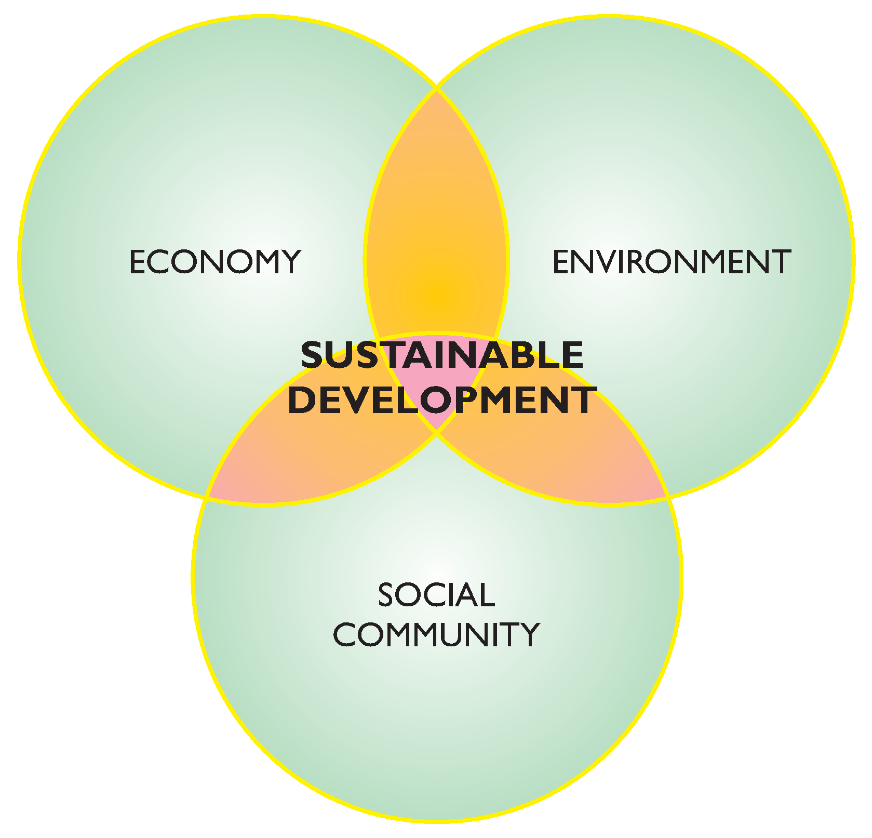

Slide 12
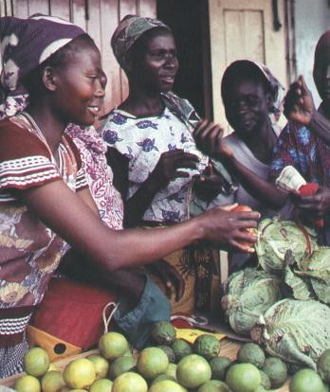
International development
What is development?
Global development
Human development
Development is about enlarging
people’s choices
7

Slide 13
… development that improves the quality of human life while living within the carrying capacity of supported ecosystems. IUCN (1991)
Sustainable Development
…development that meets the needs of current generations without compromising the ability of future generations to meet their own needs. WCED (1987)
How would you define SD?

Slide 14
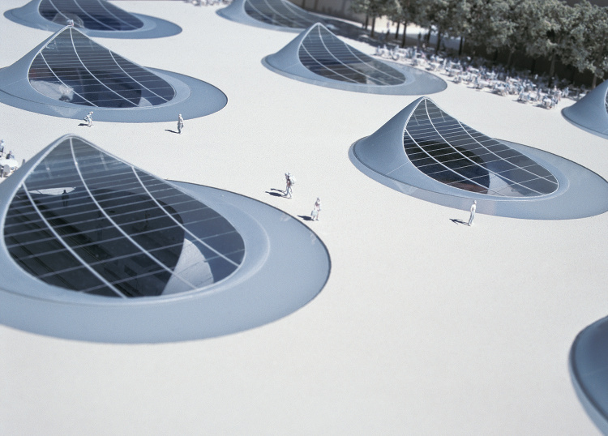
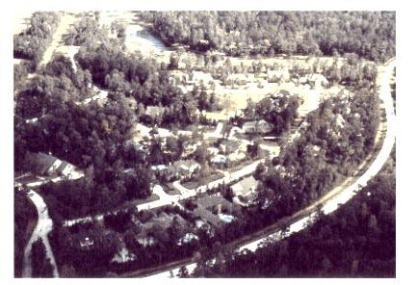
Sustainable
development
Integrating the natural with the built environment

Slide 15
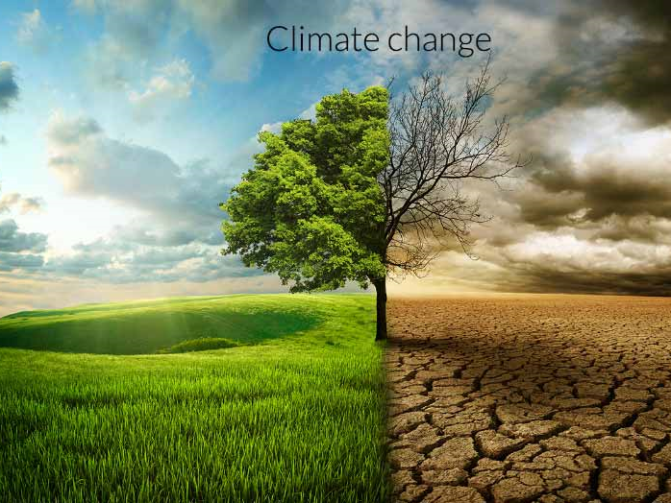
Is it all about the environment?

Slide 16
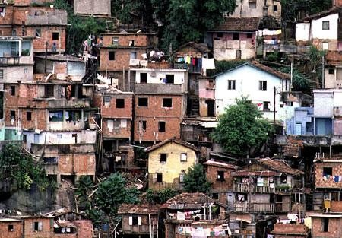
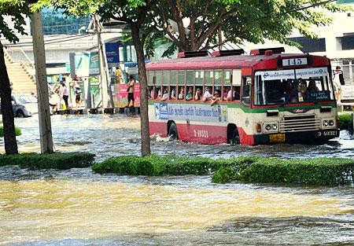
i.e., demands placed on the environment by people and commerce can be met without reducing the capacity of the environment to provide for future generations
Sustainability is often considered by some to be an economic state.
In simple terms; leave the world better than you found it, take no more than you need, try not to harm life or the environment, make amends if you do...
Picture source: United Nations

Slide 17
Economics depends on the natural environment to provide resources and ecosystem services
Natural Environment Economics
Products
Energy
Raw materials
Production
Consumption
Ecosystem Services
Money
Materials, Waste Heat

Slide 18
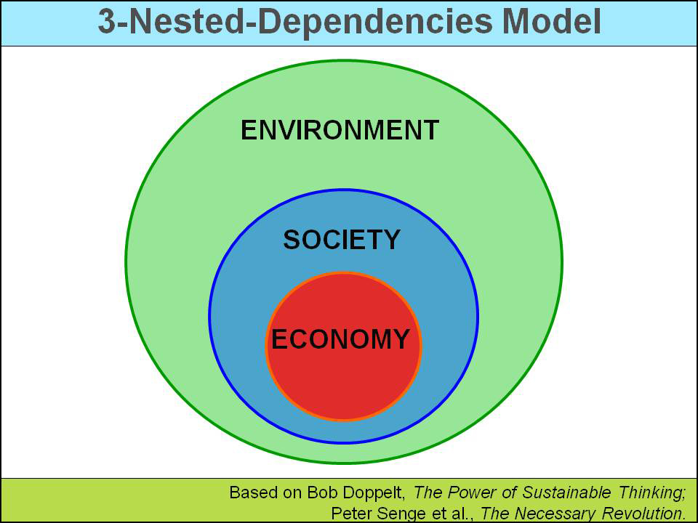

Slide 19
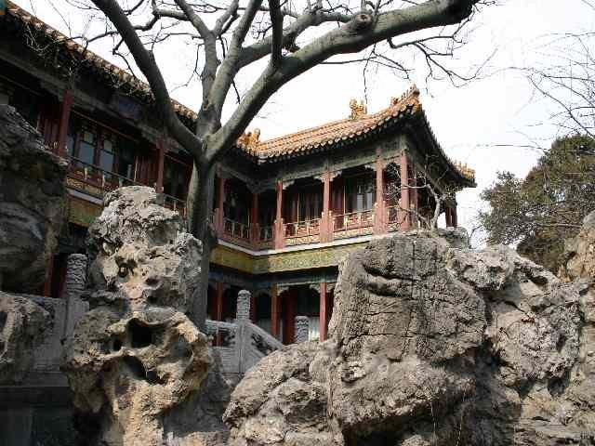
Carrying capacity of an ecosystem
…is the maximum number of individuals of a given species that the ecosystem can support indefinitely.
Two factors are important:
Resource availability
Quantity of resources that individuals of
that species require.

Slide 20
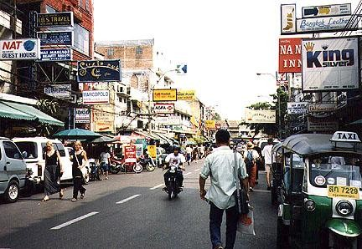
In Europe the concept of ‘environmental space’ was conceived:
‘reflects that at any given point in time, there
are limits to the amount of environmental pressure that the Earth’s
ecosystems can handle without irreversible damage to these systems or to the life support processes that they enable’
European Environment Agency
EEA

Slide 21
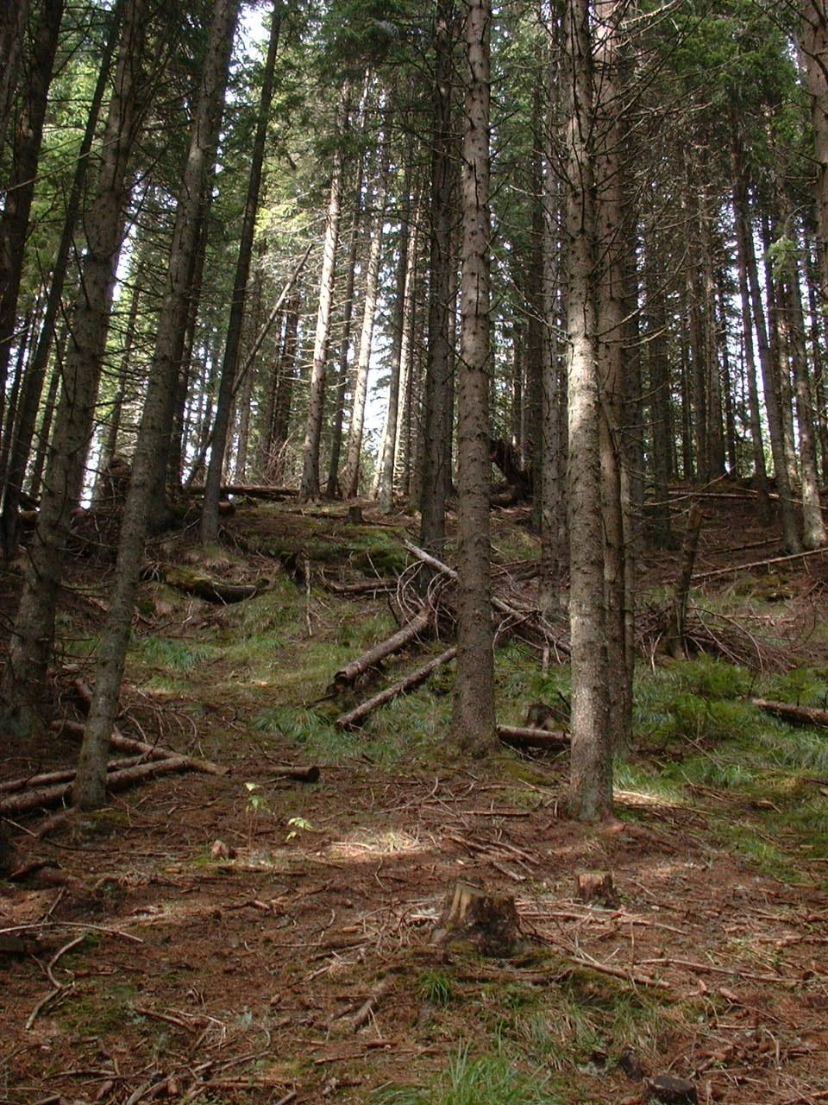
Such services provided by the Earth’s ecosystems, and for
which there is limited space include:
‘
Stocks’ of renewable, semi-renewable and non-renewable resources.
Sinks’ capacities to absorb waste, pollution and encroachment.
Sustainability then, is intended to include ‘global equity’!

Slide 22
Does it make sense then, that;
…nature cannot sustain a systematic concentration of substances extracted from the earth’s crust, such as fossil fuels?
…nature cannot sustain a systematic increase in unnatural persistent substances, such as polychlorinated biphenyls (PCBs) and chlorofluorocarbons (CFCs)?
…the physical basis for the productivity and diversity not be systematically deteriorated beyond nature’s ability to replenish itself, i.e. by overfishing, deforesting and depleting and destroying arable lands?

Slide 23
What then, about industry and commerce?
Although business may be the cause of many
environmental problems, the abilities and creativity of business means that it will also play a key role in generating workable technical and economic solutions to many environmental challenges.
Also, the environment ‘business’ is in itself an important part of the whole business world, and many commercial opportunities will arise from conservation and environmental constraints, for example, in developing ‘environmentally friendly’ goods and or services.

Slide 24
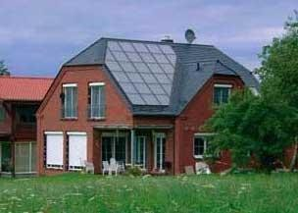
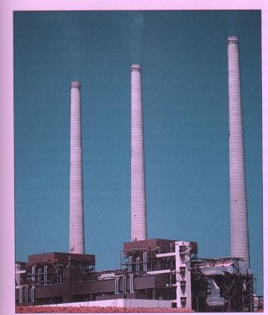
Sustainable development??
Unsustainable development! coal-burning power plant which
emits sulphur dioxide (SO₂)

Slide 25
Is the focus on the future?
Do we lose out now?
Not necessarily…
It’s about finding better ways of doing things, for the present AND the future
Existing Quality of Life does not need to be compromised…
If anything, it should improve across the board…

Slide 26
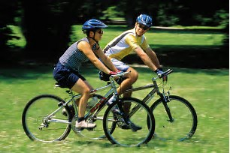
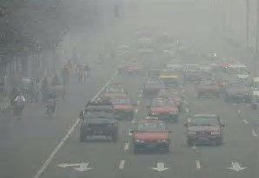
Positive effects
SD can bring benefits in the short & medium term:

Slide 27
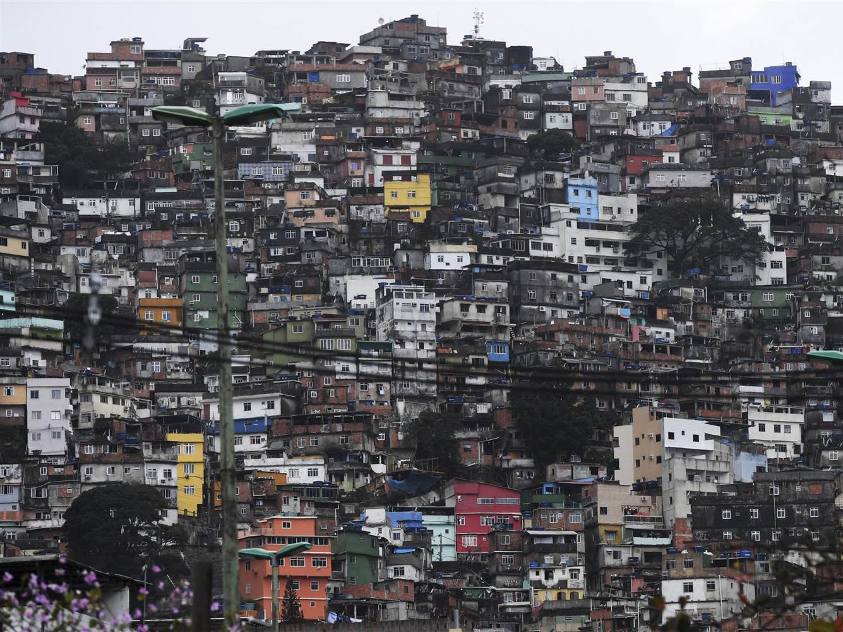

Slide 28
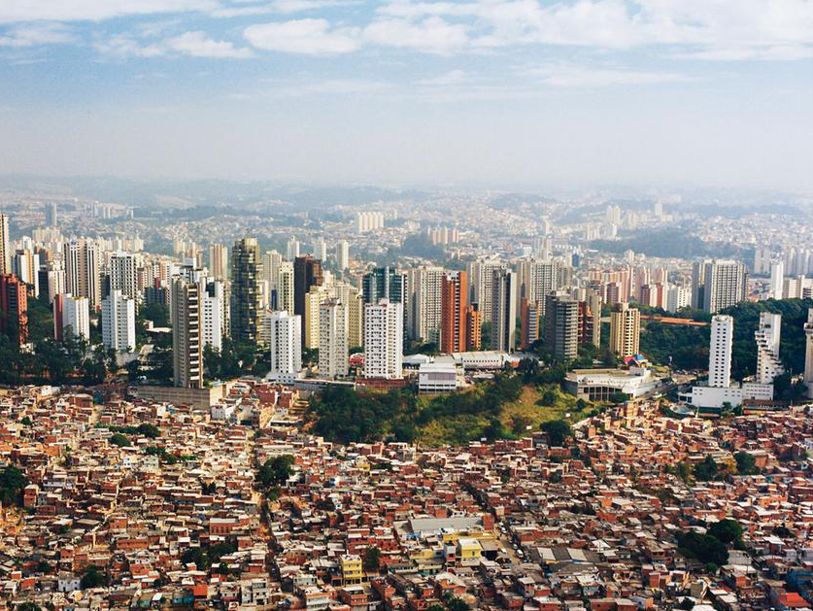

Slide 29
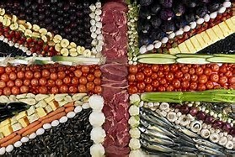
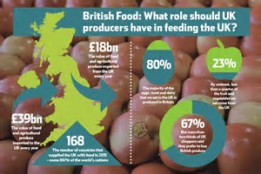
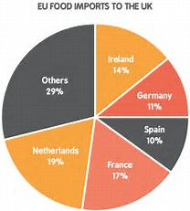

Slide 30
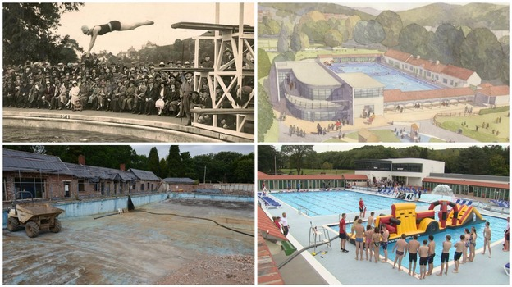

Making better decisions…
Sustainable Development provides the ability to make better decisions on a wide range of issues

Slide 31
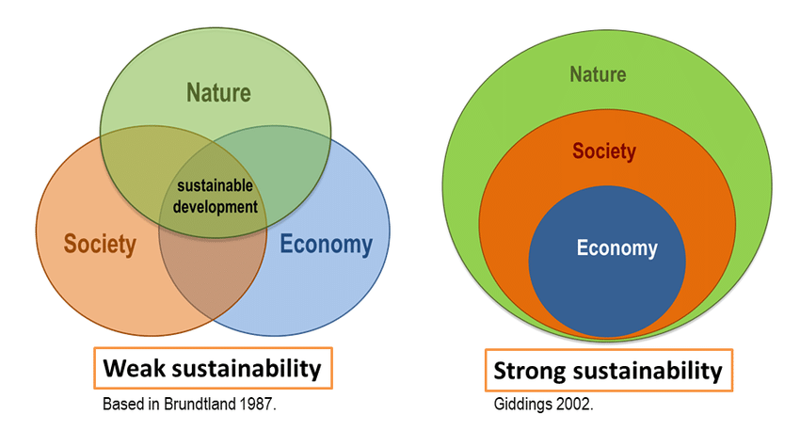
Weak and strong sustainability

Slide 32
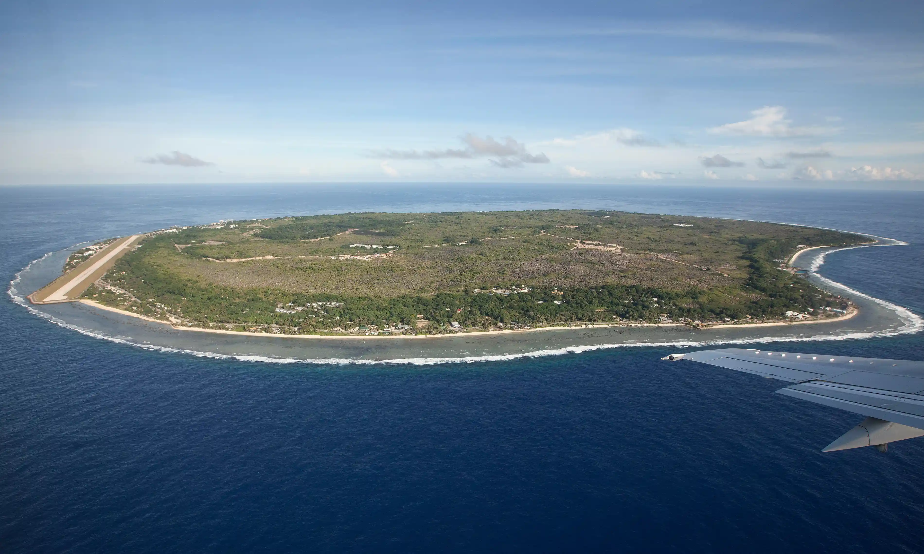
Nauru

Slide 33
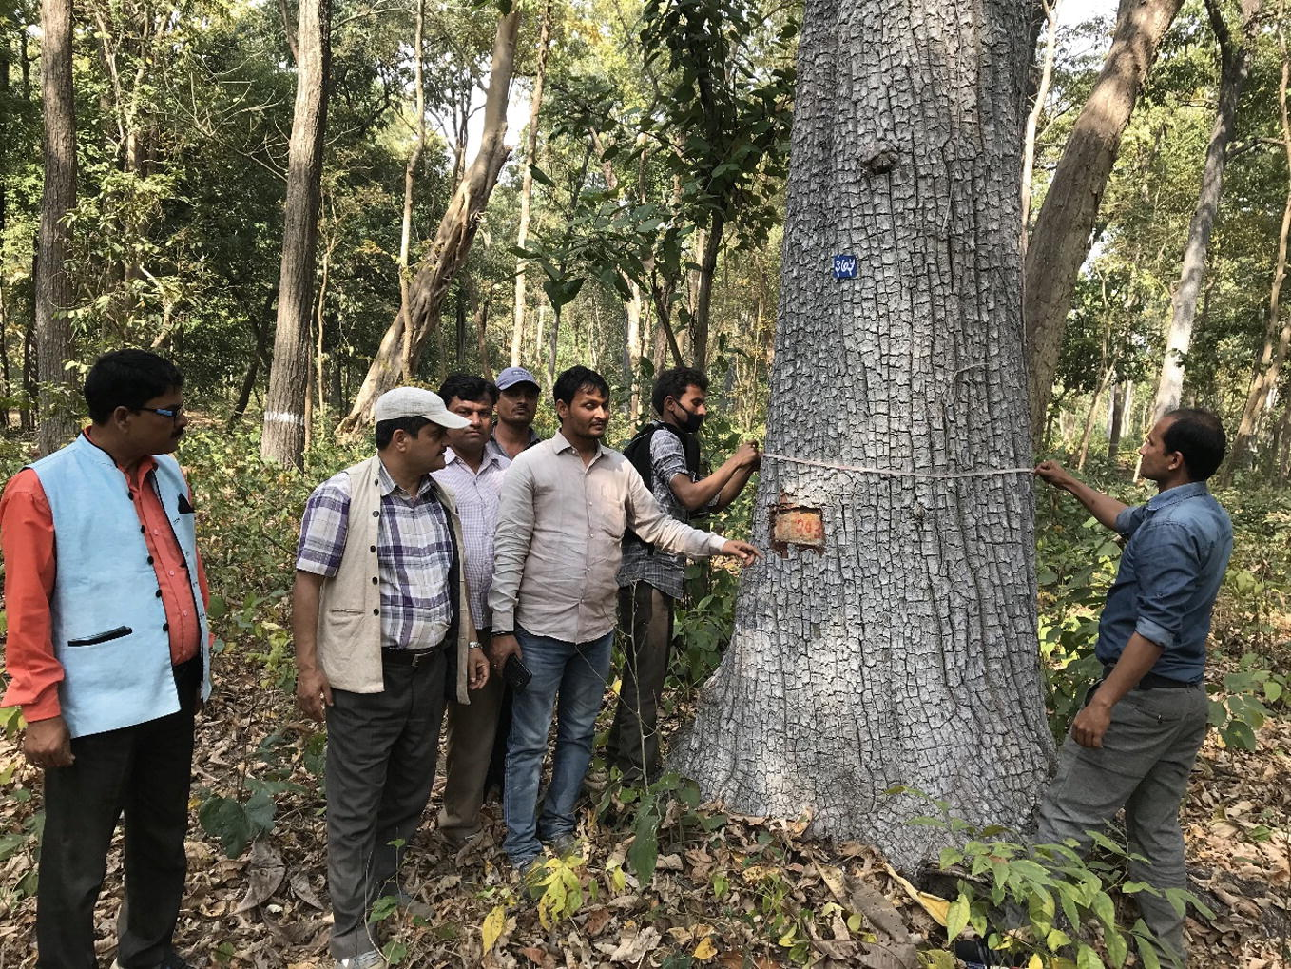
Forest Management in Nepal

Slide 34
Main differences between weak & strong sustainability
 | Strong sustainability | Weak sustainability
Key idea | Substitutability of natural capital by others is limited | Natural capital is completely substitutable by other forms
Consequences | Certain human actions can entail irreversible consequences | Technological innovation & monetary compensation for environmental degradation
Sustainability issue | Conserving irreplaceable stocks of critical natural capital for the sake of future generations | The total value of aggregate stock of capital needs maintaining / increasing for future generations
Key concept | Critical natural capital | Optimal allocation of scarce resources
Definition of thresholds | Scientific knowledge as input for public deliberation | Technic / scientific approach for determining thresholds & norms

Slide 35
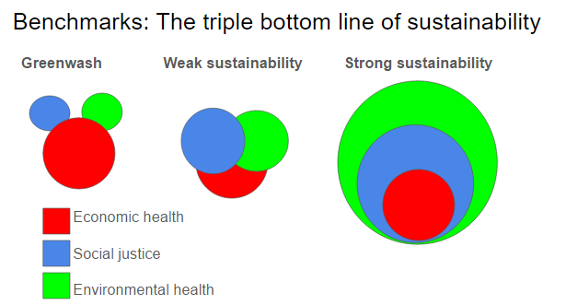
Based on Lorek, 2010

Slide 36
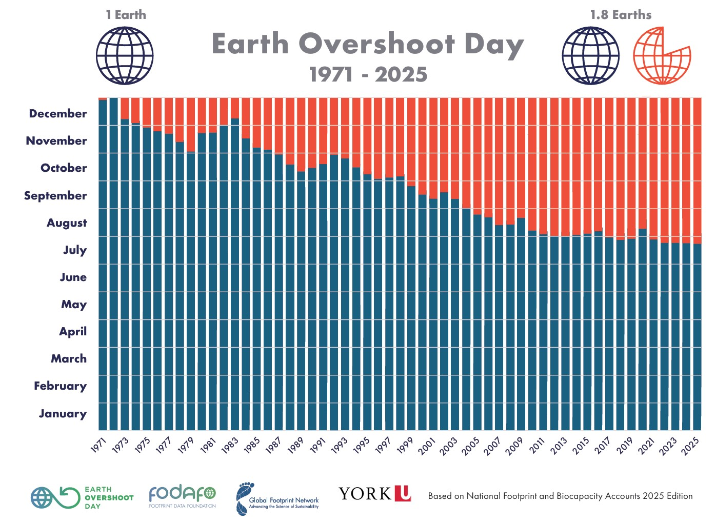
24 July 2025

Slide 37
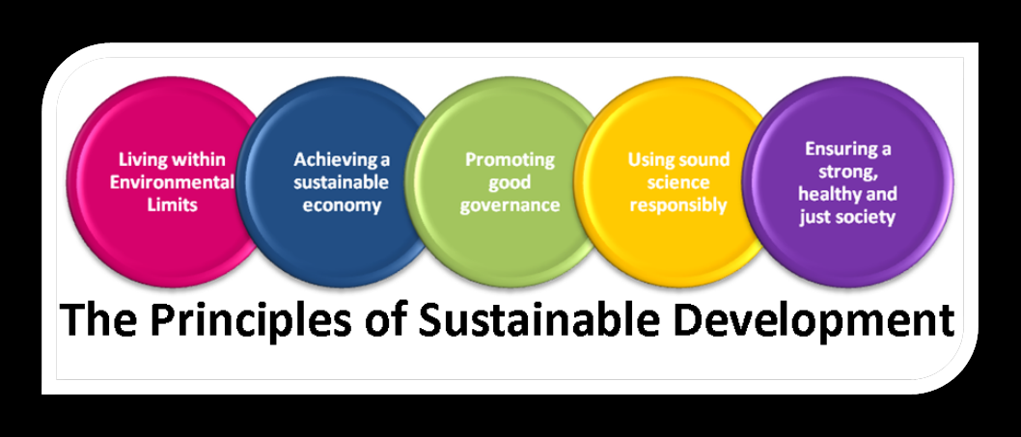
Principles

Slide 38
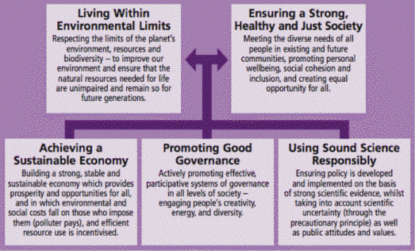

Slide 39
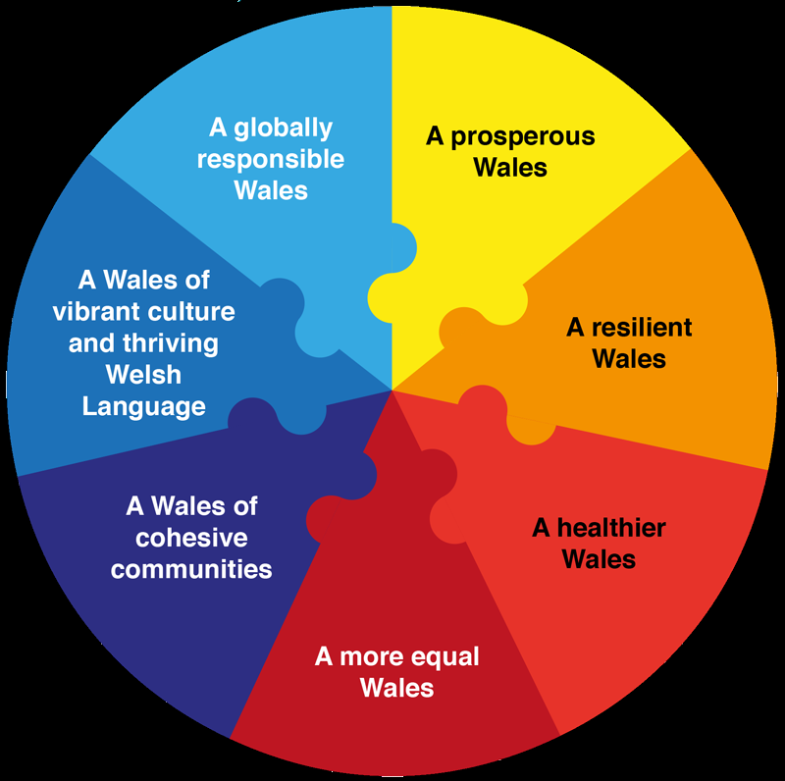
Wales has 7 principles

Slide 40
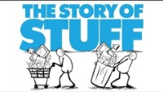
The Story of Stuff

Slide 41
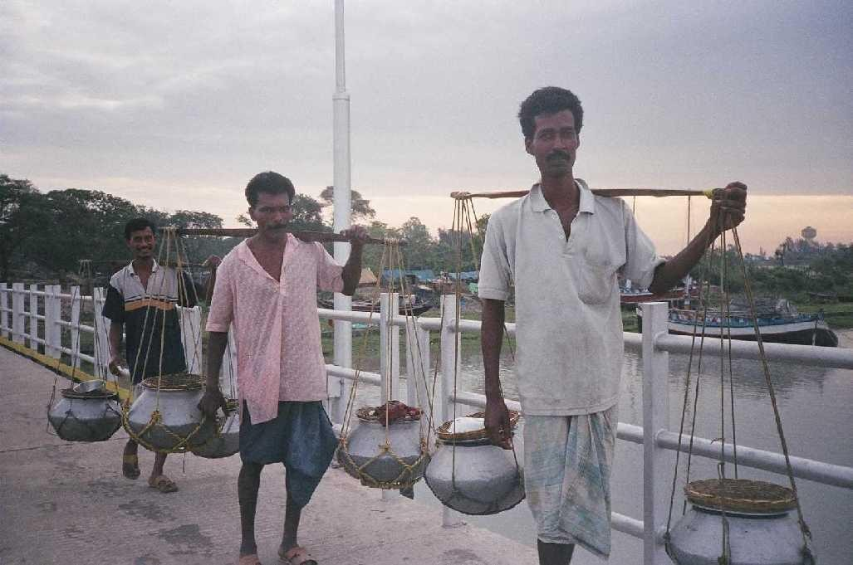
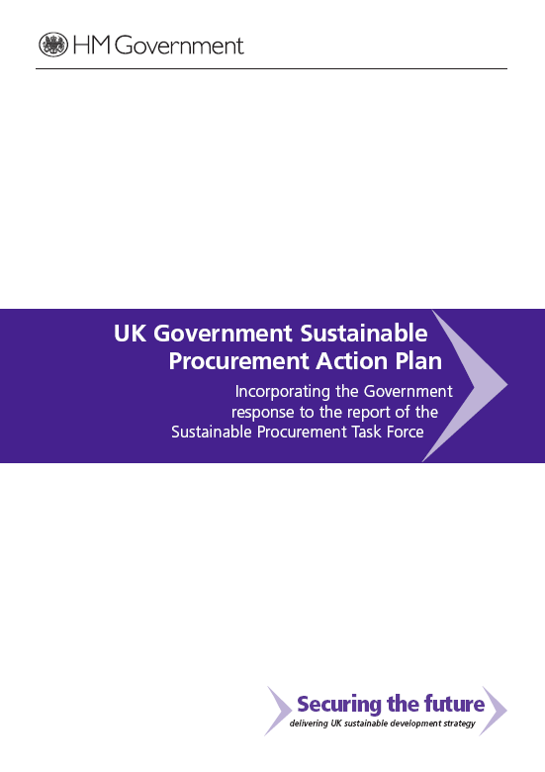
Questions?
Yes,
I told you it
would!

