Slide 1
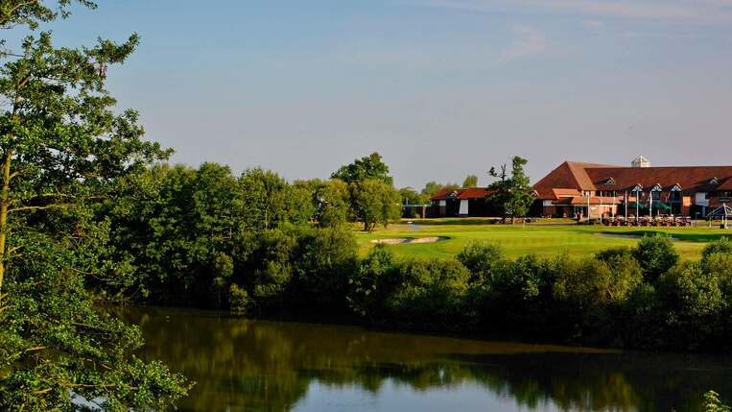
Forest of Arden Marriott Hotel & Country Club
Simona Elena Pavalache | 1816300 | M4X01918 |Food and Beverage Operations | Dr Jahanzeeb Qurashi

Slide 2
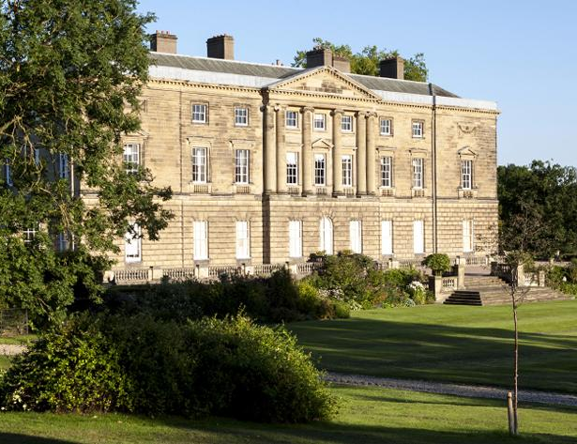
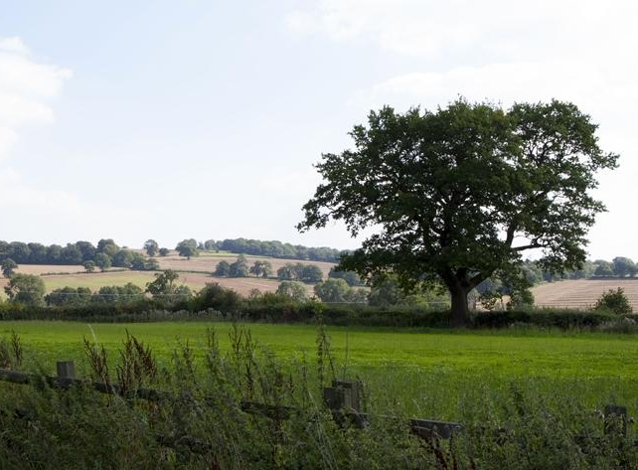
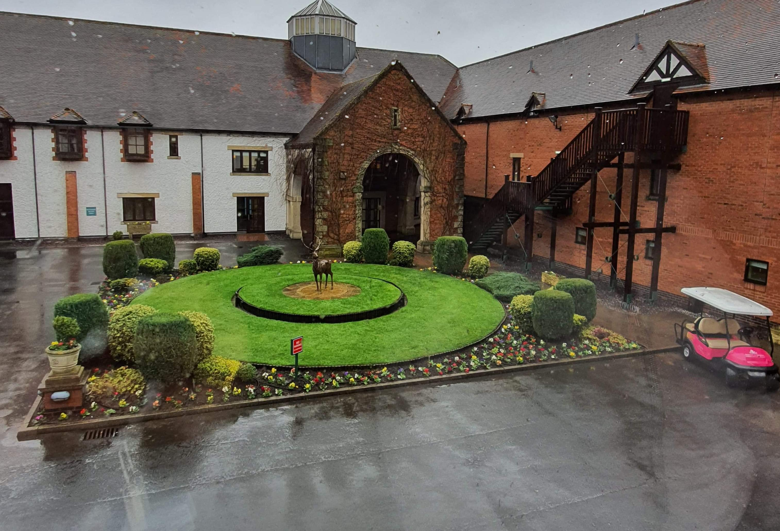
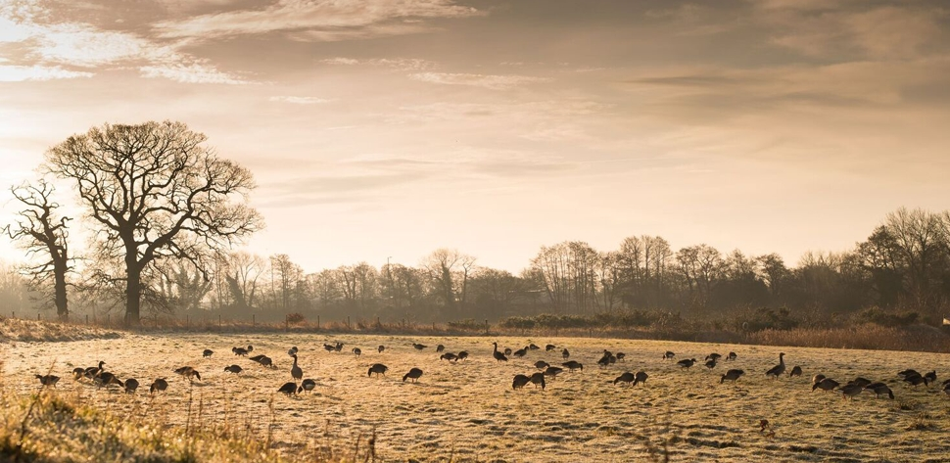
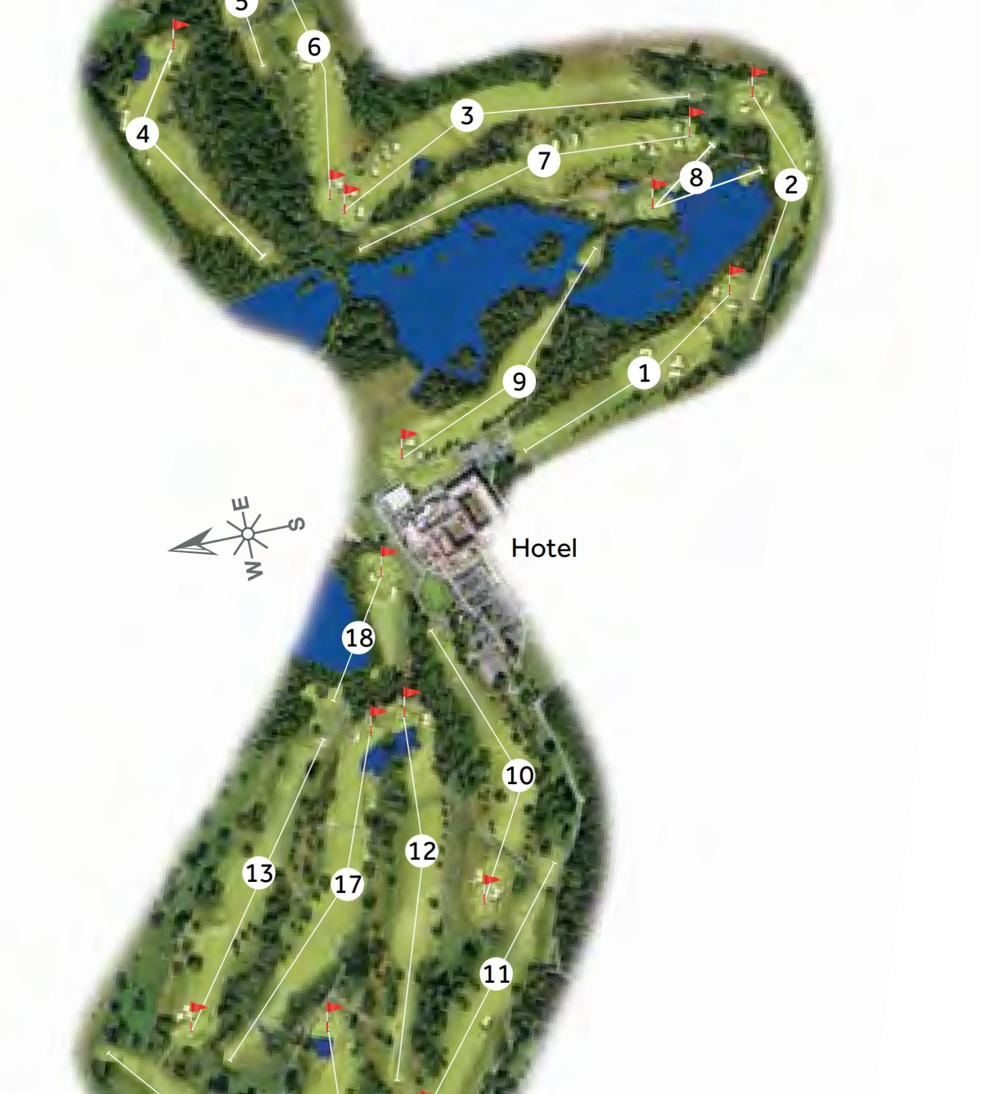
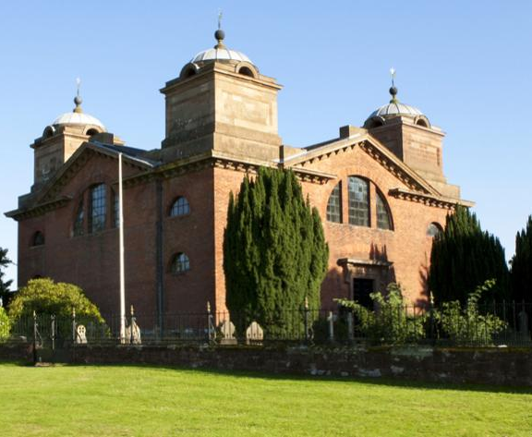
Marsh Lane Nature Reserve
(Packington Estate.2016c)
Packingon Estate
(Packington Estate.2016b)
Forest of Arden Marriot hotel & Country Club
Farming Land
(Packington Estate.2016a)
History of land and Hotel
Golf course
(ChampionsUKPLc,2020)
St Jame`s Church
(Packington Estate.2019)

Slide 3
History of land and hotel (continue)
Forest of Arden Marriott hotel & Country Club
Wedding room
(Marriott International,2020a)
Meeting room
(Marriott International,2020b)
Deluxe Room
(Marriott International,2020c)
Its set within 10.000 acres of ancient forest, full of deer and old oak trees. In 1987 North Warwickshire Borough Council gave permission to start building for 120-bedroom hotel, leisure club, conference centre and 18-hole championship golf course but soon after the permission increase to 154 bedrooms.
Hotel opened on 1 September 1989 and 18-hole golf course was open in September 1991.
Following Whitbread`s acquisition of the franchise rights the Marriott name in Britain, the hotel was rebranded the “Marriott Forest of Arden” in April 1996 and upgraded the hotel to Marriott Standards.
Between 1992 and 1997 hotel was in a major development and giving the hotel a total of 214 bedrooms on 3 floors. Now the hotel has 18 meeting rooms with a total of meeting space of 11,248 sg ft.
2005 Whitbread sale the hotel to Marriott International and take ownership.

Slide 4
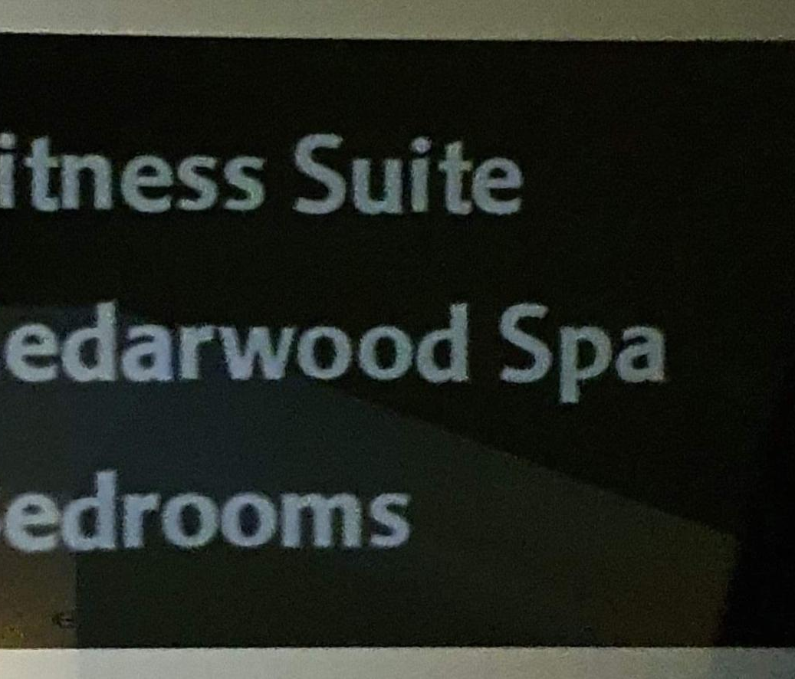
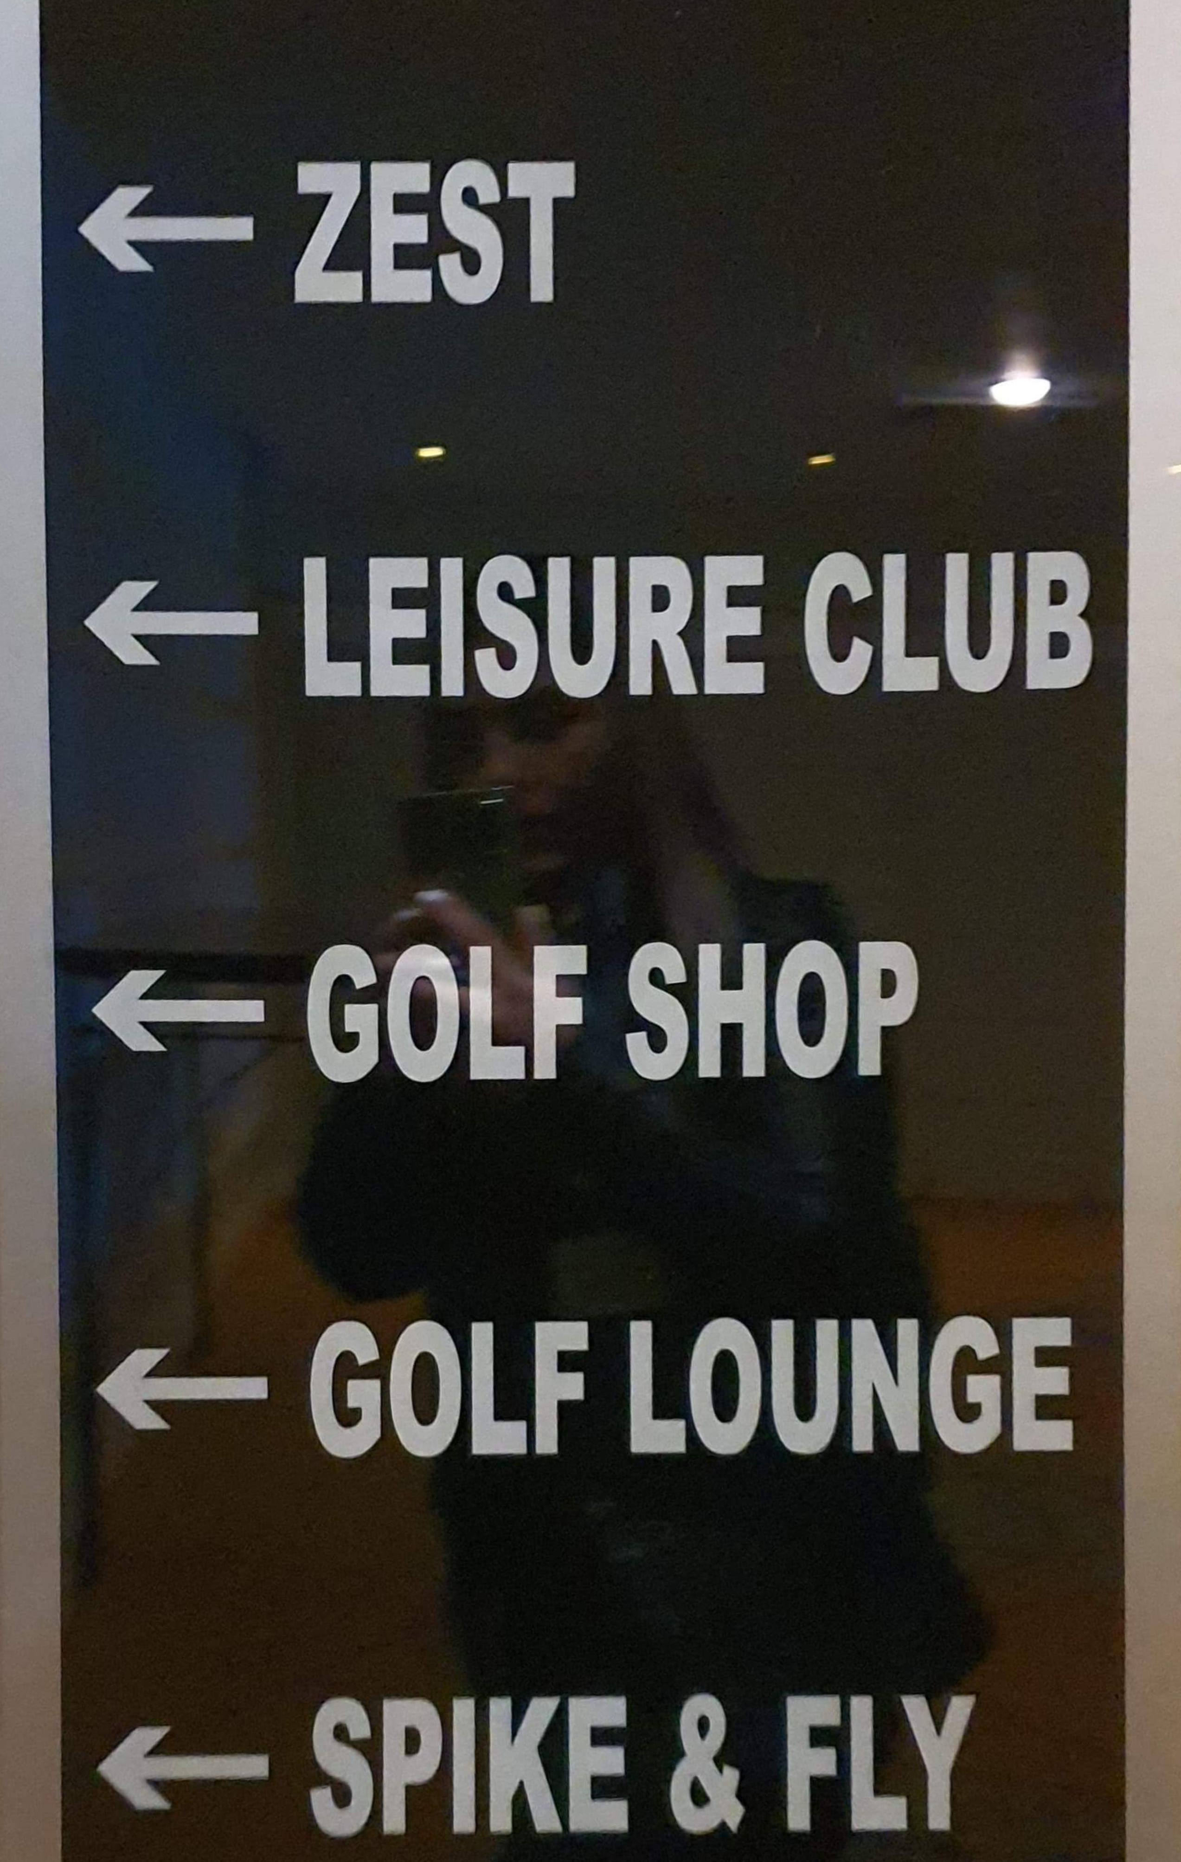
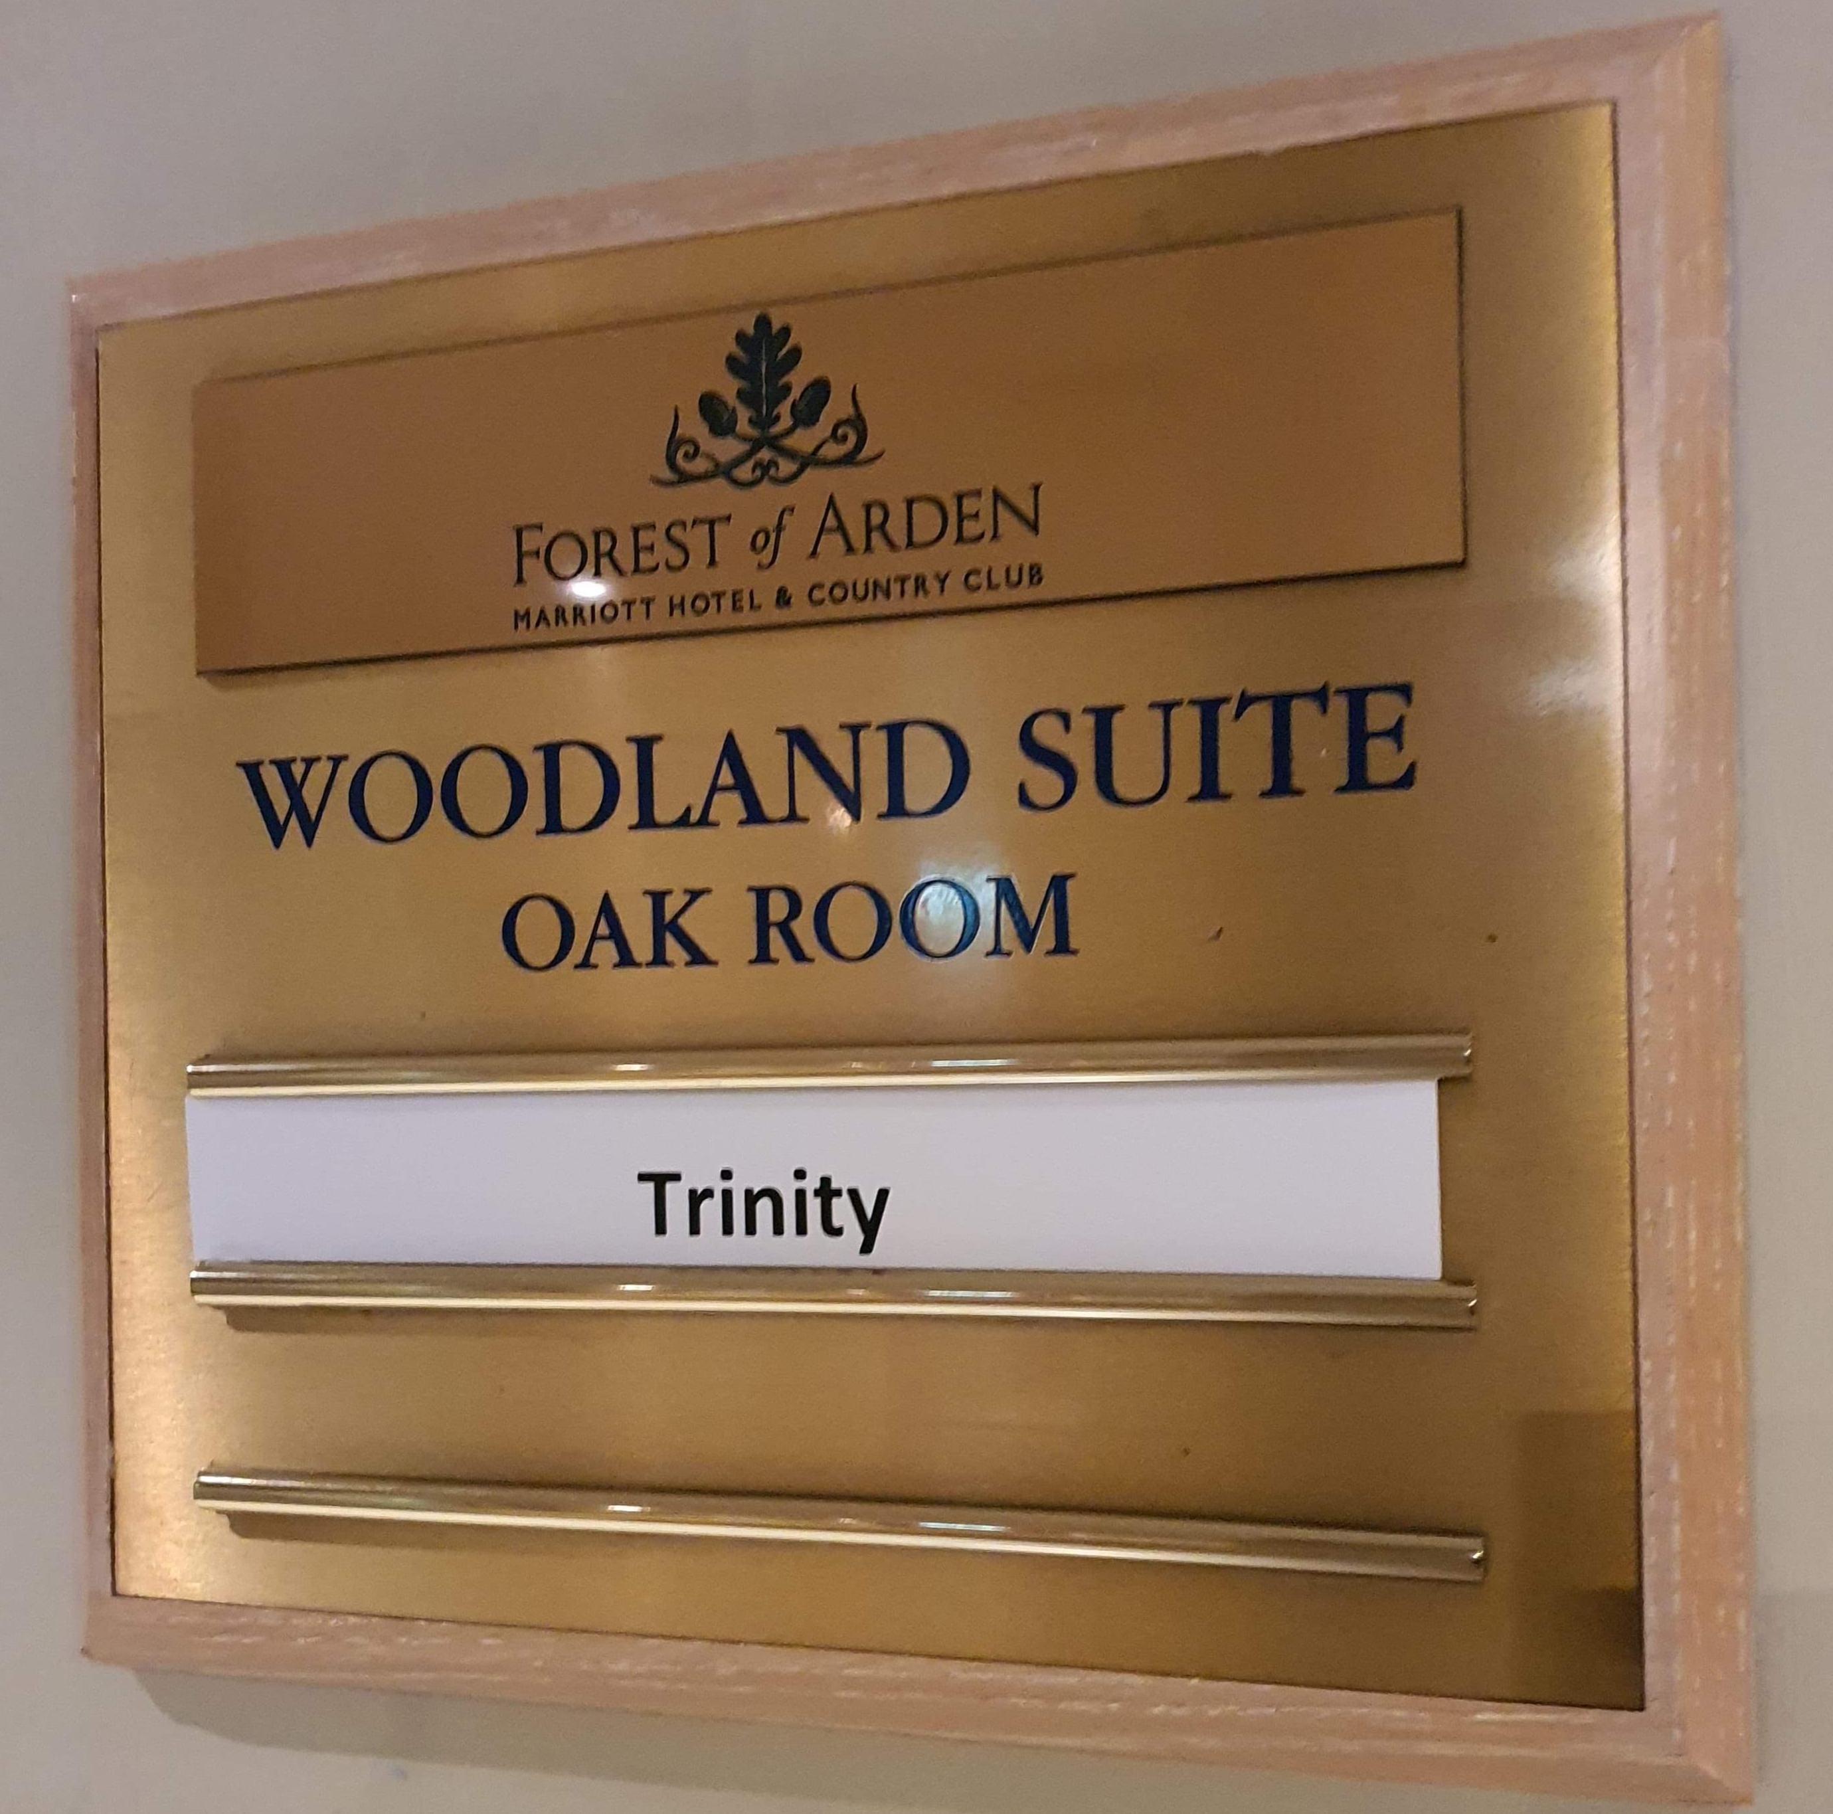
Forest of Arden Marriot Hotel & Country Club
Hotel Operations Type
Front Office / Night Auditor
Management department
HR Department
Finance / Acquisitions department
Facilities Department
Food and Beverage Conference Banqueting
Zest(Casual) and Cast Iron(Fine dining)
Marketing / Sales
Spa and Leisure
Golf Course
Transporting

Slide 5
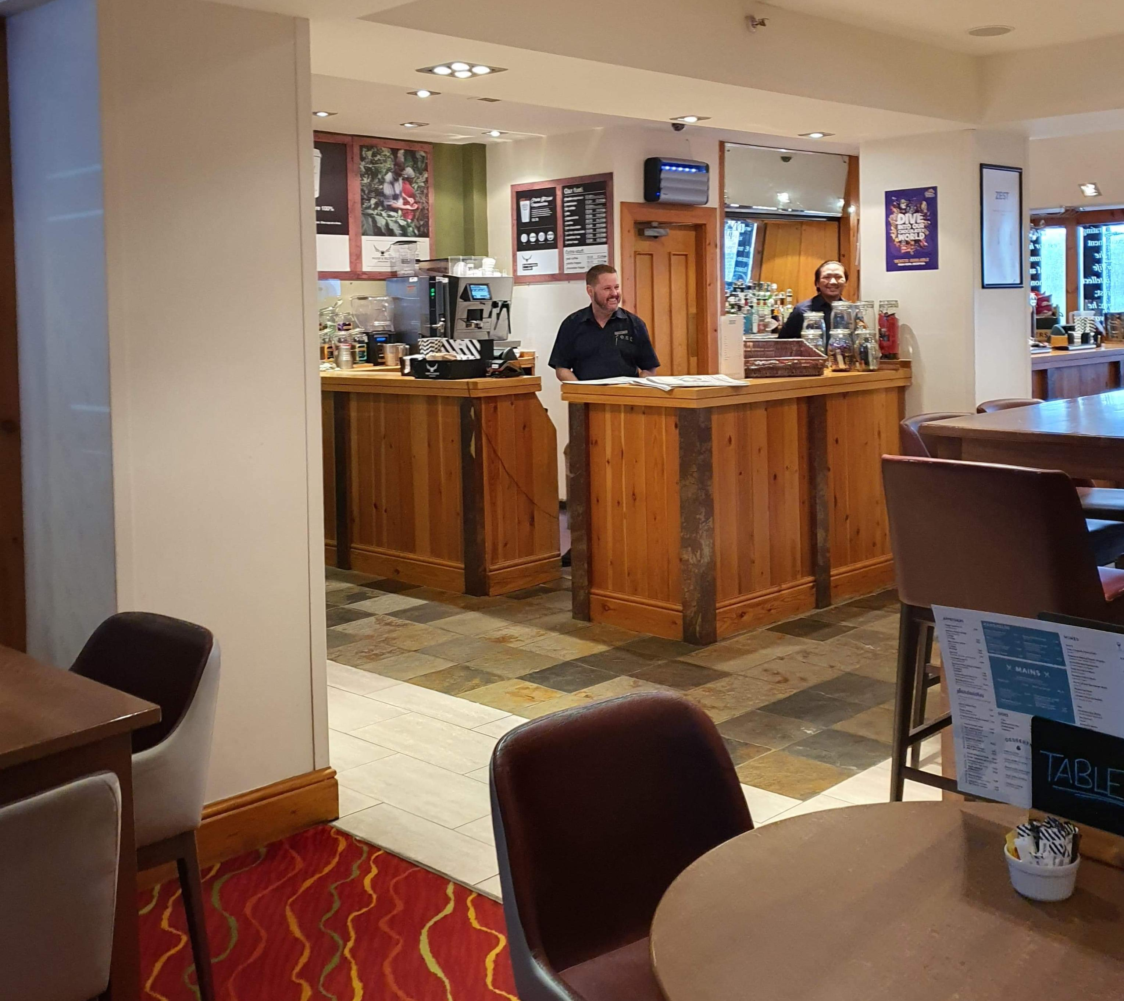
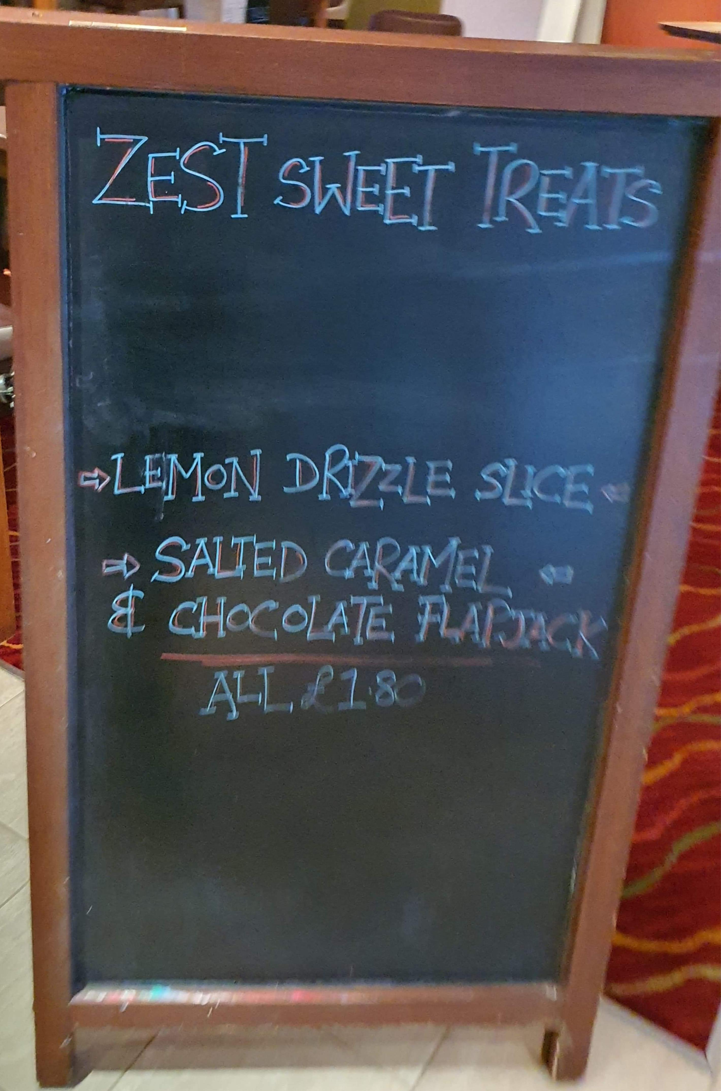
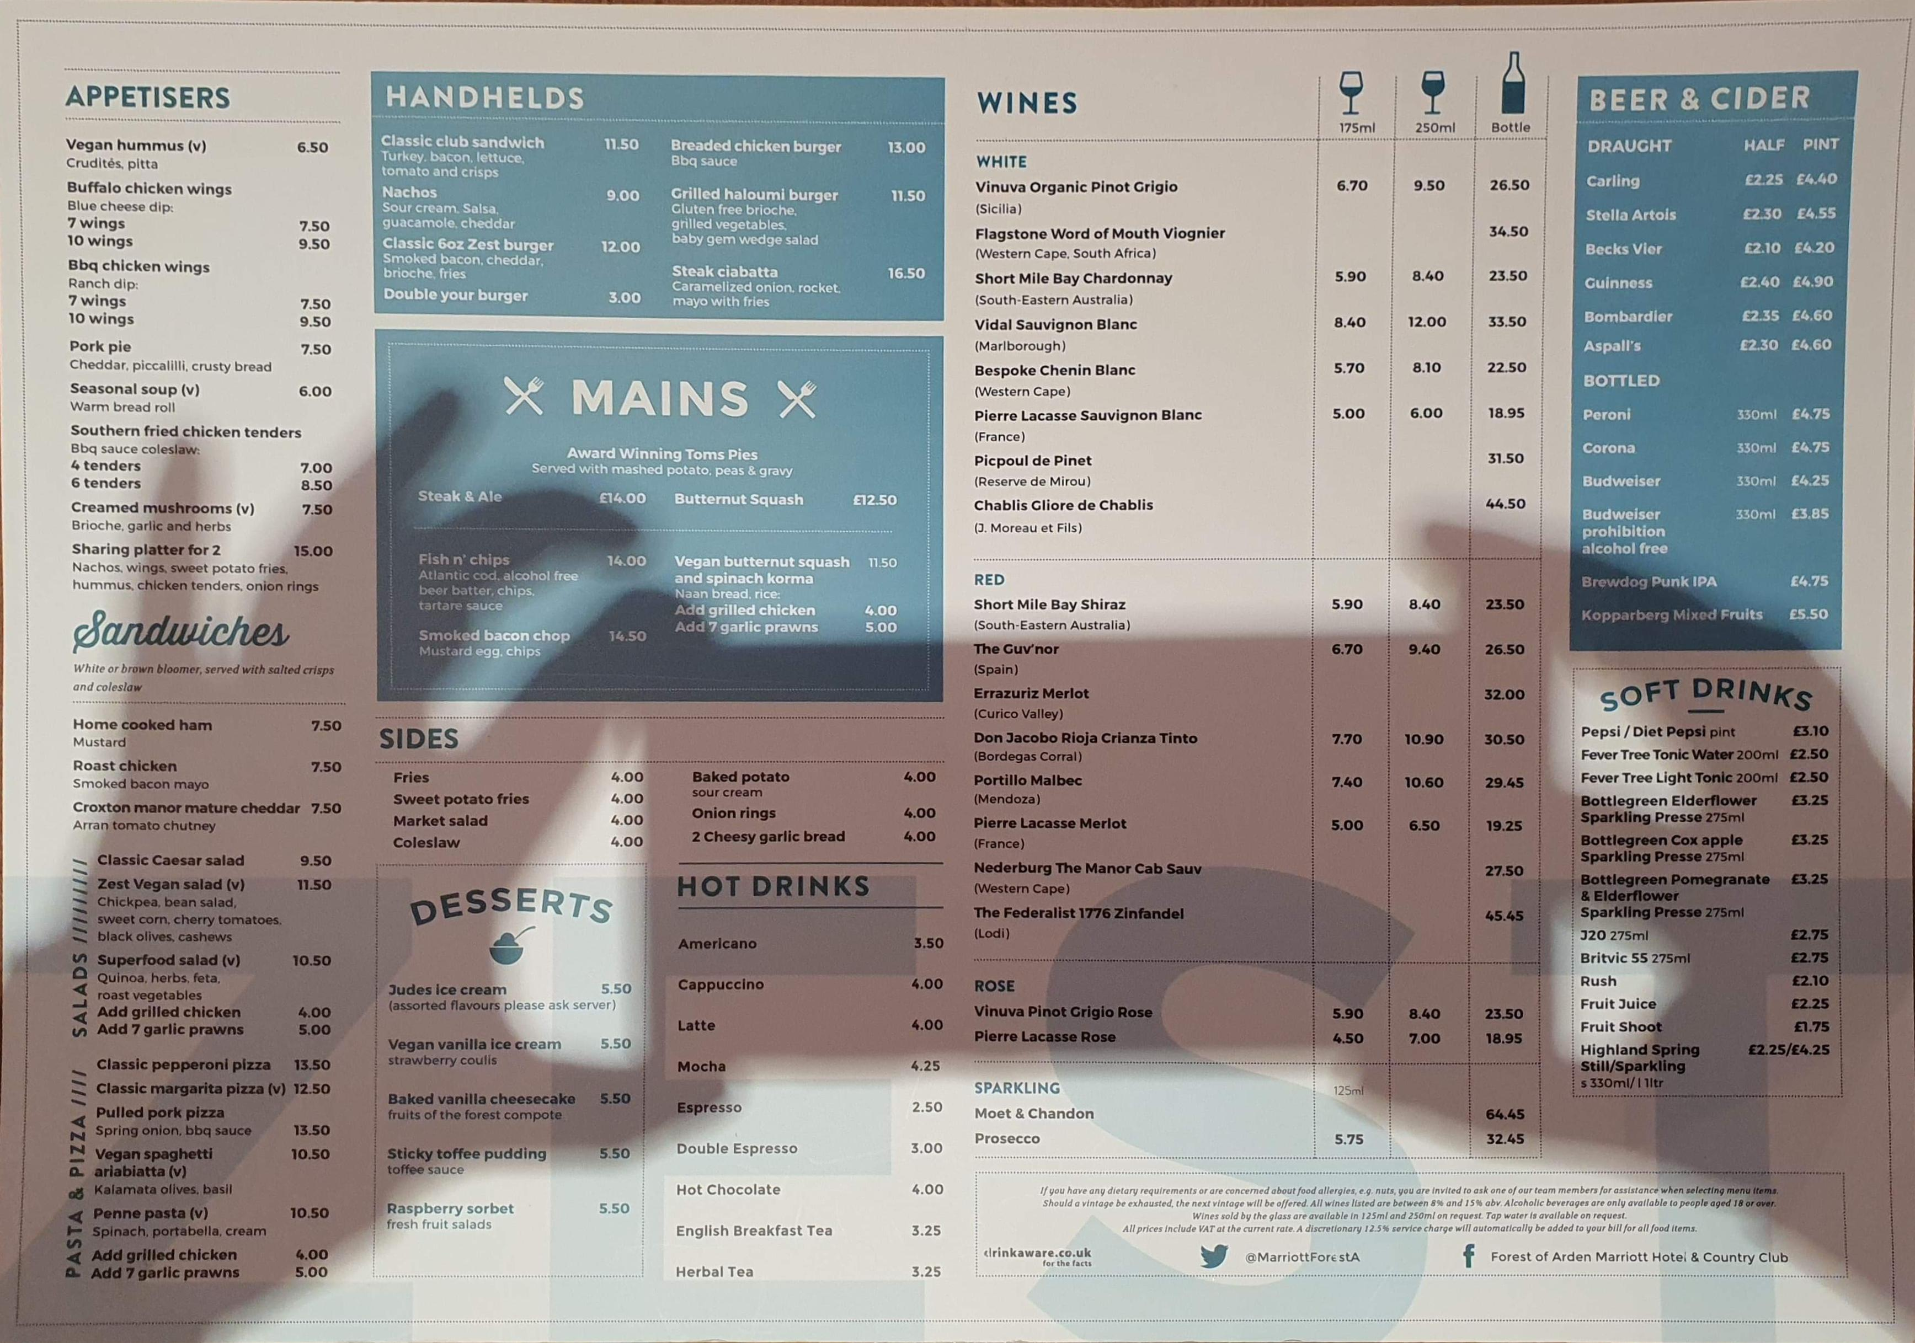
Food & Beverage
Pic.2
Pic.3
Marriott is one of the most prestigious brand because they offering to their customers the best product and service.
Forest of Arden Marriott hotel and country Club have 2 type of restaurant the first one is called Zest (Pic.2) and in their menu you can find a more casual choice of food in a French & British style as for drinks they serve a small variety of alcoholic (Not booze free) drink such as wine and beers and for the non-alcoholic ( booze free) they have soft drinks and hot drinks. The restaurant as a relaxing atmosphere.
Pic. 1

Slide 6
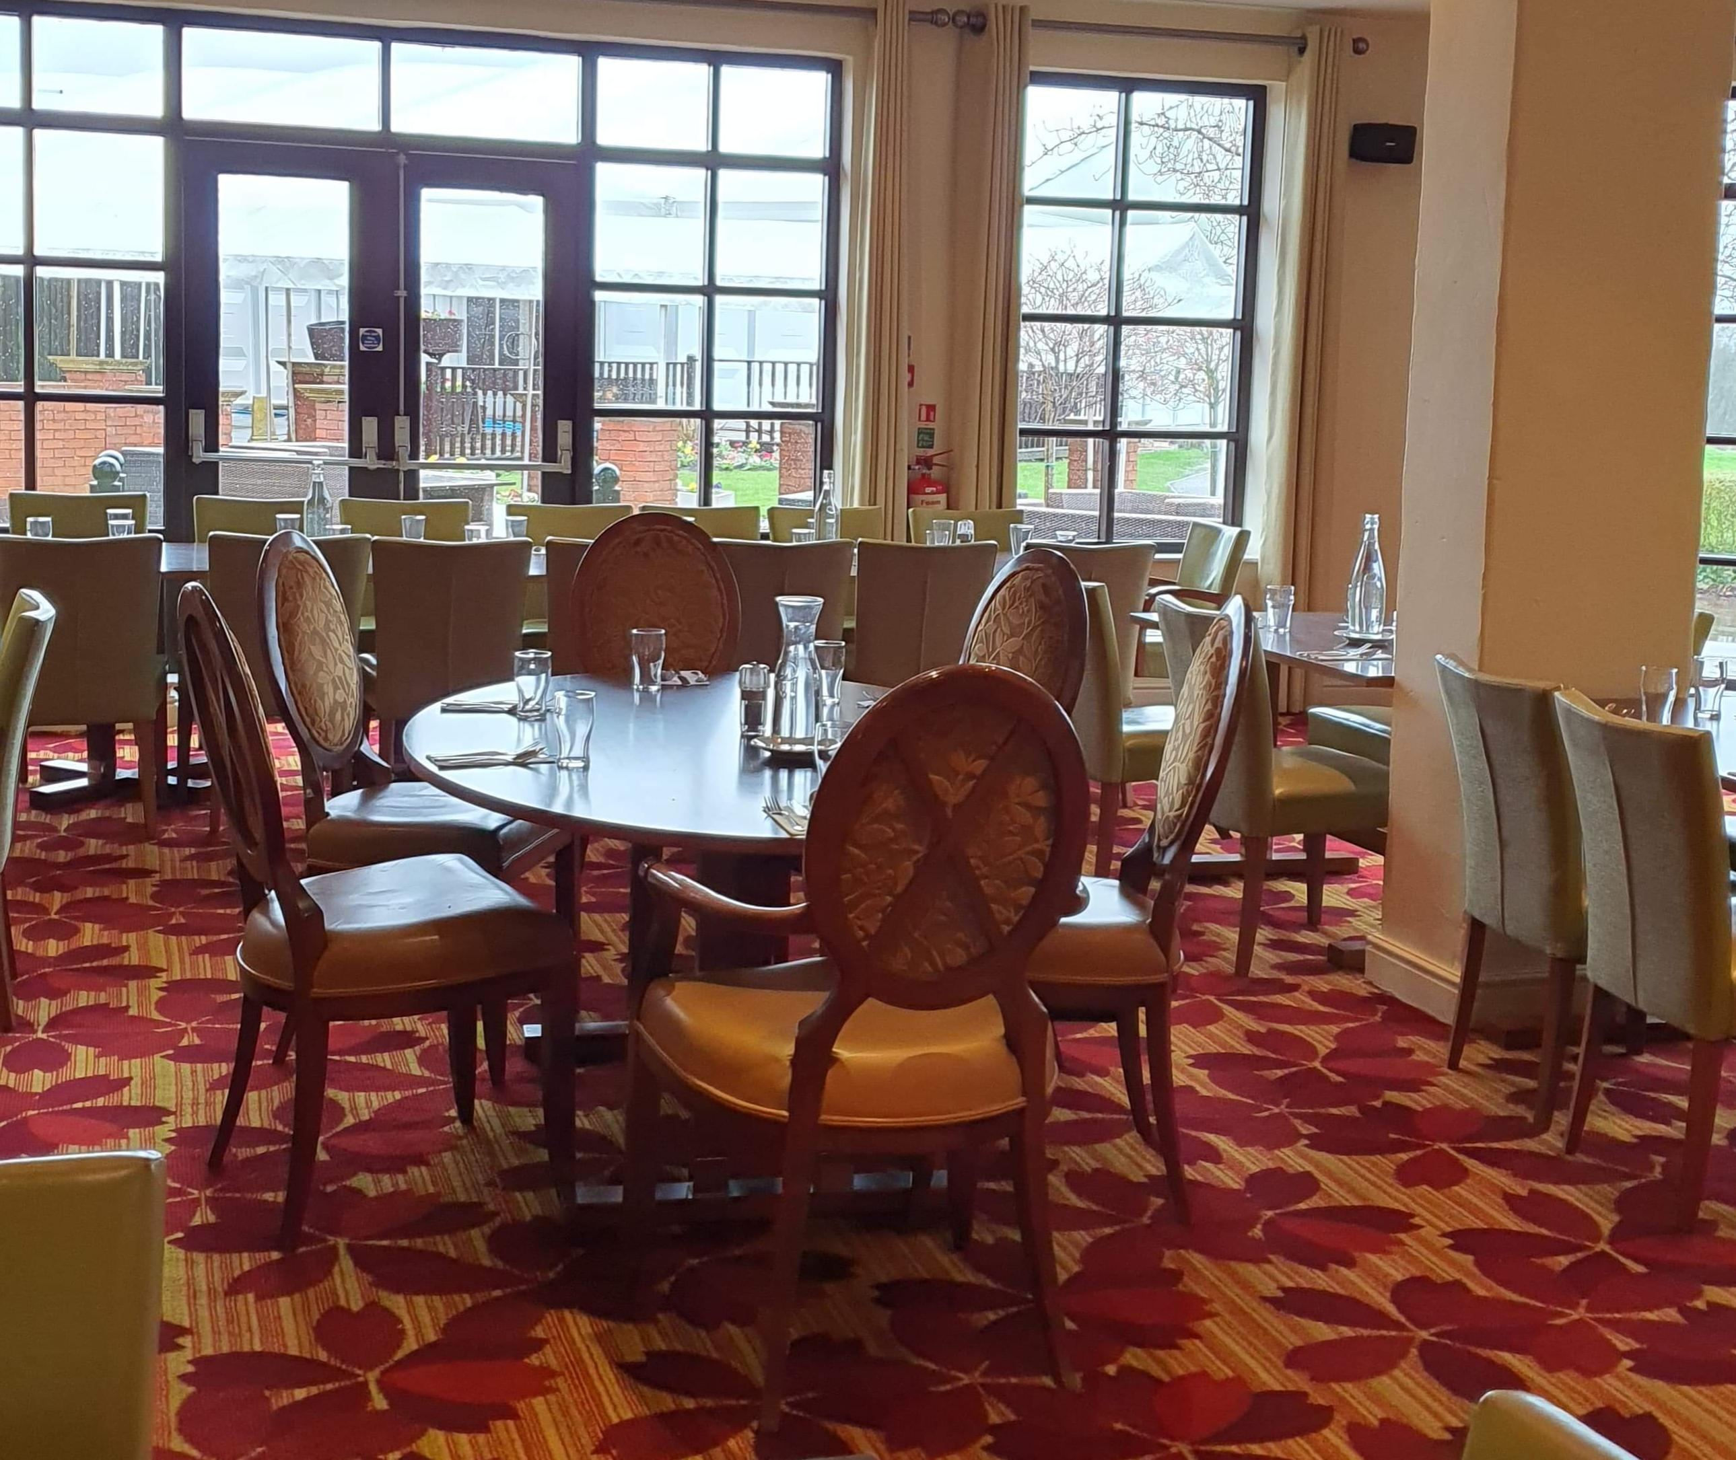
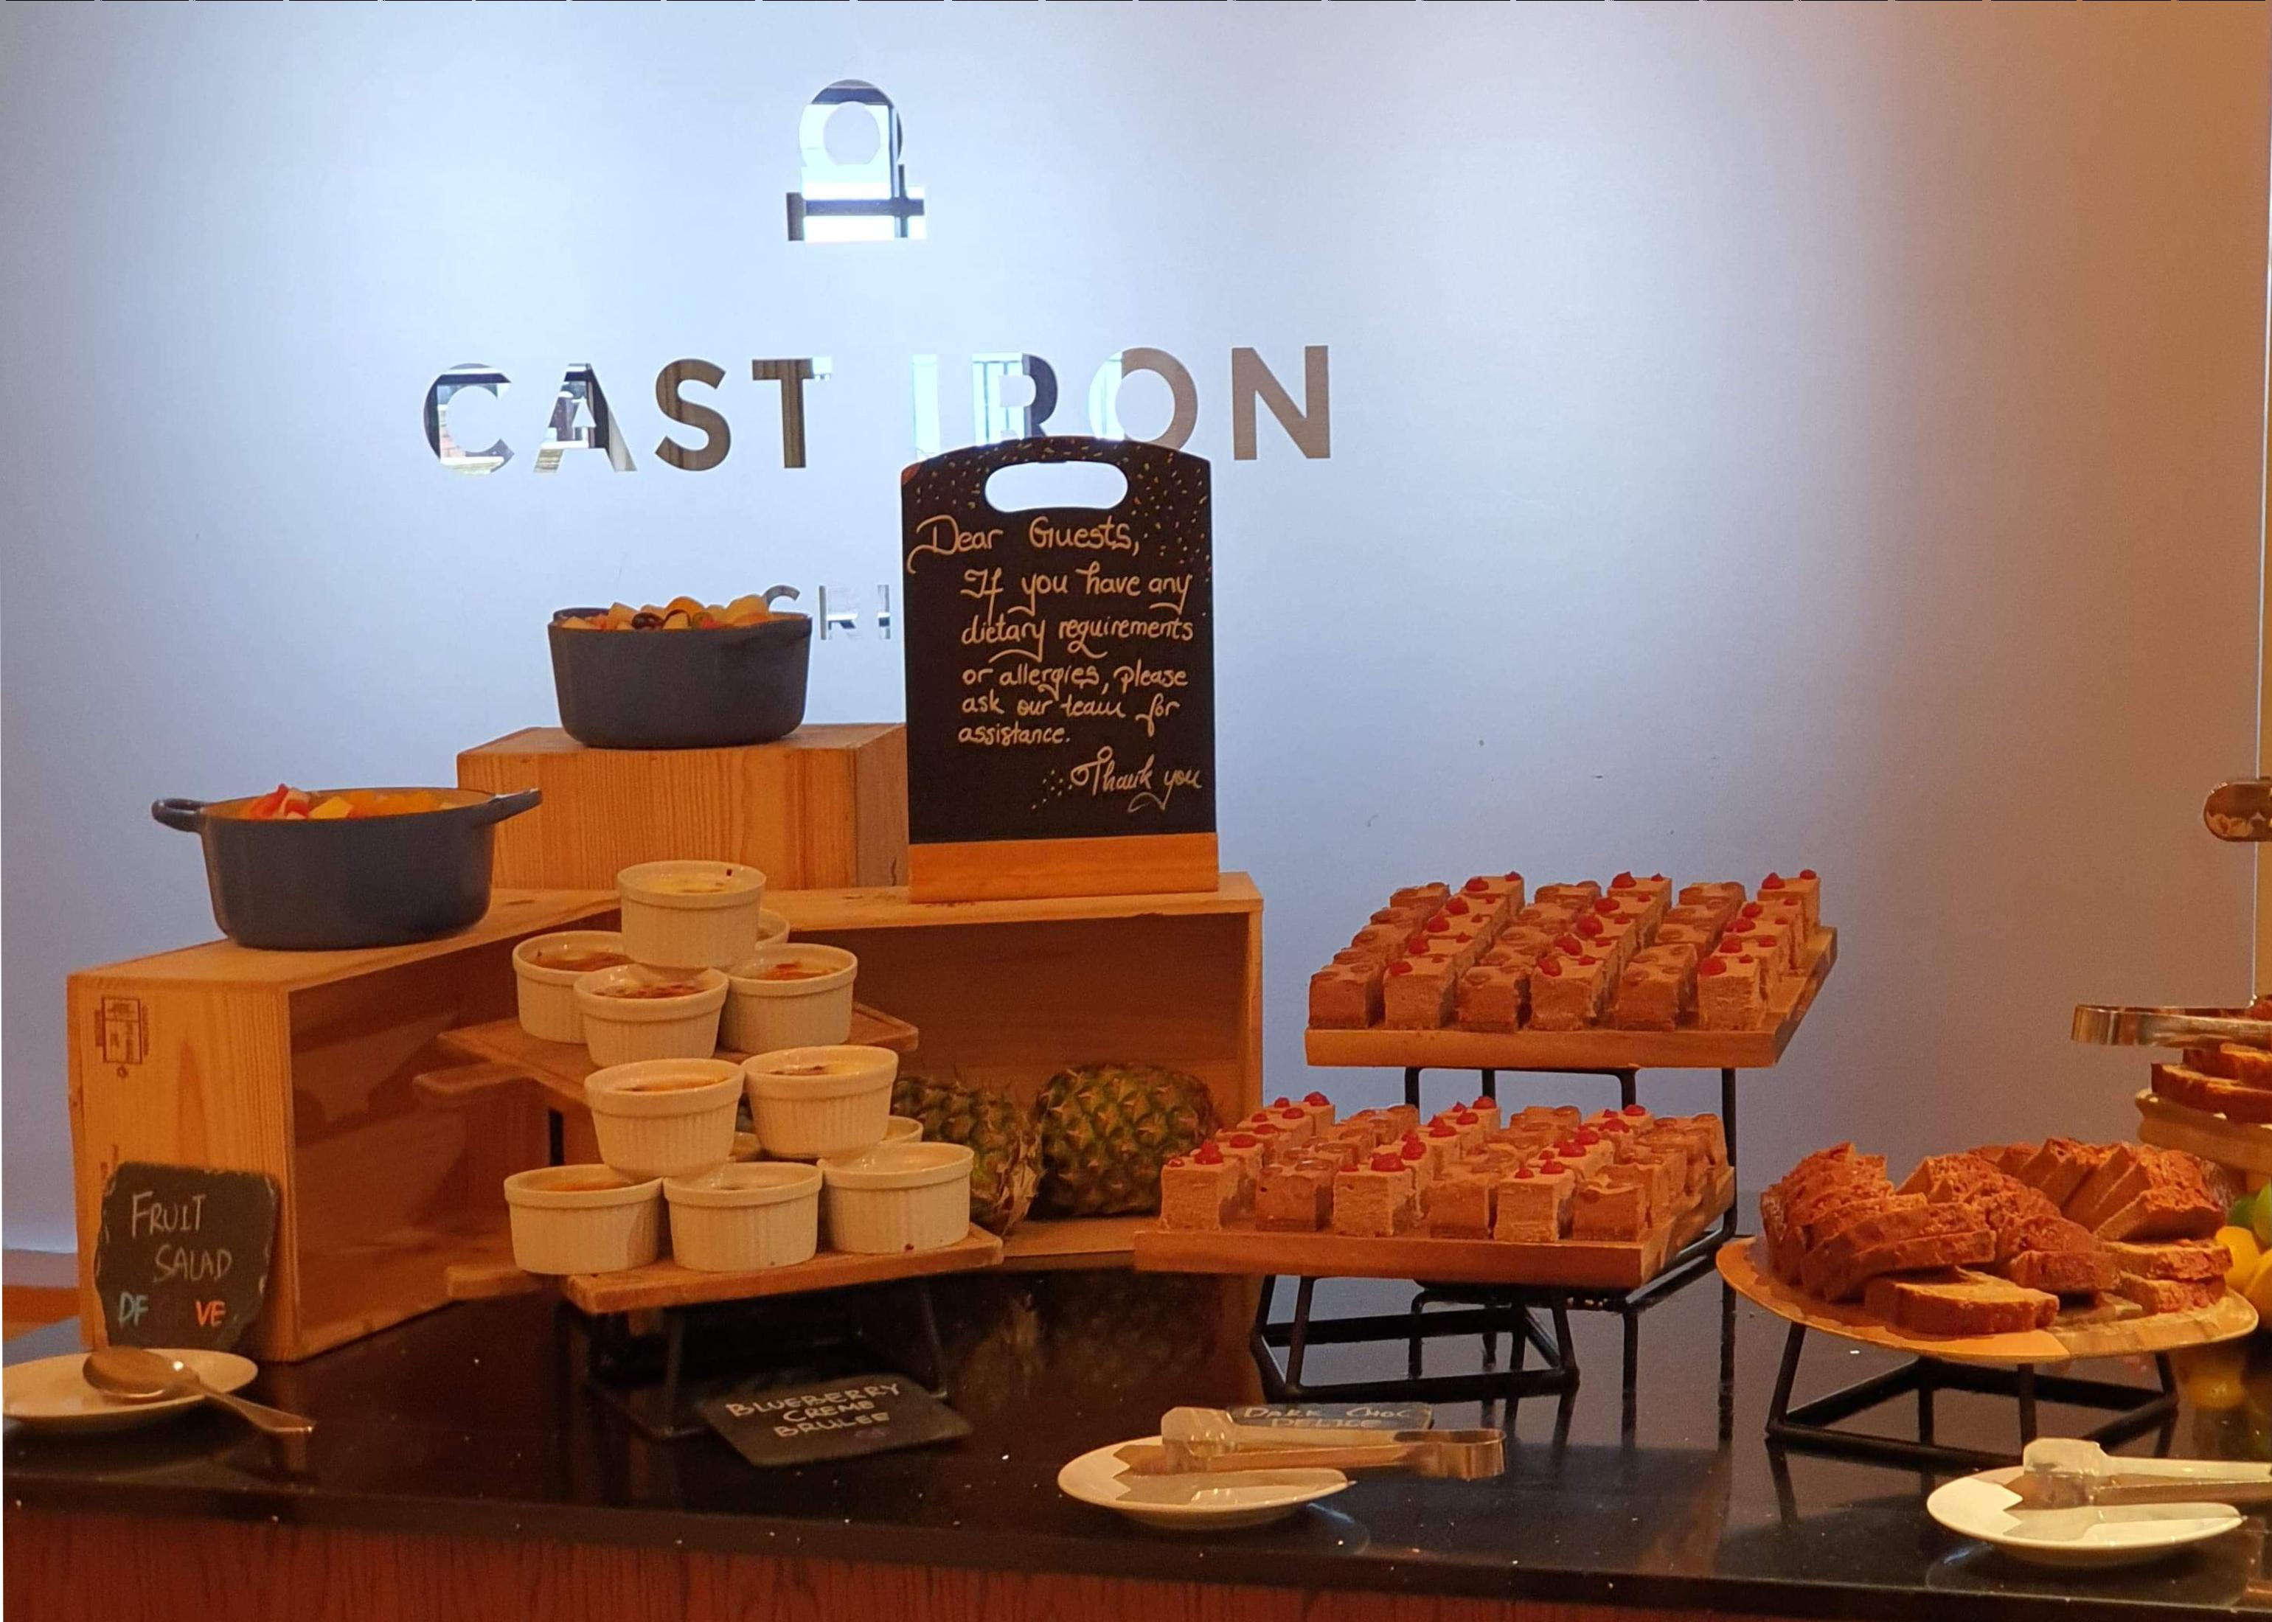
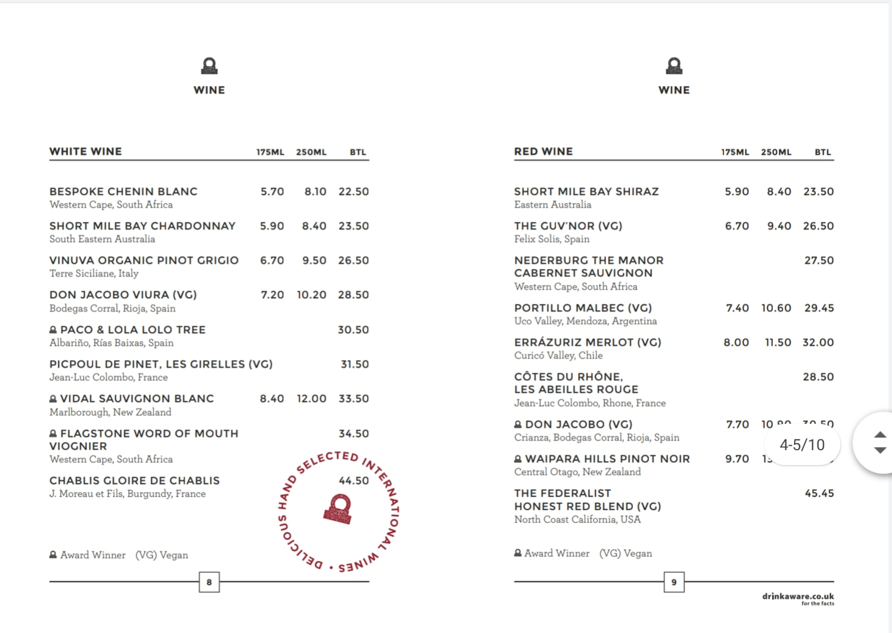
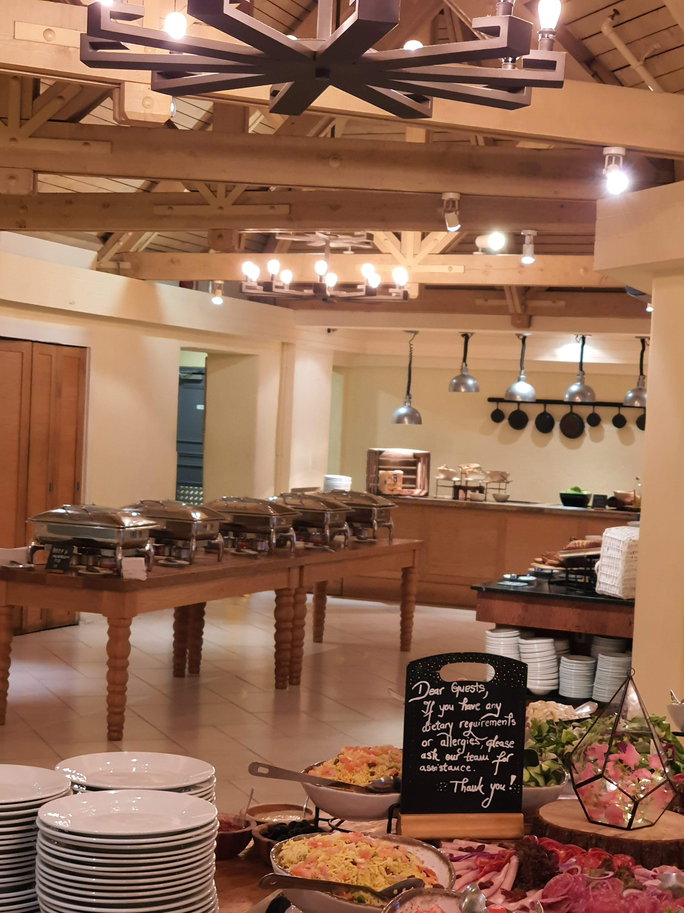
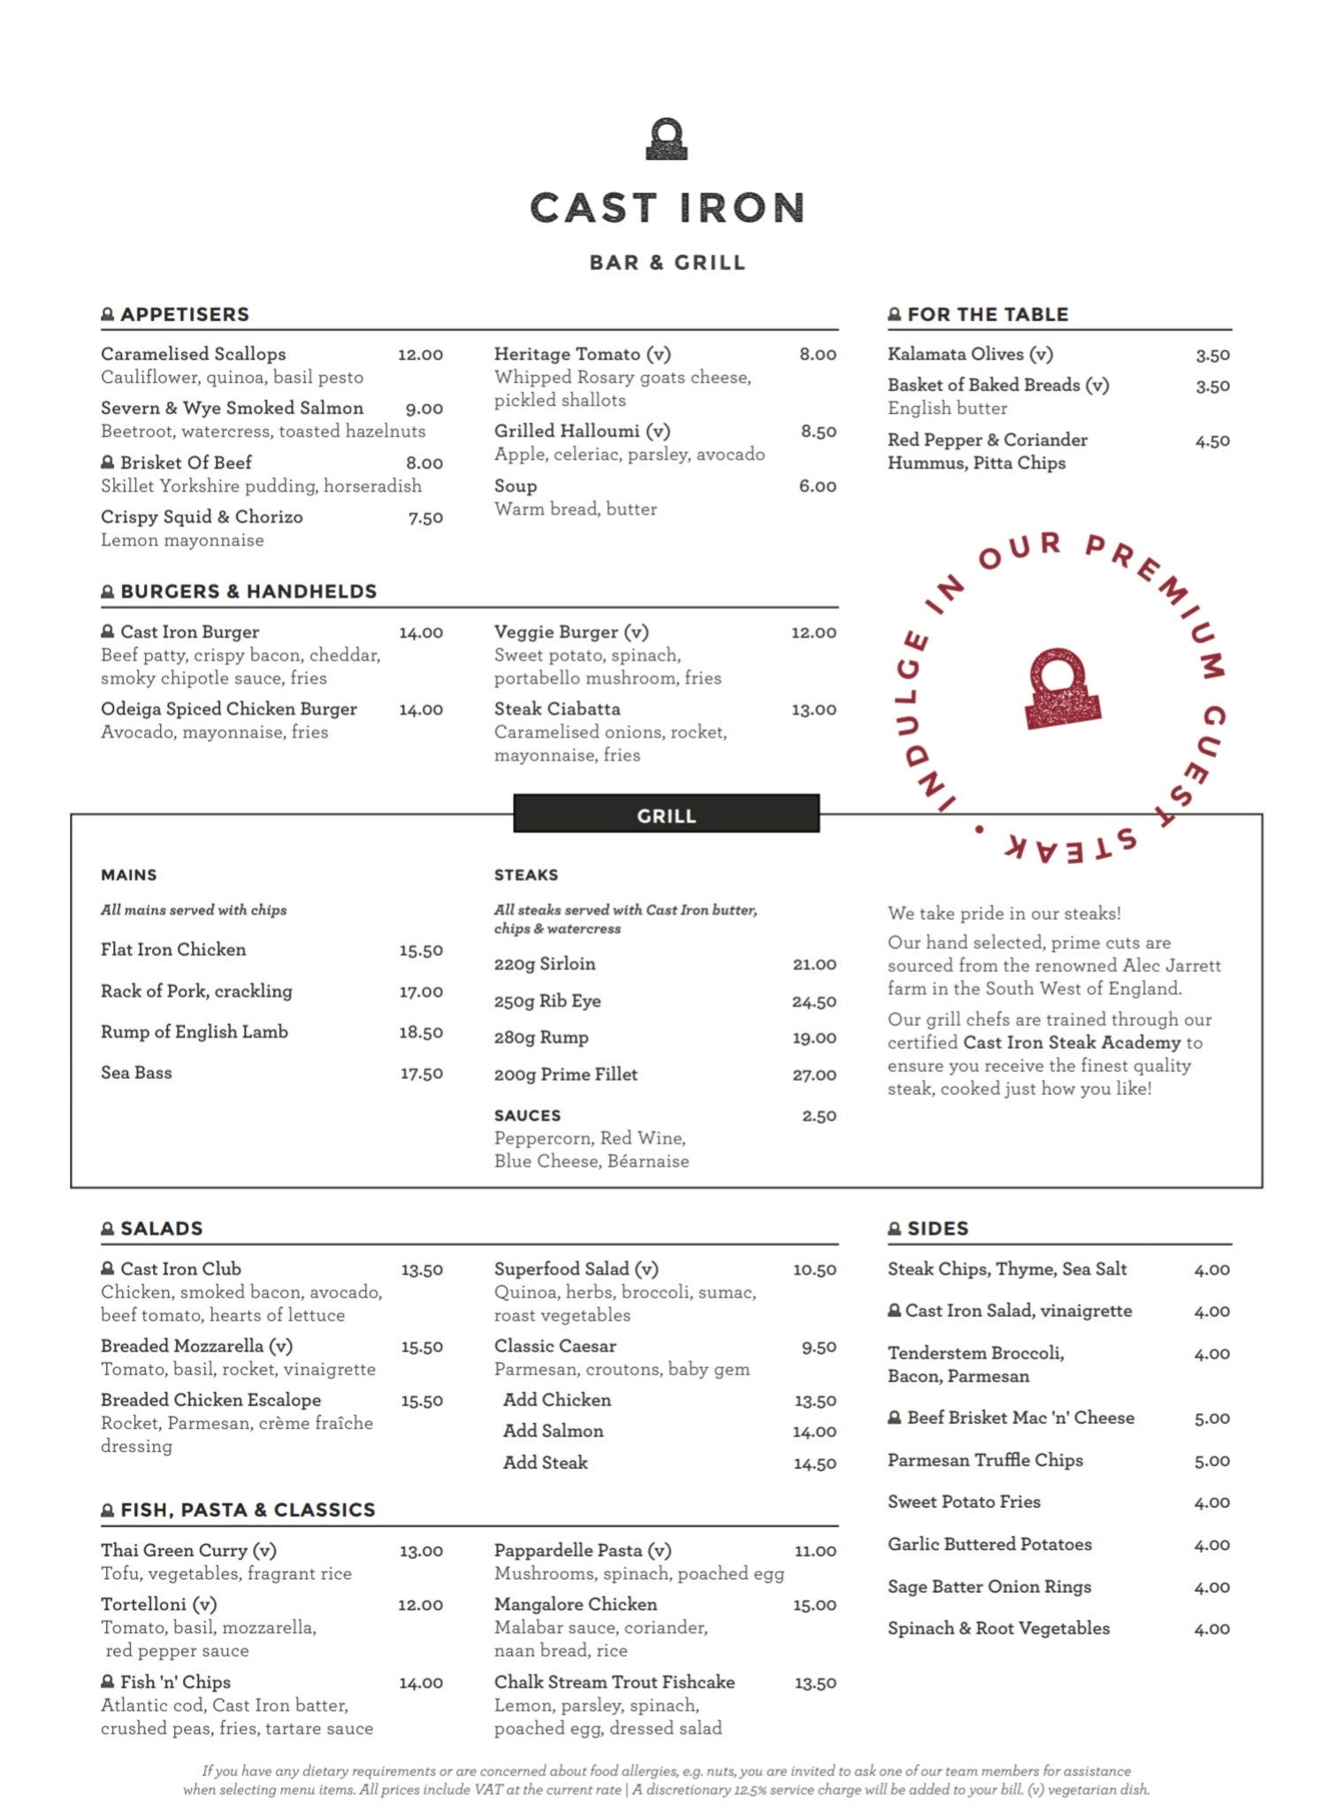
Food and Beverage (Continue)
Pic.3
(www.tableresmarriott.com,2020)
Pic. 2
Pic. 1
Pic. 5
The second restaurant Cast Iron ( Pic. 1 ) it’s a fine dinning (A LA CARTE) with food from British cuisine and premium steak,and a vast selection of delicious dishes also in this restaurant the beverage menu is more versatile range of wine than is hand selected International and some hand crafted and expertly mixed cocktails and Spirits.
Pic.4
(www.tableresmarriott.com,2020)

Slide 7

How they market
The main purpose of Marriott is to engage the loyal customers and the new customers towards the organization by communicating with them effectively about their demand, needs and expectations.
To do that they create the Loyalty program called BONV으Y when exclusive members can earn free nights stay by collecting the rewards points, also can get member rates,late check-out and many others benefit and depending of what type of membership they get.
Also they market on Facebook, Instagram, Twitter etc. (https://www.facebook.com/socialtables, 2019)
(https://www.facebook.com/socialtables, 2019)

Slide 8
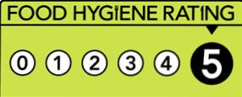

Health and safety
Forest of Arden Marriott hotel & Country Club is rating in FOOD HYGIENE with nr 5 from 0 to 5 which means (Very Good) by the North Warwickshire Borough Council on 11 February 2020 for the following (Council,2020):
Also Hotel provide employees with Health and Safety training because hospitality and catering businesses must maintain up to date and accurate safety (Riegel,2020).
Environmental impact Marriott launch in July 2019 as a globally campaign that they`re eliminating single-use toiletries and changes with larger, pump-topper bottle. (Ben (LUCKY), 2019)
Food Hygiene and Safety- GOOD
Structural Compliance – GOOD
Confidence in Management- HIGH
Council,2020
Riegel,2020

Slide 9
Customer service
Forrest of Arden Marriott hotel & country Club It’s part of the biggest hotel chain in the world they provide their employee with various type of training programs, such as:
New hire orientation program (The Gold Standard)
International hourly training
Core management training skills
Essential skills for Supervisors and Managers and many other. ( HR Staff,2010)

Slide 10
Conclusion
Forest of Arden Marriott hotel & Country club its a 4* hotel facility in one of the best area in England almost at the point center of the country, hotel provide to they costumers multiple activities and service. The hotel focus is on delivering best costumer service and costumers' satisfaction, because hotel as a rate of 99% occupancy and host many golf competition, business meeting and weeding’s they costumers service can`t fail in delivering the best service for they costumers.

Slide 11
Reference
Ben (LUCKY) (2019). Marriott Eliminating Single-Use Toiletries Globally. [online] One Mile at a Time. Available at: https://onemileatatime.com/marriott-eliminating-single-use-toiletries-globally/ [Accessed 10 Mar. 2020].
ChampionsUkPlc (2020). Course Guide | Farmfoods European Senior Masters 2019. [online] europeanseniormasters.com. Available at: https://europeanseniormasters.com/course-guide [Accessed 9 Mar. 2020].
Council, N.W.B. (2020). Marriott Forest of Arden Hotel Food Hygiene rating from North Warwickshire Borough Council on Scores On The Doors. [online] Scores On The Doors. Available at: https://www.scoresonthedoors.org.uk/business/marriott-forest-of-arden-hotel-great-packington-716349.html.
HR Staff (2010). HR: Marriott employee training and development program. [online] Hotel Management. Available at: https://www.hotelmanagement.net/human-resources/hr-marriott-employee-training-and-development-program [Accessed 10 Mar. 2020].
https://www.facebook.com/socialtables (2019). Social Media Strategy for Hotels: Why These Brands Win | Social Tables. [online] Social Tables. Available at: https://www.socialtables.com/blog/hotel-sales/social-media-marketing-for-hotels/ [Accessed 10 Mar. 2020].
Marriott International. (2020a). Forest of Arden Marriott Hotel & Country Club. [online] Available at: https://www.marriott.com/hotels/event-planning/wedding-planning/cvtgs-forest-of-arden-marriott-hotel-and-country-club/ [Accessed 9 Mar. 2020].
Marriott International. (2020b). Forest of Arden Marriott Hotel & Country Club. [online] Available at: https://www.marriott.com/hotels/event-planning/business-meeting/cvtgs-forest-of-arden-marriott-hotel-and-country-club/ [Accessed 7 Mar. 2020].
Marriott International. (2020c). Forest of Arden Marriott Hotel & Country Club. [online] Available at: https://www.marriott.com/hotels/hotel-rooms/cvtgs-forest-of-arden-marriott-hotel-and-country-club/ [Accessed 7 Mar. 2020].
Packington Estate. (2016a). Farming - Packington Estate. [online] Available at: https://www.packingtonestate.co.uk/about/farming/ [Accessed 5 Mar. 2020].
Packington Estate. (2016b). History - Packington Estate. [online] Available at: https://www.packingtonestate.co.uk/about/history/ [Accessed 5 Mar. 2020].
Packington Estate. (2016c). Marsh Lane Nature Reserve - Packington Estate. [online] Available at: https://www.packingtonestate.co.uk/about/marsh-lane-nature-reserve/ [Accessed 5 Mar. 2020].
Packington Estate. (2019). St James’ Church - Packington Estate. [online] Available at: https://www.packingtonestate.co.uk/about/st-james-church/ [Accessed 5 Mar. 2020].
Riegel, S. (2020). Health & Safety Advice and Auditing. [online] Hospitality Consulting and Advisory Services. Available at: https://www.hospitalityadvice.co.uk/portfolio-view/health-safety-advice-auditing/ [Accessed 9 Mar. 2020].
www.tableresmarriott.com. (2020). Forest of Arden Marriott Hotel & Country Club - Cast Iron Bar & Grill - Birmingham. [online] Available at: https://www.tableresmarriott.com/cast-iron-bar-grill-restaurant-birmingham-airport-nec-forest-of-arden [Accessed 8 Mar. 2020].

