Slide 1
Organisational Consultancy
Brand Management and Customer Loyalty

Slide 2
Today’s session
We will explore different aspects of branding and how they create customer value.
Customer value leads to customer satisfaction – how does this translate into customer loyalty?
How to move from satisfying customer to delighting customers.

Slide 3

Building Brands
This involves making decisions in two key areas:
  Naming brands
  Developing brands
A brand is created by means of augmentation
of a core product to add brand values
Notes:
Note: New Slide

Slide 4
Brand Name Considerations:
A good brand name should:
  Evoke positive association
  Be easy to pronounce and remember
  Suggest product benefits
  Be distinctive
  Use numerals when emphasising technology
  Not infringe an existing registered brand name

Slide 5
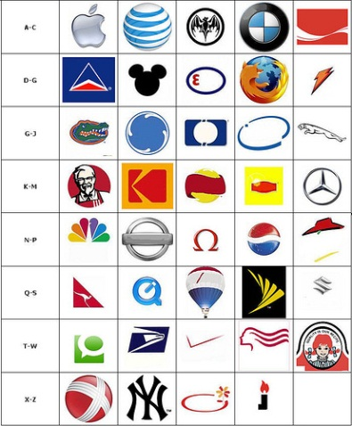
Think globally with brand names… products that did not sell
Clairol's Mist Stick → German market
Creap → (Japanese coffee whitener) English speaking markets
Green Pile → Lawn Fertiliser
Bum → (Spanish Potatoes Crisps) US Market
Pocari Sweat → US market.
Shitto → (Ghanaian Spicy Pepper Sauce) English speaking markets
Daihatsu Charade →English speaking markets
Mitsubishi Pajero → Spanish market
Fiat Uno → Finish market
Toyota MR2 → French market

Slide 6
Brand Name Strategies and Choices
Brand name strategies
Family
brand
names
Individual
brand
names
Combination
brand
names
Kellogg’s, Heinz
Persil, Ariel, Bold
Honda Civic
Microsoft Windows

Slide 7
Brand
Domination
Brand
Values
Brand
Heritage
Brand
Positioning
Brand
Reflection
Brand
Assets
Brand
Personality
Brand
personality

Slide 8
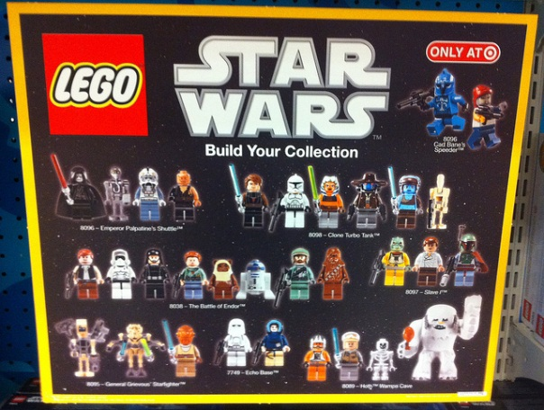
Brand Management Issues
Brand extension and stretching: Are the extensions doing
the brand any good?
Pan–European and global branding: Can the brand be used abroad?
Co-branding
(Lego & Star Wars, HP & Intel)
Example Red Bull and Go Pro Camera
Notes:
Note: added co-branding

Slide 9
Brand extensions: The good, the bad and the ugly…
Recent successes:
Duracell Powermat (wireless charger for mobile devices)
Starbucks Verismo (coffeemaker)
Disney Baby Store
Google Wallet App (Instant Pay App)
Recent failures:
Zippo The Women Perfume
Dr Pepper Marinade
Smith & Wesson Apparel (Clothing range)
Samsonite Outerwear
Virgin Water Purifier

Slide 10
Moving on … Customer Satisfaction and Loyalty

Slide 11
The Concept of Satisfaction
Customers have pre-purchase expectations which are developed from the experience with the product, word-of-mouth recommendations, advertising messages etc.
These expectations provide the basis for post purchase evaluation. A comparison between the expectation and actual consumption experience leads to satisfaction if the performance exceeds expectations ; or results in dissatisfaction

Slide 12
Application: Measuring Satisfaction
Satisfaction is widely measured across a range of sectors to establish the satisfaction of both end consumers and business customers.
Satisfaction surveys typically begin with questions trying to assess the overall satisfaction with a product/service, and then move on to more specific questions. B2B satisfaction surveys are often much more detailed than end consumer surveys.
Satisfaction surveys are typically based on 5 point Likert – type scales, with the values ranging from ‘very dissatisfied’ to ‘very satisfied’.
Satisfaction surveys often include a question that asks the consumer if they would recommend the product/service or if they would use the product/service again.
An example of a typical satisfaction survey can be found here.

Slide 13
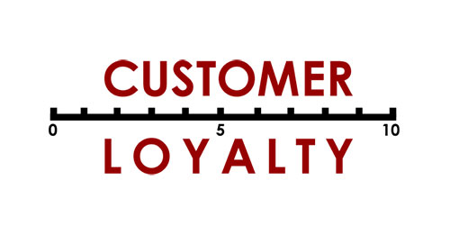
Loyalty - Dick and Basu (1994)
Three drivers of loyalty:
Consumer drivers: personal risk assessment and variety seeking behaviour
Brand drivers: brand reputation and number of close substitutes
Social drivers: level of recommendations and WOM

Slide 14
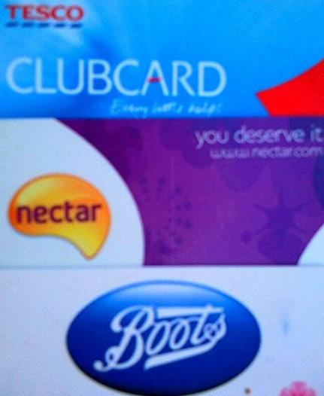
Levels of loyalty
No loyalty: no behavioural or cognitive attachment
Covetous loyalty: no purchase but attachment and predisposition towards brand based on social function of the brand
Inertia loyalty: consumers purchase out of habit or convenience, but there is no emotional or cognitive attachment to the brand
Premium loyalty: high attachment and premium purchases

Slide 15
Types of Loyalty (Oliver, 1997)
Cognitive Loyalty: Based on price, availability, product or service features. Cognitive belief that one brand is preferable to others.
Customers easily switch if a better offer is available. Advertising and other promotional tools can be used to encourage brand switching behaviour.
Affective Loyalty: Customers show a ‘liking’ for the product or service, based on satisfied usage. These costumers also switch brands easily. Discounts, free trials and PoS purchases will encourage and promote switching behaviour.

Slide 16
Types of Loyalty Oliver (1997)
Conative Loyalty: A deep level of commitment to a brand. Customers need strong incentives to switch, e.g. BOGOF offers.
Action Loyalty: Customers show inertia concerning brand switching and there may be high switching costs.
These costumers are not easily enticed to switch brands. Switching behaviour will only happen if a competing product is functionally significantly better than the preferred brand.

Slide 17
The Link between Satisfaction and Loyalty
The relationship between Satisfaction and Loyalty is not linear.
In competitive markets with intense competition, many substitutes, low switching costs even the difference between ‘satisfied’ and ‘very satisfied’ leads to a large difference in loyalty
In non competitive markets, e.g. the customer has little choice, satisfaction has little impact on loyalty (utilities, or products with high switching costs)

Slide 18
Satisfaction, Loyalty and Profitability
Satisfied customer = Loyal customer = Profitable Customer ???
A satisfied customer may not be loyal.
A loyal customer may not be satisfied.
A profitable customer may not be loyal.
Keeping customers increases sales, but satisfied and/or loyal customers may not be the most profitable customers

Slide 19
From Loyalty to Delight
Therefore, simply ‘satisfying’ customers is not enough. Only extremely satisfied customers are truly loyal.
Increasingly, companies are moving away from merely fulfilling expectations but are aiming to achieve customer ‘delight’.
Delight can be defined as unexpected value or unanticipated satisfaction (Lambin, 2000).
It is intrinsically linked to the role of emotions (joy and surprise) and experience.

Slide 20
At the end of this session
You should be familiar with five basic models of change management (Kotter, Eight Step Model, Bridge’s Transition Model, Roger’s Technology Adoption Curve, Kubler-Ross’ Five Stage Change Curve and Prosci’s ADKAR Model) and their strengths and limitations.
You should also be aware of key issues relating to change management – a need for urgency and to tell a compelling story, review of current strategy and creation of a vision, the need for inclusive communication and creation of a dialogue, changing organisational culture, visualising the journey, measuring the effectiveness of change and creating wins, and finally the adaption of performance measurement and dealing with inconsistencies.

