Slide 1

Module: Quality Assurance and Service Improvements
Module code: LCHS7006
Assignment Title: Component 1 Individual Presentation
Student Name: Prathamkumar Himmatlal Solanki
Student id:-2430951
Case Study:Mid Staffordshire NHS Foundation Trust (UK)

Slide 2
Table Of Contents
Topic | Slide No.
Case Study Overview | 3
Why the system failed | 4
The Swiss Cheese Model | 5
Analysing root causes through different model (System theory) | 6
Analyses of the policy issue contributing to the root causes and its influence on service delivery | 7
Impact of service provision | 8
Benchmarking | 9
Evaluation and improvement | 10
Summary | 11
Outlining the report | 12

Slide 3

Case Study Overview
The Mid Staffordshire NHS Trust delivered inhumane and poor care that caused patients’ suffering between 2005 and 2008.
The poor staff morale and lower accountability create a toxic culture in the organisation.
The government agencies and regulators failed to give a warning that caused the long-term issues faced by Mid Staffordshire NHS Trust (The Mid Staffordshire NHS Foundation Trust, 2026).
The case study shows the lack of patient-first culture in the trust that reduces the overall service quality.

Slide 4

Why the system failed
The system of Mid Staffordshire NHS Trust failed primarily due to its negligence in following the patient care standard.
Secondly, there was poor communication among staff and a culture of fear, which was the second reason for this trust’s failure to deliver high-quality healthcare services (The Mid Staffordshire NHS Foundation Trust, 2026).
The management and the board of this NHS trust did not take any serious action based on patients’ complaints, which reduced the accountability of their services over time.
The regulatory bodies failed to detect the actual problem in the early stage, which caused increased problems in the trust’s service delivery over the period.

Slide 5
The Swiss Cheese Model
Leadership and management [Maintaining proper monitoring and ensuring patient safety (Alanazi et al., 2024)]
Workforce and staffing
[Proper employee well-being and appropriate staffing could enhance the service delivery of the NHS trust (Lawrence et al., 2022)]
Regulatory oversight
[Timely inspection by the Care Quality Commission (CQC)]
Whistleblowing and incident reporting
[Accurate reporting about the service quality]
Organisational culture
[Collaborative and fair culture in the organisation]
lack of patient-first culture in the trust that reduces the overall service quality
Targets the financial success over patient safety and poorly oversees the overall process of the trust (The Mid Staffordshire NHS Foundation Trust, 2026).
Lower employee morale and inadequate staffing levels cause low-quality service delivery to patients (Rajan, 2021).
Delayed inspection by the CQC caused the lack of accountability in the trust’s healthcare services (Mortimore, 2021).
The Trust ignored the complaints of patients that caused the lack of proper patient safety.
The culture of fear was the major concern for the Trust’s issues. Also, there was a lack of proper patient-centred care.

Slide 6
Analysing root causes through different model (System theory)
Component | Case study example
Input | Patients seek safe services from NHS trusts and the regulatory guidance must be proper in healthcare operations. Efficient staff must also be recruited by the NHS trusts for the development of their operations (Quick, 2022).
Process | There was a lack of monitoring by the Care Quality Commission (CQC) on the operations of Mid Staffordshire NHS Trust. Also, the staff of the trust did not report negative incidents faced by patients to higher authority (The Mid Staffordshire NHS Foundation Trust, 2026).
Output | As an output, the NHS trust faced challenges related to poor service delivery and the suffering of patients. Due to the negligence of staff and a highly feared culture, the complaints of patients are ignored by staff, which causes misleading treatment in the long run (The Mid Staffordshire NHS Foundation Trust, 2026).
Feedback | Poor leadership capabilities reduce employee morale, which causes low-quality patient care.

Slide 7

Analyses of the policy issue contributing to the root causes and its influence on service delivery
The Mid Staffordshire NHS Trust failed to implement the patient-centred care policy of the NHS trust. The overlooking of patient-centred care reduces the health service quality of the trust.
The weaker monitoring by CQC impacts the monitoring policy of the NHS trust, which causes ineffective service delivery.
The NHS trust also failed to implement the Transparency Policy, which caused a lack of proper communication in the trust.

Slide 8

Impact of service provision
Quality:
The service quality of Mid Staffordshire NHS Trust was lower as it has a lower focus on patient-centred care (The Mid Staffordshire NHS Foundation Trust, 2026).
It deteriorates the overall service quality of the trust by overlooking patients’ needs and preferences.
Efficiency:
The lack of effective communication causes lower efficiency of the trust’s healthcare service delivery to patients (Simon et al., 2022).
It reduces the overall operational efficiency of the NHS trusts.
Equity:
The management and leaders of the trust failed to recognise the patient safety-related issues that caused failure of the trust to maintain better operations.

Slide 9
Benchmarking
Quality domain | Standard guideline | Current practice | NHS Initiatives | Policy metrics
Process | The UK healthcare sector runs under the strong supervision of CQC, utilising a strong person-centred care (CQC, 2022). | The CQC delays the monitoring of the trust’s overall operations. | NHS uses integrated care pathways for ensuring a standardised care process and better service quality (Van der Feltz-Cornelis, 2023). | NICE policy of the UK
Communication | Maintaining a high level of transparency among patients and the caregiver (Fukami and FUKAMI, 2024). | Weaker communication among staff affects the standard communication guidelines. | NHS implement AI-based communication forum for the betterment of the communication process (NHS Confederation, 2026). | East Kent Hospitals NHS Trust Communications and Engagement Strategy.
Structure | Developing the patient-centred care in the healthcare organisations’ operational structure (Hower et al., 2019). | The lack of person-centered care causes a lack in delivering proper care to patients. | The NHS built an integrated care system for the development of the healthcare structure (NHS England, 2024). | NHS Long Term Plan (2019).

Slide 10
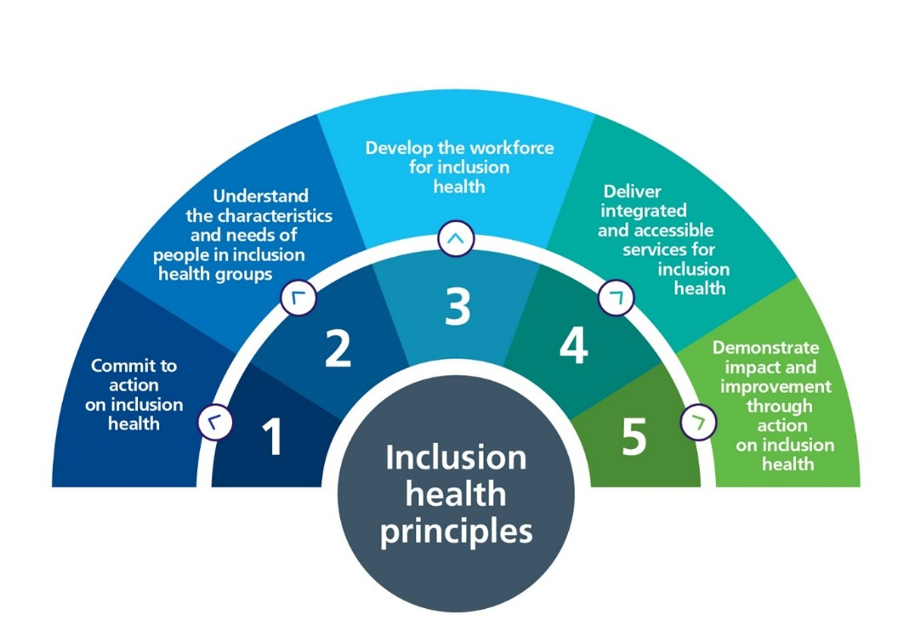
Evaluation and improvement
The NHS trust has utilised benchmarking for improving the quality of its services by recognising the gap in policy implementation.
Using the benchmarking data, the NHS could ensure its long-term operational development.
For the improvement in care service quality, the NHS should promote open and transparent communication among caregivers and patients.
Also, this NHS Trust should follow Transformational leadership style to provide patient safety and better healthcare services (Ahmed et al., 2024).

Slide 11

Summary
The Swiss Cheese Model helps in recognising the root cause of the issues faced by the NHS trust.
Using this model, it is seen that the inconsistent communication, lack of transparency and lack of person-centred care are the main reasons for poor service delivery by Mid Staffordshire NHS Trust.
The lack of communication and person-centred care is the main reason for poor service delivery by the NHS trust.
Trust should focus on service improvement by adopting Transformational leadership.

Slide 12
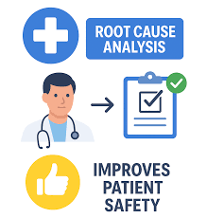
Outlining the report
The in-depth analysis will be done to identify the additional causes of poor healthcare services.
The different literature on this topic will be analysed.
Recommendations and future suggestions for the development of healthcare services.

Slide 13
References
Ahmed, Z., Ellahham, S., Soomro, M., Shams, S. and Latif, K., (2024). Exploring the impact of compassion and leadership on patient safety and quality in healthcare systems: a narrative review. BMJ open quality, 13(Suppl 2).
Alanazi, S.E.M., Al-Dharf, A.A.A., Al-Sharari, A.A., Alanazi, A.D.M., Alanazi, F.A.G., Al-Juhani, F.M., Alatawi, J.S., Albasri, M.N.M., Alshamere, M.H.M., Alwalah, M.H.A. and Al-Sharari, N.M.S., (2024). ‘Patient Safety and Quality of Care: The roles, responsibilities and practices of healthcare.’ The Review of Diabetic Studies, pp.382-386.
CQC, (2022). Person-centred care. Available at: https://www.cqc.org.uk/publications/themed-work/inpatient-coronavirus-experience-care (Accessed 10 February 2026)
Fukami, T. and FUKAMI, T., (2024). Enhancing healthcare accountability for administrators: fostering transparency for patient safety and quality enhancement. Cureus, 16(8). Available at: https://www.cureus.com/articles/268126-enhancing-healthcare-accountability-for-administrators-fostering-transparency-for-patient-safety-and-quality-enhancement.pdf (Accessed 10 February 2026)
Guppy, J.H., Widlund, H., Munro, R. and Price, J., (2024). ‘Incivility in healthcare: the impact of poor communication’. BMJ leader, 8(1). Available at: https://www.researchgate.net/profile/Jim-Price-3/publication/372211470_Incivility_in_healthcare_the_impact_of_poor_communication/links/64c002d1b9ed6874a544d4f5/Incivility-in-healthcare-the-impact-of-poor-communication.pdf
Hower, K.I., Vennedey, V., Hillen, H.A., Kuntz, L., Stock, S., Pfaff, H. and Ansmann, L.,( 2019). Implementation of patient-centred care: which organisational determinants matter from decision maker’s perspective? Results from a qualitative interview study across various health and social care organisations. BMJ open, 9(4), p.e027591. Available at: https://bmjopen.bmj.com/content/bmjopen/9/4/e027591.full.pdf
Lawrence, W., Hine, J., Watson, D., Smedley, J. and Walker-Bone, K., (2022). ‘How to improve hospital employees’ health and well-being: a staff consultation’. BMC Health Services Research, 22(1), p.1488. Available at:https://doi.org/10.1186/s12913-022-08621-y
Mortimore, J., (2021). ‘The process and impact of special measures upon an NHS trust.’
NHS Confederation, (2026). Support for NHS communicators. Available at: https://www.nhsconfed.org/leadership-support/supporting-NHS-communicators
NHS England, (2024). Structure of the NHS. Available at: https://www.england.nhs.uk/long-read/structure-of-the-nhs/
Quick, O., (2022). ‘Duties of candour in healthcare: the truth, the whole truth, and nothing but the truth?’. Medical Law Review, 30(2), pp.324-347. Available at:https://doi.org/10.1093/medlaw/fwac004
Rajan, D., (2021). Organization structure and management practice related factors causing employee turnover: An empirical study among nurses. Eurasian Journal of Higher Education, (3), pp.36-65.
Simon, M., Danner, S., Saavedra, S., Flowers, F., Jackson, A., Ross, J., Abbas, H., Adetoro, E., Ekong, A., Osei, C. and Francone, N., (2022). ‘The complex interplay of communication and trust in healthcare delivery”. Harvard public health review (Cambridge, Mass.), 39, pp.10-54111. Available at:https://doi.org/10.54111/0001/mm5
The Mid Staffordshire NHS Foundation Trust, (2026). Report of the Mid Staffordshire NHS Foundation Trust Public Inquiry. Available at: https://assets.publishing.service.gov.uk/government/uploads/system/uploads/attachment_data/file/279124/0947.pdf (Accessed 10 February 2026)
Van der Feltz-Cornelis, C., Attree, E., Heightman, M., Gabbay, M. and Allsopp, G., (2023). Integrated care pathways: a new approach for integrated care systems. The British Journal of General Practice, 73(734), p.422. Available at: https://pmc.ncbi.nlm.nih.gov/articles/PMC10471334/pdf/bjgpsep-2023-73-734-422.pdf

