Slide 1
Skills for the Workplace Program
BMSK5006
Knowledge and
Information Management
Workshop Day 2

Slide 2

Workshop Content
Assignment
Force Field Analysis

Slide 3
Assignment
Explain the relationship between data, information and knowledge. (8 marks)
Demonstrate your understanding of the uses of data, information, knowledge and wisdom. Explain the relationship between them. Think of your workplace to provide a context where you can explain data, information, knowledge and wisdom. This should help you to provide examples in a meaningful context.

Slide 4
Assignment
Explain the relationship between individual knowledge and organisational knowledge. (8 marks)

Slide 5
Assignment
Demonstrate your understanding of what is meant by individual knowledge and organisational knowledge and of the relationship between the two
Explain how individual knowledge may be converted into organisational knowledge e.g. the different ways which organisations can effectively capture, save, share, and use knowledge at an organisational level e.g. by encouraging people to tell their stories, to record their stories, to ensure they are saved in a manner in which they are easily known and accessible to colleagues within your organisation and to encourage and support others in the organisation to use this knowledge.

Slide 6
Assignment
Apply analysis and modelling techniques to identify knowledge assets. (8 marks)

Slide 7
Assignment
In analysing problems and issues related to knowledge assets, you should be able to demonstrate your understanding of the use of SWOT and PEST - see page 16 on SWOT of KM Techniques (Models) analysis and modelling techniques in order to identify knowledge assets of an organisation.

Slide 8
Assignment
Seek to go further by also identifying the value-added by the knowledge assets within your own area of your organisation
Perform an organisational SWOT analysis in the context of clearly identifying your product(s) or service (s). Apply the SWOT to your organisation in terms of KM.

Slide 9
Assignment
Evaluate actual and potential knowledge assets (8 marks)

Slide 10
Assignment
In the previous section you should have identified your actual and potential knowledge assets within your area of your organisation. You should now seek to evaluate these actual and potential knowledge assets.
In order to conduct an evaluation you should create a means to measure/evaluate them, which might be through the use of a table of what you believe are relevant criteria.
Think of criteria which will allow you to show their actual and/or potential value to the organisation.

Slide 11
Assignment
Explain what is required to create, store, apply and integrate knowledge (12 marks)

Slide 12
Assignment
You should explain how your workplace captures, stores, applies and integrates knowledge (information flow).
You should comment on the validity and value of the information contributing to the knowledge.
You could quote e.g. Davenport with Prusak (1997) re continuous information capture.

Slide 13
Assignment
Think about what kinds of information/knowledge your organisation/workplace needs to capture, store, apply/share and integrate.
Think about how it is captured, stored, shared and integrated into the organisation.
Explain the reasons for what is done.
Also, briefly consider Data Protection issues

Slide 14
Assignment
Consider the importance of Intellectual Property rights (4 marks)
You should consider the impact of IP rights on your organisation. Look to provide some evidence for your analysis.
See the ‘IP Rights doc’ and research other sources.

Slide 15
Assignment
Explain the contribution knowledge assets have on an organisation (8 marks)
You should provide an account of how a range of significant knowledge assets work or how they are used.
Ideally providing a wide evidence base that explains their contribution to the organisation.

Slide 16
Assignment
Evaluate the knowledge requirements for the organisation (8 marks)
See the doc ‘Knowledge Management Techniques (Models): Teaching & Dissemination Concepts by Ann Mackintosh, John Kingston, Ian Filby.’
You will need to provide an evaluation of the knowledge requirements of your organisation showing the value of the knowledge requirements to your organisation.

Slide 17
Assignment
Evaluate the organisation’s framework for enabling knowledge sharing (8 marks)

Slide 18
Assignment
You should provide an evaluation of your organisation’s current approach (framework) for enabling knowledge sharing.
You should seek to make use of a wide and objective evidence base. Look to offer a way forward (solution) or conclusion and/or recommendations.
For example this might include: that good KS behaviours are rewarded and recognised, that good KS practice is embedded within your organisation, that there is a demonstrable and widespread commitment to KM from senior and middle management.

Slide 19
Assignment
Recommend improvements to the current framework (8 marks)
Identify and justify what you think are appropriate and realistic improvements to the organisations current framework for enabling knowledge sharing.

Slide 20

Force Field Analysis Exercise
Consider the driving and restraining forces of change (as described by Lewin 1943)
Draw a Force Field Analysis diagram of reasons which can drive KIM and reasons which can restrain KIM in your own workplace
Illustrate at least 3 driving forces and 3 restraining forces , 1 Strong, 1 Moderate and 1 Weak.

Slide 21
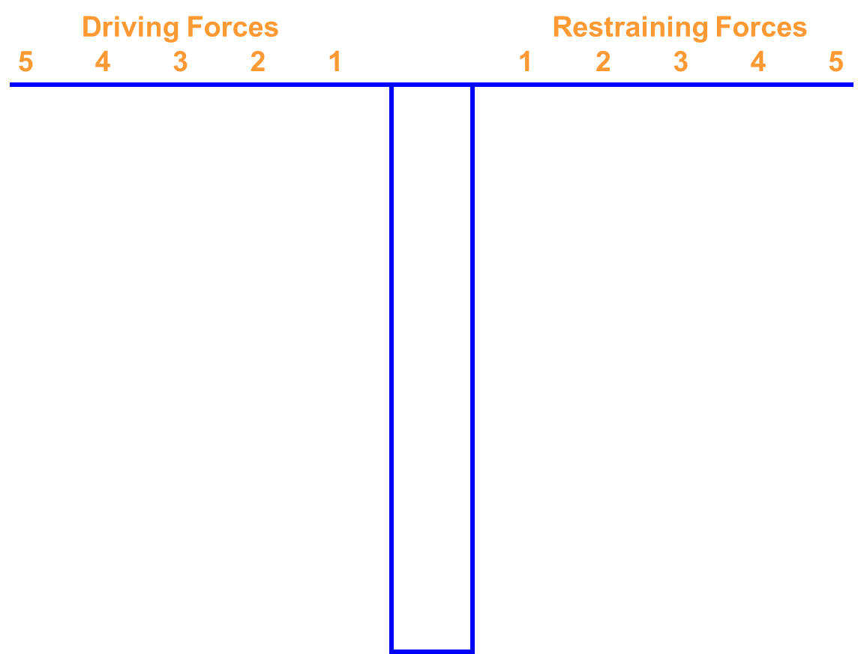
Force Field Analysis

Slide 22
Discussion
Based on your shared findings, what do you consider to be the main challenges to change in an organisational setting?
  Consider your own workplaces in answering this question
  Were there any shared common driving and restraining forces?
  Are the driving forces and restraining forces different in the public and private sector?

Slide 23
Examples Forces for Change
Appropriate Information Systems
Continuous Professional Development
KIM Strategy (if there is one)
Return on Investment (Value for Money)
Resources Allocated
Internet and Intranet
Training and Awareness Raising

Slide 24
Example Forces Against Change
Culture
Time
Resources
Access to relevant information
Protectionism
Ways of Working
Lack of skills/knowledge
Day Job
Focus and Priorities
Return on Investment (Value for Money)
Apathy
Risk Averse Culture
Mind-set
Confusing Amount of Data

Slide 25
GDPR
The General Data Protection Regulation – GDPR will apply in the UK from 25 May 2018.
Brexit will not affect the commencement of the GDPR
It applies to the Personal Data of identifiable person (data subjects)
It relates to processing personal data of EU data subjects even if processed outside the EU
It applies to “Controllers” and “Processors”
It applies to Automated personal data, and structured manual filing

Slide 26
GDPR Principles – Article 5
Personal Data shall be:
  processed lawfully, fairly and in a transparent manner
  collected for specified, explicit and legitimate purposes and not further processed in a manner that is incompatible with those purposes
  adequate, relevant and limited to what is necessary in relation to the purposes for which they are processed (‘data minimisation’)
  accurate and, where necessary, kept up to date
  kept in a form which permits identification of data subjects for no longer than is necessary
  processed in a manner that ensures appropriate security of the personal data

Slide 27
Lawfulness of Processing – Article 6
Legal Obligation
  processing of Personal Data is necessary for compliance with a legal obligation to which the Controller is subject.
Vital Interest – (of the data subject)
  processing of Personal Data is necessary to protect the vital interest of the data subject or of another data subject
Public Task
  processing of Personal Data is necessary for the performance of a task carried out in the public interest or in the exercise of official authority
Contractual Relationship
  processing of Personal Data is necessary for the performance of a contract to which the data subject is a party or for the Controller to take pre-contractual steps at the request of the data subject
Legitimate Interest
  processing is necessary under the Legitimate Interests of the Controller or Third Party, unless these interests are overridden by the data subject’s interests or fundamental rights.
Consent
  any freely given, specific, informed and unambiguous

Slide 28
Legitimate Interest - Three Part Test
Identify and establish your interest
  Why do you want to process the data – what are you trying to achieve?
  Who benefits from the processing? In what way?
  Are there any wider public benefits to the processing?
  How important are those benefits?
  What would the impact be if you couldn’t go ahead?
  Would your use of the data be unethical or unlawful in any way?
Carry out a necessity test.
  Is it a reasonable way to go about it?
  Is there another less intrusive way to achieve the same result?
Conduct a balancing test
  What is the nature of your relationship with the individual?
  Would people expect you to use their data in this way?
  Can you adopt any safeguards to minimise the impact?
  Can you offer an opt-out?

Slide 29
Rights of Data Subjects
Right to be Informed
Right of access to own personal data
Right to rectify inaccuracies
Right to request data portability
Right to be forgotten
Right to object
Right to restrict processing

Slide 30
Right to be Informed
Information for the Data subject will be include:
  Identity and contact details of controller; including DPO if applicable
  Purpose of the processing
  Legal basis for the processing
  Period of storage, or retention criteria
  Data subjects Rights
  Right to lodge a complaint with ICO
  whether the provision of personal data is a statutory or contractual requirement, or a requirement necessary to enter into a contract
  the existence of automated decision-making, including profiling

Slide 31
Receipt of Requests
Controllers shall:
  Have processes to exercise the data subjects rights
  Provide information on action within one month of request
  Provided information free of charge
  Provide the Data subject with information notice (Privacy Notice)

Slide 32
Personal Data Breach
Accidental or unlawful destruction, loss, alteration, unauthorised disclosure of, or access to, personal data. Accidental and/or deliberate causes
Examples
  access by an unauthorised third party;
  deliberate or accidental action (or inaction) by a controller or processor;
  sending personal data to an incorrect recipient;
  computing devices containing personal data being lost or stolen;
  alteration of personal data without permission; and
  loss of availability of personal data.

Slide 33
Reporting Personal Data Breach
Record Breaches
Investigate breach & determine the Impact
  How many
  Impact to the data subject
Mitigate the breach
If it is a ‘notifiable’ breach report to the ICO within 72 hrs
Inform the data subject if it is likely to impact their rights and freedoms

Slide 34
Actions – Questions to Ask
What personal data do you use?
What do you use if for?
What is your justification to process it lawfully?
Where is it stored?
How long do you keep it?
Can you comply with the Rights of the Data subject?
How do you protect it (CIA)?
What are the potential issues in your organisation?

Slide 35
For the Next Session
Think how you could introduce concepts, models and ideas from other areas that can add value to your assignment on Knowledge Management
  Communication
  Learning and Development
  Team Working
  Problem Solving & Continuous Systematic Improvement

Slide 36


Any Questions
36

