Slide 1

Global Marketing Strategy
Pricing
By Will Fleming

Slide 2
What did we learn from last time?
Explain in your own words what you understand by standardisation and adaptation and show how it relates to ethnocentric, polycentric, regiocentric and geocentric policies.
Provide some case studies for an organisation whose international product portfolio needs careful consideration when taking products into a foreign market in the areas of :
The physical product
The name / The brand
The style or design and even
Issues of service

Slide 3

Pricing - an introduction
Of all the marketing mix elements many think pricing is the most:
Flexible
Independent
Controllable
Important
However to be totally effective it needs to have a strategic role and this causes problems in Internatiomal Marketing

Slide 4
Pricing – role in the marketing mix
Pricing has a key role to play in the marketing mix of any organisation as;
An offer to the market or a reflection of value to the customer...
..and therefore as a sign of quality
It enhances differentiation in the marketplace
It signals the organisations competitive position....ant it is highly visible and emotive!

Slide 5
Pricing – approaches to deciding
When setting prices in domestic markets organisations will use the following approaches:
A cost-orientated approach
A market-orientated approach
A competitor-orientated approach
QUESTION???
Which method do you think is the best?

Slide 6
Pricing options in global markets
You should know that there are really only four possible options open to the organisation:
Standardisation or ethnocentric pricing
Adaptation or polycentric pricing
Regiocentric different pricing for different regions and,
Global (sometimes considered as invention) or geocentric pricing

Slide 7
Objectives for pricing in global markets
Objectives for the organisation:
A rate of return
For market stabilisation
To reflect demand/ the markets willingness to pay
As a competitive position
Reflect product differentiation
To achieve market skimming/ early cash recovery
To achieve market penetration & prevent new entrants in to the marketplace.

Slide 8
Pricing – stages in decision making for global markets
Doole and Lowe 2001 recommend this process:
Analyse the factors which influence price
Confirm corporate pricing strategy
Evaluate the various strategic pricing options
Implement the strategies
Manage price and international finance transactions

Slide 9
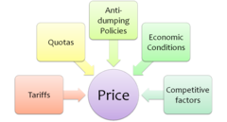
Pricing – influencing factors in global markets
Terpstra & Sarathy 2000 identify 3 major factors:
Company and product factors
Market factors
Environmental factors

Slide 10
1. Company and product factors
These are the key influencing factors & include:
Corporate & marketing objectives
Company pricing strategy/ policy
Product positioning
Cost structures
Costs of international markets
Need for standardisation? or adaptation?

Slide 11
1. Company and product factors
Five key price dynamics have been identified:
Frequency of purchase [hi – v price sensitive]
Degree of necessity [hi – must accept]
Unit price [hi – encourages comparison]
Degree of comparability [hi – accept]
Degree of fashion or status [hi – will pay]

Slide 12
1. Company and product factors
The cost structure and pricing are clearly linked:
How does the organisation allocate costs?
Sales volume affects cost base
The cost base can be managed via economies of scale, experience, production location
There are specific costs to operating in global markets like tariffs, insurance, warehousing, transport, running a sales team.

Slide 13
1. Company and product factors - the export order payment
The options available here are as follows:
A draft – co. agrees to pay
A letter of credit – bank agrees to pay
An open account – needs trust as easy route for non-payment
By consignment – exporter owns the goods until the importer finally sells them
Use of Bills of Exchange – requires payment as instructed and at a specified time.

Slide 14
1. Company and product factors - how to price global products?
There are a number of options available to organisations that are related to the additional costs of transporting when pricing for global marketing:
Ex Wks
F.O.B.
F.A.S.
C & F
C.I.F.
D.D.P.
STUDENT TASK
For next week find out what each of these expressions mean.

Slide 15
2. Market factors
The market factors cover the issues that the organisation face within their particular business/ industry/ market for instance:
Consumer perceptions and responses
Competitor responses
The market structure
The distribution channels
The supply chain
Other key stakeholders

Slide 16
3. Environmental factors
The environmental factors focus on the elements of the business transaction out with the control of the business like:
Government influence and constraints
Currency fluctuations
Currency access & non-money payments
The stage of the business cycle
Levels of inflation

Slide 17
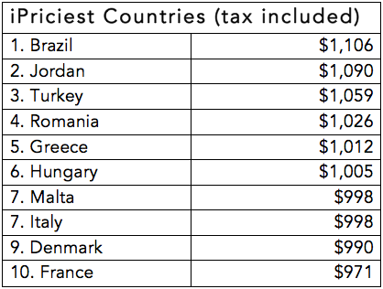
Problems in pricing in global markets
The main problems can be separated into four general categories:
Problems of multi-national
pricing co-ordination
Problems in managing foreign
currency and economic conditions
Problems in obtaining payments
Administration problems

Slide 18
Multi-national pricing co-ordination
This becomes complex as the no. of markets increase due to widely differing markets.
Assmus & Wiesse (1995) identified a particular recurring problem that they called “the grey market” involving the use of parallel importing, re-importing and lateral importing.
To overcome this organisations may use economic, centralisation, formalisation and informal co-ordination measures

Slide 19
Currency transactions
This decision is often the most risky as the organisation can lose competitiveness, profits or upset it’s own product portfolio. The most basic decision is whether to use
Domestic currency OR THE local currency.
Forward buying (buying at today’s prices)
Where there is a risk of non-payment to use leasing or some countertrade like barter, compensation trade, off-setting, switch deals

Slide 20
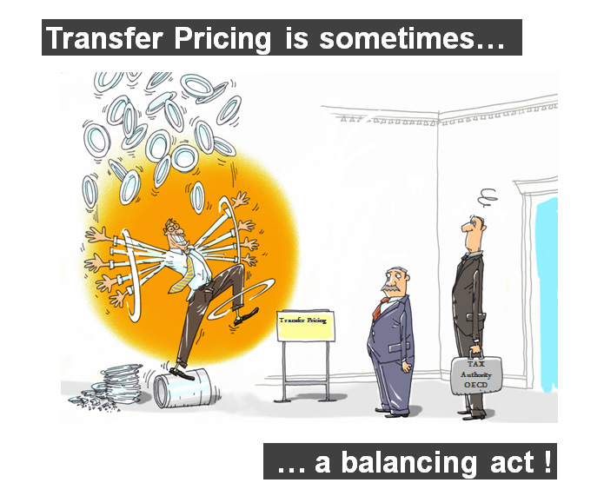
Transfer pricing problems
It is assumed that the decision here is for corporate gain and not divisional benefit. The main options include:
At cost
At arms length
At cost plus.
This area is controversial as it is often used to avoid home & foreign taxes, create barriers for new entrants, falsely improve situations.

Slide 21
For next time….
What do the different expressions related to transporting mean?
Is deciding the price of a product for foreign markets easy? esp if priced in home market.
What options exist that are linked to the adaptation and standardisation debate?
Which factors are the most important when deciding on price?
What is the hamburger or Big Mac standard and what is it used for?

