Slide 1
Colin Michael Crook
Student No: 1705826
Module Title: Live Music & Event Management
Module Code: BMTY7005
Assignment Title: Portfolio
Assignment Code: BMTY7005_LEM_A1
Lecturer: Natalie Smith

Slide 2

RAP ARC FEST
Presentation

Slide 3
Contents Page
Executive Summary
1. Background & History
Event Management/Experience
Event History
2. Event Overview
Vision and Mission
Key Outcomes/deliverables
The Event
Target Market
Stakeholder involvement and benefits
Delivery mechanism
3. Development Plan
Strategic Development
SWOT analysis
4. Event Requirements
Facilities
Services
Production
Legal & insurance
5. Operational Plan
6. Financial Plan & Considerations
Income and Expenditure Projections
7. Management and Business Controls
Event Action Plan
Risk Assessment
8. Debrief
9. Appendices
10. Bibliography

Slide 4
Executive Summary
Rap Arc Fest is a new two-day music festival celebrating the history of Rap, from its early roots in Hip-Hop through to its present association with Grime.
The event’s mission is to provide an immersive experience and education for attendees in the roots and evolution of the Rap art form and its use in a variety of musical genres.
The objective is to increase awareness of the cultural art form and history of Rap music, creating new audiences and bridging the divide that currently stands between current Rap genres.
The event will take place on the 18th – 19th August 2018 at Mote Park in Maidstone, Kent. The total capacity of the venue is 8,000, however the target is to attract 3,000 attendees.
The organiser identified a divide between Rap music fans from the various musical genres and wanted to create an event that brings them all together to experience the historical and evolutionary factors of the art form.
The event aims to attract male and female followers of Hip-Hop, Trap and Grime music aged 18 – 60.
The key benefits to hosting the event are: (1) it will generate an increase in trade for local businesses (2) provide members of the local community with employment (3) allow fans from Greater London and the South East of England the capability of seeing a variety of top international Rap acts in one place (4) increase public and media interest in the musical sectors (5) develop a wider audience for stakeholders and sponsors.
The event and Business Plan has been developed by music industry entrepreneur Colin Crook, a Music Producer, Record Label and Music Publishing Director with over twenty eight years experience in Rap music.
The organiser will conduct bi-weekly Business Plan reviews with section Managers to monitor progress and provide regular end-of-week updates to the event organisation team. Weekly meetings will take place to ensure that deadlines are being met and any problems are resolved properly.

Slide 5
1. Background & History
Event Management/Experience
Colin Crook began his career as a Recording Artist and has had numerous worldwide music releases with labels such as Chrysalis Music UK/EMI, Sony Music (Germany), Instinct Records and Century Vista Records International (USA) to name a few. Colin is a Rapper/Producer/Songwriter who proved himself as a prime mover on the British Hip Hop scene in the Nineties with his release ‘The Band Played The Boogie’ on which he featured with NW1 for Ninja Tune Records. With exceptional sales in the UK, Europe, Japan and the USA, plus mass coverage from MTV, Radio One and Kiss FM, Colin has become a recognised member of the U.K. Rap fraternity. He has been teaching for fourteen years in FE, Secondary and Primary education. He also has nineteen years experience as Managing Director of a Record, Music Publishing and Production Company. He has compiled, produced and project managed numerous Popular Music history CD compilation products, including “Rap Archives Legends” Volumes 1 & 2.
Event History
This is the first year of this event, however the “Rap Archives Legends” brand has been established for twenty three years. Rap Arc Fest is an extension of the brand that began back in 1995 as a CD compilation series created by Colin Crook (based in London), Michael Laron Stringer (based in Hollywood, LA) and Gregory Moore (based in South Bronx, NY).
The concept behind the CD compilations was to educate a younger audience in the roots of Rap and Hip-Hop, highlighting many previously unreleased and rare live performances by many of the UK & US Rap Legends. The motto of the brand is “You Can’t Know Where Hip-Hop’s At Until You Know Where It Came From”, and the CD series represented a no-holds barred audio-documentary of how Rap started in its initial form in the mid-1970’s and forged ahead in its evolution up to the present day.
Two volumes of the album were released on the Sounds Of Urban London Record Label in the UK and Arts Records International in the USA. The albums featured artists such as LL Cool J, Run DMC, Kool Moe Dee, the Beastie Boys and numerous other Rap Legends performing live prior to them being signed to record deals. Each album sold in excess of 100,000 copies and received highly respected reviews within the Hip-Hop press, including The Source, Rap Pages, Hip-Hop Connection and True magazine to name a few. Artists such as Afrika Bambaataa, Jam Master Jay, P Diddy and Hip-Hop mogul Russell Simmons have all praised the series and its concept to keep Rap true to form and educate the masses on where this art form started before it struck worldwide.
Rap Arc Fest will follow this concept, whereby the audience will receive an audio and visual educational experience of the roots of Hip-Hop and Rap through the presentation of featured live performances by current and original Rap music Legends to help bridge the gap between younger and older fans alike. Many of today’s Rap audience have no idea about the history of the art form that was very much a part of the Hip-Hop culture and from where it originated.
There are a number of Hip-Hop and Grime music events and festivals worldwide, including the Outlook Festival and Fresh Island in Croatia, The Wireless Festival in London, Couleur Café in Belgium, the Parklife Festival in Manchester, Paris Hip Hop Festival in France and Hip Hop Kemp in the Czech Republic. However, none have drawn the attention to the Rap art form that is backbone behind these musical genres or brought these Rap influenced genres under one roof.
Rap has a history spanning over forty years and has grown in popularity. The event aims to attract male and female followers of Hip-Hop, Trap and Grime music aged between eighteen and sixty years plus.

Slide 6
2. Event Overview
Vision
The long term aim of the festival is to educate, develop and strengthen the bond between the fans of Rap in its various musical forms. Rap is the art of storytelling and whilst it is still in use today and strong as it has ever been, the music that sits underneath it has diversified and created divisions between the genres. This festival will bring the genres influenced by Rap under one roof to experience, educate and nurture fans of the art form.
Mission
Rap started as the vocal element in Hip-Hop music in the mid-1970’s. It has been used in every genre from Hip-House, Garage, Jungle and Drum & Bass to its current inclusion as part of Grime and Trap music. The vision of the festival will be delivered by presenting the artists in their various musical forms on a single stage, from the international superstars of the bygone era to the breaking new acts and current superstars who are currently topping the UK and US charts. The event will also feature other art forms that have been influenced by Rap music, from break and street dancers to graffiti street art and scratch DJ’ing. The attendees will experience Rap’s musical history, influence and evolution over the span of two days.
Key Outcomes/deliverables – Targets/Objectives
The Event
The event will take place on the 18th and 19th August 2018 and operate between 12pm and 12am each day. These dates were selected due to the likelihood of good weather during the summer. Taking place at Mote Park in Maidstone in Kent, the venue is a regular provider of festivals and has an overall capacity of 8,000 people. The programme will feature seven top US Rap acts, seventeen top UK Rap acts and one new breaking UK Rap act.
The line-up includes:
Day 1 (daytime): Krept & Konan, Hijack, Paigey Cakey, Blade, the Rocksteady Crew (dance troupe), MC Merlin, Ms Banks, Ghetts and KRS One.
Day 1 (evening): Roots Manuva, Afrika Bambaata, Jay-Z and Wiley.
Day 2 (daytime): Silver Bullet, Rejjie Snow, Little Simz, Skinnyman, Diversity (dance troupe), Blak Twang, Mikez Blaze, Nadia Rose and Q-Tip.
Day 2 (evening): Rodney P, Chuck D, Drake and Stormzy.
Ticket prices will be set at £80 for a day-pass and £150.00 for both days.
In addition to live performances, Hip-Hop outdoor theatre performances will be run by throughout the day by Boy Blue Entertainment (Barbican Theatre) and UK Rapper Akala (Hip-Hop Shakespeare), plus a pop-up cinema showing a selection of classic Hip-Hop movies and documentaries. There will be fairground attractions supplied by Contraband Events and a variety of pop-up shops and stalls.
Target Market
The target market is fans of Rap in its variety of genres, from Hip-Hop to Grime and Trap music. The target audience from this fan base is aged between 18yrs and 60yrs, ranging from Hip-Hop’s original Rap fans to the fans of the present-day Grime scene. The audience is culturally diverse and come from all across the world. The direct target audience are UK fans, however future growth and development will allow for further promotion throughout Europe and the USA.
Stakeholder Involvement and Benefits –
Current event partners include the Barbican Theatre, who will benefit from the event by promoting their Hip-Hop Theatre programmes direct to their target audience through sample performances. Event partner and UK Rap artist Akala will benefit from the event by promoting his “Hip-Hop Shakespeare” Theatre performances direct to his target audience, providing growth for future shows and performances. These theatre performances are being provided for free during the event, allowing both partners to directly promote and advertise to their target audience and creating a heightened awareness of the use of Rap in theatrical performances.
Sponsors include Monster Energy and JD Sports, two brands that receive a large custom base from fans of Rap music. The benefits for both brands for sponsoring the event is that they will be able to advertise and/or sell their products on site, providing the Rap fans with new and exclusive product lines from both companies. Public funders include the British Arts Council and the PRS Foundation, who will benefit from a heightened awareness of their work and support for the arts and will benefit the Rap performers by allowing them to reach a wider audience. The host venue will benefit from drawing a new, untapped audience and the local community will benefit from receiving increased employment over the two day period.

Slide 7
Delivery Mechanism
The staff listed below will be required to deliver the event.
Project Manager: The organiser, Colin Crook, will oversee the operation of the event, management and staff as a whole. He will ensure the vision of the event is maintained throughout planning and delivery. He will manage timelines and ensure deadlines are being met on schedule. Colin will attend weekly meetings with event managers and staff to ensure targets are being met by their deadlines.
Artist/Act Bookings (UK): The responsibility for booking and negotiating fees with UK acts will lie with the event organiser, Colin Crook. With his extensive contact base, personal and business relationships within the UK Rap industry, Colin can easily access the acts proposed to perform at the event. Artist bookings will need to be confirmed by the first week in February 2018.
Artist/Act Bookings (USA): Rap Archives Legends US partner Michael Laron Stringer will be responsible for booking the proposed US acts for the event. Michael will liaise with the Project Manager with regards to the negotiation and agreement of artist fees. Michael has an extensive contact base within the US Hip-Hop market and is ideally placed to carry out this role. Additional assistance, where necessary, can be supplied by Creative Artists Agency. Artist bookings will need to be confirmed by the first week in February 2018.
Production Manager: Jordan Lazarus will be responsible for music instruments and equipment logistics. He will be responsible for the booking and delivery/pick-up times. All instruments and equipment will need to be booked by the second week of May 2018.
Tour Manager: Erzsebet Hehn will be responsible for the artist/act travel requirements and staff logistics (travel, what time they need to get to the event, lunch breaks, etc.). As a Manager with many years experience in the travel industry, she will be responsible for booking flights, accommodation, transportation, drinks and food. Accommodation will be booked through Air B’n’B and return flights will be arranged via WOW Air from the USA to the UK. All flights and accommodation will be confirmed by the second week of May 2018.
Marketing and Promotion: Desiree Banugo will be responsible for social media, press and radio promotion and advertising. A specialist in this field with many years experience working with top corporate brands, Desiree will ensure that the marketing and promotion will be delivered in a cost-effective way to ensure it remains on target with the best results.
Artist Liaison: Aaron Watts will be responsible for dealing with the acts and their managers on the event days. He will oversee the artist’s load-in of equipment and notify them of sound check times. Aaron will also show the artist/act to their dressing room and direct them to their promotional activities (i.e.: interviews, TV, Press, autograph signings). Aaron will also notify the artist/act of the time they should arrive at the event and when they are able to leave.
Staff: An estimated thirty stewards will be required for the event to work 10-hour shifts over the two days of the festival. An additional twenty volunteers will be required to clear rubbish at the end of each day.
Security: Supplied by One Nation Security, they will have a duty of care of attendees, ensuring there are no criminal or illegal acts taking place at the festival. They will ensure attendees are not partaking in excessive alcohol consumption or drug use, and be responsible for reporting matters of concern to Police and Event Organiser.
Stage Manager: Denis Simms will be responsible for making sure each artist/act are on stage at the right time
Runners: An estimated eight runners will be required to provide stage, lighting and equipment set-up support. These will be located via LinkedIn website and confirmed for hire by the end of the first week of May 2018.
Event MC: There will be two MC’s required, one for each day of the event. These will include BBC1xtra Hip-Hop DJ Charlie Sloth and Mi-Soul Radio DJ Dave ‘VJ’ Morrissey.
Artist/Act Support DJ’s: Two Scratch DJ’s will be required for the event. These will include BBC1xtra Hip-Hop DJ Charlie Sloth and Kiss FM Hip-Hop DJ MK.
Catering: Beaubray Catering Services of Maidstone will be hired to supply catering for the event.
Alcohol: Nip from the Hip Ltd of Maidstone will supply flavoured spirits for the event and local Brewer Cave Direct will supply beer for the festival. Mote Park already hold a Premises License, whilst the individual Brewers hold Entertainment and Alcohol Licenses.
First Aid: St John’s Ambulance will provide first aid cover for the event. Application will need to be made immediately to provide enough time for them to carry out a risk assessment and quote for the level of cover they recommend.

Slide 8
3. Development Plan
Strategic Development
The key objectives include cross-promotion of the various genres of Rap music to a wider fan base, providing knowledge from a historical context to Rap fans and the promotion of new and older types of Rap music by live performances being presented on the festival stage, plus movie and documentary viewings in a pop-up cinema.
SWOT analysis
Strengths | Weaknesses
Promotes both historical and future development in Rap | Distance from London for travellers
Unique event cross-promoting all areas of Rap music | Requires extensive planning and preparation across two nations
Bridges gaps between younger and older generations | Area unfamiliar to many visitors
Opportunities | Threats
To grow into new markets and invite in different age groups | Low ticket sales
To promote the emerging and developed international talents in Rap music | Label/act cancellations
Growth and development of festival into other global territories | Potential for adverse weather to disrupt the event

Slide 9
4. Event Requirements
This section outlines the requirements on an operational level to deliver the event:
Facilities – Portable toilets will be required around the site. Accommodation will be required only for US artists. Catering and communication (walkie talkies) will be required. St John’s Ambulance will need their vehicle parked on site to attend any accidents or emergencies.
Services – Kent Police will provide emergency Policing services for the event. St John’s Ambulance will provide medical requirements. Security is being supplied by One Nation Security and will require 30 staff members to cover the 3,000 attendees. Maidstone Fire Service will provide risk assessment and fire services. Traffic Management will be supplied by steward staff.
Production – The production equipment required is:
Power and fencing (supplied by venue)
Staging
PA system
Stage lighting
Projection Screen
Legal & Insurance – Public Liability insurance will be required for the event, however this will need to be checked with the venue to see if they already have cover. Insurance can also be applied for to protect the event from unpredictable weather. All staff will be employed on a self-employed basis, therefore they would be responsible for their own insurance policies. Leisure Insure provide a specialist Festival Insurance covering Public Liability, Products Liability, Employers’ Liability, Event Equipment (fire, theft and damage) and Event Cancellation Costs.
In addition, a specialist Non-Appearance Insurance can be provided and will be requested as part of a bespoke event insurance package. Insurance company Worldwide Special Risks highlights the importance of this insurance when contracting live music performers. They state:
“Non-Appearance Insurance is an additional option when taking out Cancellation cover. This creates protection where an event is dependent on the attendance of one or more individuals. For example the Key Speaker at your conference is unavoidably delayed, the singer at your concert becomes ill or the Bride can’t make it to the church in time (free will excluded of course!).” (Worldwide Special Risks, 1999).

Slide 10
Licenses – It will be vitally important to check with the venue owners that they have PRS, PPL and VPL licenses. If not, it is essential that this is consider in the operational set up. As noted by Solicitor Andy Grimsey of Poppleston Allen Solicitors, he states:
“Some people believe (or convince themselves) that obtaining a licence under the Licensing Act 2003 covers their obligations under copyright law. This is of course nonsense. Check that you are paying the correct tariffs to PRS and PPL where applicable as well as any associated video copyright requirements” (Eventbrite, 2017)
Additionally, it will be necessary to ensure that Mote Park in Maidstone have a Premises License and an Entertainment License, especially regarding the festival aim to end at midnight on each day of the event. The Resource Centre advises:
“Some types of entertainment require the premises to have an entertainment licence from the local authority. In general, events taking place at night between 11pm and 8am require an entertainment licence.” (Resource Centre, 2017)
The festival aims to host a pop-up cinema showing classic Rap movies and documentaries. An additional licence required to ensure this can take place is a Cinema Licence. In the British Film Institute guide “How to set up a Film Festival”, the film organisation advises:
“If you are holding your festival in an unusual venue such as a cathedral or a park you can apply for a one off Occasional Licence.”(bfi, 2001)
On inspection of the Maidstone Borough Website, Lorraine Neale (Maidstone Borough Council, 2014) states that Mote Park does have a Premises Licence. However, there is a time restriction of 11pm on weekends for Plays, Films, Live Music, Recorded Music, Performance of Dance and supply of alcohol. As the licence displayed on the website is three years old, the current licence policy will need to be verified with Maidstone Borough Council to establish whether these time restrictions are still in place. In the event that these restrictions are still in place, the event time will be adapted to run between 11:00 – 23:00 hours unless an extension can be applied for.

Slide 11
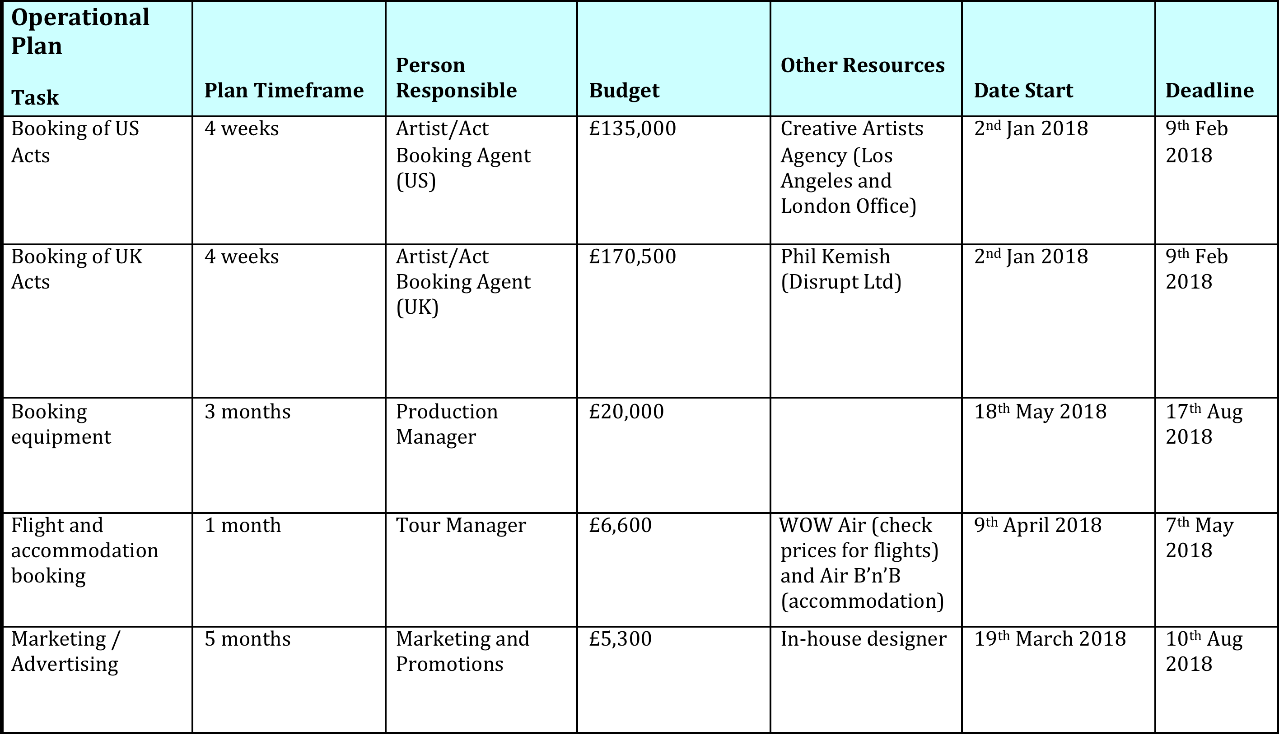
5. Operational Plan

Slide 12
6. Financial Plan & Considerations

Slide 13
Event Action Plan
7. Management & Business Controls

Slide 14
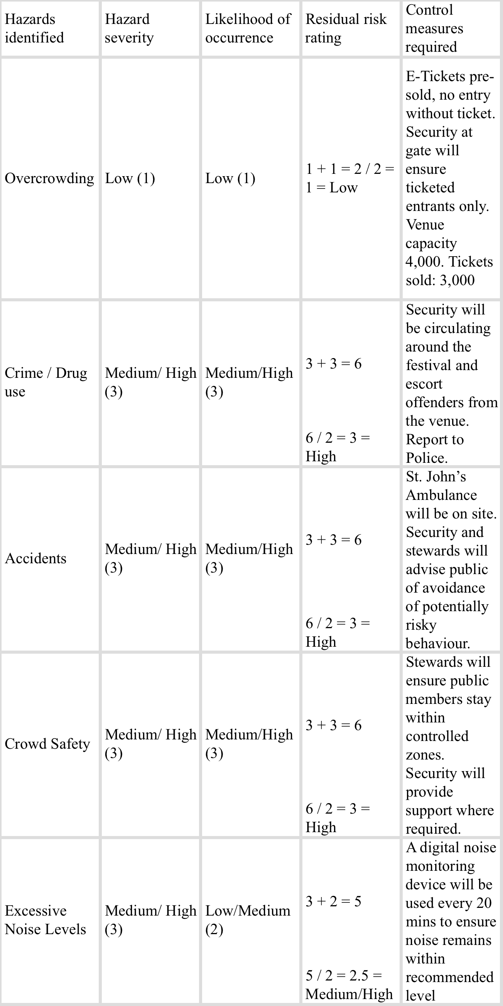
Risk Assessment

Slide 15
Risk Assessment (continued) -
As noted on the “Maidstone Borough Council Event Application Form: Public Open Spaces” (Maidstone Borough Council, 2012), it states that risk assessments need to be completed at least six weeks prior to the booked event and for large scale events, it is necessary to complete and send the application at least two months prior to the event. Therefore, it will be necessary to meet these deadline no later than 18th June 2018.
Protecting staff and workers from excessive noise levels is a legal responsibility of the event organiser. Advice provided on the Sound Advice website suggests:
“Under the law employers have a duty to protect their own employees from the risks associated with high noise exposures. In addition there is a duty to other workers who are also put at risk by their noisy activities.” (Sound Advice, 2007).
Therefore, it is important to ensure that members of staff are not positioned in front of sound speaker systems for prolonged periods. There is no such legal responsibility with regards to the audience, however Government agency Health and Safety Executive provides guidelines to protect the public from prolonged exposure to noise levels, whereby they state:
“Where practical, the audience should not be allowed within 3m of any loudspeaker. This can be achieved by the use of approved safety barriers and dedicated stewards, wearing appropriate hearing protection. Where this is not practical, the overall music sound levels will have to be modified so that people closer than 3m to the loudspeakers are not exposed to an Event LAeq of more than 107 dB or C-weighted peak sound pressure levels of more than 140 dB. Under no circumstances should the audience and loudspeaker separation distance be less than 1m.” (Health and Safety Executive, 2015).
With recent terrorism attacks targeting live events, extra precautionary methods will need to be used to lessen any risk of this happening at the festival. Website Safety & Health Practitioner advises how important procedures need to be in place:
“Perhaps the biggest mistake that an event organiser can make is to overlook the need for an effective evacuation plan – a surprisingly common error across all sectors.” (Haitjema, 2016).
,

Slide 16
8. Debrief
The event went well, however net profits at the end of the event were extremely low from ticket sales. Other than this small amount of profit (£923.00), additional profits have been generated on merchandise sales. In order for the event to be self-sustainable for future events, further funds will need to be raised through sponsorship and other methods.
Communication between the staff, management, security and St. John’s Ambulance crew was very good and safety precautions were met adequately.
Some drugs were confiscated on site, even after security searches were conducted on entry. Offenders were reported to Kent Police and escorted off of the premises. Future events will require additional stringent methods to tackle drugs being brought on to site.
Setting up and breaking down of structures and equipment was completed according to time schedule.
A strict approach was taken to gang formations and potential outbreaks of violence or fighting, avoiding any major incidence.
An update is required for the next event of the festival branding logo. Any new logo should be based on the original logo, however improvements should be made to keep the design in line with current trends.

Slide 17
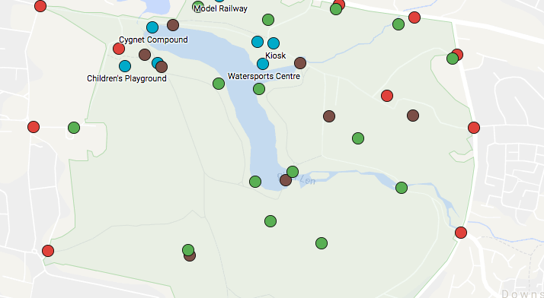
9. Appendices
Site Plan (Google Maps, 2018)

Slide 18
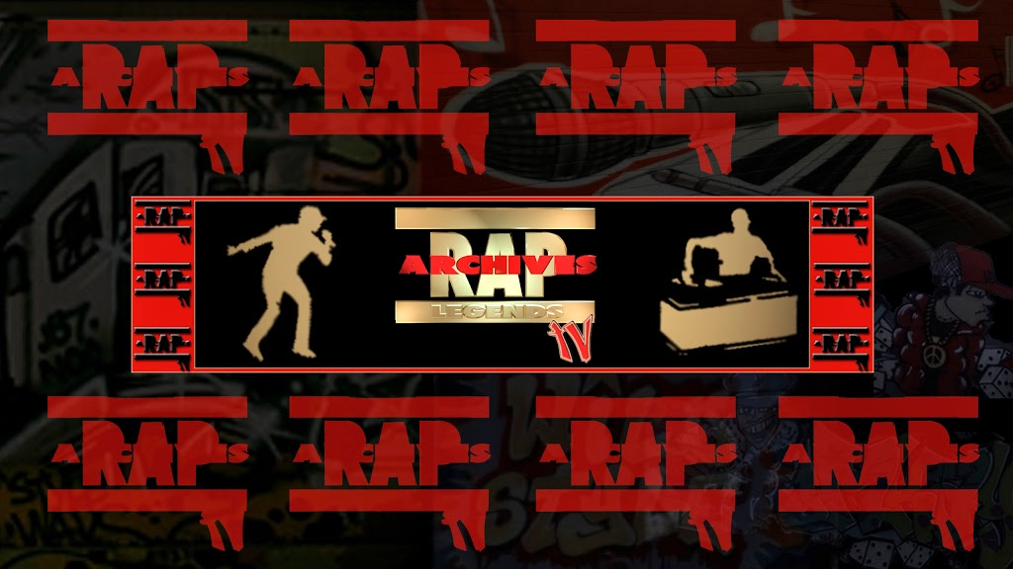





Merchandise and Banners

Slide 19
10. Bibliography
bfi (2001). How to set up a Film Festival. London: bfi. p11.
Eventbrite. (2017). A Simple Guide to Premises Licence Rules for Events. Available: https://www.eventbrite.co.uk/blog/premises-licence-rules-for-events-ds00/. Last accessed 8th Jan 2018.
Google. (2018). Map of Mote Park in Maidstone showing areas of interest.. Available: https://www.google.com/maps/d/viewer?mid=1xx7ryAB4B7pll5TrZWQtHctsBkQ&ll=51.26536325730411%2C0.5451297579193124&z=15. Last accessed 13th Jan 2018.
Haitjema, W. (2016). The risk factor – how to judge event security.Available: https://www.shponline.co.uk/the-risk-factor-how-to-judge-event-security/. Last accessed 13th Jan 2018.
Health and Safety Executive. (2015). Noise. Available: http://www.hse.gov.uk/event-safety/noise.htm. Last accessed 13th Jan 2018.
Maidstone Borough Council. (2012). Maidstone Borough Council Event Application Form: Public Open Spaces. Available: https://www.maidstone.gov.uk/__data/assets/pdf_file/0004/28849/Event-Application-Form.pdf. Last accessed 8th Jan 2018.
Neale, L. (2014). PARTS OF MOTE PARK, MAIDSTONE. Available: https://meetings.maidstone.gov.uk/documents/s37789/Premise%20Licence%20application%20under%20the%20LA%202003%20for%20Mote%20Park.html?CT=2. Last accessed 13th Jan 2018.
Resource Centre. (2017). Licensing and regulations for events and fundraising activities. Available: https://www.resourcecentre.org.uk/information/licensing-and-regulations/#Entertainment. Last accessed 8th Jan 2018.
Sound Advice. (2007). Amplified Live Music. Available: http://www.soundadvice.info/amplifiedlivemusic/casestudies.htm#outdoor. Last accessed 13th Jan 2018.
Worldwide Special Risks. (1999). Cancellation & Non Appearance.Available: http://www.worldwidespecialrisks.co.uk/event-insurance/cancellation-and-non-appearance/. Last accessed 13th Jan 2018.

