Slide 1
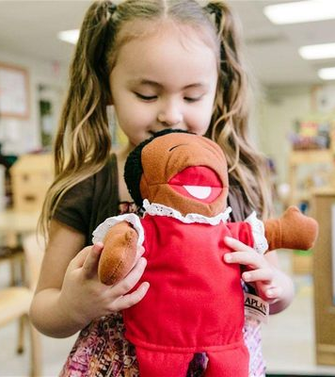

MA Developmental and Therapeutic Play
Leanna Cresci
This Photo by Unknown author is licensed under CC BY-ND.

Slide 2
What I am going to be discussing during today's presentation:
- My background in Early Years
- What I have studied during my BA in Early Years Education and Care
-What is play therapy?
-BAPT (British Association of Play Therapy)
-What I did to get on to the MA in Developmental and Therapeutic Play
-What I can offer the MA course/ play therapy industry
-Why I chose a future within Play Therapy
- About the MA course
-My plans for the future

Slide 3
My background in Early Years
I am an Early Years practitioner that has just started a role as a nursery nurse. Up until recently I was a teaching assistant for 3 years.
I became a teaching assistant after completing a level 3 in childcare and advanced playwork. This is when I found my passion for children learning through play.
I am due to graduate from my undergraduate course in 2020.

Slide 4
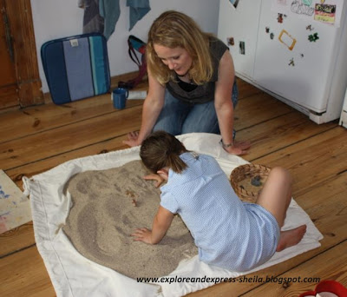
During my university course I have studied all areas of children's learning, development and needs but the part I have found most interesting is the play aspect.
I started looking in to play therapy when deciding on what to do next. I found websites such a prospects useful as it told me exactly what I needed to know about the role.
My degree has taught me how to be resilient and reflective which is a vital part of being a play therapist, therefore I felt I have gained the skills to take on such a career.
I attened an open evening to ensure I was happy with my chosen university. I found this helpful and reassuring that I was choosing the correct course for me.
This Photo by Unknown author is licensed under CC BY-NC-ND.
I decided to join groups on social media that look in to play therapy and where play therapists themselves can post about their experiences. Reading their opinions only made me want to carry out the course even more.

Slide 5
What my BA has taught me:
That thinking critically is not always a negative thing to do
To take notice of feedback
To work well under pressure and within tight time scales
The importance of safeguarding
How to become confident speaking in front of others
To work as part of a team and independently
This is to name just a few but all of which are important and enable me to take on a masters course next year...

Slide 6
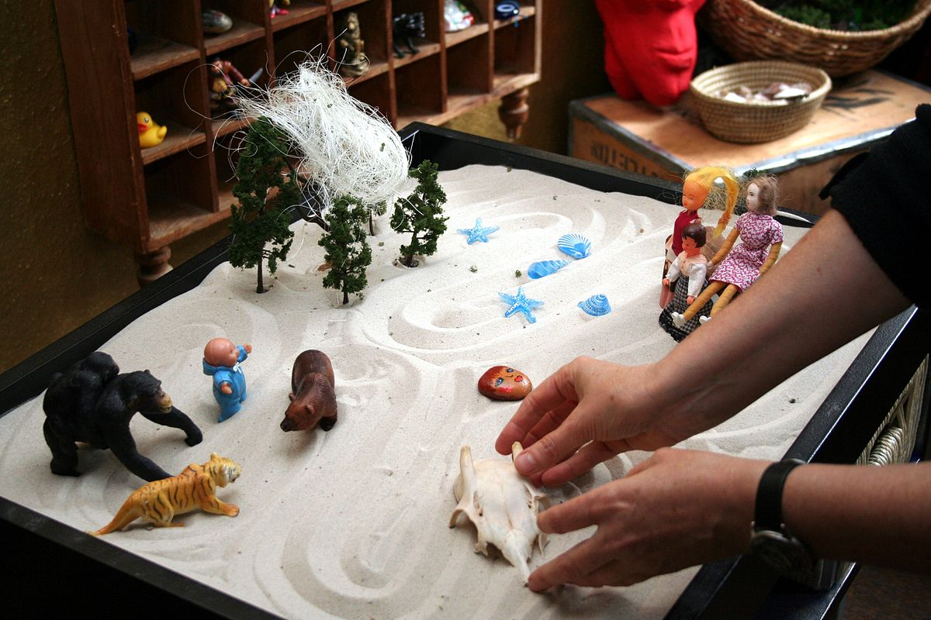
What is play therapy?
Play therapy is a response to children's mental health needs. Play therapy is unique as children can explain their feelings through play.
It can be carried out in all sorts of settings such as an educational setting, a hospital and at home.
According to the British Association of Play Therapists (2014) play is vital to children's development and play therapy can help them understand their muddled feelings in a way that they don't feel pressured to try and explain them verbally.
In order to become a play therapist you must complete the MA course.
This Photo by Unknown author is licensed under CC BY-SA.

Slide 7


Once qualified you can register as a play therapist to access many useful resources and advice.
BAPT stands for The British Association of Play Therapists. It is a charity that was formed In 2006 and it gives support to Play Therapists that are registered under them and to families seeking help from a Play Therapist.
On their webite you can search for a Play Therapist that works in your area. You can read up on their background and how they can help.
BAPT
They provide jounral articles including research that has been done in to Play Therapy.
Practitioners can find resources to aid their sessions with the children they are working with.

Slide 8

What I need to do next...
The next step after graduating from my undergraduate at UWTSD is to carry out my MA in developmental and therapeutic play at Swansea University.
I researched the course in much detail. I then got in contact with the course leader in order to have my questions answered.
I decided to apply for the course and I have since been accepted to start in September 2020.
This Photo by Unknown author is licensed under CC BY-NC-ND.

Slide 9
About the course...
The course is carried out at Swansea University's singleton campus.
It takes 1 year to complete. The entry requirements include a 2:2 at undergraduate level and some experience of working with children.
There are 5 modules including:
-Play theory and practice
-Researching childhood
-Perspectives on play
-Understanding and observing child development
-Therapeutic work with children
You are also required to produce a 20,000 word dissertation throughout the duration of the course.
With regards to employability the University services provide workshops and career fairs to help find you employment after graduation.

Slide 10
What I can offer the course/ play therapy industry
I believe it takes a nurturing and empathetic practitioner to understand the needs of children that require the use of play therapy, I strongly believe I carry out these values.
I believe I have the knowledge and understanding it takes to be able to help children.
With my background in eduaction and an undergradte degree in Early Years I have gained both hands on and academic knowledge on how to help children in all aspects of their development.
I am happy to work independently and as part of a team which is required when working as a play therapist.
I am aware of the importance of needing strong relationships with the parents of the children I am working with and I have experience doing so.

Slide 11

Why I've decided on a future within Play Therapy...
Deciding on what to do next was a decision that took a lot of research.
I chose this route as it makes me feel excited for my future. It has made me have a positive outlook on what is ahead of me and it involes being hands on helping children which is what I have always been inspired to do.
During my research I discovered that Play Therapy is becoming more recognised and professionals are now trying to promote it as they have seen the results it can have on children's development.
I have also realised the demand for Play therapists, especially in our country.
This Photo by Unknown author is licensed under CC BY-NC-ND.

Slide 12
My plans for the future...
My plan for the future is to complete my BA in Early Years in July 2020 and complete the MA in Developmental and Therapeutic play by September 2021 and my hope is to achieve a position within the NHS as a registered play therapist shortly after.
My hope is to one day become self-employed and work in all types of settings such as schools, hospitals and the home environment. I have researched how to become registered to work on a self-employed basis.
I plan on achieving the above by using the skills and values I have inherited throughout the duration of my undergraduate course. It has taught me theory, critical thinking, team-work, resilience, time keeping, working under pressure, this is just naming a few.

Slide 13
REFERENCE LIST :
BAPT (2014) Play Therapy. Available at: https://www.bapt.info/play-therapy/ [Accessed: 13th Jan 2020]
Prospects (2020) Play Therapy. Available at: https://www.prospects.ac.uk/job-profiles/play-therapist [Accessed: 12th Jan 2020]
Swansea University (no date) Developmental and Therapeutic Play. Available at: https://www.swansea.ac.uk/postgraduate/taught/humanandhealthsciences/developmental-and-therapeutic-play/ [Accessed: 14th Jan 2020]
Image of adults observing (no date) Available at: https://childdevelopmentresources.files.wordpress.com/2011/04/istock_000014510075large.jpg [online image] Accessed: 14th Jan 2020]
Image of children laying happily (no date) Available at: https://res.cloudinary.com/psychlopaedia/image/upload/w_1200,h_500,c_fill,g_face/q_40/remote/2016/09/89506247_children-lying-in-circle-on-grass_web.jpg [online image] [Accessed: 14th Jan 2020]
Image of girl playing happily (no date) Available at: https://62e528761d0685343e1c-f3d1b99a743ffa4142d9d7f1978d9686.ssl.cf2.rackcdn.com/files/37294/width237/gq6m7svh-1386637045.jpg [online image] [Accessed: 14th Jan 2020]
Image of sandtray for play therapy (no date) Available at: https://upload.wikimedia.org/wikipedia/commons/thumb/c/c2/Sandspiel1.jpg/1200px-Sandspiel1.jpg [online image] [Accessed: 14th Jan 2020]

