Slide 1
PRESENTATION
LCLM4004
Problem Solving and Decision Making
Analysing the Business Challenges of Basil's Bakery: A Problem-Solving and Decision-Making Approach
PRESENTED By: Liana Eizane

Slide 2
Introduction & Case Overview
Basil's Bakery is an independent artisan bakery located in a busy retail park in Coventry, established in 2015.
The business experienced steady sales growth until 2019, but sales have remained approximately 25% below pre-pandemic levels since COVID-19.
Rising operating costs, reduced customer footfall, and changing shopping and working patterns are threatening the bakery's long-term sustainability (Kotler et al., 2022).
This presentation analyses the causes of declining sales using the 5W2H model, PESTEL analysis, and Fishbone diagram to identify problems and support effective business decision-making (Kotler et al., 2022).

Slide 3
Nature and Scope of the Problem
Sales have remained stagnant since 2023, despite the recovery after the COVID-19 pandemic.
Customer footfall has declined because of retail store closures and increased remote and hybrid working, reducing lunchtime demand.
Rising costs for organic ingredients, rent, utilities and insurance have increased operating expenses, while the absence of delivery and an effective pre-order system limits customer convenience (Kotler et al., 2022).
These issues have reduced revenue, weakened competitiveness and placed pressure on the bakery's long-term profitability (Office for National Statistics, 2024).

Slide 4
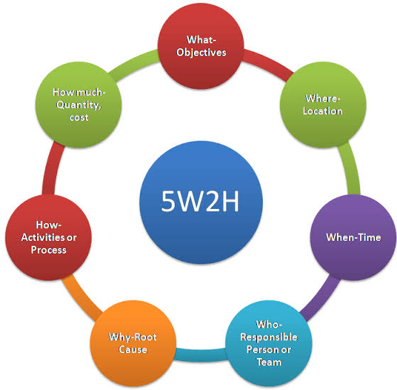
Applying the 5W2H Model
What: Sales remain around 25% below pre-pandemic levels.
Why: Changing consumer behaviour, reduced footfall and increasing operating costs.
Where: Basil's Bakery, Coventry retail park.
When: The problem has continued from 2020 to 2025.
Who: Basil, customers, retail workers and office employees are affected.
How/How Much: Limited online services and rising expenses reduce revenue and profitability. The 5W2H model provides a structured framework for understanding problems before making informed business decisions (Slack and Brandon-Jones, 2018).
Source: (TECHIEQUALITY, 2024)

Slide 5
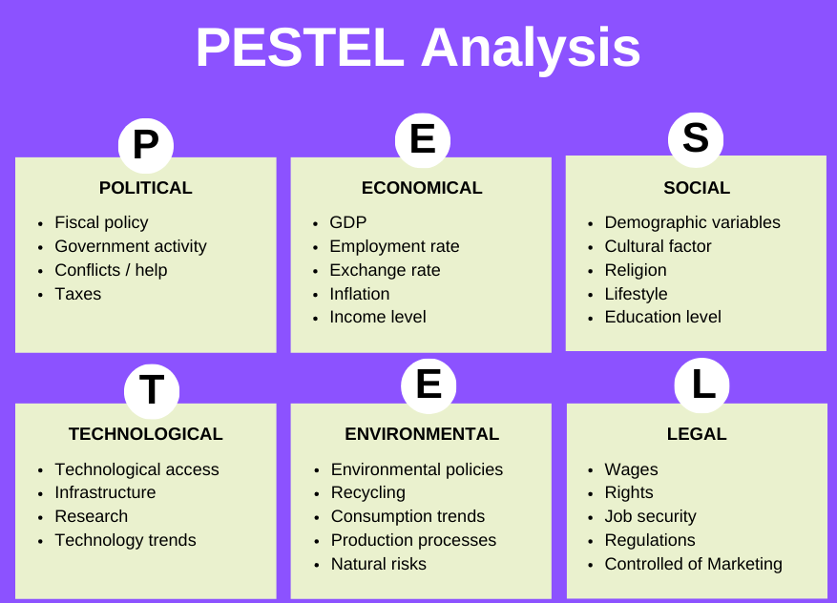
PESTEL Analysis
Political: Rising business rates and regulatory requirements increase operating costs.
Economic: Inflation and higher prices for organic ingredients reduce profit margins.
Social: Hybrid working and online shopping have decreased customer visits to the retail park.
Technological: Limited online ordering and delivery services reduce customer convenience.
Environmental: Climate change affects the availability and cost of organic produce.
Legal: Employment and food safety regulations increase compliance costs.
PESTEL analysis helps identify external factors influencing Basil's Bakery and supports strategic decision-making (Regnér et al., 2020).
Source: (Vanzandt, 2023)

Slide 6
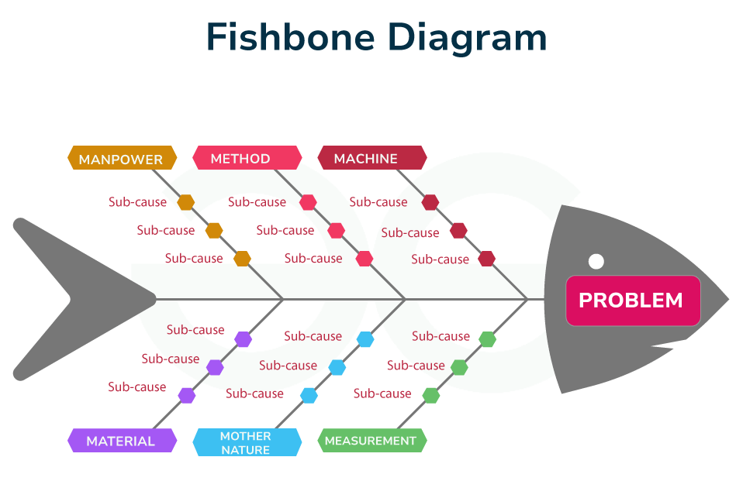
Fishbone Diagram Analysis
People: Fewer retail workers and more remote employees have reduced daily customer visits.
Process: The lack of an effective pre-order system and long waiting times reduce customer satisfaction.
Technology: No online ordering platform and limited digital presence restrict customer access.
Environment: Declining retail park footfall reduces potential sales opportunities.
Finance: Rising rent, utility bills and expensive organic ingredients increase operating costs.
Outcome: These combined factors lower customer satisfaction and contribute to declining sales. The Fishbone Diagram identifies root causes and supports effective problem-solving (Ishikawa, 1982).
Source: (GeeksforGeeks, 2024)

Slide 7
Recommendations
Launch an online ordering system with click-and-collect to improve customer convenience.
Partner with delivery platforms to reach customers who work remotely or prefer home delivery.
Strengthen social media marketing and introduce a customer loyalty programme to increase engagement (Kotler et al., 2022).
Implement a digital pre-order system to reduce waiting times.
Expand catering services for nearby offices and review supplier contracts to control costs.
Benefits: Higher customer retention, increased sales, improved operational efficiency and stronger long-term business sustainability (Kotler et al., 2022).

Slide 8
Conclusion
Basil's Bakery faces both internal and external challenges that have contributed to declining sales and reduced profitability.
The 5W2H model clearly defines the nature, causes and impact of the business problem.
PESTEL analysis identifies external economic, social and technological pressures affecting performance (Regnér et al., 2020).
The Fishbone Diagram highlights the root causes of declining sales (Ishikawa, 1986).
Digital transformation, improved customer convenience and continuous market monitoring can strengthen competitiveness and support sustainable business growth (Kotler et al., 2022).

Slide 9
References
Ishikawa, K. (1982). Guide to quality control.
Regnér, P., Angwin, D., Johnson, G. and Scholes, K. (2020). Exploring Strategy: Text and Cases. Pearson Education.
GeeksforGeeks (2024). Fishbone Diagram Cause and Effect. [online] GeeksforGeeks. Available at: https://www.geeksforgeeks.org/biology/fishbone-diagram-example-use/ [Accessed 11 July 2026].
Kotler, P., Keller, K.L. and Chernev, A. (2022). Marketing Management, Global Edition. 16th ed. S.L.: Pearson Education Limited.
Office for National Statistics (2024). Retail industry - Office for National Statistics. [online] Ons.gov.uk. Available at: https://www.ons.gov.uk/businessindustryandtrade/retailindustry [Accessed 11 July 2026].
Slack, N. and Brandon-Jones, A. (2018). Essentials of Operations Management. Pearson UK.
TECHIEQUALITY (2024). 5W2H Analysis Example |Download 5W2H Format. [online] TECHIEQUALITY. Available at: https://www.techiequality.com/2024/03/02/5w2h-analysis-example-download-5w2h-format/ [Accessed 11 July 2026].
Vanzandt, P. (2023). What Is PESTEL Analysis? Definition, Benefits and Best Practices. [online] IdeaScale. Available at: https://ideascale.com/blog/what-is-pestel-analysis/ [Accessed 11 July 2026].

Slide 10
THANK YOU

