Slide 1

Zack Cleaver
E-Portfolio
Notes:
Hello, my name is Zack Cleaver, and my student ID number is 2502510. My e-portfolio for the UWTSD Academic Skills module is this presentation. I will go over my written assignment, my academic interview recording, the changes I made in response to criticism, and the abilities I acquired over the course in this portfolio.

Slide 2
Introduction
I am currently now studying the Level 4 Diploma in Sport and Exercise Science at the University of Wales Trinity Saint David, having previously completed the Level 3 Extended Diploma in Sport and Exercise Science at Coleg Sir Gâr. By improving my knowledge and understanding of sport, exercise, health, and performance, I decided to pursue this topic further in university. I am extremely passionate about football, and I aspire to work in the sport or the football sector someday. This e-portfolio highlights my growth as a university student throughout the Academic Skills module, including developments in my writing, referencing, communication, and critical thinking skills.

Slide 3
AI Acknowledgement
I admit that while completing this project, I used artificial intelligence technologies, including ChatGPT, for research and support reasons only. Using the program, I was able to better understand topics, investigate background material, and write more clearly. I certify that I have not copied any text using artificial intelligence. All of my thoughts, analysis, research results, and finished writing are original to me. AI was not used to replace independent study, logic, or academic integrity. Rather, it was used as an added research tool. I accept full responsibility for the work that I have turned in.

Slide 4
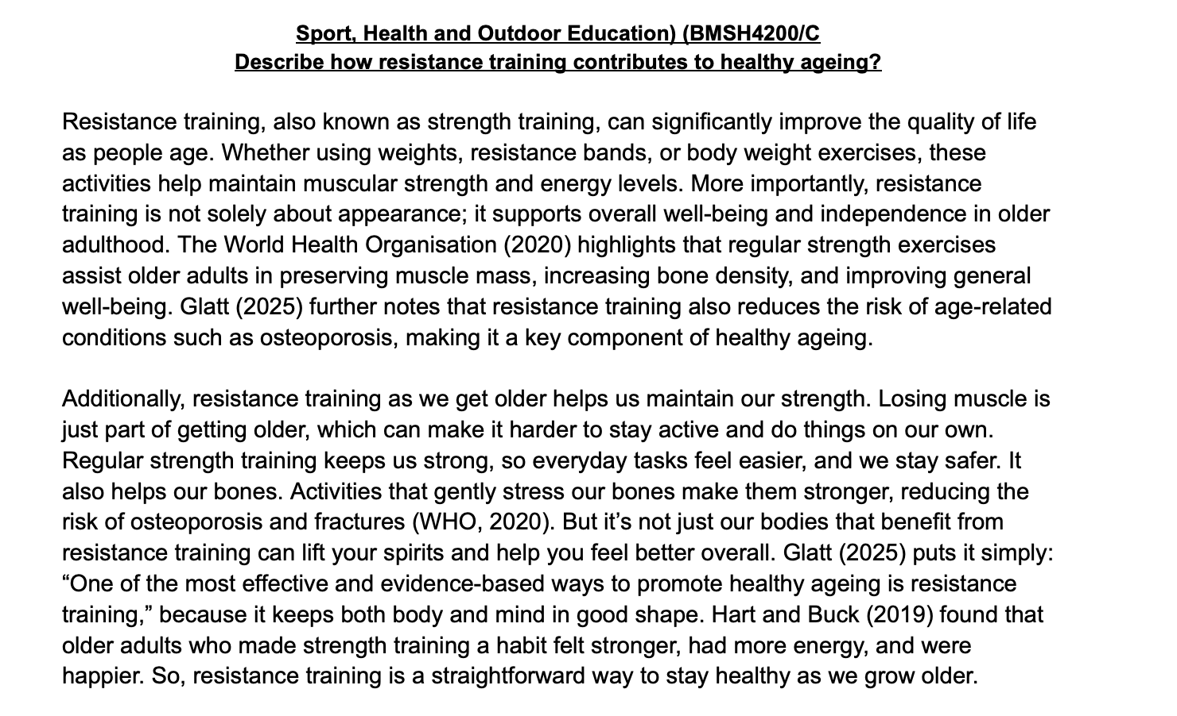
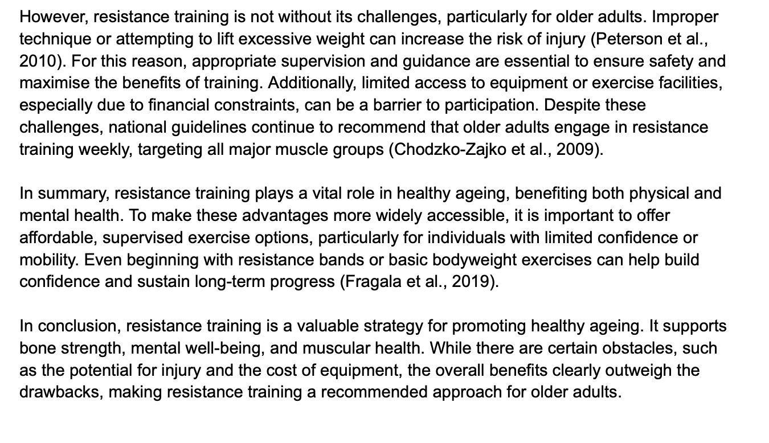
Part 1 - 500 word written:
Title - "Describe how resistance training contributes to healthy ageing?"
Brief Summary:
The study investigated how resistance training helps older persons age healthily by improving their independence, bone density, physical strength, and mental health. The essay found that the benefits outweigh the disadvantages, considering issues such as injury risk and access to facilities.
Key Points:
Increases the strength of muscles
Maintains bone density
Lowers the risk of osteoporosis
Improves mental health
Encourages independence
Encourages a healthy ageing process
Notes:
For Part 1, I drafted a 500-word essay about how resistance exercise encourages healthy ageing. I chose this subject because it highlights the value of physical activity in later life and has a strong connection to sport and exercise science. In addition to analysing difficulties like injury risk and facility access, my project examined how resistance training improves bone density, muscular strength, independence, and mental health. Overall, my research revealed that the benefits of resistance exercise exceed the negatives for older persons.

Slide 5
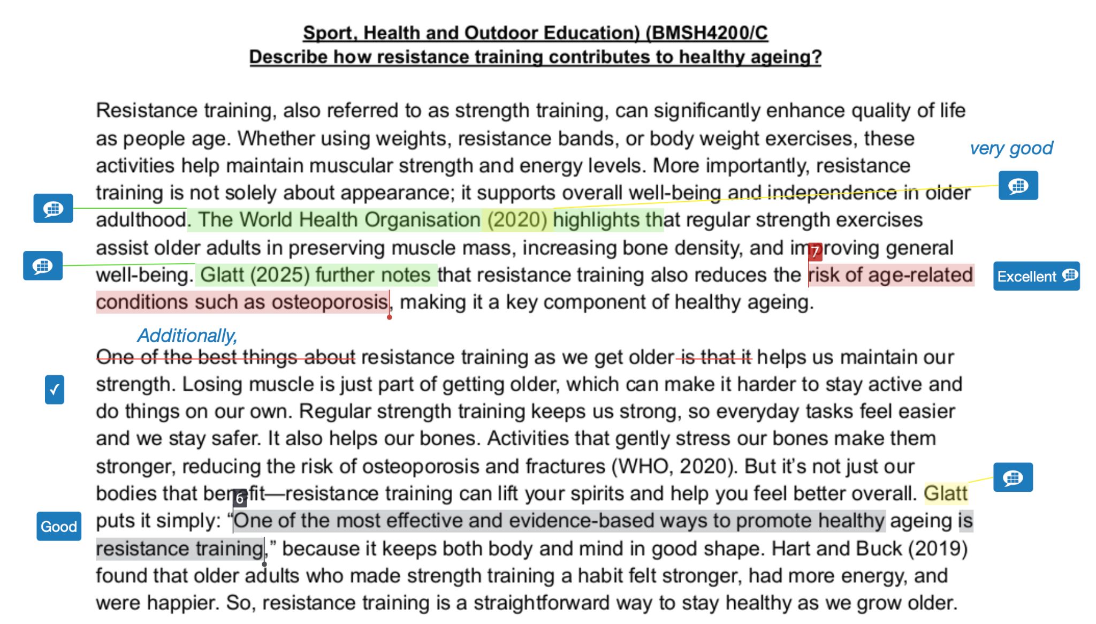
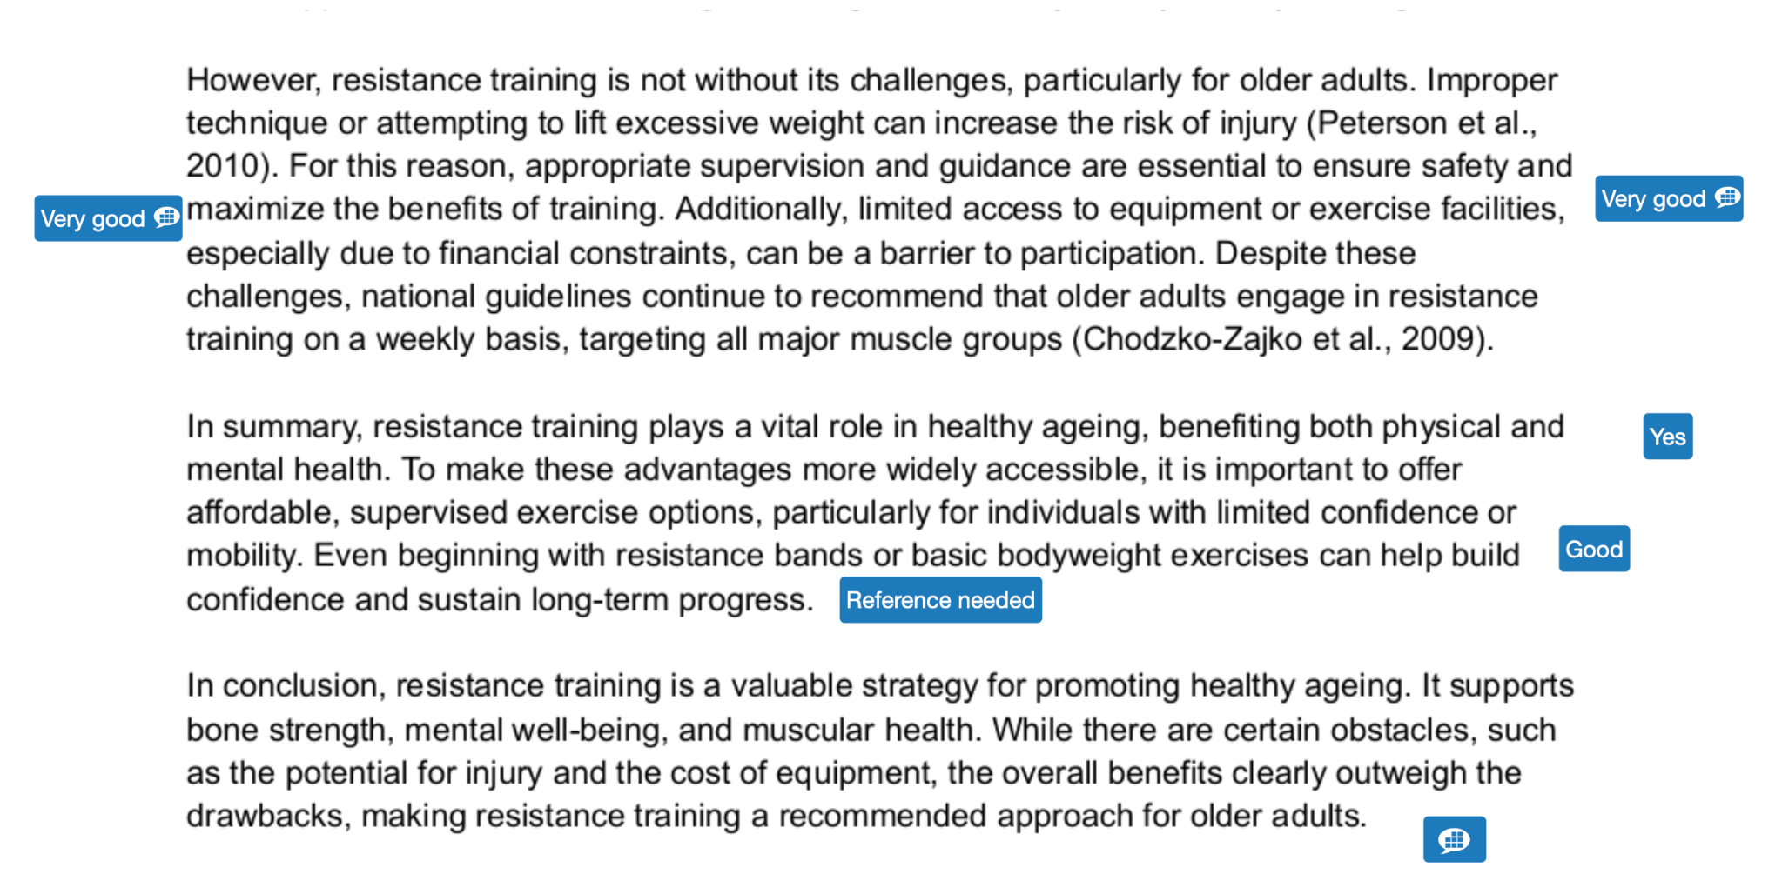
Part 1 Continued – Improvements and reflection:
My academic writing, citation, and referencing abilities have improved since finishing Part 1. During the feedback process, I recognised areas for development, especially in referencing accuracy, adding missing citations, and improving the academic tone of my work. I corrected incomplete references, added stronger academic evidence such as Fragala et al. (2019), and improved the structure and clarity of my paragraphs. The technique helped me gain confidence in using Harvard referencing and successfully integrating scholarly articles. Overall, The criticism helped me improve my university-level written skills and gain a better understanding of the importance of academic accuracy and evidence-based writing.
Notes:
Following comments on my first draft, I improved many aspects of my work, especially my academic writing, citation, and referencing skills. I updated my references, added missing citations, and improved the clarity and structure of my paragraphs. This feedback process helped me understand the value of academic accuracy and evidence-based writing. Overall, I gained confidence in using Harvard referencing and incorporating peer-reviewed sources into academic writing.

Slide 6
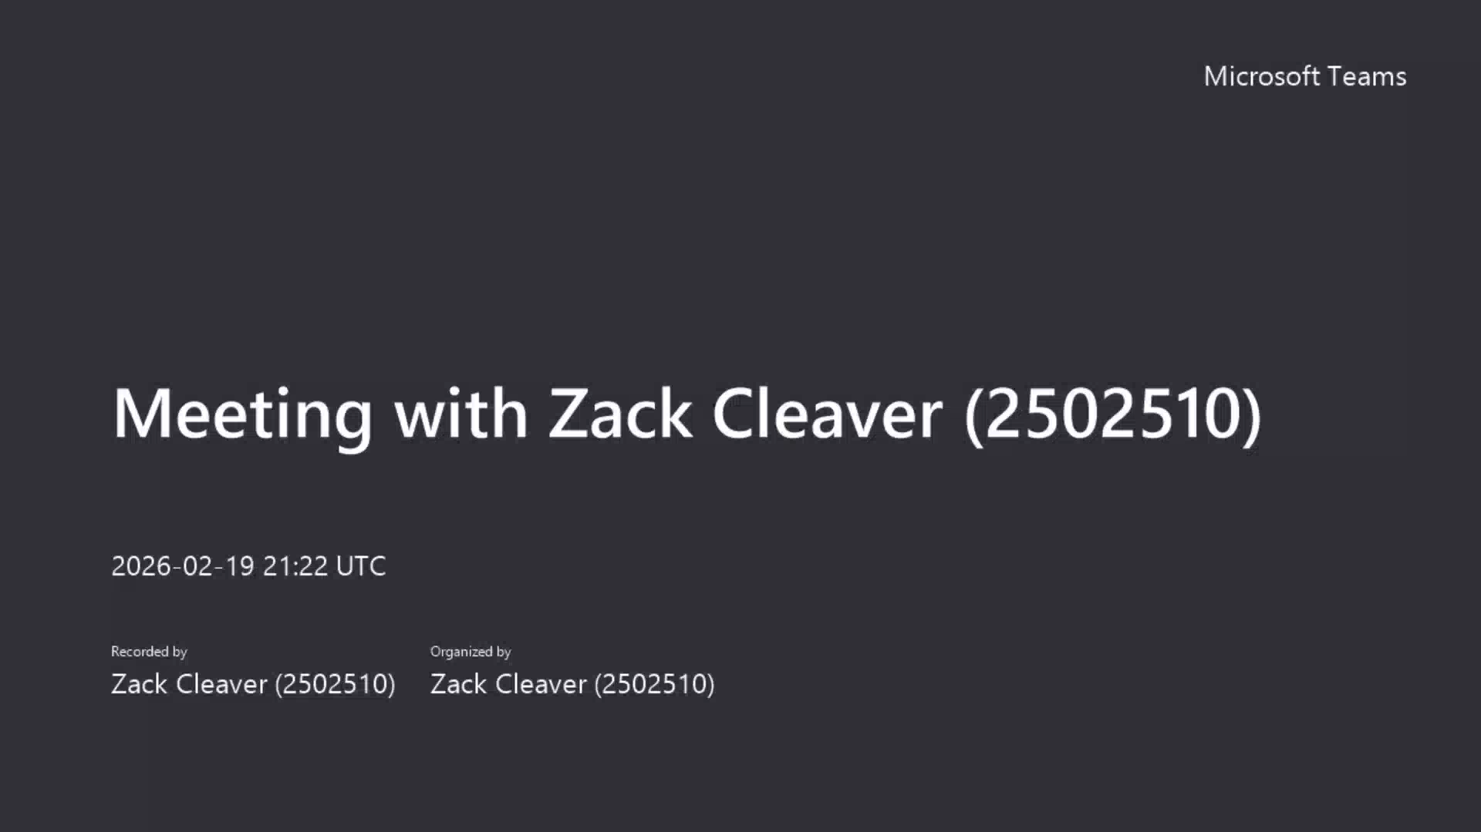
Part 2 – Recording:
Brief Summary:
The goal of CIMSPA and its significance for Sport and Exercise Science students and graduates were examined in this recording. Professional standards, employability, ongoing professional development, and the connection between higher education and The sports industry was discussed, along with alternative professional pathways, such as BASES, and how career direction can affect professional recognition. Professional standards, employability, ongoing professional development, and The connection between higher education and sports were the main topics of debate. The recording also addressed how a career path might affect job recognition and alternative career routes, such as BASES.
Reflection:
My verbal communication and presenting abilities improved after completing Part 2. I became more comfortable speaking academically and providing clear, professional explanations of evidence-based content after making the recording. Additionally, I became better at organising ideas and debating other viewpoints, especially when comparing the CIMSPA and BASES courses. In general, this assignment improved my confidence in presenting academic content verbally and my communication skills.
Notes:
For Part 2, I conducted a recorded academic interview in which I discussed the aim of CIMSPA and its significance for Sport and Exercise Science students and graduates. The recording focuses on professional standards, employability, ongoing professional development, and the interaction between higher education and the sports business. This work helped me improve my verbal communication and presentation abilities, especially when expressing evidence-based material clearly and professionally. Furthermore, it gave me more confidence when I discussed about academic literature.

Slide 7
Overall Reflection:
Overall, as a university student, this program of study has supported me in developing critical academic and personal skills. My academic writing, referencing, communication, and research abilities all improved as I finished Parts 1 and 2. Using evidence-based sources and using feedback to raise the standard of my work gave me more confidence. In addition to helping me adjust to university expectations, the module improved my time management, organisation, and independent learning skills. My confidence in delivering academic content in various formats improved after completing both verbal and written assessments. Given the circumstances, this experience has improved my understanding of academic standards and prepared me for future Sport and Exercise Science coursework.
Notes:
Overall, as a university student, the course helped me grow both academically and personally. I improved my confidence in presenting knowledge, both verbally and in writing, and further developed my academic writing, communication, and referencing skills. I gained a better understanding of university requirements and the importance of academic standards and independent study through the feedback process.

Slide 8
Next Steps:
I want to keep developing my research, communication, and academic writing abilities throughout my time in university. In addition, I want to expand my knowledge of sport and exercise science and gain more experience in the football industry. My understanding of the difficulties facing the sports sector was widened by attending the Student Conference, which exposed me to a wider range of sport-related themes, including ethical issues such as inclusion and equality in women's grassroots football. In general, I want to continue developing as a university student and explore potential future opportunities in football and sports.
Notes:
Moving forward, I hope to improve my academic writing, communication, and research abilities throughout university. Moreover, I want to expand my knowledge of sport and exercise science and gain more experience in the football industry. My knowledge of broader sports-related topics, including ethical concerns such as equality and inclusion in women's grassroots football, has grown as a result of attending the Student Conference. In general, I want to keep growing as a university student while exploring potential opportunities in football and sports.

Slide 9
Reference List – Part 1:
WHO GUIDELINES ON PHYSICAL ACTIVITY AND SEDENTARY BEHAVIOUR. (n.d.). Available at: https://iris.who.int/server/api/core/bitstreams/faa83413-d89e-4be9-bb01-b24671aef7ca/content [Accessed 27 Sep. 2025].
Glatt, R. (2025). The Benefits of Resistance Training for Older Adults | Brain & Body Health. [online] Pacific Neuroscience Institute. Available at: https://www.pacificneuroscienceinstitute.org/blog/brain-wellness-lifestyle/the-benefits-of-resistance-training-for-older-adults-supporting-brain-and-body-health/.
Fragala, M.S., Cadore, E.L., Dorgo, S., Izquierdo, M., Kraemer, W.J., Peterson, M.D. and Ryan, E.D. (2019b). Resistance Training for Older Adults: Position Statement From the National Strength and Conditioning Association. Journal of Strength and Conditioning Research, 33(8), pp.2019–2052. doi: https://doi.org/10.1519/jsc.0000000000003230
Chodzko-Zajko, W.J., Proctor, D.N., Fiatarone Singh, M.A., Minson, C.T., Nigg, C.R., Salem, G.J. and Skinner, J.S. (2009). Exercise and Physical Activity for Older Adults. Medicine & Science in Sports & Exercise, [online] 41(7), pp.1510–1530. doi: https://doi.org/10.1249/mss.0b013e3181a0c95c.
Hart, P.D. and Buck, D.J. (2019a). The effect of resistance training on health-related quality of life in older adults: Systematic review and meta-analysis. Health Promotion Perspectives, 9(1), pp.1–12. doi: https://doi.org/10.15171/hpp.2019.01.

Slide 10
Reference List part 2:
CIMSPA. (2023). CIMSPA. [online] Available at: https://cimspa.co.uk. [Accessed 19 Feb. 2026].​
HM Government (2015). Sporting Future: A New Strategy for an Active Nation SportingFuture. [online] Available at: LE.pdf.​
Shilbury, D. and Ferkins, L. (2011). Professionalisation, sport governance and strategic capability. Managing Leisure, 16(2), pp.108–127. ​
Doi: https://doi.org/10.1080/13606719.2011.559090.​
The return on investment of sport and physical activity in. (2022). Available at: https://sportengland-production-files.s3.eu-west-2.amazonaws.com/s3fs-public/2025-05/Return%20on%20Investment%20doc-08.pdf?VersionId=NScpGXmiDlAwqVWJVhfS6lfdWyfO4ltW [Accessed 19 Feb. 2026].​
​

