Slide 1
EMPLOYEE ENGAGEMENT PRESENTATION
Mohammad Shahidul Islam Chowdhury Student Id: 2026960 Date:06/12/2022 Lecturer: Tristan Hawkins

Slide 2
Definition of Engagement:
The Gallup Organization defines employee engagement as the degree to which employees are involved in their workplace and enthusiastic about their work. Therefore, you need to measure and manage employee engagement to address the essential elements of your company's culture.
Definition of engagement Robinson, Perryman, and Hayday (2004) define a positive attitude toward the organization and its values. As a result of an engaged employee, the organization benefits because the employee is aware of the business context and works collaboratively with colleagues to improve performance within the job. There must be a two-way relationship between employer and employee that cultivates engagement, which overlaps with commitment and organizational citizenship behavior, but both parties must nurture engagement. The commitment is described as "one step up.". Little, B. and Little, P. (2006), p.2

Slide 3

In terms of mental and emotional commitment, employee engagement refers to how much an individual cares about his or her job, the organization, and its objectives.
GALLUP EXPLAINED TO EMPLOYEES' ENGAGEMENT THROUGH THIS VIDEO

Slide 4
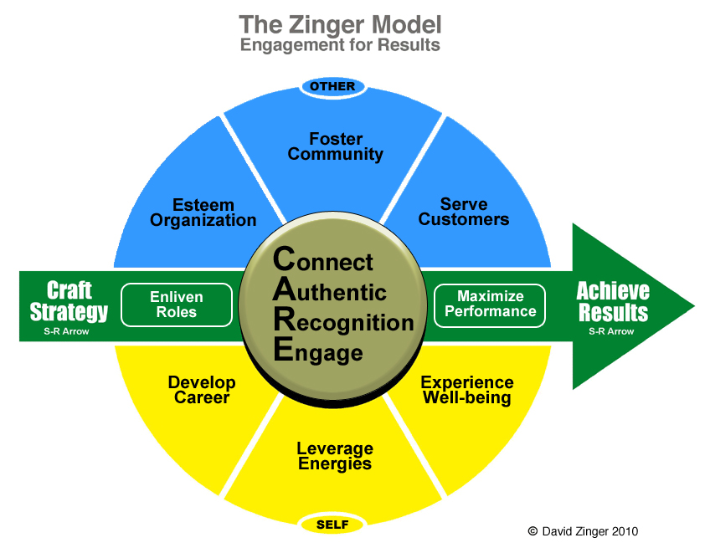
Engagement Model for Employees by Zinger

Slide 5
WHY ZINGER IS SO VALID FOR ENGAGEMENT?
Craft strategy.
We move through the model from the far right to the far left, from the far right to the far left. Our strategy for achieving results must be crafted. Can we fulfill our system if our approach is engaging and employee engagement is high enough?
Connect.
Maintaining a connection with employees is essential if you want them to be engaged. Often, connection and engagement go hand in hand. Employees' connections to their organization and happiness are crucial elements of engagement. A core component of employee engagement is connecting to the central pillars of CARE.
Authentic.
CARE is all about authenticity. It is essential to engage employees authentically. False information can be spotted by customers and employees a mile away. The goal should be to transcend superficial relationships, communities, or even happiness to achieve genuine engaged relationships. Engaging in meaningful and robust ways is what makes an engagement powerful.
Recognition.
CARE is based on recognition as its core value. A robust recognition program is essential for employee engagement. Long service awards and pens aren't the only things. Is it clear to employees how their work contributes to the organization’s results? We’re talking about. What is the level of recognition and recognition given to employees?

Slide 6
Serve customers.
We are providing customer service. There is a strong relationship between employee engagement and customer engagement in our organization, and we want to ensure that employees serve the organization's customers. Can the employee similarly serve external and internal customers when they feel appreciated by the organization and management?
Engage.
Engagement is the final part of CARE. As a society, we often use the verb "engage" to speak of "engagement" instead of a noun (engagement). In Engage, the focus is on engagement action. There is no steady state or one-time survey measurement of engagement. Work is dynamic and engaging in it is experiencing it and contributing to it.
Leverage energies.
Engaging requires energy as its raw material. Are we energetic enough to engage fully? Were our actions energy-gaining for the organization, or did they deplete our peers' energy? To engage effectively, you must master the five physical, mental, emotional, spiritual, and executive power forces. For engaged working, the point is more important than time.
Experience Well-Being.
Employees should feel well at work. A healthy work environment and experiencing healthy well-being are crucial for an employee's success. Employee productivity and health affect the results of an organization.

Slide 7
Enliven work roles.
Taking part in the engagement process requires us to fulfill various roles. Certain behaviors, rights, and responsibilities define roles at work. We need to stay manageable with functions while fully engaging in the positions that achieve results, build relationships, and engage our audiences. Managers’ and leaders’ role as employees is sometimes almost unnoticeable to them.
Esteem organization.
Does the employee have a good relationship with the organization? Do the corporate brand and the individual brand mesh? Does the organization feel like it belongs to its employees? Would they recommend the organization and be constant ambassadors if they were proud to work for it? Or does it seem separate from them?
Excel at performance.
Managing performance effectively can be achieved through engagement for results. The arrangement enables us to excel at performance, while performance signifies our meeting. Star performers should thrive in an environment where employees are engaged. We want all employees to perform at their best to benefit both customers and the organization.
Foster community.
Relationships and community play an essential role in employee engagement. Social media and personal relationships can be part of these communities. Relationships and results: are we building them? Developing relationships and building communities is at the heart of work. In the absence of community transformation, organizations risk becoming obsolete or irrelevant.

Slide 8
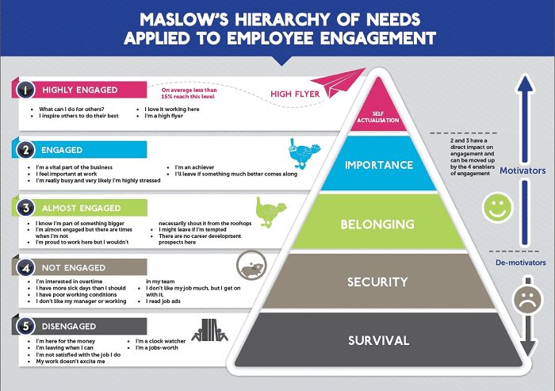
Maslow's Hierarchy of Needs can also explain employee engagement:
Highly Engaged – Helping and inspiring co-workers is something an employee will do for as long as they can.
Engaged – Having a sense of importance and accomplishing more is the key to success.
Almost Engaged – If offered a better opportunity, they may leave the company because they are part of something bigger.
Not Engaged Are looking for new opportunities, are unhappy with the working conditions, or are looking for new opportunities.
Disengaged – They want only one thing: their salary, dissatisfaction with their jobs, and the possibility of leaving the company for good.
Like Maslow's Hierarchy, employees need their basic needs met first, including their salary and working conditions. Only then can they start to meet their higher-level needs.
Businesses can save money on recruitment and training costs by increasing employee engagement and reducing churn.

Slide 9
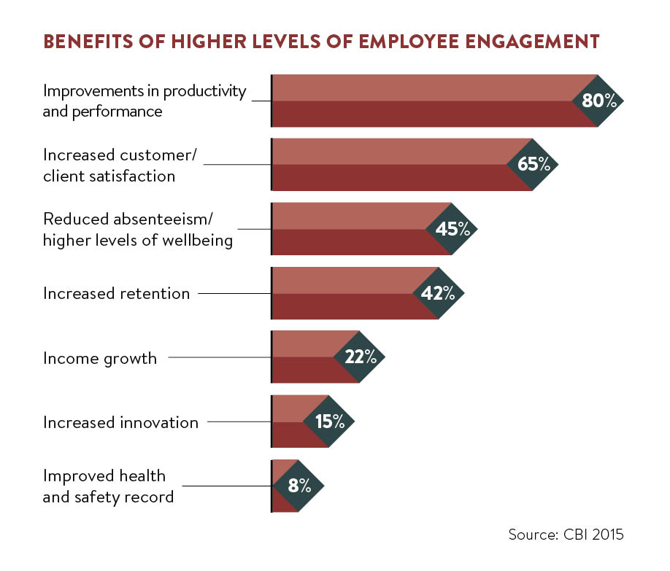
According to Deloitte, UK companies still face an employee engagement issue in 80 percent of cases. The number of companies prepared to deal with these engagement issues is only 36 percent. A global research firm ORC International survey of over 7,000 employees across 20 countries found that UK employees have some of the lowest engagement with their jobs globally, placing the UK 18th out of 20 countries. There was a reduction of £62.25 in food wastage per store when concentration increased by at least 5.24 points, for a total annual savings of £400,000.

Slide 10
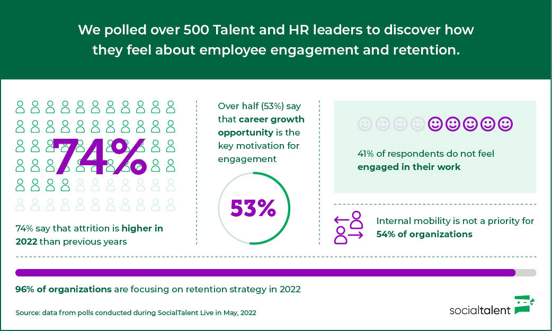
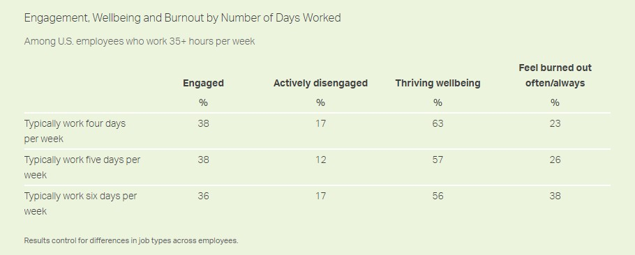
According to a Gallup survey, 85% of the world's workforce is disengaged. Taking care of talent is a top priority for any company that wishes to attract, hire, and retain the best. At a recent social talent event, we gathered over 500 talent and HR leaders to gauge their views on this topic. We surveyed global organizations on engagement and retention to gain critical insights. Here's what we found to have a look below data.

Slide 11
Referencing https://www.gallup.com/workplace/285674/improve-employee-engagement-workplace.aspx#ite-357458
Little, B. and Little, P. Volume 10, No 1 (2006) ‘Employee engagement: conceptual issues’, Journal of organizational culture, communication, and conflict, Published by Jordan Whitney Enterprise, Inc https://www.davidzinger.com/zinger-model/ https://www.contactmonkey.com/blog/employee-engagement-models https://www.socialtalent.com/blog/socialtalent-news/5-key-employee-engagement-and-retention-statistics-from-2022 https://getlighthouse.com/blog/gallup-workplace-statistics-2022/ https://www.ovationincentives.com/articles/maslows-hierarchy-of-needs-applied-to-employee-engagement https://www.valamis.com/hub/employee-engagement https://www.raconteur.net/getting-engagement-right-to-motivate-staff/

