Slide 1

Strategic Management for Business
LCLM 6001 – Week 4
Market & Portfolio Analysis
The Ansoff Matrix | BCG Growth-Share Matrix

Slide 2
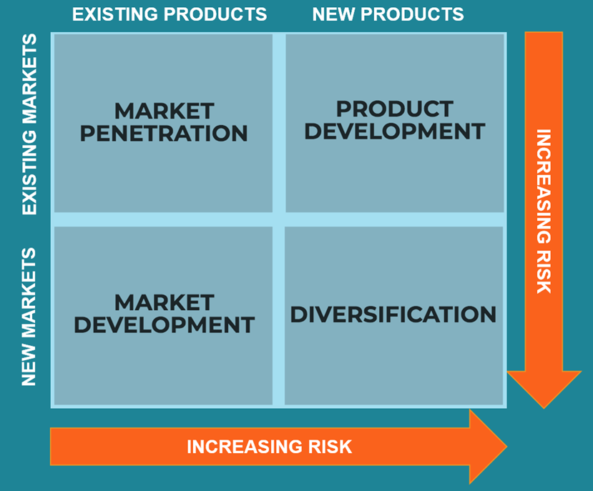
Section 1 — The Ansoff Matrix
What is the Ansoff Matrix?
Developed by Igor Ansoff (1957)
Originally published in Harvard Business Review
Also known as the 'Product-Market Matrix'
Identifies four strategic growth options based on combinations of new/existing products and markets
Still a foundational tool in strategic planning
📚 Key Reference
Johnson, G., Whittington, R., Scholes, K., Angwin, D. & Regnér, P. (2023). Exploring Strategy: Text and Cases, 12th ed. Pearson.
The Ansoff Matrix — four strategic growth options

Slide 3
Ansoff Matrix — 1. Market Penetration
Existing Product × Existing Market
Definition
Market penetration involves selling more of an existing product in existing markets. It is the lowest-risk option in the Ansoff Matrix. Firms pursue this through pricing, promotions, loyalty programmes, or by taking share from competitors.
Key Tactics
💼 Business Example
Competitive pricing or promotional campaigns
Loyalty programmes to increase purchase frequency
Improved customer experience or convenience
B2B: strengthen key account management
McDonald's — 'Loose Change' value menus and the McDonald's app loyalty scheme (My McDonald's Rewards) are classic market penetration tools. By offering discounted bundle deals and digital rewards, McDonald's increases visit frequency and average spend among existing UK customers without entering new markets.
Source: Johnson et al. (2023), Exploring Strategy, 12th ed., p. 258–260

Slide 4
Ansoff Matrix — 2. Market Development
Existing Product × New Market
Definition
Market development means introducing existing products or services into new markets — through geographic expansion, new segments, or new channels. It carries moderate risk as the product is proven but the market is unfamiliar.
Key Tactics
💼 Business Example
International/geographic expansion
Targeting new demographic segments
New distribution channels (e.g., e-commerce)
Repositioning for a different use case
Starbucks — entering China (2000s onward) with its existing café experience. Starbucks adapted its store format and added tea-based beverages while keeping its core product range, allowing it to penetrate a predominantly tea-drinking market. By 2023 it operated over 6,500 stores across China (Starbucks Annual Report, 2023).
Source: Johnson et al. (2023), Exploring Strategy, 12th ed., p. 260–261; Starbucks Annual Report (2023)

Slide 5
Ansoff Matrix — 3. Product Development
New Product × Existing Market
Definition
Product development involves creating new or improved products for existing markets. Success depends on building on core competencies and organisational capability — and increasingly on open innovation involving customers, suppliers, and ecosystem partners.
Key Tactics
💼 Business Example
R&D investment in new or improved products
Open innovation with customers/suppliers
Product line extensions (e.g., variants, editions)
Technology upgrades to existing offerings
Apple — iPhone product line iterations (e.g., iPhone 15 Pro in 2023) exemplify product development. Apple introduces new features such as the USB-C port and titanium design to its loyal existing customer base. Rather than entering new markets, it deepens engagement with current users through annual product upgrades (Apple Annual Report, 2023).
Source: Johnson et al. (2023), Exploring Strategy, 12th ed., p. 261–262; Apple Annual Report (2023)

Slide 6
Ansoff Matrix — 4. Diversification
New Product × New Market
Definition
Diversification is the highest-risk strategy — new products for new markets. It can be related (linked to current value chain) or unrelated (conglomerate). It typically requires significant new capabilities or acquisition.
Types of Diversification
💼 Business Example
Related — backward/forward/horizontal integration
Unrelated (conglomerate) — entirely new industry
Synergies often justify the move
Amazon — launch of Amazon Web Services (AWS) in 2006 is a textbook diversification. Amazon leveraged its existing IT infrastructure to create a cloud computing product for business customers — a completely new market and product category. AWS now accounts for ~62% of Amazon's operating profit (Amazon Annual Report, 2023).
Source: Johnson et al. (2023), Exploring Strategy, 12th ed., p. 262–264; Amazon Annual Report (2023)

Slide 7
Ansoff Matrix — Critical Evaluation
No Competitor Lens
Oversimplification
Paralysis by Analysis
The model focuses entirely on internal product/market choices and ignores competitor actions. A market penetration strategy may be undermined if rivals respond aggressively with price cuts or product launches (Porter, 2008).
Treating markets and products as purely 'new' or 'existing' is binary. In practice, firms operate on a continuum — partially new products, partially new customer segments — which the matrix cannot adequately represent.
Ansoff himself warned of excessive analysis at the expense of action. Over-reliance on strategic frameworks can delay implementation when market conditions require rapid, emergent responses (Mintzberg et al., 2020).
References: Porter (2008) 'The Five Competitive Forces that Shape Strategy', HBR; Mintzberg, H., Ahlstrand, B. & Lampel, J. (2020). Strategy Safari, 2nd ed. Pearson; Johnson et al. (2023)

Slide 8
Section 2
BCG Growth-Share Matrix
⭐ Stars
High share · High growth
❓ Question Marks
Low share · High growth
🐄 Cash Cows
High share · Low growth
🐕 Dogs
Low share · Low growth
Created by Bruce Henderson (1968) · Boston Consulting Group · Still widely used in strategic portfolio management
Key reference: Johnson, G. et al. (2023). Exploring Strategy, 12th ed. Pearson. Chapter 7.

Slide 9
BCG Matrix — Portfolio Overview
RELATIVE MARKET SHARE
HIGH →
← LOW
How to Read the Matrix
HIGH
⭐
❓
X-axis: Relative market share (high = left)
Y-axis: Market growth rate (high = top)
Products are placed into one of four quadrants, each suggesting a different investment strategy.
MARKET GROWTH RATE
STAR
QUESTION MARK
Invest
Develop
Strategic Logic
🐄
🐕
Cash generated by Cash Cows funds investment in Stars and development of Question Marks. Dogs are typically divested to free up resources.
CASH COW
DOG
LOW
Harvest
Divest
Source: Henderson, B. (1970). The Product Portfolio. BCG; Johnson et al. (2023), Exploring Strategy, 12th ed., p. 264–268

Slide 10
BCG Matrix — Stars — High Growth · High Share
Definition & Characteristics
⭐
Stars have high market share in a fast-growing market. They generate substantial revenue but also require heavy investment to maintain their position and defend against competitors seeking to enter the growing market.
High revenue but also high investment needs
Aim: sustain growth and eventually become a Cash Cow
Strategic recommendation: continue to invest
STAR
High Growth · High Share
💼 Business Example
Tesla — Electric Vehicle (EV) Division (2022–2023). Tesla holds dominant global EV market share while the EV segment itself is growing rapidly (~35% CAGR). Tesla continues to invest heavily in Gigafactories and R&D to maintain its lead, consistent with a Star strategy (IEA Global EV Outlook, 2023).
Source: Johnson et al. (2023), Exploring Strategy, 12th ed.; IEA (2023). Global EV Outlook. Paris: International Energy Agency.

Slide 11
BCG Matrix — Question Marks — High Growth · Low Share
Definition & Characteristics
❓
Question Marks (or 'Problem Children') are products in fast-growing markets but with low market share. They do not yet generate significant profit. The strategic question is whether to invest to grow market share (convert to Star) or divest.
Potential to become Stars — with the right investment
Key diagnostic: why is market share low? What are competitors doing right?
Strategic options: invest aggressively OR divest/harvest
QUESTION MARK
High Growth · Low Share
💼 Business Example
Microsoft Bing (2020–present). The AI-enhanced search market is growing rapidly, but Bing holds only ~3% global search market share versus Google's ~92%. Microsoft is investing heavily (via integration with OpenAI/ChatGPT) to convert Bing into a Star — a classic Question Mark invest-to-grow strategy (Statcounter Global Stats, 2023).
Source: Johnson et al. (2023), Exploring Strategy, 12th ed.; Statcounter (2023). Search Engine Market Share Worldwide.

Slide 12
BCG Matrix — Cash Cows — Low Growth · High Share
Definition & Characteristics
🐄
Cash Cows dominate mature, slow-growing markets. They generate surplus cash with relatively little investment needed. This surplus is used to fund Stars and Question Marks elsewhere in the portfolio.
High profit margins, low investment requirements
Market leadership through economies of scale
Strategy: maintain, extract profit, minimise reinvestment
CASH COW
Low Growth · High Share
💼 Business Example
Google Search (Alphabet Inc., 2023). With ~92% global search market share in a mature advertising market, Google Search is a classic Cash Cow. It generates ~$175bn in annual revenue with modest growth, and its profits subsidise Alphabet's investment in AI, autonomous vehicles (Waymo), and other ventures (Alphabet Annual Report, 2023).
Source: Johnson et al. (2023), Exploring Strategy, 12th ed.; Alphabet Inc. Annual Report (2023).

Slide 13
BCG Matrix — Dogs — Low Growth · Low Share
Definition & Characteristics
🐕
Dogs have low market share in low-growth markets. They are typically break-even or loss-making products. Continuing to invest is generally considered a misuse of resources. However, they can sometimes serve strategic niches or act as complementary products.
Low/negative profitability, high drain on management attention
Limited competitive advantage — scale economies absent
Strategy: divest, discontinue or keep only if strategically necessary
DOG
Low Growth · Low Share
💼 Business Example
Nokia Feature Phones (post-2013). Following the smartphone revolution, Nokia's feature phone range held declining market share in a contracting segment. Microsoft's acquisition and subsequent write-down of Nokia's devices unit (£5.4bn, 2015) exemplifies the financial cost of persisting with a Dog product rather than divesting (BBC News, 2015).
Source: Johnson et al. (2023), Exploring Strategy, 12th ed.; BBC News (2015). 'Microsoft takes £5.4bn Nokia write-down'.

Slide 14
BCG Matrix — Critical Evaluation
Oversimplification
Ignores Synergies
The 2×2 matrix reduces complex strategic situations to binary categories. Products rarely sit neatly in one quadrant and relative market share is an imperfect proxy for competitive strength (Grant, 2022).
The model treats each product in isolation. It cannot account for interdependencies — a Dog might support a Cash Cow's supply chain or brand umbrella (Whittington et al., 2020).
Market Share ≠ Profit
Dynamic Markets
High market share does not always equate to profitability. Niche players with low share can be highly profitable if they serve a premium segment (Porter, 2008).
The model assumes stable market structures, yet digital disruption can rapidly shift a Cash Cow to a Dog (e.g., print media, physical retail). The model struggles with fast-moving environments.
References: Grant, R.M. (2022). Contemporary Strategy Analysis, 11th ed. Wiley; Porter (2008) HBR; Whittington, R. et al. (2020). Exploring Strategy, 11th ed. Pearson.

Slide 15
References
1. Alphabet Inc. (2023). Annual Report 2023. Mountain View, CA: Alphabet Inc.
8. Johnson, G., Whittington, R., Scholes, K., Angwin, D. & Regnér, P. (2023). Exploring Strategy: Text and Cases, 12th ed. Harlow: Pearson.
2. Amazon.com, Inc. (2023). Annual Report 2023. Seattle, WA: Amazon.
9. Lynch, R. (2021). Strategic Management, 7th ed. Harlow: Pearson.
3. Apple Inc. (2023). Annual Report 2023. Cupertino, CA: Apple Inc.
10. Mintzberg, H., Ahlstrand, B. & Lampel, J. (2020). Strategy Safari, 2nd ed. Harlow: Pearson.
4. Ansoff, H.I. (1957). 'Strategies for Diversification'. Harvard Business Review, 35(5), pp. 113–124.
11. Porter, M.E. (2008). 'The Five Competitive Forces That Shape Strategy'. Harvard Business Review, 86(1), pp. 78–93.
5. Grant, R.M. (2022). Contemporary Strategy Analysis: Text and Cases, 11th ed. Chichester: Wiley.
12. Statcounter (2023). Search Engine Market Share Worldwide. [Online]. Available at: gs.statcounter.com
6. Henderson, B. (1970). The Product Portfolio. Boston: Boston Consulting Group.
13. Starbucks Corporation (2023). Annual Report 2023. Seattle, WA: Starbucks.
7. IEA (2023). Global EV Outlook 2023. Paris: International Energy Agency.

