Slide 1
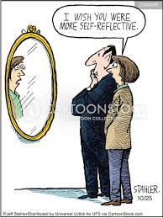

Recap from session one;
We talked last week about reflecting on your personal and professional values…why?
How could this help with your assignments?

Slide 2

Aims
To understand and recognise forms of vulnerability in children, young people and and families.
To understand the role of the Common Assessment Framework (CAF) in safeguarding practice and the Early Help Assessment (EHA)
To establish how support can be offered to vulnerable families.

Slide 3

Session 2 part one
Vulnerable Children

Slide 4

Group work
In groups, discuss/list what factors would lead you to think a child is vulnerable?
Be prepared to return to the main classroom and to feedback as a group.

Slide 5
What do we mean by the term vulnerable children? gov.uk 2020

Slide 6
Forms of Vulnerability
No child left behind
Differing models of vulnerability mean this is a complex term…how can we fully support if one sole definition does not exist – imagine if differing agencies defined ‘vulnerability’ differently

Slide 7
Forms of Vulnerability
Age - Children from birth to six years old are always vulnerable.
Physical Disability - Regardless of age, children who are physically impaired and therefore unable to remove themselves from danger are vulnerable. Those who, because of their physical limitations, are highly dependent on others to meet their basic needs are vulnerable.

Slide 8
Forms of Vulnerability
Mental Disability - Regardless of age, children who are cognitively limited are vulnerable because of a number of possible limitations: recognizing danger, knowing who can be trusted, meeting their basic needs and seeking protection.
Provocative - A child's emotional, mental health, behavioural problems can be such that they irritate and provoke others to act out toward them or to avoid them totally.
Powerless - Regardless of age, intellect and physical capacity, children who are highly dependent and susceptible to others are vulnerable.

Slide 9
Forms of Vulnerability
Powerless children typically are so influenced by emotional and psychological attachment that they are subject to the whims of those who have power over them.
Within this dynamic, you might notice children being subject to intimidation, fear and emotional manipulation.
Finally, remember that powerlessness could also be observed in vulnerable children who are exposed to threatening circumstances, which they are unable to manage.

Slide 10
Forms of Vulnerability
Defenceless - Regardless of age, a child who is unable to defend him/herself against aggression is vulnerable. This can include those children who are oblivious to danger. Children who are frail or lack mobility are more defenceless and therefore vulnerable.
Non-Assertive - Regardless of age, a child who is so passive or withdrawn not to be able to make his or her basic needs known is vulnerable. A child who cannot or will not seek help and protection from others is vulnerable.
Illness - Regardless of age, some children have continuing or acute medical problems and needs that make them vulnerable.

Slide 11
Forms of Vulnerability
Invisible - Take some time to think about that.
Children that no one sees (who are hidden) are vulnerable.
Why would caregivers keep a child isolated from others?
A child who is not visible to be noticed and observed should be considered vulnerable regardless of age.

Slide 12
Vulnerable children and families
There is no one way of measuring vulnerability, but the following are suggested;
Worklessness – no parent in the family is in work.
Housing – the family lives in poor quality and/or overcrowded housing.
Qualifications – no parent in the family has any academic or vocational qualifications.

Slide 13
Vulnerable children and families
Mental health – the mother has mental health problems;
Illness/disability – at least one parent has a limiting long-standing illness, disability or infirmity;
Low income – the family has low income (below 60% of the median);
Material deprivation – the family cannot afford a number of food and clothing items.

Slide 14
Vulnerable children and families
All these terms and factors impact the child, young people and therefore the family unit – so if you know about them – explore them.
The wider you look into and read about contextual factors such as these, the more you can understand and therefore support children, young people and families…
(This would be good for your assignments too)

Slide 15
Further Reading
Child abuse and neglect in the UK today research report by NSPCC.
https://www.nspcc.org.uk/globalassets/documents/research-reports/child-abuse-neglect-uk-today-research-report.pdf
Is maltreatment (p8) the same as neglect?

Slide 16
Impact of Early Adversity on Children’s Development
Early experiences influence the developing brain.
Chronic stress can be toxic to developing brains.
Significant early adversity can lead to lifelong problems.
Early Intervention can prevent the consequences of early adversity.
Stable caring relationships essential for healthy development.
(www.developingchild.harvard.edu)

Slide 17
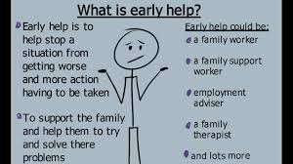
What is out there…
https://www.youngminds.org.uk/parent/parents-a-z-mental-health-guide/early-help-and-early-intervention-services/

Slide 18
Legislation Time Line (1989-2004)
Legislation Timeline Children Act 1989
Working Together 1999
Victoria Climbie died February 2000
Joint Chief Inspectors Report – Safeguarding Children October 2002
Lord Laming’s Inquiry Report 2003
Green Paper Every Child Matters September 2003 & March 2004 Every Child Matters – Change for Children December
2004 Children Act

Slide 19
Legislation Time Line (2006-onwards)
Working Together to Safeguard Children (2006)
Peter Connolly died August 2007
Kyra Ishaq died 2008 - Lord Laming’s Progress Report March 2009
The Governments Response to Lord Laming May 2009
Working Together to Safeguard Children March 2010
The Governments Response to Lord Laming: One Year On March 2010 (Change of Government 2010)
Munro Review of Child Protection: a child-centred system 2011
Working Together to Safeguard Children 2013 and 2015
These all give recent historical literature and change in policy again think assignments

Slide 20
Assessing the Needs of Families
Assess
Plan
Implement
Review and Evaluate

Slide 21
Our belief is that the most effective services will be local, agile and relationship based. They will be rooted in community and work collaboratively with children and families cco_childrens_social_care_putting_childrens_voices_at_the_heart_of_reform.pdf (childrenscommissioner.gov.uk)

Slide 22
Case study example; Chris
Chris grew up in a family with domestic violence, and he had ADHD which meant that he sometimes struggled at school. Despite this, Chris did well at primary school.
However, when he got to secondary school he struggled. Chris became involved with gangs and engaged in increasingly dangerous behaviour.
By the time Chris was 13 he had been arrested for a range of different offences and had been found with a large quantity of drugs.
Chris told authorities he was in fear of his life.
During this period Chris’ family were repeatedly referred to social services, but it was decided they did not meet the threshold for support.

Slide 23
Case study example; Chris
Chris was not attending school but was a virtual pupil at a Pupil Referral Unit.
He got short-term support from a Youth Offending Team, which was stopped when he went to live with his uncle. This broke down and he returned to his mum who told the local authority that she thought Chris was going to be killed and asked her housing authority to move her out the area to help protect him. Neither acted.
Chris was shot and killed when he was just 14.
By the time of his death, Chris had been known to 12 agencies, yet it appears that the last time Chris had a stable and supportive relationship with any professional was when he was at primary school.

Slide 24
Assessing the Needs of Families
More details about Chris’s life, and the failures in his care can be read at: Serious Case
Review – Chris (newhamscp.org.uk)
What needs to happen for children like Chris:
There were significant failures in the police and local authority response to Chris leading up to his murder, but they are indicative of a fragmented system within which no one took responsibility for Chris or took the time to understand what was really happening in his life.
Chris was expected to engage with service on their terms, and when he was seen as too difficult, he was simply passed on. Again, Chris needed an integrated offer covering education, health, youth offending, housing and social care, but instead was passed between them. Childrens commissioner

Slide 25
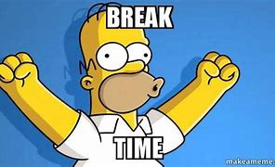
BREAK????

Slide 26
https://www.nhs.uk/conditions/social-care-and-support-guide/caring-for-children-and-young-people/children-and-young-peoples-services/
Just another link about further support

Slide 27
Activity
Investigate the ‘Common Assessment Framework’
What is it?
Who uses it
Why is it used?
When wouldn’t you use it?
What are the different levels?
Do we still use it?

Slide 28
Common Assessment Framework why and when…
‘Every Child Matters’ Green Paper (2003) proposed the introduction of a Common Assessment Framework (CAF) as a central element of the strategy for helping children, young people and their families.
The framework supports the gathering of data and information about children and families, and then they are used to analyse, make judgements, plan, intervene and review:
Child’s Development
Parenting Capacity
Family and Environment

Slide 29
Common Assessment Framework (CAF) …now Early Help Assessment (EHA)
Aims is to support early intervention and improve joint working and communication between practitioners.
Described as a common language for assessment purposes, which gives a consistent view for delivering the most appropriate response.
https://www.nscb.org.uk/sites/default/files/HANDOUT%20Refresher%20PP%20Notes%20November%202016.pdf

Slide 30
Common Assessment Framework (CAF) and Early Help Assessment (EHA)
CAF helps to identify in the early stages the child’s additional needs and promote coordinated service provision to meet them.
Plays a key part in delivering front line services that are integrated and focused around the needs of children and young people.
CAF guide
CAF framework support overview
CAF form
Early Help Assessment form EHA
early-help-assessment-and-plan-v22-april-2022.docx (live.com)

Slide 31
Levels of Intervention
Level 1 – Universal Response
Level 2 – Early Support Response
Level 3 – Targeted Early Support Response
Level 4 – Statutory Response

Slide 32
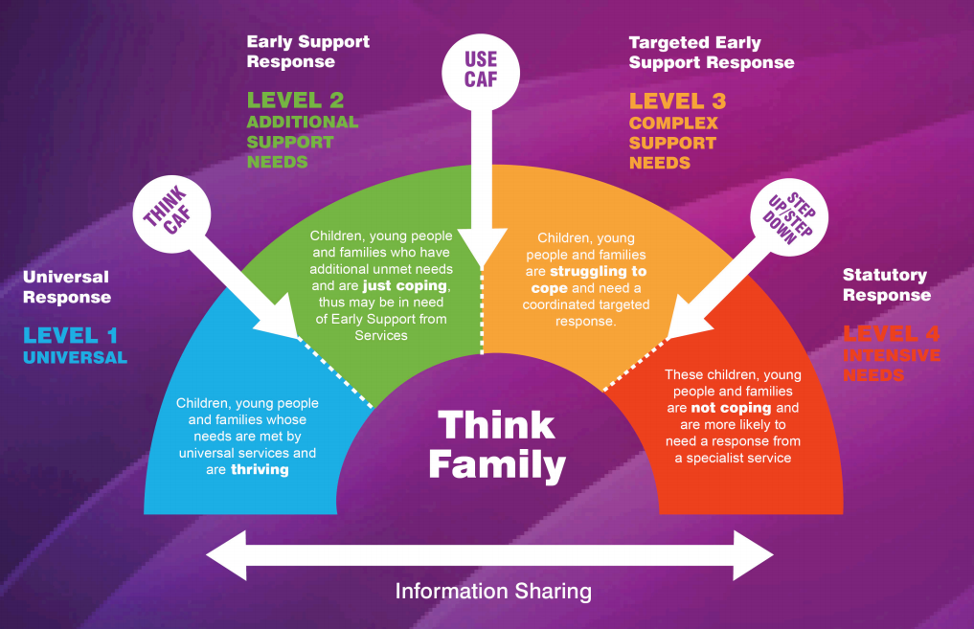
http://lancashire.gov.uk/corporate/web/?siteid=5943&pageid=43535&e=e

Slide 33
Supporting Families
A key task for support workers is identifying the resources (or strengths) that families have to enable them to achieve their goals.
In order to succeed families need to be able to use their skills, abilities and external sources of support.
This can help families to be self-reliant and competent and helps them identify new ways of using resources.
Key workers can help families to identify and access additional resources that are beyond their capacity.

Slide 34
Family Resources
Skills
Strengths
Qualities
Beliefs
Family
Community Social Networks
Universal or Specialised Statutory or Voluntary Services
Internal
External
Key workers often have to work hard to find out what a family’s resources are.
Sometimes a family’s needs can be met from their existing network of support, without them having to depend on external support

Slide 35
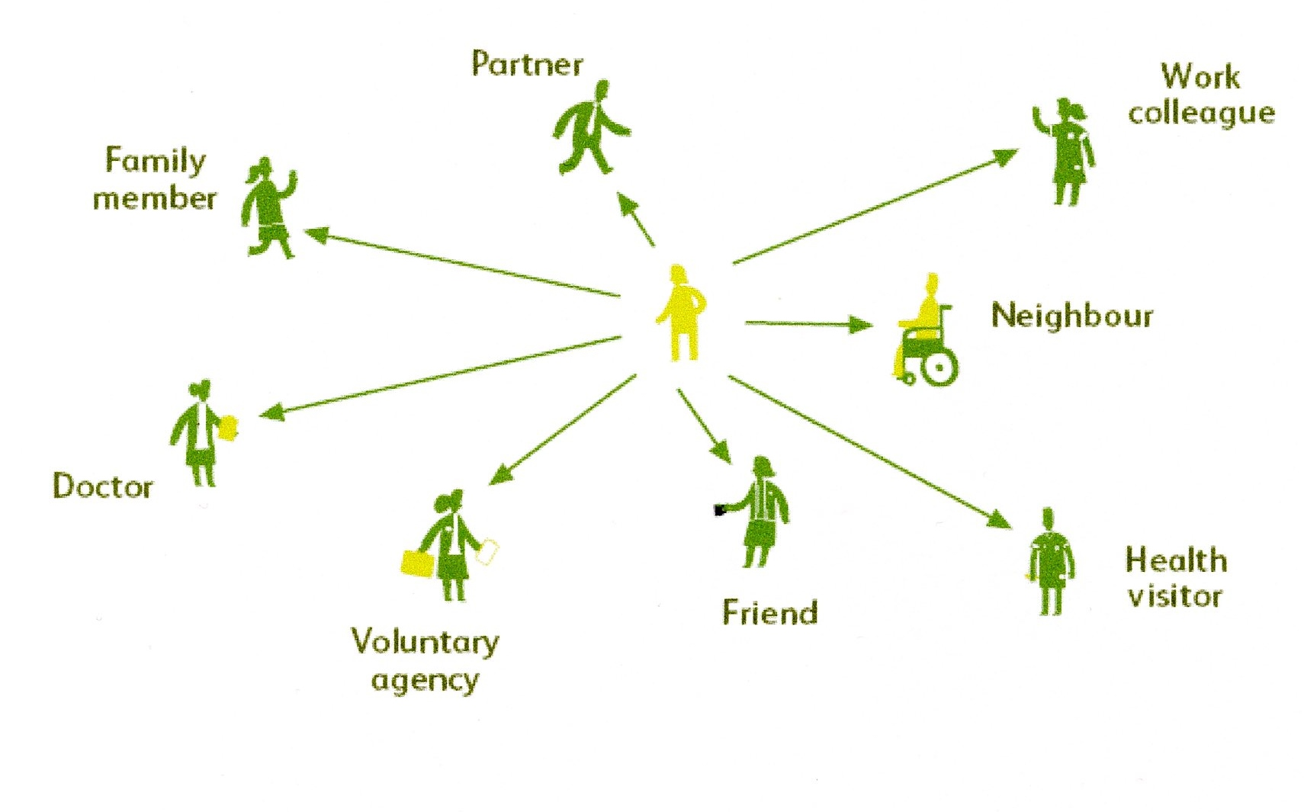
Networks of Support

Slide 36
Further Reading
Children’s Workforce Development Council (CWDC) (2011) Providing Intense Support for Families with Multiple and Complex Needs. London: CWDC [Online] Available at: http://www.outcomesforchildren.org/lpg_documents/cavan_familysupport/providing_intense_support_families_cdwc.pdf
[Accessed 2nd February 2018]

