Slide 1

17/10/2025
ACNA5000:
Lecture 3
Skills Workshop
Dr Alisdair Cunningham
Senior Lecturer
2025 / 2026
17/10/2025
Slide 1 / 9

Slide 2

Module ACNA5000: 2025 / 2026 Recap
17/10/2025
In last week’s lecture we covered:
The difference between hard and soft skills.
Explored skill evaluation, for current prospecting of future roles, but also development within roles.
Looked at methods for upskilling, including online courses, volunteering and increased awareness outside of formal learning settings.
Determined what transferrable skills are.
A. Cunningham Lecture 2: Skills evaluation
Slide 2 / 9

Slide 3

Module ACNA5000: 2025 / 2026 Jobs and required skills?
17/10/2025
ACTIVITY:
In the previous lecture, certain skills were presented.
Using the template provided on Teams, for each skillset, place a score of 1-5 next to each, where 1 means Beginner and 5 means Expert
Alternatively, take one of these assessments:
Career test: Skills audit | Careersmart (https://careersmart.org.uk/tools/career-test-skills-audit)
Home | Discover your skills and careers | National Careers Service
(https://nationalcareers.service.gov.uk/discover-your-skills-and-careers)
A. Cunningham Lecture 2: Skills evaluation
Slide 3 / 9

Slide 4
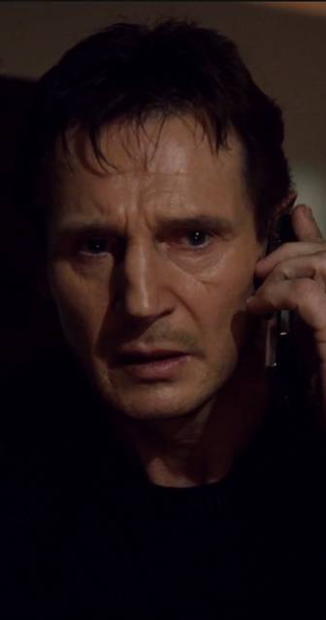
Module ACNA5000: 2025 / 2026 What are my skills?
17/10/2025
“I have a very particular set of…
…combined abilities and knowledge which I can readily execute with aptitude…”
It is worthwhile to spend time thinking about, and recording, your current skill set and competency level.
Activity:
Take a few minutes to reflect on your current skill levels across the following areas:
Leadership and Management
Advising
Coaching
Conflict resolution
Decision making
Delegating
Diplomacy
People management
Problem solving
Strategic thinking
Team Building
Collaboration
Communication
Flexibility
Listening
Observation
Participation
Respect
Sharing
Organizational
Coordinating
Goal setting
Meeting deadlines
Multi-tasking
Prioritizing
Project management
Scheduling
Strategic planning
Time management
Analytical
Critical thinking
Data analysis
Numeracy
Reporting
Research
Troubleshooting
Professionalism
Dedication
Honesty
Integrity
Maturity
Patience
Reliability
Self confidence
A. Cunningham Lecture 2: Skills evaluation
Slide 4 / 9
Technical e.g. coding, Microsoft suite, data science, geotechnical survey, etc.
Personal e.g. written communication, public speaking, teamwork, time management, adaptability, etc.

Slide 5
Module ACNA5000: 2025 / 2026 Skills evaluation
17/10/2025
ACTIVITY:
Now that you have completed that task…
Review your findings
Identify areas you are very competent in – take a moment to recognise this
Identify skill gaps – consider these against your potential future career goals and prioritise them into the top 3
Tip: You may wish to use a job advert to identify common skills for your chosen career
A. Cunningham Lecture 2: Skills evaluation
Slide 5 / 9

Slide 6
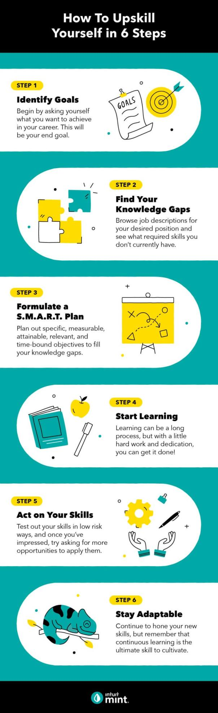
Module ACNA5000: 2025 / 2026 Personal Development Plan
17/10/2025
ACTIVITY:
Using these top 3 goals – create a PDP (you can use the below template)
Goal / Objective | Reason (professional / personal) | Opportunity |  |  | Aimed completion (date / period)
 |  | Volunteering | Course / MOOC | Subject Awareness
A. Cunningham Lecture 2: Skills evaluation
Slide 6 / 9

Slide 7

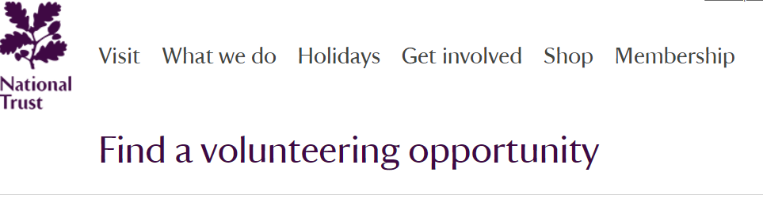


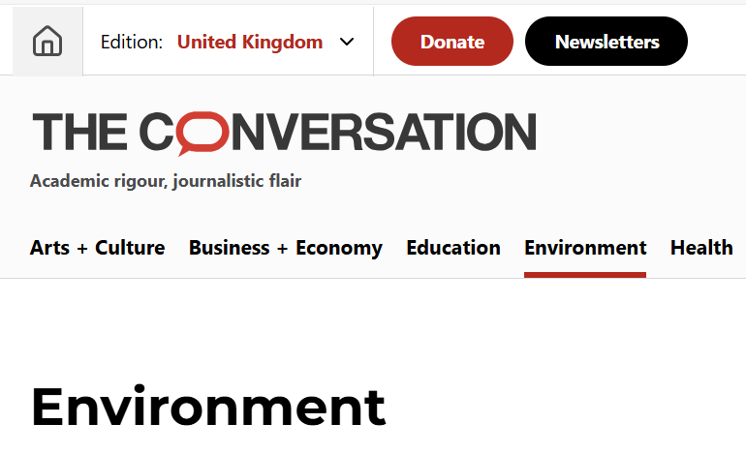

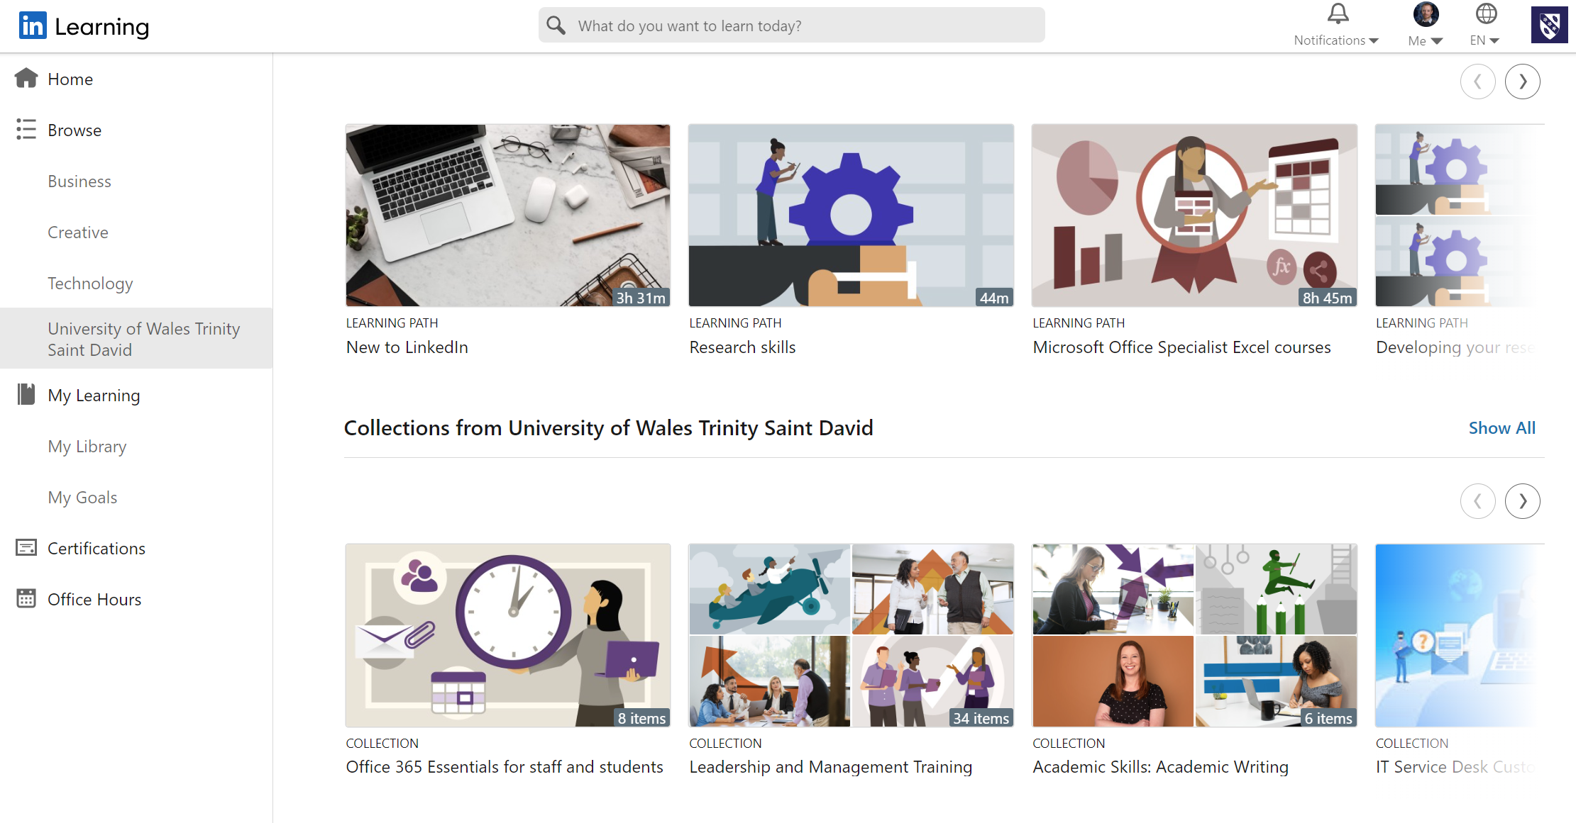


Module ACNA5000: 2025 / 2026 Upskilling options
17/10/2025
Volunteering opportunity
Massive Open Online Courses (MOOCs)
Open University or LinkedIn Learning
Subscribe to a podcast, newsletter, or blog
Join a society / institute
ISEP
A. Cunningham Lecture 2: Skills evaluation
Slide 7 / 9

Slide 8
Module ACNA5000: 2025 / 2026 Next Session
17/10/2025
Next weeks session will not take place:
Fieldwork week in Carmarthen
The next lecture (Friday 31st) will cover:
Blogging for Sustainability
A. Cunningham Lecture 2: Skills evaluation
Slide 8 / 9

Slide 9

Module ACNA5000: 2025 / 2026 Questions
17/10/2025
Any questions?
Please contact via:
Email: a.cunningham@uwtsd.ac.uk
Teams: “ACNA5000_Changemakers Build Your Own Brand 25/26_GRP”
General | ACNA5000 Changemakers Build Your Own Brand 25/26_GRP | Microsoft Teams
A. Cunningham Lecture 2: Skills evaluation
Slide 9 / 9

