Slide 1

Disappearance of Dr. Dana Hart
Mateusz Byczyk

Slide 2
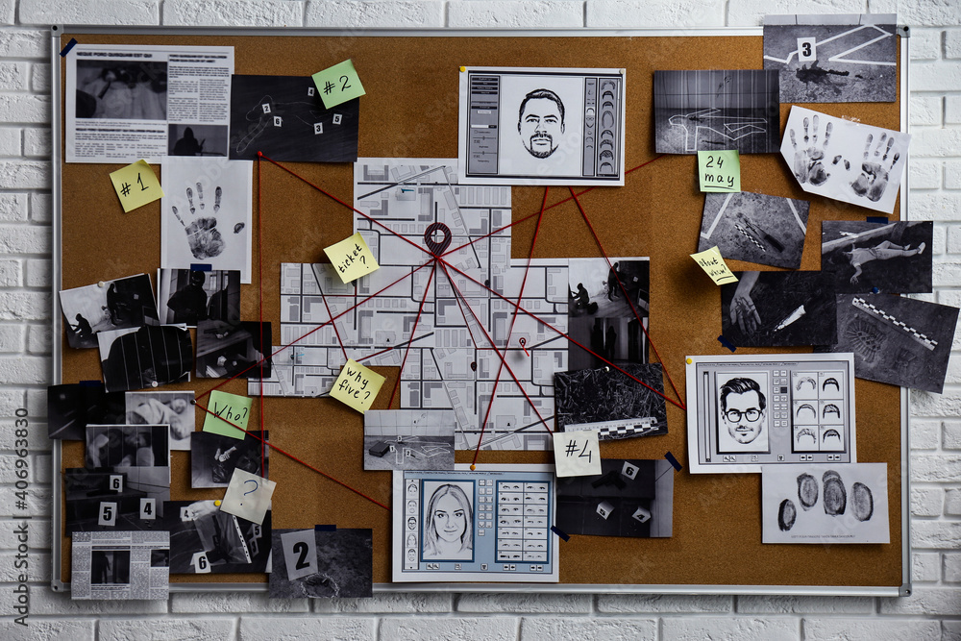

Introduction
This presentation examines the disappearance of Dr. Dana Hart. We will analyse the key events surrounding her disappearance, involved individuals and possible motives.

Slide 3
Personal Profile and Timeline
Personal Profile of Dr. Dana Hart:
January 5th
January 6th
Assistant Peter Singh found the lab “trashed” with no sign of Dr. Dana presence. He reported her disappearance and the investigation has begun.
Dr. Hart was last seen leaving her lab around 9:30PM
Height: 5’7”
Hair: Dark Brown
Eyes: Green
Distinctive Features: Wears a silver necklace with the engraving "Innovate with Purpose.“
Age: 42
Occupation: Senior AI and Robotics Engineer at Nova Tech Industries Achievements: Developed the "Harmony AI" system for emotional synchronization in robotics and was an ethical advocate for AI in medicine and education.

Slide 4
Individuals Involved
Peter Singh
Last to see Dr. Hart and reported her stress over the company Meeting.
Cynthia Ramirez
Saw a suspicious Suv near Dr. Hart’s residence night before her disappearance.
Dr. Fox Alaric
A competitor with know ethical disagreements with Dr. Hart.

Slide 5
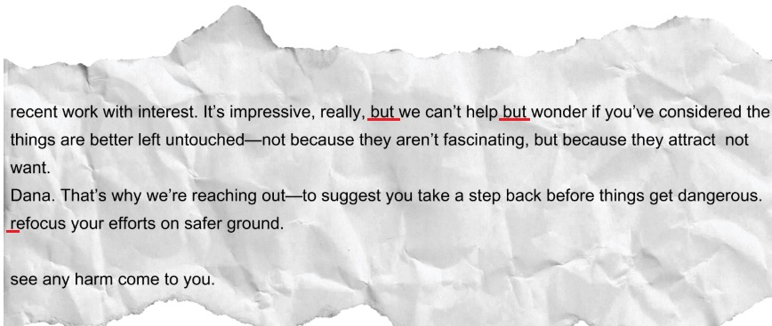
Evidence Collected
A torn paper found during the search for Dr. Hart.
The letter contained phrases that suggest possible threats. However, the distressed tone and unclear grammar imply that the letter could have been written in rush, possibly under pressure or in a stressful situation, leading to mistakes. Also, the errors might be intentional to make it seem like someone else wrote it or to mislead investigators.

Slide 6
Conclusion
Dr. Hart's disappearance may have been influenced by several factors, including stress or professional conflict. Collected evidences, no sign of forced entry to the lab and untouched AI equipment suggest inside job or the suspect was well known by Dr. Hart. Its also possible that it was Dr. Dana own actions. In this regard, I have come with two possible theories.

Slide 7
Recommendations
Examine the SUV and Footage: Investigating the SUV and nearby footage may reveal information about potential suspects.
Interview NovaTech Executives: Additional interviews with executives may clarify any workplace-related pressures on Dr. Hart.
Examine Peter Singh’s Role: Further investigation into Singh’s actions is crucial, especially considering that he was the last person who seen Dr. Harth and he has access to the lab.

Slide 8
Reference List:
Goodwin, T. (2020). AI and its Role in Society: Ethical Considerations and Future Implications.
Helft, M. (2023). Tesla Robot Attacks Engineer in Texas. The Independent. Available at: https://www.independent.co.uk/news/world/americas/tesla-robot-attacks-engineer-texas-b2470252.html
Hollandsworth, K. (2023). AI in the Modern Age: Opportunities and Risks. Virginia Tech Magazine. Available at: https://eng.vt.edu/magazine/stories/fall-2023/ai.html
Kashiwabara, T. (2021). Roboethics Principles and Policies in Europe and North America. Springer. Available at: https://link.springer.com/chapter/10.1007/978-3-030-54173-6_1
Great Place to Work (August 2024) Over half of UK employees experience ‘excessive stress’. Available at: https://www.greatplacetowork.co.uk/resources/research-excessive-stress-employees

Slide 9

THANK YOU
Mateusz Byczyk
Graphic pictures used in this presentation has been generated by AI and downloaded from Google.

