Slide 1
Augmented Reality Overview
Modified and Adapted from I. Rakollainen

Slide 2
Definition:
Azuma[1] provides a commonly accepted definition of AR as a technology which:-
combines real and virtual imagery,
(2) is interactive in real time, and
(3) registers the virtual imagery with the real world.
As such there are many possible domains that could benefit from the use of AR technology such as engineering, entertainment and education.
Alternative definition based on the above:
Augmented Reality (AR) takes the real world and enhances it by adding virtual objects, thus giving the user the illusion of a richer environment and enabling designers to create a coherent, interactive experience.[2]
[1] R.T. Azuma. A survey of augmented reality. Presence: Teleoperators and Virtual Environments 6:4, 355-385, 1997.

Slide 3
AR combines real and virtual, is interactive in real time and is 3D
Augmented reality alters how we see the real world
AR supplements reality
VR completely replaces reality
Blends real and virtual in a real environment
Applies to other augmented senses too!
Adds graphics, sounds, haptics and/or smell to the natural world
On the spectrum between virtual reality and the real world, augmented reality is closer to the real world
Ref: I. Rakollainen

Slide 4

Relationship between the real world, VR and AR

Slide 5
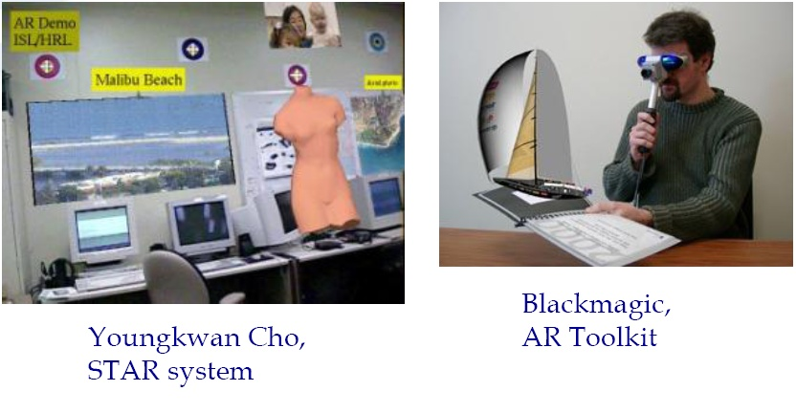
Example AR Images

Slide 6
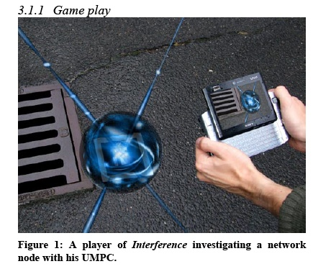
Another Example[3]
[3] Bichard, John Paul and Waern, Annika: Pervasive Play,
Immersion and Story: Designing Interference. In Proceedings
of DIMEA2008

Slide 7
Basic Types
HMD(head mounted display)-based AR
  Optical see-through, transparent HMD
  Video see-through, videomix HMD
  HMD-AR is the ”classic” AR style
Projector-based AR
  AR on real surfaces
Monitor-based AR
  Videomix for monitor/handheld display
  Augmented sports broadcasts
  Computer games mixing real images and computer graphics (Sony Eye-toy,Nintendo 3DS, etc.)

Slide 8
Focus, Contrast, Portability
Focusing
  Need to measure eye accommodation?
  Autofocus video camera?
Contrast
  Match the display and environmental brightness
  Real world has large dynamic range! (night to sunshine)
  More difficult with optical?
VE: User stays in one place
AR: User moves widely in the task location
  Use in factories, outdoors, etc.
  Less controlled environments
  Very demanding for the technology

Slide 9
Registration Problem
Virtual and real must stay properly aligned
If not:
Compromises illusion that the two coexist
Prevents acceptance of many serious applications -do you want a surgeon cutting into you if the virtual cut-marks are misaligned?
Static errors
Optical distortions
Mechanical misalignments
Tracker errors
Incorrect viewing parameters
Dynamic errors
System delays

Slide 10
ART Toolkit
HITL open source
  http://www.hitl.washington.edu/artoolkit/
Vision-based AR library
Recognizes patterns, markers
Applications: MagicBook, VOMAR, ARGroove, Tiles, Shared space, …
ARToolkit iPhone: http://www.youtube.com/watch?v=5M-oAmBDcZk
Other AR authoring and development tools:
  ARToolWorks, Metaio, Total Immersion, HandVu

Slide 11
Processes involved
Two stages:-
1 Pre-processing of input image to identify salient features of fiduciary markers using established feature detection methods followed by establishment of a world co-ordinate system based upon input data (and possibly a-priori knowledge of scene).
2 Establishing fiduciary local co-ordinate system and projection of virtual objects to this co-ordinate system.

Slide 12
What is a fiduciary marker?
A fiduciary marker or fiducial refers to a reference object placed in a scene captured by an imaging system (e.g – video camera) which appears in the image produced.
Alternatively it could be a mark or set of marks in the reticule of an optical instrument, e.g. cross hairs in a lens.
In order to identify a fiduciary marker feature detection methods are applied to the image. For example edge detection (Sobel, Canny,etc);
corner detection;
dilation and erosion;
colour marking/tagging.

Slide 13
Some Links:
Nov. 2001 IEEE Computer Graphics and Applications:Recent Advances in Augmented Reality,Jul.
Aug. 2008 IEEE Computer Graphics and ApplicationsThe State of the Art in Mobile Graphics Research
Hainich: The End of Hardware, 3rdedition
Bimber –Raskar: Spatial Augmented RealityAlso online www.SpatialAR.com
Haller, Billinghurst and Thomas: Emerging Technologies of Augmented Reality: Interfaces and Design
http://www.se.rit.edu/~jrv/research/ar/
http://www.augmented-reality.org
http://www.cs.unc.edu/~azuma/
http://www.cis.unisa.edu.au/~ciswp/
http://www.hitl.washington.edu/projects/
http://www.augmented-reality.net/

