Slide 1
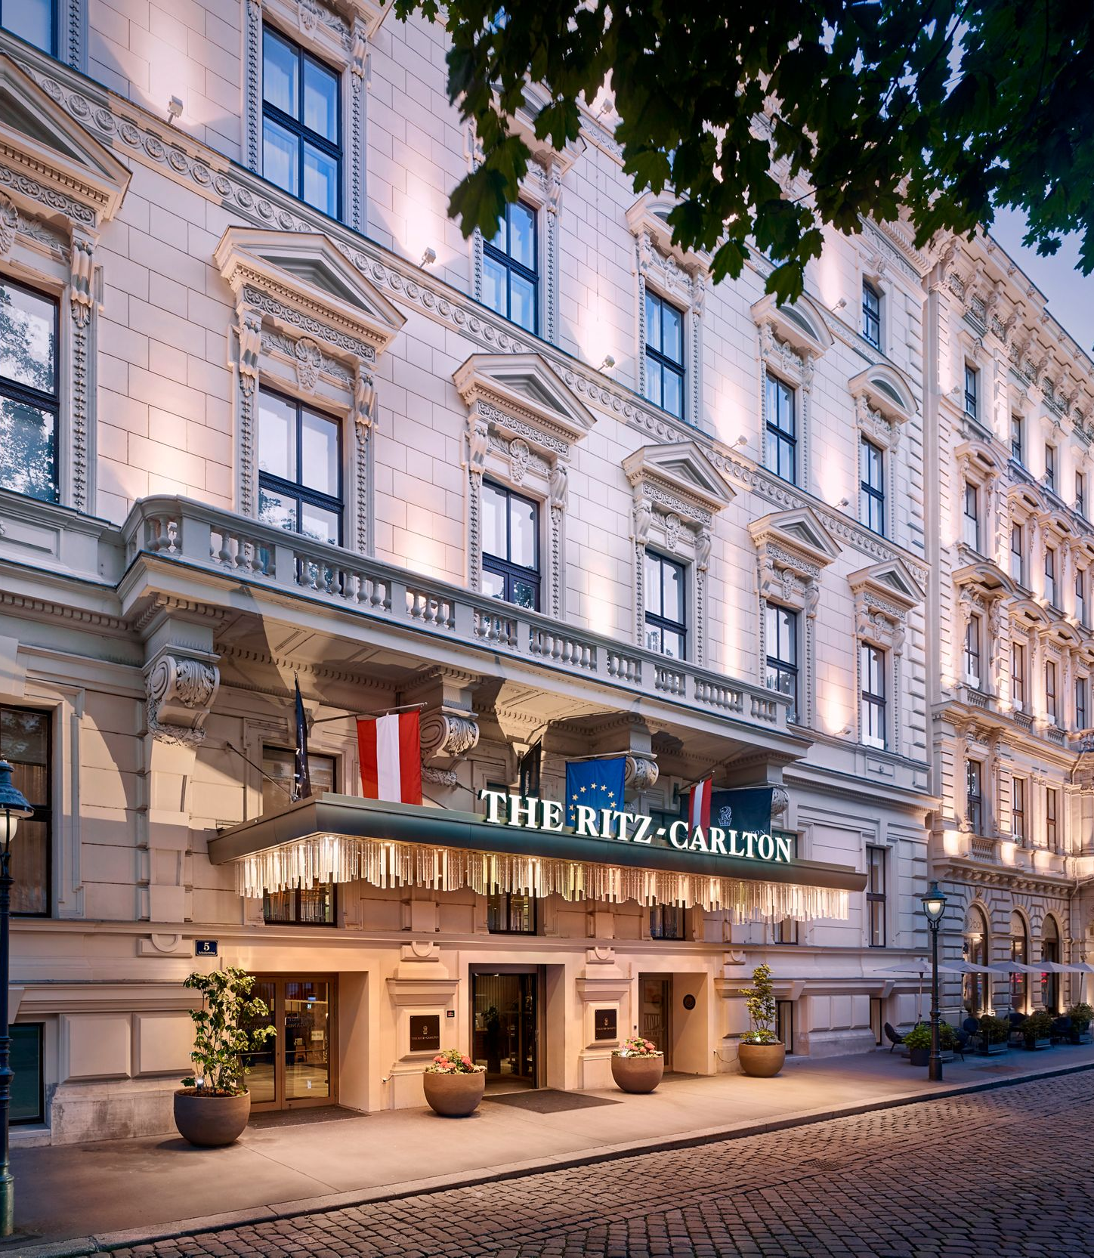


The Role & Importance of quality service, Hospitality & Guest Services within the Hotel Industry
BA International Hotel Management
Module: Hospitality & Guest Services (BMIH4003) LEVEL 4
Student Name: Ovidiu-Mario Trasc
Tutor name: Lisa Bassler

Slide 2


Table of Content
2. Ritz –Carlton brand
1. Marriott International
3. Main consumers
4. Nature, scope and role of the guest services
6. How the hotel meet guest expectations

Slide 3

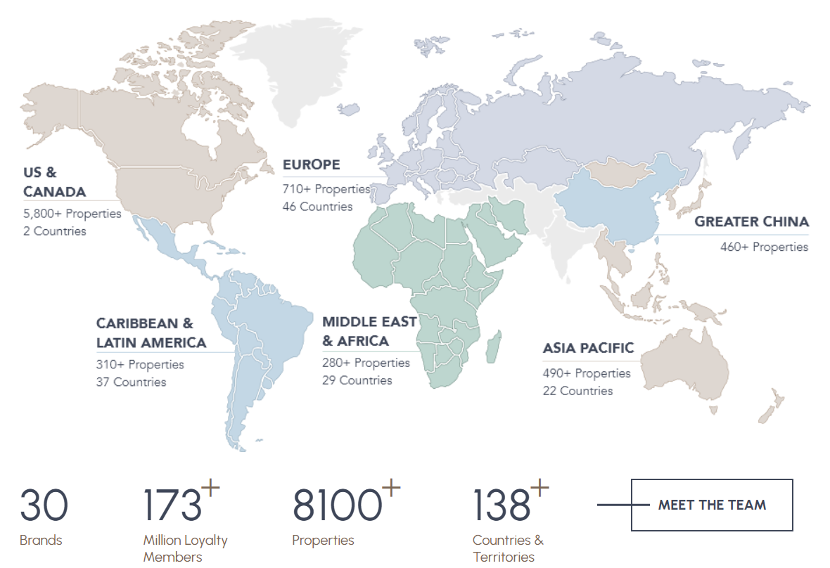
Marriott International
the most powerful portfolio in the industry
Founded by J. Willard and Alice Marriott in 1927
All over the world, 139 countries
30 brands divided in 4 categories: luxury, premium, select and longer stays.
3

Slide 4
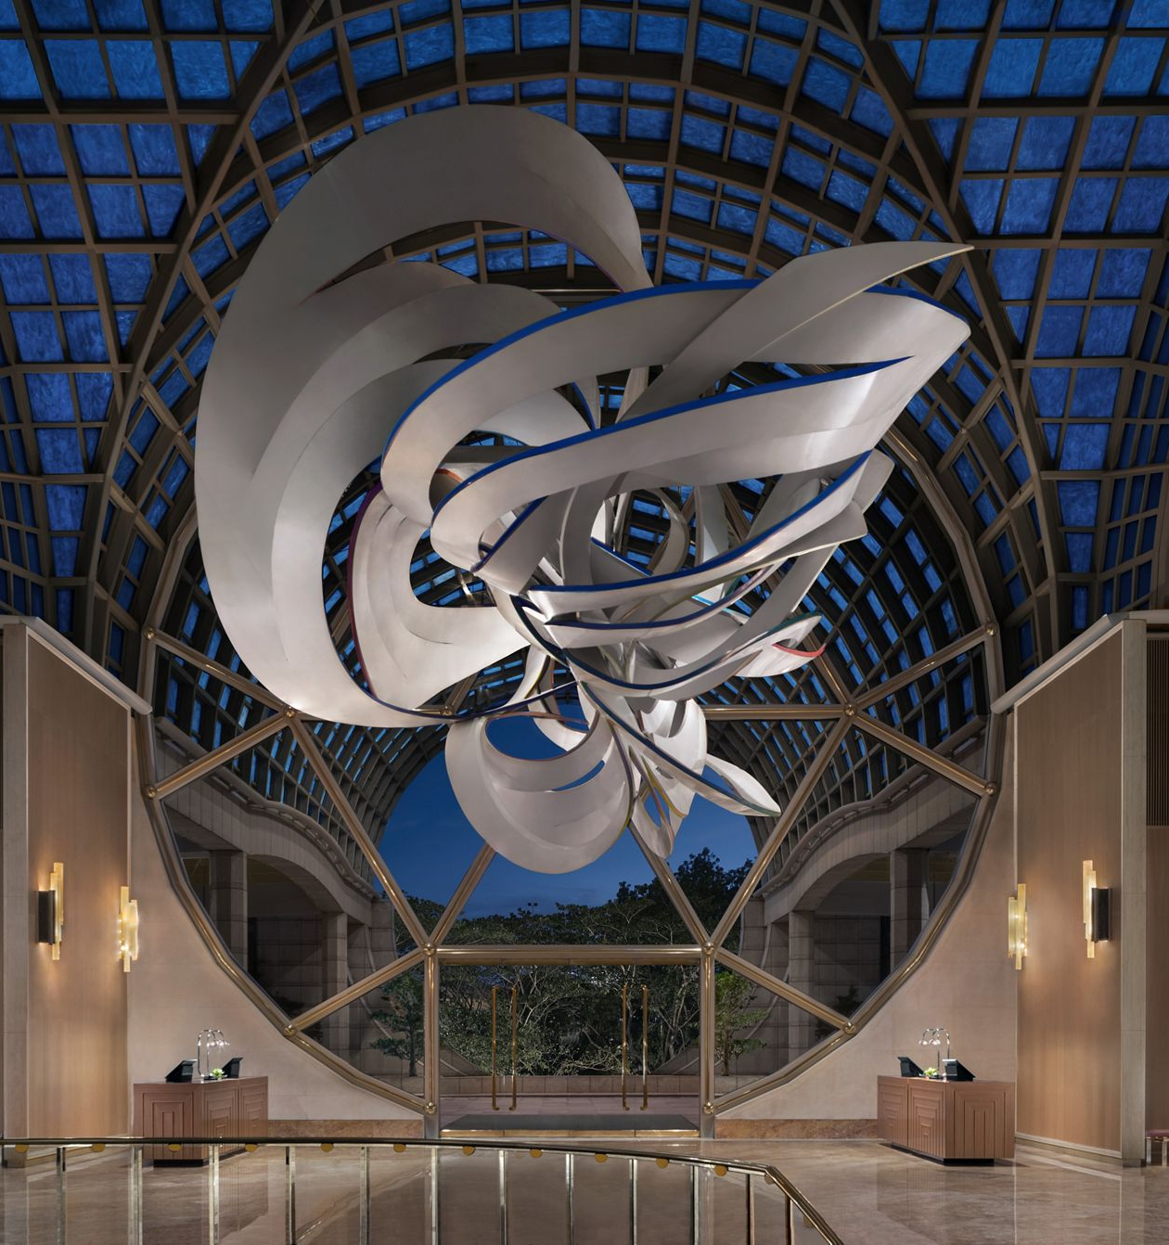
Ritz-Carlton
One of the most luxury brand of Marriott International
A history of more than 100 years:
The Ritz-Carlton Investing Company was established in 1906
In 1983, The Ritz-Carlton Hotel Company, LLC was formed
In 1998 the brand was purchased by Marriott International.
108 hotels ( USA & CANADA, MEXICO, CARIBBEAN & LATIN AMERICA, EUROPE, ASiA-PACIFIC, MIDDLE EAST & AFRICA )
Offers: hotels and resorts, yachts, weddings, meetings and residences
In 2000 opened first residence in Washington
In 2008 opened the first Ritz-Carlton Reserve property in Thailand

Slide 5
Main consumers:
The main consumers of Ritz-Carlton hotels & resorts are:
Reach people
Celebrities
Corporates, businessmen
Leisure travellers
Upper class
People willing to pay for unique experiences
5

Slide 6
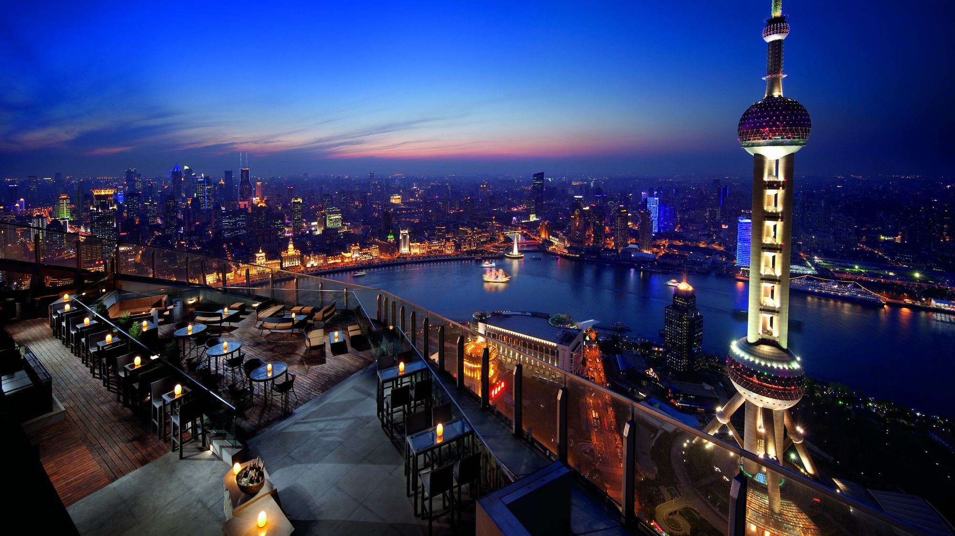
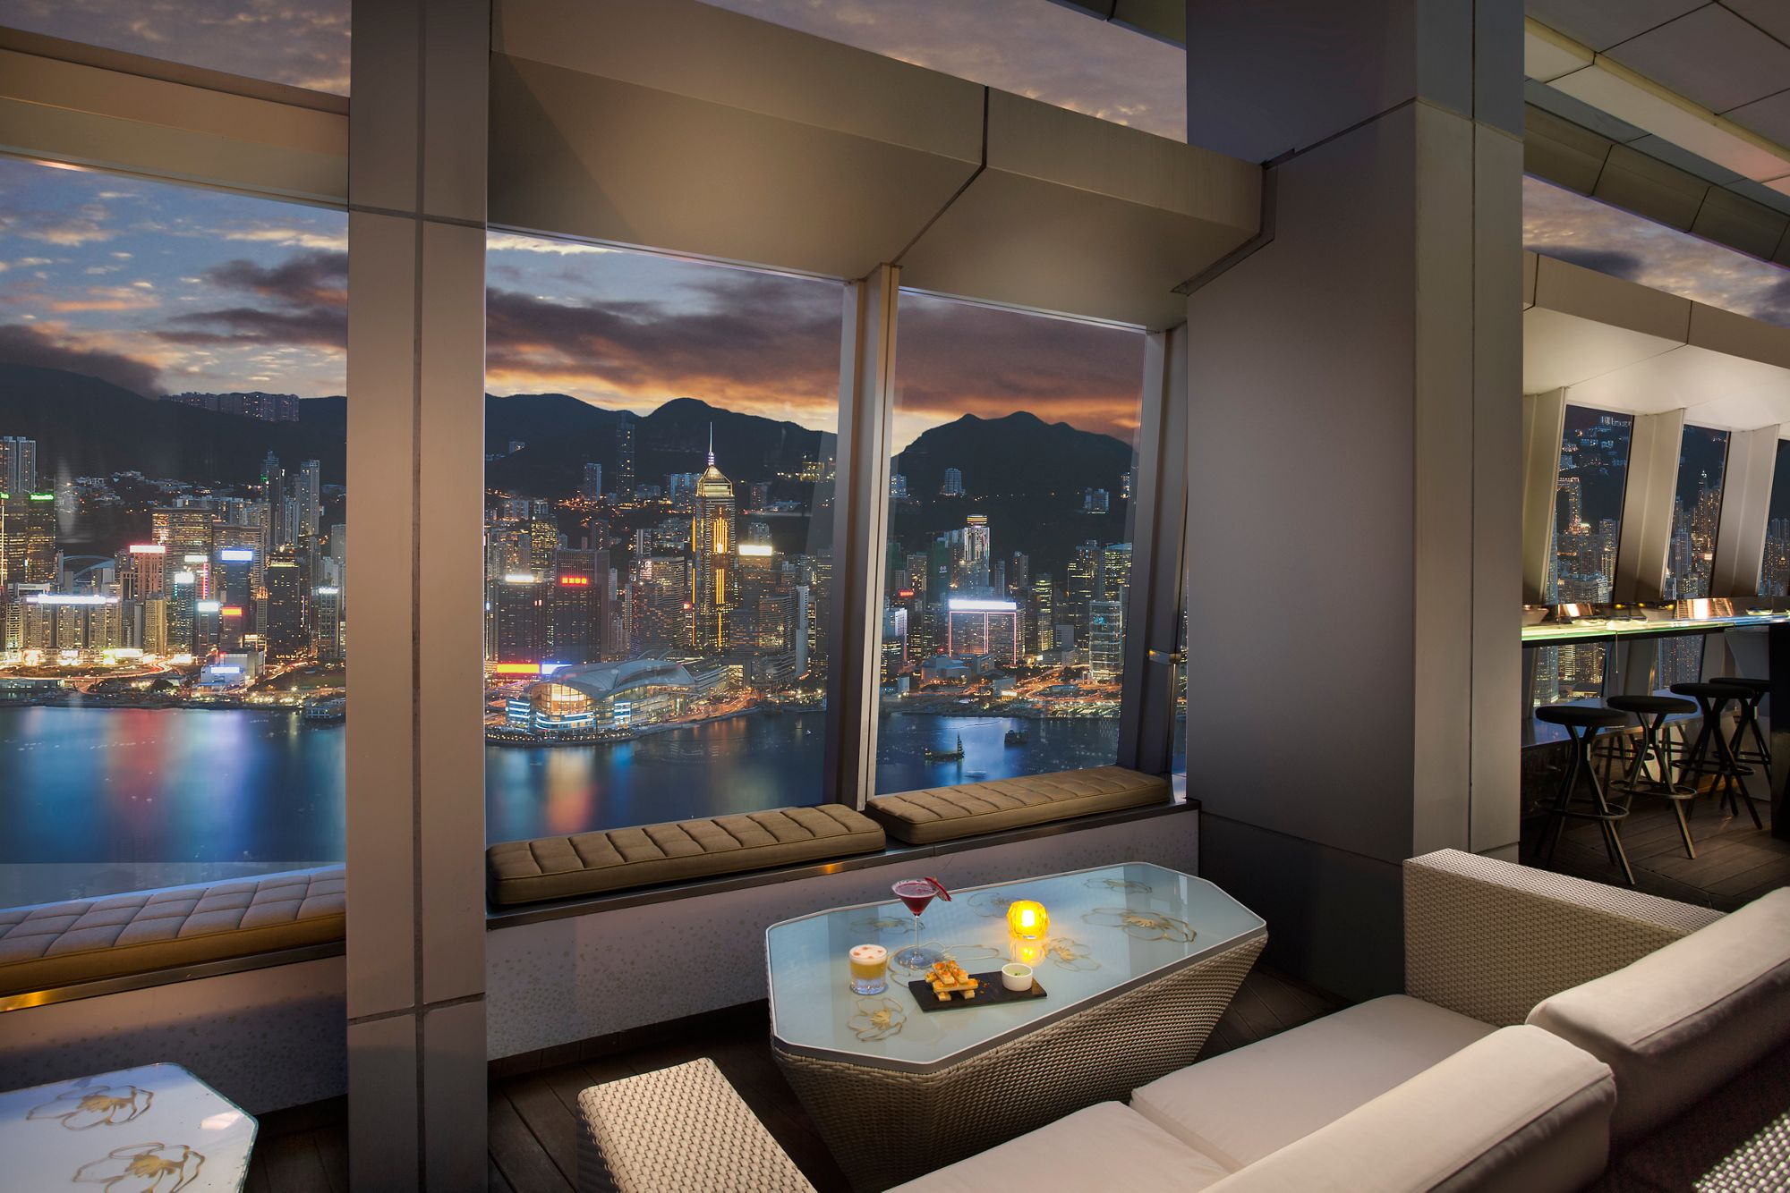


Unique guest services:
amazing views from which to say "cheers“
KID-FRIENDLY VACATIONS
Grand Cayman’s Caribbean - the beachfront eatery and bar evokes.
Ras Al Khaimah, Al Wadi Desert - the rooftop Moon Bar.
At Ozone Hong Kong, floor-to-ceiling windows at 118 floor.
ArtDeco-inspired tower Shanghai's highest rooftop bar
Tea parties
Ocean expeditions
Drawing kits
Kid-friendly menus
Board games, puzzles
Kids movies
The Ritz-Carlton, Millenia Singapore -Ritz Kids Night Safari sleeping tent
Abama : Planetarium Room, outdoor playground
6

Slide 7
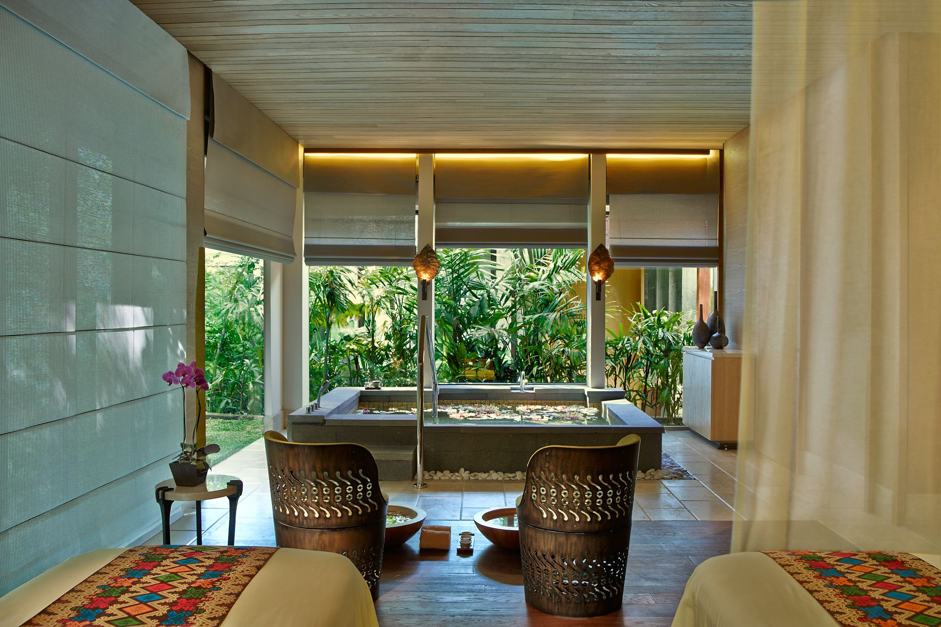
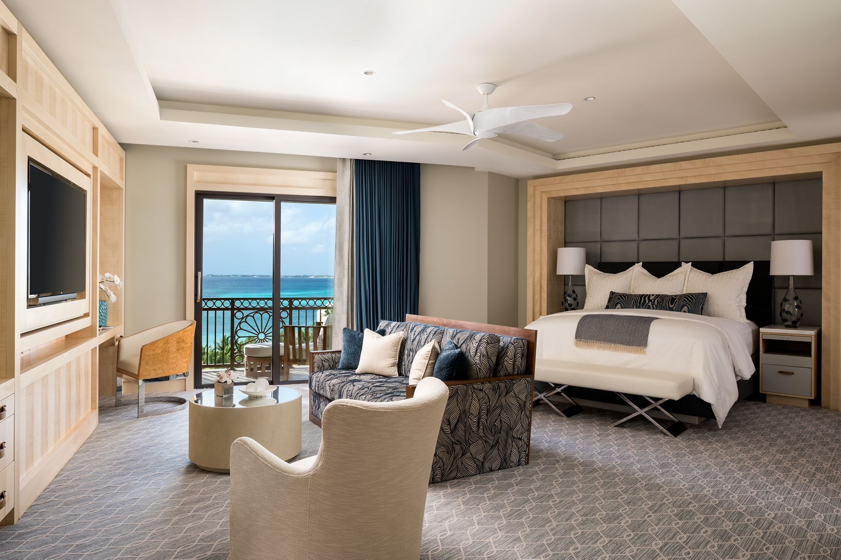
GUEST SERVICES
TANGIBLE
INTANGIBLE
Marble bath with city views
Outdoor swimming pool
In-room Nespresso coffee machine
Fireplace (select rooms)
Wine-tasting room offer flights and culinary experiences
Electric vehicle charging stations
Bicycle rentals
Town car service available
Chauffeured limousine service
Translator
Multi-lingual staff
Kids program
Complimentary overnight shoeshine
Notary public
Twice-daily housekeeping
Babysitting
7

Slide 8
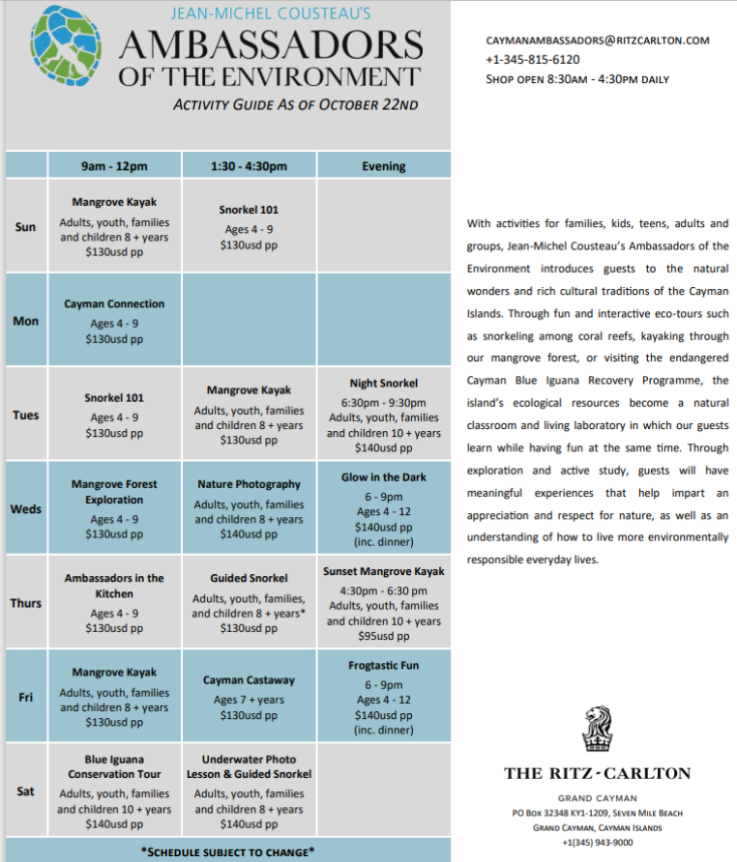
Experiences:
Ritz-Carlton Cayman offers a variety of activities for the customers with activities for kids, adults and groups.
8

Slide 9
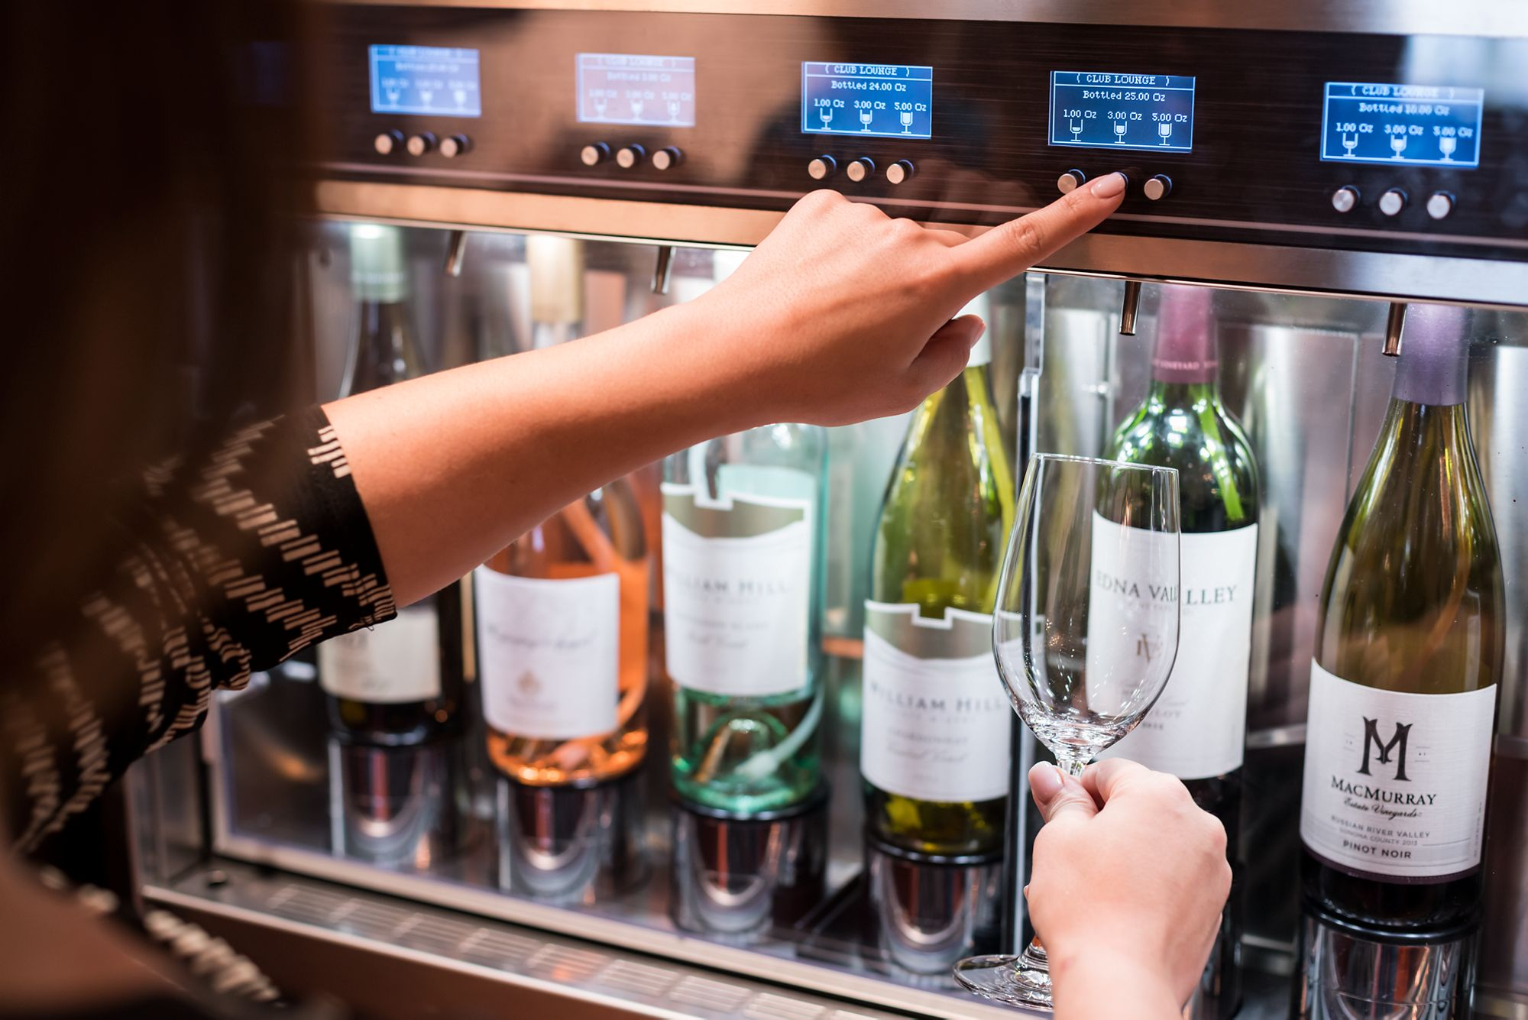
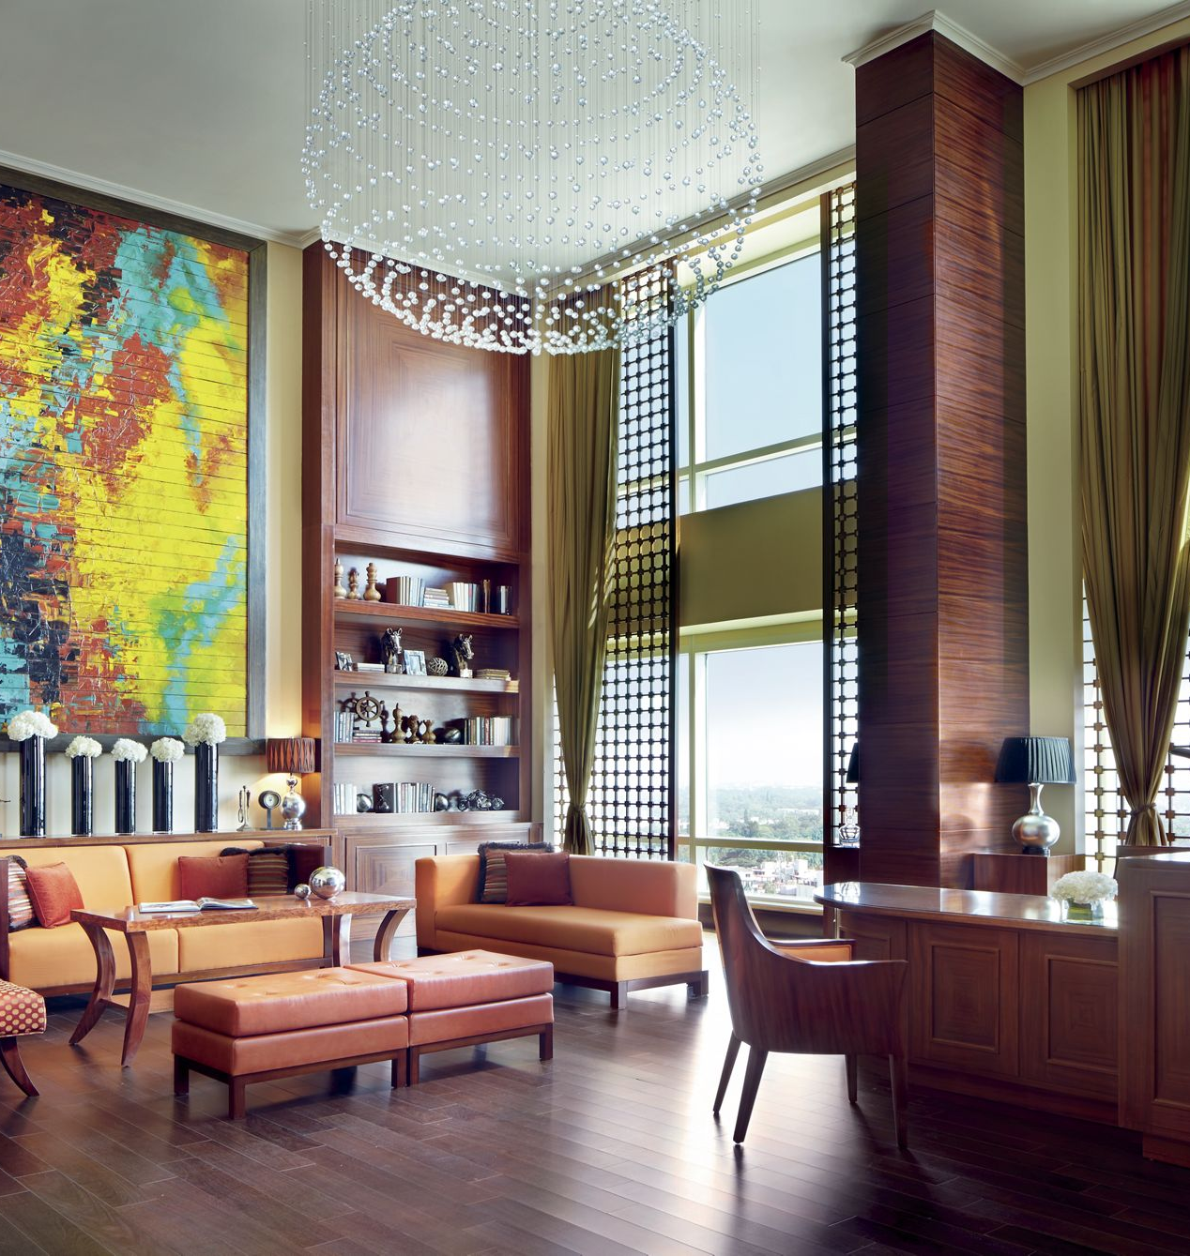
Unique guest services
EXCLUSIVE CLUB LEVEL
Exclusive experiences at Ritz-Carlton Tysons Corner Washington:
High end vendors frequently visit the Lounge to hold events
Meet yoga instructors, fashion professionals, chefs, and culinary experts
Participate in international food tastings
Be pampered by our spa specialists
THE RITZ-CARLTON BANGALORE:
Elegant culinary indulgence for breakfast, light lunch, afternoon tea,
Spectacular views of the Bangalore skyline
Casting enabled TVs in Club Rooms and Club Executive Suites
Wi-Fi access throughout the hotel
Use of the board room up to two hours and secretarial services on availability
Personalized check in and check out service at The Club Lounge
9

Slide 10
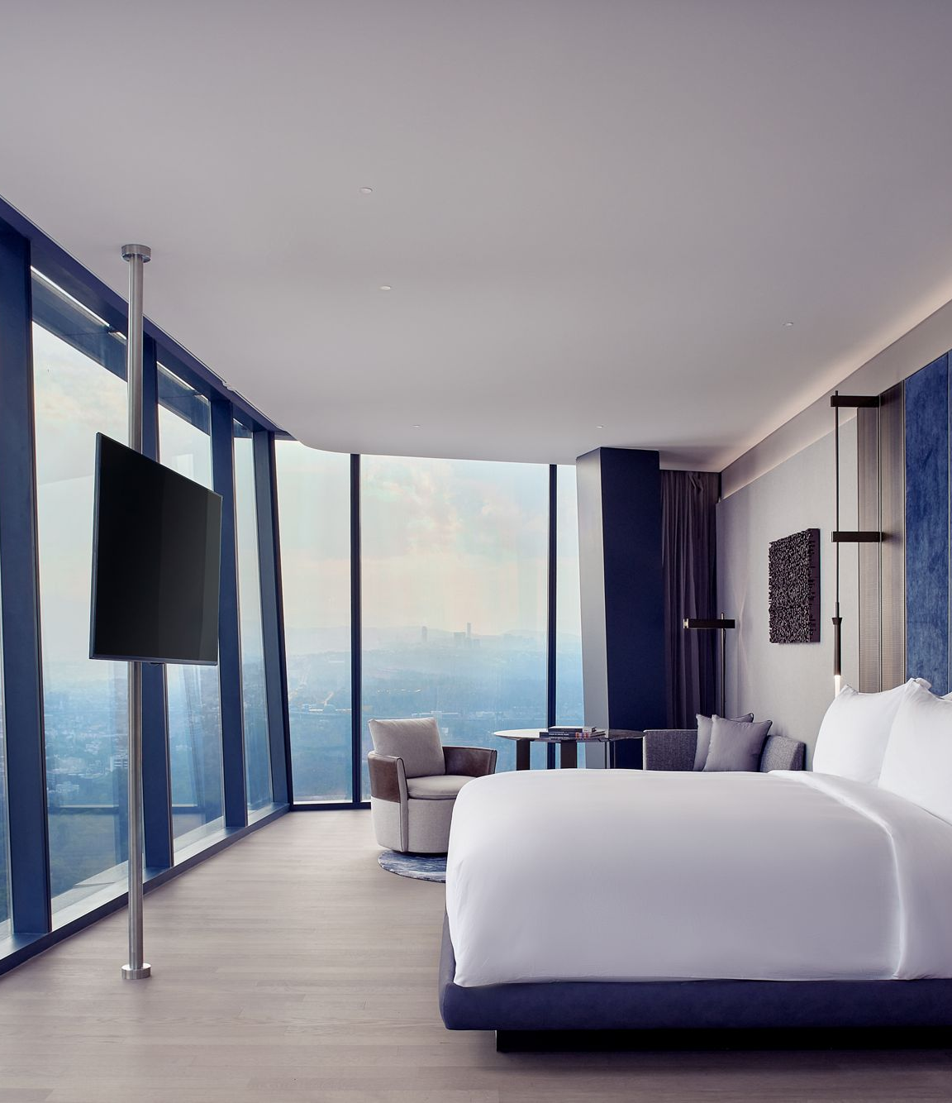
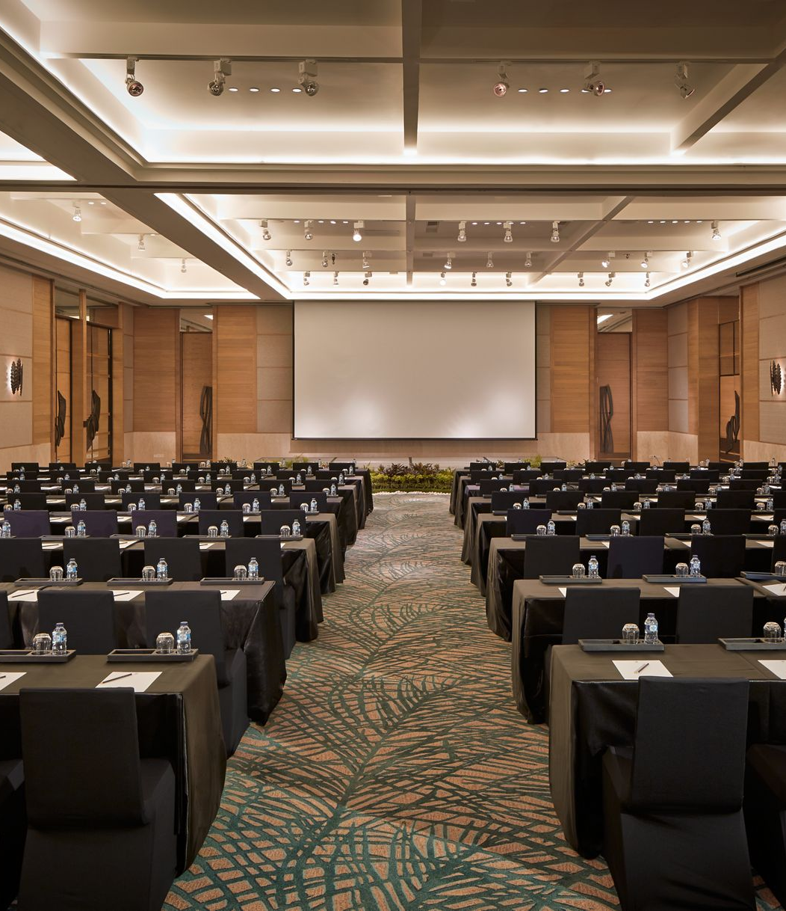
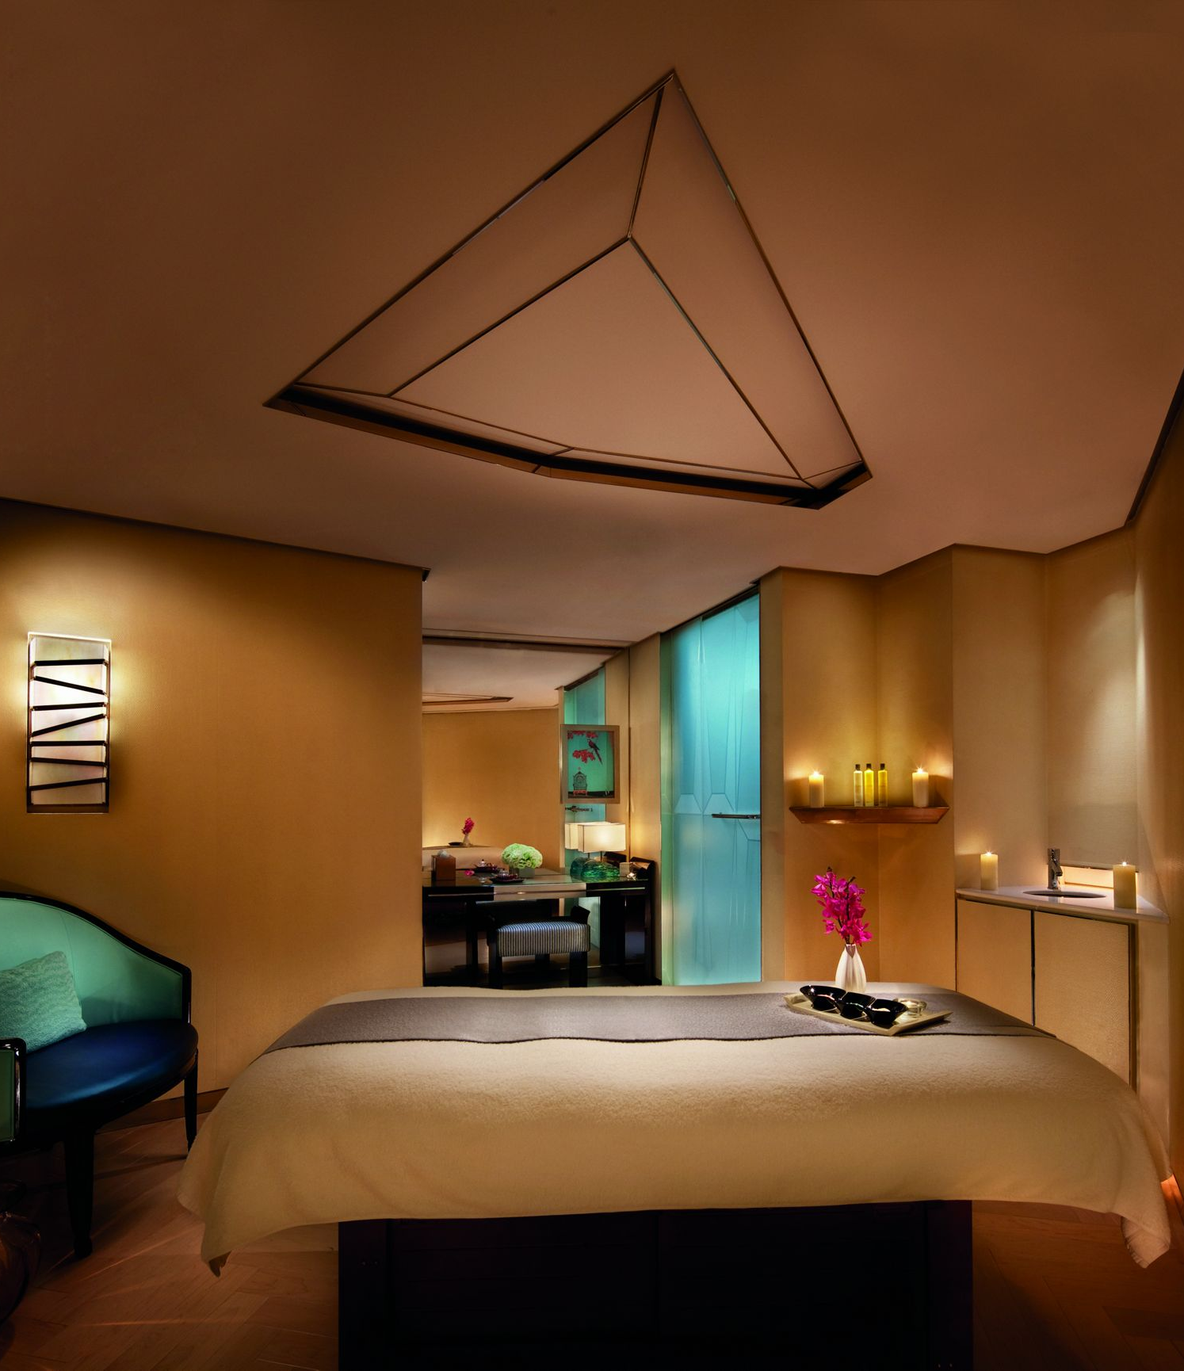
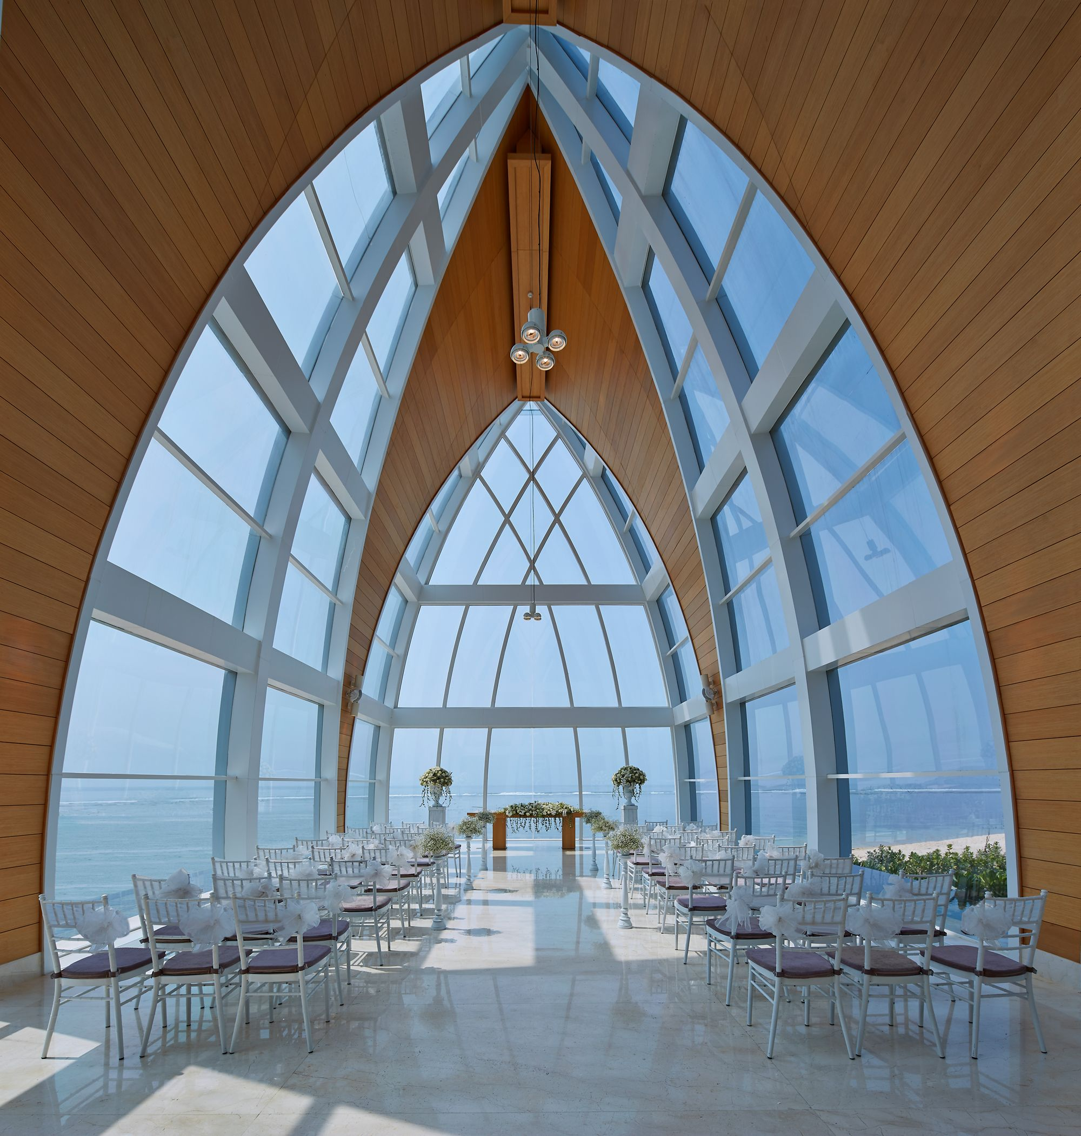
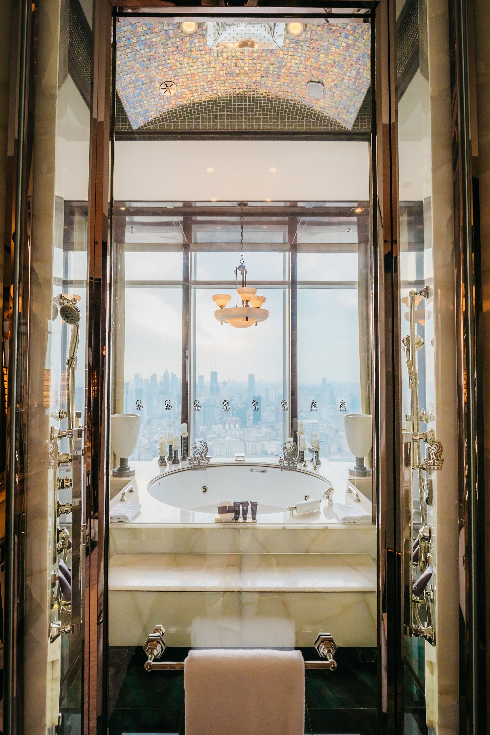
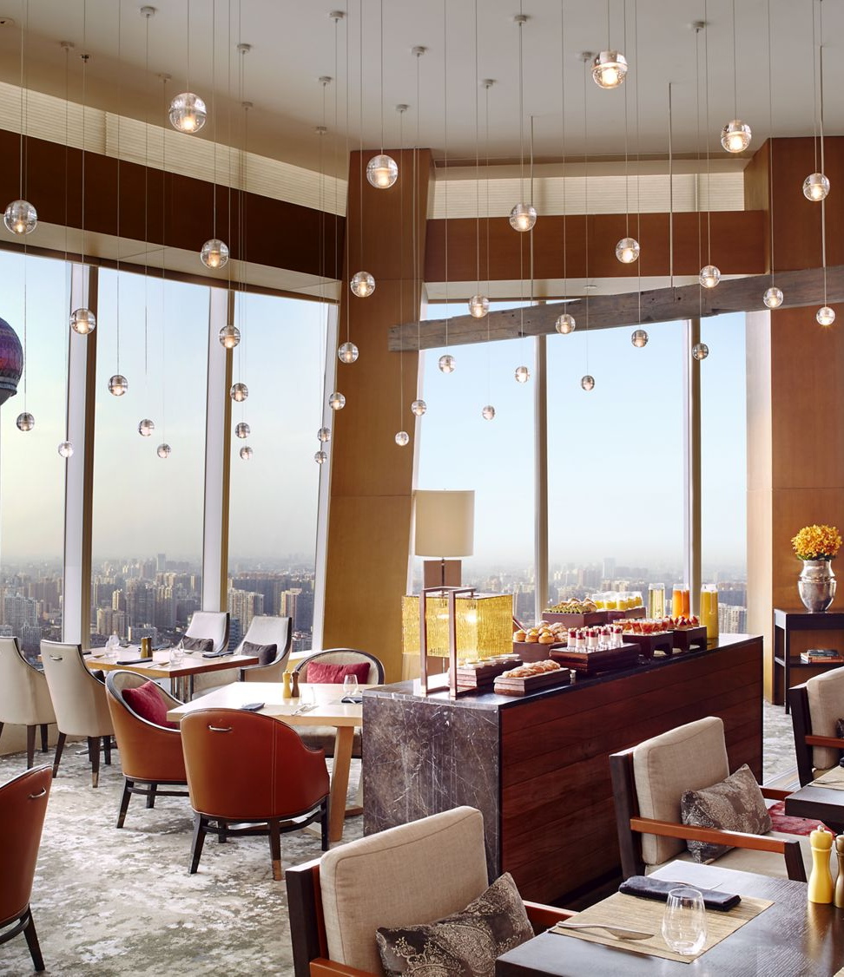
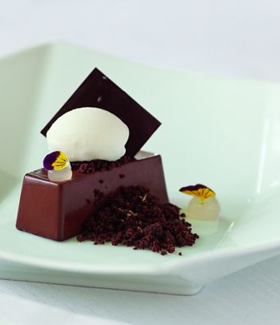
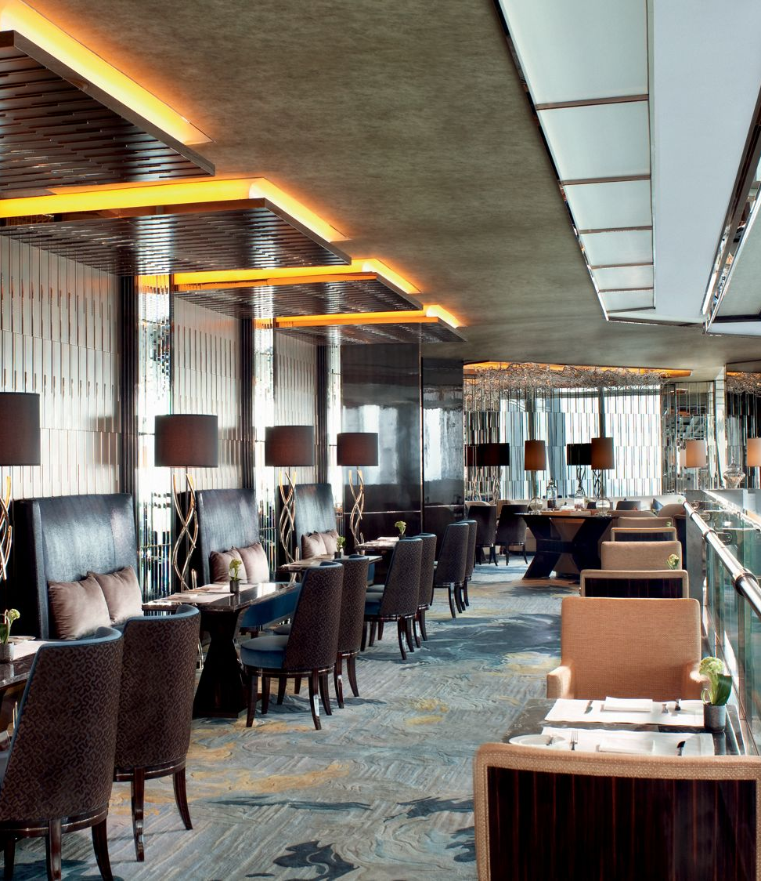
How the hotel meet guest expectations:
- targeting the right customers
- collect feedback
- understand the customers
- quality customer service
- building relationship with customers
MEETING SERVICES
SPECIAL ROOMS
Every event is a masterpiece waiting to happen
WEEDING SERVICES
SPA
Experiences at The Ritz-Carlton Club
Provide WOW factor
Unique and personalized experiences
FINE DINING DRIVEN BY EXPERIENCES
The 2000$ policy
10

Slide 11
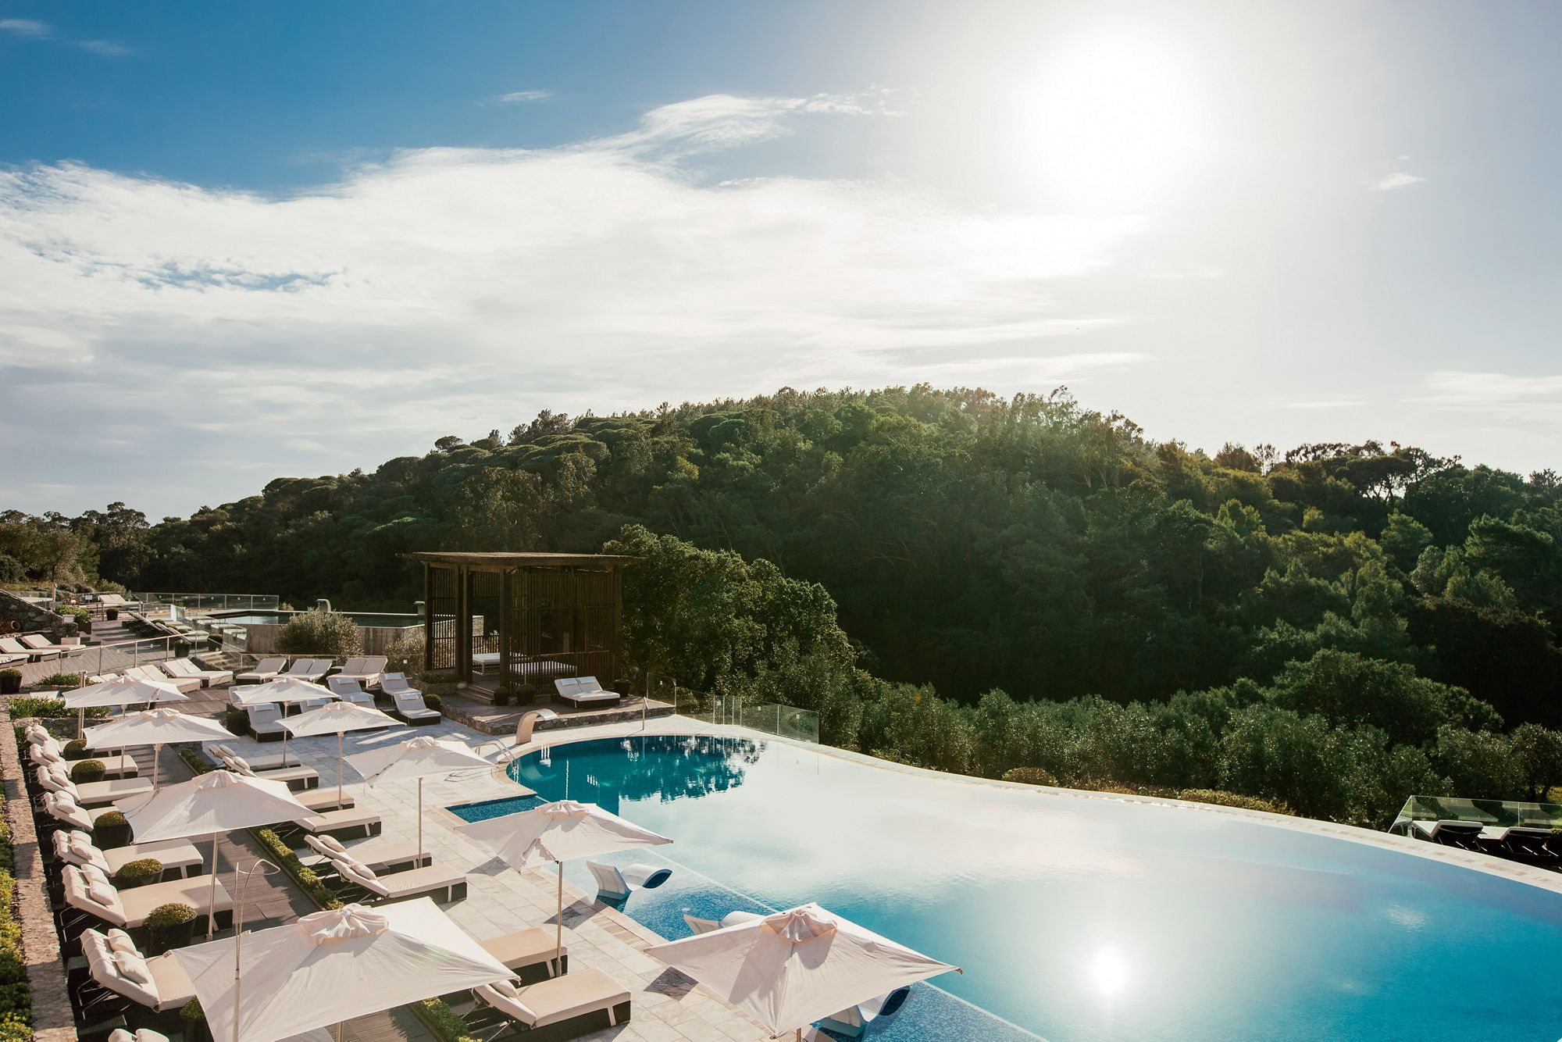
Reference list:
Heppell, M. (2015) Five Star Service: How to deliver Exceptional Customer Service, Pearson, London
Marriott (2023) HotelDevelopment. Available at: Hotel Development | Marriott International ( Accessed at: 03 February 2023)
RitzCarlton (2023) TysonsCorner. Available at: Northern VA Hotels | The Ritz-Carlton, Tysons Corner (ritzcarlton.com) ( Accessed at: 29 January 2023)
RitzCarlton(2023) NewOrleans. Available at: Club Level | The Ritz-Carlton, New Orleans (ritzcarlton.com) Accessed at: 29 January 2023)
RitzCarlton(2023) Bangalore. Available at: Club Level in Bangalore, India | The Ritz-Carlton, Bangalore (ritzcarlton.com) Accessed at: 30 January 2023)
RitzCarlton (2023) Cocktail-views. Available at: Cocktails With a View | Journey Into The Ritz-Carlton (ritzcarlton.com) ( Accessed at: 01 February 2023)
RitzCarlton (2023) ClubLevel. Available at: Hong Kong Hotel Club Lounge – Suites in Hong Kong | The Ritz-Carlton, Hong Kong (ritzcarlton.com) ( Accessed at: 04 February 2023)
Solomon, M. (2018) The Heart of Hospitality : Great Hotel and Restaurant Leaders Share Their Secrets. New York: SELECT Books INC
Theritzlondon (2023) History. Available at: https://www.theritzlondon.com/about-the-ritz/history/ ( Accessed at: 02 February 2023)
Wood, R.C., (2015). Hospitality Management: a brief introduction, Sage, London
11

Slide 12
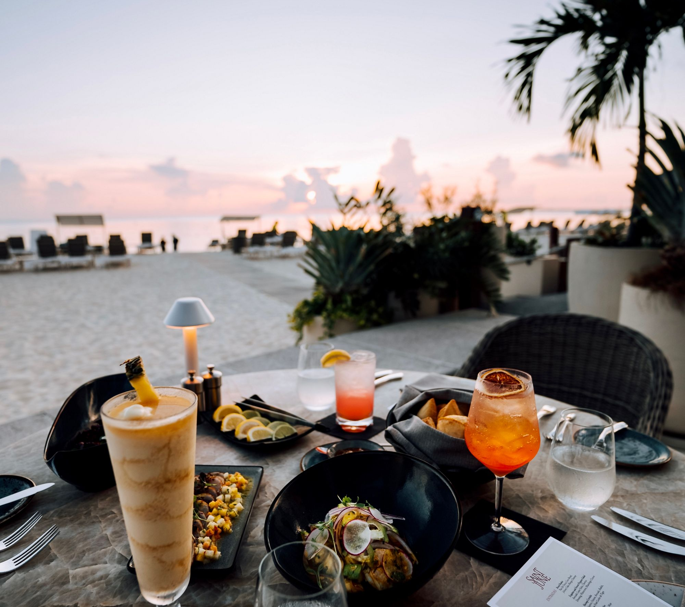
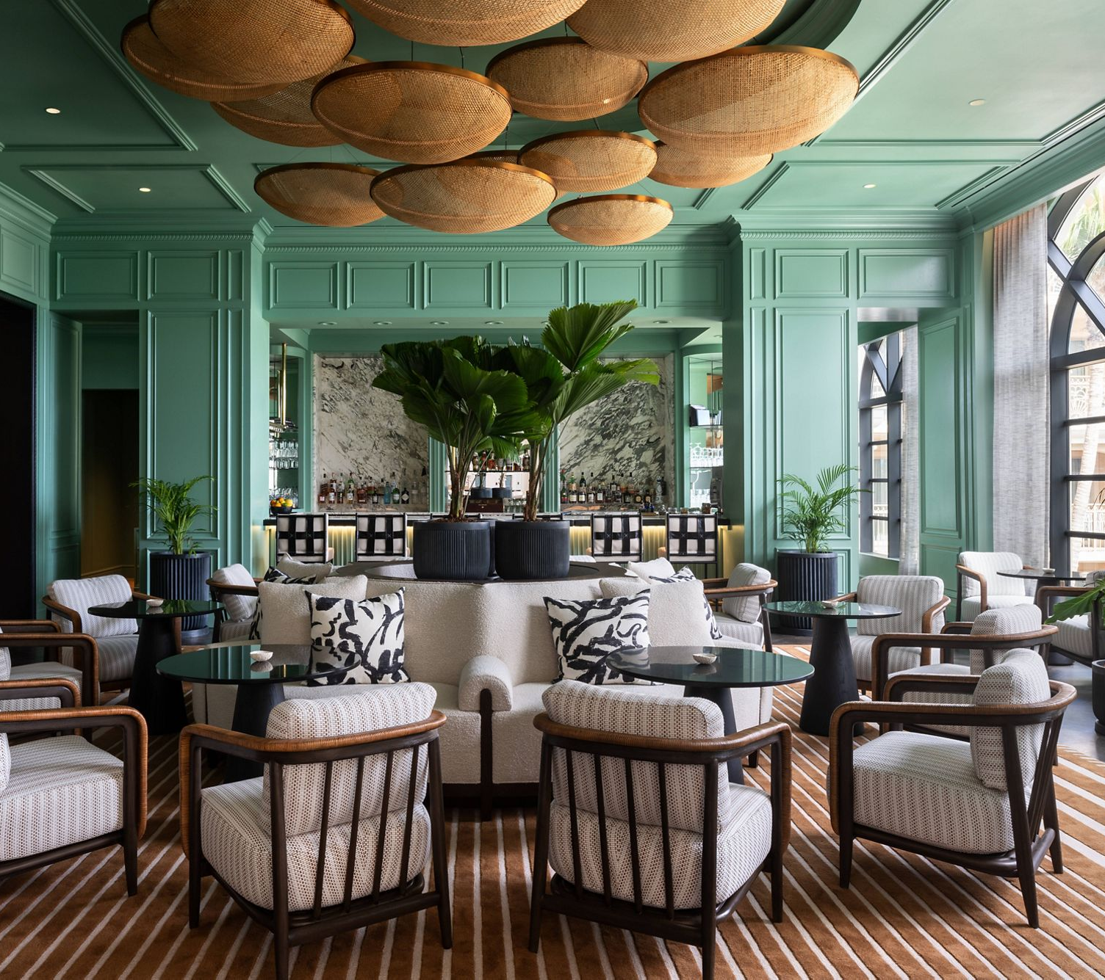
Thank you!
Student:
Ovidiu-Mario Trasc

