Slide 1



Digital Transformation in the Health and Care Professions
BMHP_6026
Evaluating DERM : An Autonomous AI Dermatology System by Skin Analytics in NHS Skin Cancer Assessment
Student Id: 2321291
Student Name: Nashima Ghufran
Lecturer Name: Joanna Davies
Submission Date: 06/03/2026

Slide 2
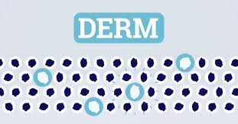
Introduction
Rising demand and staff shortages in NHS dermatology(NHS England, 2019) .
Increasing referrals for suspected skin cancer.
Digital innovation is a key NHS priority (DHSC, 2022).
DERM is an AI system used to assess suspicious skin lesions (Skin Analytics, 2025b).
Source: (Skin Analytics, 2025)

Slide 3
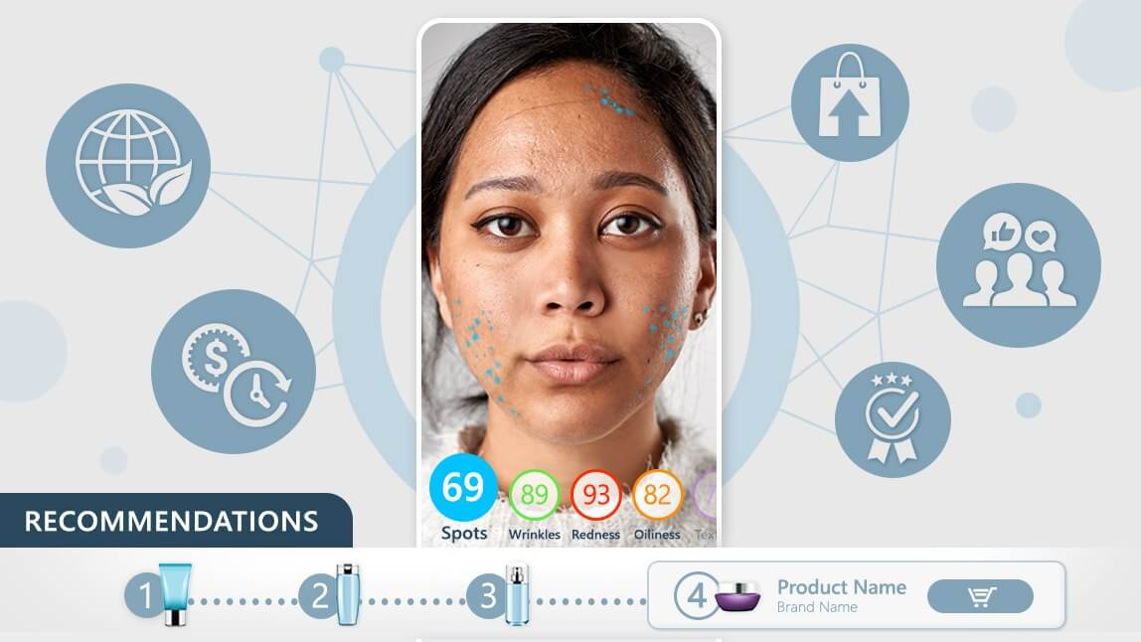
DERM Overview
Developed by Skin Analytics (Skin Analytics, 2025b).
Uses deep learning technology to analyze images of skin lesions.
First autonomous AI medical device approved for NHS use (Skene et al., 2024).
Certified as a UKCA Class IIa medical device (Mann, 2025).
Used in primary and community care settings.
Source: (Mann, 2025)

Slide 4
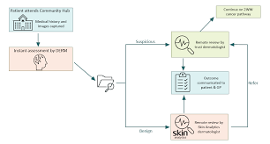
Rationale for DERM use
Skin cancer is one of the most common cancers in the UK
(Cancer Research UK, 2024).
Dermatology services experience long waiting times.
Many referrals are benign or low-risk (Skin Analytics, 2025a).
Workforce shortages limit
Specialist capacity
(Marsden et al., 2024).
DERM supports faster and safer triage decisions
(Thomas et al., 2023).
Source: (Thomas et al., 2023)

Slide 5
(A) Workforce Impact
Positive Impacts
Reduces workload for dermatologists.
Can safely rule out 40-50% of low-risk referrals (NICE, 2025).
Clinicians can focus on high-risk or complex cases (Marsden et al., 2023).
Nurses and healthcare assistants gain new roles in imaging and diagnostics.
Improve digital skills and workforce flexibility (NHS England, 2025).

Slide 6
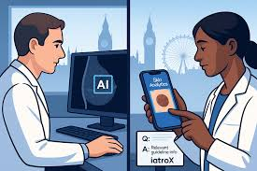
Workforce Impact
Negative Impacts
Staff require training to capture images and interpret AI outputs.
Short-term increase in workload during implementation.
Concerns about responsibility for AI decisions (Li et al., 2022).
Fear of deskilling or Job displacement (Mann, 2025).
Strong leadership and governance are needed to reduce resistance (NHS England, 2021)
Source: (Li et al., 2022)

Slide 7
(B) PATIENT/Service USER Impact
Positive Impact
Reduces waiting times and patient anxiety.
Local assessments reduce travel and disruption
Early reassurance for benign conditions lowers stress.
Supports early diagnosis of melanoma, improving survival rates (Abdulrahman & Trengove,2025).
Faster referral for high-risk cases improves outcomes.

Slide 8
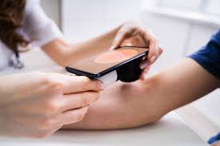
Source: (Li et al., 2022)
PATIENT/SERVICE USER IMPACT
Negative Impact
Need for transparency, informed consent and ability to request human review (Young et al., 2022).
Some patients may feel uncomfortable with AI in care.
Ethical concerns: algorithmic bias may reduce accuracy for darker skin tones ((Li et al., 2022).
Compliance with UK GDPR and Data Protection Act 2018 is essential(GDPR, 2018).

Slide 9
(C) Community Impact
Positive Impact
Reduces hospital visits, travel time and costs.
Early detection improves public health outcomes.
Supports care closer to home (NHS England,2023)
Frees hospital dermatology resources for complex cases.
Contributes to prevention and early intervention strategies(Skin Analytics, 2025a).

Slide 10
Community Impact
Negative Impact
Need for ongoing monitoring, transparency and regulatory oversight.
Algorithmic bias may increase health inequalities (Lim et al., 2022)
Reduced human interaction may affect public acceptance.
Possible trust issues if people are unfamiliar with AI.

Slide 11
Conclusion
DERM is a recent and effective digital innovation in NHS dermatology (Skin Analytics, 2025b; Skene et al., 2024)
It reduces unnecessary referrals, prioritizes high-risk cases and supports earlier skin cancer detection (Marsden et al.,2023; Mann, 2025)
Improves workforce efficiency and community health outcomes.
Successful implementation requires staff training, governance, patient consent and ethical data use (Young et al., 2020; UK GDPR, 2018).

Slide 12
Recommendations
Provide ongoing staff training in AI and imaging skills.
Maintain clear accountability frameworks for AI-assisted decisions (Thomas et al., 2023).
Regular monitor algorithm performance, bias and safety (Li et al., 2022).
Engage patients and communities in evaluation and feedback (Janda et al., 2020; Kawsar et al., 2023).
Follow UK GDPR and Data Protection Act guidelines strictly (UK GDPR, 2018).

Slide 13
Reference List
Abdulrahman, S. and Trengove, M. (2025). Mitigated deployment strategy for ethical AI in clinical settings. BMJ Health & Care Informatics, 32(1), pp. e101363–e101363.
Available at: https://doi.org/10.1136/bmjhci-2024-101363(Accessed: 8 February 2026).
Cancer Research UK (2024). Melanoma skin cancer statistics. Available at: https://www.cancerresearchuk.org (Accessed : 8 February 2026).
Department of Health and Social Care (DHSC) (2022) A Plan for Digital Health and Social Care. London: DHSC. Available at: https://www.gov.uk/government/publications/a-plan-for-digital-health-and-social-care (Accessed: 8 February 2026).
Great Britain (2018) UK General Data Protection Regulation (Retained Regulation (EU) 2016/679). London: HMSO . Available at: https://www.legislation.gov.uk/eur/2016/679/contents (Accessed: 19 February 2026)
Janda, M., Horsham, C., Vagenas, D., Loescher, L. J., Gillespie, N., Koh, U. and Soyer, H. P. (2020). Accuracy of mobile digital teledermoscopy for skin self-examinations in adults at high risk of skin cancer: an open-label, randomized controlled trial. The Lancet Digital Health, 2(3), e129-e137. Available at: https://www.thelancet.com/journals/landig/article/PIIS2589-7500(20)30001-7/fulltext (Accessed: 10 February 2026).
Kawsar, A., Hussain, K., Kalsi, D., Kemos, P., Marsden, H. and Thomas, L. (2023). Patient perspectives of artificial intelligence as a medical device in a skin cancer pathway. Frontiers in Medicine, 10, 1259595. Available at: https://www.frontiersin.org/journals/medicine/articles/10.3389/fmed.2023.1259595/pdf (Accessed: 11 February 2026).
Li, Z., Koban, K. C., Schenck, T. L., Giunta, R. E., Li, Q. and Sun, Y. (2022). Artificial intelligence in dermatology image analysis: current developments and future trends. Journal of Clinical Medicine, 11(22), 6826. Available at: https://www.mdpi.com/2077-0383/11/22/6826 (Accessed: 13 February 2026).
Lim, K., Neal‐Smith, G., Mitchell, C., Xerri, J. and Chuanromanee, P. (2022). Perceptions of the use of artificial intelligence in the diagnosis of skin cancer: an outpatient survey. Clinical and Experimental Dermatology, 47(3), 542-546.
Available at: https://academic.oup.com/ced/article-abstract/47/3/542/6693211(Accessed: 13 February 2026).

Slide 14
Mann, D. (2025). ‘UK’s NICE backs DERM, an AI skin cancer detection tool - The Dermatology Digest. Available at: https://thedermdigest.com /(Accessed : 13 February 2026).
Marsden, H., Morgan, C., Austin, S., DeGiovanni, C., Venzi, M., Kemos, P. and Palamaras, I. (2023). Effectiveness of an image analyzing AI-based digital health technology to identify non-melanoma skin cancer and other skin lesions: results of the DERM-003 study. Frontiers in Medicine, 10, 1288521. Available at: https://www.frontiersin.org/journals/medicine/articles/10.3389/fmed.2023.1288521/pdf (Accessed : 12 February 2026)
Marsden, H., Kemos, P., Venzi, M., Noy, M., Maheswaran, S., Francis, N. and Thomas, L. (2024). Accuracy of artificial intelligence as a medical device as part of a UK-based skin cancer tele dermatology service. Frontiers in Medicine, 11, 1302363. Available at: https://www.frontiersin.org/journals/medicine/articles/10.3389/fmed.2024.1302363/pdf (Accessed : 11 February 2026)
NHS England (2019). The NHS Long Term Plan . London: NHS England. Available at: https://www.england.nhs.uk/2019/01/long-term-plan/(Accessed: 14 February 2026)
NHS England (2021) What Good Looks Like framework for digital transformation. London. First published 31 August 2021, updated 4 October 2021. NHS England. Available at: https://transform.england.nhs.uk/digitise-connect-transform/what-good-looks-like/what-good-looks-like-publication(Accessed: 8 February 2026)
NHS England (2023). AI- based skin lesion analysis technology. Available at: https://www.england.nhs.uk/elective-care/best-practice-solutions/ai-based-skin-lesion-analysis-technology/ (Accessed: 14 February 2026)
NHS England (2025). Merseyside hospital uses AI for early skin cancer detection. NHS University Hospitals of Liverpool Group. Available at: https://www.uhliverpool.nhs.uk/about-us/our-stories/merseyside-hospital-pioneers-use-ai-technology-early-detection-skin-cancer (Accessed: 15 February 2026)
National Institute for Health and Care Excellence (NICE) (2025). AI skin cancer detection system gets green light for conditional NHS use. Available at: https://www.nice.org.uk/news/articles/ai-skin-cancer-detection-system-gets-green-light-for-conditional-nhs-use (Accessed: 16 February 2026).
Skin Analytics (2025a). NICE recommends DERM for early use within the NHS, while further evidence is gathered - Commentary from Neil Daly, Founder and CEO, Skin Analytics - Skin Analytics. Available at: https://skin-analytics.com/news/regulatory-certification/nice-recommends-derm-nhs/ (Accessed : 17 February 2026)
Skin Analytics (2025b). DERM makes medical history the world’s first autonomous skin cancer detection system is approved for clinical decisions in Europe - Skin Analytics Available at: https://skin-analytics.com/news/regulatory-certification/derm-class-iii-ce-mark/(Accessed: 19 February 2026)
Skene, S., Armes, J., Moschoyiannis, S., Sutton, K., Mendis, J., Jenkins, H. and Insights, U. (2024). AI in Healthcare Award-Final Report: Skin Analytics (DERM). Available at: https://openresearch.surrey.ac.uk/esploro/fulltext/report/AI-in-Healthcare-Award---Final/99873466002346?repId=12203690690002346&mId=13204200700002346&institution=44SUR_INST(Accessed : 17 February 2026)

Slide 15
Thomas, L., Hyde, C., Mullarkey, D., Greenhalgh, J., Kalsi, D. and Ko, J. (2023). Real-world post-deployment performance of a novel machine learning-based digital health technology for skin lesion assessment and suggestions for post-market surveillance. Frontiers in Medicine, 10, 1264846. Available at: https://www.frontiersin.org/journals/medicine/articles/10.3389/fmed.2023.1264846/pdf (Accessed : 19 February 2026)
Young, A. T., Xiong, M., Pfau, J., Keiser, M. J. and Wei, M. L. (2020). Artificial intelligence in dermatology: a primer. Journal of Investigative Dermatology, 140(8), 1504-1512. Available at: https://www.sciencedirect.com/science/article/pii/S0022202X2031201X (Accessed: 19 February 2026)

