Slide 1
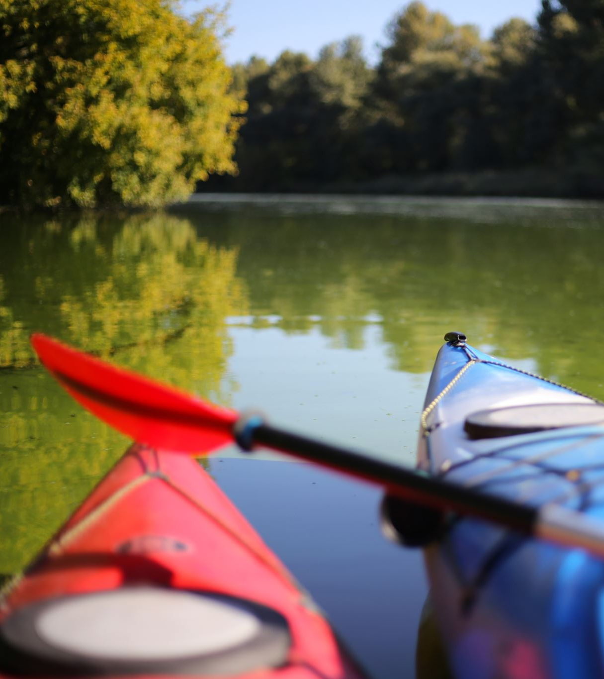
Participant
Female
Over 50 years old
Main activity is canoeing
Since COVID-19

Slide 2
Interview Results

Slide 3

Motives Identified from interview
Enjoyment and Fun
Being outdoors / Nature connection
Social interaction
Skill Development
Mental Health
Sense of freedom
Personal Fitness / Challenge
Routine
Risk awareness

Slide 4
Themes Identified within the interview

Slide 5
Theme 1
"I enjoy going with others because it adds a shared sense of adventure".
Social Connection
Money Saving Expert, 2022

Slide 6
Theme 2
“I do it mainly for recreation I just enjoy being on the water”
Enjoyment and intrinsic motivation

Slide 7
Theme 3
“There’s something unique about gliding across the water and being close to nature”
Environmental and nature-based motivation

Slide 8
Theme 4
“I enjoy mastering strokes and improving my skills”.
Skill Development and competence

Slide 9
Theme 5
“I feel mentally clearer and refreshed after being out”.
Mental Health and Wellbeing

Slide 10
Theme 6
“The risks don’t put me off they just make me more prepared”
Risk awareness and safety

Slide 11
How the themes link to research.

Slide 12
Social connection.
Down et al. (2025) — Psychosocial outcomes of outdoor adventure education for adolescents
Why it fits the theme.
The participant said they enjoyed canoeing with others because it adds a shared sense of adventure, which aligns with the article’s findings on social benefits.
The article talks about how, during the Outdoor Adventure Education programs, it is important that you develop and maintain connections with others.
The article says “Opportunities for connections, tangible responsibilities and challenges. May positively impact psychosocial outcomes.

Slide 13
Enjoyment and intrinsic motivation.
Brymer et al. (2024) — Adventure and Mental Health: An Ecological Perspective
Why it fits the theme
This supports the theme because canoeing is enjoyable and intrinsically motivating, which links to what my participant said about canoeing.
The article talks about how adventure facilitates the realisation of fundamental human affordances and enhances mental health and wellbeing.

Slide 14
Environmental and nature-based motivation
Puhakka (2024) — Effects of Outdoor Adventures on Well‑Being and Connection with Nature
Why this fits the theme
This supports the theme because canoeing allows you to glide through the water almost animal-like, allowing you to feel closer to nature.
Nature curiosity and increased connection about natural environments.

Slide 15
Skill Development and Competence.
Pomfret & Bramwell (2014) — The characteristics and motivational decisions of outdoor adventure tourists
Why it fits the theme
This supports the theme because the participant mentioned they enjoy mastering strokes and improving skills.
The paper talks about how motives encourage outdoor adventure participation that include challenge, skill development and mastery.
Outdoor adventure tourists are a diverse group with a wide range of ability, competence and challenge consistently emerge as key motivators.

Slide 16
Mental Health and well-being
Pomfret et al. (2025) — Exploring the Transformational Role of Regular Nature‑Based Adventure Activity Engagement in Mental Health and Long‑Term Eudaimonic Well‑Being
Why this fits the theme
This directly supports the theme that canoeing makes you feel calmer and more refreshed.
This paper talks about how outdoor adventure engagement can be transformational in reducing feelings of ill-being and enhancing well-being.
Regular activity participation can improve self-efficacy and identity development.
Experiencing emotions and overcoming challenges and risks are crucial to long-lasting mental health and well-being transformation.

Slide 17
Risk awareness and safety
Yurtseven, C. N. (2025). Safety precautions and risk management in recreational canoe activities.
Why it fits the theme
This supports the theme as it’s important to understand the risks involved while participating in adventurous activities. This links to what my participant said, “risks don’t put me off, but they make me more cautious and prepared”.
This article talks about what risks could happen while canoeing and the importance of preparation to manage these risks.
Sudden weather changes, strong currents, equipment failures, pre-activity training, and how to manage these risks.

Slide 18
Self Determination Theory
Participant quotes
“I enjoy the freedom and exploration of being on the water
“I enjoy mastering strokes and improving my skills”
“I enjoy going with others because it adds a shared sense of adventure”.
What is the Self-determination theory?
Autonomy
Competence
Relatedness

Slide 19
Basic Needs theory
What is basic needs theory?
Self Actualization
Esteem
Love and belonging
Safety Needs
Physiological needs

Slide 20
Self-Efficacy Theory
Participant Quotes
“I’ve been canoeing for a number of years and feel confident on the water”
“My first experience was with a school group and an instructor”
“Going with others makes it more enjoyable and motivating”
“I feel mentally clearer and refreshed after being out”
What is Self-Efficacy Theory??
Mastery experiences
Vicarious experiences
Verbal persuasion
Emotional States Pari

Slide 21
Future research needed
Cross-Theory Gaps
Interaction between risk awareness, competence, and self-efficacy
Micro adventures as a model for sustainable participation.
Differences in solo/social participation

Slide 22
Reference List
Brymer, E., Vinathe Sharma-Brymer, Willis, R. and Leach, M. (2024). Adventure and mental health: an ecological perspective. Frontiers in Psychology, 15. doi:https://doi.org/10.3389/fpsyg.2024.1352352.
Down, M., Picknoll, D., Hoyne, G., Piggott, B. and Bulsara, C. (2024). ‘When the real stuff happens’: A qualitative descriptive study of the psychosocial outcomes of outdoor adventure education for adolescents. Journal of Outdoor and Environmental Education, 28(1). doi:https://doi.org/10.1007/s42322-023-00151-3.
Garrido, G.L. (2025). Bandura’s Self-Efficacy Theory of Motivation in Psychology. [online] Simply Psychology. Available at: https://www.simplypsychology.org/self-efficacy.html.
McLeod, S. (2025). Maslow’s hierarchy of needs. [online] Simply Psychology. Available at: https://www.simplypsychology.org/maslow.html.
Pomfret, G. and Bramwell, B. (2014). The characteristics and motivational decisions of outdoor adventure tourists: a review and analysis. Current Issues in Tourism, 19(14), pp.1447–1478. doi:https://doi.org/10.1080/13683500.2014.925430.
Pomfret, G., Sand, M., May, C. and Farkić, J. (2025). Exploring the Transformational Role of Regular Nature-Based Adventure Activity Engagement in Mental Health and Long-Term Eudaimonic Well-Being. Behavioral Sciences, [online] 15(4), p.418. doi:https://doi.org/10.3390/bs15040418.
Puhakka, R. (2023). Effects of outdoor adventures on emerging adults’ well-being and connection with nature. Journal of Adventure Education & Outdoor Learning, pp.1–16. doi:https://doi.org/10.1080/14729679.2023.2220836.
Warburton, V.E., Bartholomew, K.J. and Beaumont, L.C. (2026). Optimising motivation in adventure education and outdoor learning: insights from the last 20 years of self-determination theory research. Journal of Adventure Education and Outdoor Learning, pp.1–17. doi:https://doi.org/10.1080/14729679.2026.2653249.

