Slide 1
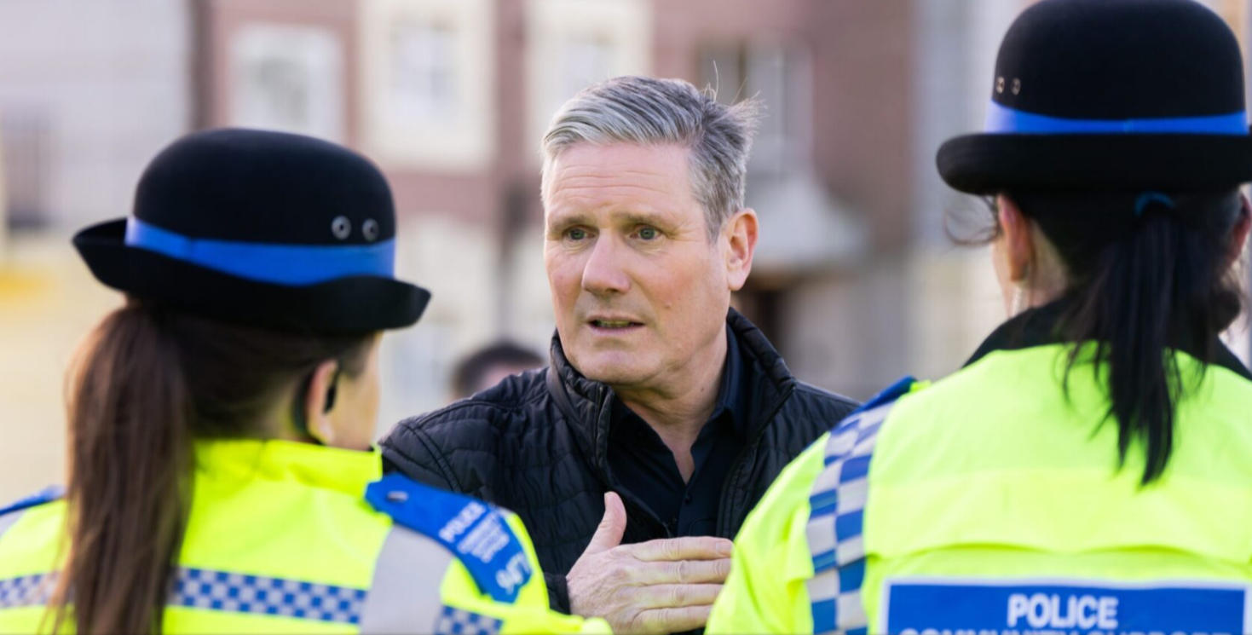

The Complex Interplay Between Political Influence, Policing Priorities & Public Engagement
(Labour Party Manifesto, 2024)
Lisa Jones (Student number: 2417686)
Policing & the political landscape – BMPO7003D
Notes:
This presentation is in support of my written report with the same title which is to “Examine the complex interplay between political influence, policing priorities & public engagement at a national, regional and local level”
The presentation will explore how political agendas influence policing priorities and community engagement across those various perspectives
I will review the positive impact political influence can exert upon police accountability, strategic direction and legislative reform, balanced against the opposing view that political interference can lead to conflict and negatively impact upon public trust and legitimacy
In order to examine the advantages and disadvantages of politicising policing, I will go on to concentrate on the political influence on police responses to protests and provide some case studies

Slide 2
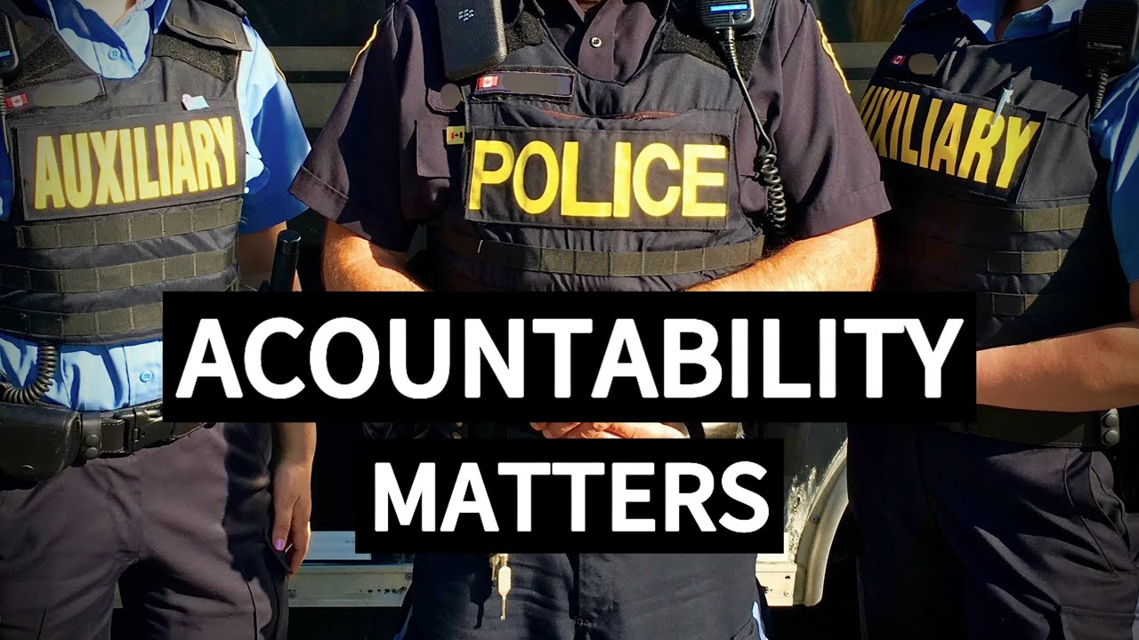
Contents
Politics & Police Accountability
Politics, Policing Priorities & Community Engagement
Politics, Policing & Protests
Conclusion
References
(Police Accountability: YouTube 2024)
Notes:
The concepts discussed in my written report will be expanded upon in this presentation, with particular attention paid to the following areas:
Politics & Accountability
Policing, Priorities & community Engagement
Politics, Policing & Protests (Case studies)
Conclusion
References (Images & text)

Slide 3

Politics & Police Accountability
Politics plays a central role in shaping police oversight (Caless et al., 2016)
PCCs have the power to “hire or fire” Chief Constables, shape force priorities and allocate funding (Loveday, 2018)
Operational independence V’s political accountability (Joyce, 2011)
Politicisation of operational policing (Crompton, 2017)
“While democratic accountability is essential, there is a fine line beyond which political influence becomes manipulation, threatening both the professionalism and neutrality of the police” (Loader & Mulchay, 2003)
(North Wales Police and Crime Plan, 2025)
Notes:
In the UK, police accountability is heavily influenced by politics. Politicians play a crucial role in shaping police oversight. Whilst police forces maintain operational independence, various political structures hold them to account for their conduct, priorities and performance (Caless et al. 2016)
PCCs have increased public accountability whilst simultaneously making policing more political, they have allowed communities to influence police priorities and brought policing closer to local communities beliefs and concerns
Directly elected PCCs have considerable power to hire or fire Chief Constables in addition to setting police priorities and managing budgets. Their authority can put pressure on Chief Constables to support PCC priorities even if in conflict with operational judgement which Loveday (2018) argues introduces new risks of politicisation of policing
Political structures can offer frameworks for examining police behaviour and policy in order to ensure that policing is lawful and consistent with public values
X Critics have argued that because of their own inexperience, poor voter turnout, and contentious disputes with Chief Constables, PCCs run the risk of undermining efficient policing governance
X Operational independence vs political oversight – by introducing political pressure into policing choices, PCCs run the risk of compromising police operational in dependence (Joyce, 2011)
X Politicians also risk pressuring police to prioritise according to political agendas or public opinion rather than evidence-based policing or professional judgement which can undermine the independence, fairness and effectiveness of the police (Crompton, 2017)
When functioning properly, political structures don’t just control policing, they serve as safeguards against abuses of power. The challenge is ensure those structures truly serve the public interest rather than politicising policing for political gain.
**READ QUOTE**

Slide 4

Politics, Policing Priorities &
Community Engagement
National: Home Secretary – legislative reform, strategic priorities & funding levers (Waddington, 1999)
Regional: PCCs – Shape local policing plans, bring policing to the people (Caless et al., 2016)
Local: Councillors/MPs – community safety partnerships, scrutiny panels & local meetings (Crawford, 1998)
Conflict between National priorities & local community needs (Loader & Mulchay, 2003)
Public perceptions of legitimacy and fairness (Tyler & Huo, 2002)
(Humberside Constabulary, 2025)
Notes:
National: The Government is responsible for enacting new laws which are essential for defining police powers and conduct, making sure that policing adheres to the law (E.g., The Police and Criminal Evidence Act (PACE),1984). The Home Secretary plays a central role in determining national policing priorities via the Strategic Policing Requirement, which gives them considerable control over police direction, resource allocation and operational focus. The central governments funding levels also have a big impact on police forces, determining their operational priorities, capabilities and resources. Additional funding is also tied specifically to government priorities such as Counter-terrorism policing or the Safer Streets fund, the government arguably has significant influence over policing because of this financial control (Waddington, 1999)
Regional: To improve local democratic accountability, the Police Reform and Social Responsibility Act, 2011 established PCCs as elected officials. Their role is to set the police precept, manage the police budget and create police and crime plans that take into account local issues (Caless et al., 2016). Critics have expressed concerns that police and crime plans are motivated to prioritise policies that are visible and popular over than those that are necessary and successful, and they may skew policing objectives to serve political goals or campaign promises
Local: Through community safety partnerships, oversight panels, and funding for various neighbourhood projects, councils, community leaders and MPs can apply pressure on the police at a more local level. It is the responsibility of elected officials to represent the publics concerns and voice opinions, this constitutes democratic oversight, not interference. According to Crawford (1998), trust, legitimacy and accountability are arguably most evident at this local level.
Conflict between National priorities and the local needs of communities can create tension in how police forces allocate resources, make operational decisions and maintain public trust (Loader & Mulchay, 2003). Small or rural forces might not be able to support national priorities without neglecting local needs and these forces may find that national expectations undermine their ability to be responsive to local democratic will
The public’s perception of the police’s impartiality, independence and fairness is essential to their legitimacy. Perceived or actual political bias erodes public confidence in policing and threatens their credibility as a neutral and impartial public service (Tyler & Huo, 2002)

Slide 5
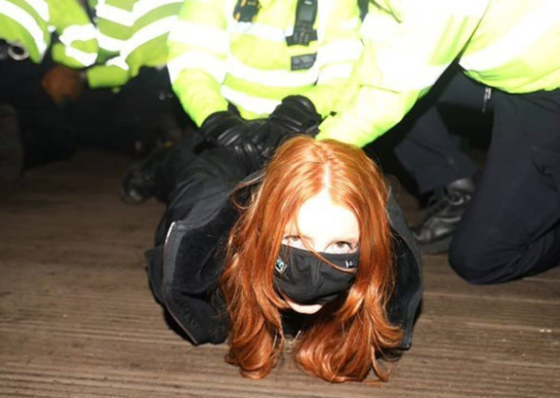
Politics, Policing & Protests
Protests challenge legitimacy – policing becomes political (Jackson & Bell, 2022)
Government influence over police tactics and legislation (Lister, 2013)
Police should act without “fear or favour” (Shiner et al., 2018)
Balance between Freedom of assembly & duty to maintain public order & safety (Loader & Mulchay, 2003)
Police, Crime, Sentencing and Courts Act, 2022 (Fenwick, 2022)
Black Lives Matter (BLM) (2020) Sarah Everard Vigil (2021) (Baldock & Loder, 2022)
(Patsy Stevenson, Twitter, 2021)
Notes:
Politicisation can amplify a protests message by pushing it into the public arena compelling governments and political parties to respond
When protests become politicised they can directly influence public policy and legislative reform (Jackson & Bell, 2022)
In order to establish clear legal frameworks for policing protests, politicians can enact legislation that balance rights and public safety
X Danger of creating overtly restrictive regulation that curbs free expression and risks fundamental protest rights (e.g., Police, Crime, Sentencing and Courts Act, 2022 allows police to restrict protests for being “too noisy”).
X Ministers publicly criticising police tactics can undermine operational independence. Politicisation can deepen social divides and provoke opposition and public hostility
X Police should act without “fear or favour” and enforce the law fairly and equally, resisting pressure from politicians, the media or the public (Shiner et al., 2016)
A critical element of democratic policing is striking a balance between the right of free assembly and the obligation to uphold law and order. It involves respecting fundamental human rights while maintaining social stability (Loader & Mulchay, 2003).
The Police, Crime, Sentencing and Courts Act (2022) has had a significant impact on protest policing in the UK, expanding police powers to manage protests and public assemblies. While the government claims it assists in dealing with significant disruption and adapting to changing protest strategies, critics contend it tips the scales too much in favour of control and away from defending the freedom to protest (Fenwick, 2022)
Case study - Black Lives Matter (BLM) 2020 –
In response to the George Floyd’s death in the US, protests erupted throughout the UK. On the 3rd June, 2020, police were seen “taking the knee” in front of crowds at Downing Street, later that evening violent clashes broke out between the police and protesters resulting in 14 people being arrested. Over the weekend of 6-7 June, more than 210,000 people joined demonstrations in the UK, a BLM procession through Bristol City Centre was joined by 10,000 people with only 80 officers deployed to it. A bronze statue of slave trader Edward Colston was rolled, damaged and graffitied into Bristol Harbour by demonstrators while police watched. Government figures, including the Prime Minister, criticised BLM action, particularly over the statue. Whilst some praised the police’s de-escalation efforts, the Home Secretary harshly criticised them creating pressure for tougher action. Later protests saw heavier hand policing, particularly near government buildings. This demonstrated how police responses were influenced by political narratives and the government’s desire for firm enforcement. Chief Constable Stephen Watson of Greater Manchester Police noted that “I do not think that things like taking your knee, demonstrating that you have a commonality of view with the protesters that you’re policing is compatible with the standards of service that people require of their police”.
Case Study – Sarah Everard Vigil 2021
A vigil was planned for 13th March 2021 by women’s group Reclaim the Streets following the murder of Sarah Everard by a police officer. The vigil was intended as a peaceful act of mourning and protest against gender-based violence. In the wake of the Covid pandemic the government had introduced emergency legislation that restricted public gatherings. Despite for calls for sensitivity, the government made no effort to modify or flexibly interpret regulations for the occasion and police were instructed to strictly enforce the lockdown rules. Nine individuals were arrested and videos of police handcuffing and removing women by force sparked public outrage, particularly given the context i.e., violence against women and the police’s failure to protect them. Critics argue that political pressure contributed to the aggressive policing response, damaging public trust and legitimacy, particularly among women
Both case studies taken from Baldock and Loder (2022) demonstrate how mounting political pressure has influenced how high-profile, emotionally charged protests are policed in the UK. Police must navigate the intricate relationship between public sentiment, political expectations and legal duties under intense media scrutiny. Political narratives seem to have a greater influence on operational decisions rather than by professional policing standards or human rights

Slide 6

Conclusion
Politics has a profound impact on policing priorities and community engagement (Lister & Rowe, 2015)
Politicisation of protests can advance causes and achieve legislative reform (Jackson & Bell, 2022)
Political influence must not compromise operational independence (Reiner, 2010)
Overt political pressure risks undermining legitimacy (Shiner et al, 2018)
“The future of policing lies not simply in improving tactics or technologies, but in negotiating its legitimacy within a political environment where power is dispersed, expectations are high, and trust is fragile” (Loader, 2006)
(The Metropolitan Police Force, 2025)
Notes:
Politics has a profound impact on how resources are allocated, how the police and the public interact, and how policing priorities and community policing are shaped (Lister & Rowe, 2015).
Politicisation of protests can be a powerful force for social change, policy development and legislative reform (Jackson & Bell, 2022)
It is crucial to differentiate between legitimate political oversight and excessive interference in policing. While democratic accountability is essential, political influence must not compromise the operational independence of the police (Reiner, 2010)
Excessive and overt political interference in policing threatens democratic values and erodes police credibility and public trust (Shiner et al., 2018).
**READ QUOTE**
Maintaining operational independence, re-establishing community trust and fending off political pressure that could threaten impartiality and legitimacy are all critical to the future of policing

Slide 7
References (Images):
Humberside Constabulary (2025). Get to know your neighbourhood policing teams #SaferSteetsSummer – policing your neighbourhodds and your priorities [Online image] Available at : https://www.humberside.police.uk/police-forces/humberside-police/areas/campaigns/campaigns/get-to-know-your-neighbourhood-policing-teams/ (accessed 23rd July 2025)
Labour party manifesto (2024).Image of Keir Stamer launching the ‘Take back our streets’ mission [Online image] Available at: https://labour.org.uk/change/take-back-our-streets (accessed 23rd July 2025)
North Wales Police and Crime Plan (2025). Image of the North Wales Police and Crime Commissioner [Online image] Available at: https://www.northwales-pcc.gov.uk/sites/default/files/2025-01/North%20Wales%20Police%20and%20Crime%20Plan%202025-2028.pdf (accessed 23rd July 205)
Patsy Stevenson (2021). Images showing arrest of Patsy Stevenson during the vigil for Sarah Everard: Twitter [Online image] Available at: https://www.sbs.com.au/news/article/inquiry-ordered-into-deeply-disturbing-police-tactics-at-london-vigil-for-murdered-woman-sarah-everard/r2h058uew (accessed 24th July 2025)
Police accountability: YouTube (2024). Image of police accountability [Online image] Available at: https://www.youtube.com/watch?v=-RIgKiDiFMo (accessed 24th July 2025)
The Metropolitan Police Force (2025). Change needs you, recruitment campaign [Online image] Available at: https://www.met.police.uk/police-forces/metropolitan-police/areas/about-us/about-the-met/campaigns/ (accessed 24th July 2025)

Slide 8
References:
Lister, Stuart. Rowe, Michael., 2015. Electing police and crime commissioners in England and Wales; prospecting for democratic policing at the periphery of governance. Policing and Society, 25(4), pp. 258 - 277.
Loader, Ian. Mulchay Aogan., 2003. Policing and the Condition of England: Memory, Politics and Culture. Oxford: Oxford University Press.
Loder, Chris. Baldock, Hannah., 2022. Backing our Police: How Parliament can give police forces the tools to combat disruptive protesters. [Online]
Available at: https://henryjacksonsociety.org/publilcations/backing-our-police
[Accessed 18 July 2025].
Loveday, Barry., 2018. Police and Crime Commissioners: Developing and sustaining a new model of Police Governance in England and Wales. International Journal of Police Science and Management, 20(1), pp. 28-37.
Reiner, Robert.,2010. The Politics of the Police. 4th Edtn. Oxford. Oxford University Press.
Shiner, Michael. Carre, Zoe. Delsol, Rebekah. Eastwood, Niamh., 2018. The Colour of Injustice: "Race", drugs and law enforcement in England and Wales. London: Stopwatch, LSE & Release.
Tyler, Tom. Huo. Yuen., 2002. Trust in the law: Encouraging public cooperation with police and the courts. New York: Russell Sage Foundation.
Waddigton, Peter. Anthony. James., 1999. Policing citizens: Authority and rights. London: UCL Press.
Bayley, David. &. Shearing, Clifford., 2001. The new structure of policing: description, conceptualisation, and research agenda (NCJ 187083). U.S Department of Justice, National Institute of Justice, pp. 1-50.
Caless, Bryn. Owens, Jane., 2016. Police and Crime Commissioners: the Transformation of Police Accountability. 1 ed. Bristol, UK: Policy Press.
Crawford, Adam., 1998. Crime Prevention and Community Safety: Politics, Policies and Practices. London: Longman.
Crompton, David., 2017. R (on the application of Crompton) v Police and Crime Commissioner for South Yorkshire. UK Legal case: EWHC 1349.
Fenwick, Helen., 2022. Police protest in a democracy: Human rights and the creeping authoritarianism of the Police, Crime, Sentencing and Courts Act. Public Law, pp. 521 - 540.
Jackson, Will. Bell, Emma., 2022. Protest, policing and politics; The erosion of the facilitation model in the UK. The British Journal of Criminology, 62(4), pp. p. 859 - 877.
Joyce, Peter., 2011. Police Reform: from police authorities to police and crime commissioners. Safer Communities, 10(4), pp. 5 - 13.

Slide 9
Thank you
“Policing is inherently a political activity. Decisions about what to police, how to police, and whom to police are deeply embedded in the politics of a society” (Bayley & Shearing, 2001)
Lisa Jones (Student number: 2417686)
Policing & the political landscape – BMPO7003D
Notes:
** READ QUOTE**
The rule of law, where police are impartial, fair and unaffected by politics, is essential to democracy. Police politicisation damages their relationship with the public, undermining trust and legitimacy. Operational independence and legitimate political scrutiny must be carefully balanced.

