Slide 1


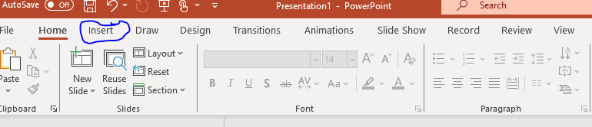
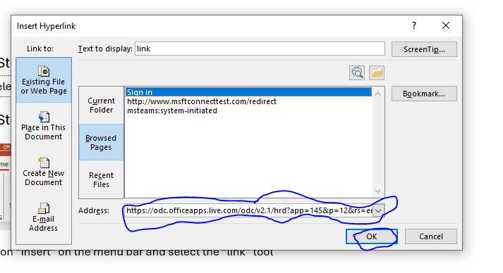
Links in PowerPoint
Yedry B Mateo Reyes
LCLM4002_LON
ID 2438635
Rejwan B. Suleiman
Digital Skills
Step 1:
Select the link text
Step 2:
Click on “Insert” on the menu bar and select the “link” tool
Step 3:
We need to click on the highlighted options and the press ”OK”.
Sure! Could you please upload the image or screenshot showing the highlighted options you’re referring to? That way, I can guide you more accurately on what to click and where to press “OK”.

