Slide 1

Sexual Offences Involving Children

Slide 2

Health Warning

Slide 3

What are the challenges ?

Slide 4
Statistics
According to the NSPCC 2023
Police recorded more than 200 child sex offences on average, EVERY DAY last year.
There were 73,518 recorded offences including rape, online grooming and sexual assault against children in the UK in 2019/20 up 57% in the 5 years since 2014/15
Girls were 4 times more likely to be victims.
There were more than 8,000 offences committed against 14-year-olds ( the most common age group to report)
12,374 sex crimes recorded against children under 10
449 offences were recorded against babies yet to reach their 1st birthday.

Slide 5
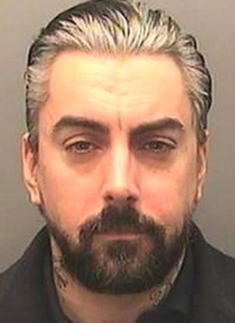
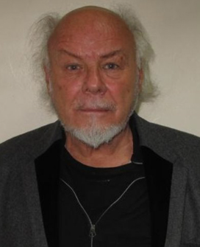

Case Studies
Ian Karlake (Watkins) Vanessa George Gary Glitter
Notes:
Ian David Karslake – Welsh Musician and convicted paedophile- Lead singer of the lost prophets- The band disbanded in 2013 after Watkins was charged with sexual offences in 2012.
He pleaded guilty to 13 charges in including the attempted rape and sexual assault of a child under 13- Offences committed against the infant children of two fans who were also convicted.
Sentenced to 29 years in prison.
Vanessa George 39 – was charged with seven offences including two of sexual assault by penetration and two of sexual assault by touching – She was also charged with making, possessing and distributing indecent images of children. Little Teds Nursery Plymouth 2009.
Gary Glitter – 2015 Convicted of attempted rape, 4 counts of indecent assault and one of having sex with a girl under the age of 13- sentenced to 16 years in

Slide 6
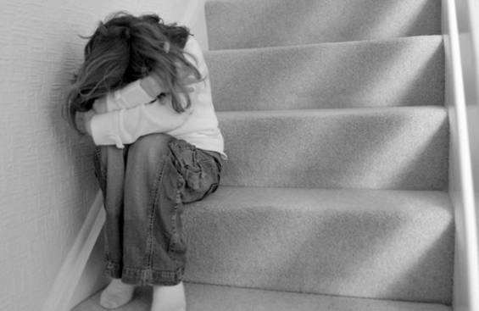
Offences Involving Children Under 13
Sections 5 – 8 Sexual Offences Act 2003
These offences mirror that of s1 -4 of the sexual offences act. But the victim is under 13. The definitions of terms will mirror the s1-4 offences.
For the offences in these sections, it is immaterial whether the child consents or not.
A children under 13 is unable to give consent and therefore the defendants belief in consent will not be relevant.
Notes:
These offences are the ones of strict liability as to age and investigators only have to prove;
The intentional sexual activity and
The age of the complainant at the date of the activity
Not even a reasonable belief that B was 13 or over will excuse A.

Slide 7
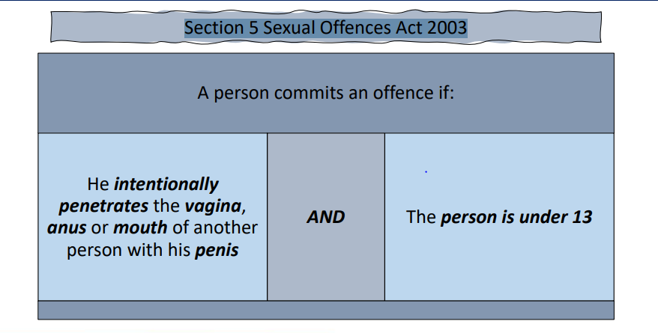
Rape of a Child under 13
Section 5 Sexual Offences Act 2003
Notes:
Indictable only offence – life imprisonment
This offence and section 1 (rape)are the only offences that can onluy be committed by a male , because they relate to penile penetration.

Slide 8
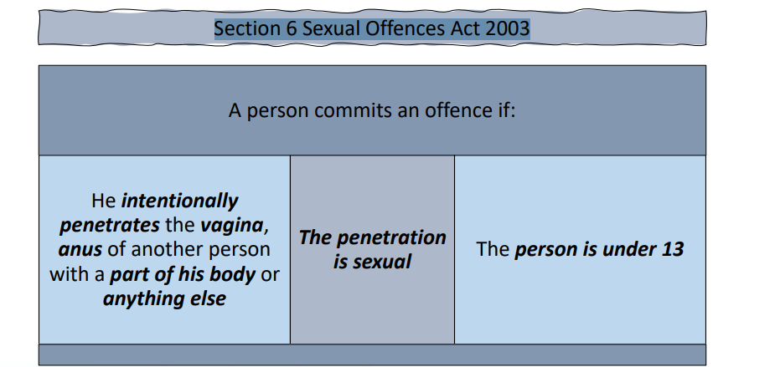
Sexual Assault of a Child under 13 by Penetration
Section 6 Sexual Offences Act 2003
Notes:
Indictable only offence - life imprisonment
Sexual Assault of a Child under 13 by Penetration

Slide 9
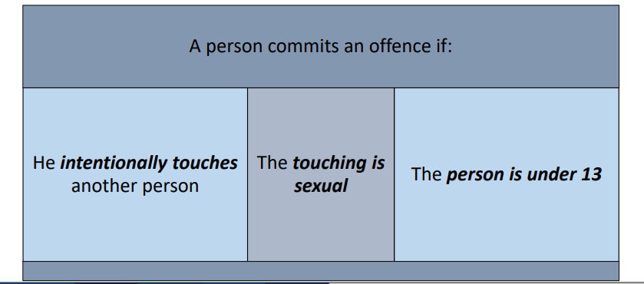
Sexual Assault of a Child under 13 by Touching
Section 7 Sexual Offences Act 2003
Notes:
Either way offence 14 years imprisonment
Whether or not the child consented to the act is irrelevant
Whilst offences between adults and children are always to be viewed as extremely serious , these offences apply to acts between children. Account should be taken of article 8 of the European Convention of Human rights – respect for private life – the criminalisation of consenting children aged 13 -18 may breach their rights –example where a 12 year old willingly kisses her boyfriend's genitals – both are criminal acts.

Slide 10
Causing or Inciting a Child under 13 to engage in Sexual Activity
Section 8 Sexual Offences Act 2003
A person commits an offence if:
If he intentionally causes or incites another to engage in a sexual activity & the child in under 1

Slide 11

Offences Involving Children
Sections 9 -12 Sexual Offences Act 2003

Slide 12

Sexual Activity with a Child
Section 9 Sexual Offences Act 2003
Triable on indictment
Power of arrest without warrant – constables/ other persons
These are committed by an adult 18 years or over
Whilst investigating remember proof that the adult knew that the victim was under 16 years
Consider seizing any photos offenders may have of the victim, such as them wearing school uniform which would support the case.

Slide 13
Other Sexual Offences against Children
Sexual Touching a child under 16 years
Causing or Inciting a child under 16 to engage is Sexual Activity
Engaging in Sexual Activity in the Presence of a Child under 16 years
Causing a Child under 16 years to Watch a Sexual Act

Slide 14
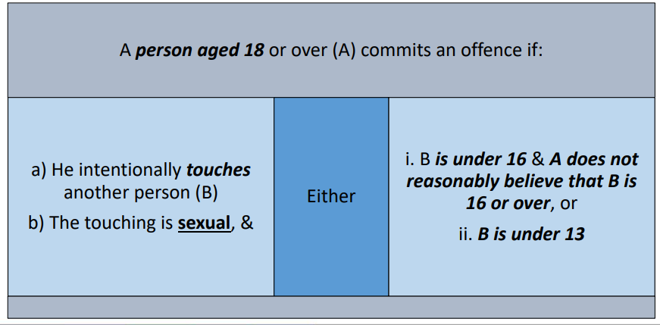
Section 9 (1) Assault with no penetration
Notes:
If the victim is under 13 years if is much more likely that the suspect will be charged with sc 6 or 7 offence
Proof of age required that the victim is under 16
Defence available of reasonable belief that the victim was over 16
Either way offence – max penalty of 14 years on indictment or 6 months summary

Slide 15
Section 9 (2)
A person is guilty of an offence under this section if the touching involved:
(a) penetration of B’s anus or vagina with a part of A’s body or anything else
(b) penetration of B’s mouth with A’s penis
(c) penetration of A’s anus or vagina with a part of B’s body, or
(d) penetration of A’s mouth with B’s penis
If the sexual activity involves penetration the more serious offence of S9 (20 will apply
Indictment only – 14 years max

Slide 16

To summarise …..
Section 9 of the Sexual Offences Act 2003 makes it an offence for……
….a person aged 18 or over to intentionally engage in sexual touching of a child under 16 years
Where the child is 13 years or over but is under 16 years, the prosecution must prove that the defendant did not reasonable believe that the child was 16 years or over.
This offence can be committed by a male or female offender against a male or female victim.
Notes:
It is expected that where the child is under 13, one of the under 13 offences sec 5-8 eg rape of a child under 13, rather than the offence of sexual activity with a child would normally be charged.
These offences have higher penalties to reflect the fact that a child under 13 cannot legally consent to sexual activity.

Slide 17
Causing or Inciting a Child to Engage in Sexual Activity
Section 10 Sexual Offences Act 2003
Where Penetration Involved – Indictment only otherwise either way.
Power of arrest without warrant – constables/ other persons.
Discuss: What is the difference between “cause” and “incite”?
Notes:
Committed by an adult 18 years or over

Slide 18
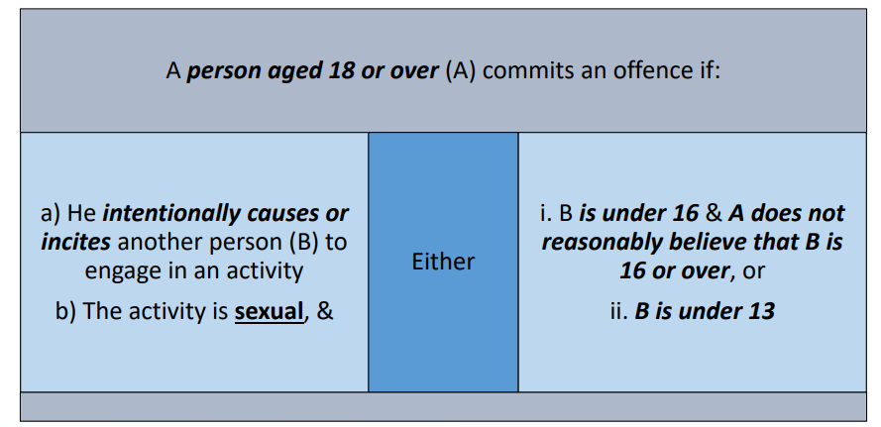
Section 10(1)
Notes:
Similar to s8 offence but appropriate if the victim is between 13 -15
\Triable either ay- 14 years max
Where the child is aged 13 or over , but under 16 the prosecution must prove that the defendant did not reasonably believe that they were over 16 or over.
The sexual activity which is caused , encouraged or assisted may be activity with the victim (for example where the defendant causes , encourages or assists the child to have sexual intercourse with hm) on the child himself ( for example where the defendant encourages, or assists the child to strip for the defendants sexual gratification or with a third person ( eg the defendant causes encourages or assists the child to have sexual intercourse with the victims friend.
The encourage an assistance constitutes an offence whether or not the activity encouraged or assisted actually takes place – eg someone intervenes. Whether or not the child consented to the activity is irrelevant

Slide 19

Examples
An adult causing, encouraging or assisting a child:
Rewards promised
Telling them it is acceptable behaviour
Other children do it
Saying it was necessary to check their body for lice/bruises/signs of illness
It is not intended to cover professionals.

Slide 20
Section 10(2)
A person is guilty of an offence under this section if the activity caused or incited involved:
a) penetration of B’s anus or vagina
(b) penetration of B’s mouth with person’s penis
(c) penetration of a person’s anus or vagina with a part of B’s body, or by B with anything else, or
(d) penetration of a person’s mouth with B’s penis
Notes:
Again, more serious offence under sec 10 (2) if the act involves penetration
Indictment only – 14 years max

Slide 21
To summarise …..
Section 10 of the Sexual Offences Act 2003 makes it an offence for a person ages 18 or over
intentionally to cause, encourage or assist a child under 16 years to engage in sexual activity
Notes:
Where the child is under 13, it is expected that the adult would normally be charged with the offence of causing or inciting a cvhild under 13 to engage in sexual activity at section 8. However occasionally the offence at section 10 might be used where the child is under 13 ( as with sec 9 previously discussed)
An example would be where a person was charged with causing or inciting a child to engage in seual activity , all parties believing the child to be 13 or over, and it then became known in the course of the trial that the child was actually under 13. The extension of section 10 to under 13s means that the trial could continue with the original charge where necessary. This closed a potential loop hole.

Slide 22

Engaging in Sexual Activity in the Presence of a Child
Section 11 Sexual Offences Act 2003
Triable either way
Power of arrest without warrant – constable / other persons
Notes:
Committed by an adult 18years or older

Slide 23
Section 11(1)
A person ages 18 or over (A) commits and offence if: a) He intentionally engages in an activity b) The activity is sexual c) For the purpose of obtaining sexual gratification, he engages in it.
i. When another person (B) is present or in a place from which A can be observed &
ii. Knowing or believing that B is aware, or intending that B should be aware, that he is engaging in it &
iii. B is under 16 & A does not reasonably believe that B is 16 or over, or B is under 13
Notes:
The offence is committed if the defendant knows or believes that the child is aware that he is engaging in the activity or intends that the child should be aware of this. This offence would cover someone masturbating in front of a child or the defendant masturbating himself in the presence of the child to whom he is describing what he is doing because the child is covering their eyes.
It would also cover the situation where the defendant performs a sexual act in a place where he knows that he can be seen by a child – eg webcam.
Even if the child does not see the act the offence is complete because of the offenders intention. IE A CHILD HAS FALLEN ASLEEP.
But if B leaves the position where observation of A Is possible to a place where it is not possible before the activity begins then the offence has not be committed. If B leaves half way through then the offence is complete.
This offence can be attempted if A arranges for B to be present and starts the activity but B has left before commencement or not turned up.

Slide 24
To summarise …..
Section 11 of the Sexual Offences Act 2003 makes it an offence for a person ages 18 or over intentionally to engage in sexual activity in order to gain sexual gratification
when a child under 16 is present or in a place from which the defendant can be observed
Notes:
When the child is aged 13 or over but under 16 the prosecution must prove that the defendant did not reasonable believe that he was 16 or over.
The offence is intended to cover the situation where someone seeks sexual gratification not from the act itself but rather from the fact that he is performing that sct in the presence or intended presence of a child.
This offence can be committed by a male or female offender against a male or female victim.
The motive of sexual gratification is necessary safeguard intended to avoid capturing those who engage in sexual activity in front of a child for a legitimate reason. Eg teaching kissing partner outside the school.

Slide 25

Causing a Child to Watch a Sexual Act
Section 12 Sexual Offences Act 2003
Triable either way
Power of arrest without warrant – constables/ other persons
What types of situations could this happen in?

Slide 26
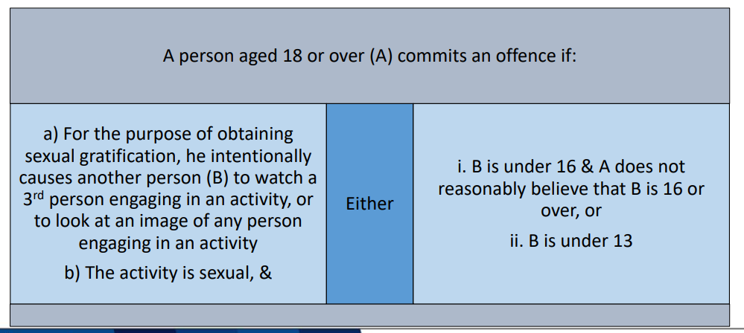
Section 12(1)
Notes:
The offence is intended to cover the situation where someone seeks sexual gratification not from the sexual act itself but rather from causing the child to watch a third party involved in a sexual activity (live or recorded.
The motive of sexual gratification is necessary safeguard intended to avoid capturing those who engage in sexual activity in front of a child for a legitimate reason. Eg teaching kissing partner outside the school.

Slide 27
To summarise …..
Section 12 of the Sexual Offences Act 2003 makes it an offence for a person intentionally to cause a child aged under 16, for the purpose of obtaining the sexual gratification themselves, to watch a third person engaging in sexual activity or to look at an image of a person engaging in sexual activity
For the offence to be committed , the adult must act for their own sexual gratification.
Notes:
The sexual gratification does not need to be at the same time as showing the child material. Therefore you could show the child the material with the intention of gaining sexual gratification some hours later.
Teachers showing children sex ed image in a school setting would not be liable for this offence.
Where the child is aged 13 or over but under 16 the prosecution must prove that the defendant did not reasonably believe that they were 16 or over. The definition of sexual activity is explained in section 78. A person who for his own sexual gratification forces a child to watch two people have sex, or forces a child to watch porn would commit this offence. This offence does not require any element of coercion, the child may even agree this is irrelevant, the offence is committed when where the child apparently consents.

Slide 28

Any Questions

