Slide 1
Managing Projects in the Workplace
BMSW 5104
Project Management Plan
Plan B
Student Name Md Ruhul Amin
Student Number 1712097
Lecturer Name Vajira Balasuriya

Slide 2
Project Outline
Title: Extension of the service area of a small-scale restaurant
Purpose Increase service area to accommodate raised booking and increase service revenue. | Customers Families Couples Foodies Solo diners Regulars etc.
Desired Result The outside terrace can be used all year round and bookings have raised significantly | Criteria of Success Time: 5 weeks Budget: £ 16000 Quality: To serve the long-term need

Slide 3
Stakeholder Analysis
Stakeholder | Impact | Communication
Project Manager | Planning, executing, monitoring, controlling, and closing out projects | E-mails, instant messages, meetings, voice calls etc.
Project Management Team | Helps the managers and team members to set up and organize project | Face-to-face meetings, video conference etc.
Project Sponsors | Endorses and defends the project as a valued investment | Written reports, email, meetings etc.
Customers | Beneficiary of the final outcome | E-mail, Website, Social Media, Text Messaging etc.

Slide 4
Work Breakdown structure (WBS)
Serial No. | Activity | Duration | Preceding Activity
1.2.1 | Management of Booking System | 4 days | Requirements and Planning
1.2.2 | Designing of the Facility | 2 | Management of Booking System
1.2.3 | Interior Setup | 1 | Designing of the Facility
1.3.1 | Ventilation | 10 | Interior Setup
1.3.2 | Billing | 7 | Ventilation
1.3.3 | Ordering | 1 | Billing
1.4 | Operations Management | 9 | Ordering

Slide 5
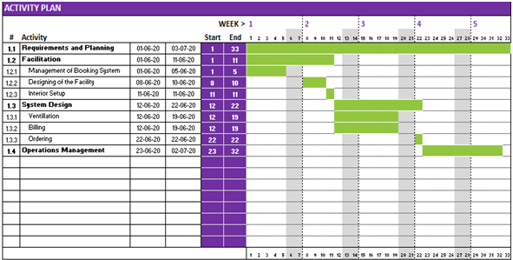
Gantt Chart

Slide 6
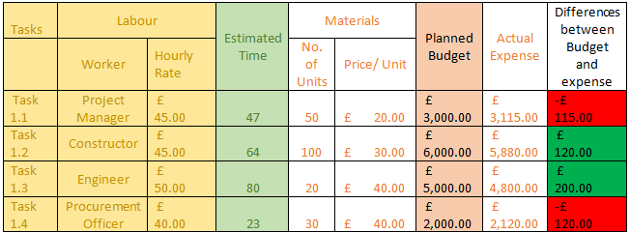
Cost Allocation

