Slide 1


How do students use technology to collaborate at UWTSD?
Presentation by: Sharon 2133276 & Salima 2128697
Tutor: Robert Nartowski

Slide 2

Introduction
In this presentation we will be researching how students find using technology to collaborate. This will include extensive research on how students use technology and how difficult/not difficult they find it using technology in their student life especially when working with others. We also believe that despite how difficult it may be for others to learn how to use technology people are going to be willing to learn how to use it as it’s a part of our present and most importantly our future.

Slide 3
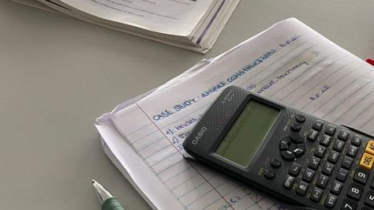
Hypothesis
Are students confident in using technology to collaborate? Our hypothesis is that whilst some students are comfortable in using technology, most may struggle with using technology to aid in working with others and their student life in general. We believe that most students will need to be taught how to use technology thoroughly before using it in their student life to work with others.

Slide 4

Questions
These are some questions that we have asked when the research was conducted from the research task, ‘How do students use technology to collaborate’. We have decided to do a survey and we have documented it using pie charts (which can be seen on the next two slides).
How confident are you at using technology?
What are the things you find difficult when using technology?
What are the things you find easier when using technology?
How often do you use technology?
In a group setting are you confident in using technology or do you rely on others?
What would help you to be more confident?

Slide 7


Who did we ask?
We asked students at UWTSD from ages 18-60+ to get an accurate representation of what age ranges use technology best and if they can use it at all to aid in how well they can work with technology to use it when working with others.

Slide 8

Ethical consideration
During our survey none of the participants were harmed and were willing to answer the questions we had for them. We have made sure that they remained anonymous and their information has been kept confidential. We have communicated to them the reason for the survey and have been completely honest to avoid deception.

Slide 9
Reference list
Fulton, K. (1998). Learning in a Digital Age: Insights into the Issues: The Skills Students Need for Technological Fluency. T.H.E. Journal, 25 (7), 60-63.
Fabry DL, Higgs JR. (1997). Barriers to the Effective Use of Technology in Education: Current Status. Journal of Educational Computing Research.17(4):385-395.
J. Scott Hilberg and Gabriele Meiselwitz.(2008). Undergraduate fluency with information and communication technology: perceptions and reality. In Proceedings of the 9th ACM SIGITE conference on Information technology education. 5-10
Cloete, A., (2017). Technology and education : challenges and opportunities. HTS : Theological Studies. [online] HTS : Theological Studies.
Johnson, D. and Johnson, R., (2004). Cooperation and the Use of Technology. [online] Taylor & Francis. 2nd ed
murphy, K. and Cifuentes, L., (2006). Using Web tools, collaborating, and learning online. [online] Tandfonline.com. 285-305
Yau, H. and Cheng, A., 2012. Students' Age Difference of Confidence in Using Technology for Learning in Higher Education. Eric.ed [online] 4

