Slide 1
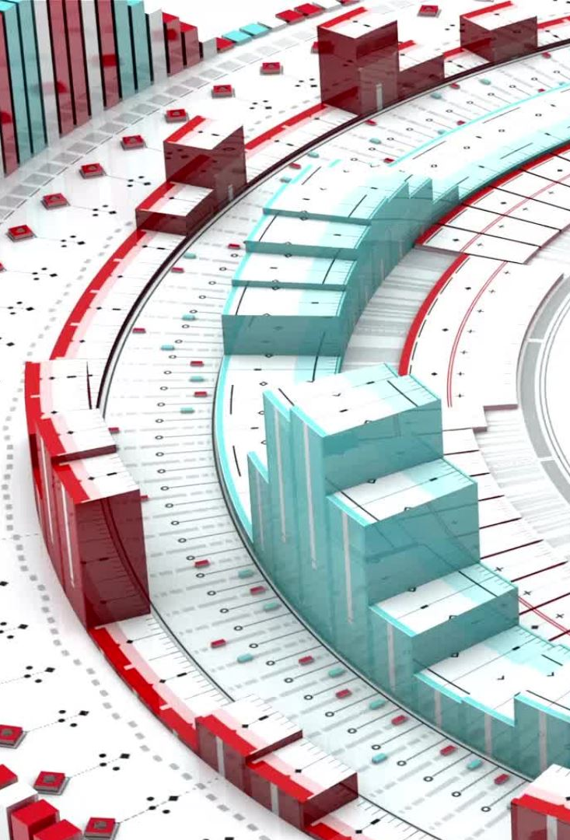
MSc Data and Artificial Intelligence
Data Mining & Visualisation
Exploratory Data Analysis – Presentation
Lecture: Dr Nouh Elmitwally
Student number : 2029731

Slide 2
Project Aim & Objectives
Aim: Explore, clean and analyze the Telecom Customer churn dataset using EDA.
Objectives:
Data cleaning and preparation for analysis.
Discovering trends, patterns, and relationships in data.
Presenting and explaining the results of (EDA) analysis.
Detecting missing values and outliers, using appropriate solutions to improve data quality and increase the accuracy of the analysis.
Using the results obtained for decision-making recommendations.

Slide 3
Introduction
Customer churn is one of the main challenges faced by telecom companies. Since keeping existing customers is usually cheaper than attracting new ones, understanding why customers leave is important. In this analysis, EDA techniques were used to explore the dataset, identify key patterns, and gain insights that could support customer retention strategies. We noticed that usage patterns and service quality often influence whether customers stay or leave [1].
The main goal of customer churn analysis is to understand and predict as early as possible which users are likely to leave the service. This allows us to respond to their issues in time, improve the service experience, and better meet their needs in order to retain them as customers [2].
The results will help us with predictive modeling and guide us towards ideas for conducting proactive customer retention campaigns.

Slide 4
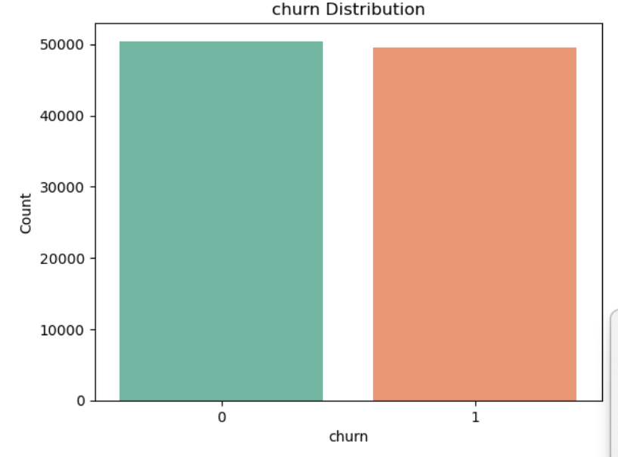
Data Overview
Dataset Name: Telecom Customer Churn – Top Predictive Features
Target Variable: churn (0 = stays, 1 = leaves)
Description
This dataset contains 100 variables and approximately 100 thousand records.
All variables are numerical and represent different aspects of customer behavior.

Slide 5
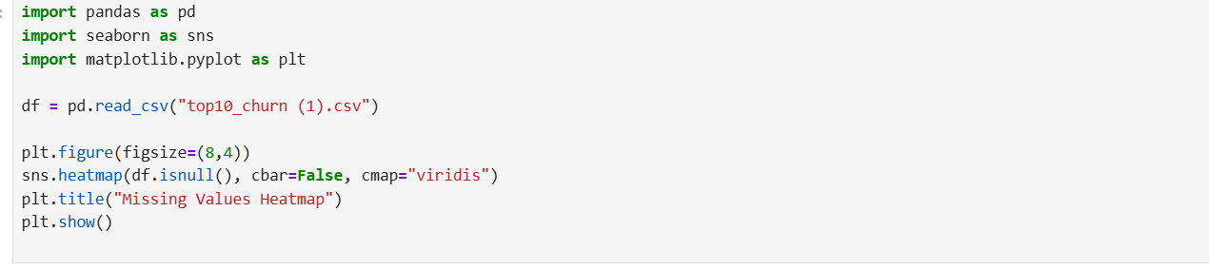
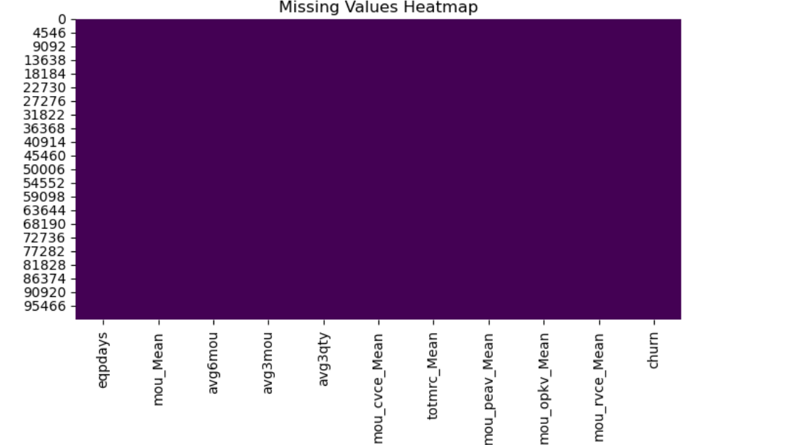
Practical Data Handling
Missing Values:
When checking the dataset for missing data, no significant gaps were found in the selected variables. Overall, the completeness of the data is high.
The heatmap shows the completeness of the dataset.
Outliers:
Outliers are present in the MOU (Minutes of Use) variables, indicating unusually high or low levels of service usage.
Data Types:
All attributes are numerical, while the target variable (churn) is binary (0 = stays, 1 = leaves).
Consistency:
No negative or unrealistic values were identified, and all variable ranges appear reasonable and consistent.

Slide 6
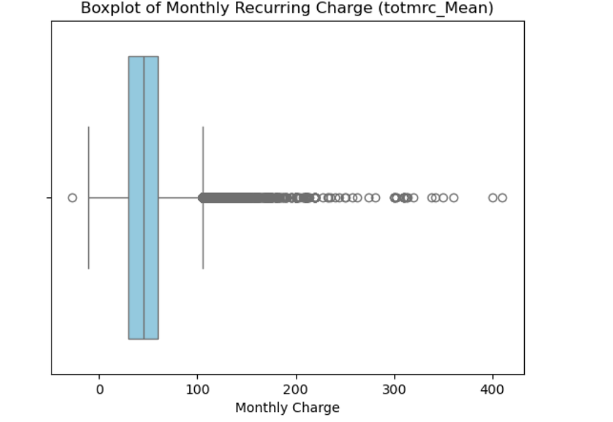
Data Cleaning and Preparation
Missing Values:
Since no major gaps were detected, no imputation was required. The dataset was ready for further analysis without additional data filling.
Data Types:
All variables are numeric, while churn is a binary variable (0 = stay, 1 = leave), so no data type conversion was required.
Consistency Checks:
To ensure data quality, unrealistic values such as negative MOU values were removed.
Standardization:
The data was scaled using StandardScaler to ensure consistent scaling before running further analysis.

Slide 7
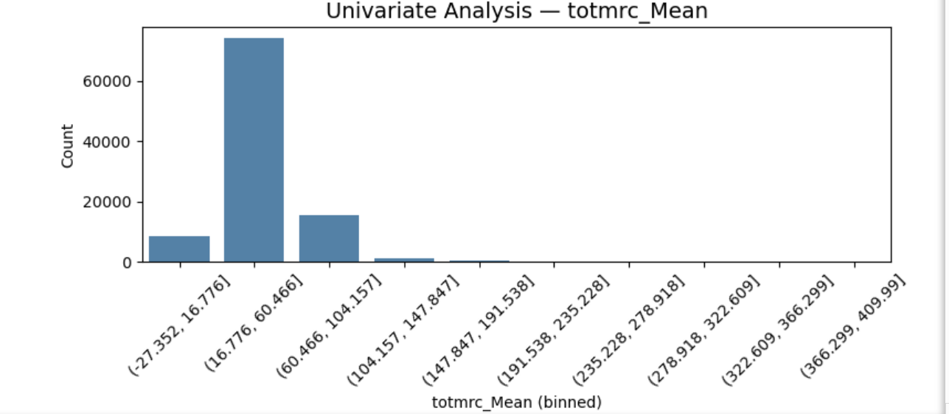
Univariate Analysis (Total Monthly Recurring Charge )
The graph shows that most customers pay relatively low monthly charges, while only a few pay much higher fees.
Customers who pay more might decide to leave if they feel they are not getting enough value for their money.
Customers with lower charges may not use the service as much and could be more likely to switch providers.
Overall, monthly charges seem to play an important role in customer churn.

Slide 8
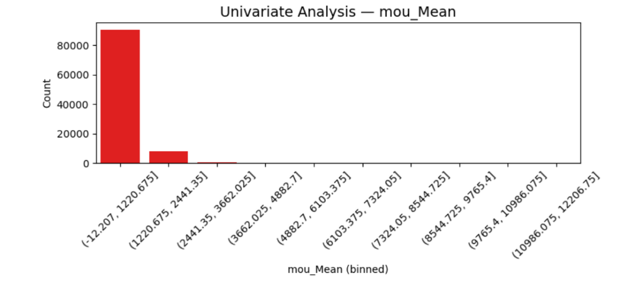
Univariate Analysis (Mean Minutes of Use)
The histogram shows that most customers have relatively low usage levels, with values concentrated close to zero.
As usage increases, the number of customers decreases significantly.
Only a small group of customers use the service very heavily, reaching exceptionally high usage levels.
This creates a right-skewed distribution, indicating that while low usage is common, a few customers are much more active than the rest.

Slide 9
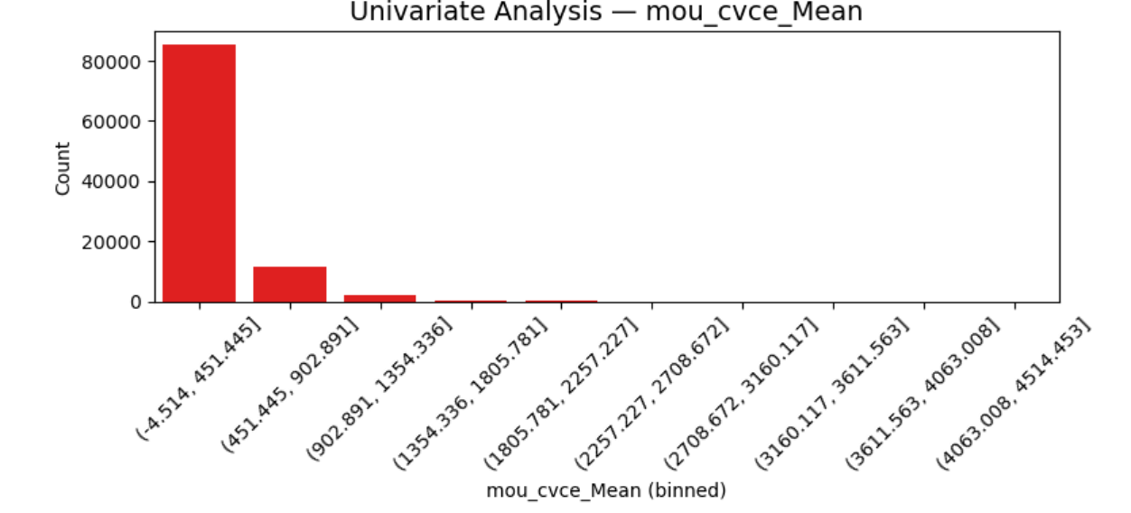
Univariate Analysis
Customer care calls
The chart shows that most customers have little or no contact with customer service. Only a small number of customers contact support frequently, which may suggest that they are experiencing problems or are less satisfied with the service.

Slide 10
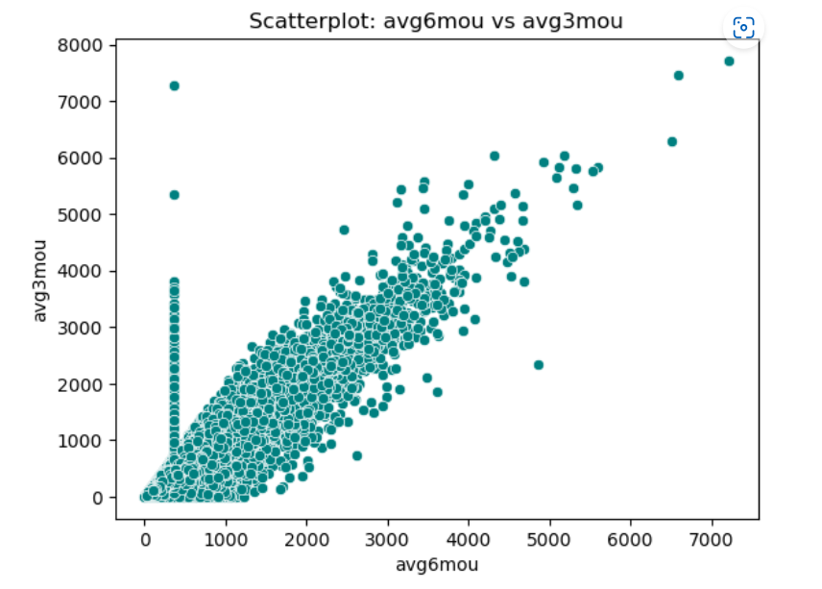
Multivariate Analysis 1
Average Minutes of Use: 6 Months vs 3 Months
From this diagram, we see that customers who have been more active in the last 6 months also spread their activity over the last 3 months.
This indicates their loyalty and a low probability churn.

Slide 11
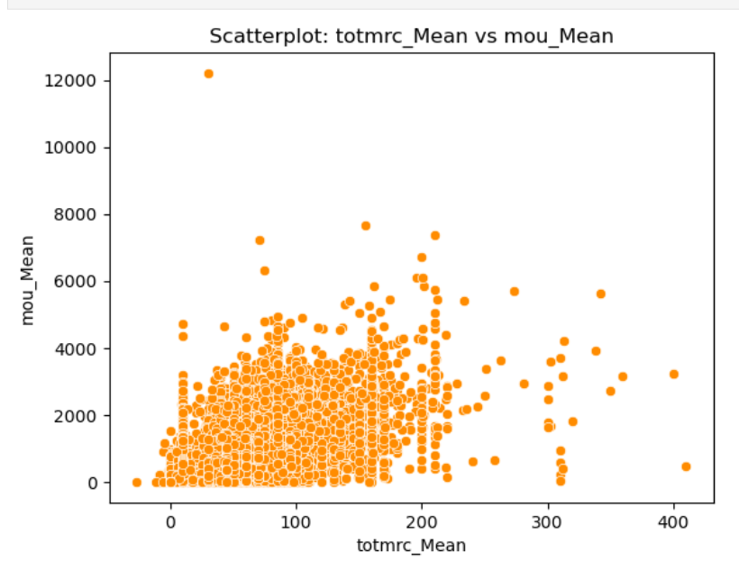
Multivariate Analysis 2
Total Monthly Recurring Charge vs Minutes of Use
The diagram shows that most customers have low monthly fees and low usage.
We notice that customers with higher monthly fees tend to have higher usage, although the relationship is not very strong.
There are a few outliers with very high mou_Mean values, which refer to customers with extremely active consumption, regardless of price.
We can assume that price is not the only factor determining consumption levels.

Slide 12
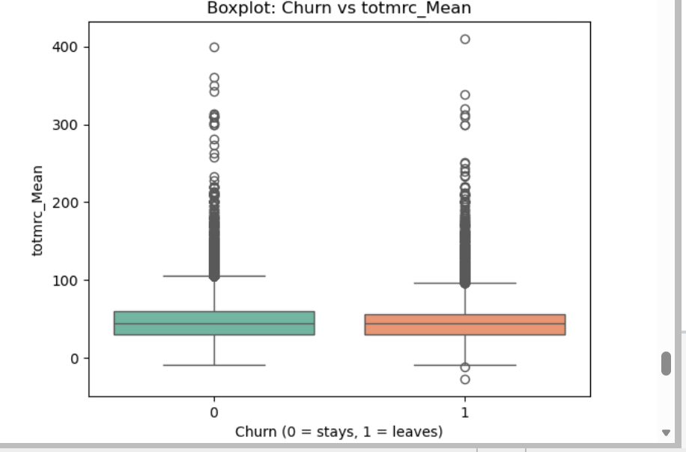
Multivariate Analysis 3
Churn vs Total Monthly Recurring Charge
The graph shows that there is not much difference between the churn and non-churn groups.
Both groups have a similar median.
The conclusion is that monthly fee does not have a strong influence on churn.

Slide 13
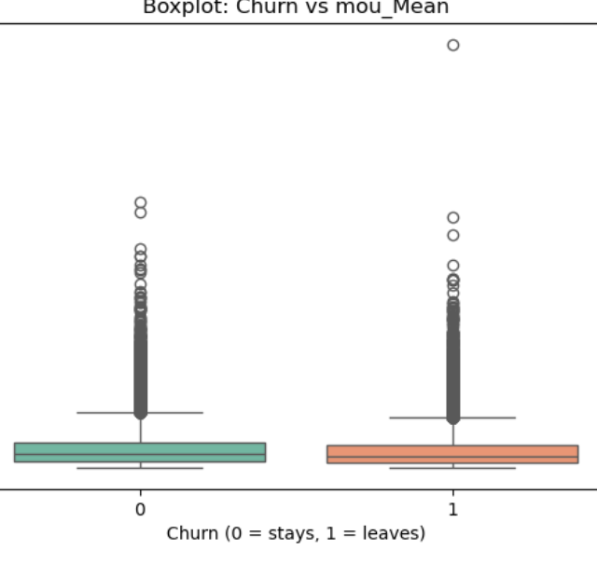
Multivariate Analysis 4
Churn vs Minutes of Use
The graph shows that customers who stay (churn = 0) have a slightly higher median mou_Mean — that is, they use the service more than those who leave (churn = 1).
The difference between the two groups is not huge, but it is consistent — churn customers talk less.
The conclusion is that less usage is associated with less engagement and a higher likelihood of churning.

Slide 14
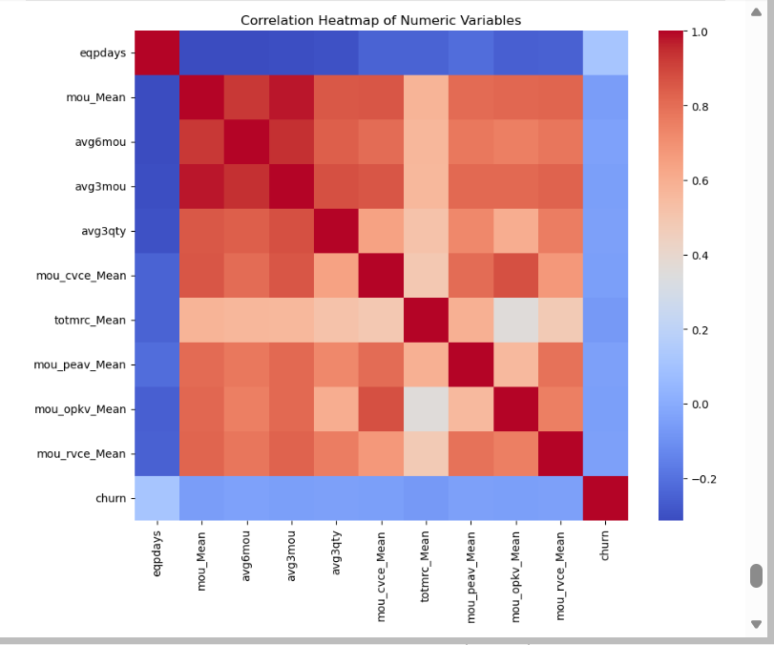
Correlation Heatmap
This heatmap shows a strong positive correlation between: mou_Mean, avg6mou, avg3mou, totmrc_Mean, indicating that customers who talk more pay more.
Customer churn has a weak correlation with most variables, meaning that customers with higher activity are less likely to leave.

Slide 15
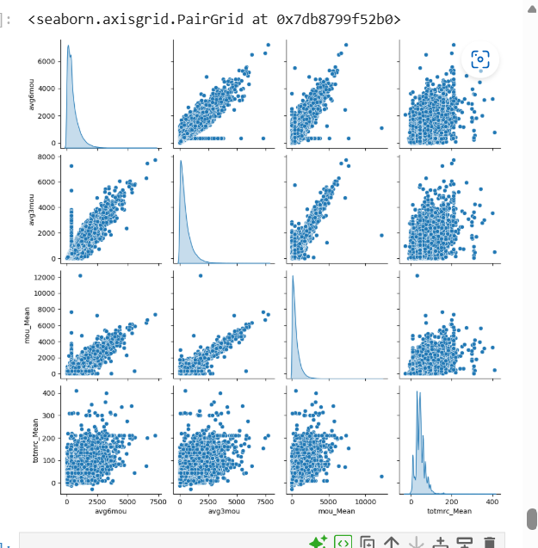
Feature Relationships(Pairwise Scatter Matrix)
From the scatter matrix, I noticed a strong relationship between the usage variables (avg6mou, avg3mou, and mou_Mean), which is expected since they all measure customer activity.
There is also a moderate relationship between usage and monthly charges (totmrc_Mean), suggesting that customers who use the service more generally pay higher fees.
The distributions are right-skewed, showing that most customers have relatively low usage levels, while only a small number are highly active.
Overall, customer activity appears to be a stronger indicator of churn than monthly charges alone.

Slide 16
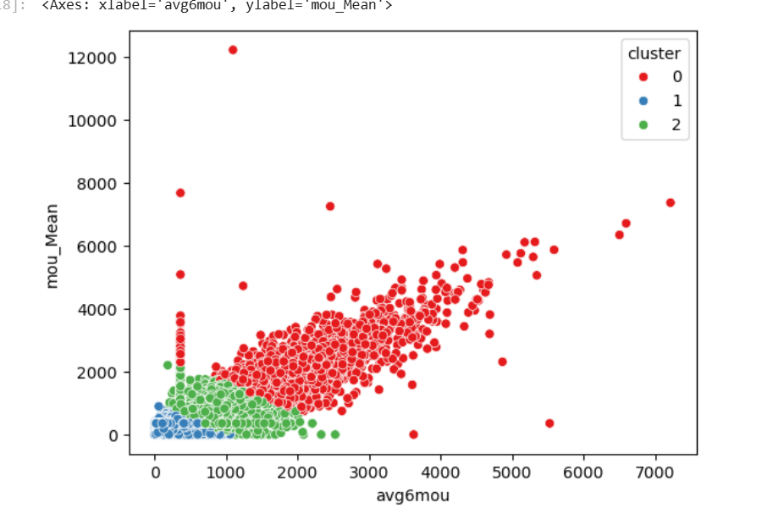
Cluster analysis
Cluster analysis splits customers into three main groups based on their level of activity. The most active customers (red cluster) show the highest usage and are likely less prone to churn, while the low-activity group (blue cluster) appears to be the most at risk. The medium-activity group (green cluster) sits in between and could potentially be retained with targeted marketing or service improvement efforts.

Slide 17

Executive summary
Most customers show low service usage and low monthly fees. Customers with lower usage tend to churn more often.
Higher activity usually means stronger engagement and lower risk of churn.
Customers who talk more tend to pay more. However, price alone does not determine churn.
Few customers contact support frequently, which may indicate dissatisfaction or service issues.
There are strong correlations between usage variables (mou_Mean, avg3mou, avg6mou).
Churn shows weak correlation with most characteristics.

Slide 18
Recommendations
Focus on customers with low usage and encourage them to use the service more through rewards or special offers.
Give loyal customers extra benefits to keep them interested in the service.
Promote annual plans, as they may help reduce churn.
Offer small discounts when customers renew their plans.
Improve customer support and reduce response times.
Use customer data to provide more relevant offers.

Slide 19
References
[1]
Z. Hudli, R. Kademani, P. Patil, S. Harakuni, and S. Shahapur, “A Predictive Model for Telecom Customer Churn Using Machine Learning,” 2025 IEEE 4th International Conference for Advancement in Technology (ICONAT), pp. 1–7, Sep. 2025, doi: https://doi.org/10.1109/iconat66879.2025.11362579.
[2]
S. K. Wagh, A. A. Andhale, K. S. Wagh, J. R. Pansare, S. P. Ambadekar, and S. H. Gawande, “Customer Churn Prediction in Telecom Sector using Machine Learning Techniques,” Results in Control and Optimization, vol. 14, p. 100342, Nov. 2023, doi: https://doi.org/10.1016/j.rico.2023.100342.

