Slide 1
Advancing to Doctoral Research Stage
LCDB 7012
Week 3 – Research paradigms
Notes:
Fill in the relevant information for the cohort

Slide 2
Session Plan
FORUM Question:
- Explain the Philosophies of Qualitative Research: Positivism and Realism
- Reflect on the philosophies in relation to your topic.
The Article is uploaded on Moodle. Brinkma 2017 British philosophies of qualitative research - positivism and realism.pdf
Presentation by Hoang using template that you could use to identify and list the most relevant articles (prior research) on your topic and also reflect on how it related to your research.
Discussion on research philosophies and revisiting HAARP

Slide 3
Research Philosophy
The term research philosophy refers to a system of beliefs and assumptions about the development of knowledge.
Although this sounds rather profound, it is precisely what you are doing when embarking on research: developing knowledge in a particular field.
The knowledge development you are embarking upon may not be as dramatic as a new theory of human motivation, but even addressing a specific problem in a particular organisation you are, nonetheless, developing new knowledge (Saunders 2019)
.

Slide 4
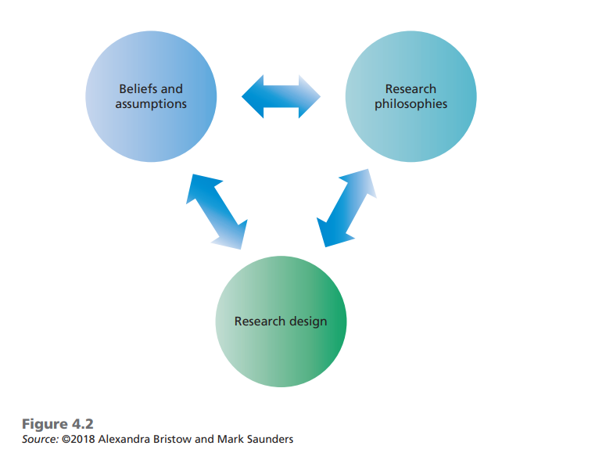

Slide 5
Ontology
Ontology refers to assumptions about the nature of reality. In this chapter’s opening vignette we saw how voters made different assumptions regarding the realities of the UK’s European Union membership, some perceiving it as over-bureaucratic whilst others saw it as providing legal protections for workplace rights and the environment.

Slide 6
epistemology
Epistemology refers to assumptions about knowledge, what constitutes acceptable, valid and legitimate knowledge, and how we can communicate knowledge to others (Burrell and Morgan 2016)

Slide 7
Axiology
Axiology refers to the role of values and ethics. We see this in the opening vignette where parts of the electorate felt their values have been ignored by mainstream politicians.

Slide 8
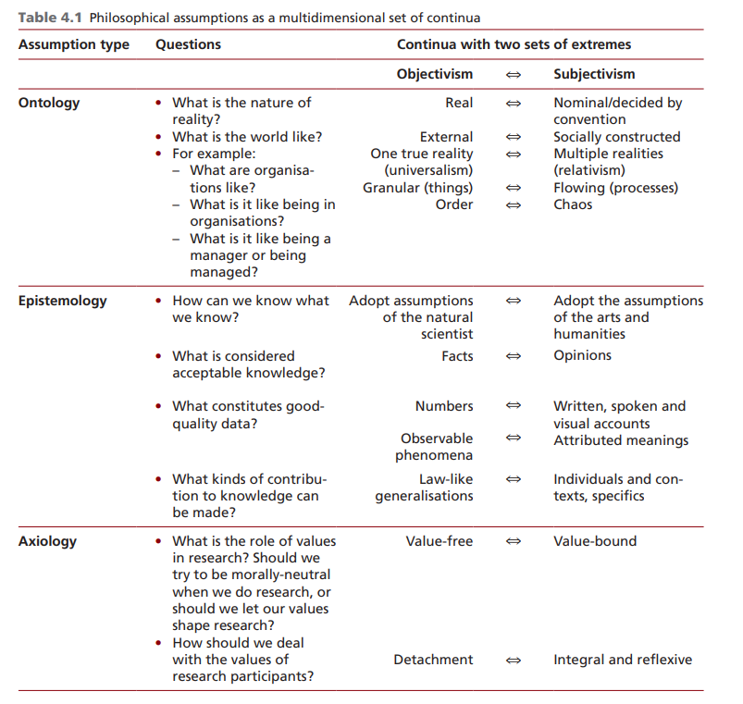

Slide 9
Sociological paradigms and organisational analysis
In their book Sociological Paradigms and Organisational Analysis (2016), Burrell and Morgan combine the objectivist–subjectivist continuum with a regulation–radical change continuum to create a 2×2 matrix of four distinct and rival ‘paradigms’ of organisational analysis (Figure 4.3)
a paradigm is a set of basic and taken-for-granted assumptions which underwrite the frame of reference, mode of theorising and ways of working in which a group operates. The matrix’s four paradigms represent four different ways of viewing the social and organisational world

Slide 10
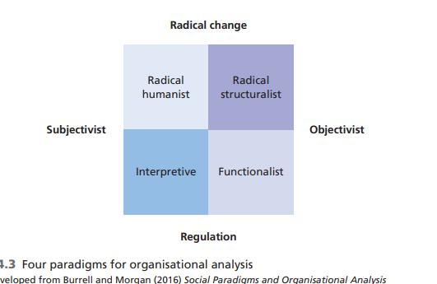

Slide 11
5 management philosophies
Positivism
Critical Realism
Interpretivism
Postmodernism
Pragmatism

Slide 12
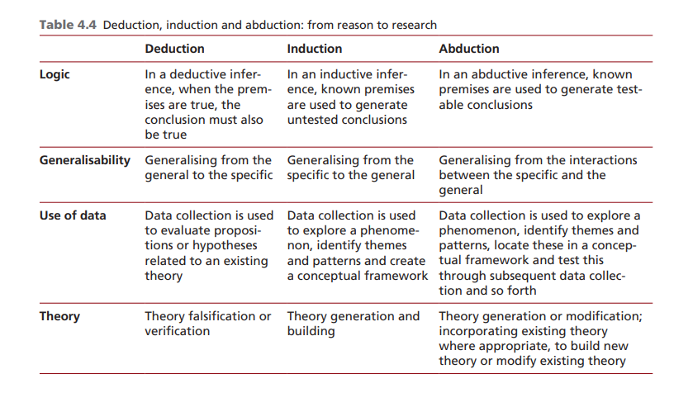
Approaches to theory development : Induction and Deduction

Slide 13
HAARP
Please revisit!

