Slide 1
GROUP 4
LECTURER :ADE ADEGBITE
PRESENTORS:
FLORENTINA COSMA 2213581
SHERIFE ALEKSIEVA 2211682
JOZEF GRAJCAR 2210062
RALUCA SERBAN 2213917
Writing module: Effective Team working & communication
Module code: LCLM 4003
Assignment Title: Presentation-Strategies for Effective Communication in a Business Setting

Slide 2
STRATEGIES FOR EFFECTIVE COMMUNICATION IN A BUSINESS SETTING

Slide 3

INTRODUCTION
.Workplace communication is a powerful tool that can influence the success of an entire organisation .
.Effective teamwork refer to a group of individuals working collaboratively to achieve common goals ,where each person’s strengths and weaknesses complement each other resulting in improved performance and increased productivity
Notes:
In management of a project, effective communication is highly important because it allows the project to progress smoothly, effectively and on time. It ensures the members of the team are connected with the goals of a project and understand exactly what is expected of them . An effective communication helps to develop trust among the managers of the team so that everyone performs better together from project initiation to completion. The purpose of the current study is to analyze the communication strategy that Tom should use to foster the safest and most effective delivery service of Amazon across Europe.

Slide 4
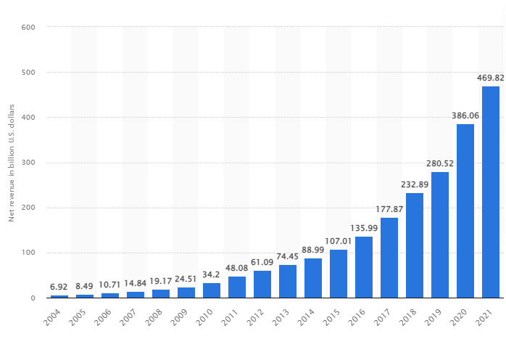
OVERVIEW OF THE ORGANIZATION
An effective progression of a project is dependent on communication channel used in a project.
For this ,a communication strategy must be developed to motivate and promote the safest and most efficient Amazon delivery service throughout Europe
Amazon is a multinational company located in the USA that focuses on e-commerce.
The net revenue of Amazon (2021) is 470 million U.S dollar (Statista, 2023).
Notes:
Amazon is a multinational company located in the USA that focuses on e-commerce. The mission of the company is to be the most-buyer centric organization in the world. The company delivers the services such as “Amazon store”, “web services “, “Logistics” and “entertainment”. In 2021, the net revenue of the company was 470 million U.S dollars, which is greater than previous year. The research reflects that the company has more than 1200 facilities for logistics including small and big logistics throughout America. Following the case study, the company is going to open three warehouses throughout Europe.

Slide 5
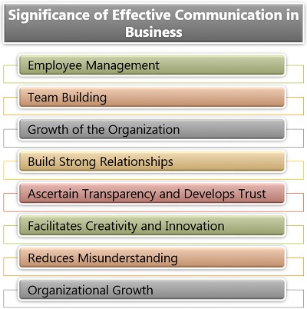
BENEFITS OF EFFECTIVE COMMUNICATION TO TOM, PROJECT TEAM AND AMAZON
Communication is important for the team to set clear expectations (Santos et al., 2021).
It will help Amazon to form clear decisions based on each team member's responsibilities.
Notes:
The case study reflects that Amazon is going to open warehouses throughout different cities in Europe under guidance of Tom. However, some communication issues have been noticed between Tom, their team and company that can negatively affect the project. Communication is important to help the team set clear expectations in a project. It can help understand the expectations and their responsibility to proceed with tasks accordingly. It also helps Amazon to develop clear decisions based on each team member's responsibilities.

Slide 6
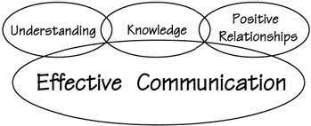
BENEFITS OF EFFECTIVE COMMUNICATION TO TOM, PROJECT TEAM AND AMAZON (Cont.)
An effective communications strategy can streamline the planning of projects that can help Tom, his team and the business.
It reduces the chances of wasting time by removing unnecessary meetings and follow-ups (Prabaningrum and Waluya, 2020).
Notes:
An effective plan or strategy for communication will be considered for successful completion, update of status, requirements as well as project progression. The specific knowledge of time will leave no room for unnecessary meetings and follow up that can waste the time.

Slide 7
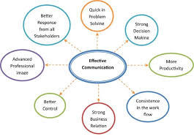
BENEFITS OF EFFECTIVE COMMUNICATION TO TOM, PROJECT TEAM AND AMAZON (Cont.)
Effective communication strategy is a reliable information source (Kalogiannidis, 2020).
It has the capacity to resolve potential conflicts that might arise due to lack of communication.
Notes:
Effective communication can be considered as a reliable information source that can resolve the potential conflict on the project. With individual specific tasks as well as details on the member's responsibility and flow of work, it can be utilized as reference for participating and misguiding persons. It can help the project to complete it on time.

Slide 8
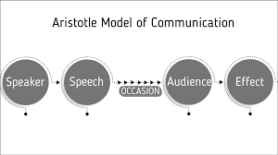
COMMUNICATION MODEL TOM SHOULD APPLY AND REASON
Tom could use the “Aristotle model of communication” to ensure effective communication during the project (Umeozor, 2020).
Following the model, information is sent by render to the receiver for influencing them to respond accordingly.
Notes:
Tom can utilize the “Aristotle model of communication” to ensure effective communication throughout the project. This specific model is widely accepted as well as the most common mode where the information is sent by the sender to the receiver in order to influence them as well as make them act or respond accordingly.

Slide 9
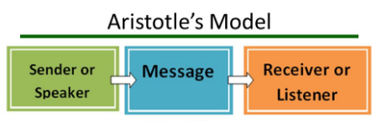
COMMUNICATION MODEL TOM SHOULD APPLY AND REASON (Cont.)
The concerned communication model focus more on speaker and speech (Sütterlin and Yu, 2021)
The critical elements for the following model are speaker, speech, Occasion, audience and effect.
Notes:
The mention model of communication has been developed for oral communication and recognised as the first communication model that critically focuses mainly on speaker as well as speech. The following model can be broadly separated into five primary elements are speaker, speech, Occasion, audience and effect.

Slide 10
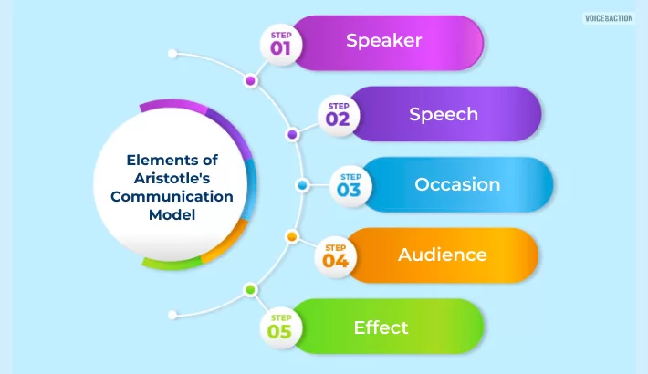
COMMUNICATION MODEL TOM SHOULD APPLY AND REASON (Cont.)
The most advantage of the model is its emphasis more on the speaker (Matei and Hunter, 2021).
Here Tom will get enough chances to motivate and influence the team through relevant information and make the project successful.
Notes:
The proposed communication model will be advantageous for Tom and their team because it emphasized more on the role of a speaker. The speech of the speaker and information provided by him can impact the entire project and team. The team's motivation will highly depend on the speaker's speech. Here Tom's role will be significant where he will provide significant information effectively to the receiver to influence or motivate them and the team will respond accordingly. The clear communication procedure will minimize the chances of conflict extensively during the project.

Slide 11
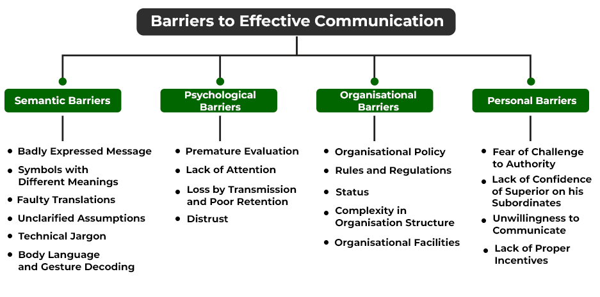
THE BARRIERS OF COMMUNICATION THAT CAN NEGATIVELY IMPACT THE TEAM OF PROJECT
Communication inconsistency is one of the major challenges that can negatively affect a project team (Kwofie et al, 2019).
It can lead to lack of motivation and team disengagement throughout the project.
Notes:
Communication inconsistency can be a barrier of communication that negatively affects the entire project team. Lack of clarity can create inconsistencies in communication procedures and can make the team members confused. Incorrect information can create a lack of clarity that can negatively affect the project. In order to overcome the potential issue, Tom can deliver simple messages that can be easily understood by all the members of the team. Tom must allow each member of the team to make suggestions and share their issues and talk to resolve.

Slide 12
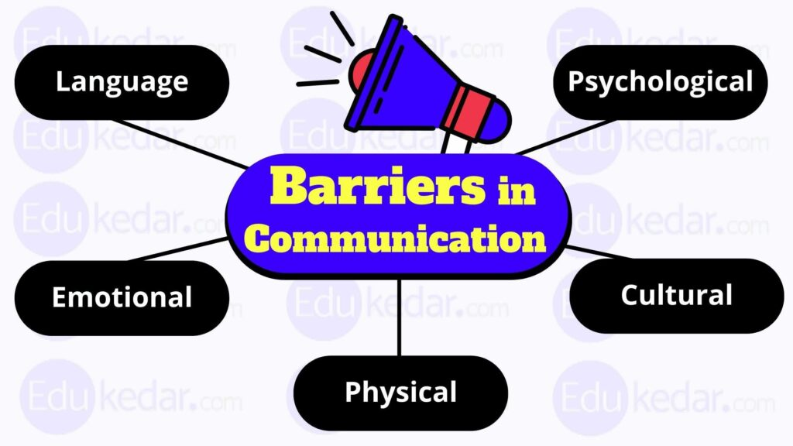
THE BARRIERS OF COMMUNICATION THAT CAN NEGATIVELY IMPACT THE TEAM OF PROJECT (Cont.)
The project can hamper due to lack of trust among the team members of Amazon (Kwofie et al, 2019).
Being a project guide, Tom must apply effective communication processes to increase trust among team members.
NEGATIVE IMPACTS OF COMMUNICATION BARRIERS IS:
. Misunderstandings And Errors
. Decreased Efficiency
. Decreased Motivation And Morale
. Decreased Trust And Collaboration
. Increased Conflict
. Decreased Satisfaction
Notes:
Lack of trust can also be another challenge that hampers communication during the project procedure. No effective communication is possible when there is no trust among the team members. Lack of trust can limit members to attain the goals of organization. In order to overcome the issue, building trust with effective communication procedures will be extremely important for the following project.

Slide 13
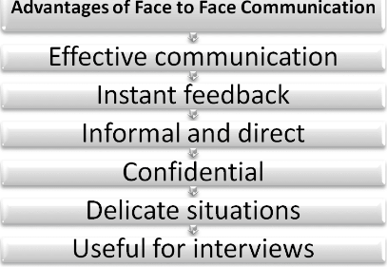
THE COMMUNICATION CHANNELS TO BE USED BY TOM TO IMPROVE COMMUNICATION
The face to face want of communication can be used by Tom to improve communication
It will reduce the chances of miscommunication through allowing facial expression and body language (Aljuwaiber, 2019).
Notes:
Tom can apply different communication channels to improve the communication. They can utilise “Face-to-face communication” because it is the most effective way for teams to interact. The chances of miscommunication can be reduced as the channel allows for facial expression, body language for communication.

Slide 14
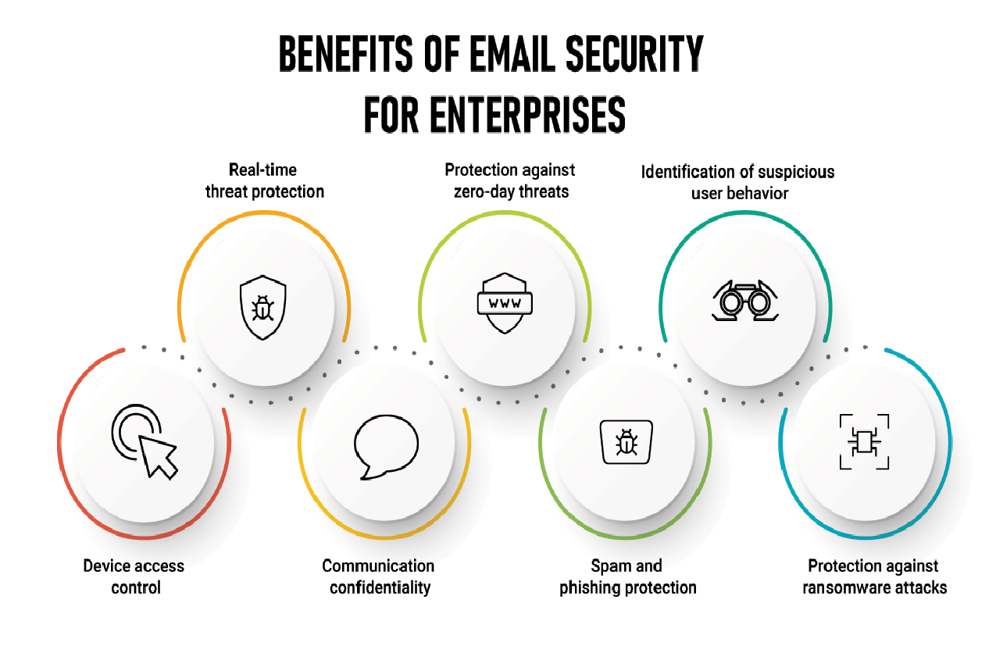
THE COMMUNICATION CHANNELS TO BE USED BY TOM TO IMPROVE COMMUNICATION (cont.)
The email is another communication channel that can be used by Tom to ensure effective communication.
The team can send formal announcement through email, which will reduce the chances of misinterpretation.
Notes:
Tom needs to develop a formal channel for communication and he does not want to waste time in scheduling. In this case, selection of email as an effective channel for communication will be appropriate for their project. This channel can be considered as an effective way for the project team to send formal announcements in a more structured way. The channel will be effective while messages will end down the “chain of command”. From a security perspective, this specific channel is also very good.

Slide 15
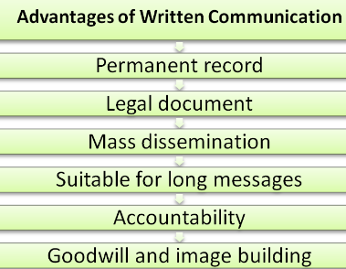
THE COMMUNICATION CHANNELS TO BE USED BY TOM TO IMPROVE COMMUNICATION (cont.)
The team can use formal written documents to maximize communication efficiency.
The team members can understand the other member’s purpose of writing clearly though the channel (Dinis et al., 2019).
Notes:
Formal written documents can also be used as an effective communication medium because it shows a team member’s respect for the other team member. The channel will be effective as it clear out the purpose and information delivered though document. The chances for conflict and confusion will be minimized in the team through using the specific medium of communication.

Slide 16
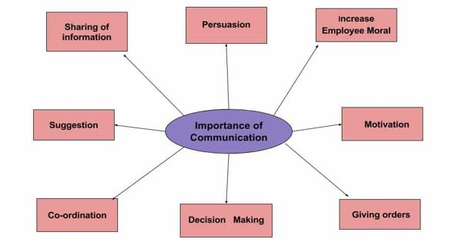
POSITIVE IMPACT OF PROPOSED
Positive channel for communication can create better relationships among each member of the team.
It helps Tom to handle the project conflict better throughout the project (Liu et al., 2022).
Notes:
The positive channel for communication can create better relationships among each member of the team, which will ensure project success. Additionally, it helps Tom to handle the project conflict better throughout the project. Effective communication can increase self-awareness and build trust among the team members. Tom can complete the project b within time by selecting appropriate channels for communication.

Slide 17
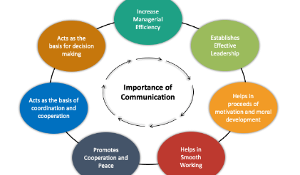
CONCLUSION
Effective communication can enhance clarity among the team members.
Face to face communication; email can remove communication barriers such as inconsistency.
Notes:
Based on analysis it can be concluded that effective communication can enhance clarity among the team members. Tom can use “Aristotle communication model” to increase communication efficiency in the project. The communication channels such as face-to-face communication, email and formal written document can remove communication barriers such as communication inconsistency and lack of trust.

Slide 18
REFERENCE
Aljuwaiber, A., 2019. Technology-based vs. face-to-face interaction for knowledge sharing in the project teams. International Journal of Project Organisation and Management, 11(3), pp.227-242.
Dinis ,F.M., Martins, J.P. and Ramos, N.M., 2019. Improving project communication in the architecture, engineering and construction industry: Coupling virtual reality and laser scanning. Journal of Building Engineering, 30, p.101287.
Kalogiannidis, S., 2020. Impact of effective business communication on employee performance. European Journal of Business and Management Research, 5(6).
Kwofie, T.E., Ohis Aigbavboa, C. and Thwala, W.D., 2019. Communication performance challenges in PPP projects: cases of Ghana and South Africa. Built Environment Project and Asset Management, 9(5), pp.628-641.
Liu, F., Masouros, C , Xu, J., Han, T.X., Eldar, Y.C. and Buzzi, S., 2020. Integrated sensing and communications: Towards dual-functional wireless networks for 6G and beyond. IEEE journal on selected areas in communications.
Matei, S.A. and Hunter, L., 2021. Data storytelling is not storytelling with data: A framework for storytelling in science communication and data journalism. The Information Society, 37(5), pp.312-322.
Molek-Kozakowska, K. and Molek-Winiarska, D., 2022. Managing in Writing: Recommendations from Textual Patterns in Managers’ Email Communication. Business and Professional Communication Quarterly, p.23294906221137860.
Prabaningrum, D. , 2020, June. The Improvement of mathematical communication skill through project based learning with STEM strategy. In International Conference on Science and Education and Technology (ISET 2019) (pp. 646-651). Atlantis Press.
Santos, P.D.O. and de Carvalho, M.M., 2021. Exploring the challenges and benefits for scaling agile project management to large projects: a review. Requirements Engineering, pp.1-18.
Statista, 2023, Sütterlin, C. and Yu, X., 2021. Aristotle's dream: Evolutionary and neural aspects of aesthetic communication in the arts. PsyCh Journal, 10(2), pp.224-243.
Umeozor, S.N., 2020. Information retrieval: a communication process in the 21st century library. International Journal of Knowledge Content Development & Technology, 10(2), pp.7-18.
Notes:
Based on analysis it can be concluded that effective communication can enhance clarity among the team members. Tom can use “Aristotle communication model” to increase communication efficiency in the project. The communication channels such as face-to-face communication, email and formal written document can remove communication barriers such as communication inconsistency and lack of trust.

Slide 19


