Slide 1
Cultural Appropriation Under Mass Migration and Oppression (African Diaspora Dance)
Christian Hopkins

Slide 2
The Slave Trade
The Atlantic slave trade began on a small scale in 1502.
The Slave Trade Act of 1807 was created by UK parliament as a counter slavery measure. The act specifically aided in the collapse of the Atlantic slave Trade.
In 1820 the Slave Trade Act 1807 was amended to declare that participation in the slave trade would now be declared as piracy.
In 1863 Abraham Lincoln signed the Emancipation Proclaimation declaring that all slaves are free. It would be a further two and a half years before Texan slaves would learn of their legal freedom.

Slide 3
Juba Dancing
https://www.youtube.com/watch?v=jBwBscuc08g 4 min 30
https://www.youtube.com/watch?v=m9kaQ3ZKPE0 0 min 40

Slide 4
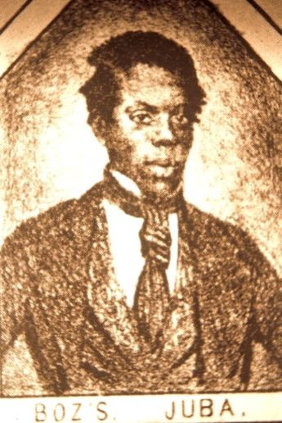
William Henry Lane (Master Juba)

Slide 5
Charles Dickens Eye Whiteness Account
"He never leaves off making queer faces, and is the delight of all the rest, who grin from ear to ear incessantly. Single shuffle, double shuffle, cut and cross-cut: snapping his fingers, rolling his eyes, turning in his knees, presenting the backs of his legs in front, spinning about on his toes and heels like nothing but the man's fingers on the tambourine; dancing with two left legs, two right legs, two wooden legs, two wire legs, two spring legs - all sorts of legs and no legs - what is this to him?" (Charles Dickens 1868)

Slide 6
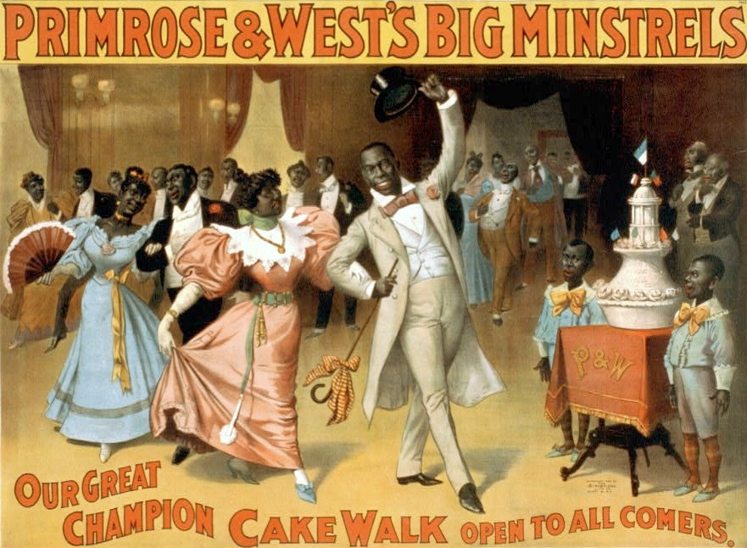
Cake Walking
https://www.youtube.com/watch?v=GCsptiarrzw

Slide 7
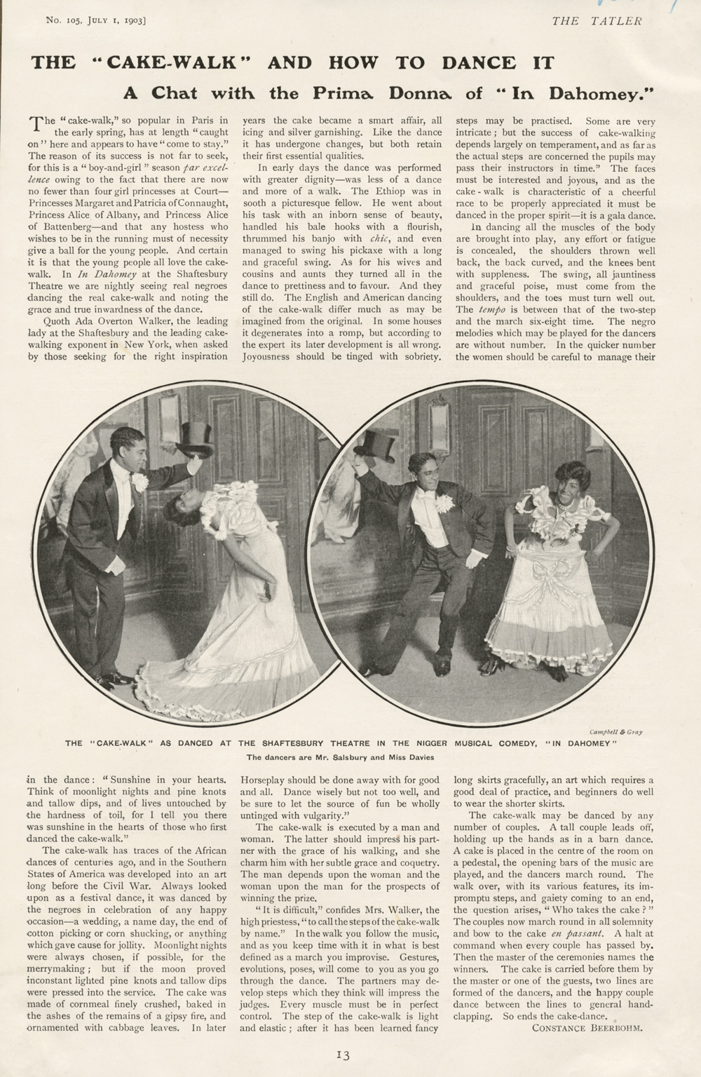
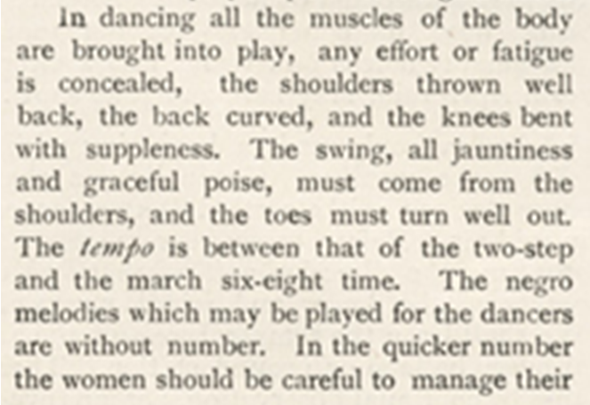
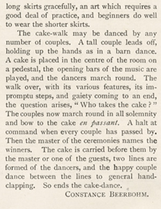

Slide 8
Think you can cake walk?
Remember:
Get into pairs
Take big exaggerated steps
Bounce to the beat of the music
Tip your hat/ courtesy
Pretend to be “posh”
Smile!
https://www.youtube.com/watch?v=MeVfesWPkbU

Slide 9
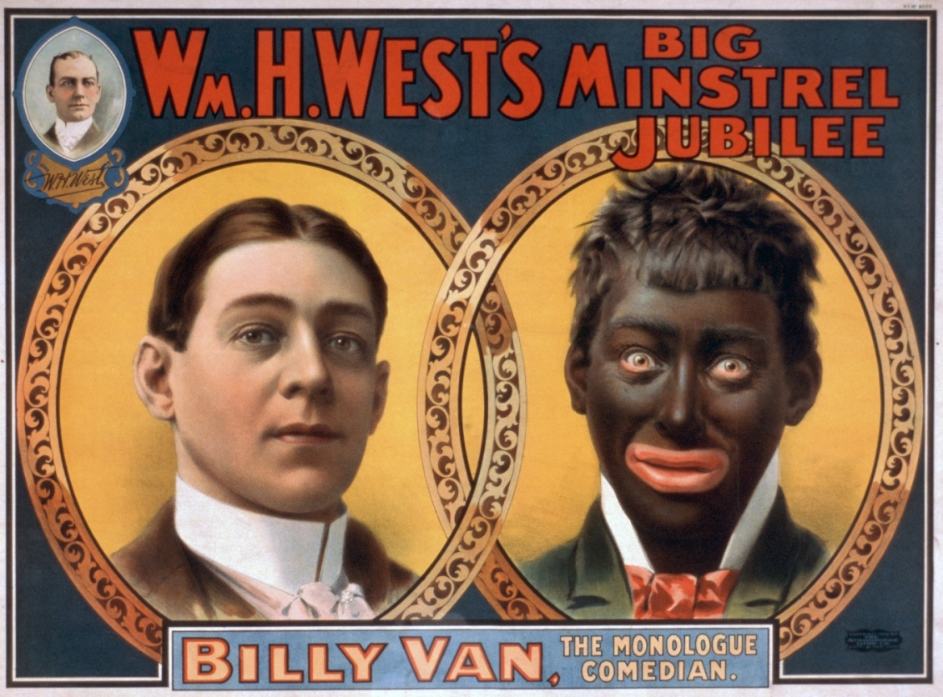
Minstrels

Slide 10
Representations, however sensitively and carefully handled, will carry their own political significance and resonance in the broader socio-political sphere and will be constantly vulnerable to appropriation and redefinition.’ (Preston, 2009:65)
I would argue that Minstrelsy’s representation of black plantation slaves

Slide 11
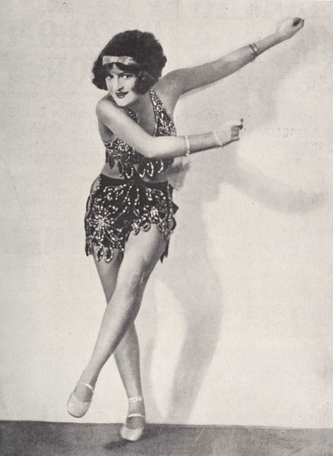
The Charleston

Slide 12
African Diaspora Dance in Contemporary forms of Art
https://www.youtube.com/watch?v=Tqjl4nRSorM

Slide 13
Does African American Slave Dance Have a Place in 2018?

Slide 14
Bibliography
Prentki, T. & Preston, S. (Eds) 2009. The Applied Theatre Reader. Routledge: London.
Dickens, C. (1868). American notes ; and Reprinted pieces. London: Chapman and Hall.
References
Dickens, C. (1868). American notes ; and Reprinted pieces. London: Chapman and Hall.
YouTube. (2018). Black Girl Linguistic Play | Camille A. Brown | TEDxBeaconStreetSalon. [online] Available at: https://www.youtube.com/watch?v=jBwBscuc08g [Accessed 8 Mar. 2018].
YouTube. (2018). Blackface Minstrel Show Sand Dance. [online] Available at: https://www.youtube.com/watch?v=A6dXrm1YjBE [Accessed 8 Mar. 2018].
YouTube. (2018). Steve Hickman Hambone Artist - live in concert!. [online] Available at: https://www.youtube.com/watch?v=m9kaQ3ZKPE0 [Accessed 8 Mar. 2018].
YouTube. (2018). Uncle Tom's Cabin - Group and Solo Cakewalk dance (1903). [online] Available at: https://www.youtube.com/watch?v=GCsptiarrzw [Accessed 8 Mar. 2018].
YouTube. (2018). will.i.am - Bang Bang (Official Video). [online] Available at: https://www.youtube.com/watch?v=Tqjl4nRSorM [Accessed 8 Mar. 2018].
YouTube. (2018). 1920's The Charleston. [online] Available at: https://www.youtube.com/watch?v=ZJC21zzkwoE [Accessed 8 Mar. 2018].

Slide 15
Script
JUBA
Juba dancing or sometimes known as Hamboning, was one of the earliest styles of African Diaspora dance; it was brought to Charleston, South Carolina by slaves from the Congo. This form of dance was created for the benefit of the dancers and was performed during the slave’s free time. The dance consisted of body percussion and turning anticlockwise, often with one leg raised in the air. Signature moves include “the pigeon wing” and “blow that candle out”. Traditionally the dance will end with a step called “the Long dog scratch”. Body percussion plays heavy part in the juba dance as All Africa Diaspora dance is based on a call and response relationship to a drum and so clapping, foot stomping and slapping of the thighs arms and legs now had to substitute as drums were banned by plantation owners in fear that slaves might use them to communicate.
SWITCH TO SHORT HAMBONE CLIP
Steve Hickman is a Hamboning artist still practicing today. He is most commonly recognised for brushing the crumbs off a Greggs sausage roll off himself on a meme that went viral. I find it interesting that a white man should choose to specialise in a profession that only exists because of the persecution of its inventors by his own not so distant ancestors.
MASTER JUBA SLIDE
It is widely believed that the juba dance heavily influenced the development of tap dance. This is yet another example of cultural appropriation. Some believe the very first tap dancer to be William Henry Lane more commonly known as Master Juba. Master Juba was widely considered to be the world’s greatest juba dancer at the time. Lane was one of the first black people to ever perform to a white audience and he was certainly the first ever black man to perform with a group of white minstrels.
PLAY CAKEWALKING VIDEO
Cake walking was developed by slaves as a way of making fun of their oppressors. Because of the nature of social dance and its strong communal ties, it is difficult-impossible to pin point a specific time of creation however cake walking became most popular in the late 19th century. This form of dance was observed by plantation owners who found it highly amusing. In many cases plantation owners would judge which slave danced the best. Couples would line up to form a queue and take turns to perform a high stepping promenade, the slave owner would then award a cake as prize to the couple who danced best, this is where the dance acquired its name. The cake walk was fully embraced by southern “high society” who at first was unaware that the sole purpose of the dance was mockery of the upper classes. The dance would consist of grand exaggerated gestures typically associated with the upper classes of the time. There was a lot of bending and bowing and curtseying or tipping of the hat and everyone looks like their having a jolly old time.

Slide 16
PLAY MINSTREL VIDEO
Cake walking birthed retaliation from the white communities. As whites became aware of the mockery coming from the black community they developed mockery of their own in the form of minstrelsy or minstrel shows. These shows were designed specifically to mock people of African descent and portray black people as lazy, dim witted, superstitious and happy go lucky.
Originally performances of minstrelsy were limited to white people who would use burnt cork to darken their skin. Performances consisted mostly of African ring dancing mixed with Irish jig.
Later on black performers began taking part in minstrel shows such as Master Juba who we spoke about earlier. This was an important step forward as now much like cake walking and the high class plantation owners, black people were now in on the joke too which took away some of the power the whites had to offend but also provided audience with some reassurance that it was okay to laugh.
PLAY CHARLESTON VIDEO
The Charleston came from the star dances which falls under the umbrella of juba dance. The move was adapted in 1923 for the Broadway show “Runnin’ Wild”. This dance move had now been adopted by white culture. Both black and white people were dancing the Charleston and it was at the offence of neither party. Mass marketing and globalization paved way for universally recognisable social dance such as the twist, the running man and the wop.
The Charleston is a milestone in the integration of black and white communities. When you know the moves to a social dance you are then recognised as part of a community of people joined together by self expression and a passion for movement. The Charleston paved way for a more culturally diverse and tollerant American future. (need a quote stuart hall sharing the codes)
WILL. I. AM VIDEO
Whilst researching, I found a piece of typical Charleston style music that I noticed had been recycled by popular rap artist Will. I. Am for use in the composition of his hit song Bang Bang from the power album.
There doesn’t seem to be much link between the song and 19th century black culture. The references to black history are easy to miss unless analysing the piece with knowledge of slave culture.
DOES AFRICAN SLAVE DANCE BELONG IN 2018?
Demonstration of knowledge of slave dancing in a 21st century context could indicate cultural understanding of a historical community. The dances serve as reminder to the mistakes of the past, should they be kept alive to prevent the past from repeating itself?
From the perspective of a white westernised male, it makes me feel uncomfortable to see performances that have come from such atrocities. I feel a sense of guilt in belonging to a culture associated with such horrible persecution of human beings. I feel that performances like “bang bang” serve as a reminder of the division between black and white communities in the past and makes me question how much have we really come on?

