Slide 1
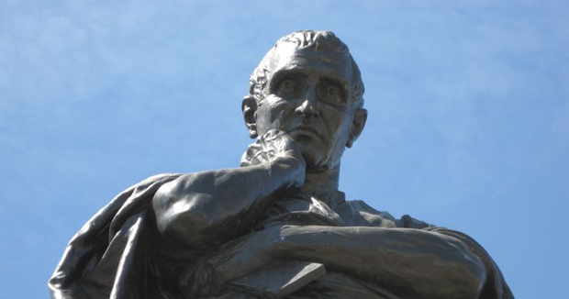

Myth
Ovid, Heroides 3,
and Homer, Iliad

Slide 2
sources
Esp. Iliad (but not only)
“in the same way, when the Trojans heard that the spearman Achilles was remaining in his tent on account of the blond woman, lovely-limbed Briseis, they stretched up their hands to the gods, since they saw the bright gleam under the stormcloud’ (Bacchylides 13.133–40).

Slide 3
Iliadic Achilles/Briseis relationship
“You said you would make me godlike Achilleus' wedded wife” (Il. 19.297, Briseis in lament for dead Patroclus)
“any good man of sense loves his own wife and cares for her – as I too loved this girl from my heart, even though I won her by my spear” (Achilles to Agamemnon Il. 9.341-3) (BUT motivation?)

Slide 4
Iliadic Achilles/Briseis relationship
“I wish that Aremis had killed her [Briseis] with an arrow on board my ships, on that day when I destroyed Lyrnessos and won her” (Il.19.59-60, Achilles)
“And Achilleus slept ... beside him lay a woman he had brought from Lesbos, Phorbas' daughter, beautiful Diomede” (Il. 9.663-5)

Slide 5
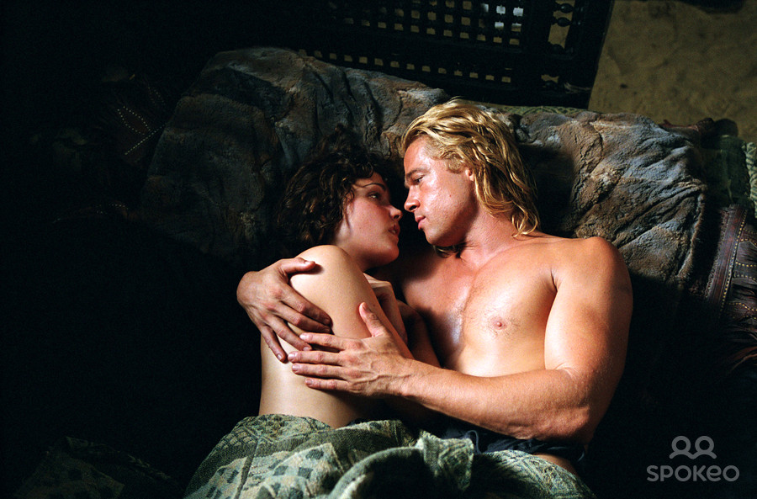
Scholarly reception
See Fantuzzi, M. 2012. Achilles in Love: Intertextual Studies (Oxford), ch. 3
Suggests Hellenistic interpreters of Homer downplay the few sentimental phrases Achilles utters about Briseis and magnify her love for him and that we should take this into account when studying Heroides 3.

Slide 6
reader’s privileged knowledge/dramatic irony
“fetch from my ship all the gifts that we promised yesterday to give Achilleus, and bring the women too.” (Hom Il. 19.194-5; tr. Hammond)
“‘Why do you weep? But a short time,’ he said, ‘will you be here’” (Ov. Her. 3.24, Patroclus to Briseis)
What future will she have with him? “Son of Atreus, could we possibly say this has proved good for both of us, for you and for me, that the two of us in our passions quarrelled in heart-consuming anger over a girl? I wish that Artemis had killed her with an arrow on board my ships, on that day when I destroyed Lyrnessos and won her.” (Hom. Il. 19.56-60; tr. Hammond)

Slide 7
Extra-textual knowledge
“Let me be stricken with that sword of ours, which, had the goddess not said nay, would have made its way into the heart of Atreus’ son!” (Ov. Her. 3.147-8; tr. Grant Showerman, rev. Goold)
“Athene came up behind him and caught the son of Peleus by his yellow hair, visible to him alone- none of the others saw her.” (Hom. Il. 1.197-8; tr. Hammond)
Reading her Homer? (interest in keeping tabs on Achilles) Effect?

