Slide 1


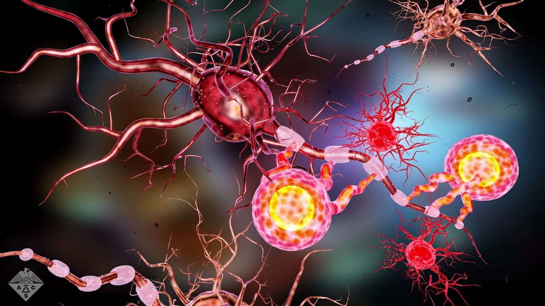



Community Care and Management of
Longer-term Conditions – LCHS7003
Topic – Multiple Sclerosis
2539014-Kashish Sunilbhai Ardeshna
Sources: Mayo Clinic (n.d.); National Multiple Sclerosis Society (n.d.).

Slide 2

Overview of Multiple Sclerosis
Definition, Etiology, and Symptoms
DEFINATION:
Multiple Sclerosis is a long-term autoimmune disease that affects the central nervous system. It causes inflammation, loss of myelin, scarring and damage to nerve cells. (MS Society, 2026a)
AETIOLOGY: (CAUSES)
The precise aetiology is unknown. It is believed to be an autoimmune disease, in which the immune system attacks fatty material that covers and protects the nerve fibres in the brain and spinal cord. (MS Society, 2026b)
When myelin is damaged and the nerve fibre is exposed, the electrical message travelling along the nerve fibre can be slowed down or stopped. (MS Society, 2026a)
Scientists don’t know why MS develops in some people and not in others. It is likely due to a combination of factors, including genetic influences and various aspects of a person's environment. (MS Society, 2026b)
Source: MyMSTeam (2021)

Slide 3

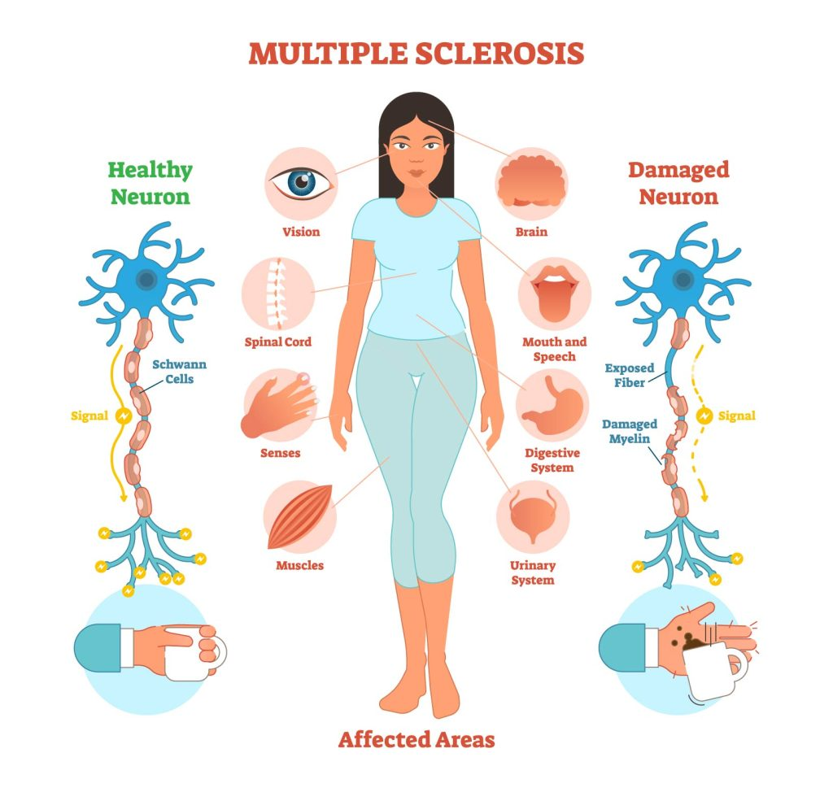

SYMPTOMS
Extreme tiredness (fatigue) (NHS, 2024)
Problems with your eyes or your vision, such as blurred vision or pain (NHS,2024)
Numbness or Tingling feeling in parts of your body (NHS,2024)
Feeling Dizzy, off balance or clumsy (uncoordinated) (NHS,2024)
Muscle spasms, cramps and stiffness(NHS,2024)
Need to pee frequently or inability to control when you pee (NHS,2024)
Memory or concentration problems (NHS,2024)
Sexual problems, such as dry vagina or erectile dysfunction (NHS,2024)
Symptoms may come and go. When they get worse, they are called “FLARE-UPS” or “RELAPSES”. When they improve, they are called “REMISSIONS”. Symptoms can also get gradually worse over time (NHS,2024)
(Cambridge University Press & Assessment, 2025)

Slide 4
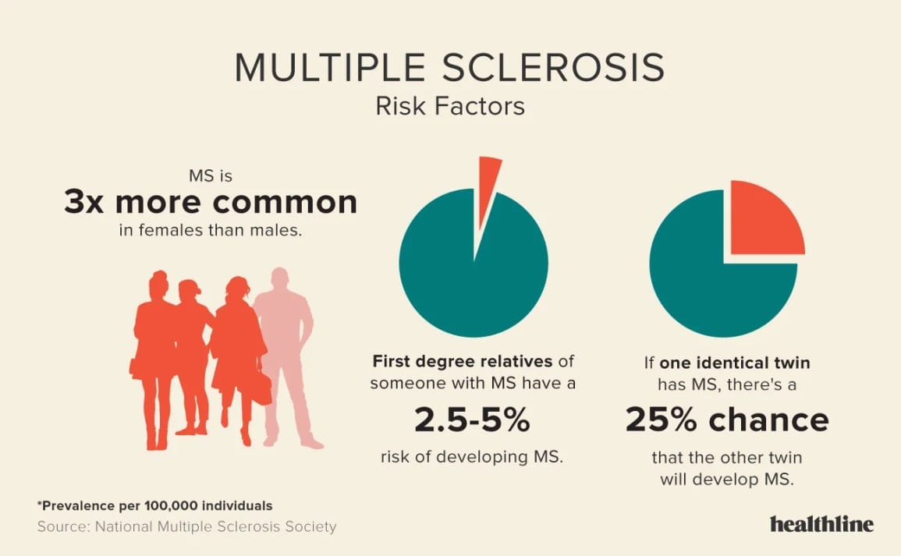
Worldwide Prevalence
Approximately 2.8 million people live with MS worldwide as of 2020, averaging 35.9 cases per 100,000 individuals (Walton et al., 2020)
Prevalence has risen by about 30% since 2013, with only 14% of countries reporting stable or declining rates. (MSIF, 2020))
There are approximately 2.1 new cases per 100,000 each year, equating to someone being diagnosed every 5 minutes (around 62,000 annually). (Walton et al., 2020)
Over 30,000 cases have been reported in individuals under 18, showing improved recognition in younger patients. (MSIF, 2020)
Women are twice as likely to be diagnosed as men, with some countries seeing a ratio of 4 to 1. (Walton et al., 2020)
About 16,000 deaths worldwide each year are attributed to MS. (GBD 2021 MS Collaborators, 2025)
Without better interventions, the burden of MS is expected to worsen, particularly in Europe, by 2050. (GBD 2021 MS Collaborators, 2025)
(Healthline, n.d)

Slide 5
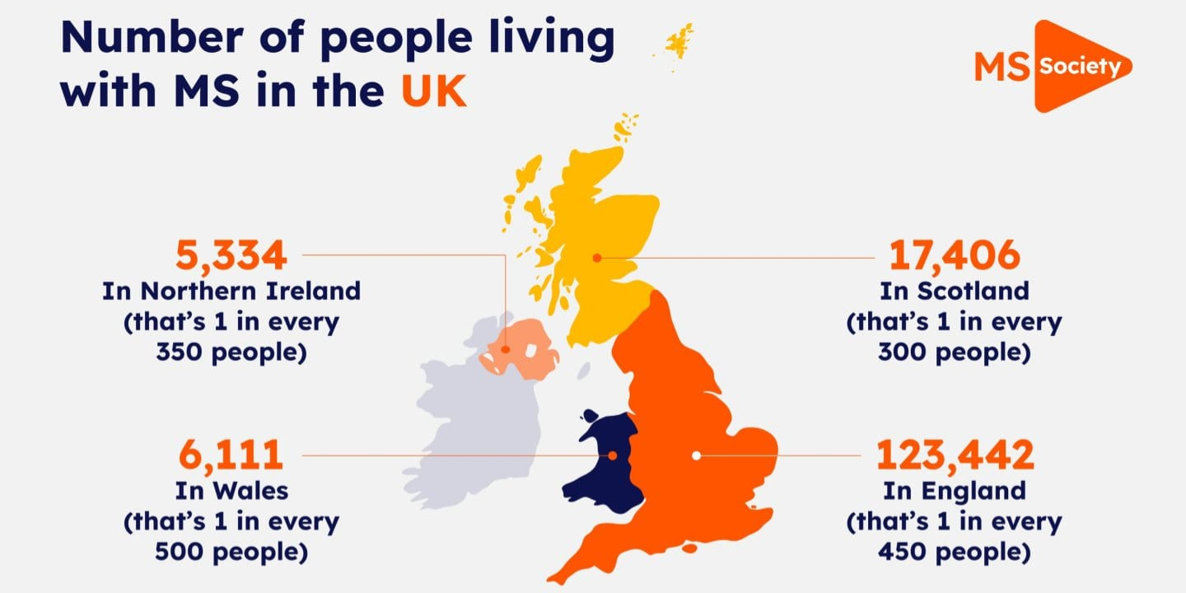
UK Prevalence
The estimated prevalence of MS in England stands at approximately 190 cases per 100,000 people, translating to around 105,780 individuals living with it as of early 2018. Notably, it appears that females are affected more than twice as frequently as males overall. (Public Health England, 2019)
In terms of statistics, this is reflected in 272 cases per 100,000 females compared to 106 for males. Females account for over 72 per cent of recorded cases. Across all observed age groups, the prevalence remains higher among females than among males. (Public Health England, 2019)
The most significant disparity is found in the 50 to 59 age group, where the rates soar to 578 per 100,000 for females and 184 for males. For individuals over the age of 30, the female rate consistently remains more than double that of males. This pattern seems to hold fairly steady beyond that age, although some finer details become somewhat complicated upon closer examination. (Public Health England, 2019)
Source: MS Society (2024)

Slide 6

Social Impact of Multiple Sclerosis
Social area most significantly impacted, with 51% of participants feeling the effects. This highlights how crucial social interactions are for overall well-being. - Almost half (48%) reported their work-life was affected, showing a strong link between employment and personal satisfaction. (European Academy of Neurology, 2026)
About 34% faced financial challenges, illustrating how economic stability is intricately tied to quality of life. (European Academy of Neurology, 2026)
19% experienced disruptions in their educational pursuits, indicating that learning opportunities were also compromised. (European Academy of Neurology, 2026)
Issues in one area frequently led to difficulties in others. For instance, struggles with work often spilt into social life and financial stability, creating a ripple effect. (European Academy of Neurology, 2026)
Those hit hardest included individuals facing financial strain, the unemployed or early retirees, those with additional health conditions, and individuals with higher levels of disability. Their experiences reflect greater vulnerability during challenging times. (European Academy of Neurology, 2026)
Among those whose social lives suffered, over half noted strain in their relationships with partners. Nearly half also reported negative effects on friendships, revealing how vital connections can be easily disrupted under stress. (European Academy of Neurology, 2026)
Source: Google Images 2026

Slide 7
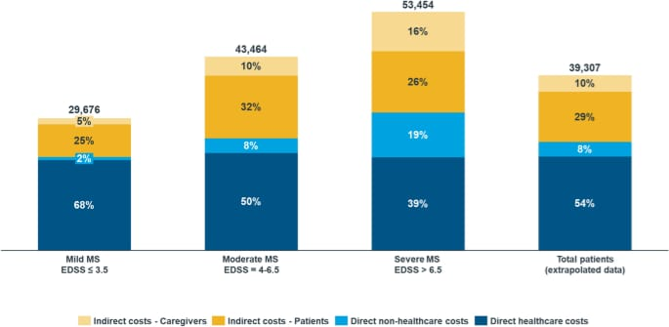
Economic Burden of Multiple Sclerosis
The economic impact of multiple sclerosis (MS) is significant, affecting not just individuals but society as a whole. (Parker et al., 2020)
In the UK, the annual cost of MS has been estimated to reach £1.4 billion. (Parker et al., 2020)
Health economic assessments for MS treatments have become crucial over the last 20 years to balance rising costs with clinical benefits. (Parker et al., 2020)
The National Institute for Health and Care Excellence (NICE) evaluates the cost-effectiveness of MS treatments in the UK, guiding their availability. (Parker et al., 2020)
NICE uses data on personal and social care costs based on disease severity to evaluate treatment value. (Parker et al., 2020)
Source: Battaglia et al., 2022

Slide 8
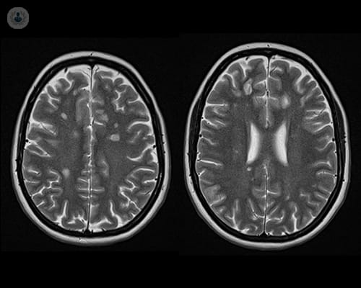
Diagnosis and Initial Assessment of Multiple Sclerosis
When assessing for multiple sclerosis (MS), the process combines clinical evaluations with diagnostic tests to confirm the disease and rule out other conditions. (NICE, 2026a; Thompson et al., 2018)
Clinical Assessment: Look for symptoms like optic neuritis, numbness, muscle weakness, and balance issues that last over 24 hours. Understanding whether the symptoms are relapsing-remitting or progressive is also crucial, along with noting any red flags for alternative diagnoses. (NICE, 2026a; Thompson et al., 2018)
MRI: This imaging technique is key for detecting demyelinating lesions in the brain and spinal cord, helping to confirm evidence of both Dissemination in Space (DIS) and Dissemination in Time (DIT). (Thompson et al., 2018)
CSF Analysis: A lumbar puncture can reveal oligoclonal bands in the cerebrospinal fluid, supporting the diagnosis when MRI results are unclear. (Thompson et al., 2018)
Evoked Potentials: These tests assess electrical signals in the visual and sensory pathways to uncover hidden nerve damage. (NICE, 2026a)
In summary, a diagnosis of MS is made by integrating clinical findings, MRI results, CSF analysis, and evoked potentials while ruling out other possible conditions. (NICE, 2026a; Thompson et al., 2018)
Source: Mayo Clinic (n.d.)

Slide 9
Management of Multiple Sclerosis with current Frameworks and Models.
UK Guidelines and Frameworks for Multiple Sclerosis Management
The NICE Guideline NG220 outlines the management of multiple sclerosis (MS) in adults, established in 2022. (NICE, 2026a)
1. Multidisciplinary Team (MDT) Care: A collaborative approach involving various healthcare professionals to provide comprehensive, patient-focused management. (NICE, 2026a)
2. Specialised MS Nursing: MS nurses coordinate care, educate patients, and monitor treatment. (NICE, 2026a)
3. Annual Reviews: Regular assessments to evaluate disease progression and treatment effectiveness. (NICE, 2026a)
4. Personalised Care Planning: Treatment plans tailored to individual clinical needs and disease status. (NICE, 2026a)
5. Relapse Management: Quick access to assessment and corticosteroid treatment during relapses. (NICE, 2026a)
6. Disease-Modifying Therapies (DMTs): Prescribed based on the ABN framework for evidence-based decisions. (NICE, 2026a; Association of British Neurologists, 2015)
7. Symptom Management: Ongoing treatment of MS symptoms to enhance quality of life. (NICE, 2026a)

Slide 10

Treatment options for Multiple Sclerosis in the UK
Managing multiple sclerosis (MS) involves a combination of treatments and supportive measures.
Pharmacological Treatments :
Disease-Modifying Therapies (DMTs): Reduce the frequency and severity of relapses. (MS Society, 2026a)
HSCT (Hematopoietic Stem Cell Transplantation): Intensive chemotherapy for eligible individuals, aimed at resetting the immune system. (MS Society, 2025)
Steroids: Help reduce inflammation during relapses. (NICE, 2026a)
Muscle Relaxants: Alleviate spasms, cramps, and stiffness. (NICE, 2026a)
Medicines for Symptoms: Manage pain, vision issues, and other symptoms. (NICE, 2026a)
Sativex (Cannabis-Based Medicine): Approved for spasticity when other treatments haven't worked. (NICE, 2021)
Physiotherapy Treatments:
A physiotherapist can assess and improve movement and other physical functions, helping individuals maintain mobility and independence. (MS Society, 2026b)
Supportive/Symptom Management: Some people use cannabis to help relieve symptoms and enhance their quality of life. Taking a personalised approach through these treatments can empower those with MS to manage their condition more effectively. (NICE, 2021; NICE, 2026a)
(Multiple Sclerosis Trust, n.d.)

Slide 11
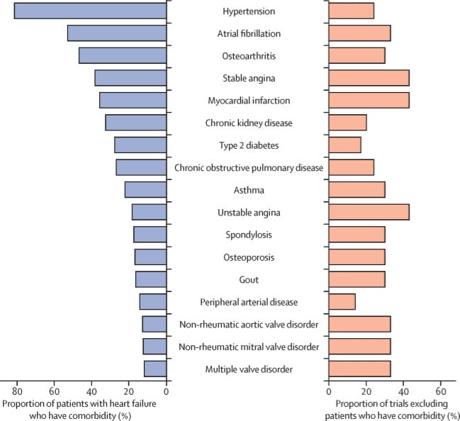
Comorbidity of Multiple Sclerosis
People living with Multiple Sclerosis (MS) often face a range of additional health challenges, known as comorbidities. These conditions can significantly impact the progression of MS, levels of disability, overall quality of life, and management of the disease. Comorbidities can be categorized into several groups: (Marrie et al., 2015)
Psychiatric Comorbidities: Depression: Affects approximately 23.7% of those with MS.
Anxiety: Observed in about 21.9% of individuals. (Marrie et al., 2015)
Vascular Comorbidities: Hypertension: Found in around 18.6% of MS patients.
Hypercholesterolaemia: Affects about 10.9% of individuals. (Marrie et al., 2015)
Other conditions include Hyperlipidaemia, Ischaemic heart disease, and various Cerebrovascular and cardiovascular diseases. (Marrie et al., 2015)
Autoimmune Comorbidities: Diabetes, Thyroid disorders, Inflammatory bowel disease, Psoriasis. (Marrie et al., 2015)
Respiratory Comorbidities: Chronic lung disease - affects about 10% of those with MS.
Chronic obstructive pulmonary disease (COPD). (Marrie et al., 2015)
Neurological & Sleep-Related Comorbidities: Migraine, Sleep-related breathing disorders, Insomnia, Restless legs syndrome. (Marrie et al., 2015)
Cancer: Research provides no significant evidence of increased malignancy risk among individuals with MS. (Marrie et al., 2015)
Source: Kuan et al. (2023), Figure 2.

Slide 12
Skills, Values and Behaviours for Co-productive Care
Skills for Co-productive Care in MS:
Effective Communication: Listen actively to the person with MS to understand their needs. (NHS England, 2026a)
Shared Decision Making: Collaborate on treatment choices to empower the individual. (NHS England, 2026b)
Teamwork: Work closely with healthcare professionals, patients, and families for holistic care. (NHS England, 2026a)
Clear Information: Provide accurate and unbiased details to help informed decision-making. (NHS England, 2026b)
.Self-Management Support: Encourage goal setting and independence in managing their condition. (NHS England, 2026c)
Values for Co-productive Care:
Respect for Experience: Acknowledge the individual’s lived experience and insights. (NHS England, 2026a)
Partnership: Treat them as equal partners in care planning. (NHS England, 2026a)
Empathy and Compassion: Show kindness and understanding in all interactions. (NHS England, 2026a)
Trust and Openness: Foster honest communication and strong relationships. (NHS England, 2026a)
Person-Centred Care: Focus on individual needs and preferences at every stage. (NHS England, 2026c)

Slide 13
Behaviours for Co-productive Care :
Encourage Communication: Invite feedback and participation in care processes. (NHS England, 2026a)
Involve in Decisions: Ensure the person is part of all choices about their care. (NHS England, 2026b)
Collaborate Across Teams: Engage multiple professionals for comprehensive support (NHS England, 2026a).
Value Preferences: Recognize and incorporate the individual’s priorities (NHS England, 2026c)
Provide Ongoing Support: Maintain regular check-ins and problem-solving together. (NHS England, 2026c)

Slide 14
Comprehensive Model of Personalized Care and Self-Management Support
1. Personalized Care and Self-Management Support
Shared Decision-Making: Patients collaborate with healthcare providers to choose treatments that align with their values and goals. (Oxford Academic, 2025)
Symptom Management: Monitoring symptoms like fatigue and pain helps optimize disease control and medication adherence. (MAG Online Library, 2024)
Healthy Lifestyle Habits: Encouraging regular exercise, a balanced diet, good sleep, stress management, and adequate vitamin D can significantly improve health. (MAG Online Library, 2024; Frontiers, 2024)
Psychological Resilience: Providing emotional support and coping strategies enhances mental well-being and helps with goal setting. (NIH, 2025)
Planning and Pacing: Teaching energy conservation and activity pacing supports independence and better fatigue management. (MAG Online Library, 2024)

Slide 15
2. Context-Centric Navigational Support
Family and Social Support: Engaging families and support groups improves emotional health and treatment adherence. (NIH, 2025)
Community Resources: Connecting patients with local MS societies and rehabilitation services provides necessary resources and assistance. (NIH, 2025)
Multidisciplinary Team (MDT): Coordinated care among various specialists ensures comprehensive support tailored to individual needs. (Oxford Academic, 2025)
Digital Health and Remote Monitoring: Utilizing telemedicine and wearable tech enables personalized follow-ups and early interventions. (Frontiers, 2024; NIH, 2025)
Continuous Review and Personalized Care Planning: Regular assessments of progress help adjust care plans based on evolving needs, ensuring effective support. This approach highlights the importance of collaboration, support, and personalization in managing health conditions effectively. (Oxford Academic, 2025)

Slide 16
Six evidence-based components
Shared Decision-Making: Clinicians and individuals with MS collaborate to make treatment choices based on clinical evidence and personal preferences. (Elwyn et al., 2012; NICE NG220)
Personalized Care and Support Planning: An individualized care plan is created, focusing on the specific needs, goals, and preferences of each person with MS. (NICE, 2022)
Enabling Choice: People with MS are supported in selecting healthcare providers and evidence-based treatment options, including disease-modifying therapies. (NICE, 2022)
Social Prescribing and Community Support: Connections are made to community services, peer support, and voluntary organizations to enhance wellbeing and reduce isolation (NHS England, n.d.)
Supported Self-Management: Individuals develop the knowledge and skills to manage their symptoms, treatments, and daily activities effectively. (National Neurosciences Advisory Group, 2024)
Personal Health Budgets: Flexible funding is provided to help meet individual health and wellbeing needs through personalized care solutions. (NHS England, 2023)

Slide 17
Conclusion:
Multiple Sclerosis (MS) is a complex, long-term neurological condition that can affect physical, psychological, social and economic aspects of an individual’s life. Although the exact cause remains unknown, early diagnosis, appropriate treatment and ongoing monitoring can help manage symptoms, reduce relapses and support quality of life.
Effective MS management requires a multidisciplinary, person-centred and personalised approach, including disease-modifying therapies, symptom management, rehabilitation and self-management support. Regular review and personalised care planning are essential as the individual’s needs may change over time.
Co-production and shared decision-making are central to high-quality MS care. By respecting the individual’s experiences, preferences, values and goals, healthcare professionals can work in partnership with people with MS to make informed decisions and promote independence.
Overall, combining clinical treatment with psychological, social, community and self-management support can provide more holistic care and help people with MS achieve the best possible quality of life.

Slide 18
References:
Multiple Sclerosis Society (2026a) What is MS? Multiple Sclerosis Society. Available at: https://www.mssociety.org.uk/about-ms/what-ms (Accessed: 20 July 2026).
Multiple Sclerosis Society (2026b) What causes MS? Multiple Sclerosis Society. Available at: https://www.mssociety.org.uk/about-ms/what-causes-ms (Accessed: 20 July 2026).
Scolding, N., Barnes, D., Cader, S., Chataway, J., Coles, A., Giovannoni, G., Miller, D., Palace, J., Schmierer, K., Shehu, A. and Young, C. (2015) ‘Association of British Neurologists: revised (2015) guidelines for prescribing disease-modifying treatments in multiple sclerosis’, Practical Neurology, 15(4), pp. 273–279. Available at: https://pubmed.ncbi.nlm.nih.gov/26101144/ (Accessed: 20 July 2026).
European Academy of Neurology (2026) Multiple sclerosis impacts daily life far beyond its physical symptoms, new study finds. European Academy of Neurology. Available at: European Academy of Neurology – MS daily-life study (Accessed: 20 July 2026).
GBD 2021 Multiple Sclerosis Collaborators (2025) ‘Global, regional, and national burden of multiple sclerosis, 1990–2021: a systematic analysis for the Global Burden of Disease Study 2021’, The Lancet Neurology. Available at: PubMed – GBD 2021 Multiple Sclerosis study (Accessed: 20 July 2026).
Marrie, R.A., Cohen, J., Stuve, O., Trojano, M., Sorensen, P.S., Reingold, S., Cutter, G. and Reider, N. (2015) ‘Recommendations for observational studies of comorbidity in multiple sclerosis’, Neurology, 85(23), pp. 1972–1979. Available at: PubMed – Recommendations for observational studies of comorbidity in MS (Accessed: 20 July 2026).
Multiple Sclerosis International Federation (MSIF) (2020) Atlas of MS 2020: Epidemiology report. London: MSIF. Available at: MSIF – Atlas of MS 2020 (Accessed: 20 July 2026).
Multiple Sclerosis International Federation (MSIF) (2020) Atlas of MS 2020: The global faces of MS. London: MSIF. Available at: MSIF – Atlas of MS 2020 (Accessed: 20 July 2026).
Multiple Sclerosis Society (2025) HSCT for MS. Multiple Sclerosis Society. Available at: MS Society – HSCT for MS (Accessed: 20 July 2026).
MS Society (2026b) Physiotherapy for multiple sclerosis. Available at: MS Society – Physiotherapy for MS (Accessed: 20 July 2026).
National Health Service (NHS) (2024) Multiple sclerosis. Available at: NHS – Multiple sclerosis (Accessed: 20 July 2026).
NHS England (2026a) Co-production. Available at: NHS England – Co-production (Accessed: 20 July 2026).
NHS England (2026b) Shared decision-making. Available at: NHS England – Shared decision-making (Accessed: 20 July 2026).
NHS England (2026c) Comprehensive model of personalised care. Available at: NHS England – Comprehensive model of personalised care (Accessed: 20 July 2026).
National Institute for Health and Care Excellence (NICE) (2021) Cannabis-based medicinal products: NICE guideline NG144. Available at: NICE – Cannabis-based medicinal products (Accessed: 20 July 2026).
National Institute for Health and Care Excellence (NICE) (2026a) Multiple sclerosis in adults: management (NG220). Available at: NICE – Multiple sclerosis in adults: management (Accessed: 20 July 2026).
Parker, W. et al. (2020) ‘Personal and societal costs of multiple sclerosis in the UK: A population-based MS Registry study’, Multiple Sclerosis Journal, 26(11), pp. 1413–1422. Available at: PMC – Personal and societal costs of MS in the UK (Accessed: 20 July 2026).
Public Health England (2019) Multiple sclerosis: prevalence, incidence and smoking status – data briefing. Available at: GOV.UK – Multiple sclerosis prevalence in England (Accessed: 20 July 2026).
Thompson, A.J. et al. (2018) ‘Diagnosis of multiple sclerosis: 2017 revisions of the McDonald criteria’, The Lancet Neurology, 17(2), pp. 162–173. Available at: PubMed – McDonald diagnostic criteria (Accessed: 20 July 2026).
Walton, C. et al. (2020) ‘Rising prevalence of multiple sclerosis worldwide: Insights from the Atlas of MS, third edition’, Multiple Sclerosis Journal, 26(14), pp. 1816–1821. Available at: PubMed – Rising prevalence of MS worldwide (Accessed: 20 July 2026).
NHS England (2022) Shared decision-making: Summary guide. Available at: NHS England – Shared decision-making summary guide (Accessed: 20 July 2026)
Elwyn, G., Joseph-Williams, N., Edwards, A., Stiggelbout, A.M., Bos, W.J.W., Smith, L. and Lewis, S. (eds.) (2025) Oxford Textbook of Shared Decision Making in Healthcare. 4th edn. Oxford: Oxford University Press. Available at: https://academic.oup.com/book/60842 (Accessed: 20 July 2026)
24. National Institute for Health and Care Excellence (NICE) (2022) Multiple sclerosis in adults: management (NG220). London: NICE. Available at: https://www.nice.org.uk/guidance/ng220 (Accessed: 20 July 2026).
25. Du, L., Xi, H., Zhang, S., Zhou, Y., Tao, X., Lv, Y., Hou, X. and Yu, L. (2024) ‘Effects of exercise in people with multiple sclerosis: a systematic review and meta-analysis’, Frontiers in Public Health, 12, 1387658. Available at: https://pubmed.ncbi.nlm.nih.gov/38660348/ (Accessed: 20 July 2026)

Slide 19
25. Knowles, L.M., Mistretta, E.G., Arewasikporn, A., Hugos, C.L., Cameron, M.H., Haselkorn, J.K. and Turner, A.P. (2024) ‘Improvement in depressive symptoms is associated with sustained improvement in fatigue impact in adults with multiple sclerosis’, Multiple Sclerosis and Related Disorders, 92, 106158. Available at: https://pubmed.ncbi.nlm.nih.gov/39577297/ (Accessed: 20 July 2026).
26. Silverman, S.P.C., Yang, B., Mata-Greve, F., Sajeev, N., Samiee, S., Norton, J. and Hugos, C.L. (2024) ‘Multiple Sclerosis Fatigue Self-Management: Strategies and Influencing Factors 5 Years After a Multimodal Intervention’, International Journal of MS Care, 26(4), pp. 363–369. Available at: https://pubmed.ncbi.nlm.nih.gov/39719964/ (Accessed: 20 July 2026).
27. Stiggelbout, A.M., Bos, W.J.W., Smith, L. and Lewis, S. (2025) ‘Value-based healthcare and shared decision making’, in Elwyn, G., Joseph-Williams, N. and Edwards, A. (eds.) Oxford Textbook of Shared Decision Making in Healthcare. 4th edn. Oxford: Oxford University Press, pp. 22–26. Available at: https://academic.oup.com/book/60842/chapter/529682803 (Accessed: 20 July 2026).
28. Costello, K., Kalb, R. and Giesser, B.S. (2025) ‘Care Partners, Support Partners, Carers, and Caregivers: This Is About You’, in Costello, K., Kalb, R. and Giesser, B.S. (eds.) Navigating Life with Multiple Sclerosis. 2nd edn. Oxford: Oxford University Press, pp. 113–122. Available at: https://academic.oup.com/book/59252/chapter/499352236 (Accessed: 20 July 2026).
Cambridge University Press & Assessment (2025) Homeostasis: Regulation and Feedback Mechanisms, Chapter 4, Figure 4: ‘Multiple sclerosis affects many areas of the body’. Cambridge University Press & Assessment. Available at: Cambridge University Press source (Accessed: 20 July 2026).Healthline (n.d.) Multiple sclerosis: Symptoms, causes, diagnosis and treatment [source of the risk-factor infographic]. Available at: Healthline (Accessed: 20 July 2026).
Google Images (2026) Illustration of a person experiencing stress/mental health difficulties. Available at: Google Images (Accessed: 10 August 2026).
Battaglia, M.A., Bezzini, D., Cecchini, I., Cordioli, C., Fiorentino, F., Manacorda, T., Nica, M., Ponzio, M., Ritrovato, D., Vassallo, C. and Patti, F. (2022) ‘Patients with multiple sclerosis: a burden and cost of illness study’, Journal of Neurology, 269(9), pp. 5127–5135. doi: 10.1007/s00415-022-11169-w.
Mayo Clinic (n.d.) MRI multiple sclerosis lesions. Available at: Mayo Clinic (Accessed: 20 July 2026).
Multiple Sclerosis Trust (n.d.) Expanded Disability Status Scale (EDSS). Available at: https://mstrust.org.uk/a-z/expanded-disability-status-scale-edss (Accessed: 20 July 2026)
MyMSTeam (2021) Breaking down the pathophysiology of multiple sclerosis. Available at: https://www.mymsteam.com/resources/understanding-multiple-sclerosis-ms-pathophysiology (Accessed: 20 July 2026).
Elwyn, G., Frosch, D., Thomson, R. et al. (2012) ‘Shared decision making: a model for clinical practice’, Journal of General Internal Medicine, 27, pp. 1361–1367. Available at: https://link.springer.com/article/10.1007/s11606-012-2077-6 (Accessed: 20 July 2026).
National Institute for Health and Care Excellence (NICE) (2022) Multiple sclerosis in adults: management (NG220). London: NICE. Available at: https://www.ncbi.nlm.nih.gov/books/NBK585280/ (Accessed: 20 July 2026).
37. NHS England (n.d.) What is personalised care? Available at: https://www.england.nhs.uk/personalisedcare/what-is-personalised-care/ (Accessed: 20 July 2026).
38. National Neurosciences Advisory Group (2024) Optimal Clinical Care Pathway for Adults: Multiple Sclerosis. London: National Neurosciences Advisory Group. Available at: https://www.mssociety.org.uk/sites/default/files/2024-12/NNAG%20MS%20optimal%20pathway%202024.pdf (Accessed: 20 July 2026)
NHS England (2023) Personal Health Budget (PHB) Quality Framework. Available at: https://www.england.nhs.uk/long-read/personal-health-budget-phb-quality-framework/ (Accessed: 20 July 2026).
Mayo Clinic (n.d.) Multiple sclerosis. Available at: Mayo Clinic – Multiple sclerosis (Accessed: 20 July 2026).
Mayo Clinic (n.d.) Myelin damage and the nervous system. Available at: Mayo Clinic – Myelin damage and the nervous system (Accessed: 20 July 2026).
Mayo Clinic National Multiple Sclerosis Society (n.d.) Multiple sclerosis. Available at: National Multiple Sclerosis Society (Accessed: 20 July 2026).
NHS (n.d.) Multiple sclerosis. Available at: NHS – Multiple sclerosis (Accessed: 20 July 2026).

