Slide 1

Psychological perspective on lifespan development: Jenny’s case
mODULE TITLE: PSYCHOLOGY IN HEALTH AND SOCIAL CARE
MODULE CODE: LCHS4010
ASSIGNMENT 1: PRESENTATION
STUDENT NAME: RACQUEAL ABIGAIL COLLINS
STUDENT ID: 2442244
LECTURERS NAME: DR FARAH WIITA

Slide 2
Acknowledge the use of AI
I can confirm that there is no use of AI.

Slide 3
Supporting Jenny: A lifespan Development Perspective
Applying Bowlby's Attachment Theory
Key Points:
Jenny, 16 years old, young carer for 5 years
Mother has mobility, memory and mood difficulties
Father died from when she was a young age
Aim: To explore developmental impact and propose a support plan using this lifespan theory.

Slide 4
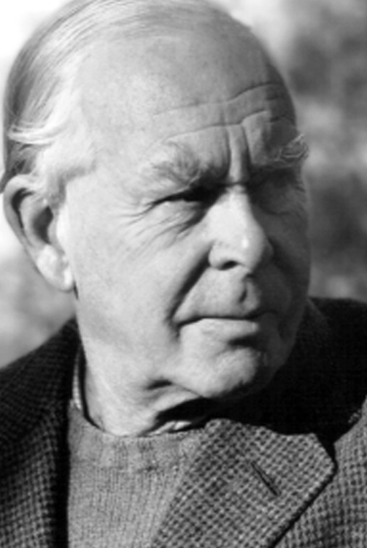
Why Bowlby's Attachment Theory?
Focuses on early relationships shaping emotional, social and cognitive development (Bowlby, 1998; Ainsworth, 2015).
Relevant because Jenny's caregiving role may have disrupted typical attachment processes.
Explains how prolonged stress and role reversal can affect adolescence (Howe, 2011).

Slide 5
Key Concepts of Bowlby's Theory
Attachment: A deep emotional bond between child and caregiver.
Internal Working Model: Mental blueprint for relationships and self-worth.
Secure vs Insecure Attachment: Impacts emotional regulation and resilience.
Maternal Sensitivity: Consistent, responsive caregiving supports secure attachment.
Separation & Loss: Long-term caregiving stress can mimic chronic emotional strain.

Slide 6
Relevance to Jenny's History
Jenny’s past 5 years:
Father died which resulted in major attachment disruption (Bowlby, 1988).
Mother’s illness which reduced emotional availability (Howe, 2011).
Jenny became a caregiver indicating role reversal (parentification).
Limited peer interaction and normal adolescent autonomy (Falkner and Tarleton, 2020).
Potential developmental impacts:
Heightened anxiety, hyper-independence, or emotional suppression.
Difficulty trusting others or seeking help.
Increased risk of low mood or stress-related symptoms.
Academic disruption due to caring responsibilities (Department of Health and Social Care, 2021).

Slide 7
Biological and Environmental Factors (Nature and Nurture)
Biological influences:
Stress hormones (cortisol) elevated in young carers which affects mood and memory.
Adolescence is a sensitive period for brain development (prefrontal cortex, emotional regulation) (Falkner and Tarleton, 2020).
Environmental influences:
Loss of father, mother’s illness, financial strain.
Reduced social support and limited opportunities for typical teenage experiences.
School pressures and caring responsibilities.
Interaction:
Chronic stress and limited emotional support resulted in increased vulnerability to insecure attachment patterns.

Slide 8
Applying Attachment Theory to Jenny's Current Situation
How the theory explains her needs now:
Jenny may struggle to express her own needs due to long-term caregiving.
She may avoid seeking help because she feels responsible for her mother’s wellbeing.
She may have internalised beliefs such as “I must cope alone” or “My needs don’t matter.” (Bowlby, 1988; Howe, 2011)
Attachment-informed interpretation:
Jenny requires consistent, reliable support from adults and services.
She needs opportunities to rebuild trust, autonomy (ability to make decisions), and emotional safety (Cassidy and Shaver, 2016).

Slide 9
Support Plan: Practical Strategies (Attachment-Based)
1. Emotional Support Interventions
Assign a key worker or youth support worker to provide consistent, predictable support.
Offer counselling using attachment-informed approaches (e.g., building secure base, emotional literacy) (Bowlby, 1988).
2. Social Development Support
Encourage participation in peer groups or young carers’ groups to build social confidence.
Provide school-based support (flexible deadlines, pastoral care) (NHS England, 2022).
3. Reducing Care Burden
Arrange home care services for cooking, cleaning, and shopping.
Provide administrative support for mother (benefits, appointments) (Department of Health and Social Care, 2021).
4. Strengthening Autonomy
Support Jenny in planning her future (education, career).
Encourage healthy boundaries between caring and personal life (Howe, 2011).

Slide 10
Nature and Nurture in the Support Plan
Nature:
Stress management strategies (mindfulness, sleep hygiene) to regulate biological stress responses (Falkner and Tarleton, 2020).
Nurture:
Stable relationships with professionals.
Environmental changes: reduced caring load, improved home support, increased social opportunities (NHS England, 2022).
This is a holistic plan that supports both emotional and biological wellbeing (Cassidy and Shaver, 2016).

Slide 11
Critical Evaluation of Bowlby's Theory
Usefulness:
Highlights importance of early relationships and emotional security (Bowlby, 1988).
Explains how loss and reduced parental availability affect development (Howe, 2011).
Helps identify emotional needs behind Jenny’s behaviour.
Limitations:
Overemphasis on mother–child relationship; modern families are more diverse (Cassidy and Shaver, 2016).
Does not fully account for resilience or positive adaptation (Falkner and Tarleton, 2020).
Underestimates social, cultural, and economic factors affecting young carers (Department of Health and Social Care, 2021).
More deterministic than contemporary theories (e.g., Vygotsky, ecological models).
This theory is useful for understanding emotional impact but must be combined with social and environmental frameworks.

Slide 12
Conclusion
Jenny’s caring role has likely shaped her emotional, social, and cognitive development.
Bowlby’s theory helps explain the impact of disrupted attachment and chronic stress.
A support plan must reduce her caring burden, strengthen emotional support, and promote autonomy.
Evidence-based, holistic interventions can improve her wellbeing and future development.

Slide 13
Reference List
Ainsworth, M. (2015) Patterns of Attachment. Psychology Press.
Bowlby, J. (1988) A Secure Base: Parent-Child Attachment and Healthy Human Development. Routledge.
Cassidy, J. and Shaver, P. (2016) Handbook of Attachment: Theory, Research, and Clinical Applications. 3rd ed. Guilford Press.
Department of Health and Social Care (2021) Supporting Young Carers. UK Government.
Falkner, A. and Tarleton, B. (2020) ‘Young carers and mental health’, Child & Family Social Work, 25(3), pp. 567–579.
Howe, D. (2011) Attachment Across the Lifecourse. Palgrave Macmillan. NHS England (2022) Young Carers: Guidance for Professionals.

