Slide 1
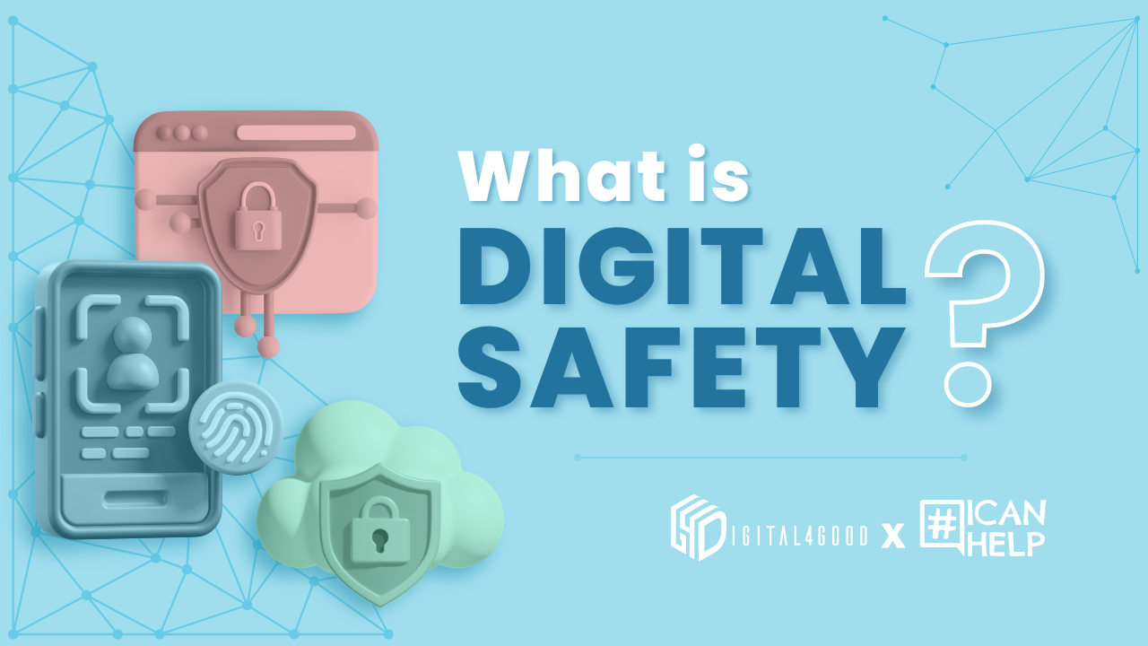
Stay Safe Online: Basic Digital Safety Tips
Student Number: 2417980
Student name: Mukaddus Ali Anwar
Your guide to staying secure in the digital world

Slide 2

Why Digital Safety Matters
- Protect your personal information.
- Avoid cyber threats like hacking and phishing.
- Ensure a safe and secure online experience.

Slide 3
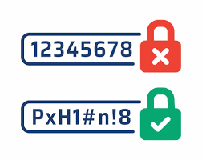
Key Tips for Digital Safety
1. Use Strong and Unique Passwords:
- Avoid common words or phrases.
- Use a mix of letters, numbers, and symbols.
- Enable two-factor authentication (2FA).
2. Be Aware of Phishing Scams:
- Don't click on suspicious links or attachments.
- Verify sender emails before responding.
- Look for warning signs like typos and urgency in messages.

Slide 4

Tools for Digital Safety
- Password Managers: Keep passwords secure and organised.
- Antivirus Software: Detect and remove malware.
- Ad Blockers: Prevent intrusive ads and trackers.

Slide 5

What to Do If You’re Hacked
1. Change your passwords.
2. Disconnect from the internet.
3. Run a full system scan using antivirus software.
4. Report the breach to relevant platforms or authorities.

