Slide 1
Week 3: Algiers: Colonial City
Lecture 10: Settler Algiers: Albert Camus and the Pieds-Noirs
1. Pépé le Moko
2. Algiers of the Pieds-Noirs
Expansion and Suburbanisation
Cagayous
Nomenclature
3. Camus’s Algiers
‘The Silent Men’
‘Summer in Algiers’
L'Étranger
4. Build-up to the War of Independence
‘New colonialism’
Urban sprawl and the bidonvilles
Masterplans
Algeria during World War Two
Decolonisation
5. War of Independence
Camus, ‘Algeria’
Battle of Algiers

Slide 2
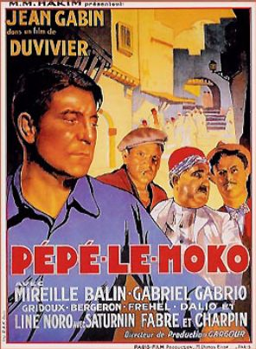
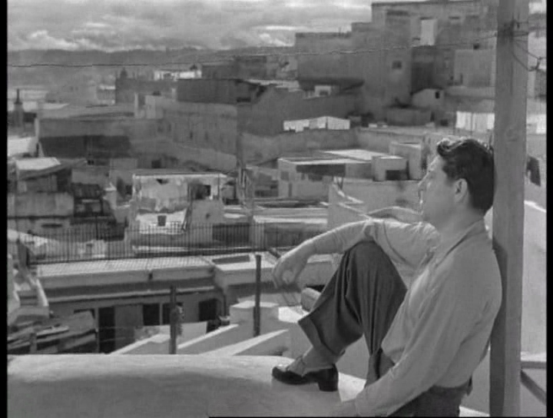
1. Pépé le Moko (1937)
Opening scene:
http://www.dailymotion.com/video/x2xafv7

Slide 3
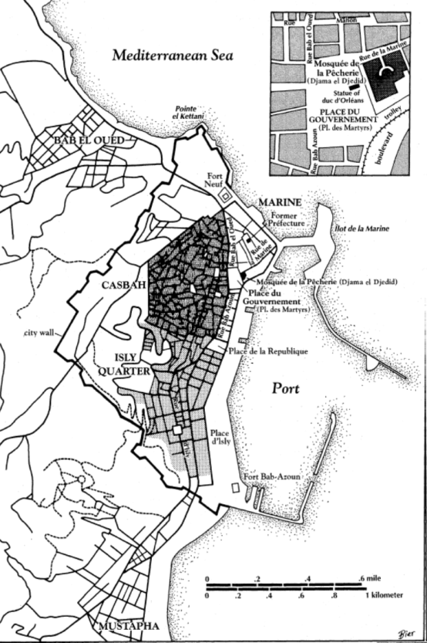
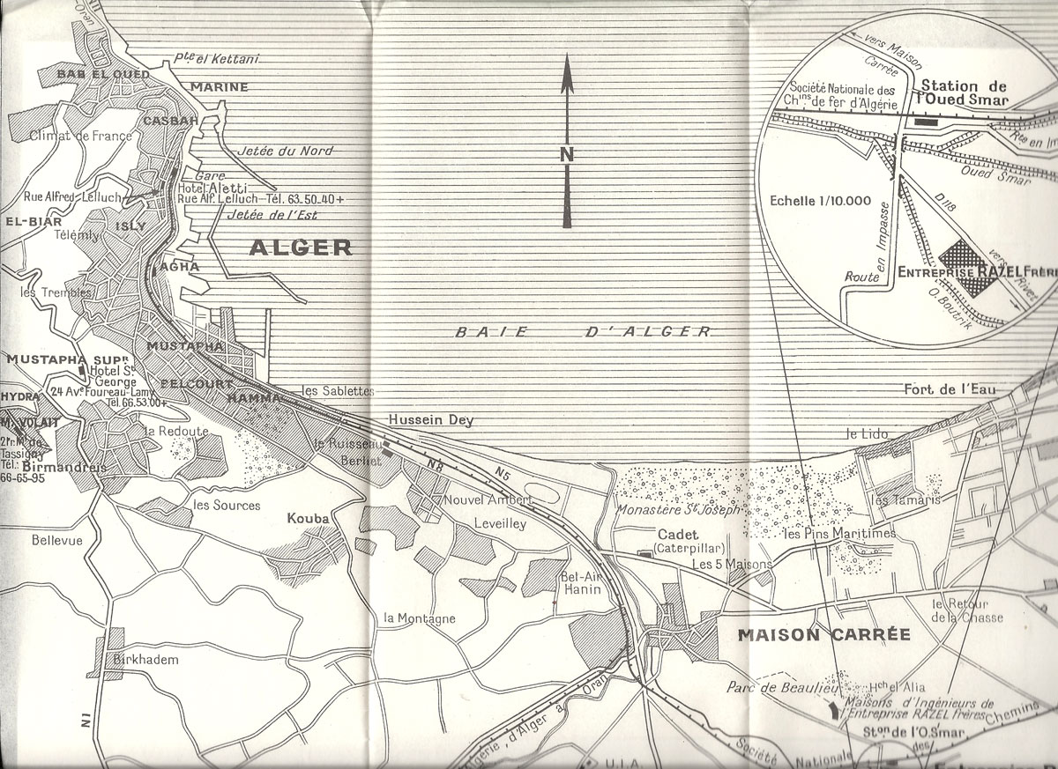
2. Algiers of the Pieds-Noirs: Expansion and Suburbanisation
Map of Algiers, 1960 and c. 1900 (inset)

Slide 4
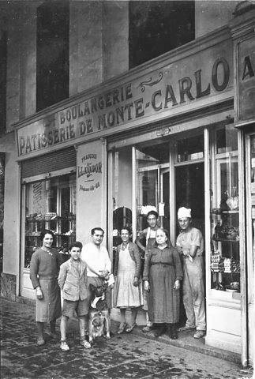
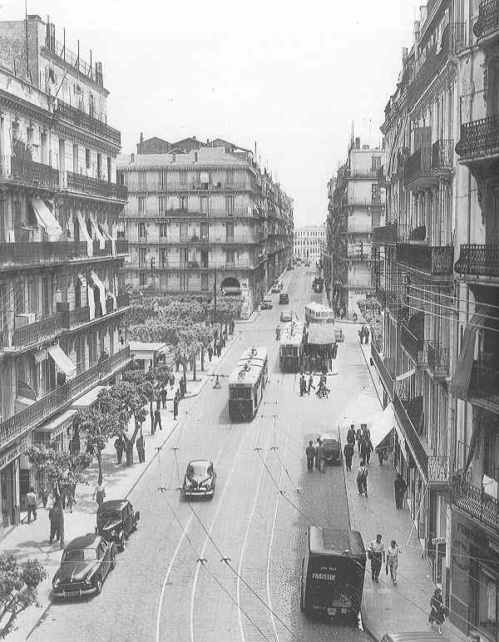
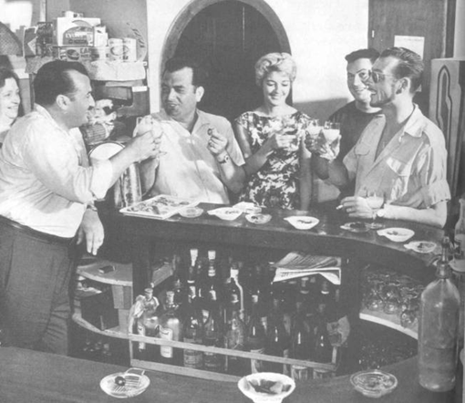
2. Algiers of the Pieds-Noirs: Expansion and Suburbanisation
1898–1926, Bab-el-Oued population doubled in size
Photographs from: http://algeroisementvotre.free.fr

Slide 5
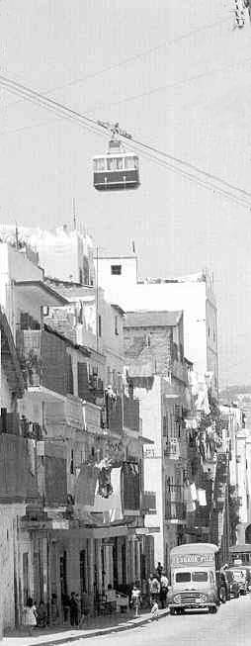
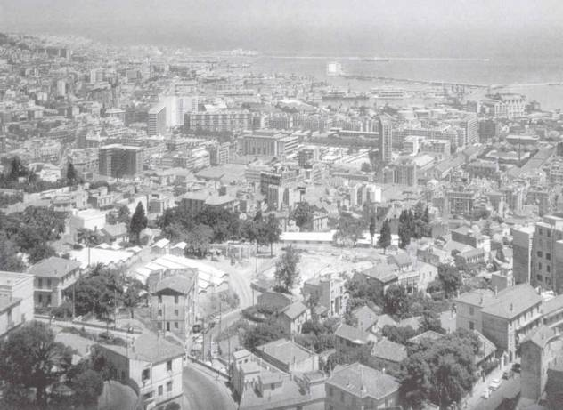
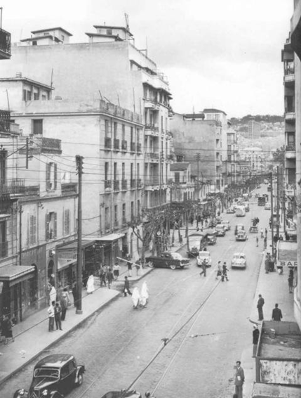
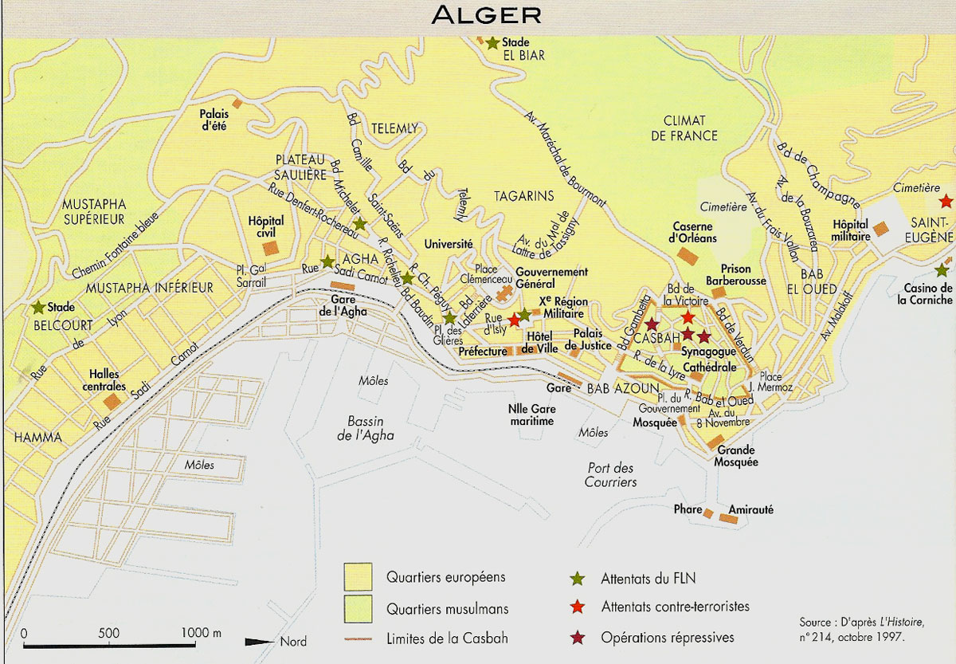
2. Algiers of the Pieds-Noirs: Expansion and Suburbanisation
Belcourt
Views of Belcourt and Rue-de-Lyon; cable car (téléphérique) connecting workplaces on Rue-de-Lyon to new suburbs of Diar es Saada and Diar el-Mahçoul

Slide 6
2. Algiers of the Pieds-Noirs: Expansion and Suburbanisation
Working-Class Algiers
Employment
Dock work
Food-processing
Tobacco industry
Service industry
Demographics
Mixed: French, Spanish, Jewish, Maltese as well as native Berbers and Arabs
By 1908, population of Algiers totalled 145,280 – with a ratio of 3:1 Europeans to Algerians (as opposed to 1:6 in Algeria overall)

Slide 7
2. Algiers of the Pieds-Noirs: Nomenclature
In 1889, all European residents of Algeria given French citizenship – Jews also naturalised. By contrast, Muslims had no automatic right to citizenship (hard to obtain) and were instead ‘subjects’ (NB: Muslims made citizens post-1946, but without full civil status of Europeans)
Development of composite white, Euro-Algerian identity: some lobbying for greater autonomy and home rule
In early 20th century, the phrase used to self-identify this community was ‘Algerian’
Semantics of European community terminology:
Petits-blancs = ‘Little whites’ – similar to petite bourgeoisie
Pauvre-blancs = ‘Poor whites’
Colons = colonists
Grand-colons = ‘great colonists’ – wealthy, propertied, landowning, business-owning

Slide 8

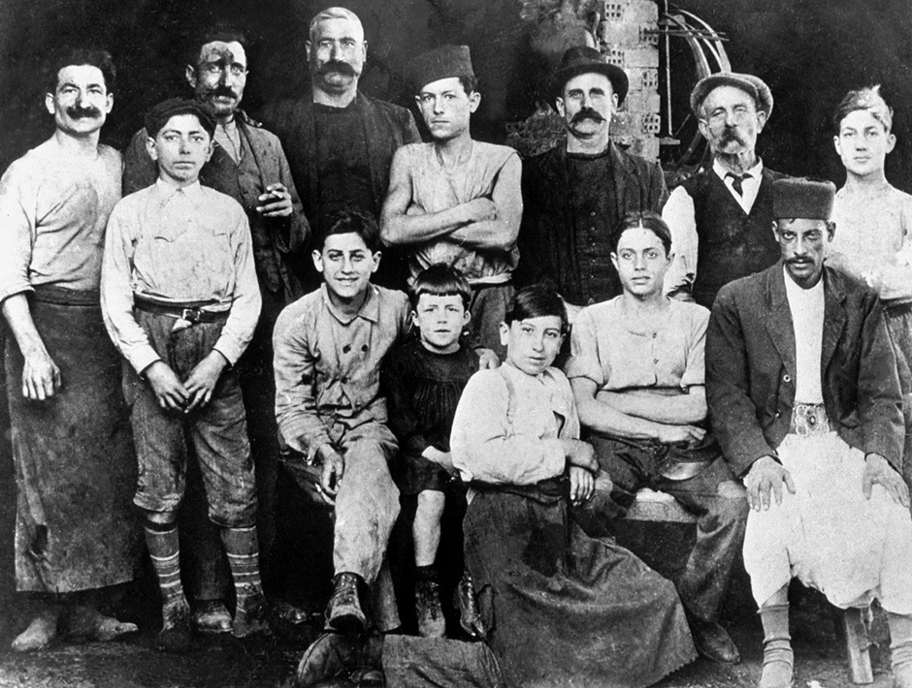
2. Algiers of the Pieds-Noirs: Nomenclature
Eventually, the accepted term of self-identification for the white, European settler community is pieds-noirs – ‘black feet’
Origins of term obscure; competing explanations:
  Black boots of 1830 invasion force?
  Staining of feet in wine production?
  ‘Blackened feet’ of coal-using workers aboard ships?
Pieds-noirs identity embraced in the era of decolonisation
Emblem used by post-independence pied-noir associations

Slide 9
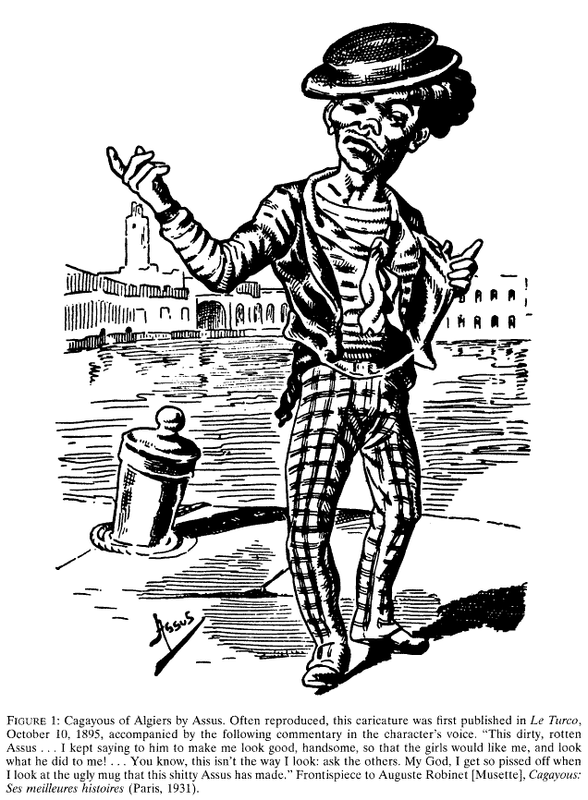
2. Algiers of the Pieds-Noirs: Cagayous
Character created by ‘Musette,’ nom-de-plume of Auguste Robinet (1862–1930), colonial administrator – inspector of orphanages in Bab-el-Oued
Le roi des Salaouetches = king of the layabouts
Stories (published 1894–1920) concentrate on Cagayous’ street escapades in Bab-el-Oued and Marine Quarter (only occasional forays into the Casbah or hillside French villas)
Speaks plebeian patouète (‘potato-eater’) Algiers-French dialect; uses coarse language
Stories act as a vessal for satire and for exploring political satire issues:
  Anti-Semitism
  Debates about Algerian autonomy
  Stands for election in Paris as antitout (‘anti-everything’) candidate

Slide 10
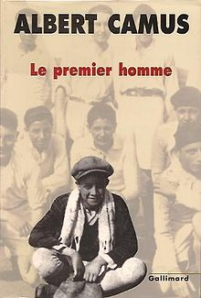
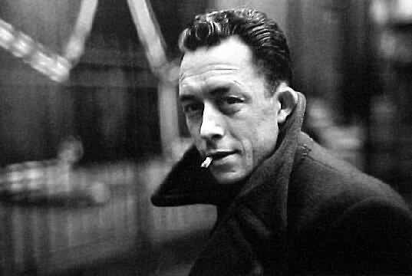
3. Camus’s Algiers
Albert Camus (1913–1960)
b. in coastal town of Dréan, Algeria
Father died in WWI (1914); grew up with his (illiterate, Spanish-descended) mother in Belcourt, Algiers
Educated at University of Algiers – played goalkeeper for Racing Universitaire d'Alger
Moved to France – served in WWII resistance Worked as journalist, playwright and essayist, gaining fame as novelist and philosopher – notable associates inc. Jean-Paul Sartre and Simone de Beauvoir
Several works commentate on colonialism and Algerian society
Key works
The Stranger (L'Étranger, often translated as The Outsider) (1942)
The Myth of Sisyphus (Le Mythe de Sisyphe) (1942)
The Plague (La Peste) (1947)
The Fall (La Chute) (1956)
The First Man (Le premier homme) (incomplete, published 1995)

Slide 11

4. Camus’ Algiers: ‘The Silent Men’ (1957)
What is the plot/situation dramatized in ‘The Silent Men’?
What impressions does ‘The Silent Men’ convey about the pieds-noir community in colonial Algiers?
What impressions does convey about the Arab community in colonial Algiers?
Albert Camus at the age of seven (centre, wearing black) in his uncle’s workshop, Algiers, 1920

Slide 12
4. Camus’ Algiers: ‘Summer in Algiers’ (1936)
What impression does ‘Summer in Algiers’ give of life in colonial Algiers?
What details does ‘Summer in Algiers’ provide about the geography and architecture of colonial Algiers? What does he say about the following:
    The city’s beaches;
    The harbour;
    Place du Gouvernement;
    The Casbah (Kasbah)
    Belcourt
    Bab-el-Oued?
Why does Camus think Algiers has “no lessons to teach” (p. 87)? Why does “intelligence ha[ve] no place” in Algiers (p. 93)?

Slide 13
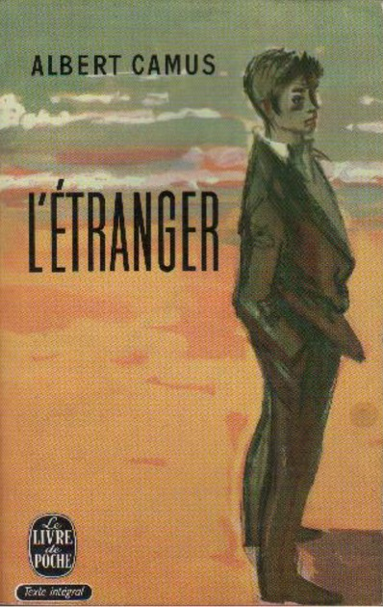

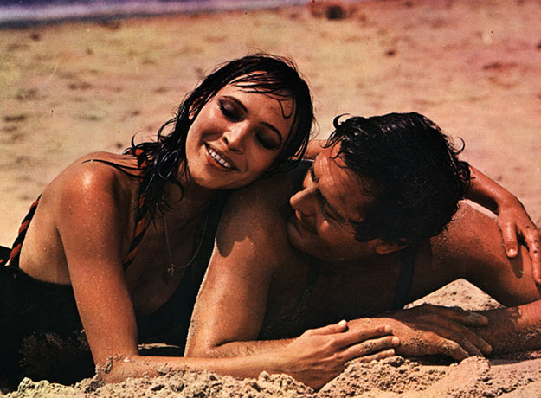
4. Camus’ Algiers: L'Étranger (1942)
Film version (1967), available here:
https://www.youtube.com/watch?v=OkjGt678TNA

Slide 14
4. Camus’s Algiers: Said critiques
“It would be correct to regard Camus’s work as affiliated historically both with the French colonial venture itself (since he
assumes it to be immutable) and with outright opposition to Algerian independence. This Algerian perspective may unblock and release aspects hidden, taken for granted, or denied by Camus.
“ … Meursault kills an Arab, but this Arab is not named and seems co be without a history, let alone a mother and father; true also, Arabs die of plague in Oran, but they are not named either.”
Edward Said, ‘Camus and the French Imperial Experience,’ Culture and Imperialism (New York: Vintage Books, 1994), pp. 175–176.

Slide 15
4. Camus’s Algiers: Said critiques
“The novels and short stories narrate the result of a victory won over a pacified, decimated Muslim population whose rights to the land have been severely curtailed.”
Said, ‘Camus and the French Imperial Experience,’ p. 181.

Slide 16
4. Camus’s Algiers: The Meursault Investigation
“I’ll tell you this up front: The other dead man, the murder victim, was my brother. There’s nothing left of him. There’s only me, left to speak in his place, sitting in this bar, waiting for condolences no one’s ever going to offer.
“ … My brother’s name was Musa. He had a name. But he’ll remain ‘the Arab’ forever … Strange, isn’t it? For centuries, the settler increases his fortune, giving names to whatever he appropriates and taking them away from whatever makes him
feel uncomfortable. If he calls my brother ‘the Arab,’ it’s so he can kill him the way one kills time, by strolling around aimlessly.”
Kamel Daoud, The Meursault Investigation (London: Oneworld Publications, 2015 [2013]), pp. 1, 13.

Slide 17
4. Camus’ Algiers: ‘New Mediterranean Culture’ (1937)
Camus speech at opening of Maison de la Culture, Algiers, 1937
“[Algeria] is one of the few countries where East and West live close together. And there is, at this junction, little difference between the way a Spaniard or an Italian lives on the quays of Algiers, and the way Arabs live around them.”
“Our task here is to rehabilitate the Mediterranean, to take it back from those who claim it unjustly for themselves … We are all the more prepared for the task in that we are in immediate contact with the Orient, which can teach us so much in this respect. We are, here, on the side of the Mediterranean against Rome. And the essential role that towns like Algiers and Barcelona can play is to serve, in their own small way, that aspect of Mediterranean culture which favours man instead of crushing him … What we seek is the culture that finds life in the trees, the hills, and in mankind.”

Slide 18
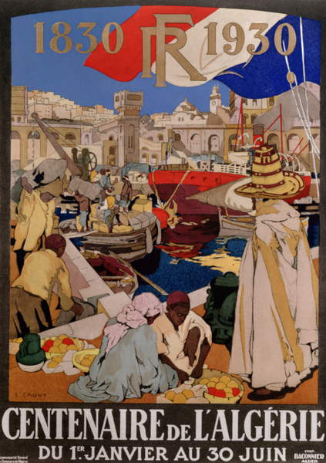
4. Build-up to War of Independence: ‘New Colonialism’

Slide 19
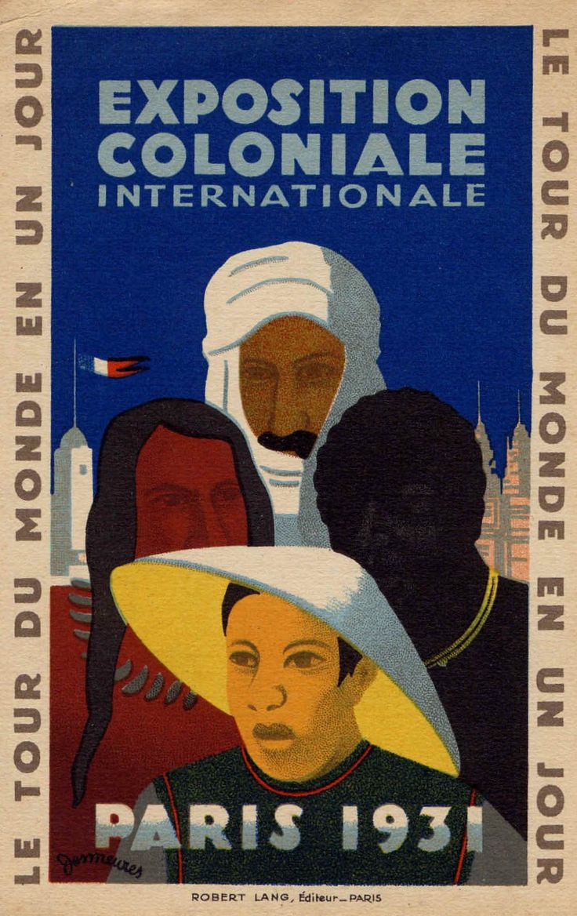
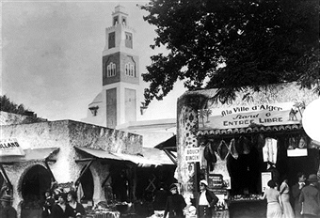
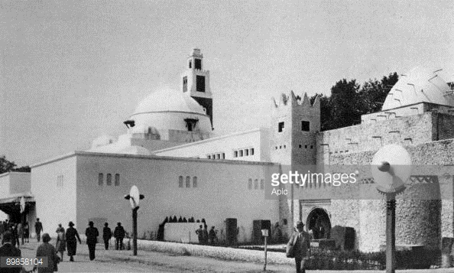
4. Build-up to War of Independence: ‘New Colonialism’
Algerian village, Colonial Exposition, Paris, 1931

Slide 20
4. Build-up to War of Independence: Urban Sprawl and e Bidonvilles
Changing demographics:
Population size
Inward migration from impoverished rural areas – increasing Muslim-Algerian presence in city
By 1950s, Algiers France’s 4th-largest city (after Paris, Marseille, Lyon)
Data taken from Zeynep Çelik, Urban Forms and Colonial Confrontations: Algiers under French Rule
Algiers
1866 = 64,809
1926 = 266,268
1948 = 473,261
1954 = 570,000
Algeria
1830 c. 1,500,000–3,000,000
1851 2,554,100
1900 4,675,000
1910 5,500,000
1940 7,600,000
1960 10,853,000

Slide 21
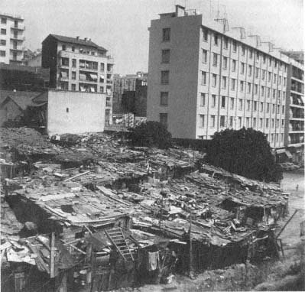
4. Build-up to War of Independence: Urban Sprawl and the Bidonvilles
By 1954, 41,000 squatter homes were recorded in Algiers – 39,500 of which belonged to Muslims
41.5% of Algiers’ Muslim population lived in bidonvilles – ‘shantytowns’
Density: 1.2 persons-per-room in European homes; 3.4 for Algerians
A bidonville in Algiers, 1961
Image and data taken from Zeynep Çelik, Urban Forms and Colonial Confrontations: Algiers under French Rule

Slide 22
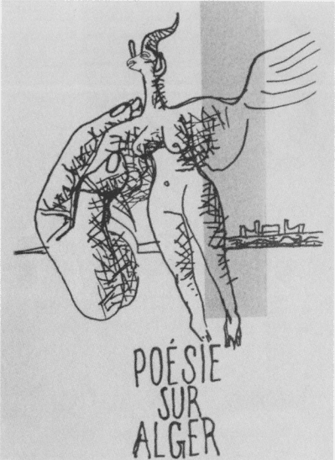
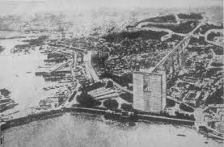
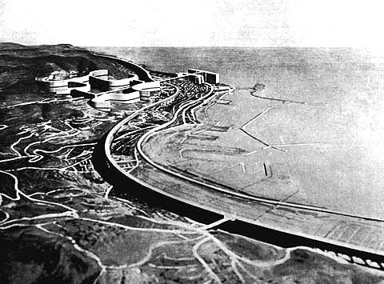
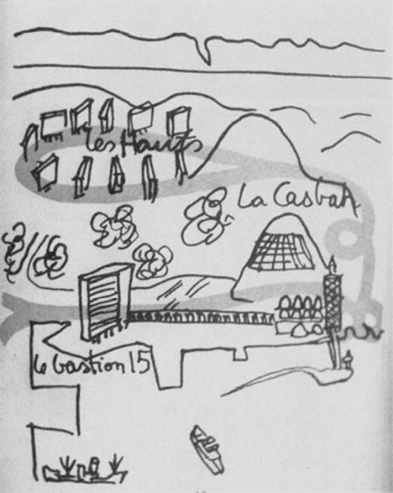
4. Build-up to War of Independence: Masterplans
Attempts to envisage ways to address housing problems in Algiers – most famously by Le Corbusier’s 1930s series

Slide 23
4. Build-up to War of Independence: ‘New Colonialism’
Le Corbusier,
maps showing
geographical axis between
France and Algiers

Slide 24
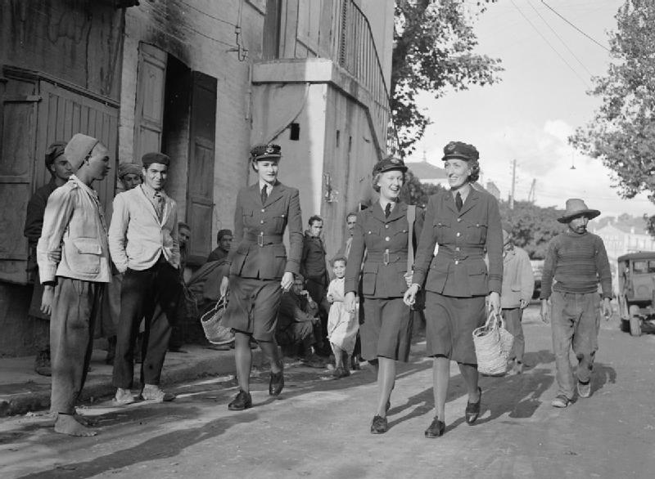
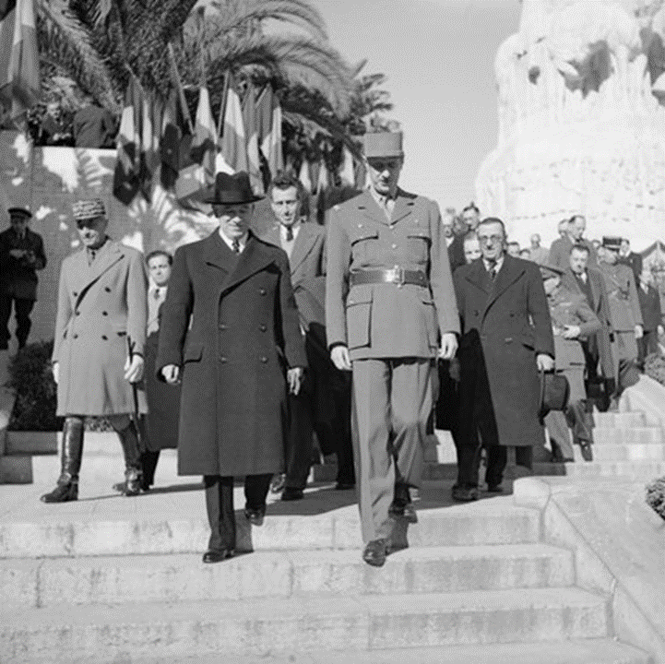
4. Build-up to War of Independence: Algeria during WWII
General Charles de Gaulle, chairman of provisional French government, with Czechoslovak President-in-exile Edvard Beneš, Algiers, January 1945
With Nazi invasion of France in May 1940, Algeria was placed under the dominion of collaborationist Vichy government
Liberated by Allies during Operation Torch invasion of North Africa, November 1942 – occupied by British and American forces, and home of Free France provisional government
100,000s of Algerians serve in resistance and in Free French army
Increased sense of distance from metropolitan France, and lent urgency to nationalist calls for liberation
British servicewomen in a suburb of Algiers, 1943.

Slide 25
4. Build-up to War of Independence: Algeria during WWII
“ … I point out one fact of which too many French people are ignorant— namely, that hundreds of thousands of Arabs have spent the past two years fighting for the liberation of France.”
Camus in Combat, May 13–14 1945, cited by Arthur Scherr, ‘Albert Camus’s L’Étranger and “Les Muets”: Violence and Reconciliation between Arab and Pied-Noir,’ Texas Studies in Literature and Language, Vol. 59, No. 1 (Spring 2017), p. 79

Slide 26
4. Build-up to War of Independence: Nationalism
Precursors
‘Young Algerians,’ 1900s–1910s
Algerian Communist Party est. 1936
Algerian People's Party est. 1937 – superseded by Movement for the Triumph of Democratic Liberties, 1946
Splintering between Movement for the Triumph of Democratic Liberties and National Liberation Front (Front de Libération Nationale, FLN [NLF]), 1954

Slide 27
4. Build-up to War of Independence: Algeria during WWII
Sétif Massacre: thousands (upper estimate 45,000) Algerians murdered in French retaliation to street demonstrations in market town, May 8 1945
Protests began as celebration of VE Day and liberation – clashed with French military police who objected to anti-colonial and nationalist flags and banners
Muslim attacks on local pieds-noirs
Retaliation by French Foreign Legion sees massacre of members of Muslim population

Slide 28
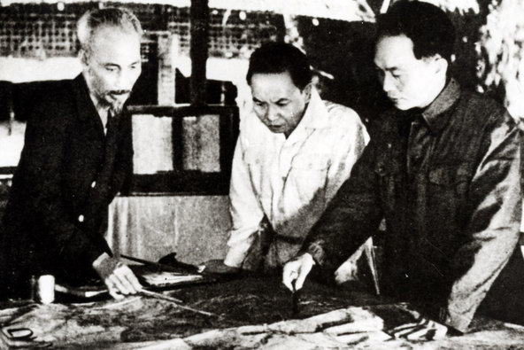
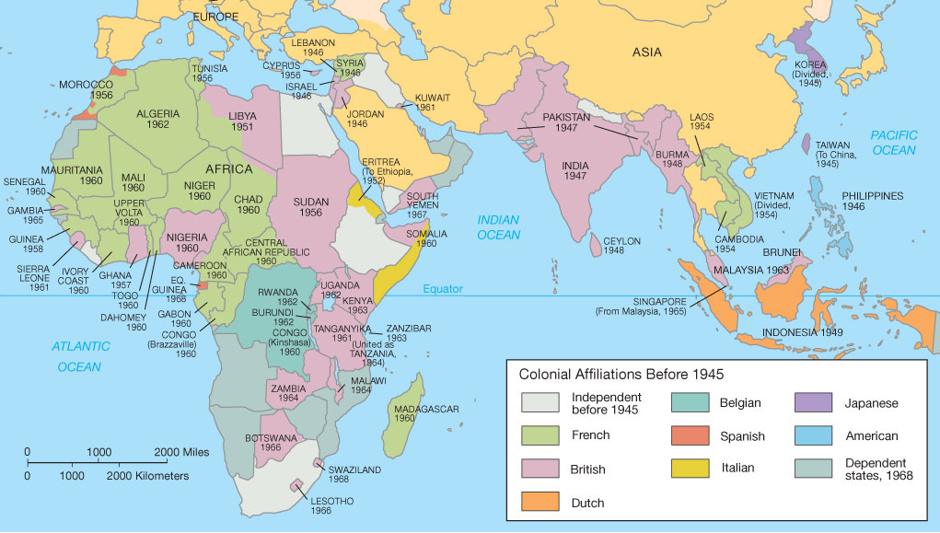
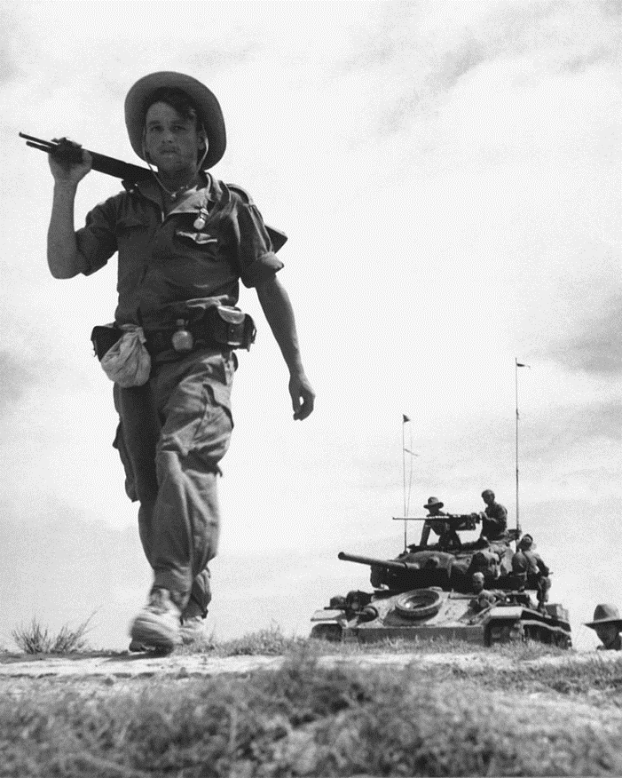
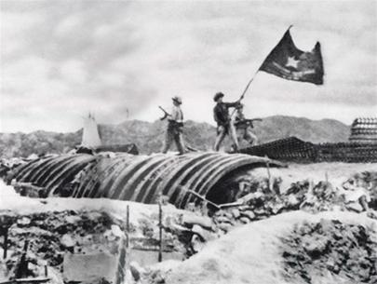
4. Build-up to War of Independence: Decolonisation
First Indochina War (1946–1954)
French legionnaire in Vietnam, with US-made tank in background, 1954; Ho Chi Minh with military advisors, before battle of Battle of Dien Bien Phu,
1954; Viet Minh troops fly flag during decisive victory in Battle of Dien Bien Phu, 1954

Slide 29
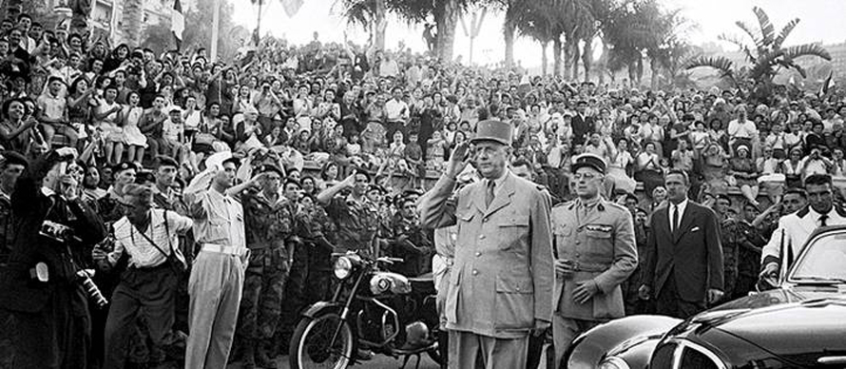
6. War of Independence (1954–1962)
NLF initiates armed combat November 1954
Battle of Algiers, 1956–1957
Weak French state, plus international support for decolonisation
May 1958 crisis – attempted coup by French military generals contributed to downfall of Fourth French Republic, and the return to power of Charles De Gaulle, who later favoured independence
French President Charles de Gaulle in Algiers, June 4 1958

Slide 30
5. War of Independence: Camus, ‘Algeria’
“One must recognise that with regard to Algeria, national independence is a formula of pure passion. There has never yet been an Algerian nation. The Jews, Turks, Greeks, Italians, or Berbers would have as much right to reclaim the direction of this virtual nation. Actually, the Arabs do not form Algeria alone. The importance and the antiquity of he French settlement in particular, suffice to create a problem that is incomparable with anything else in history. The French of Algeria are also, in a strong sense of the word, indigenous. It must be added that a purely Arab Algeria would not be able to acceded to the economic independence without which political independence is only an alluring illusion.”
Camus, ‘Algeria’ (1958)

Slide 31
5. War of Independence: Camus, ‘Algeria’
“ … Then it was Camus's turn [to speak]. We had gone to his lecture to hear one of our elders and if need be protect him from the fascists. On this point we were not called on to intervene. Camus's audience had been carefully screened and the approaches to the hall were guarded by the helmeted CRS [Compagnie Republicaine de Securite, a national constabulary army corps, independent of the regular army]. We expected that Camus would take a clear position on the Algerian problem. What we were treated to was a sweet-sister speech. He explained to us at length that the innocent civilian population must be protected, but he was categorically against fund raising in favor of the innocent families of political prisoners. We in the hall were dumbfounded. Outside, the mob of fascists was rhythmically yelling: ‘Algérie Française!’ and screaming: ‘Camus to the gallows!’”
Account of Camus’s speech in Algiers, January 1956, by Charles Geromini, psychiatry intern. Included as appendix in Fanon, A Dying Colonialism, pp. 172–173.

Slide 32
5. War of Independence: Camus, ‘Algeria’
“ … ‘You have to choose sides,’ cry those gorged on hatred. Yes! I have chosen. I have chosen my land. I have chosen the Algeria of justice, where French and Arabs associate with each other freely.”
Camus, January 10 1956 cited by Arthur Scherr, ‘Albert Camus’s L’Étranger and “Les Muets”: Violence and Reconciliation between Arab and Pied-Noir,’ Texas Studies in Literature and Language, Vol. 59, No. 1 (Spring 2017), p. 77.

Slide 33
5. War of Independence: Battle of Algiers, 1956–1957
Urban guerrilla movement by NLF: terrorist attacks on selected targets in Algiers
June 1956 – 49 European civilians killed by NLF in retaliation for guillotining of two nationalist prisoners; in turn, Union française nord-africaine bomb kills 73 residents of the Casbah
NLF assassinations of local politicians
Decision to enclose Casbah and to create checkpoints to regulate inhabitants’ movements
10th Parachute Division of French Army take over control of city from police
January 1957 – General Strike called by NLF to coincide with UN debates on ‘Algerian Question’
Paratroopers win Battle of Casbah, disarming NLF in Algiers
NLF leadership in Algiers killed or captured by September 1957

Slide 34
5. War of Independence: Camus, ‘Algeria’
“I have said and repeated that it is necessary to render justice to the Algerian people and grant them a fully democratic regime — I have always condemned terror. I must also condemn a terrorism that is practiced blindly, in the streets of Algiers for example, and that one day could strike my mother or my family. I believe in justice, but I will defend my mother before justice”.
Camus, cited by Scherr, ‘Albert Camus’s L’Étranger and “Les Muets,’ p. 80

Slide 35
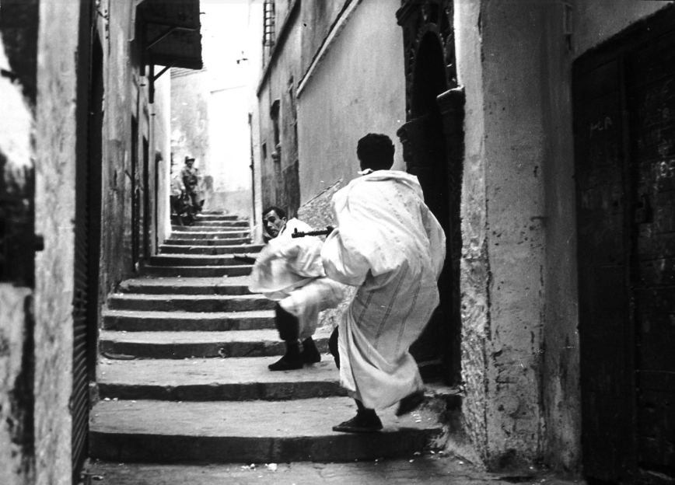
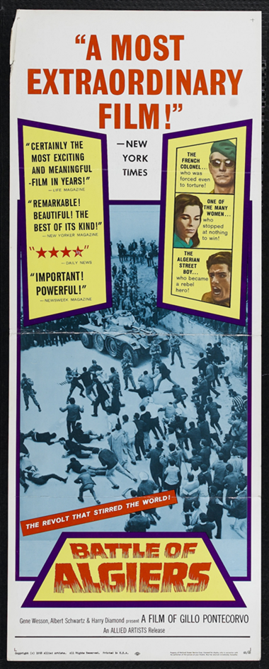
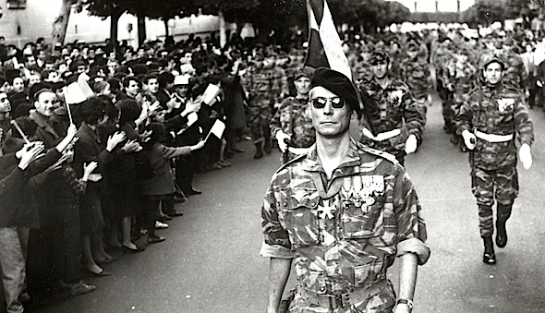
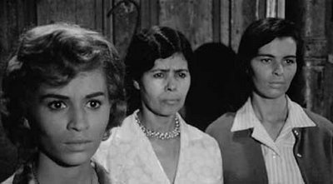
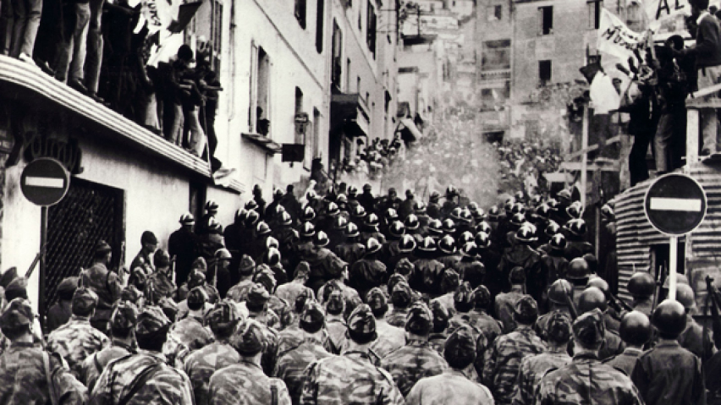
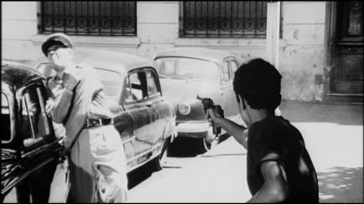
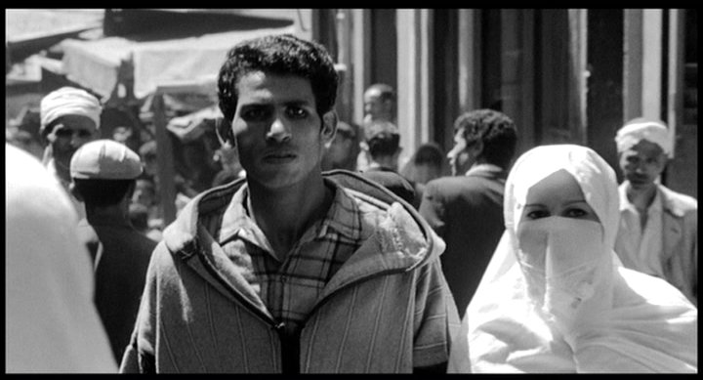
5. War of Independence: The Battle of Algiers (1966)

