Slide 1

Understanding Plagiarism and Citing References

Slide 2


Session objectives:
Quick re-cap on finding sources and making notes
Recognising and avoiding plagiarism
Citing and referencing
Notes:
This is plagiarism. Although students won’t know this, few words have been changed, this is copied out almost entirely word for word and there are no references. It is not acceptable.

Slide 3
Search process
Define topic
Identify scope and keywords
Structure your search
Choose information sources
Perform your search
Review your results
Notes:
Quick re-cap on how to refine search for relevant and appropriate literature.
It would be useful to draw attention to the assessment grid criteria – wide range, appropriate/relevant – consider reliability and date of publication etc.

Slide 4

Managing information and note taking
Think about how you might keep track of things you have to read?
What techniques do you use at the moment?
Do you think there are any tools that can help?
Think about how you arrange your reference material – books, web, journals etc?
Notes:
Post it note exercise – quick couple of minutes

Slide 5
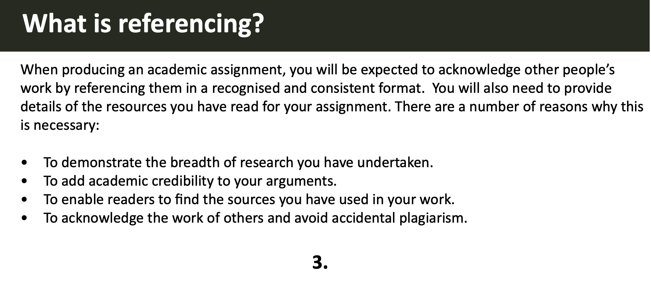

Slide 6


Good referencing practice:
Keep track of what you find from the beginning
Record full details of the sources you might use
Make good quality notes, don’t just copy
Look at source – often how to cite detail is provided
Don’t leave it to the last minute

Slide 7

Find your system
Work out a system of storing references that works for you
  Reference management tool
  Word document with all references formatted and ready
  Structured filing system for notes with full references
  Spreadsheet of references
This Photo by Unknown Author is licensed under CC BY
Notes:
May suggest mgt tools such as Endnote – but not necessary.
References may be copied and pasted straight into a bibliography on a Word doc – in alphabetical order
Noting page numbers of references is essential if using direct quotations

Slide 8
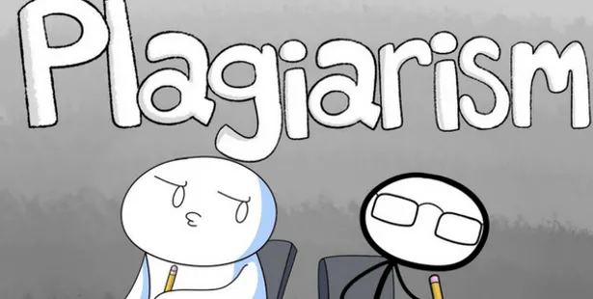
What is plagiarism?
Notes:
Allow students to feedback responses/share ideas.

Slide 9

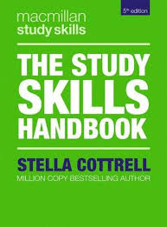
Plagiarism is the use of the work of others without acknowledgement of your source of information or inspiration.
Cottrell,S. (2019) The Study Skills Handbook Red Globe Press, London.
Notes:
Note that the Study Skills Handbook is the source of information for some of this session.

Slide 10
Is it plagiarism if you…
Copy a paragraph from a text and put it in your essay without putting it in quotation marks and referencing the source?
This is probably the most well known example of plagiarism. If you copy exact words, you must enclose them in quotation marks and acknowledge your source in your reference list.

Slide 11
Is it plagiarism if you…
Incorporate text from another source, changing one or two words and providing a citation?
If you do not intend to quote directly from the source, you must write about it in your own words. Using too many words from the original source is plagiarism, even if you provide a reference.

Slide 12
Is it plagiarism if you…
Copy a diagram or data table from a website, providing a reference for the source underneath?
This isn’t plagiarism. You can include tables, diagrams or images from another source as long as you provide a reference.

Slide 13


Plagiarism includes:
Using words more or less exactly the same as they have been used in articles, lectures, television programmes, books, or anywhere else
Using other people’s ideas or theories without saying whose ideas they are
Paraphrasing what you read or hear without stating where it comes from
Notes:
Note that if you alter a few words or sentences that you’ve ‘borrowed’ , or re-ordered them – it’s still plagiarism.
Plagiarism is treated very seriously – your work may be disqualified; it can have a significant impact on marks

Slide 14
What is plagiarism?
Cutting and pasting from other documents.
Quoting without quotation marks or references.
Paraphrasing without referencing.
Summarising without referencing.
Using an image, source and/or diagram without referencing.
Taking another student’s ideas and passing them off as your own.
Collaborating on what should be individual work.
Forgetting to cite is still plagiarism!

Slide 15

Recognising plagiarism
Notes:
Allow students time to read the following texts; decide whether each is an example of plagiarism and the reason for decision

Slide 16
1. Is this plagiarism?
Original source
In order to communicate effectively with other people, one must have a reasonably accurate idea of what they do and do not know that is pertinent to the communication. Treating people as though they have knowledge that they do not have can result in miscommunication and perhaps embarrassment.
Nickerson, R. S. (1999). How we know - and sometimes misjudge - what others know: Imputing one's own knowledge to others. Psychological Bulletin, 125(6), 737-759.
Student’s own work
Effective communication depends on a generally accurate knowledge of what the audience knows. If a speaker assumes too much knowledge about the subject, the audience will either misunderstand or be bewildered.

Slide 17
1. Is this plagiarism?
Yes, this is plagiarism.
Although the student paraphrased from the original source, a citation must be provided in text and a reference at the end of the assignment.
e.g. …or be bewildered (Nickerson, 1999).
Original source
In order to communicate effectively with other people, one must have a reasonably accurate idea of what they do and do not know that is pertinent to the communication. Treating people as though they have knowledge that they do not have can result in miscommunication and perhaps embarrassment.
Nickerson, R. S. (1999). How we know - and sometimes misjudge - what others know: Imputing one's own knowledge to others. Psychological Bulletin, 125(6), 737-759.
Student’s own work
Effective communication depends on a generally accurate knowledge of what the audience knows. If a speaker assumes too much knowledge about the subject, the audience will either misunderstand or be bewildered.

Slide 18
2. Is this plagiarism?
Original source
Social exchange theory (Blau, 1964) proposes that when one party provides benefits to the other, the other party becomes obliged to reciprocate by returning the favor.
Hatipoglu, B., & Inelmen, K. (2018). Demographic diversity in the workplace and its impact on employee voice: The role of trust in the employer. The International Journal of Human Resource Management, 29(5), 970-994.
Student’s own work
According to social exchange theory, a party should give in return when receiving benefits from another (Blau, 1964, as cited in Hatipoglu & Inelmen, 2018, p.976).
Hatipoglu, B., & Inelmen, K. (2018). Demographic diversity in the workplace and its impact on employee voice: The role of trust in the employer. The International Journal of Human Resource Management, 29(5), 970-994.

Slide 19
2. Is this plagiarism?
Original source
Social exchange theory (Blau, 1964) proposes that when one party provides benefits to the other, the other party becomes obliged to reciprocate by returning the favor.
Hatipoglu, B., & Inelmen, K. (2018). Demographic diversity in the workplace and its impact on employee voice: The role of trust in the employer. The International Journal of Human Resource Management, 29(5), 970-994.
No, not plagiarism.
This is known as secondary referencing. Always cite and reference the source where you found the information, not the original source if you have not read that yourself.
Student’s own work
According to social exchange theory, a party should give in return when receiving benefits from another (Blau, 1964, as cited in Hatipoglu & Inelmen, 2018, p.976).
Hatipoglu, B., & Inelmen, K. (2018). Demographic diversity in the workplace and its impact on employee voice: The role of trust in the employer. The International Journal of Human Resource Management, 29(5), 970-994.

Slide 20
3. Is this plagiarism?
Student A
It is advised that “you should cite all sources and present full details of these in your list of references” (Neville, 2010).
Student B
Neville (2010) comments that:
  It can sometimes be difficult, if not impossible, to avoid using some of the author’s original words, particularly those that describe or label phenomena. However, you need to avoid copying out what the author said, word for word. Choose words that you feel give a true impression of the author’s original ideas or action.

Slide 21
3. Is this plagiarism?
Student A
It is advised that “you should cite all sources and present full details of these in your list of references” (Neville, 2010, p. 37).
This is poor practice.
Whenever quoting, you should always include page numbers.
Student B
Neville (2010) comments that:
  It can sometimes be difficult, if not impossible, to avoid using some of the author’s original words, particularly those that describe or label phenomena. However, you need to avoid copying out what the author said, word for word. Choose words that you feel give a true impression of the author’s original ideas or action (p. 38).

Slide 22
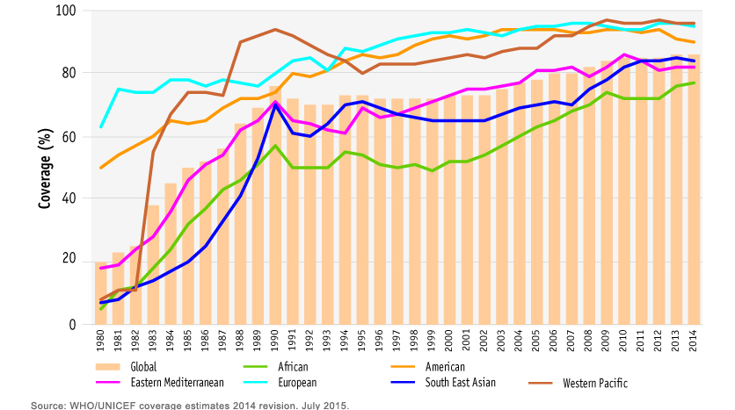
4. Is this plagiarism?
Figure 5. DTP3 % immunisation coverage (WHO, 2015).
Reference list
WHO. (2015). Immunization. Retrieved from: www.who.int/gho/immunization/en/

Slide 23
4. Is this plagiarism?
No, not plagiarism.
As long as you provide a citation and a reference, you can reuse tables, diagrams and images.
Figure 5. DTP3 % immunisation coverage (WHO, 2015).
Reference list
WHO. (2015). Immunization. Retrieved from: www.who.int/gho/immunization/en/

Slide 24


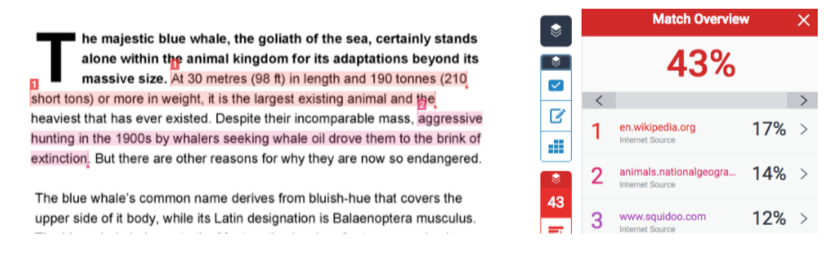
Notes:
Time to discuss similarity score and how plagiarism is identified by the person marking the assignment.

Slide 25
How to avoid plagiarism
Write all your notes in your own words
Note down exactly where you read the information you put in your notes
In your assignment, cite the sources of ideas and information. This should be done even if you are not using a direct quotation
At the end of your work, write a full list of references

Slide 26

Avoid accidental plagiarism
If you have a habit of copying:
Put your pen or keyboard out of reach
Read a passage without taking any notes
Cover up the page and sum up what you have read. If this is possible, say this aloud or record yourself so that you hear your words in your voice
Once you can say what the passage is about, note that down in your own words
If you want to copy material for use as a quotation, highlight it in a different colour so that it stands out from your own words. This will show you how much you copy.

Slide 27
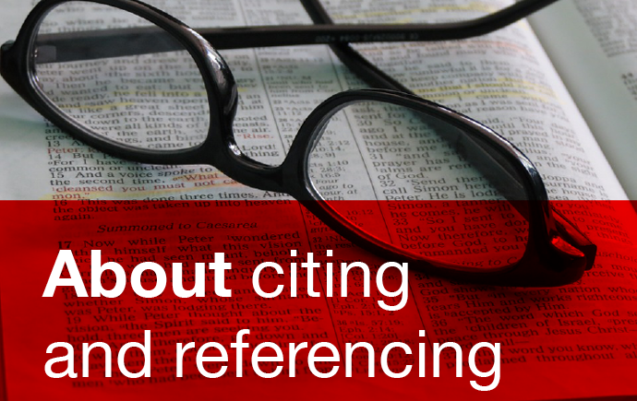

Slide 28
What is citing and referencing?
References in brackets in the text of your essay or project plus a reference list at the end
Used in academic writing, to show what you have read and to enable others to trace your sources
A standard way of citing makes it easier to trace your reading more efficiently
If you cite correctly, then you don’t have to worry about plagiarism.
UWTSD asks for the Harvard Method. This means an in the text short reference and then a way of setting out the reference in the reference list. Sometimes known as author / date method.

Slide 29

Citing demonstrates that you…
gathered evidence to support your ideas and arguments
used credible, good quality sources
read widely and at an appropriate academic level
uphold and contribute to academic standards and integrity
allow your reader/marker to differentiate between your own work and the work of others, and to locate your sources.
Notes:
Refer again to what the marker is looking for/ assessment criteria

Slide 30
When and what to cite:
Within & at the end of the text when you use ideas from, or refer to, another person’s work.
Applies to:
facts, figures, ideas & theories
From:
books, journals, internet, videos, lecture notes etc.
Exception:
common knowledge

Slide 31
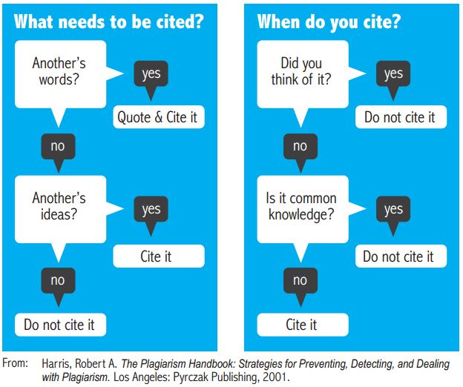



Slide 32

Referencing books: how to do it!
Have a think about what pieces of information you might need if you are going to reference a book and create a reference list for your assignment e.g. author’s name, date etc.

Slide 33
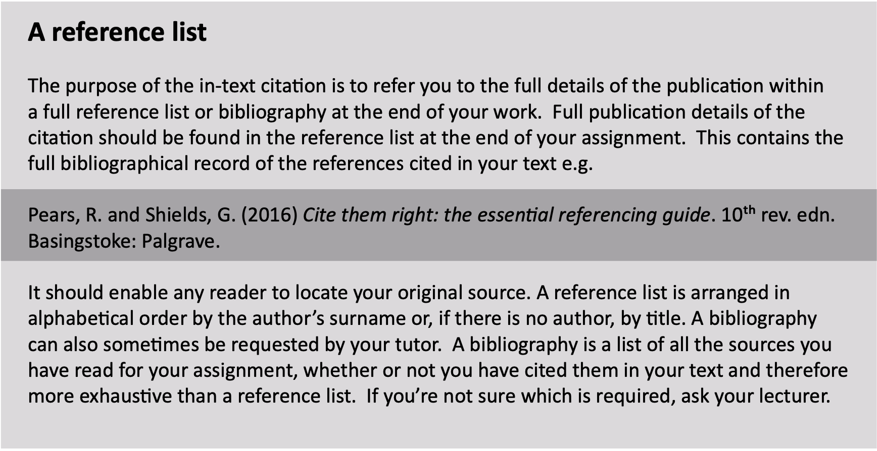


Slide 34
Surname of author first
Comma
Initial of first name

Slide 35
Surname of author first
Comma
Initial of first name
Date of publication in brackets

Slide 36
Surname of author first
Comma
Initial of first name
Date of publication in brackets
Title of the book in italics
Full stop

Slide 37
Surname of author first
Comma
Initial of first name
Date of publication in brackets
Title of the book in italics
Full stop
Edition (if required)
Full stop

Slide 38
Surname of author first
Comma
Initial of first name
Date of publication in brackets
Title of the book in italics
Full stop
Edition (if required)
Full stop
Location of publisher
colon

Slide 39
Surname of author first
Comma
Initial of first name
Date of publication in brackets
Title of the book in italics
Full stop
Edition (if required)
Full stop
Location of publisher
colon
Name of publisher
Full stop

Slide 40
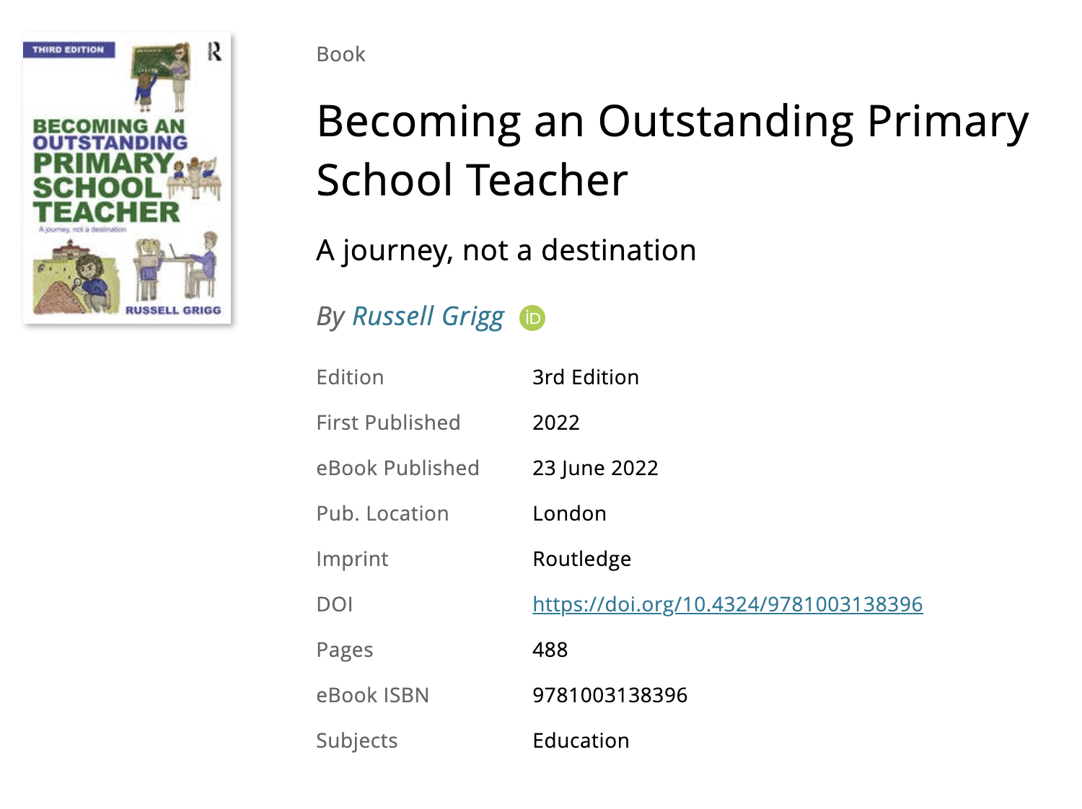
Have a go!

Slide 41
Have a go!
Grigg, R. (2022) Becoming an Outstanding Primary School Teacher A journey, not a destination. 3rd rev. edn. London: Routledge.

Slide 42
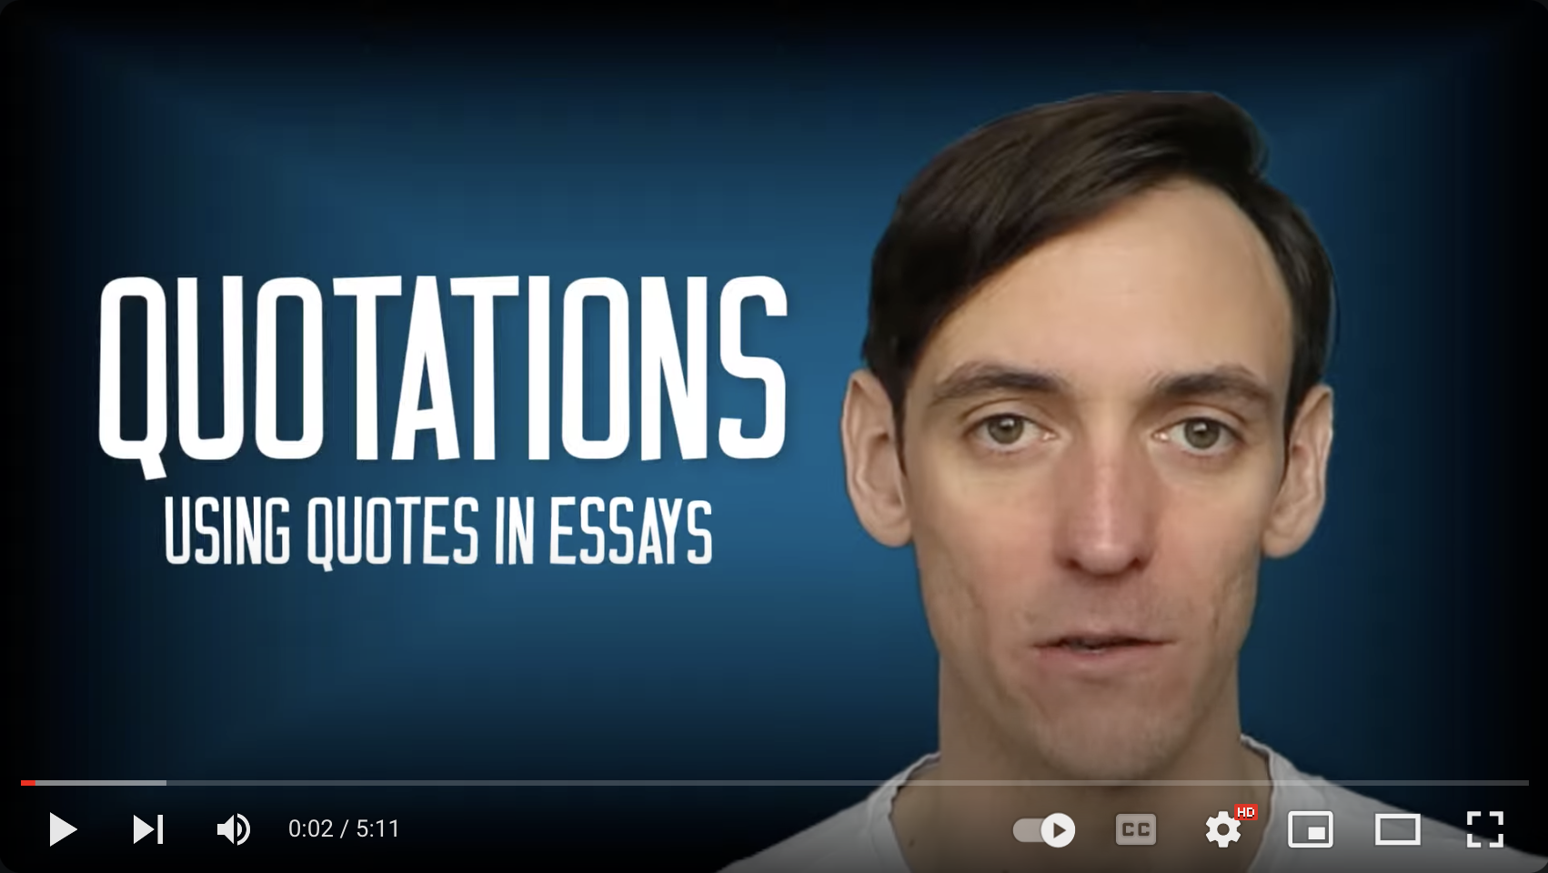
https://www.youtube.com/watch?v=wt5G7XT3UlQ
Notes:
https://www.youtube.com/watch?v=wt5G7XT3UlQ

Slide 43
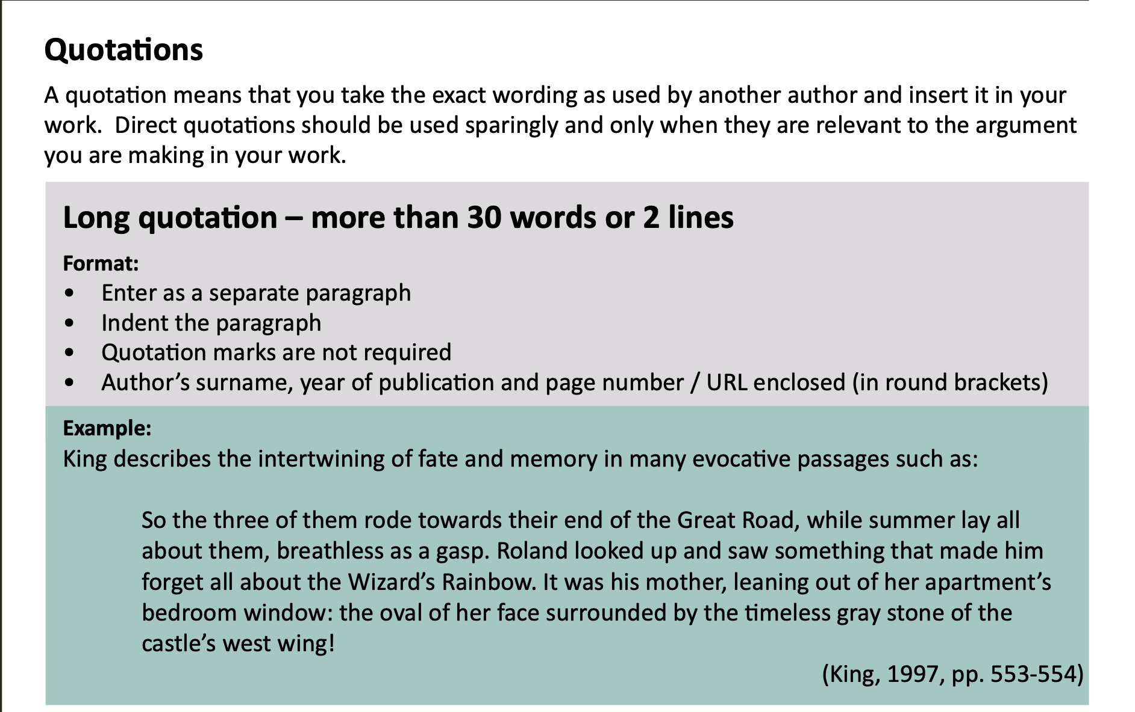

Slide 44
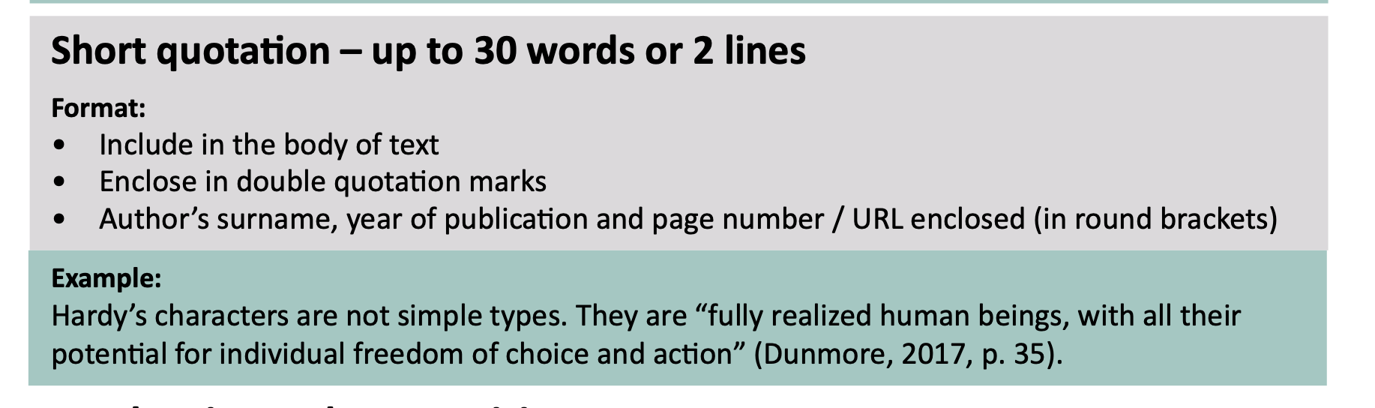

Slide 45
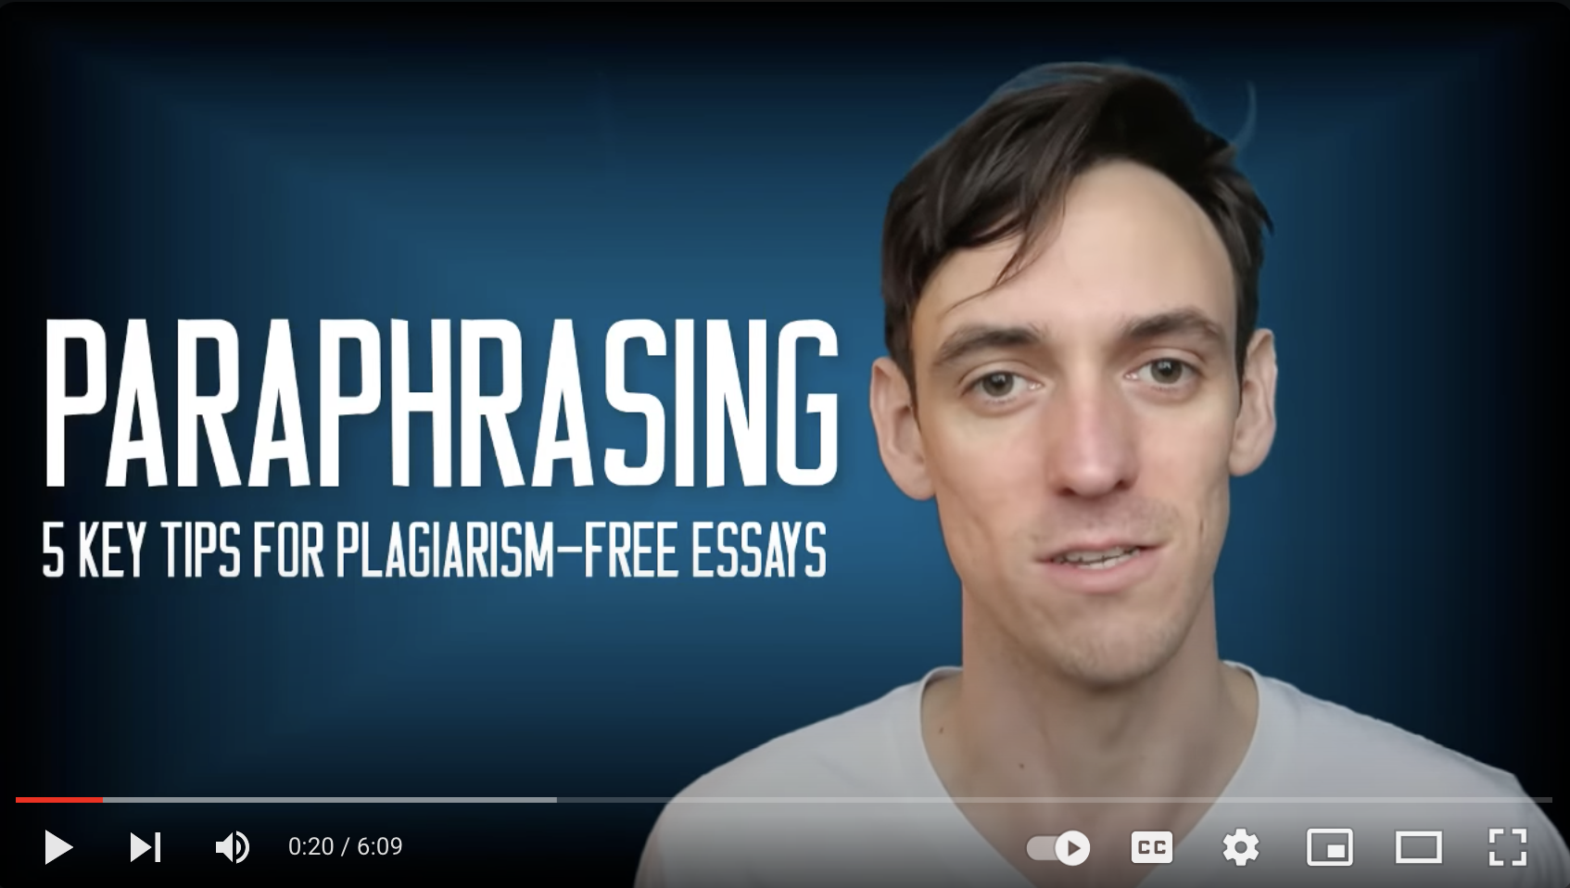

Slide 46
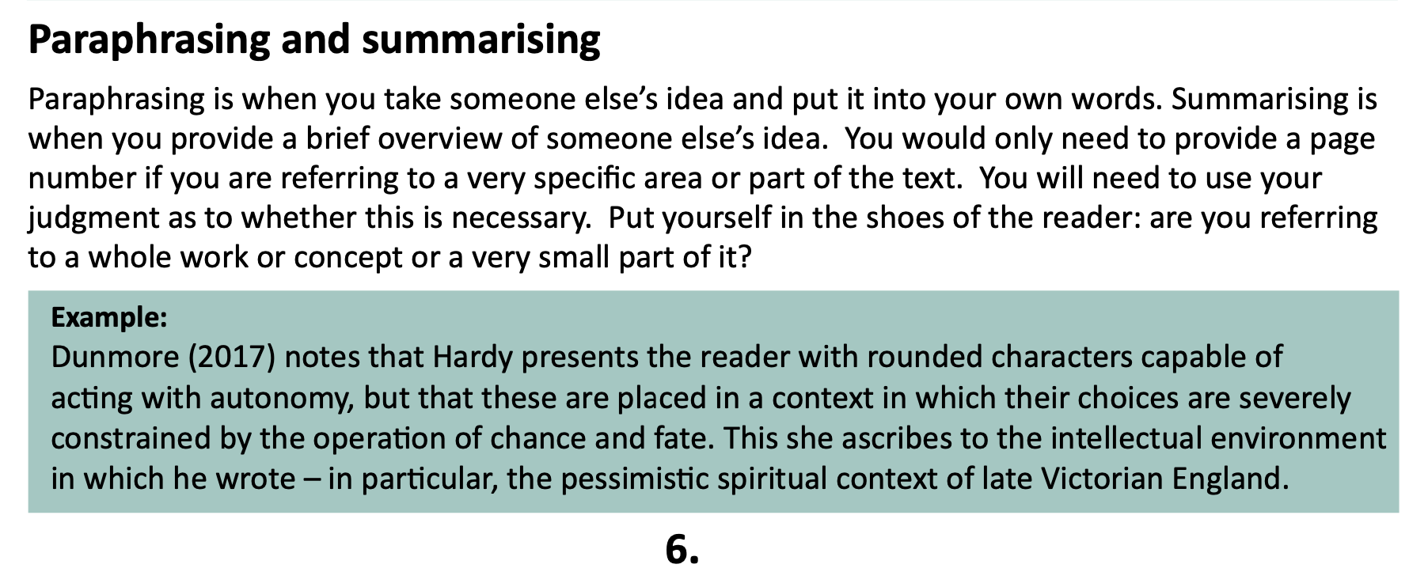

Slide 47
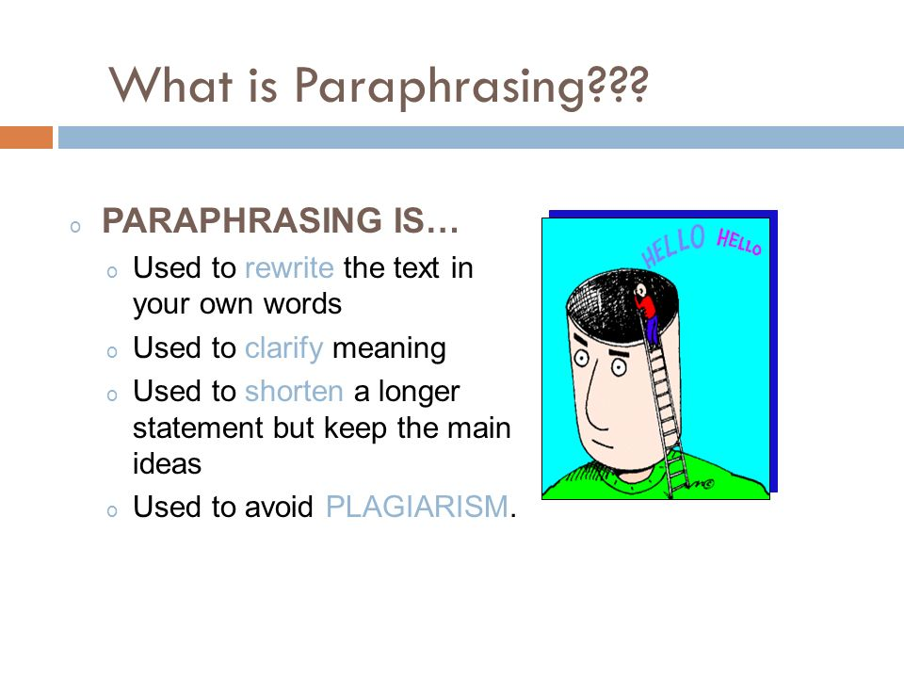
Develop confidence in your own words
Use your own words, even if you don’t think you write well – they count for more than copied text
Notes:
Another short clip by the same author – 6 mins – succinctly explains the key points of paraphrasing with some really useful tips https://www.youtube.com/watch?v=j3A0UVGrjb8
Highlight that students need to develop the confidence to write in their own words – even if they don’t think they write well – they count for more than copied text.

Slide 48
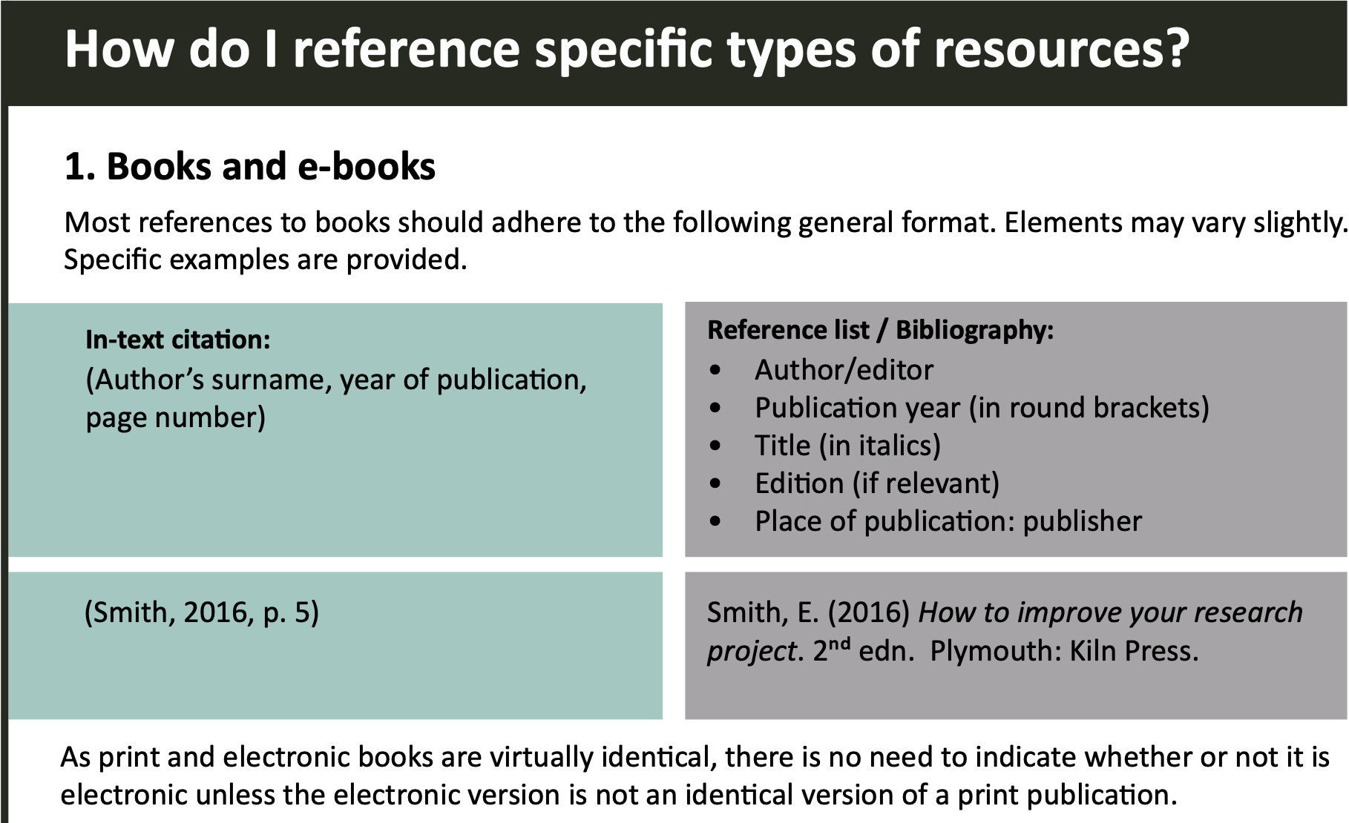

Slide 49
Start or finish?
Some teachers suggest that the best chocolate bar ever
invented was the Drifter (Cox, 2023, pg.7).
Or
Cox (2023, pg.7) suggests that the best chocolate bar ever
invented was the Drifter.

Slide 50
Start or finish?
Some teachers suggest that the best chocolate bar ever
invented was the Drifter (Cox, 2023, pg.7).
Or
Cox (2023, pg.7) suggests that the best chocolate bar ever
invented was the Drifter.
Outside brackets
Inside brackets

Slide 51
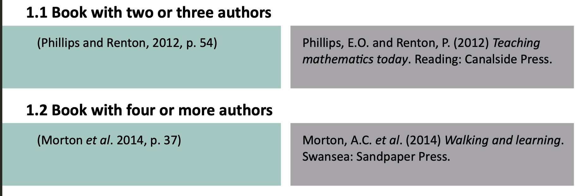

Slide 52
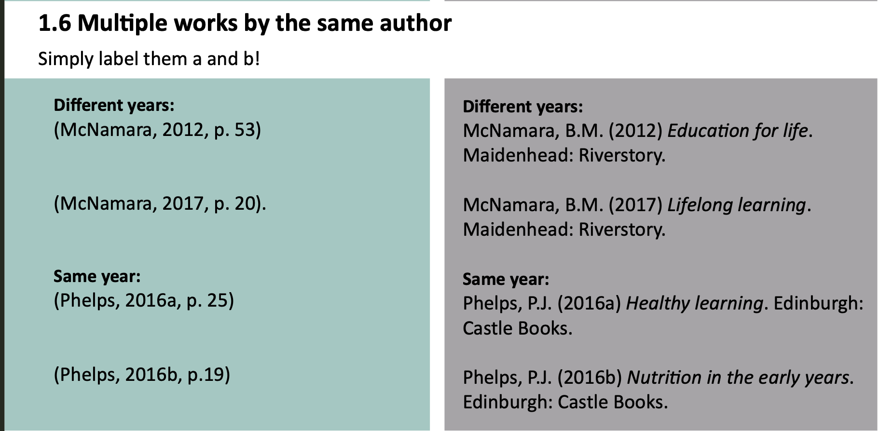

Slide 53

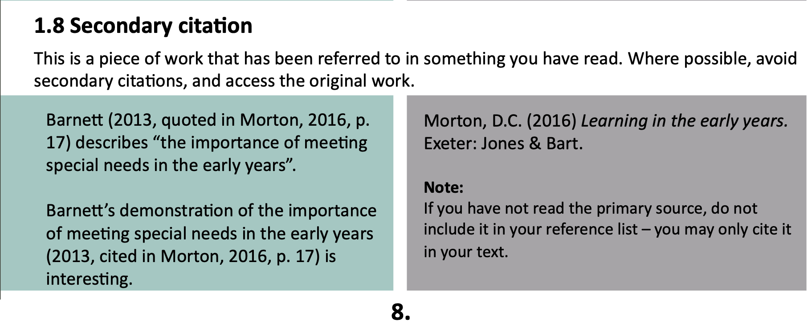

Slide 54
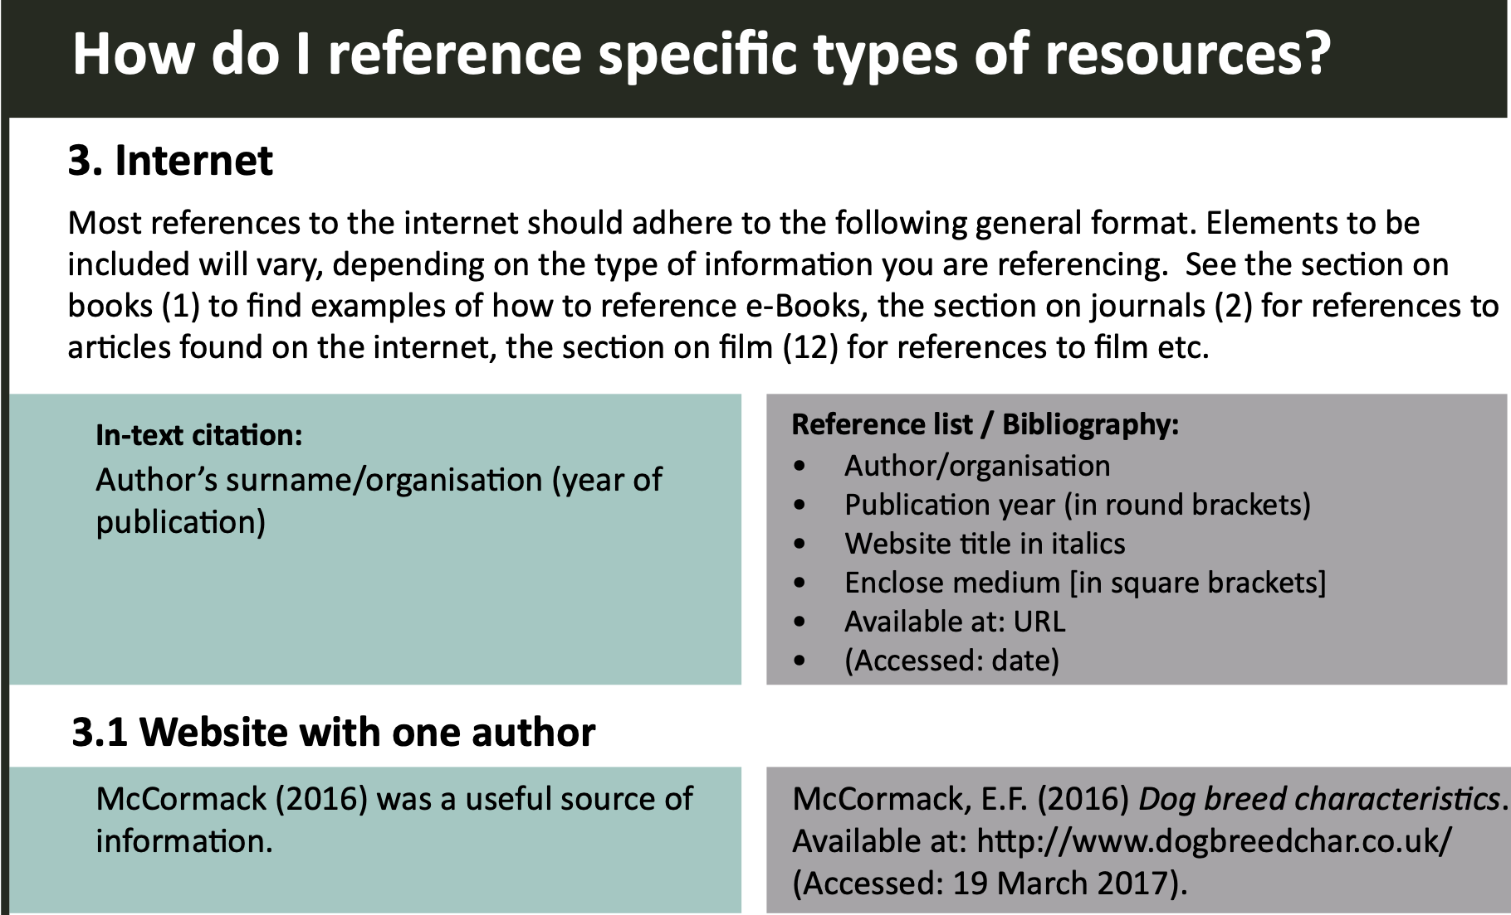

Slide 55
Anything missing here from the bullet points?

Slide 56
Anything missing here from the bullet points?
No Medium in square brackets required for just a website with one author.

Slide 57
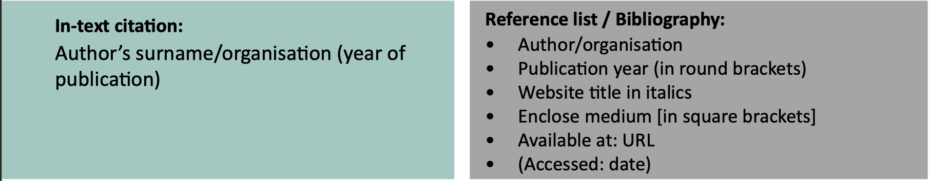
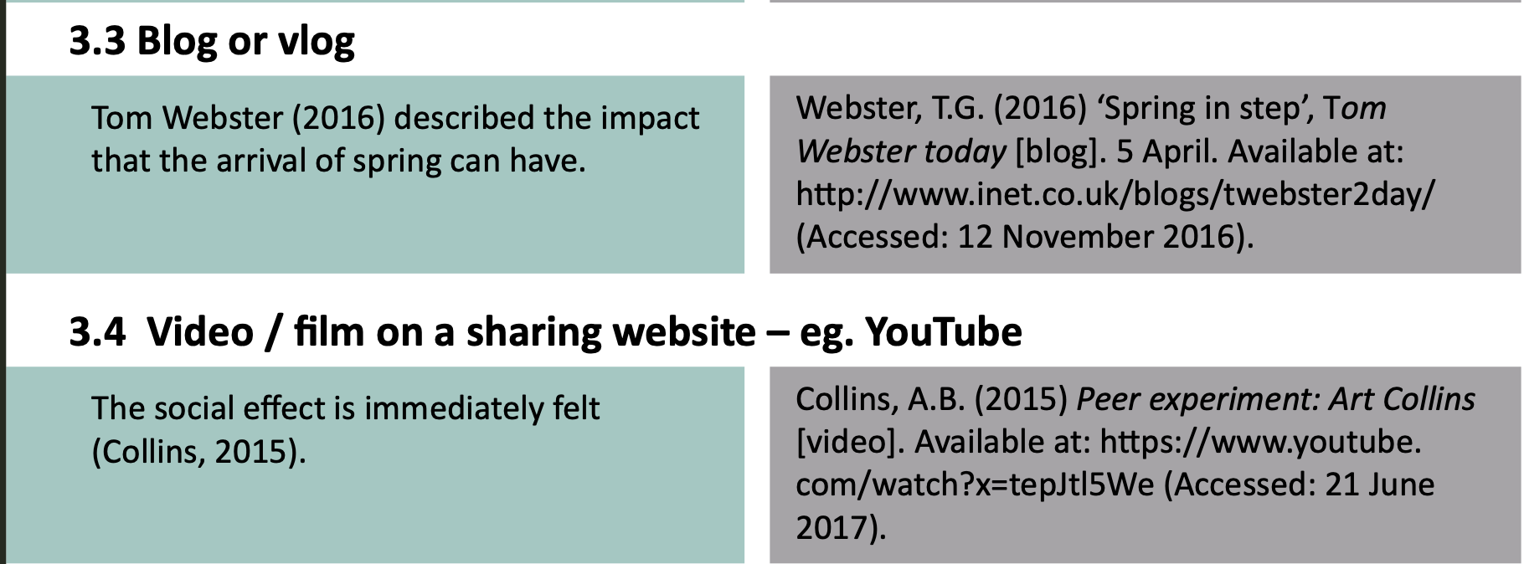

Slide 59


