Slide 1
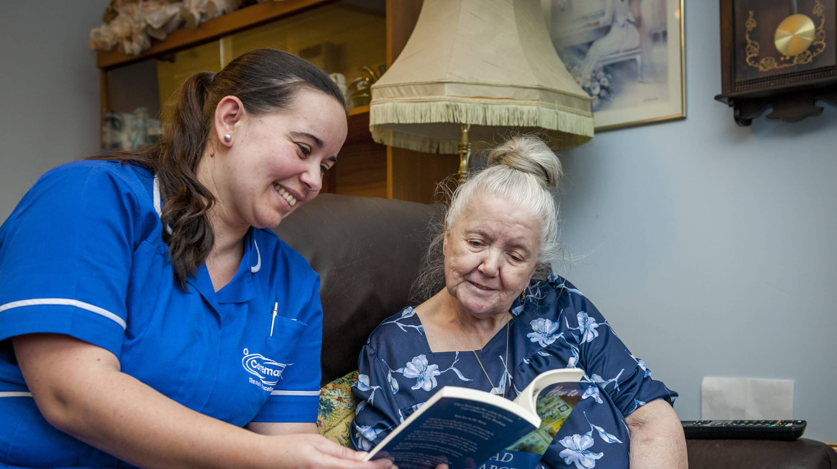
Haena Begum
2508171
Component 1
LCHS4009
Professional Development with Health and social care
Zarah Ahmed

Slide 2
Communication
I have chosen Communication is important in health and social care because it helps staff understand people’s needs and provide safe, person‑centred support. When communication is clear, service users feel listened to, respected, and involved in their own care. It also helps build trust, which is essential when working with people who may feel anxious, unwell, or vulnerable.
Good communication also supports teamwork. Health and social care staff need to share information accurately with colleagues so that everyone knows what a person needs, what risks are present, and what support should be given. When communication is poor, mistakes can happen, and this can put people at risk.

Slide 3
There are different types of communication
Non‑Verbal Communication Body Language
This includes facial expressions, eye contact, gestures, posture, and touch. Non‑verbal cues help residents feel safe, especially those with dementia or hearing difficulties.
Example Smiling, nodding, and maintaining gentle eye contact to show understanding.
Written Communication
Care staff write notes, care plans, incident reports, and handover records. Clear writing helps keep everyone informed and ensures safe, consistent care.
Example Recording a resident’s mood, food intake, or mobility changes in their daily notes.
Visual Communication
Pictures, signs, symbols, and charts help residents who struggle with reading, memory, or language.
Example Using picture cards to help a resident choose meals or activities.

Slide 4
Example in Care Home Setting
In a care home, a support worker is helping an older resident who has dementia. The worker uses simple language, speaks slowly, and maintains eye contact. They listen carefully to the resident’s concerns and repeat information back to check understanding. After supporting the resident, the worker records what happened and tells the next staff member during handover. This ensures the whole team knows how the resident is feeling and what support they need.
This example shows how communication helps keep the resident safe, reduces confusion, and ensures consistent care.

Slide 5

Skills needed in Care Home Settings.
In a health and social care setting, staff need a range of skills to support people safely and respectfully. Good communication helps workers understand each person’s needs and build trust. Empathy and patience are important for supporting people who may feel anxious or confused. Teamwork ensures information is shared properly so everyone knows how to care for everyone. Workers also need good problem‑solving skills and accurate record keeping to keep people safe. Together, these skills help provide high quality, person‑centred care.

Slide 6
Tuckman’s model explains how teams develop through four stages: forming, storming, norming and performing. It links to communication because each stage shows how staff must communicate to work well together. In the forming stage, communication needs to be polite and clear. In storming, good communication helps manage disagreements. In norming, the team starts to trust each other and share information more openly. By the performing stage, communication is smooth and effective, helping staff deliver safe, person‑centred care in a care home.
Tuckman’s model shows that good communication is essential at every stage of team development. In a care home, staff must communicate clearly during handovers, share concerns about residents, and work together to keep people safe. Without strong communication, the team cannot reach the “performing” stage where care is delivered effectively.

Slide 7
Conclusion
In a care home, good communication is essential because it helps staff understand each resident’s needs, preferences, and feelings. Clear communication builds trust, reduces anxiety, and makes residents feel valued and safe. It also supports teamwork by ensuring that important information is shared correctly between staff, which helps prevent mistakes and improves the quality of care. Overall, effective communication leads to better relationships, safer practice, and more person‑centred support for every resident.

Slide 8

References
Chambers, M. (2018) Interpersonal relationships and communication. Health Expectations, 21(2), pp. 407–408.
Iedema, R. et al. (2019) Spoken communication and patient safety. BMJ Open Quality, 8, e000742.
Tuckman, B. (1965) Developmental sequence in small groups. Psychological Bulletin, 63(6), pp. 384–399.
This Photo by Unknown Author is licensed under CC BY-ND

