Slide 1

LCLM4003 Effective Teamwork and Communication
Assignment Title: Group Presentation – Flight Foods Ltd
Student | ID number
Marian-Orlando Paun | 2517199
Elis-Ciprian Niculae | 2515681

Slide 2
Introduction
Flight Foods Ltd faces communication breakdown threatening quality and market share
Five barriers operate together: noise, language, generational, cultural, emotional
Communication underpins food safety compliance in manufacturing operations (Daud et al., 2023)
Presentation applies theory to diagnose barriers and propose solutions for Gary
Analysis draws on Shannon and Weaver alongside Berlo SMCR frameworks (Getchell, Dubinsky and Lentz, 2023)

Slide 3
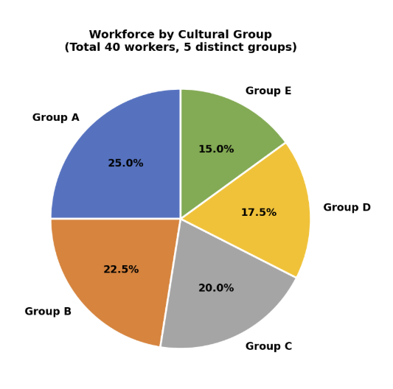
Overview of Key Components
Identify five barriers operating inside Flight Foods Ltd
Apply Shannon and Weaver and Berlo SMCR to each barrier
Examine Gary's role in communication failures (Plant Engineering, 2025)
Recommend training, environmental redesign and managerial changes
Link improvements to recovered market share and client trust (Magiya, 2023)

Slide 4
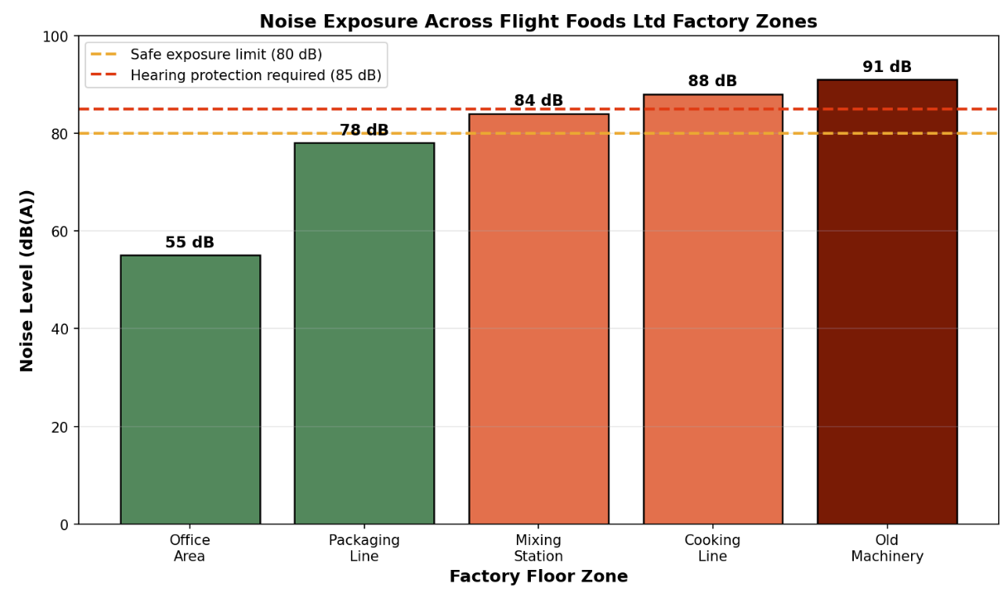
Environmental Noise Barrier
Old clanking machines mask Gary's verbal instructions
Workers strain to hear safety alerts and hygiene reminders
Shannon and Weaver classify this as channel noise distorting messages (Patkar et al., 2025)
Prolonged exposure reduces concentration and raises fatigue
Engineering controls reduce both health risk and miscommunication (Toms, 2025)

Slide 5
Overcoming Environmental Noise
Replace ageing machinery with quieter modern models
Install sound dampening panels around loudest equipment
Provide two way headset systems for verbal instructions (Plant Engineering, 2025)
Hold team briefings inside enclosed quiet zones
Conduct regular noise audits to monitor exposure (Patkar et al., 2025)

Slide 6
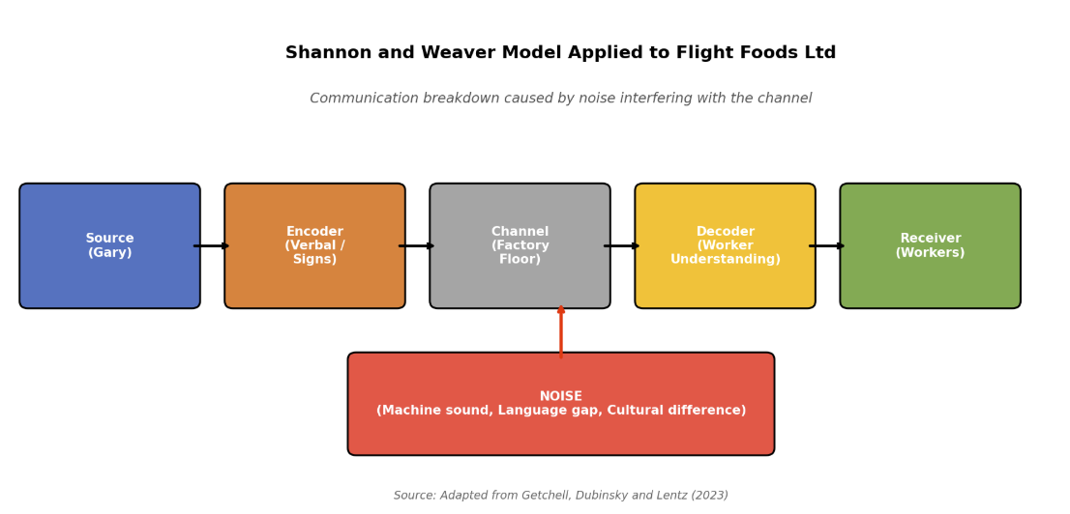
Language and Communication Barrier
Five cultural groups speak limited English, losing Gary's instructions
Shannon and Weaver describe this as semantic noise blocking decoding
English signs assume reading literacy many workers lack (Liu et al., 2019)
Berlo SMCR identifies shared communication skills as essential
Language gaps consistently undermine multinational coordination (Olamide and Adesina, 2025)

Slide 7
Overcoming Language Barriers
Replace
Replace text signs with pictograms for handwashing and chilling
Deliver
Deliver bilingual hygiene training before workers operate machinery
Pair
Pair new workers with bilingual mentors on the floor (Liu et al., 2019)
Use
Use short subtitled videos in multiple languages
Recruit
Recruit team leaders fluent in dominant non English languages (Zhang, 2023)

Slide 8
Generational Barrier
Workforce spans 16 to 60 year olds with differing learning preferences
Younger workers struggle with verbal instructions, older comply readily
Younger workers prefer concise direct digital messages over formal briefings (Bauer and Troger, 2024)
Older workers respond better to face to face instruction
Mismatched styles between Gary and younger staff produce procedural errors (Marshall, 2025)

Slide 9
Overcoming Generational Barriers
Blend verbal briefings with short digital videos and visual checklists
1
Use mobile messaging apps for shift reminders and updates
2
Provide structured feedback so younger workers understand the reasoning (Bauer and Troger, 2024)
3
Pair younger and older staff in mentoring partnerships
4
Tailor recognition to acknowledge both seniority and innovation (Marshall, 2025)
5

Slide 10
Cultural Barrier
Five cultural groups bring differing norms on hygiene and authority
Some workers avoid asking Gary out of cultural respect
Berlo SMCR highlights social and cultural systems as core influences (Zhang, 2023)
Cultural variation shifts interpretation of rules like wash regularly
Multicultural teams without training experience higher misunderstanding rates (Leifels and Zhang, 2023)

Slide 11
Overcoming Cultural Barriers
Deliver mandatory cultural awareness training for managers and team leaders
01
Establish written hygiene standards with measurable behaviours not vague terms
02
Create mixed cultural working teams to encourage daily norm sharing (Lifintsev et al., 2025)
03
Translate hygiene policies into the five dominant workforce languages
04
Appoint cultural liaisons within each group to surface concerns (Leifels and Zhang, 2023)
05

Slide 12
Emotional Barrier
Gary arrives tired and stressed, then shouts Idiots at staff
His outburst creates psychological noise damaging trust and openness
Stressed managers communicate less clearly and provoke defensive reactions (Kumar and Krishna, 2023)
Workers absorb managerial anger and underperform on safety tasks
Emotional intelligence in supervisors directly reduces miscommunication (Kalbag and Rose, 2023)

Slide 13
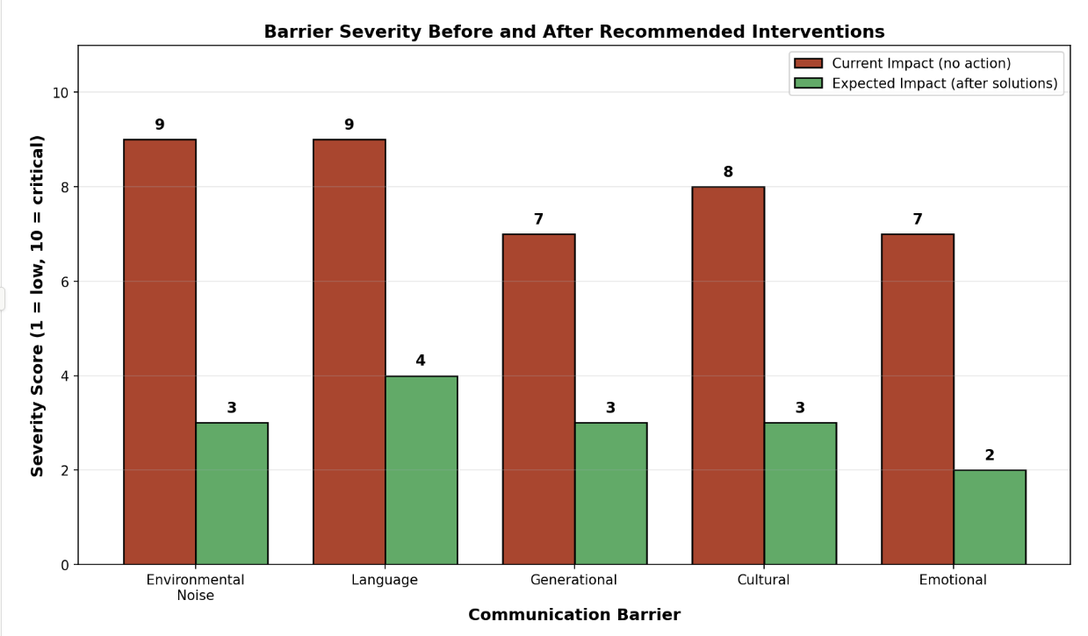
Conclusion
Five interconnected barriers explain ongoing food quality failures at Flight Foods Ltd
Shannon and Weaver alongside Berlo SMCR diagnose breakdowns across sender, channel and receiver (Getchell, Dubinsky and Lentz, 2023)
Addressing one barrier in isolation leaves remaining barriers producing errors
Training, environmental redesign, visual tools and emotional support resolve root causes together (Freedman et al., 2025)
Parallel action restores hygiene standards, airline client confidence and lost market share

Slide 14
References
Bauer, R. and Troger, T. (2024) Generational differences in attitudes towards work and career a systematic literature review on the preferences of generations X Y and Z. Available at https://www.researchgate.net/publication/383860257 (Accessed 14 April 2026).
Daud, M.F., Jelani, F. and Nordin, N.S. (2023) Communication barriers in work environment understanding impact and challenges. International Journal of Academic Research in Business and Social Sciences, 13(11). Available at https://hrmars.com/papers_submitted/19500/communication-barriers-in-work-environment-understanding-impact-and-challenges.pdf (Accessed 13 April 2026).
Freedman, J.M., Freedman, P.E., Choi, D.Y. and Miller, M. (2025) The emotional recession global declines in emotional intelligence and its impact on organizational retention burnout and workforce resilience. Frontiers in Psychology, 16. Available at https://www.frontiersin.org/journals/psychology/articles/10.3389/fpsyg.2025.1701703/full (Accessed 12 April 2026).
Getchell, K., Dubinsky, J. and Lentz, P. (2023) A critique of transmission communication models in introductory management and organizational behavior textbooks. Journal of Management Education, 47(5). Available at https://journals.sagepub.com/doi/abs/10.1177/10525629231182156 (Accessed 11 April 2026).
Kalbag, M. and Rose, S. (2023) Emotional intelligence workplace stress and coping among working individuals. International Journal of Indian Psychology, 11(1), pp. 1818-1827. Available at https://ijip.in/articles/emotional-intelligence-workplace-stress-and-coping-among-working-individuals/ (Accessed 10 April 2026).
Kumar, R.U. and Krishna, T.V. (2023) Emotional intelligence role in reducing workplace stress among employees. International Journal of Scientific Research in Engineering and Management, 7(5). Available at https://ijsrem.com/download/emotional-intelligences-role-in-reducing-workplace-stress-among-employees/ (Accessed 9 April 2026).
Leifels, K. and Zhang, R.P. (2023) Cultural diversity in work teams and wellbeing impairments a stress perspective. International Journal of Cross Cultural Management, 23(3). Available at https://journals.sagepub.com/doi/full/10.1177/14705958231188807 (Accessed 8 April 2026).
Lifintsev, D., Zelihic, M., Grebliauskiene, B., Wellbrock, W., Patel, S.V. and Sharma, R.K. (2025) Young professionals perspectives on cross cultural communication assessing competence and employer support across regions. International Journal of Cross Cultural Management. Available at https://journals.sagepub.com/doi/10.1177/14705958251319695 (Accessed 7 April 2026).
Patkar, P., Sankar, S., Lecoeuche, P., Khoreva, A., Munteanu, M.A. and Carrera, S. (2025) Integrated noise management strategies in industrial environments a framework for occupational safety health and productivity. Sustainability, 17(3). Available at https://www.mdpi.com/2071-1050/17/3/1181 (Accessed 6 April 2026).
Zhang, C. (2023) Addressing cultural differences effective communication techniques in complex organization. Academic Journal of Management and Social Sciences, 5(3), pp. 30-33. Available at https://drpress.org/ojs/index.php/ajmss/article/view/15418 (Accessed 5 April 2026).

